Slide 1
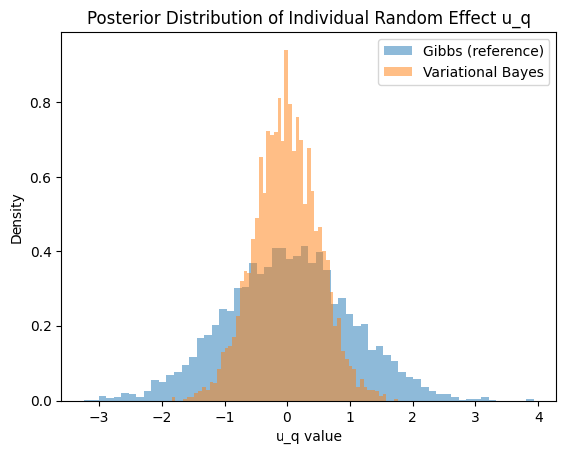
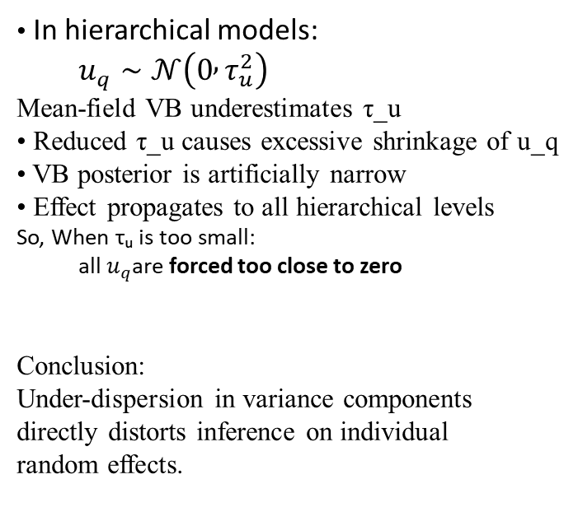
Effect of Variance Under-Dispersion on Individual Random Effects
• In hierarchical models:
  $u_{q}∼𝒩\left(0 , τ_{u}^{2}\right)$
Mean-field VB underestimates τ_u
• Reduced τ_u causes excessive shrinkage of u_q
• VB posterior is artificially narrow
• Effect propagates to all hierarchical levels
So, When τᵤ is too small:
  all $u_{q}$are forced too close to zero
Conclusion:
Under-dispersion in variance components
directly distorts inference on individual
random effects.

