Slide 1
Lead: Kieran McBride
Developers:
Kieran Puaar,
Dave Forster
Testers:
William Dewfield,
Callum Smith,
Hannah Maiden

Slide 2
Brief
Introduction
First Choice recruitment, a company that advertises recruits and trains apprentices for employers is looking to re-design its existing website due to merger with First choice Digital Marketing.
Now the company offers a wider range of apprenticeships to industry, Ranging from; IT, Software Development, Digital Marketing, and Creative Media.
Aims
The aim of the new website is to effectively present the company as a vibrant and forward-looking company that stands out from the competition, and offers high quality training to all apprentices.
The website should good looking, easy to navigate, uncluttered and a consistent theme.
Requirements
The requirements are:
The website must have:
The home page must have some animation, showing, apprenticeships on offer.
A page dedicated to each subject; IT, Networking, Software Development, Creative Media and Digital Marketing
A map showing the company location.
A contact us form.
A page dedicated to awards or achievements.
Consistent theme
The website must be responsive.
The website must be tested, to show its bug free and works as intended.
The contact us form must have data validated using JavaScript before being posted to server.
You will need to prepare all images, buttons, banners, animations yourselves.

Slide 3
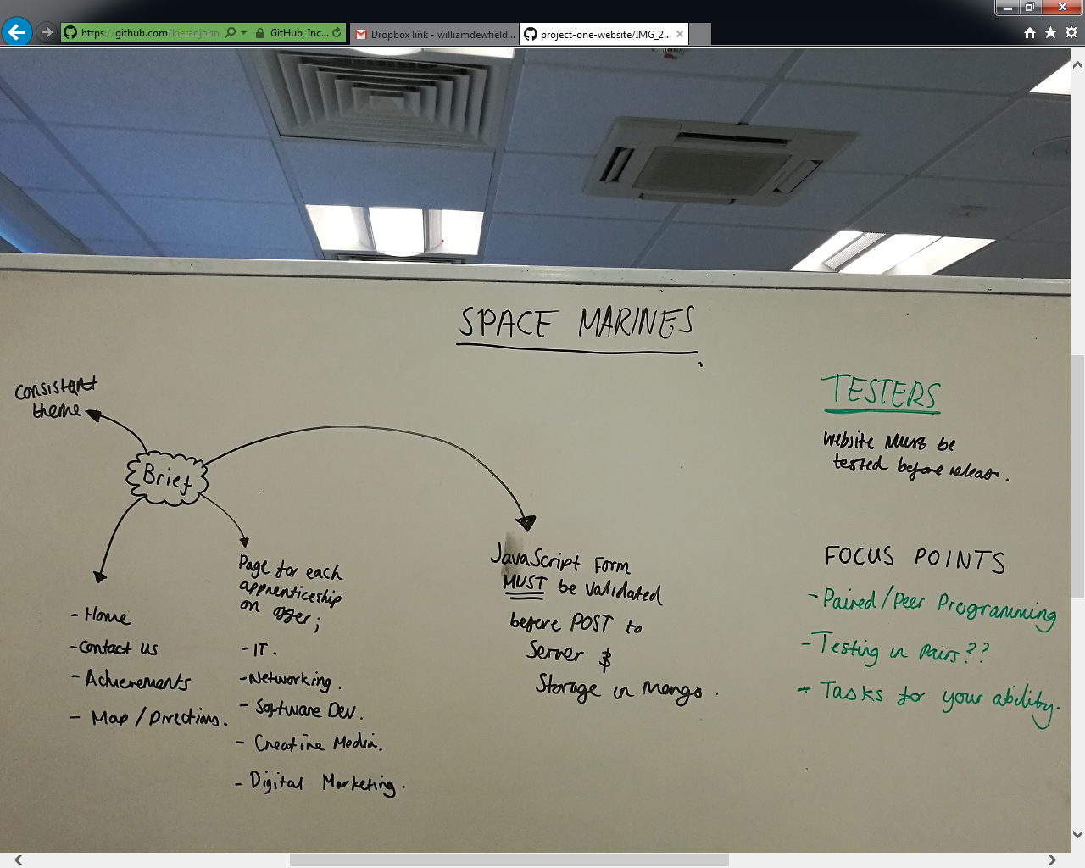
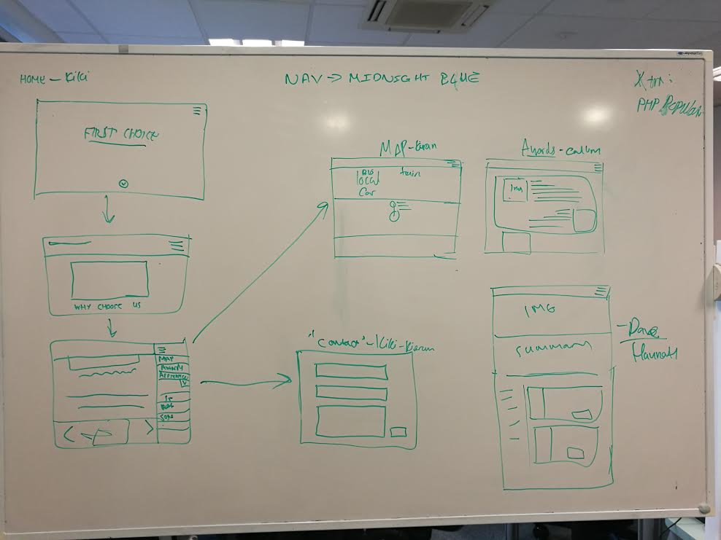
Design Stage
We took to the whiteboard for a general design layout of the website in its simplest form to see what we need to do on each page.
From this point we can start to fill in other such design aspects such as images, banners, buttons and formatting templates.

Slide 4
Homepage

Slide 5
Awards

Slide 6
How to find us

Slide 7
Contacts

Slide 8
Apprenticeships

Slide 9
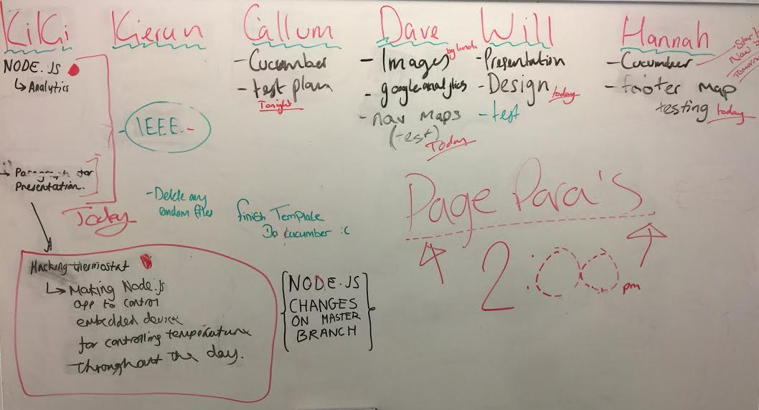
Job Roles
Kieran McBride - lead and developer
Kieran Puaar - Web developer
Dave Forster - JSP developer
Hannah Maiden - Test Analyst
Callum Smith - Tester/Web development
William Dewfield - Tester/ Designer

Slide 10

LOGO

Slide 11
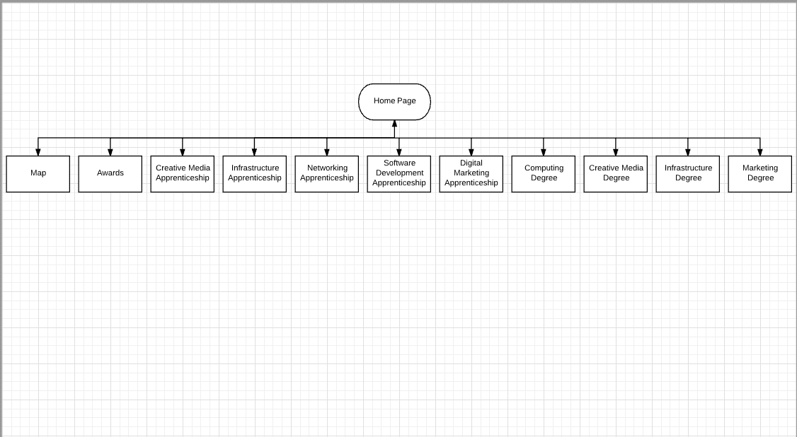
Flow chart

Slide 12
Problems
These are problems which we encountered throughout the project we feel it's necessary that we include this in our presentation to show that problems will arise but we can fix them.
Problems in a project can range from personal team members to coding issues.

Slide 13
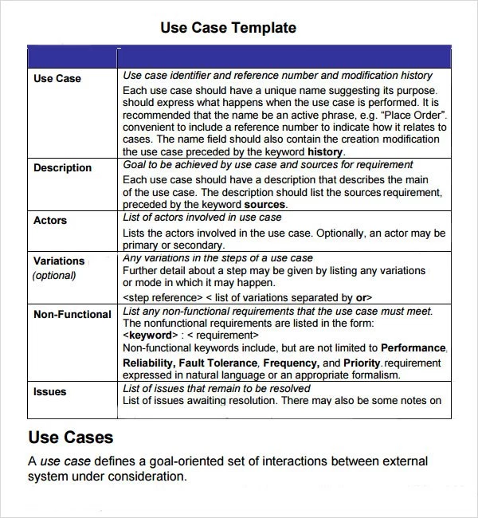
Testing
Test Plan

