Slide 1
3-Statement Financial Model & Forecast
Apple Inc. (AAPL) | FY2022 - FY2027 Projection
By: David Felix Winata (2026)

Slide 2
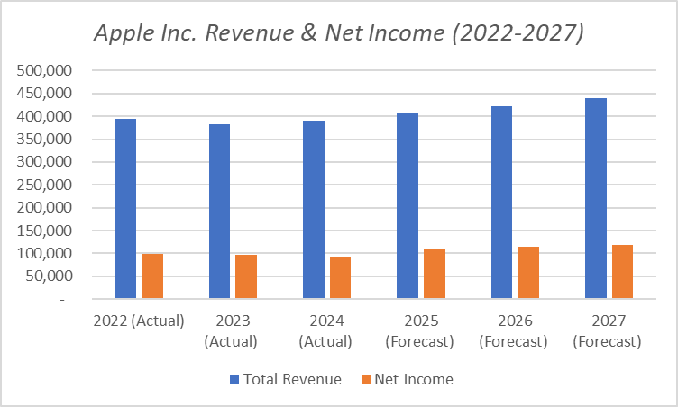
Historical & Projected Financials
Revenue Forecast:
Projecting a 4.0% CAGR to reach $439.8 Billion by 2027, driven by steady growth in Services and Wearables.
Profitability:
Net Income is projected to grow steadily to $118.4 Billion, maintaining a strong net margin of ~24%.
Cost Control:
Operating expenses are efficiently managed at a healthy 14.5% of revenue, ensuring sustainable margin expansion.

Slide 3
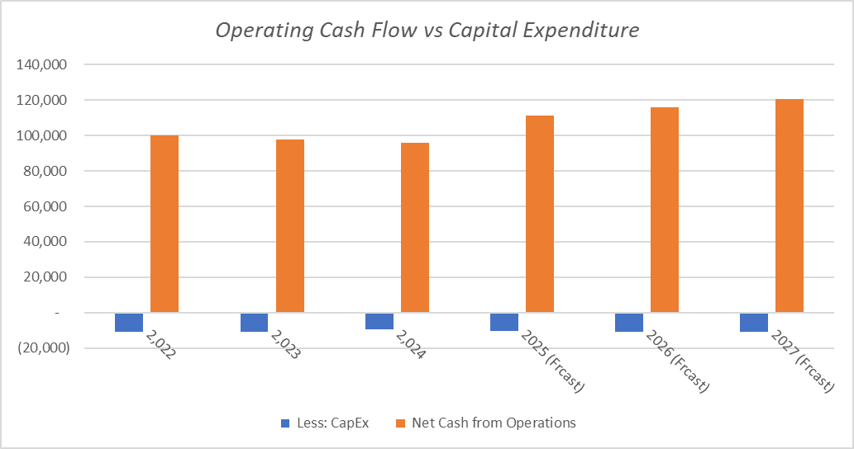
Cash Flow & Balance Sheet Integrity
Strong FCF Generation:
Operating Cash Flow consistently covers CapEx, leaving ample Free Cash Flow for buybacks and dividends.
Model Integrity (Auditor's Check):
The 3-statement model is fully dynamic. The Balance Sheet remains "BALANCED" across all projected years, confirming zero solvency risk.
Cash Position:
Cash is projected to grow to $377.2 Billion by 2027, strengthening Apple's liquidity position.

Slide 4
Investment Thesis & Key Takeaways
Defensive Moat:
Apple's ecosystem and pricing power ensure predictable, stable revenue growth even in uncertain macro environments.
Capital Allocation:
High FCF conversion supports aggressive capital return programs (buybacks), driving EPS growth and shareholder value.
Model Readiness:
This 3-statement model serves as a foundational tool for advanced valuation (e.g., DCF Analysis) and scenario planning (Bull/Base/Bear cases) for investment decision-making.

