Slide 1
BANK TRANSACTIONS FRAUD DETECTION
Data used : bank_transactions_data_2.csv
Total number of transactions: 2,512
Number of unique days: 261
(Year 2023 - from Jan 2, 2023 until Jan 1, 2024)
Number of unique customers (AccountID): 495

Slide 2
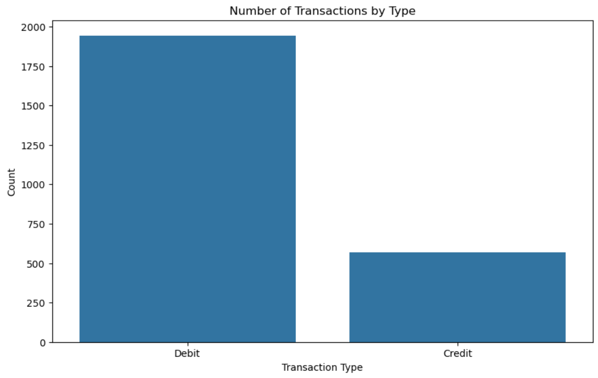
DATA EXPLANATORY

Slide 3
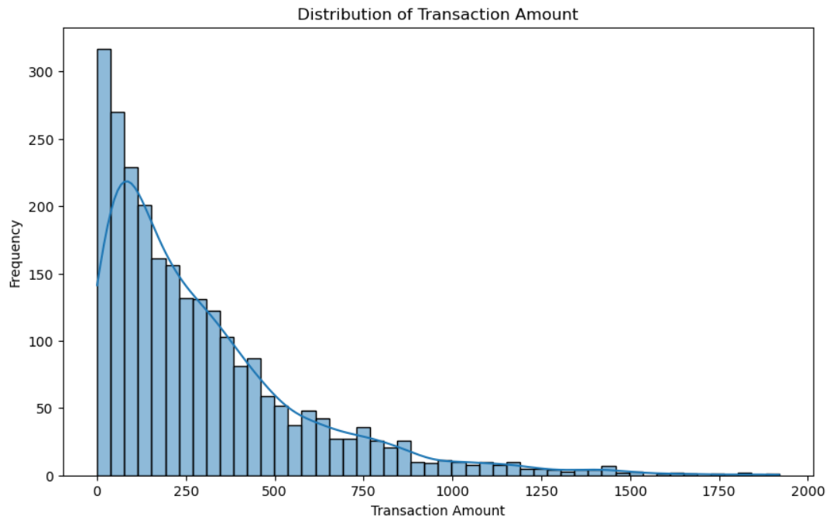

Slide 4
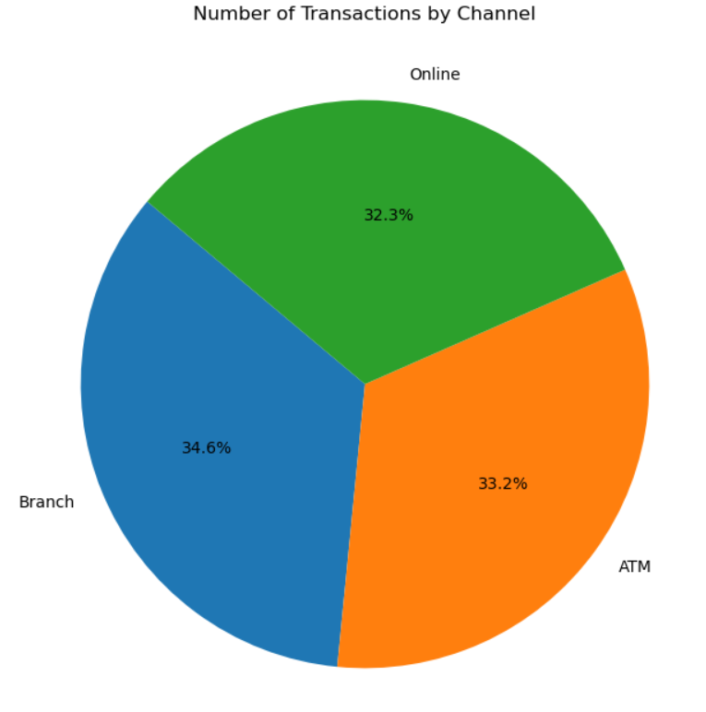
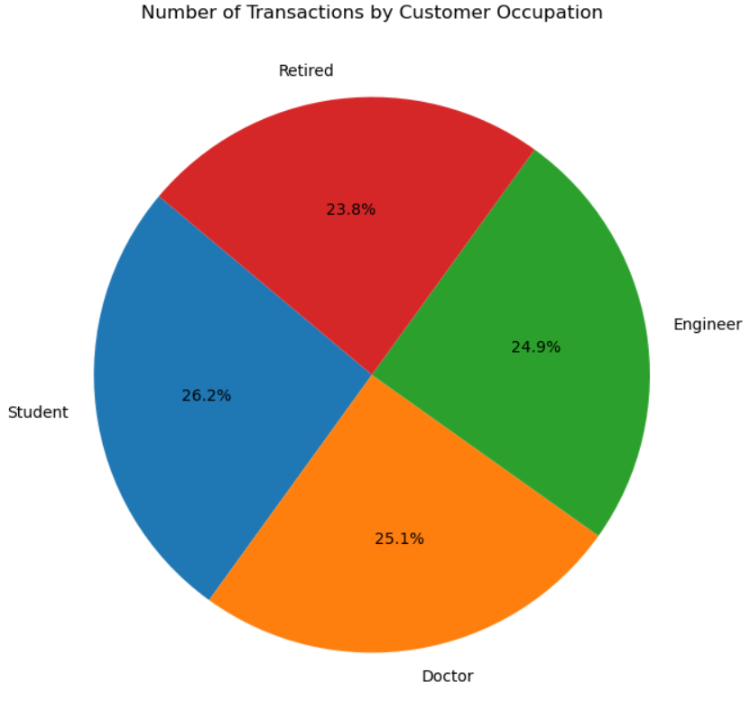

Slide 5
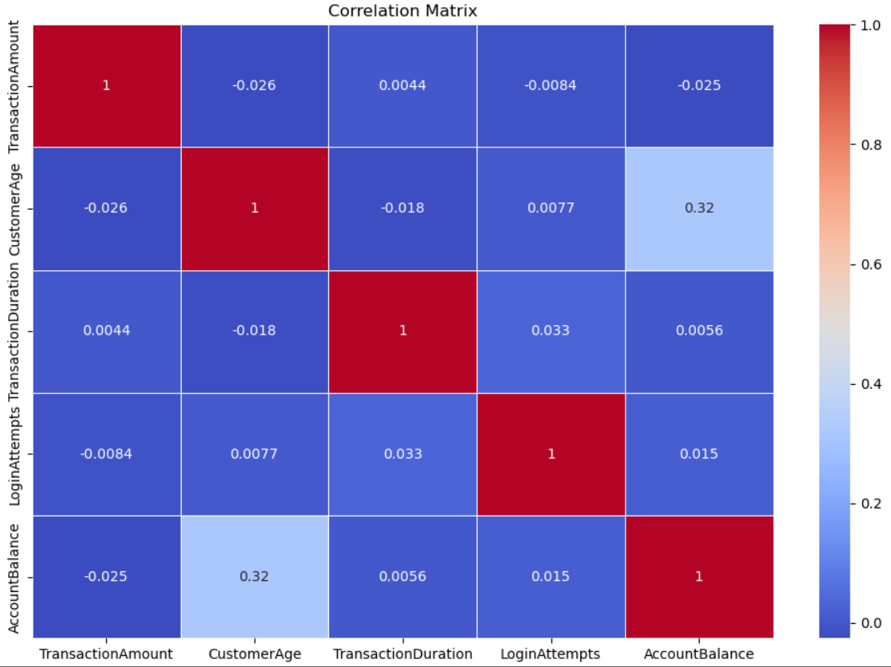

Slide 6
METHODS USED for FINDING ANOMALY
Statistical
Machine Learning
Combined
BOXPLOT
ANOMALIES
ISOLATION FOREST
5% outlier
Precision
0.1 (10%)

Slide 7
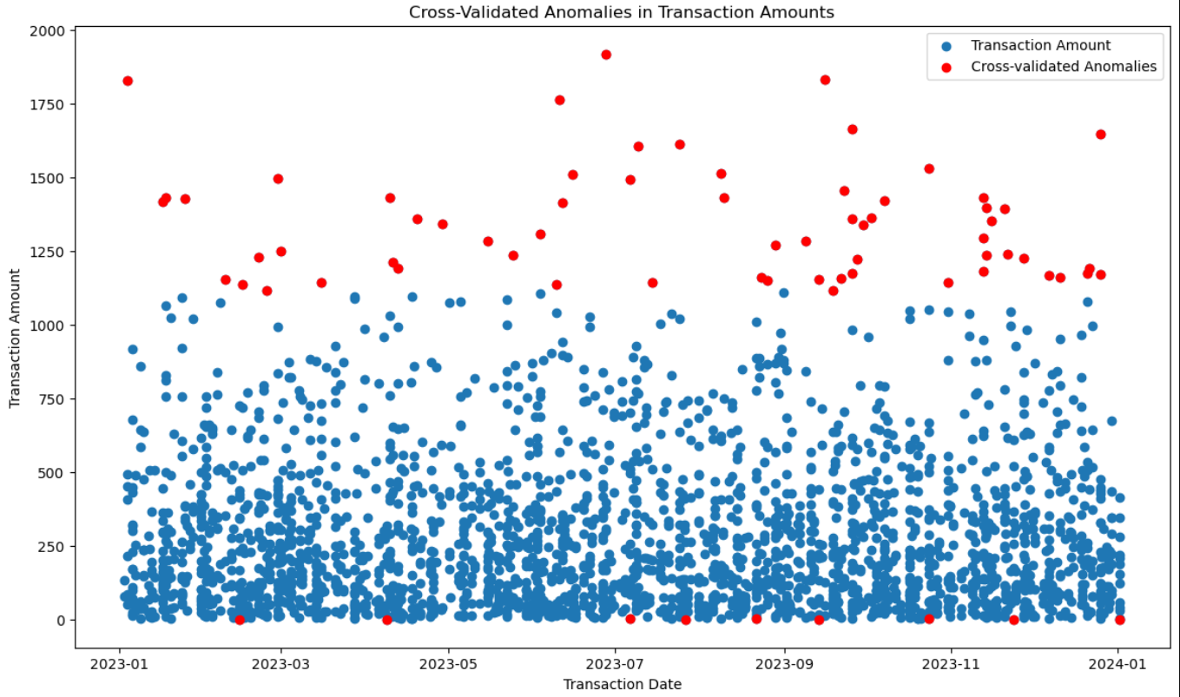
Number of transactions with anomalies detected by BoxPlot 5% range: 126 Number of transactions with anomalies detected by Isolation Forest: 126
Number of transactions with anomalies detected by BoxPlot 5% range: 126
Number of transactions with anomalies detected by Isolation Forest: 126

Slide 8
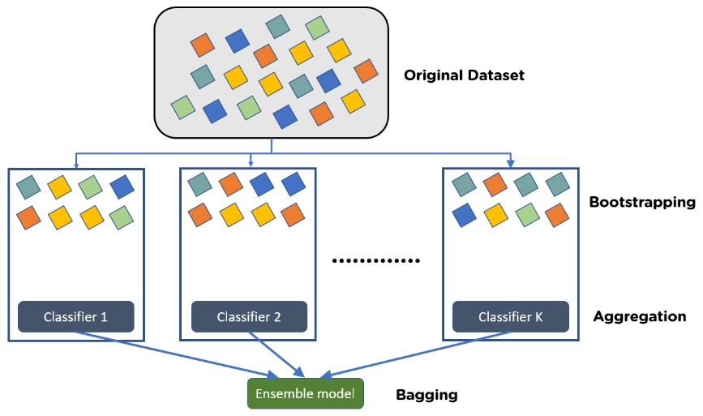
ENSEMBLE LEARNING – Random Forest
Random Forest :
Make lots of different decision trees and combine the results

Slide 9
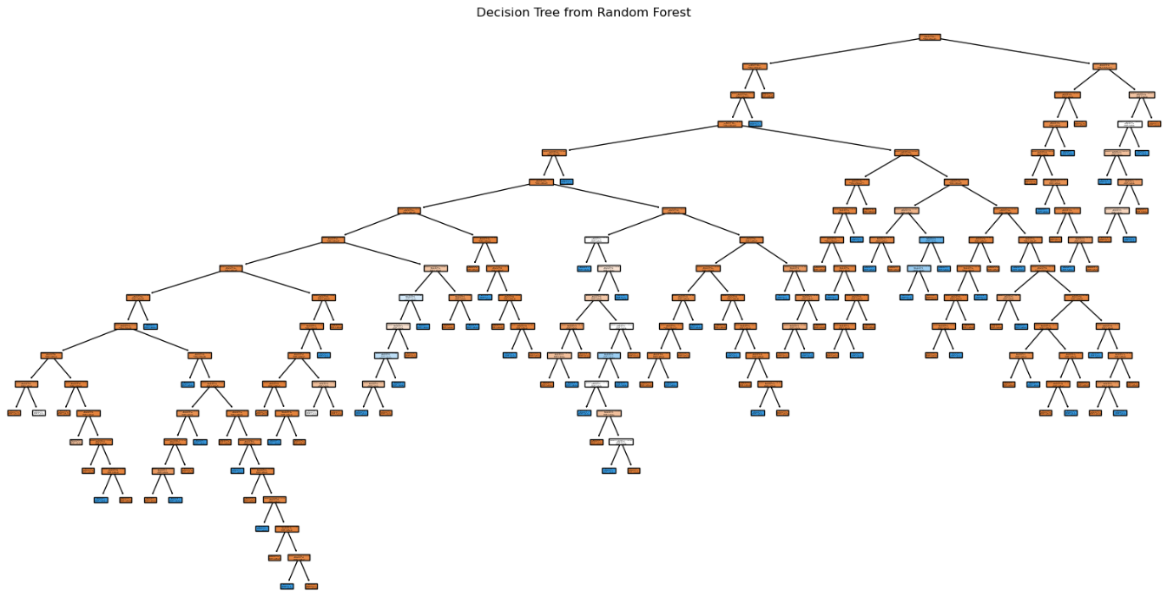
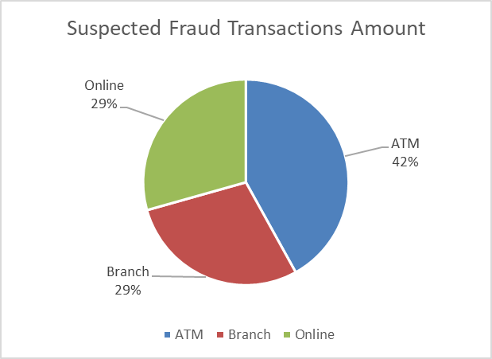
Random Forest found Suspected Fraud
Random Forest Model Accuracy: 0.96 (96%)
Random Forest detection : 132 anomaly transactions
From 110 Account ID
125 transaction from only 1 login attempt
MerchantID with Most suspected fraud occurrences :
M065 ( 6 times ) and MN057 ( 5 times )
Locations with Most suspected fraud occurrences :
Fort Worth ( 8 times , 4 times by ATM )
San Jose ( 7 times, 5 times by branch ) and
Tucson ( 7 times, by ATM and by branch )

