Slide 1

WWF FY2024 Sustainable Finance & Impact Efficiency
David Fx Winata
March 6, 2025

Slide 2




Agenda
Project Overview & Methodology
Financial Position (Balance Sheet Highlights)
Operational Performance (Activities)
Key Performance Indicators (KPIs)
Key Takeaways & Conclusion

Slide 3



Project Overview & Methodology
Methodology:
  Horizontal Analysis: Year-over-Year (YoY) variance analysis.
  Financial Ratio Analysis: Liquidity, Leverage, and Efficiency metrics.
  Data Visualization: Development of a financial dashboard to highlight key trends.
Data Source: Consolidated Financial Statements of WWF, Inc. and Subsidiaries (FY2024 & FY2023)

Slide 4

Financial Position
(Balance Sheet Highlights)

Slide 5
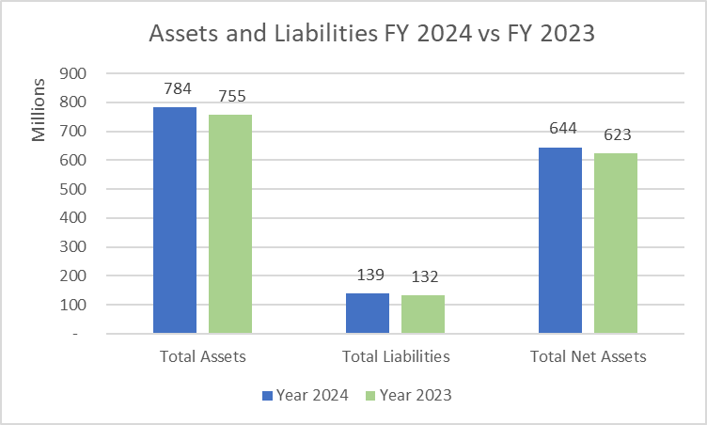
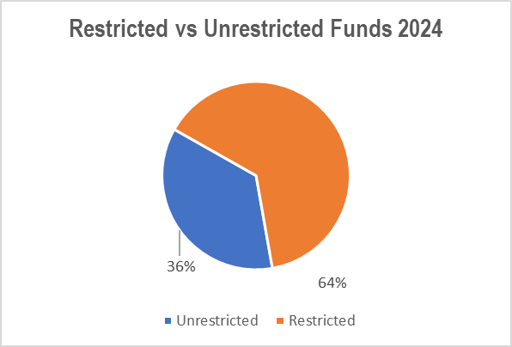
Total Assets: $783.9M (+3.8% YoY)
  Growth driven by significant increases in Prepaid Assets (+233.3%) and Short-term Investments (+42.6%).
Total Liabilities: $139.5M (+5.4% YoY)
  Remains exceptionally low compared to assets, indicating a highly conservative and stable capital structure.
Net Assets: $644.4M
  Unrestricted Net Assets grew by a healthy 10.1%.
Fund Structure:
  With 64% of funds restricted, flexibility for administrative costs remains tight, requiring careful liquidity management.

Slide 6



Balance Sheet Key Takeaway
Strong Liquidity (Current Ratio: 3.92)
Demonstrates a robust ability to meet short-term obligations.
Minimal Leverage Risk Highly robust balance sheet with a conservative capital structure and virtually zero leverage risk.
However, with a majority of funds restricted (64%), financial management must focus heavily on optimizing cash flow for operational overhead.

Slide 7
Operational Performance
(Activities)

Slide 8
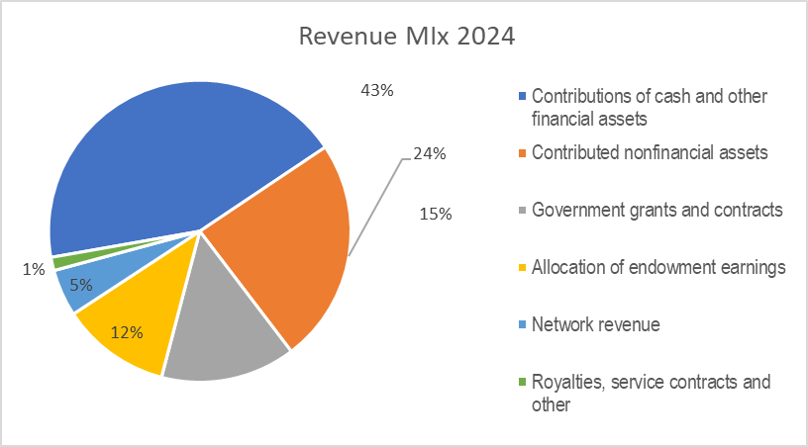
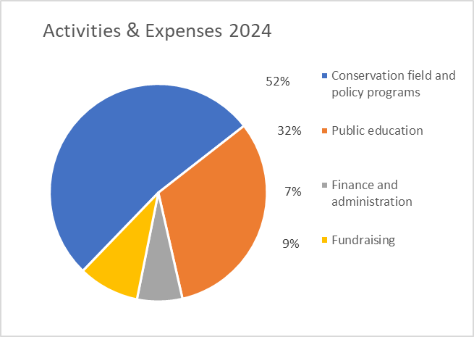
Revenue 2024:
43% from Contributions of Cash
24% from Nonfinancial Assets
15% from Government Grants
12% from Endowment Earnings
Activities 2024:
52% for Conservation & Policy programs
32% for Public Education
9% for Fundraising expenses
7% for Administration
Key Insight: The organization demonstrates exceptional program efficiency, allocating 84% of total expenses directly to program services (Conservation and Education), while maintaining a lean overhead for Administration (7%) and Fundraising (9%)

Slide 9
Key Performance Indicators
KPIs

Slide 10
Financial Health
Current Ratio = 3.92
Debt Ratio = 17.8%
KPI
Operational Efficiency
Program Efficiency = 84.2 %
Fundraising Ratio = 9.1%
Fund Structure
Restricted Net Assets = 64%
💡 Key Insight: The organization exhibits an exceptionally strong financial profile with near-zero leverage risk. While operational efficiency is highly optimal, management must maintain strict cash flow monitoring due to high reliance on restricted funding.

Slide 11
Key Takeaways & Conclusion
Financial Stability
With a Current Ratio of 3.92 and a Debt Ratio of just 17.8%, the organization maintains an exceptionally strong, liquid balance sheet with virtually zero leverage risk.
Operational Efficiency (High Mission-Driven Efficiency)
An impressive 84.2% of total expenses are allocated directly to Program Services (Conservation & Education), proving highly effective and efficient fund utilization.
Fund Structure - Navigating Restricted Capital
While funding is abundant, 64% of Net Assets are restricted. This requires highly disciplined cash
flow management to ensure adequate liquidity for administrative and operational overhead.
Growth & Outlook - Positive Net Asset Trajectory
Unrestricted Net Assets grew by a healthy 10.1%. Moving forward, the focus should be on diversifying unrestricted revenue streams to balance the high reliance on restricted funding.

Slide 12


Summary
🎯 Overall Conclusion: WWF, Inc. demonstrates a highly robust financial profile and excellent operational efficiency. The organization is exceptionally well-positioned to sustain its mission. Strategic focus for FY2025 should be directed toward optimizing cash flow for restricted funds and exploring new unrestricted revenue streams.

