Slide 1
Abigail Sandquist
First DSCI student

Slide 2
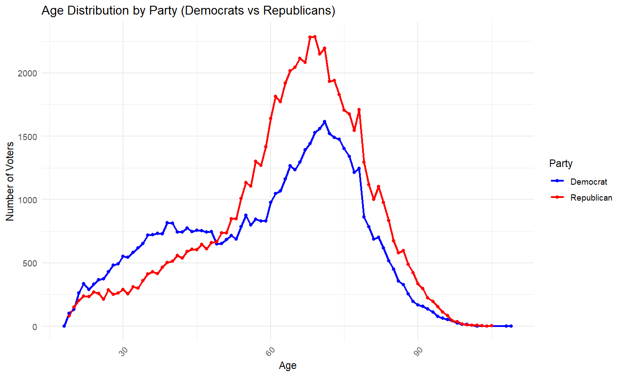
Median Age by Party Affiliation:
Democrat 63 Republican 66

Slide 3
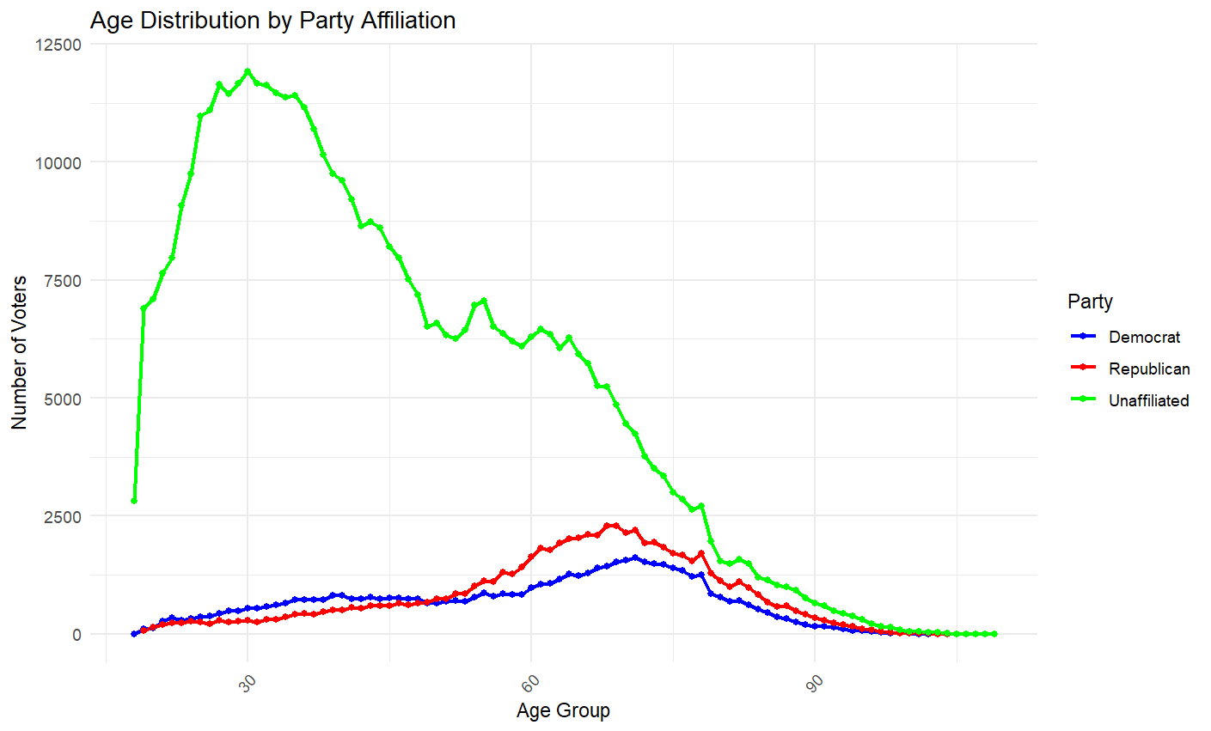
Median Age by Party Affiliation:
Democrat 63 Republican 66 Unaffiliated 41

