Slide 1
Bayesian optimization with Orthogonal Additive Kernels

Slide 2
_{Classical calibration}
_{Calibration}
Minimize
x₁
CE Model
…
ɛ
x_{n}

Slide 3


_{Bayesian optimization}
_{Calibration}
Minimize
CE Model
Acquisition function
(Expected Improvement)
x₁
Surrogate regression model (Gaussian process)
…
ɛ
x_{n}
Kernel
Optimize hyperparameters
Hyperparameters
Squared exponential
Additive
Orthogonal additive
$$l$$
$l$₁, …, $l$_{n}
$l$₁, …, $l$_{n}
σ²
σ₁², …, σ_{n}²
σ₀², σ₁² , …, σ_{n}²

Slide 4
Bayesian optimization methodology
Initialize observation set
Initial observations
Build Gaussian Process with observed values
Calculate acquisition function using Gaussian Process
Choose next observation as the maximum of acquisition function
Add observation to observation set
Calculate actual error from CE model for this observation
Stopping criterion reached?
No
Yes
Optimum

Slide 5
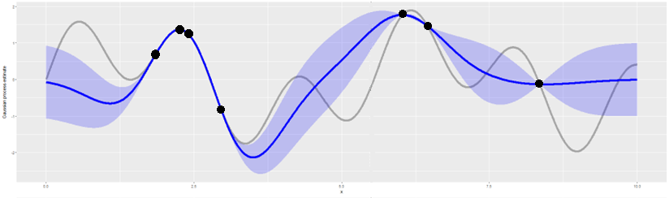

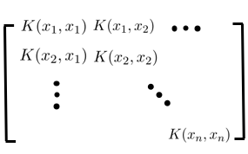
Bayesian optimization methodology
CE model error (actual)
Initialize observation set
Gaussian process mean + 2 SD (estimate)
Initial observations
Build Gaussian Process with observed values
Calculate acquisition function using Gaussian Process
Choose next observation as the maximum of acquisition function
Calculate actual error from CE model for this observation
Stopping criterion reached?
=
Yes
Optimum

Slide 6
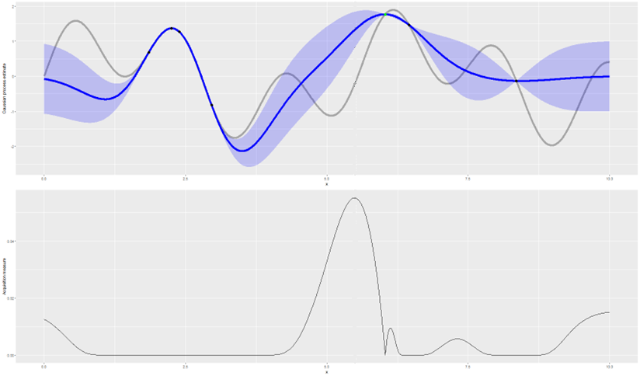

Bayesian optimization methodology
CE model error (actual)
Initialize observation set
Gaussian process mean + 2 SD (estimate)
Initial observations
Build Gaussian Process with observed values
Calculate acquisition function using Gaussian Process
Choose next observation as the maximum of acquisition function
Calculate actual error from CE model for this observation
Stopping criterion reached?
$$EI\left(x\right)=E[\max\left(f\left(x\right)−f\left(x_{max}\right), 0\right)]$$
Yes
Random variable
Optimum

Slide 7
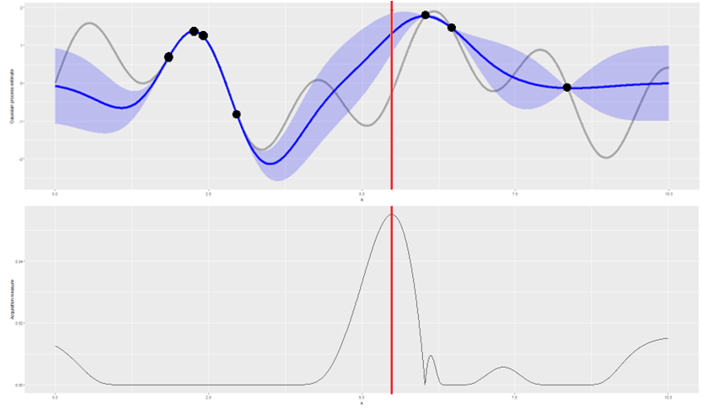
Bayesian optimization methodology
CE model error (actual)
Initialize observation set
Gaussian process mean + 2 SD (estimate)
Initial observations
Build Gaussian Process with observed values
Calculate acquisition function using Gaussian Process
Choose next observation as the maximum of acquisition function
Calculate actual error from CE model for this observation
Stopping criterion reached?
Yes
Optimum

Slide 8
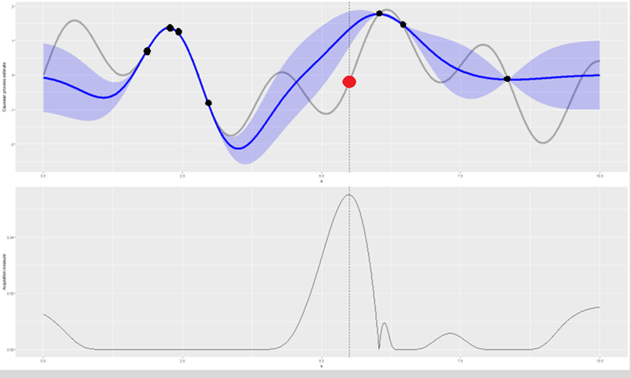
Bayesian optimization methodology
CE model error (actual)
Initialize observation set
Gaussian process mean + 2 SD (estimate)
Initial observations
Build Gaussian Process with observed values
Calculate acquisition function using Gaussian Process
Choose next observation as the maximum of acquisition function
Calculate actual error from CE model for this observation
Stopping criterion reached?
Yes
Optimum

Slide 9
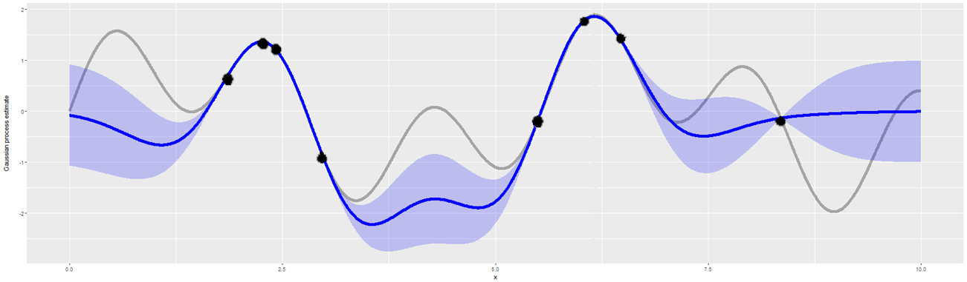
Bayesian optimization methodology
CE model error (actual)
Initialize observation set
Gaussian process mean + 2 SD (estimate)
Initial observations
Build Gaussian Process with observed values
Calculate acquisition function using Gaussian Process
Choose next observation as the maximum of acquisition function
Calculate actual error from CE model for this observation
No
Stopping criterion reached?
Yes
Optimum

Slide 10
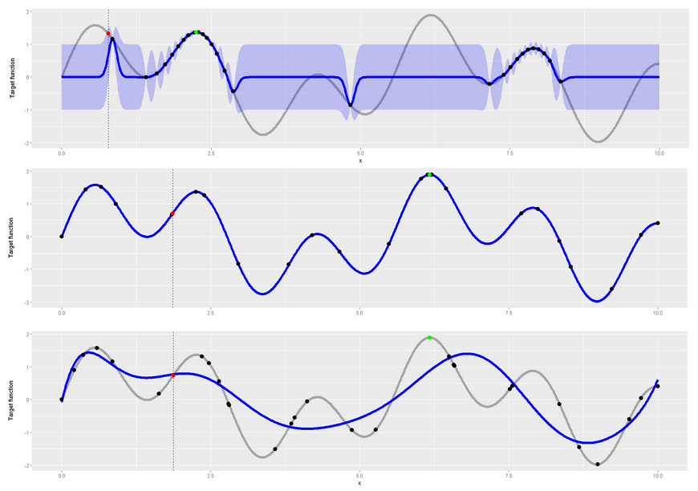
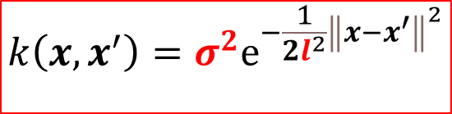
Squared exponential kernel
$$k\left(x,x^{′}\right)=σ^{2}ⅇ^{−\frac{1}{{2l}^{2}}{\left\|x−x^{′}\right\|}^{2}}$$
Too small lengthscale
Appropriate lengthscale
Too large lengthscale

Slide 11

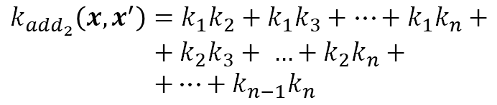
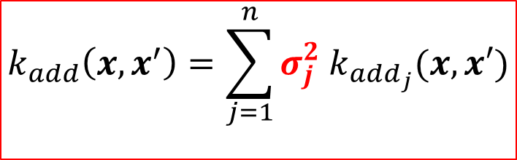

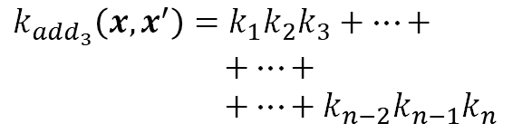


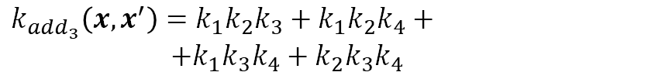

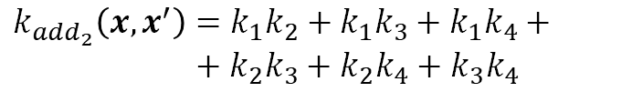
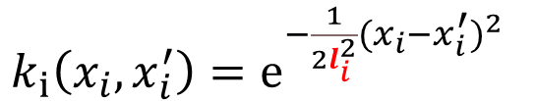
Additive kernel
$$k_{add}\left(x,x^{′}\right)=\sum_{j=1}^{n}{σ_{j}^{2} k_{add_{j}}(x,x′)}$$
One kernel per dimension
Example n=4
$$k_{1}, k_{2},k_{3},k_{4}$$
$k_{i}\left(x_{i},x_{i}^{′}\right)=ⅇ^{−\frac{1}{{2l}_{i}^{2}}{(x_{i}−x_{i}^{′})}^{2}}$
$$k_{add_{1}}\left(x,x^{′}\right)=k_{1}+k_{2}+ k_{3}+k_{4}$$
$$k_{add_{2}}\left(x,x^{′}\right)=k_{1}k_{2}+k_{1}k_{3}+k_{1}k_{4}+$$
$+$ $k_{2}k_{3}+k_{2}k_{4}+k_{3}k_{4}$
Let$k_{i}≔k_{i}\left(x_{i}, x_{i}^{′}\right)$
$$k_{add_{3}}\left(x,x^{′}\right)=k_{1}k_{2}k_{3}+k_{1}k_{2}k_{4}+$$
$+k_{1}k_{3}k_{4}+k_{2}k_{3}k_{4}$
$$k_{add_{1}}\left(x,x^{′}\right)=k_{1}+k_{2}+ …+k_{n}$$
$$k_{add_{4}}\left(x,x^{′}\right)=k_{1}k_{2}k_{3}k_{4}$$
$$k_{add_{2}}\left(x,x^{′}\right)=k_{1}k_{2}+k_{1}k_{3}+…+k_{1}k_{n}+$$
$$+ k_{2}k_{3}+ …+k_{2}k_{n}+$$
$$+…+k_{n−1}k_{n}$$
One additive kernel per order of interaction
$$k_{add_{3}}\left(x,x^{′}\right)=k_{1}k_{2}k_{3}+…+$$
$$+…+$$
$$+…+{k_{n−2}k}_{n−1}k_{n}$$
$k_{add}\left(x,x^{′}\right)=σ_{1}^{2}{ k}_{add_{1}}\left(x,x^{′}\right)$ $+$
$+σ_{2}^{2}{ k}_{add_{2}}\left(x,x^{′}\right)$ $+$
$+σ_{3}^{2}{ k}_{add_{3}}\left(x,x^{′}\right)$ $+$
$$+σ_{4}^{2}{ k}_{add_{4}}(x,x^{′})$$
$$…$$
$$k_{add_{n}}\left(x,x^{′}\right)=k_{1}k_{2}…k_{n}$$
O(n²) using Newton-Girard formulae

Slide 12



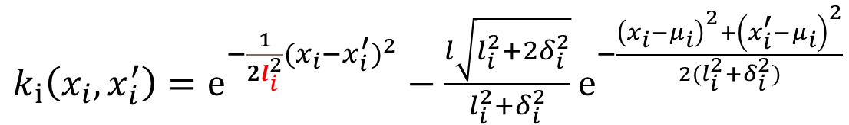
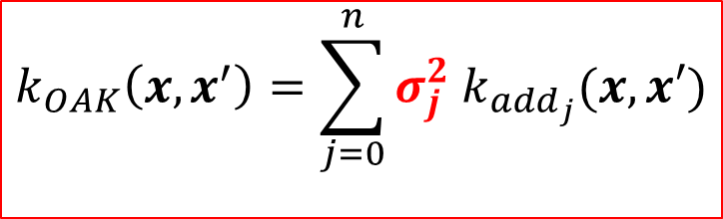



Orthogonal additive kernel
$$k_{OAK}\left(x,x^{′}\right)=\sum_{j=0}^{n}{σ_{j}^{2} k_{add_{j}}(x,x′)}$$
One kernel per dimension
Assuming each $x_{i}\sim N(μ_{i}, δ_{i}^{2})$
Example n=4
F$or x_{i}\sim Beta(α, β)$?
F$or x_{i}\sim U(a, b)$?
$k_{i}\left(x_{i},x_{i}^{′}\right)=ⅇ^{−\frac{1}{{2l}_{i}^{2}}{(x_{i}−x_{i}^{′})}^{2}}−\frac{l\sqrt{l_{i}^{2}+2δ_{i}^{2}}}{l_{i}^{2}+δ_{i}^{2}}ⅇ^{−\frac{{\left(x_{i}−μ_{i}\right)}^{2}+{\left(x_{i}^{′}−μ_{i}\right)}^{2}}{2(l_{i}^{2}+δ_{i}^{2})}}$
$$k_{1}, k_{2},k_{3},k_{4}$$
$$k_{add_{0}}\left(x,x^{′}\right)=1$$
$$k_{add_{1}}\left(x,x^{′}\right)=k_{1}+k_{2}+ k_{3}+k_{4}$$
Let$k_{i}≔k_{i}\left(x_{i}, x_{i}^{′}\right)$
$$k_{add_{2}}\left(x,x^{′}\right)=k_{1}k_{2}+k_{1}k_{3}+k_{1}k_{4}+$$
$+$ $k_{2}k_{3}+k_{2}k_{4}+k_{3}k_{4}$
$$k_{add_{3}}\left(x,x^{′}\right)=k_{1}k_{2}k_{3}+k_{1}k_{2}k_{4}+$$
$+k_{1}k_{3}k_{4}+k_{2}k_{3}k_{4}$
$$k_{add_{0}}\left(x,x^{′}\right)=1$$
$$k_{add_{1}}\left(x,x^{′}\right)=k_{1}+k_{2}+ …+k_{n}$$
$$k_{add_{4}}\left(x,x^{′}\right)=k_{1}k_{2}k_{3}k_{4}$$
$$k_{add_{2}}\left(x,x^{′}\right)=k_{1}k_{2}+k_{1}k_{3}+…+k_{1}k_{n}+$$
$$+ k_{2}k_{3}+ …+k_{2}k_{n}+$$
$$+…+k_{n−1}k_{n}$$
One additive kernel per order of interaction
+ 1 (constant)
$$k_{add_{3}}\left(x,x^{′}\right)=k_{1}k_{2}k_{3}+…+$$
$$+…+$$
$$+…+{k_{n−2}k}_{n−1}k_{n}$$
$$k_{OAK}\left(x,x^{′}\right)=σ_{0}^{2}{ k}_{add_{0}}\left(x,x^{′}\right) +$$
$+σ_{1}^{2}{ k}_{add_{1}}\left(x,x^{′}\right)$ $+$
$+σ_{2}^{2}{ k}_{add_{2}}\left(x,x^{′}\right)$ $+$
$+σ_{3}^{2}{ k}_{add_{3}}\left(x,x^{′}\right)$ $+$
$$+σ_{4}^{2}{ k}_{add_{4}}(x,x^{′})$$
$$…$$
$$k_{add_{n}}\left(x,x^{′}\right)=k_{1}k_{2}…k_{n}$$
O(n²) using Newton-Girard formulae

Slide 13
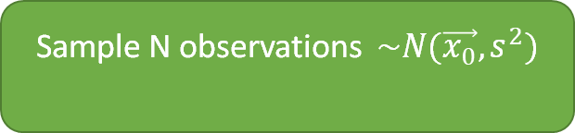
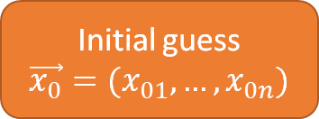
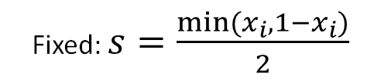

OAK Hyperparameter tuning (0): dataset generation
Training dataset
Initial guess
$$\vec{x_{0}}=(x_{01}, …, x_{0n})$$
Sample N observations $\sim N(\vec{x_{0}},s^{2})$
Observations
Errors
CE Model
Fixed: $s=\frac{min⁡(x_{i}, 1−x_{i})}{2}$
Test dataset
Sample M observations $\sim N(\vec{x_{0}},s^{2})$
Observations
Errors
CE Model

Slide 14
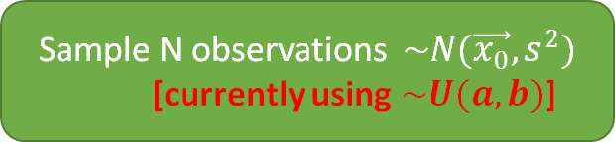
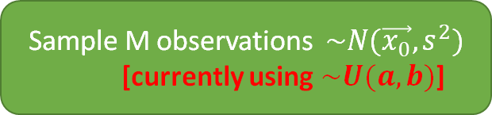
OAK Hyperparameter tuning (0): dataset generation
Training dataset
Initial guess
$$\vec{x_{0}}=(x_{01}, …, x_{0n})$$
Sample N observations $\sim N(\vec{x_{0}},s^{2})$
[currently using $\sim U(a,b)$]
Observations
Errors
CE Model
Fixed: $s=\frac{min⁡(x_{i}, 1−x_{i})}{2}$
Test dataset
Sample M observations $\sim N(\vec{x_{0}},s^{2})$
[currently using $\sim U(a,b)$]
Observations
Errors
CE Model

Slide 15

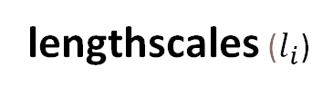
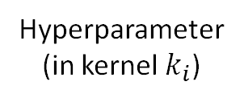
_{OAK Hyperparameter tuning (1):}
lengthscales ($l_{i}$)
Considering each $k_{i}\left(x,x^{′}\right)=ⅇ^{−\frac{1}{{2l}_{i}^{2}}{\left\|x−x^{′}\right\|}^{2}}$individually, train GPs using $k_{i}$ optimizing $l_{i}$
Minimize
Hyperparameter
(in kernel $k_{i}$)
Surrogate regression model (Gaussian process)
$$l_{i}$$
Train
Test
MSE
Input
Multiple regressions with different datasets averaged to obtain consistent estimate + CI
Training dataset
Test dataset
Observations
Errors
Observations
Errors
New datasets generated each iteration

Slide 16
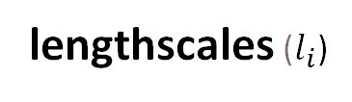
_{OAK Hyperparameter tuning (1):}
_{Alternative: MLE}
lengthscales ($l_{i}$)
Considering each $k_{i}\left(x,x^{′}\right)=ⅇ^{−\frac{1}{{2l}_{i}^{2}}{\left\|x−x^{′}\right\|}^{2}}$individually, train GPs using $k_{i}$ optimizing $l_{i}$
Maximize
Hyperparameter
(in kernel $k_{i}$)
Surrogate regression model (Gaussian process)
$$l_{i}$$
Train
Likelihood
Input
Training dataset
Observations
Errors
New datasets generated each iteration (?)

Slide 17
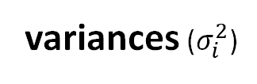

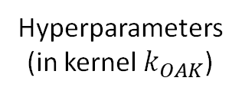
_{OAK Hyperparameter tuning (2):}
variances ($σ_{i}^{2}$)
Considering previously fit $l_{i}$, train GPs with OAK optimizing $σ_{0}^{2},σ_{1}^{2}, …,σ_{n}^{2}$
Minimize
Hyperparameters
(in kernel $k_{OAK}$)
Surrogate regression model (Gaussian process)
$$σ_{0}^{2},σ_{1}^{2}, …,σ_{n}^{2}$$
Train
Test
MSE
Input
Multiple regressions with different datasets averaged to obtain consistent estimate + CI
Training dataset
Test dataset
Observations
Errors
Observations
Errors
New datasets generated each iteration

Slide 18
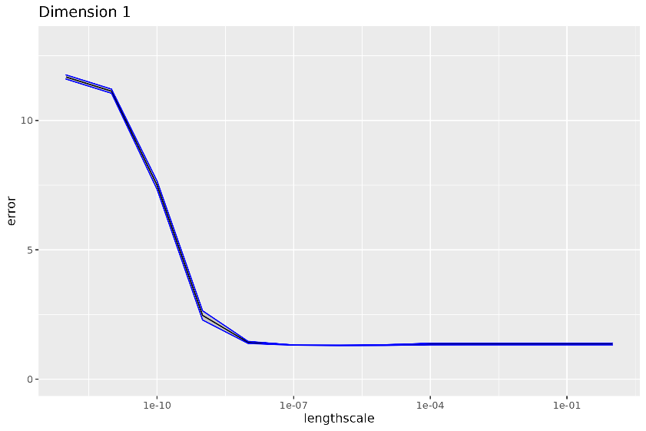
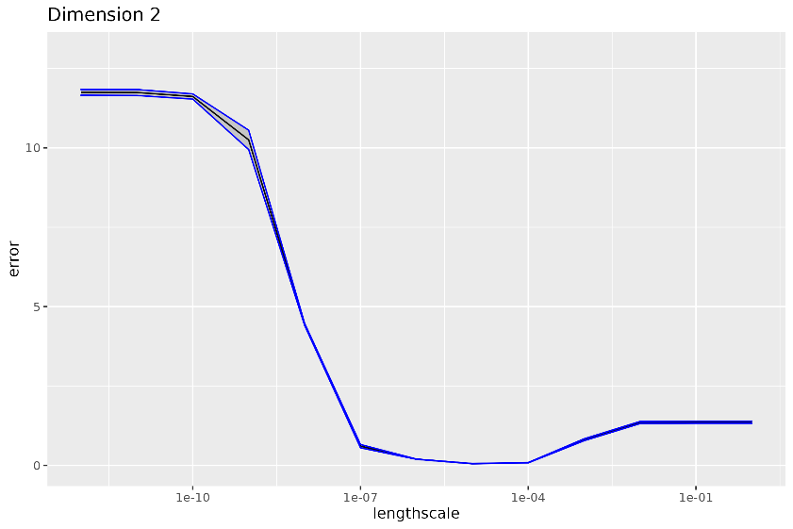
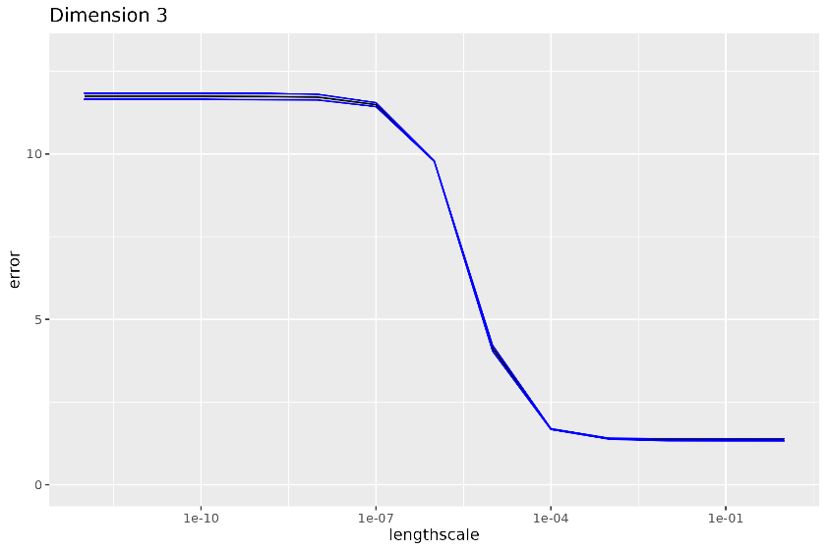
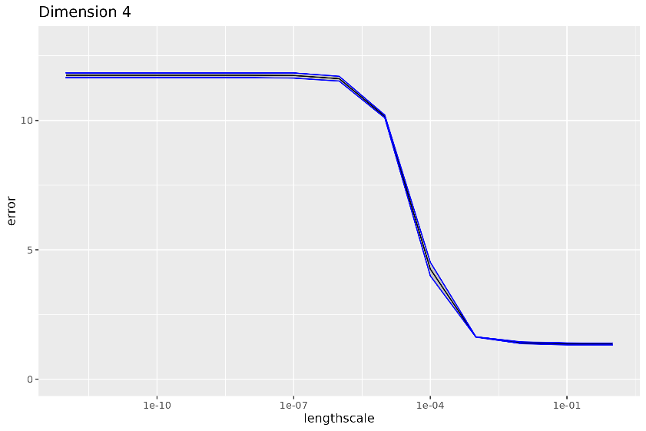
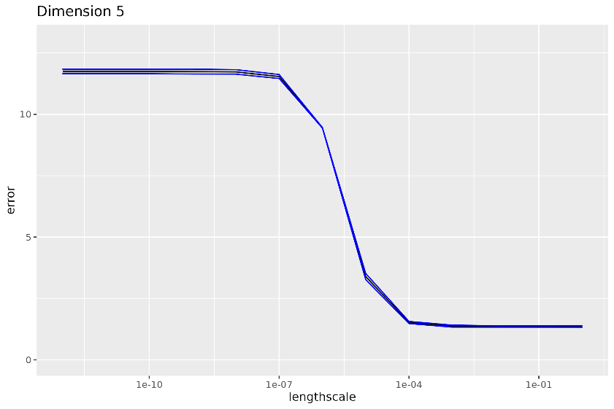
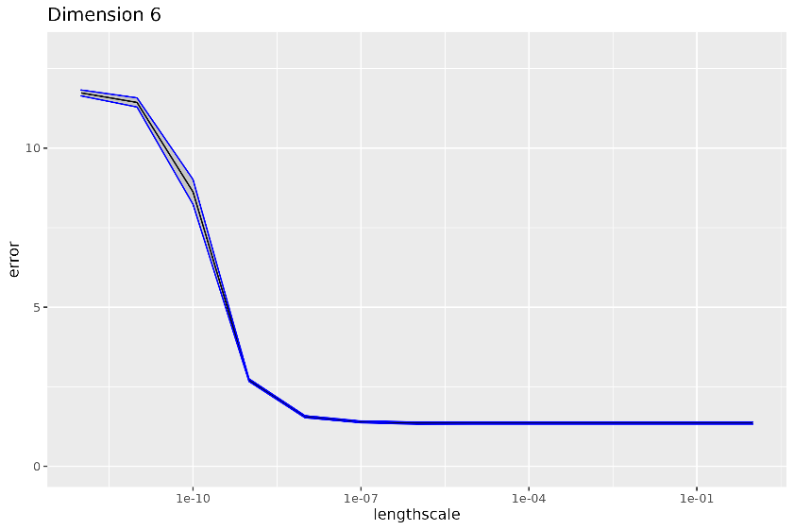
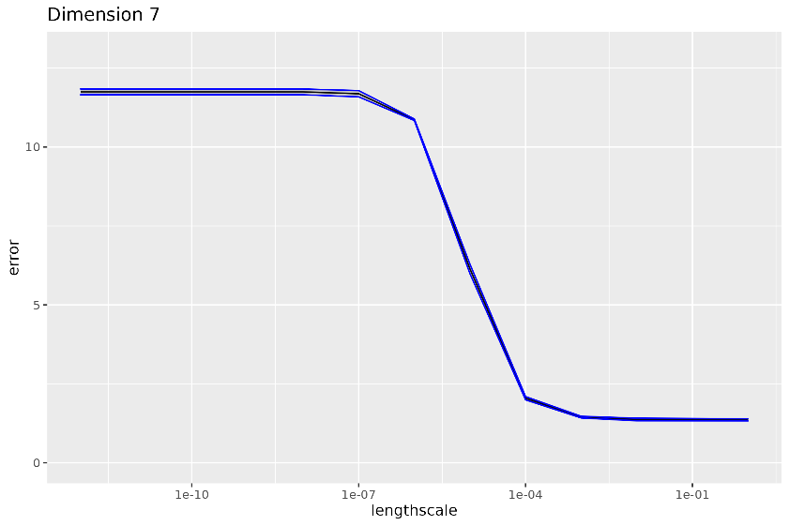

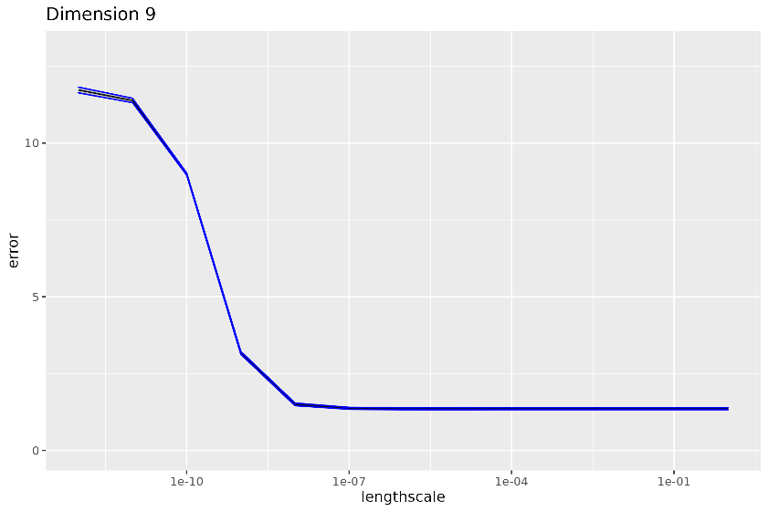
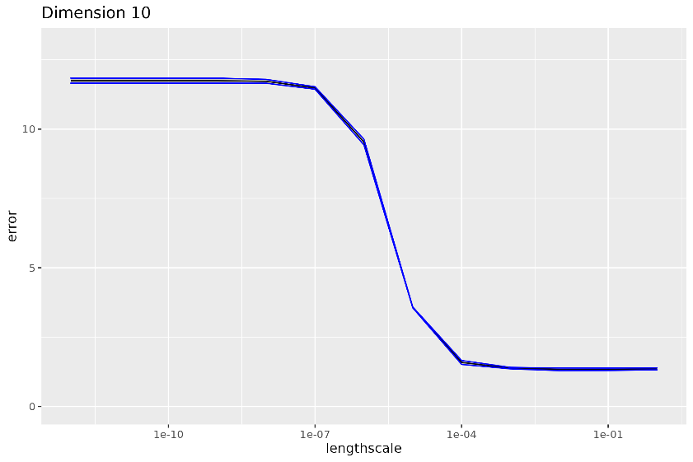
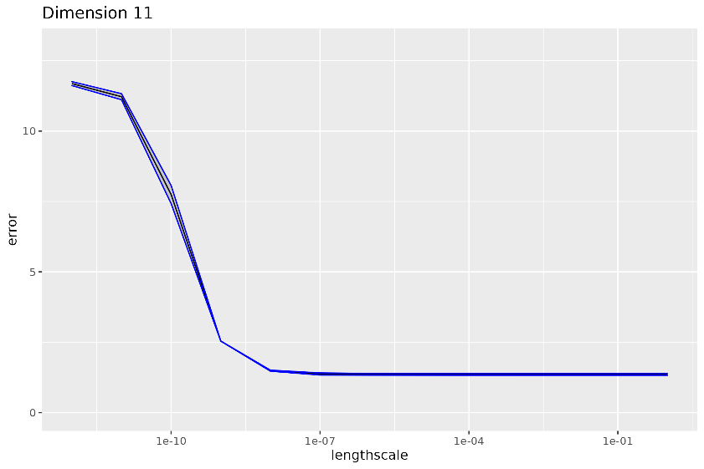
OAK Hyperparameter tuning results (1):
lengthscales ($l_{i}$)

Slide 19
OAK Hyperparameter tuning results (1):
lengthscales ($l_{i}$)

Slide 20
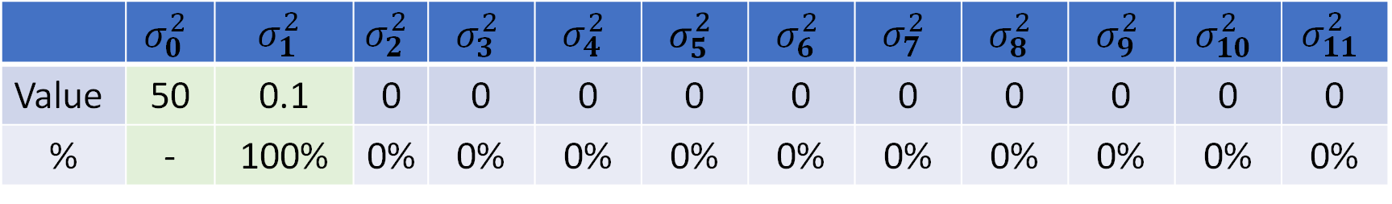
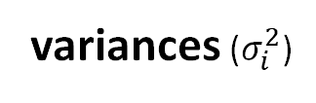
OAK Hyperparameter tuning results (2):
variances ($σ_{i}^{2}$)
 | $$σ_{0}^{2}$$ | $$σ_{1}^{2}$$ | $$σ_{2}^{2}$$ | $$σ_{3}^{2}$$ | $$σ_{4}^{2}$$ | $$σ_{5}^{2}$$ | $$σ_{6}^{2}$$ | $$σ_{7}^{2}$$ | $$σ_{8}^{2}$$ | $$σ_{9}^{2}$$ | $$σ_{10}^{2}$$ | $$σ_{11}^{2}$$
Value | 50 | 0.1 | 0 | 0 | 0 | 0 | 0 | 0 | 0 | 0 | 0 | 0
% | - | 100% | 0% | 0% | 0% | 0% | 0% | 0% | 0% | 0% | 0% | 0%
…
sigma2=2.03519410746478e-10,2.29110891349773,0.1,0,0,0,0,0,0,0,0,0 (mse=3895.64611204964 +- 2085.72492047724)
sigma2=2.03519410746478e-10,2.29110891349773,0,0,0,0,0,0,0,0,0,0 (mse=1.18466630756783 +- 0.0489720165163682)
sigma2=2.03519410746478e-10,2.29110891349773,0,0.1,0,0,0,0,0,0,0,0 (mse=5779527.28482821 +- 4235258.95625561) sigma2=2.03519410746478e-10,2.29110891349773,0,0,0.1,0,0,0,0,0,0,0 (mse=284205.987135911 +- 333469.542612972) sigma2=2.03519410746478e-10,2.29110891349773,0,0,0,0.1,0,0,0,0,0,0 (mse=49787.346236051 +- 17695.3981494417) sigma2=2.03519410746478e-10,2.29110891349773,0,0,0,0,0.1,0,0,0,0,0 (mse=72365.0566452471 +- 44482.5730060544) sigma2=2.03519410746478e-10,2.29110891349773,0,0,0,0,0,0.1,0,0,0,0 (mse=13547183.6697572 +- 7350390.75027773) sigma2=2.03519410746478e-10,2.29110891349773,0,0,0,0,0,0,0.1,0,0,0 (mse=59463.5473874371 +- 32588.7380085133) sigma2=2.03519410746478e-10,2.29110891349773,0,0,0,0,0,0,0,0.1,0,0 (mse=1705.4503654832 +- 685.697088926635) sigma2=2.03519410746478e-10,2.29110891349773,0,0,0,0,0,0,0,0,0.1,0 (mse=532.237994335928 +- 350.580523778001) sigma2=2.03519410746478e-10,2.29110891349773,0,0,0,0,0,0,0,0,0,0.1 (mse=444720.939104846 +- 612306.704687999)
…

Slide 21
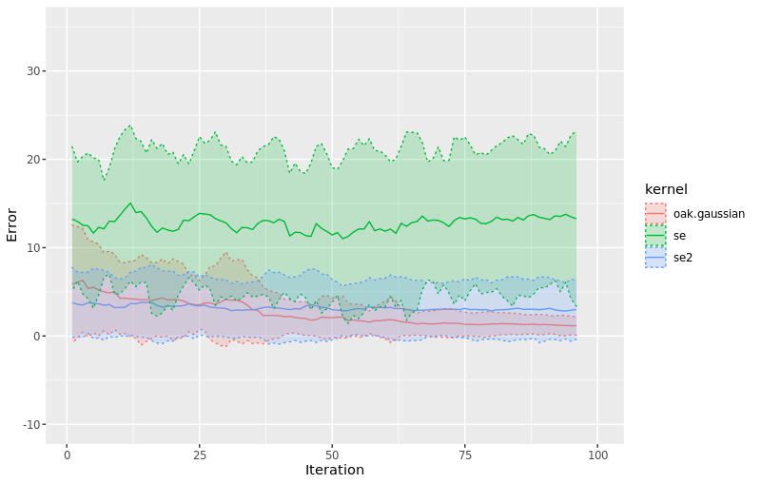
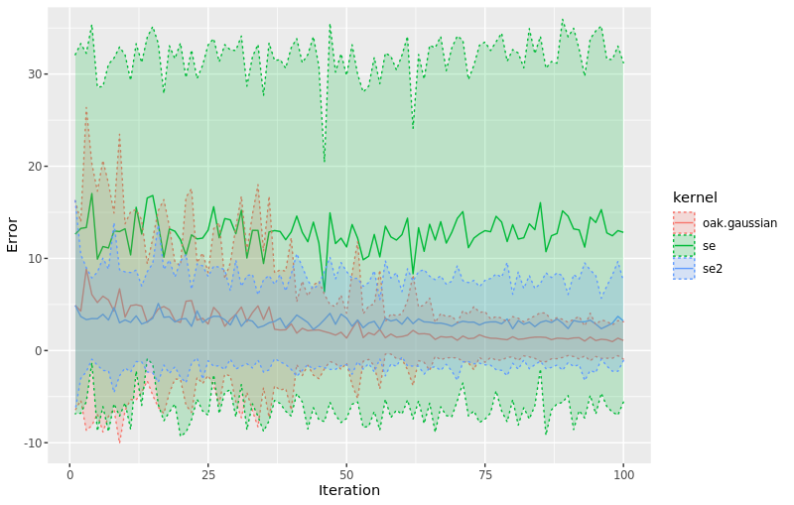
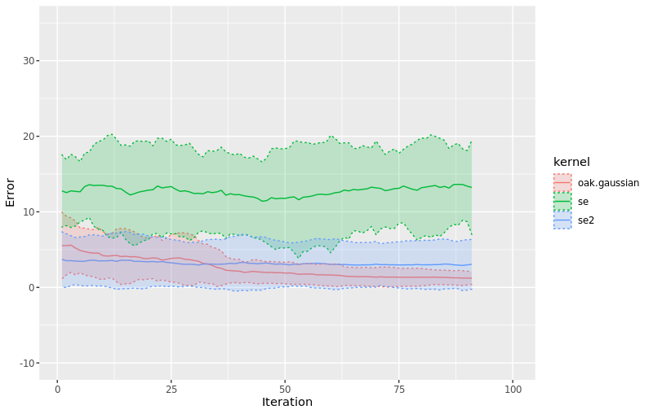
Bayesian optimization results (Squared-exponential vs OAK)
Error per iteration
(30 executions/kernel)
Moving average (k=5)
Moving average (k=10)

Slide 22
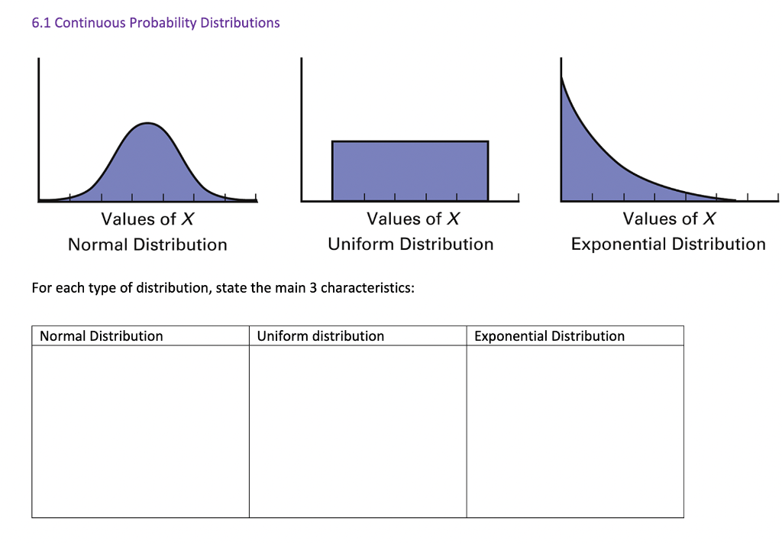


_{OAK Input distribution}
Should be coherent
$k_{i}$ assumption
Hyperparameter tuning
training dataset
Bayesian optimization

Slide 23
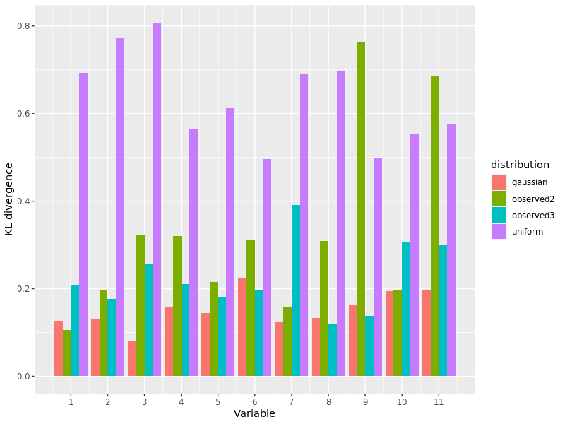
OAK Input distribution comparison (BO evaluated input (n=500) vs others)
???

