Slide 1
Endometrial cancer cost-effectiveness analysis

Slide 2
Cost-effectiveness sensitivity analysis
DSA for 4 parameter types: probabilities, costs, life years, other
Parameter range for base value v: [.5*v, 1.5*v]
Costs in £
Life expectancies not quality-adjusted (QALE)

Slide 3
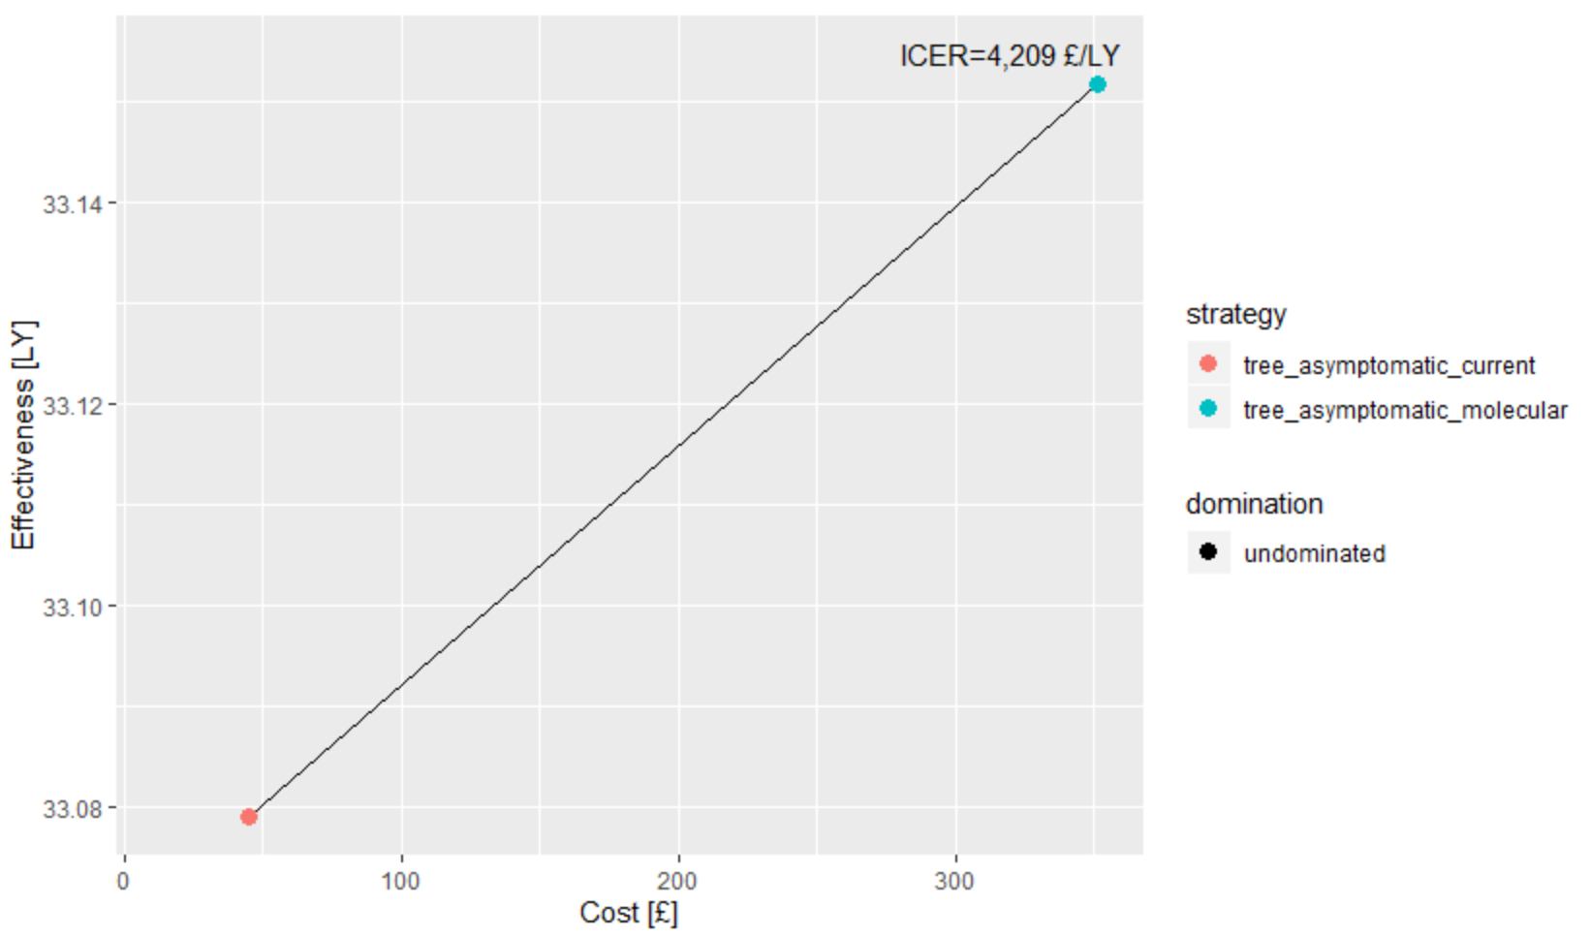
Postmenopausal asymptomatic

Slide 4
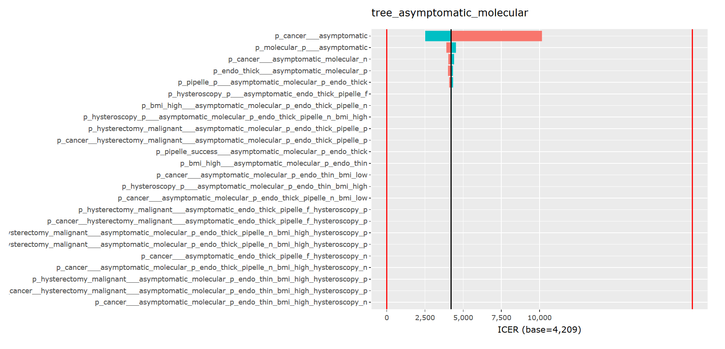
Postmenopausal asymptomatic (DSA - probs)

Slide 5
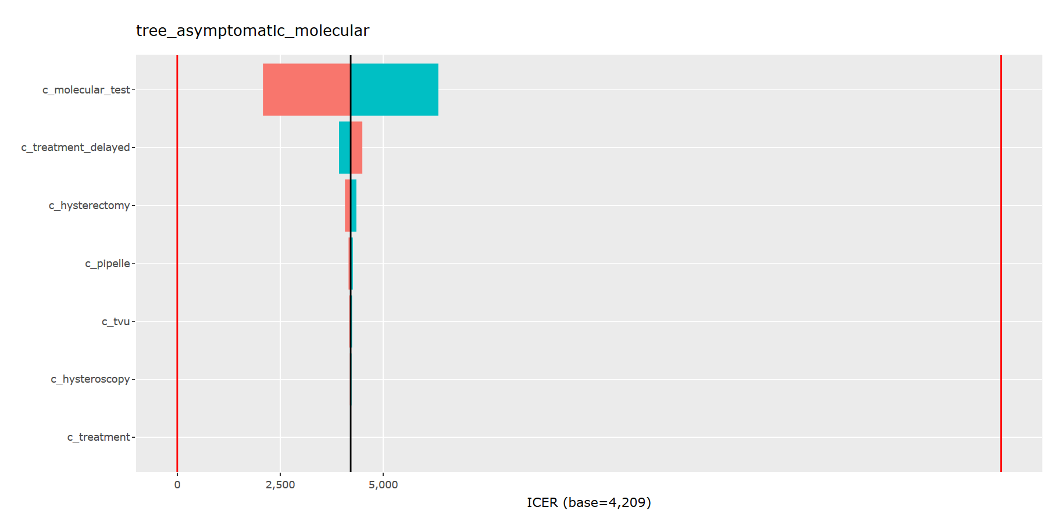
Postmenopausal asymptomatic (DSA - costs)

Slide 6
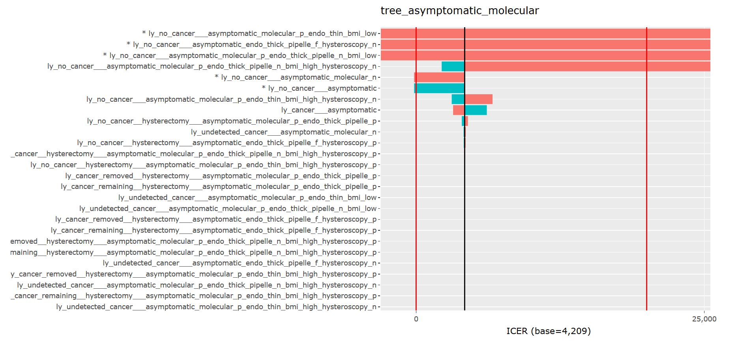
Postmenopausal asymptomatic (DSA - LYs)

Slide 7
Postmenopausal asymptomatic (DSA - LYs)
Base =
33.16
16
50
ly_no_cancer___asymptomatic
>34.8
ly_no_cancer___asymptomatic_endo_
thick_pipelle_f_hysteroscopy_n
<23.3
ly_no_cancer___asymptomatic_molecular_n
<31.5
ly_no_cancer___asymptomatic_molecular_p_
endo_thick_pipelle_n_bmi_low
<28.2
ly_no_cancer___asymptomatic_molecular_p_
endo_thin_bmi_low
<23.2
None dominates
Molecular strategy dominated

Slide 8
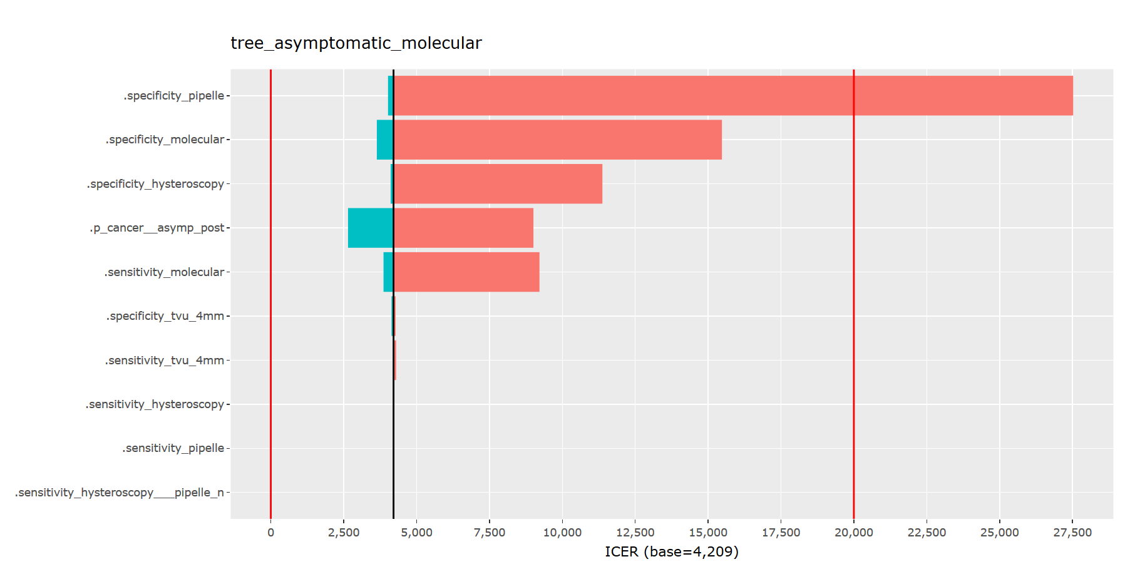
Postmenopausal asymptomatic (DSA - other)

Slide 9
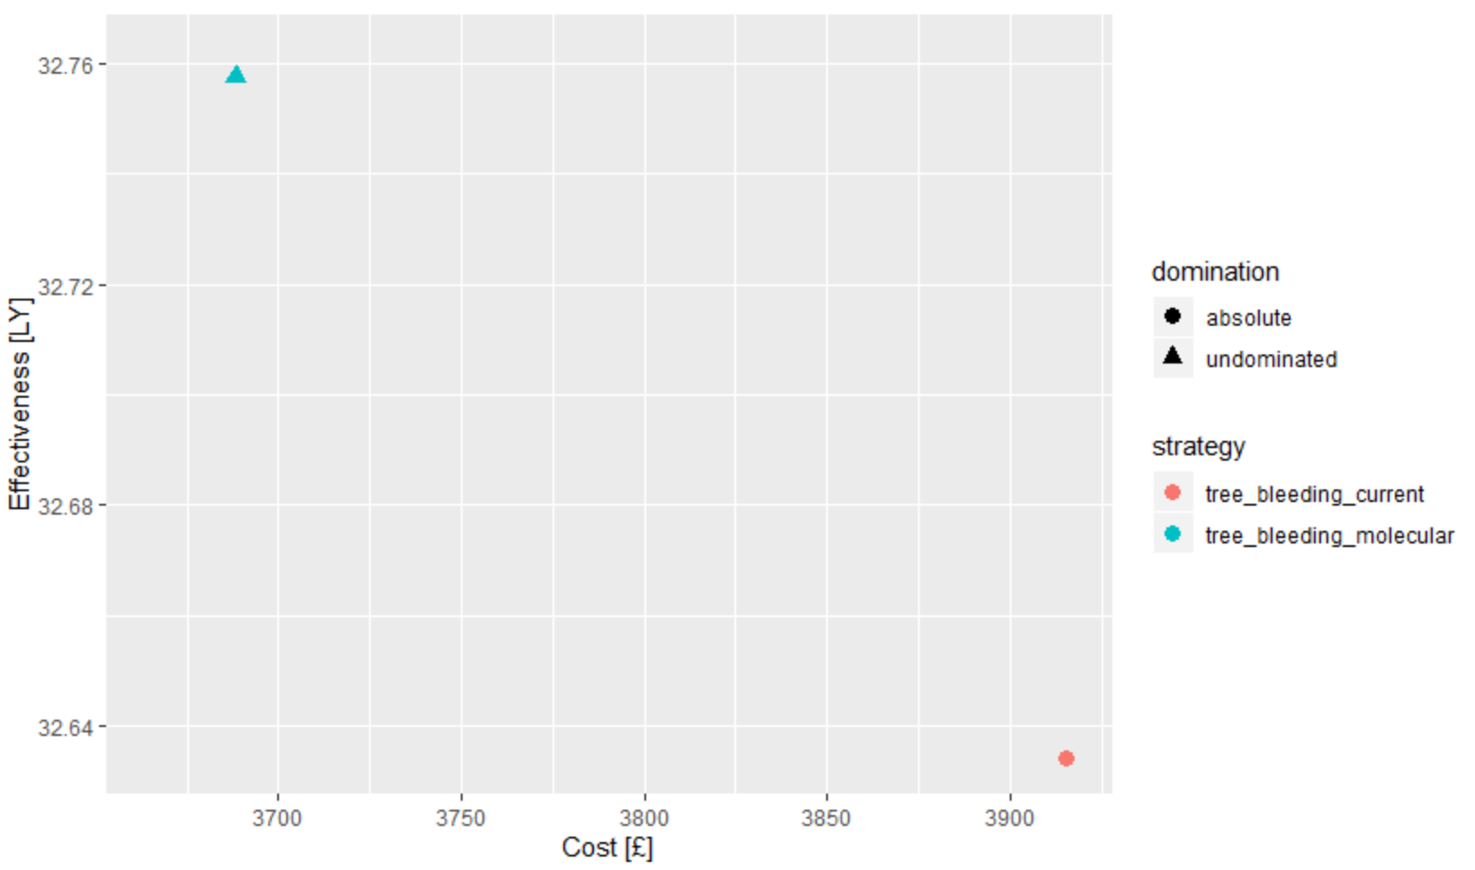
Postmenopausal bleeding

Slide 10
Postmenopausal bleeding (DSA - other)
0.43
0.86
0.98
1
.sensitivity_pipelle
0.46
0.84
0.929
1
.sensitivity_molecular
0.48
0.77
0.9
0.96
1
.specificity_molecular
Molecular strategy dominates
None dominates
Molecular strategy dominated

Slide 11
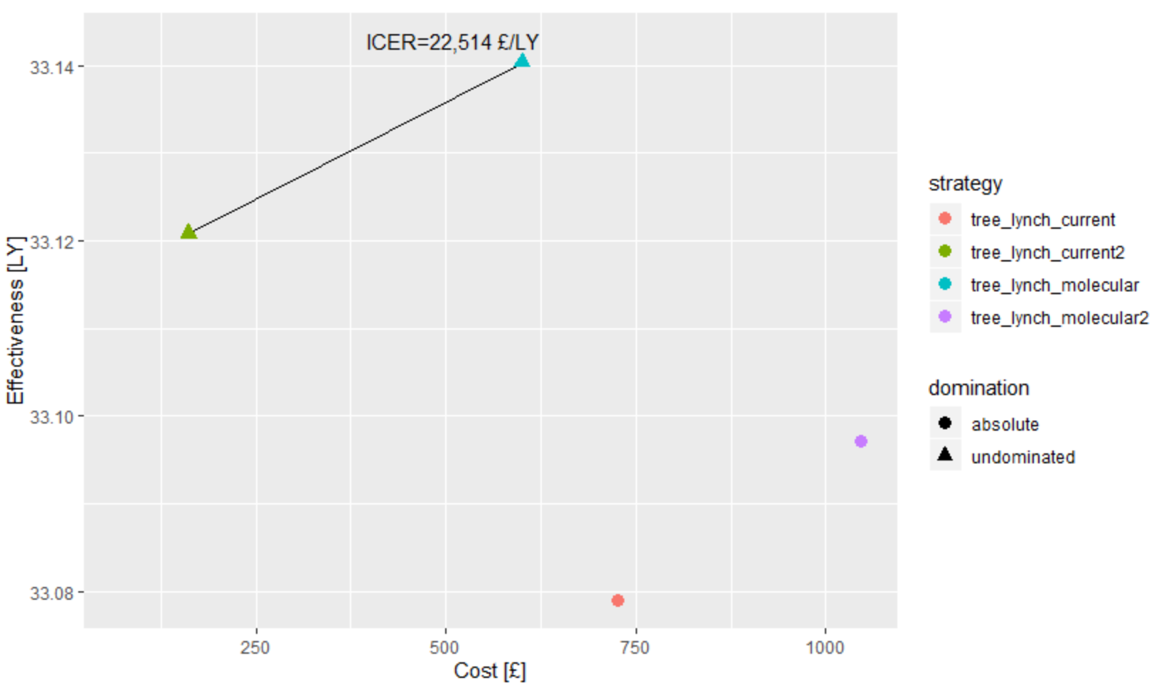
Lynch

Slide 12
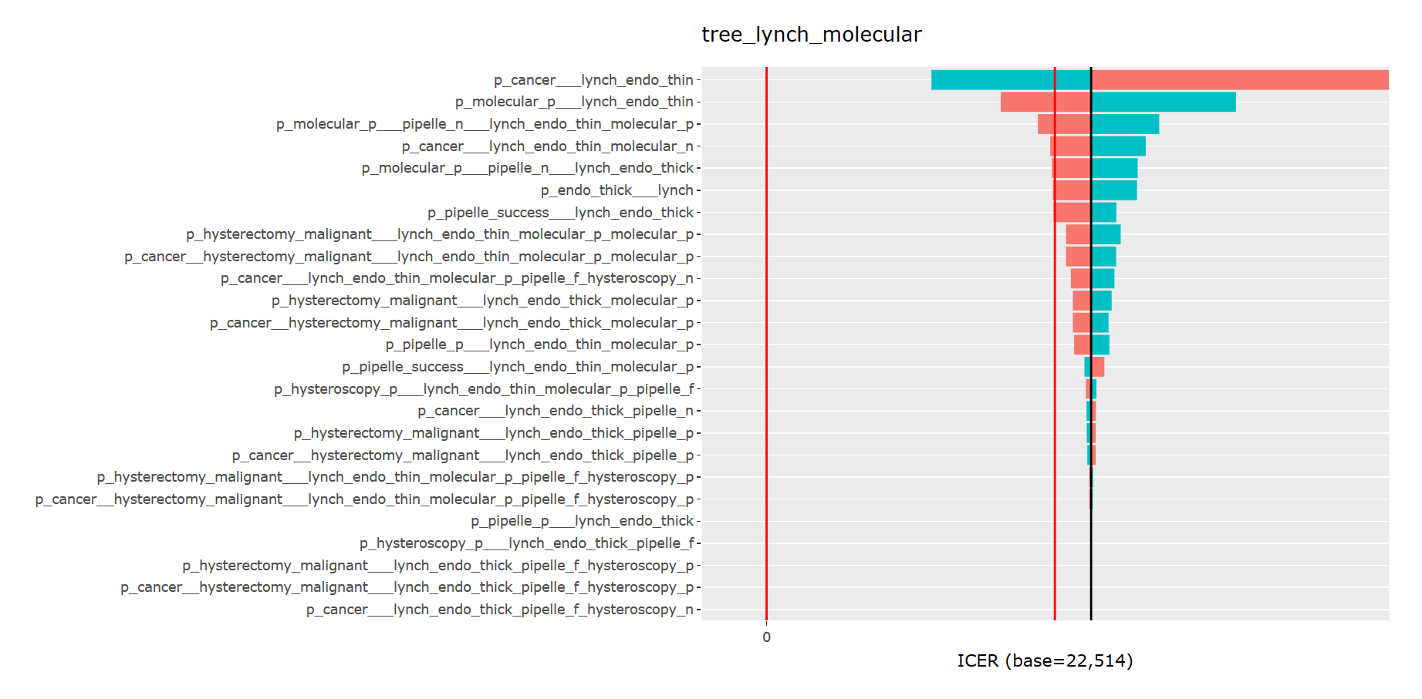
Lynch (DSA – probs)

Slide 13
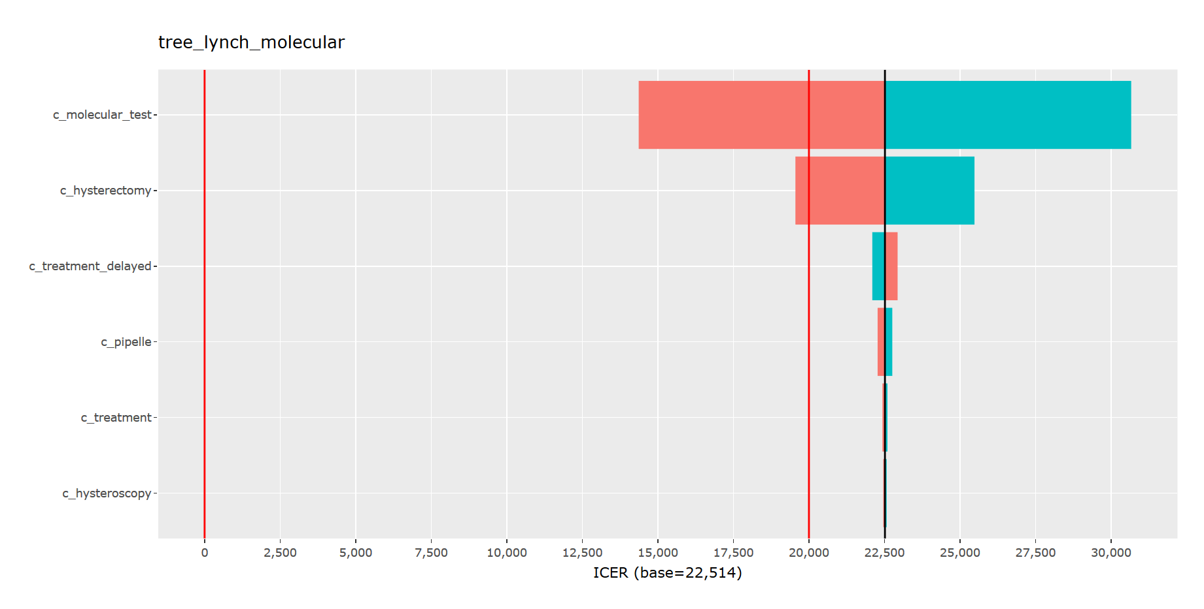
Lynch (DSA – costs)

Slide 14
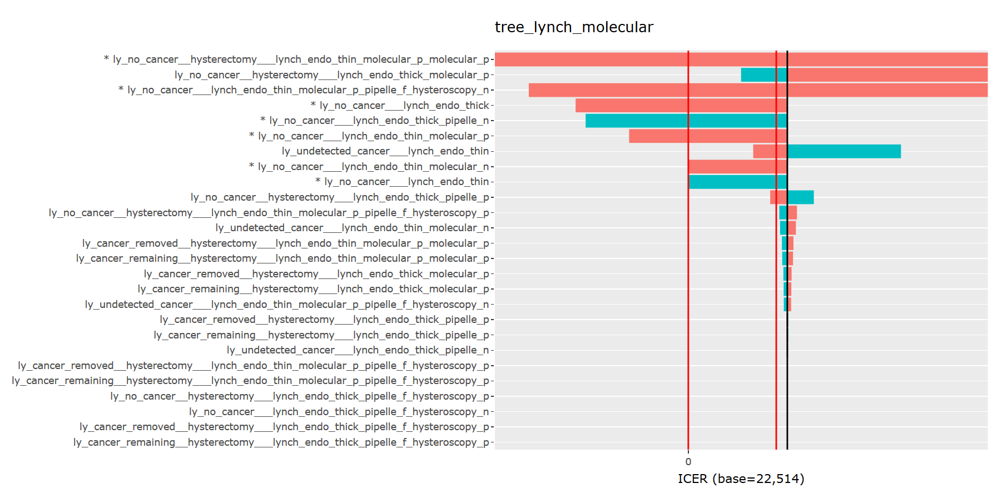
Lynch (DSA – LYs)

Slide 15
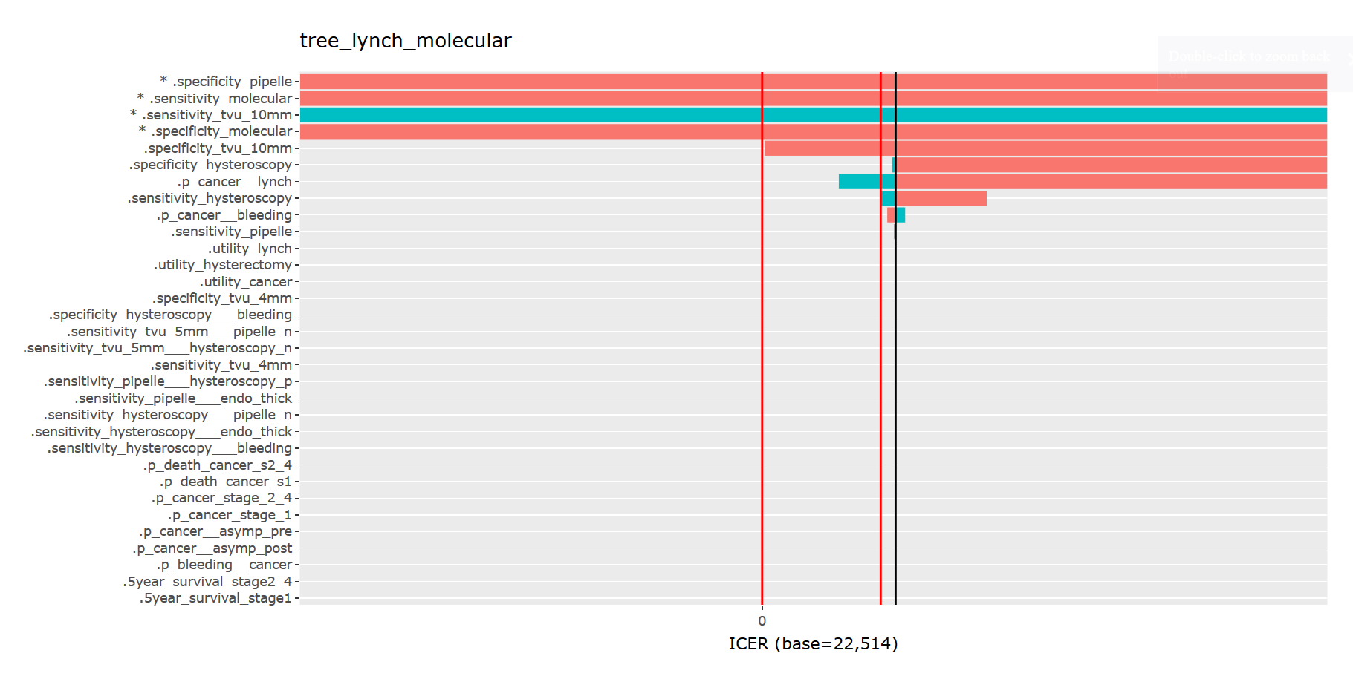
Lynch (DSA – other)

Slide 16
Lynch (DSA - other)
None dominates
Current strategy 2 dominates
0.43
0.8
0.99
1
.specificity_pipelle
0.27
0.541
0.78
0.81
.sensitivity_tvu_10mm
0.49
0.72
0.972
1
.specificity_tvu_10mm
0.46
0.65
0.929
1
.sensitivity_molecular
0.48
0.92
0.96
1
.specificity_molecular

Slide 17
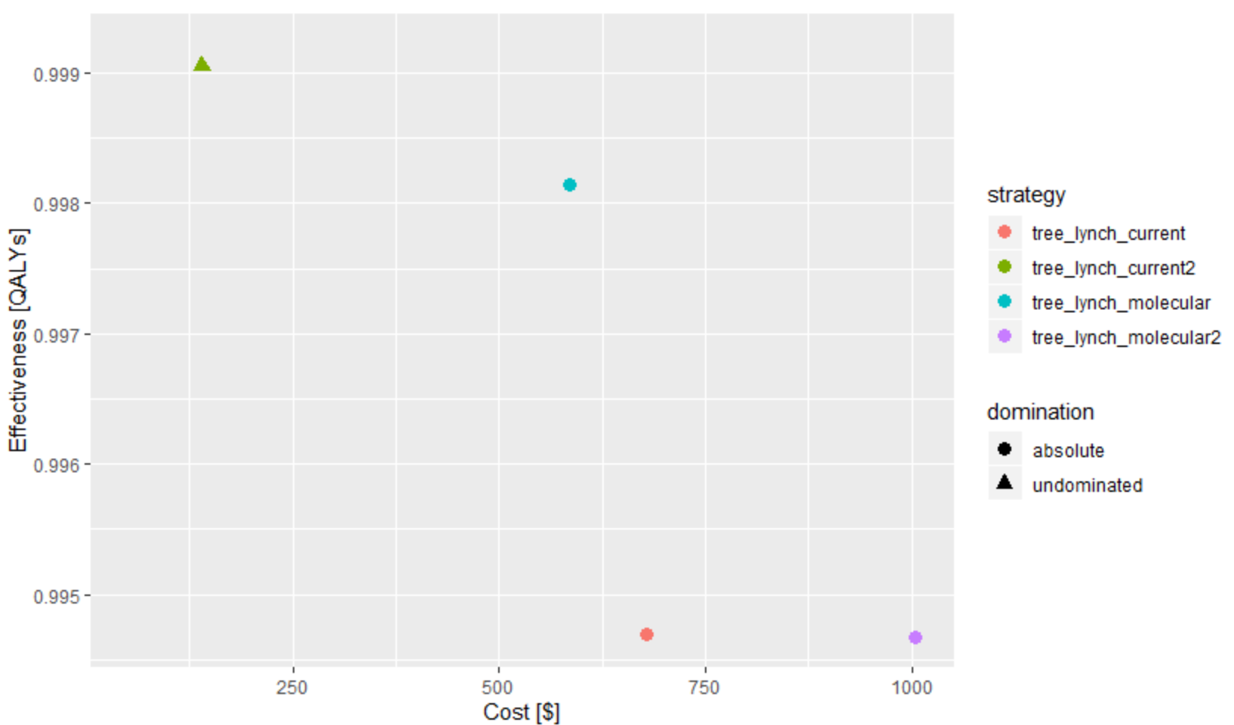
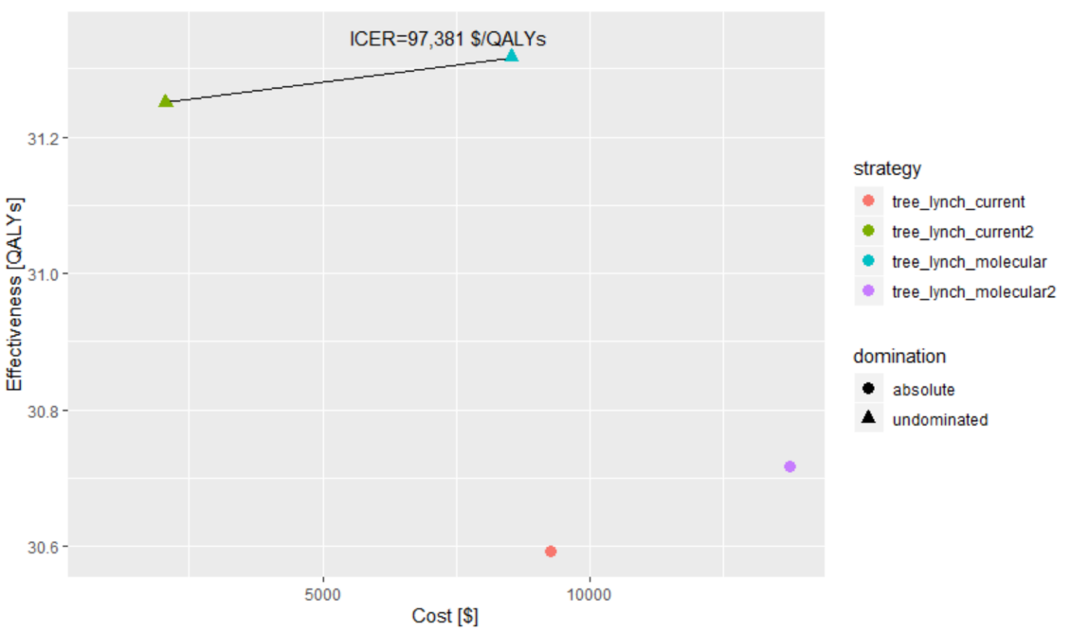
Alternatives
- Use utilities
Lynch - 1 year
Lynch - 45 years
- Use DOGC costs (to do)

