Slide 1


Interactive Impact of Solar Radiation and Normal Approaching Wind on Pollutant Transmission Characteristics in High-rise Building
穆迪
机械与能源工程学院---高效清洁能源课题组

Slide 2
Content
Introduction
Methodology
Case study
Conclusions
机械与能源工程学院---高效清洁能源课题组

Slide 3
The Impact of Solar Radiation on Pollutant Transmission Characteristics in High-rise Building
Introduction
Methodology
Case study
Conclusions
In windless or breezy sunny days, the outer vertical walls of a building could be heated strongly by solar radiation. The flow caused by natural convection adjacent to the heated wall becomes an important mechanism in the creation of wind flows, especially in cities with high-rise buildings. The wall thermal plume could drive the gaseous pollutant releasing from lower floor to upper floors. Combined with the effect of the background ambient wind, the vertical transmission routes will change as the relative forces of buoyancy and wind variation.
机械与能源工程学院---高效清洁能源课题组

Slide 4
The Impact of Solar Radiation on Pollutant Transmission Characteristics in High-rise Building
Introduction
Methodology
Case study
Conclusions
1. Solar radiation intensity Calculation
The vertical wall facing south could receive solar radiation for a relatively long time in a day, but the north wall could not get direct solar radiation. For the sunward and shady side vertical walls at noon, the received solar radiation intensity are in a very small range, which could be seen as a steady-state condition for the following calculation.
The solar radiation intensity in each direction
(S-South, N-North, E-East, W-West, H-Horizontal)
机械与能源工程学院---高效清洁能源课题组

Slide 5
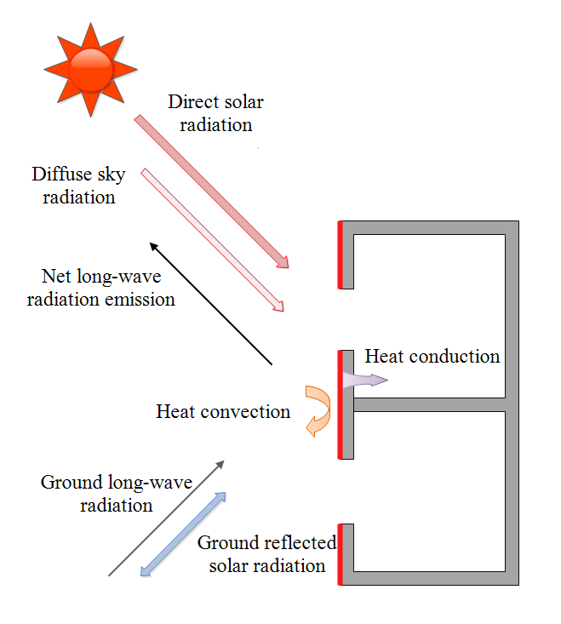
The Impact of Solar Radiation on Pollutant Transmission Characteristics in High-rise Building
Introduction
Methodology
Case study
Conclusions
For the outer wall surface
2. Temperature of wall surface
Relative parameters
Parameters |  | Value
Time |  | Noon
Outdoor air temperature (K) |  | 288.15
Sky effective temperature (K) |  | 270
Solar radiation intensity (W/m²) | Sunward | 430
 | Shady side | 165
Wall surface temperature (K) | Sunward | 301.16
 | Shady side | 291.67
For the inner wall surface
机械与能源工程学院---高效清洁能源课题组

Slide 6
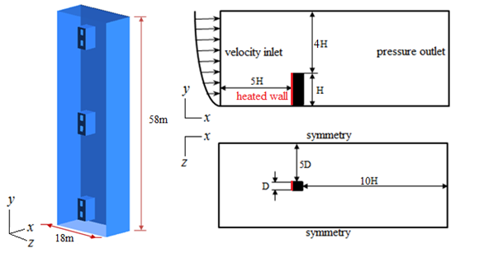
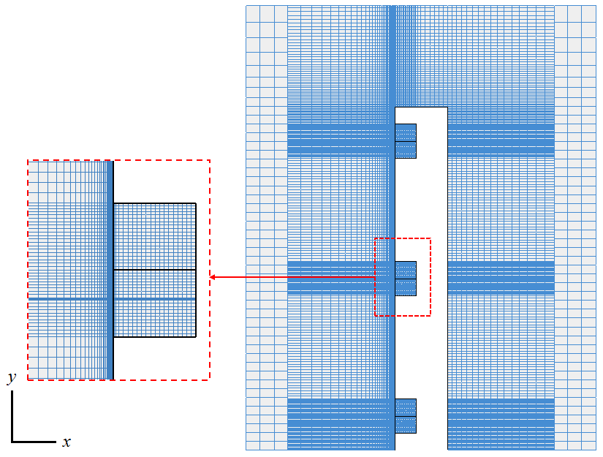
The Impact of Solar Radiation on Pollutant Transmission Characteristics in High-rise Building
Introduction
Methodology
Case study
Conclusions
3. Physical model and case configuration
Turbulent effect | Pressure-velocity coupling algorithm | Pressure interpolation method | Other discretization scheme | Inlet | Wall | Outlet
RNG k-ε +Enhanced WF | SIMPLE | PRESTO! | Second order | Wind profile TI = 8%, LS=1m, T_{in} | Windward T_{w} Adiabatic | Pressure outlet
机械与能源工程学院---高效清洁能源课题组

Slide 7
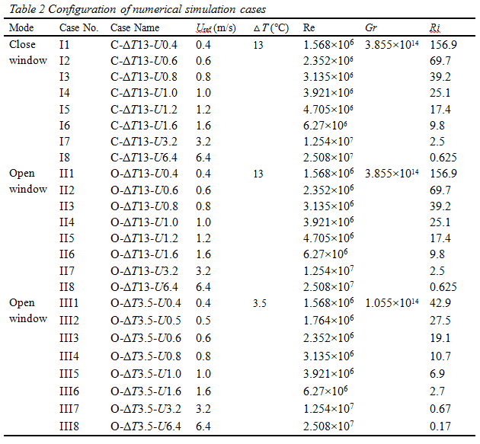
The Impact of Solar Radiation on Pollutant Transmission Characteristics in High-rise Building
Introduction
Methodology
Case study
Conclusions
3. Physical model and case configuration
Considering the effects of window active status, wind speed, temperature difference and source location, totally 72 cases are calculated. Table 2 shows 24 sets of configuration based on the airflow field without the influence of source, and these cases are divided into three groups according to the window condition and the temperature difference.
A dimensionless number, Richardson number, is adopted to represent the relative strength of buoyancy lift and wind.
机械与能源工程学院---高效清洁能源课题组

Slide 8
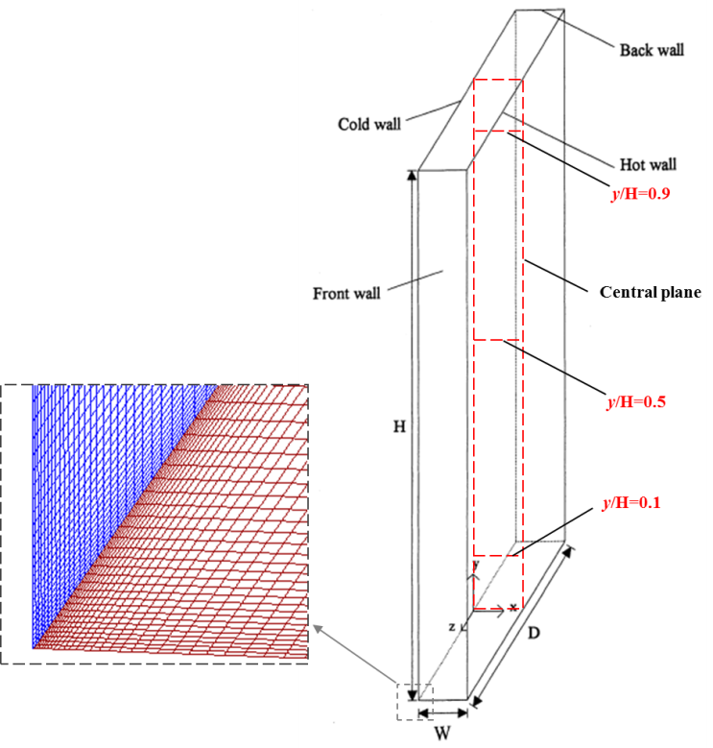
The Impact of Solar Radiation on Pollutant Transmission Characteristics in High-rise Building
Introduction
Methodology
Case study
Conclusions
3. Model validation
A schematic view of the air cavity with natural convection
Comparisons of temperature and velocity profiles between simulation and experiment at different heights of the central x-y plane
机械与能源工程学院---高效清洁能源课题组

Slide 9
The Impact of Solar Radiation on Pollutant Transmission Characteristics in High-rise Building
Introduction
Methodology
Case study
Conclusions
3. Model validation
Sketch of the cubic model and the locations of velocity test lines
Comparisons of the mean velocity along the test lines between simulation and experiment
机械与能源工程学院---高效清洁能源课题组

Slide 10
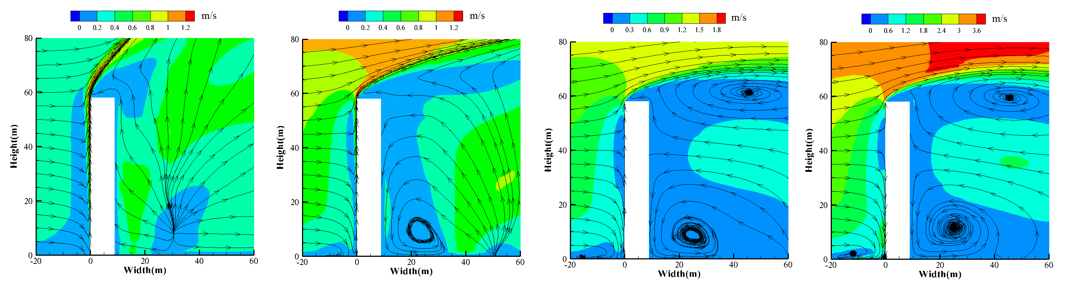
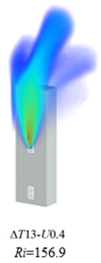
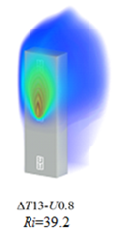
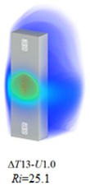
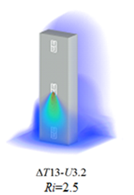
The Impact of Solar Radiation on Pollutant Transmission Characteristics in High-rise Building
Introduction
Methodology
Case study
Conclusions
机械与能源工程学院---高效清洁能源课题组

Slide 11
The Impact of Solar Radiation on Pollutant Transmission Characteristics in High-rise Building
Introduction
Methodology
Case study
Conclusions
机械与能源工程学院---高效清洁能源课题组

Slide 12
The Impact of Solar Radiation on Pollutant Transmission Characteristics in High-rise Building
Introduction
Methodology
Case study
Conclusions
Case No. | II1 | II3 | II4 | II7 | III1 | III3 | III5 | III7
U(m/s) | 0.4 | 0.8 | 1.0 | 3.2 | 0.4 | 0.6 | 1.0 | 3.2
ΔT(℃) | 13 | 13 | 13 | 13 | 3.5 | 3.5 | 3.5 | 3.5
Ri | 156.9 | 39.2 | 25.1 | 2.5 | 42.9 | 19.1 | 6.9 | 0.67
19th | 7.7 | 9.5 | 9.6 | 6.9 | 5.3 | 5.4 | 4.5 | 4.4
18th | 7.2 | 9.0 | 9.2 | 4.7 | 5.1 | 5.4 | 3.6 | 1.7
11th | 8.4 | 9.3 | 9.2 | 1.2 | 5.3 | 5.3 | 4.0 | 1.1
10th | 8.0 | 8.9 | 7.6 | 0.7 | 5.2 | 4.3 | 3.2 | 1.3
3rd | 8.1 | 8.3 | 8.1 | 0.7 | 4.9 | 4.7 | 2.6 | 1.1
2nd | 8.7 | 7.2 | 6.7 | 2.2 | 4.4 | 3.9 | 2.7 | 0.8
机械与能源工程学院---高效清洁能源课题组

Slide 13
The Impact of Solar Radiation on Pollutant Transmission Characteristics in High-rise Building
Introduction
Methodology
Case study
Conclusions
%
Case No. | II1 | II3 | II4 | II7 | III1 | III3 | III5 | III7
U(m/s) | 0.4 | 0.8 | 1.0 | 3.2 | 0.4 | 0.6 | 1.0 | 3.2
ΔT(℃) | 13 | 13 | 13 | 13 | 3.5 | 3.5 | 3.5 | 3.5
Ri | 156.9 | 39.2 | 25.1 | 2.5 | 42.9 | 19.1 | 6.9 | 0.67
19th | 0.11
18th | 0.12
11th | 0.85 |  |  |  | 0.04
10th | 1.05 |  |  |  | 0.06
3rd | 20.56 | 19.97 | 4.69 |  | 19.09 | 2.82
2nd | ● | ● | ● | ● | ● | ● | ● | ●
机械与能源工程学院---高效清洁能源课题组

Slide 14
The Impact of Solar Radiation on Pollutant Transmission Characteristics in High-rise Building
Introduction
Methodology
Case study
Conclusions
%
Case No. | II1 | II3 | II4 | II7 | III1 | III3 | III5 | III7
U(m/s) | 0.4 | 0.8 | 1.0 | 3.2 | 0.4 | 0.6 | 1.0 | 3.2
ΔT(℃) | 13 | 13 | 13 | 13 | 3.5 | 3.5 | 3.5 | 3.5
Ri | 156.9 | 39.2 | 25.1 | 2.5 | 42.9 | 19.1 | 6.9 | 0.67
19th | 1.08 | 0.58 | 0.02 |  | 0.93
18th | 1.24 | 0.77 | 0.03 |  | 1.18 | 0.01
11th | 24.38 | 36.95 | 24.50 |  | 27.72 | 15.34
10th | ● | ● | ● | ● | ● | ● | ● | ●
3rd |  |  | 0.01 | 0.30 |  | 0.01 | 0.14 | 0.29
2nd |  |  |  | 0.61 |  | 0.01 | 0.09 | 0.13
机械与能源工程学院---高效清洁能源课题组

Slide 15
The Impact of Solar Radiation on Pollutant Transmission Characteristics in High-rise Building
Introduction
Methodology
Case study
Conclusions
%
Case No. | II1 | II3 | II4 | II7 | III1 | III3 | III5 | III7
U(m/s) | 0.4 | 0.8 | 1.0 | 3.2 | 0.4 | 0.6 | 1.0 | 3.2
ΔT(℃) | 13 | 13 | 13 | 13 | 3.5 | 3.5 | 3.5 | 3.5
Ri | 156.9 | 39.2 | 25.1 | 2.5 | 42.9 | 19.1 | 6.9 | 0.67
19th | 23.59 | 27.76 | 23.89 | 20.64 | 24.86 | 20.58 | 23.65 | 32.18
18th | ● | ● | ● | ● | ● | ● | ● | ●
11th
10th
3rd
2nd
机械与能源工程学院---高效清洁能源课题组

Slide 16
The Impact of Solar Radiation on Pollutant Transmission Characteristics in High-rise Building
Introduction
Methodology
Case study
Conclusions
For a 58m high building at noon of April 21st in Shanghai, the near wall thermal plume speed at the building height is up to 1.2m/s;
For the pollutant transmission, the source is released from a point at a constant intensity, the following conclusions can be obtained:
(1) When the source location is below the stagnation zone, as the Ri number decreases, the effect of force convection strengthen, so the pollutant spread from lower floor to upper ones is weaken;
(2) When the source location is the 2nd floor, the vertical transmission is suppressed once Ri is about 40. When the source is released from the 10th floor, the vertical transmission is restrained once Ri is about 20;
(3) When the source location is above the stagnation zone, the pollutant always goes up;
(4) When the effect of buoyancy lift is stronger than the approaching wind or these two forces are equivalent, at least two units above the source one get high concentration at a range of 10⁻⁶~1.
机械与能源工程学院---高效清洁能源课题组

Slide 17

The Impact of Solar Radiation on Pollutant Transmission Characteristics in High-rise Building
Q&A
Thank you
16
机械与能源工程学院---高效清洁能源课题组

