Slide 1
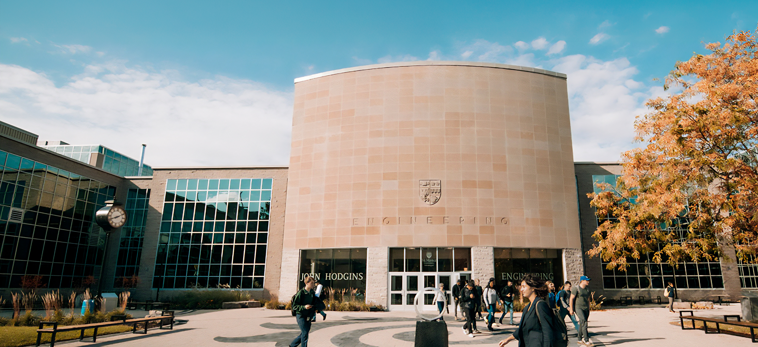


Title
Name
Supervisory committee meeting

Slide 2
Progress
2024 September – 2025 August
Course requirements: completed
CAS 123: Example course A+
CAS 123: Example course A+
CAS 123: Example course A+
CAS 123: Example course A+
Seminar attendance: completed
Attended seminars: 6 (minimum this year: 4)
Department poster competition: in 2025 Fall
Research: in progress
Literature survey: completed
Scope of research: identified
Technical contributions: in 2025 Summer and Fall

Slide 3
Research
Background
Explain problem and key takeaway
Explain methods and argue for their appropriateness, e.g.,
why an SLR, MLR, scoping review, ethnography,
how data was collected and analyzed,
…
Are the results reported anywhere?
Technical report, or
conference paper, or
journal article?

Slide 4
Research
Technical scope
Based on the survey, identify the scope of the technical (engineering) contribution of the thesis

Slide 5
Research
Sample points for Master’s presentations
Roadmap
2025 Summer
Goals and expected outcomes in this period
Typically: design and first prototype, perhaps initial evaluation and documentation of results
May elaborate on approach, process, evaluation methods, etc
2025 Fall
Goals and expected outcomes in this period
Typically: final deliverable and evaluation
May elaborate on evaluation methods, hypotheses, fallback plans, etc
2026 Winter
Goals and expected outcomes in this period
Typically: writing and defending thesis

Slide 6
Research
Sample points for PhD presentations
Roadmap
Short-term goals
Goals and expected outcomes
These are firm and actionable ideas, based on the background and previous results
Ideally: tied to the publication strategy
Medium- and long-term goals
Goals and expected outcomes
These are less refined ideas but still plausible
Ideally: tied to the publication strategy
Last term (e.g., 2028 Winter)
Goals and expected outcomes in this period
Typically: writing and defending thesis

Slide 7
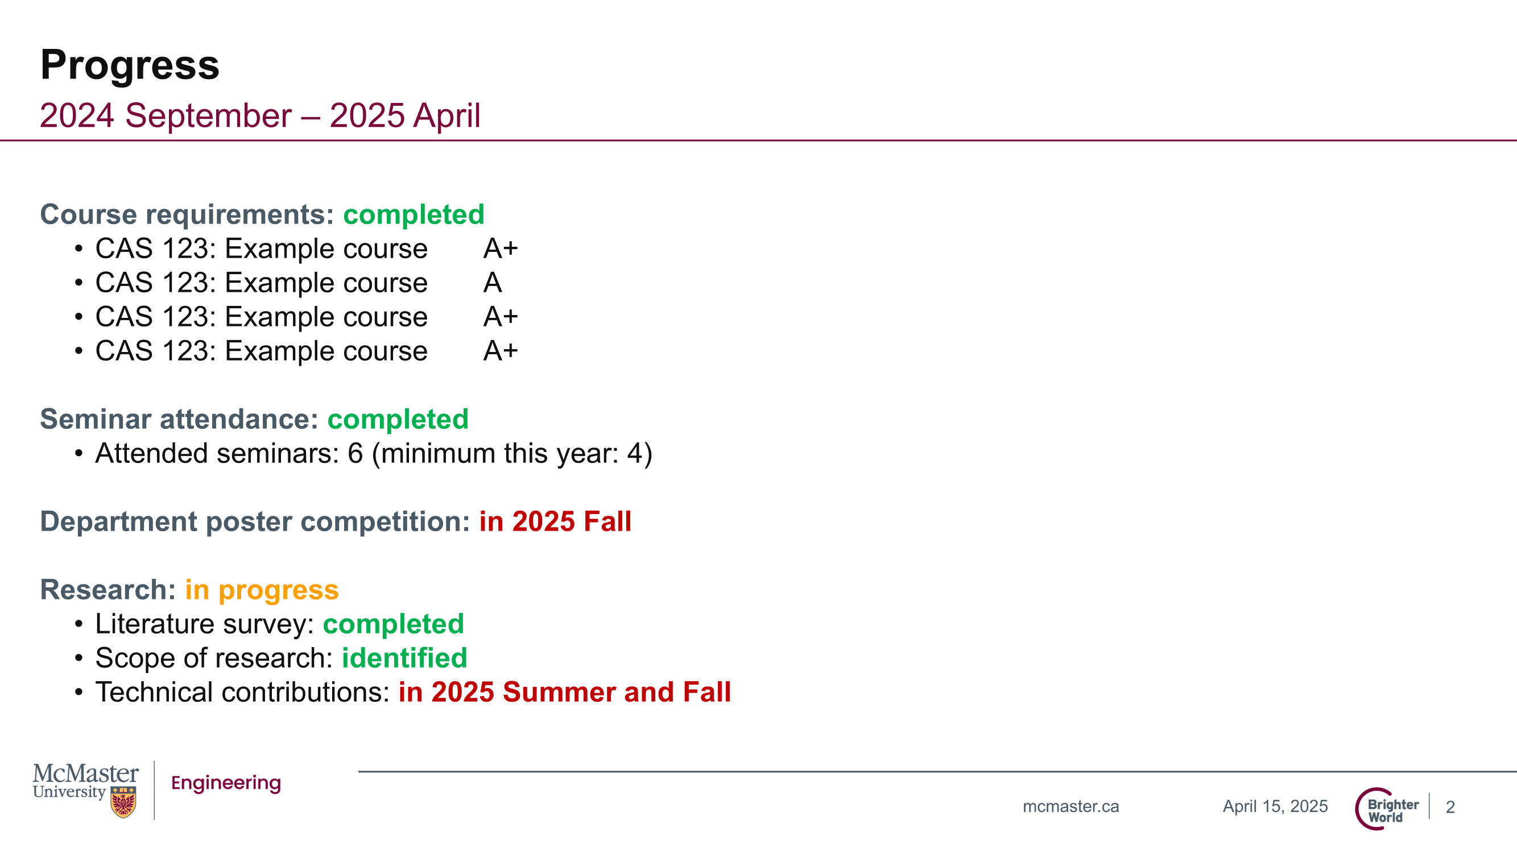
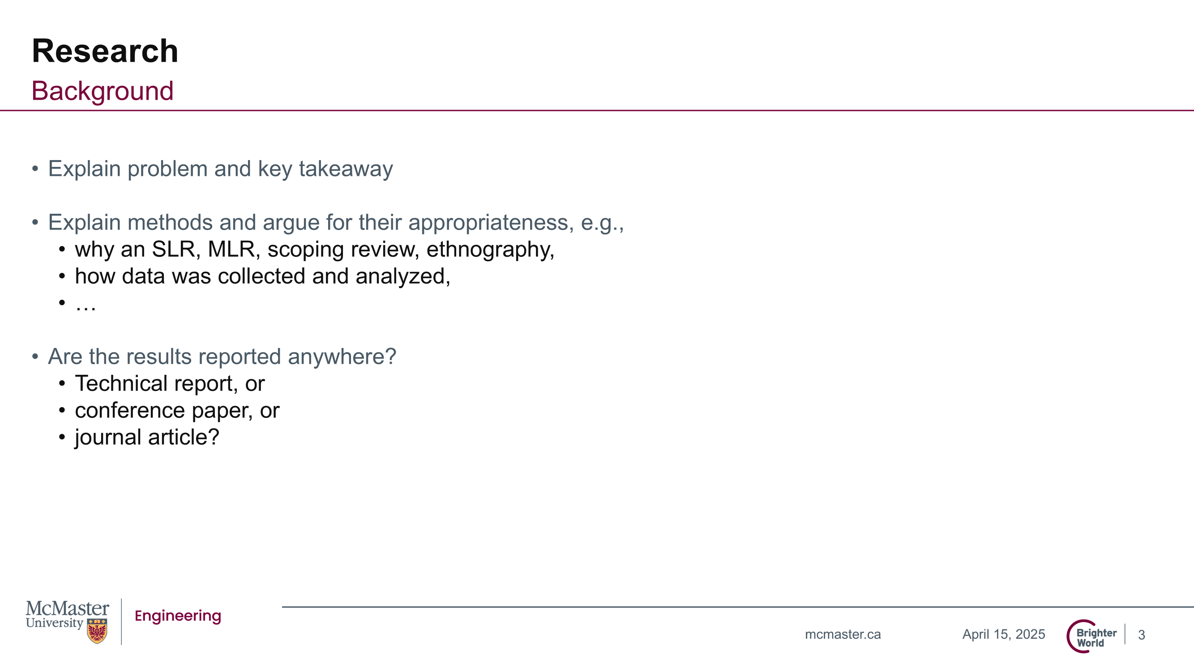
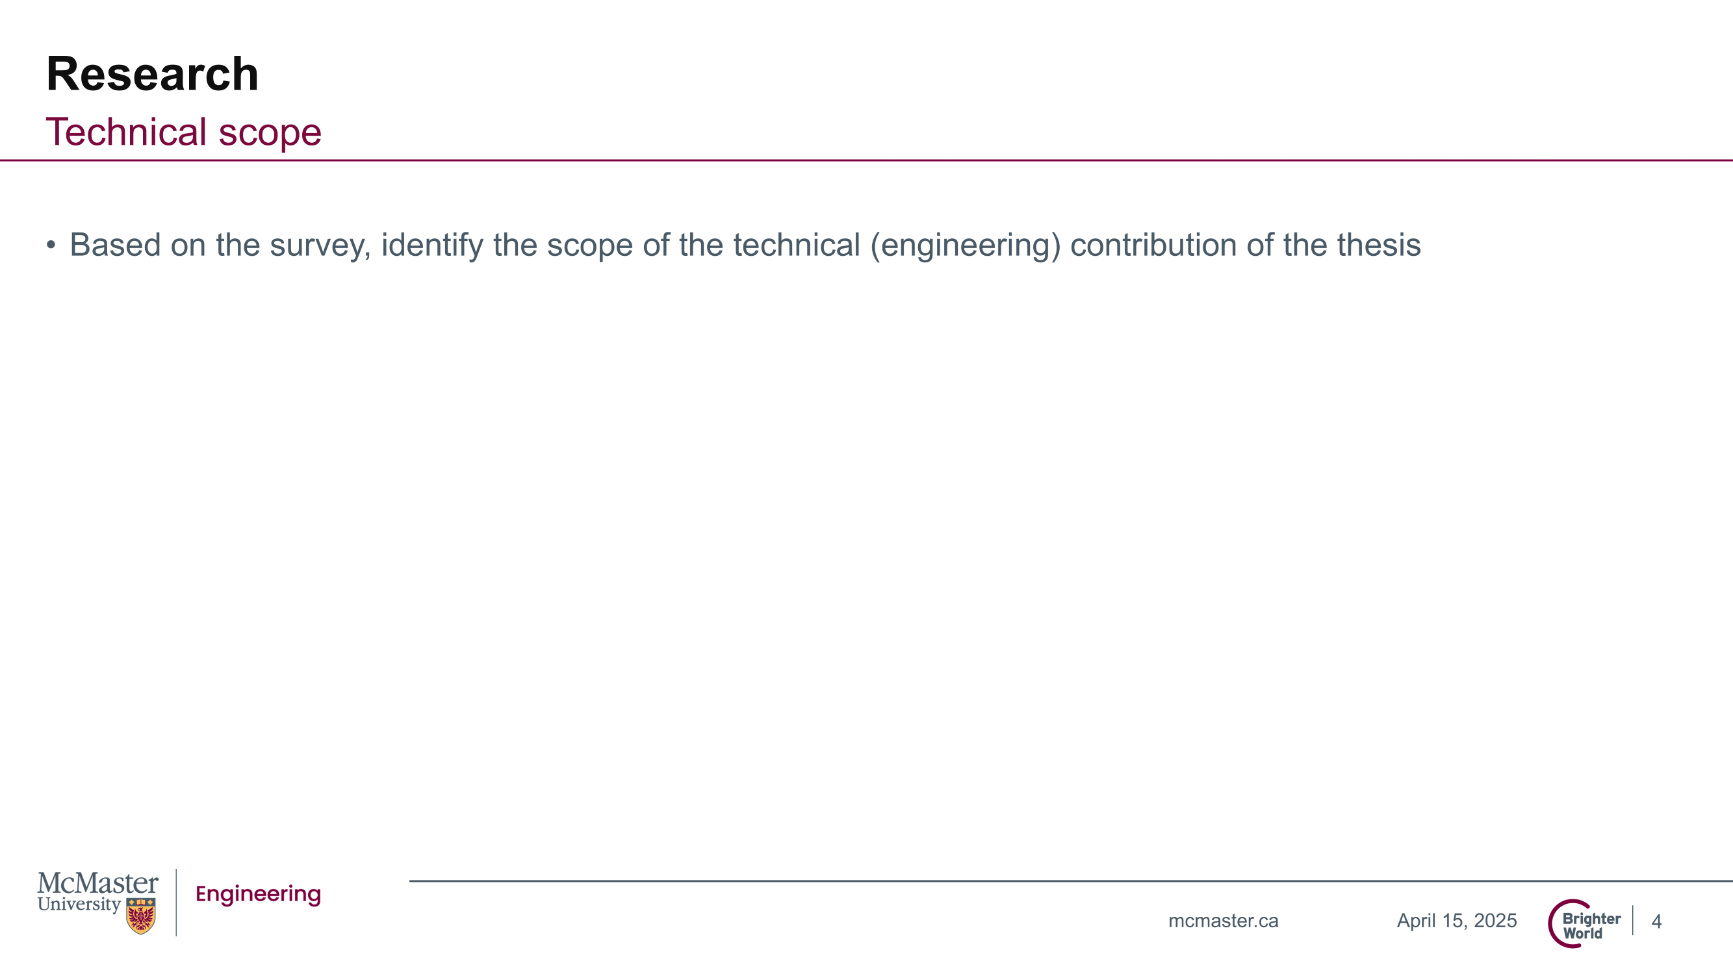
Conclusion
Provide 3-4 highlights of the presentation, e.g., insert key slides as pictures to support the concluding remark – which basically should be “I know what, how, and when I want to work on for the remainder of my program and I understand the impact of my work”

