Slide 1
Issue Tracker Project
David Jenn
AWD 1111 Database Driven Web Development
Fall 2021

Slide 2
Project Objective
Full stack application used to store and modify issues that are found in a system
Store data on users, bugs, comments, and test cases
Full CRUD capability to create, read, update, and delete (close a bug) entities
Users have different levels of authorization to perform a variety of tasks within the application.

Slide 3
Project Background
Why build this project?
What Would I Do Differently?
Learn how front-end, back-end, and the database all work together
Understand how to store data efficiently in MongoDB
Get practice with react and better understand how to work with it
Gain knowledge of sending and receiving data across the web
More careful on code organization and naming conventions.
Work on front-end earlier on
Implement an upvote or downvote system on comments

Slide 4
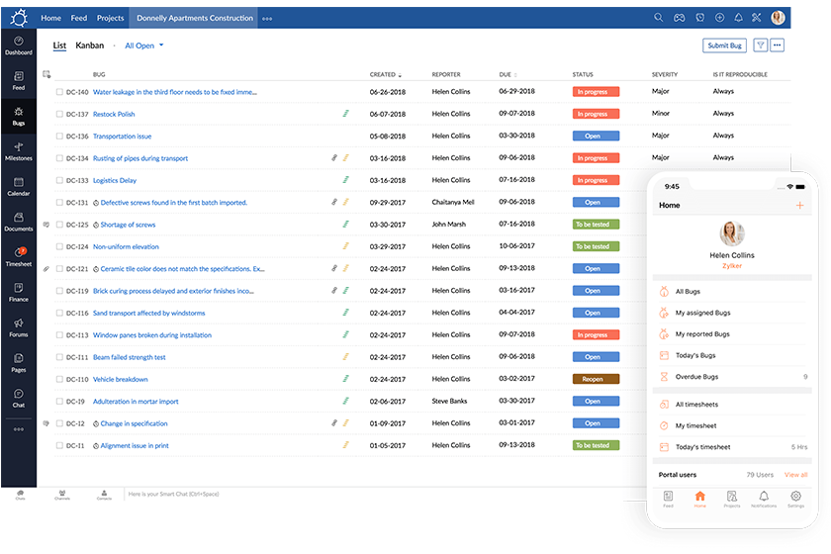
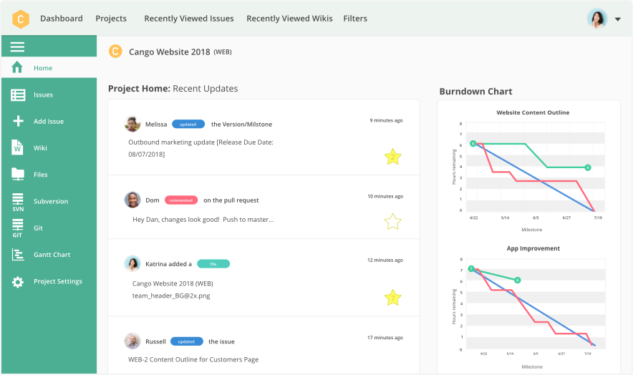
Similar Applications
Zoho Bug Tracker
Backlog Bug Tracker

Slide 5
Key Features
Store and organize a list a bugs and users
Create and update new or existing bugs or users
Users can leave comments on a bug that are stored in a separate collection
Configurable roles to allow customizing of roles
Validation done on backend to prevent attacks and invalid data

Slide 6
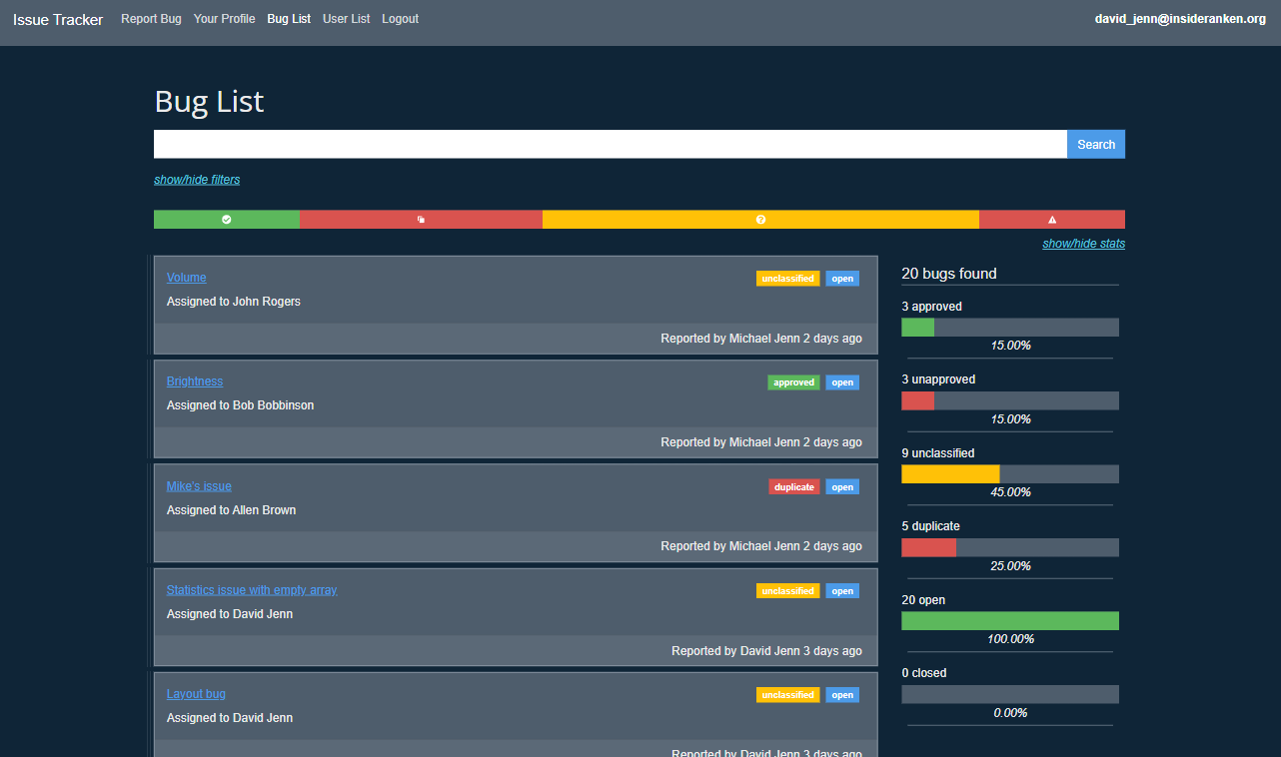
My Project

Slide 7
The End

