Slide 1
Unity HDRP Overview
David Lively
11/05/2019

Slide 2
Hdrp Architecture & flow
Graphics device and context are owned by the engine
An abstract device (“GfxDevice”) is created based on selected API
Note: Unity supports API fallback for most projects
Editor preferences provide an editable prioritized list of preferred APIs
Works very well as long as you follow the rules for the different APIs.
Engine code still owns some things:
Update / render loop.
Update() logic is still controlled by the engine.
Real graphics device. In the C++ engine source, this is a class GfxDevice with PIMPL for DX11, DX12, GL, etc.
Real API calls are still hidden.
CommandBuffer class provides equivalent methods.
For instance, use CommandBuffer.DrawInstanced() rather than ID3D11DeviceContext::DrawInstanced()
More on this later

Slide 3
The Least you need to know
Abstract class RenderPipeline
Defines entry point for Render loop
Provides static callback functions to notify engine of important render events
BeginCameraRender / EndCameraRender
BeginFrameRender / EndFrameRender
Class CommandBuffer
Provides all ::Draw*() methods and anything else required to populate a command list
Class ScriptableRenderContext
Provides Submit(CommandBuffer) and misc. methods.
Posts rendering commands to the GfxDevice queue

Slide 4
Custom rp – the simplest possible render
Simplest possible render pipeline system
Illustrates a higher-level view of HDRP that’s a little easier to parse
Basis for later HDRP-specific discussion (HDRP inherits from SRP)

Slide 5
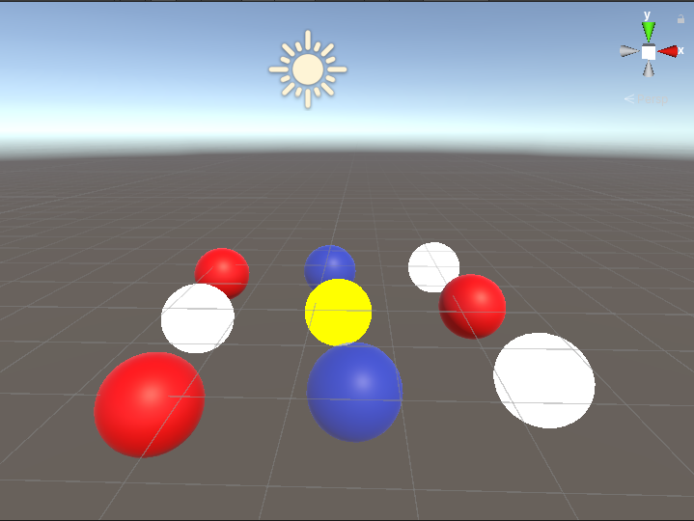

Simple RP
Scene with legacy renderer
Same scene with simple SRP. Skybox is explicitly drawn by custom SRP

Slide 6
Simple rp – render skybox
Inherit abstract class UnityEngine.Rendering.RenderPipeline
Override .Render()
Buffer rendering commands via ScriptableRenderContext object
Call Submit() to complete this pass.
using System.Collections;
using System.Collections.Generic;
using UnityEngine;
using UnityEngine.Rendering;
public class MyPipeline : RenderPipeline
{
protected override void Render(
ScriptableRenderContext context
, Camera[] cameras)
{
context.DrawSkybox(cameras[0]);
context.Submit();
}
}

Slide 7
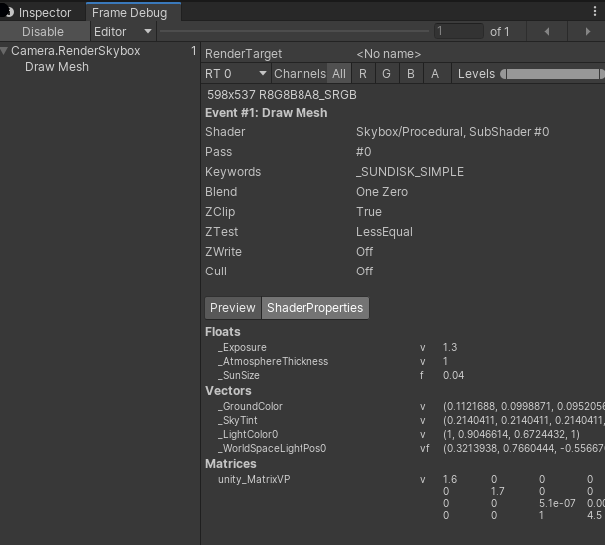
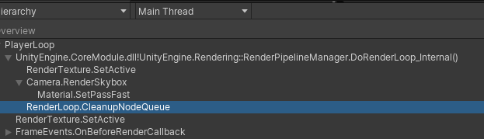
Simple rp – render skybox
Profiler output:
As expected, RenderSkybox is the only render event in frame.

Slide 8
Simple rp – render skybox
Takeaways:
Nothing is rendered outside of SRP class. Without the .drawSkybox() call, the viewport is completely blank.
Render commands are buffered by ScriptableRenderContext object
SRP is used all rendered views – editor, play, etc.
Everything in the pipeline must be implemented in script.
GameObjects, materials, and other settings are available to the renderer. It’s up to the developer to decide how or if these are used.
Notes:
The engine still controls culling internally. This may be exposed to script in future release.

Slide 9
Simple rp – Command buffers
Discrete collections of grouped commands
Provides wrappers for Unity RenderCommand objects.
Draw
Dispatch
Fences
Raytracing
Etc.
public void DrawProceduralIndirect(Matrix4x4 matrix, Material material, int shaderPass, MeshTopology topology, ComputeBuffer bufferWithArgs, int argsOffset, MaterialPropertyBlock properties);
public void GenerateMips(RenderTexture rt);
public void RequestAsyncReadback(ComputeBuffer src, int size, int offset, Action<AsyncGPUReadbackRequest> callback);
public void SetComputeBufferParam([NotNull] ComputeShader computeShader, int kernelIndex, int nameID, ComputeBuffer buffer);

Slide 10
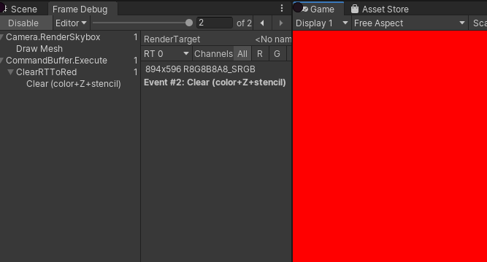
Simlpe RP – command buffers
protected override void Render(
ScriptableRenderContext context
, Camera[] cameras)
{
foreach (var camera in cameras)
context.SetupCameraProperties(camera);
using (var buffer = new CommandBuffer())
{
buffer.name = "ClearRTToRed";
buffer.ClearRenderTarget(true, true, Color.red);
context.ExecuteCommandBuffer(buffer);
}
context.Submit();
}

Slide 11
Basic srp logic
RenderPipeline.Render()
Culling via helper classes
Populate command buffers to render non-culled objects
Context.ExecuteCommandBuffer() or .ExecuteCommandBufferAsync()
Context.Submit()

