Slide 1
Unity HDRP Overview
David Lively
11/05/2019

Slide 2
SRP & HDRP overview
Graphics device and context are owned by the engine
An abstract device (“GfxDevice”) is created based on selected API
Note: Unity supports API fallback for most projects
Editor preferences provide an editable prioritized list of preferred APIs
Works very well as long as you follow the rules for the different APIs.
Engine code still owns some things:
Update / render loop.
Update() logic is still controlled by the engine.
Real graphics device. In the C++ engine source, this is a class GfxDevice with PIMPL for DX11, DX12, Vk, GL, etc.
Real API calls are still hidden.
CommandBuffer class provides equivalent methods.
For instance, use CommandBuffer.DrawInstanced() rather than ID3D11DeviceContext::DrawInstanced()
More on this later

Slide 3
SRP - The Least you need to know
Abstract class RenderPipeline
Defines entry point for Render loop
Provides static callback functions to notify engine of important render events
BeginCameraRender / EndCameraRender
BeginFrameRender / EndFrameRender
Class CommandBuffer
Provides all ::Draw*() methods and anything else required to populate a command list
Class ScriptableRenderContext
Provides Submit(CommandBuffer) and misc. methods.
Posts rendering commands to the GfxDevice queue

Slide 4
SRP – basic usage
RenderPipeline.Render()
Culling via helper classes. RP implementations may override or ignore this.
Render objects
Use Context.Draw…() for simple tasks
CommandBuffer.Draw*() for more granular control
Context.ExecuteCommandBuffer() or .ExecuteCommandBufferAsync()
Context.Submit()
Submit all pending commands to Unity’s render command queue.

Slide 5
Simple rp – the simplest possible render
Simplest possible render pipeline system
Illustrates a higher-level view of HDRP that’s a little easier to parse
Basis for later HDRP-specific discussion (HDRP inherits from SRP)
Notes:
Project available at https://github.com/david-lively/CustomSRP

Slide 6
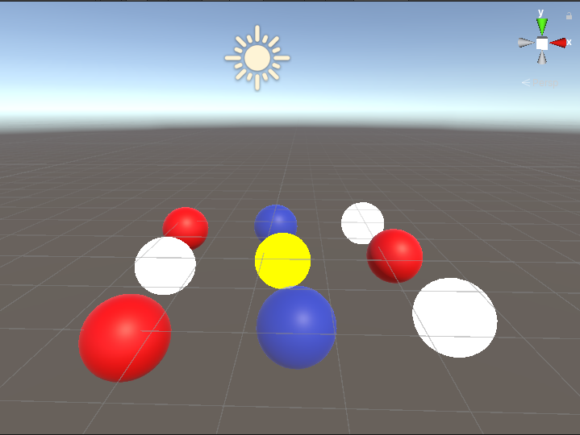
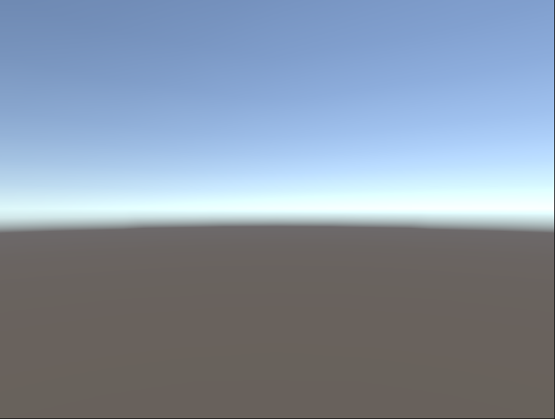
Simple RP
Scene with legacy renderer
Same scene with simple SRP. Skybox is explicitly drawn by custom SRP
Notes:
See https://github.com/david-lively/CustomSRP
Some material borrowed from https://blogs.unity3d.com/2018/01/31/srp-overview/

Slide 7
Simple rp – render skybox
Inherit abstract class UnityEngine.Rendering.RenderPipeline
Override .Render()
Buffer rendering commands via ScriptableRenderContext object
Call Submit() to complete this pass.
using System.Collections;
using System.Collections.Generic;
using UnityEngine;
using UnityEngine.Rendering;
public class MyPipeline : RenderPipeline
{
protected override void Render(
ScriptableRenderContext context
, Camera[] cameras)
{
context.DrawSkybox(cameras[0]);
context.Submit();
}
}

Slide 8
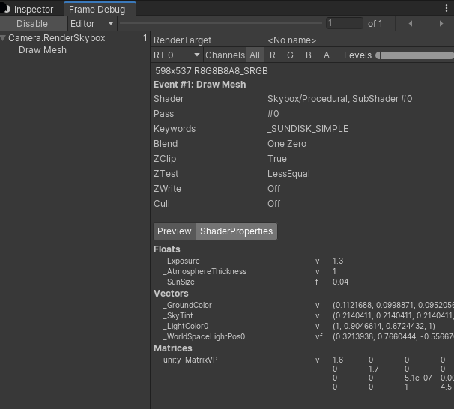
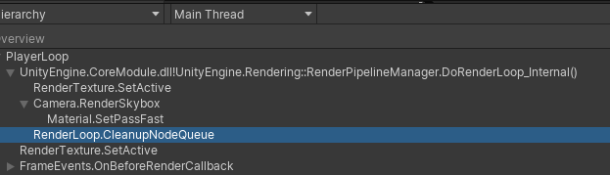
Simple rp – render skybox
Profiler output:

Slide 9
Simple rp – render skybox
Takeaways:
Nothing is rendered outside of SRP class. Without the .drawSkybox() call, the viewport is completely blank.
Render commands are buffered by ScriptableRenderContext object
SRP is used all rendered views – editor, play, material editor.
Everything in the pipeline must be implemented in script.
GameObjects, materials, and other settings are available to the renderer. It’s up to the developer to decide how or if these are used.
Notes:
The engine still controls culling internally. This may be exposed to script in future release.

Slide 10
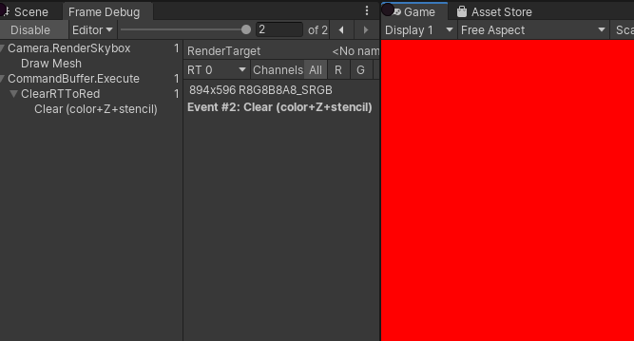
Simlpe RP – command buffers
Provides more native API-like methods
Used to populate context command queue
Engine internall translates to API-specific calls in render thread.
protected override void Render(
ScriptableRenderContext context
, Camera[] cameras)
{
foreach (var camera in cameras)
context.SetupCameraProperties(camera);
using (var buffer = new CommandBuffer())
{
buffer.name = "ClearRTToRed";
buffer.ClearRenderTarget(true, true, Color.red);
context.ExecuteCommandBuffer(buffer);
}
context.Submit();
}

Slide 11
Simple rp – Command buffers
Discrete collections of grouped commands
Provides wrappers for Unity RenderCommand objects.
Draw
Dispatch
Fences
Raytracing
Etc.
public void DrawProceduralIndirect(Matrix4x4 matrix, Material material, int shaderPass, MeshTopology topology, ComputeBuffer bufferWithArgs, int argsOffset, MaterialPropertyBlock properties);
public void GenerateMips(RenderTexture rt);
public void RequestAsyncReadback(ComputeBuffer src, int size, int offset, Action<AsyncGPUReadbackRequest> callback);
public void SetComputeBufferParam([NotNull] ComputeShader computeShader, int kernelIndex, int nameID, ComputeBuffer buffer);
Notes:
Just a sample of the CommandBuffer class interface. MANY MANY overrides and other methods removed so it’ll fit on a slide.

Slide 12
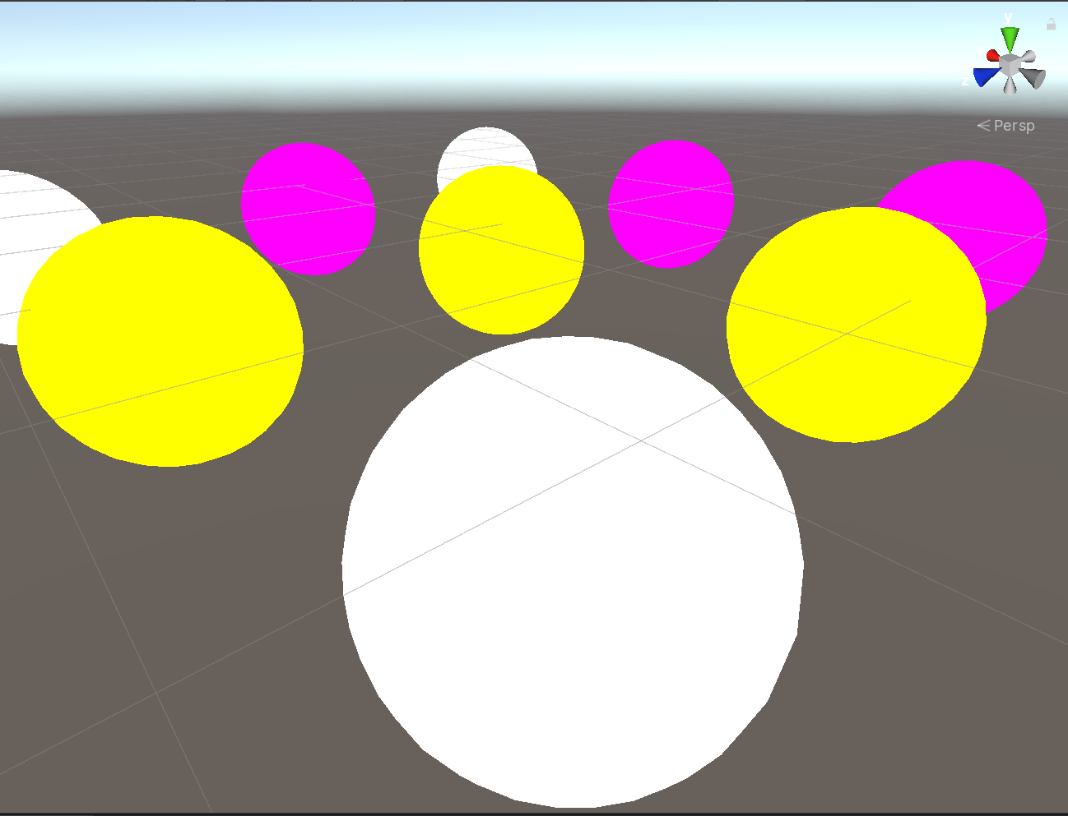
Simple RP - Geometry
protected override void Render(ScriptableRenderContext context, Camera[] cameras)
{
BeginFrameRendering(context, cameras);
ScriptableCullingParameters cullParams;
var clearColor = new Color(0, 0, 0.1f);
foreach (var camera in cameras)
{
if (!camera.TryGetCullingParameters(out cullParams))
continue;
// notify engine and plugins that this camera is starting to render.
BeginCameraRendering(context, camera);
// configure view matrix, clipping, etc.
context.SetupCameraProperties(camera);
{
var buffer = new CommandBuffer();
buffer.ClearRenderTarget(true, true, clearColor);
context.ExecuteCommandBuffer(buffer);
buffer.Release();
}
// cull for this camera
var cullResults = context.Cull(ref cullParams);
// Draw opaque objects
var drawSettings = new DrawingSettings(new ShaderTagId("SRPDefaultUnlit"), new SortingSettings(camera));
var filterSettings = FilteringSettings.defaultValue;
filterSettings.renderQueueRange = RenderQueueRange.opaque;
context.DrawRenderers(cullResults, ref drawSettings, ref filterSettings);
// Draw skybox
context.DrawSkybox(camera);
// Draw transparent objects
drawSettings.sortingSettings = new SortingSettings(camera) { criteria = SortingCriteria.CommonTransparent };
filterSettings.renderQueueRange = RenderQueueRange.transparent;
context.DrawRenderers(cullResults, ref drawSettings, ref filterSettings);
// draw anything with incompatible materials with an error shader.
DrawWithDefaultPipeline(context, camera, cullResults);
// Notify engine, plugins, etc. that this camera is finished rendering.
EndCameraRendering(context, camera);
}
context.Submit();
EndFrameRendering(context, cameras);
}

Slide 13
SRP capabilities
Some other capabilities not explored here:
Batching. DrawSettings class controls instance vs non-instanced drawing
Sorting based on
Layers
Object tags
Materials
Pass ID
Custom
Build Your Own
ScriptableRenderContext provides convenience methods for skybox, basic rendering etc.
Can also implement complete bespoke system via CommandBuffer
Still allows use of Unity ShaderGraph, materials system
Use as much or as little as is required of the built-in system.
Materials are incompatible with legacy Unity materials
But you can overcome that by launching shaders manually
Porting a project may require significant asset rework
Unity provides a conversion tool for standard materials.

Slide 14
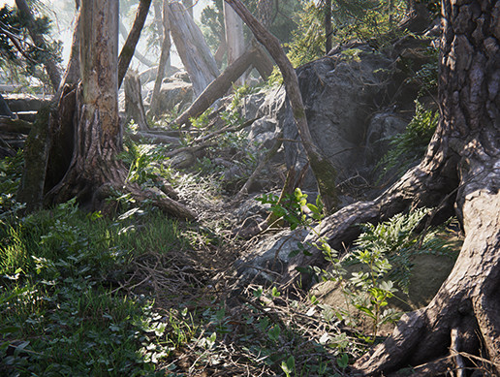
HDRP
Built on SRP in the same way as the SimpleRP example
Provides script-level implementation of
Culling
Shadows
Transparency
Post processing
Dynamic resolution, upsampling, and everything else required.
Used in all current and upcoming Unity demos
ArchViz
Adam 2
Book of the Dead
The Heretic
Megacity
The Heretic

Slide 15
HDRP - frame lifecycle
MegaCity demo used for frame analysis

Slide 16
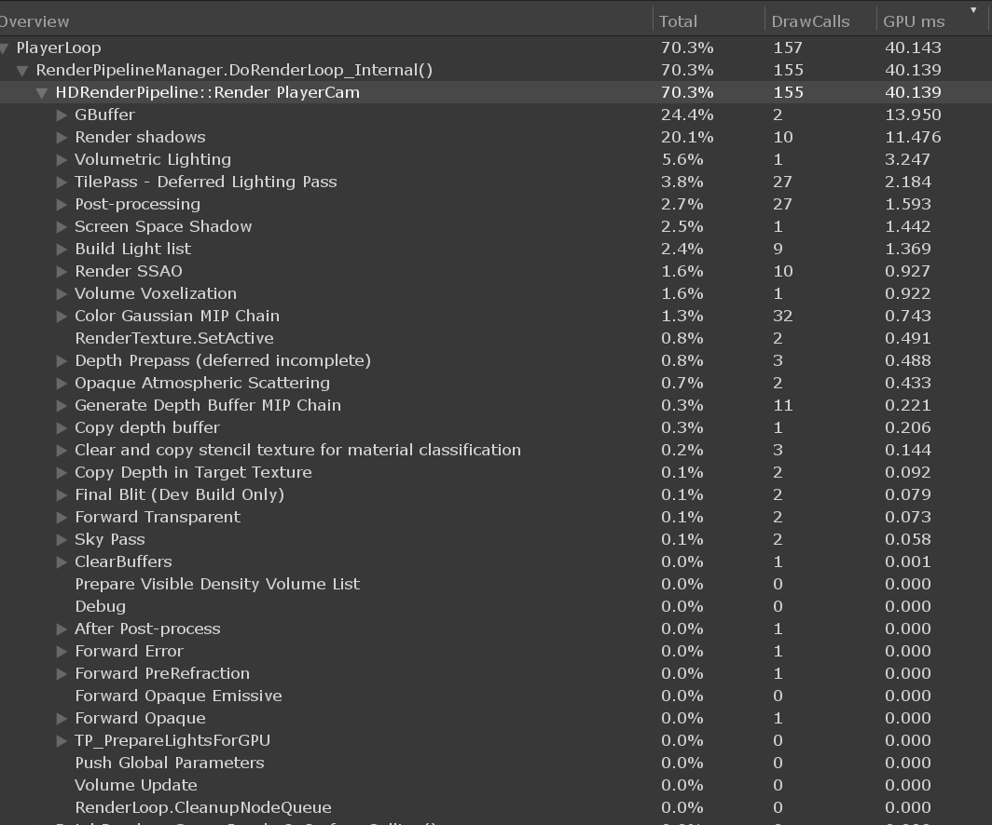
HDRP frame analysis

