Slide 1
Shapes and Colors

Slide 2
Topics
The Coordinate System
Shapes
Coding in Processing
Color

Slide 3
The Coordinate System

Slide 4
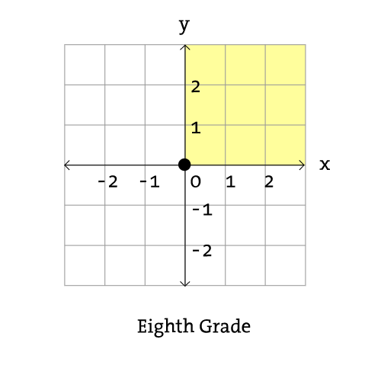
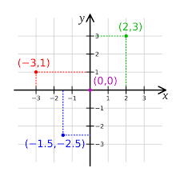
Cartesian Coordinate System

Slide 5
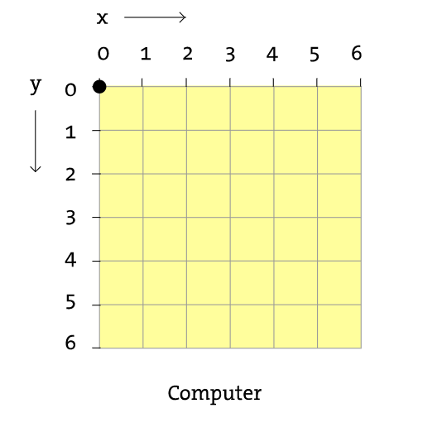
Computer Coordinate System

Slide 6
Shapes

Slide 7
What information do we need to draw a...
Point
Line
Rectangle
Ellipse

Slide 8
Coding in Processing

Slide 9
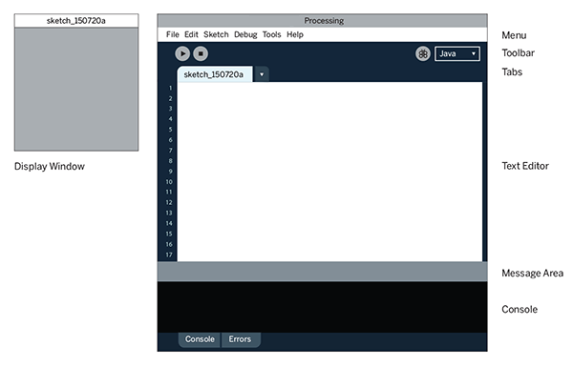
The Processing IDE
IDE stands for Integrated Development Environment. An IDE is an application that provides tools to help programmers develop software.

Slide 10
Comments
A comment is a piece of text that is ignored by the computer
// This is a comment on one line
/*
This is a comment
on multiple lines
*/

Slide 11
The Basic Command Format
commandName(argument1, argument2, ...);
All commands must end with a semi-colon
Arguments
Some commands need additional information
How do we know which commands need arguments?
The Processing Reference
https://processing.org/reference/

Slide 12
commandName(argument1, argument2, …);

Slide 13
size(width, height);
Sets the size of the display window to width pixels wide and height pixels tall
width and height should be whole numbers (no decimal point)

Slide 14
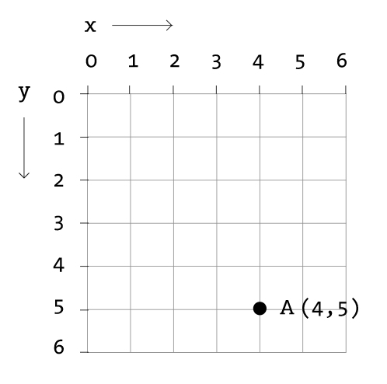
point(x, y);
Draws a point at coordinate location (x, y)

Slide 15
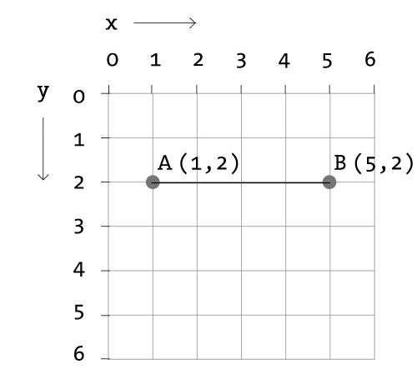
line(x1, y1, x2, y2);
Draws a line from point (x1, y1) to point (x2, y2)

Slide 16
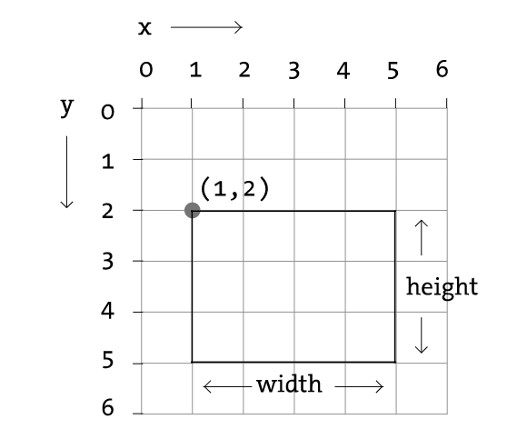
rect(x, y, w, h);
Draws a rectangle whose top-left corner is at point (x, y). The rectangle will have a width of w and a height of h.

Slide 17
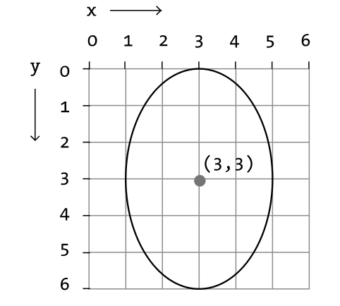
ellipse(x, y, w, h);
Draws an ellipse whose center is at point (x, y). The ellipse will have a width of w and a height of h.

Slide 18
Errors
Errors occur when there is something wrong with your code

Slide 19
Drawing in Processing
Commands in Processing are executed in order
The last shape command you give will appear to be “on top” of the other shapes drawn before it

Slide 20
Compressing a File

Slide 21
Colors

Slide 22
How Do We Represent a Color Value in Processing?
Range of any color component = 0-255
Grayscale (0 = Black, 255 = White)
RGB (Red, Green, Blue)

Slide 23
RGB Color
Google: rgb color picker
Processing: Color Selector Tool

Slide 24
Color Mixing
RGB color uses light mixing rules instead of pigment mixing rules
Red + Green = Yellow
Green + Blue = Cyan
Blue + Red = Magenta
Red + Blue + Green = White

Slide 25
fill(gray); or fill(r, g, b);
Sets the fill of the following shapes to the specified color
A single argument sets the color to a grayscale value
Three arguments set the color to some RGB color value

Slide 26
stroke(gray); or stroke(r, g, b);
Sets the outline of the following shapes to the specified color
A single argument sets the color to a grayscale value
Three arguments set the color to some RGB color value

Slide 27
background(gray); or background(r, g, b);
Sets the background of the whole display window to the specified color

Slide 28
noStroke(); and noFill();

Slide 29
Alpha Values
We can change the transparency of a color by adding an alpha value
Alpha is the measure of the colors opacity 0 = 0% opaque (100% transparent) 255 = 100% opaque (0% transparent)
fill(grayscale, alpha);
stroke(r, g, b, alpha);

Slide 30
Resources
Shiffman, Daniel. Learning Processing: Ch. 1-2
Learning Processing Videos (Chapters 0, 1, 2)
Processing Tutorials: Getting Started
Processing Tutorials: Coordinate System and Shapes
Processing Tutorials: Color
The Processing Reference

