Slide 1
Setup and Draw

Slide 2
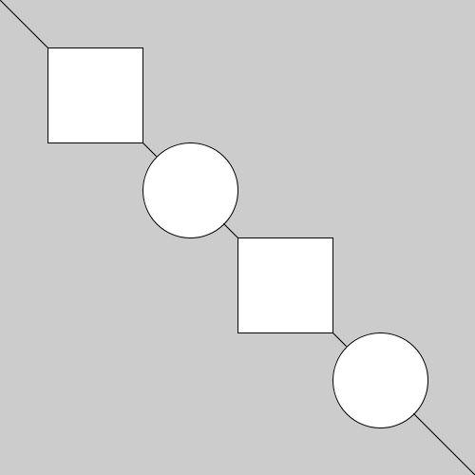
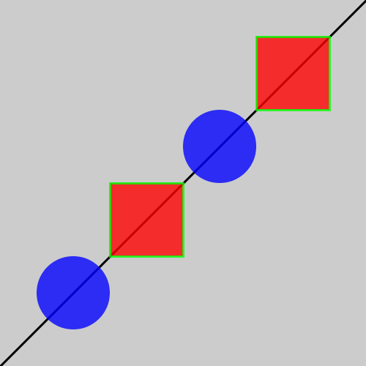
Pre-Topic Exercise
Recreate this image.
Challenge: Recreate this image

Slide 3
Topics
The Run Button
Setup and Draw
User Interaction

Slide 4
The Run Button

Slide 5
The Run Button
When we click the run button, the program is compiled and executed
First, the program goes through a compilation process
Then, the program is executed

Slide 6
Compilation
“Compilation is the process the computer takes to convert a high-level programming language into a … language the computer can understand”
Computer Hope

Slide 7
Compilation in Processing
Step 1. Convert the Processing program into Java
Step 2. Compile the Java Program
Step 3. Execute the compiled Java program on the Java Virtual Machine (JVM)

Slide 8
Setup and Draw

Slide 9
What is a Block of Code?
A block of code is a section of code enclosed in curly braces
{ a block of code }
{ a different block of code { a block of code inside a block of code } }

Slide 10
The Flow of Time
Programs execute over a period of time
Setup initial conditions (set player score to zero, open blank document)
Initial conditions are changed over time (play the game, write a word document)

Slide 11
setup() and draw()
Blocks of code that allow us to create dynamic sketches where a set of initial conditions are changed over time
setup() and draw() are blocks of code known as functions

Slide 12
setup()
Contains initialization code
Executed once at the very beginning of the program

Slide 13
draw()
Executed after setup()
Contains code that will happen over and over again
Executes again and again and again and again until you close the program window

Slide 14
Command Execution Order
void setup() { command 1 command 2 command 3 } void draw() { command 4 command 5 }
command 1, command 2, command 3, command 4, command 5, command 4, command 5, command 4, command 5, command 4, command 5, command 4, command 5, command 4, command 5, command 4, command 5, ...

Slide 15
User Interaction

Slide 16
Mouse Position
The mouseX and mouseY keywords can be used to represent the mouse’s current position
mouseX = the mouse’s current horizontal position
mouseY = the mouse’s current vertical position
Can replace “literal” values in a function
pmouseX and pmouseY represent the mouse’s previous location (the mouse’s location in the last frame)

Slide 17
Event Functions
Events like mouse clicks and key presses interrupt the regular flow of the program
Event functions tell the computer what to do when certain events occur

Slide 18
Mouse Click (mousePressed())
The code in the mousePressed() function is executed once every time the mouse is clicked within the program window
void mousePressed() { // code to execute when the mouse is clicked }

Slide 19
Mouse Drag (mouseDragged())
The code in the mouseDragged() function is executed again and again while the mouse is being pressed and moved at the same time
void mouseDragged() { // code to be executed while the mouse is being dragged }

Slide 20
Keyboard (keyPressed())
The code in the keyPressed() function is executed once every time a key on the key on the keyboard is pressed
void keyPressed() { // code to execute when a key is pressed }

Slide 21
Resources
Shiffman, Daniel. Learning Processing: Chapter 2 and 3

