Slide 1
Chilling time ON tulip growth
David Lowe

Slide 2
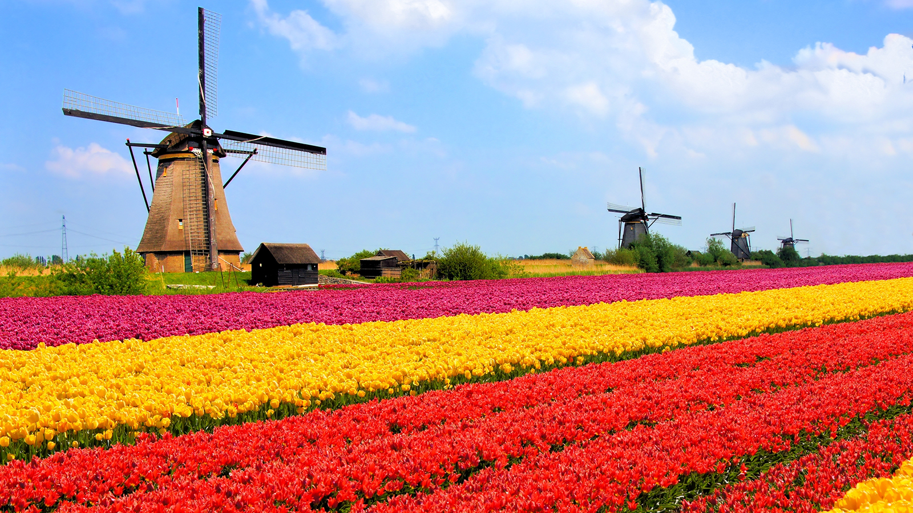
Background
Tulips account for a large portion of the tradition, tourism, and trade in the Netherlands
Keeping the tulip fields healthy is extremely important to the Netherlands
Image: http://kids.nationalgeographic.com/explore/countries/netherlands/#netherlands-tulip-fields.jpg

Slide 3
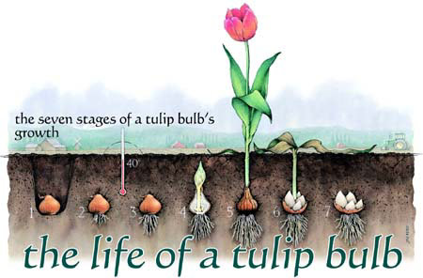
Background
Healthy tulip growth depends heavily on the soil, temperature, and watering conditions of the tulip bulbs
Tulip bulbs must experience a cooling period before germinating
Climate changes can greatly affect tulip populations in the Netherlands
Image: http://www.tulips.com/bulbs_life_of

Slide 4
Goals
Measure the effect of different chilling times on tulip bulbs, and assess what amount of chilling time is optimal
Assess and compare how chilling times affect different populations of tulips
Determine the effect of decreasing chill times for tulip bulbs from 10 to 8 weeks

Slide 5
Data
210 bulbs from 11 populations collected from Netherland fields from 2005-2009
30 bulbs from each population are assigned to one of seven chill times (0, 2, 4, …, 12 weeks)
After chilling period, bulbs are planted and observed. Bulbs are classified as either having germinated or not.

Slide 6
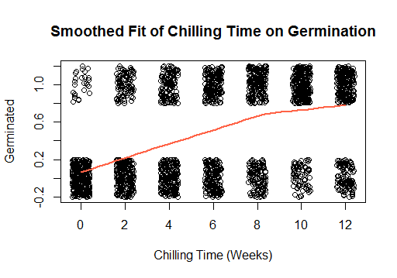
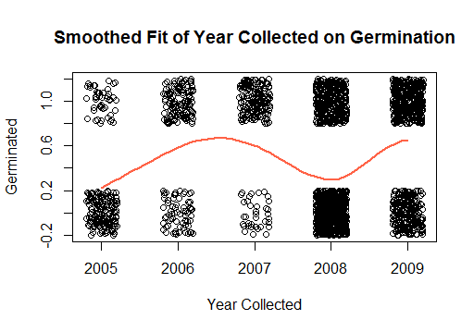
Data Exploration
Smoothed fits indicate some non monotonicity in probability of germination with chilling time and year.
Nonlinear fits may be appropriate for these variables.

Slide 7
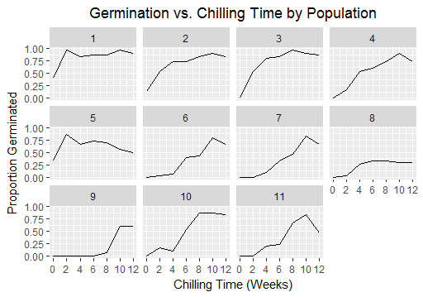
Data Exploration
Each population seems to have different reactions to chilling time.
In general, there seems to be an increase in germination with chilling time, except for a chill time of 12 weeks.

Slide 8
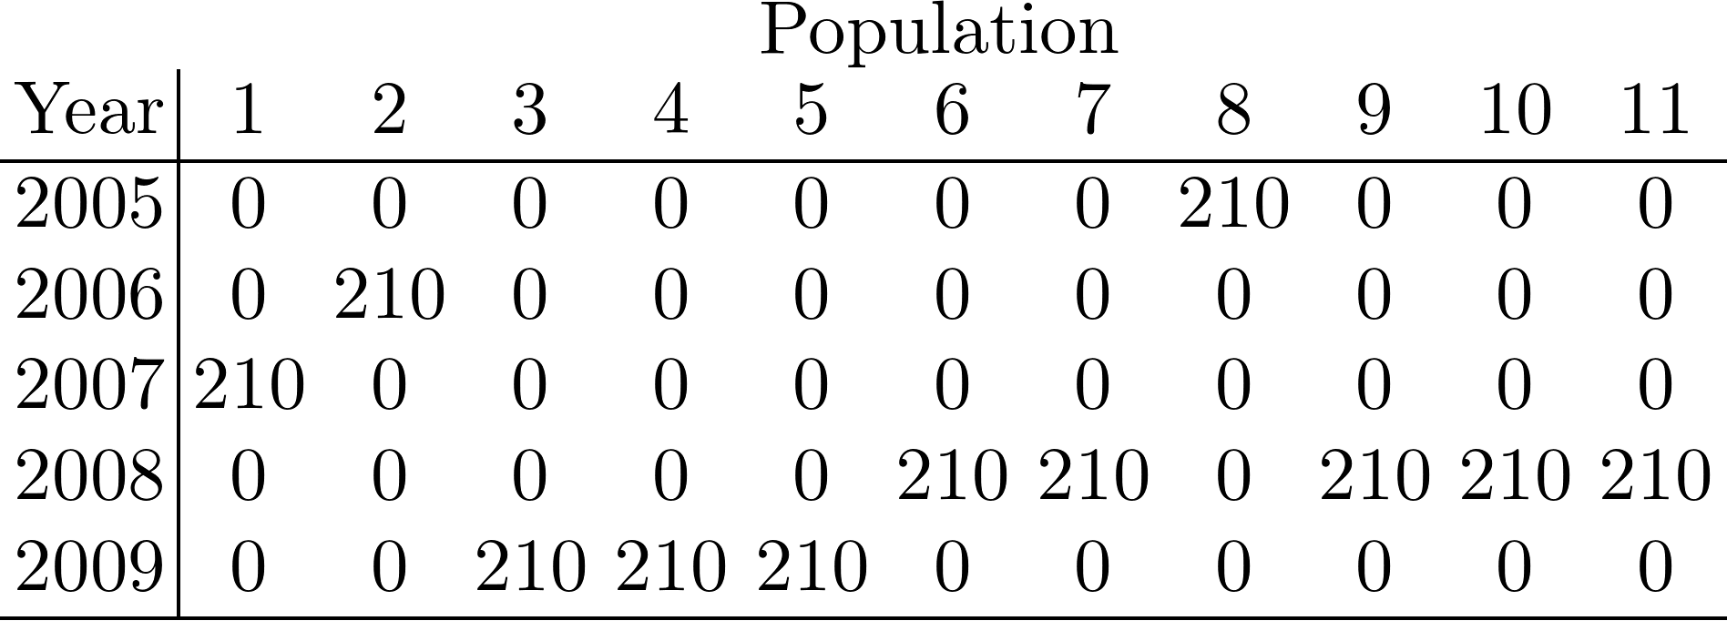
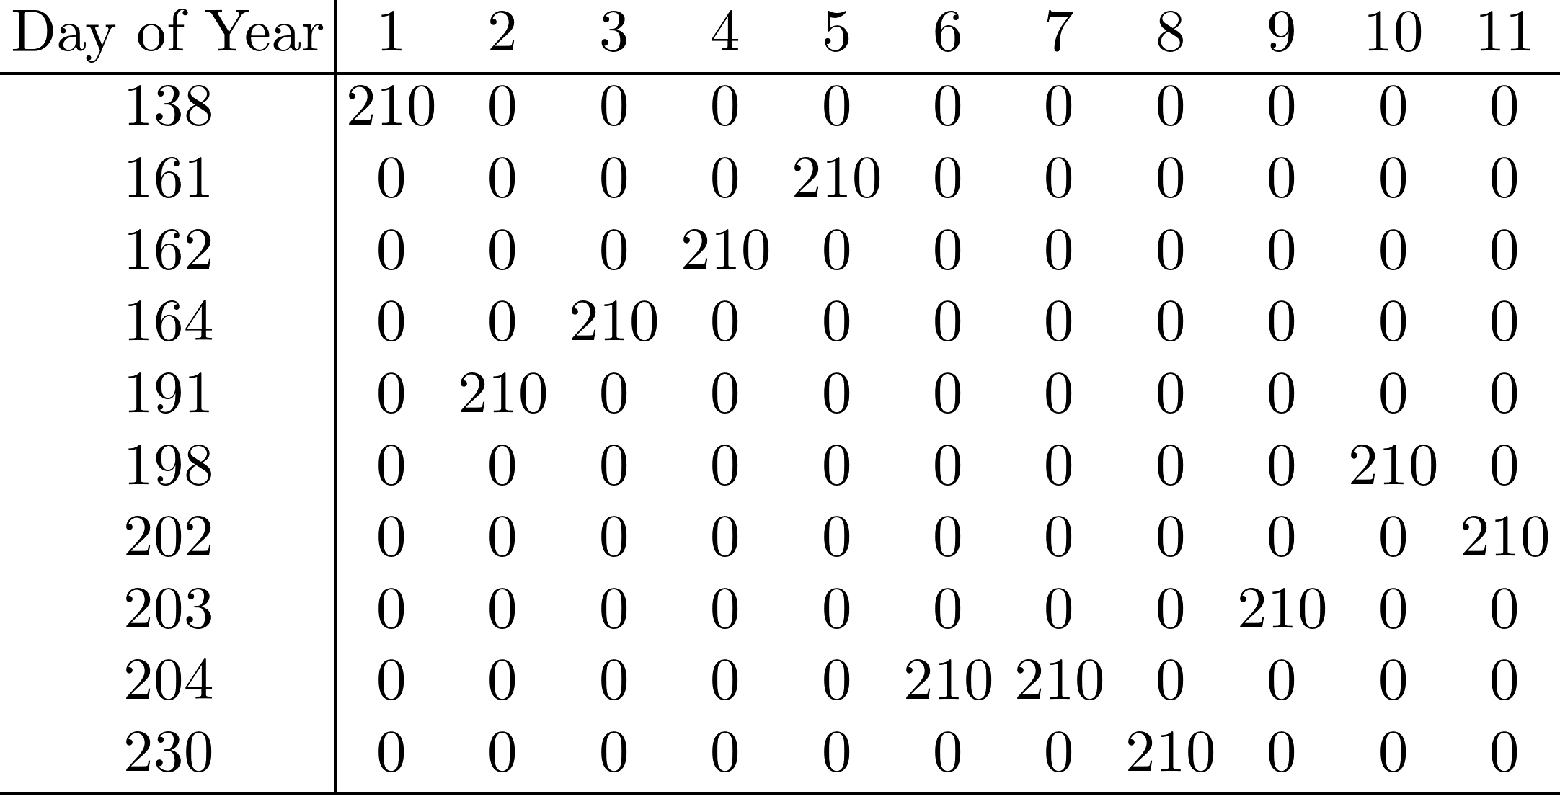
Data Exploration
The experiment takes into account several years, and collection times vary from year to year.
Many tulip populations have a unique collection day and year.
This experimental construction makes it difficult to include the collection date in the analysis.

Slide 9
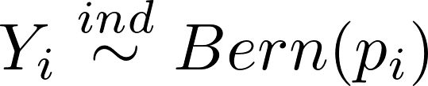
Model

Slide 10



Model

Slide 11
Model Selection
No intercept term allows each population to have its own intercept
Main interest is in the effect of chilling time on tulip germination
Quadratic effect of chilling time added to account for non-monotonicity of probability (although may cause collinearity with CT)
Interaction is added between chilling time and population to account for the different behavior between populations over the same chilling periods
Year and day collected present challenges of singularity in the model fit (they may tell the same story as population)
Tested significance of each variable and compared models with AIC and Pseudo-R²

Slide 12
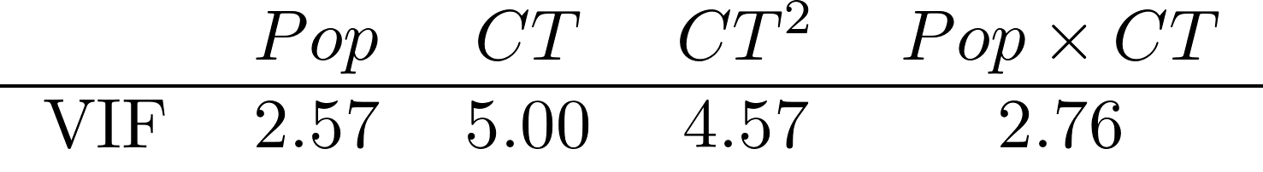
Assumptions
The germination of one tulip bulb is independent of the other (this may be more related to population, or year, than is accounted for in the model)
Non-monotonicity in the log-odds probability is accounted for by the quadratic effect
There is minimal collinearity between predictor variables

Slide 13
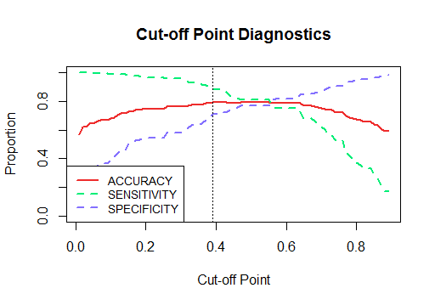
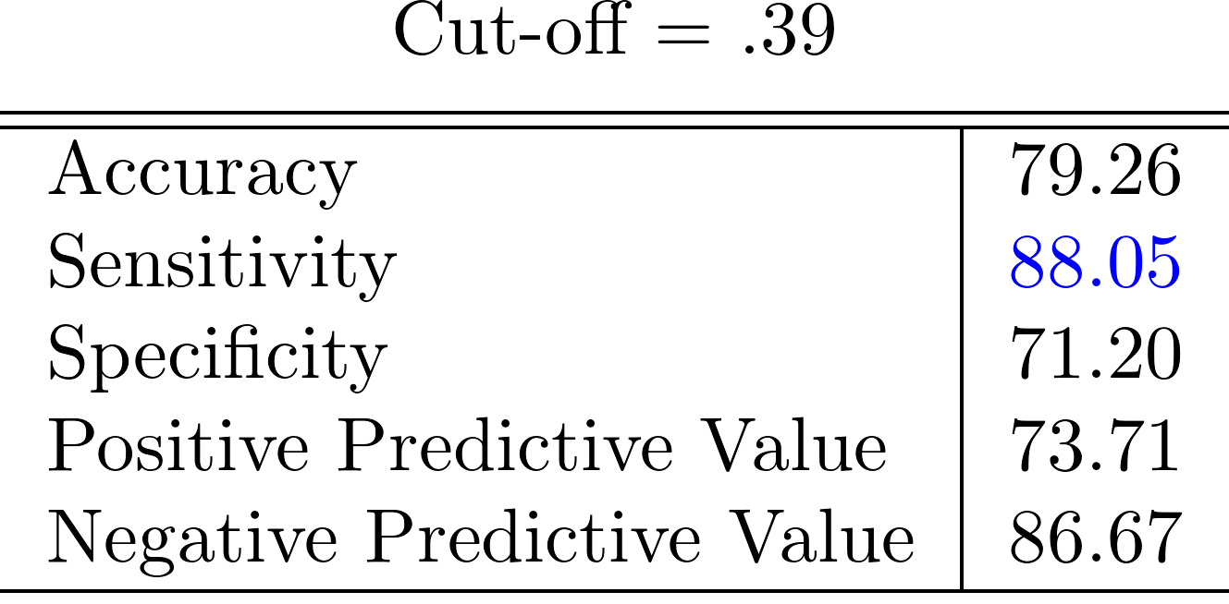
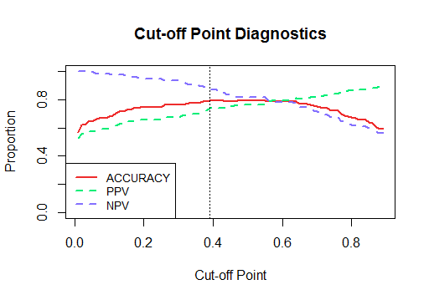
Assessing the Model
Pseudo-R² of 36.83%
Sensitivity is most important, as we want to correctly classify germinated bulbs
Specificity indicates how well we classify non-germinated bulbs

Slide 14
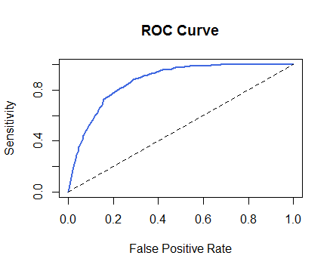
Assessing the Model
Area under the curve: .871
Indicates fairly high accuracy in classifying a bulb germinating or not.
Overall assessment: The model fits the data well, and gives insight into the effect of chilling time on tulip bulb germination.

Slide 15
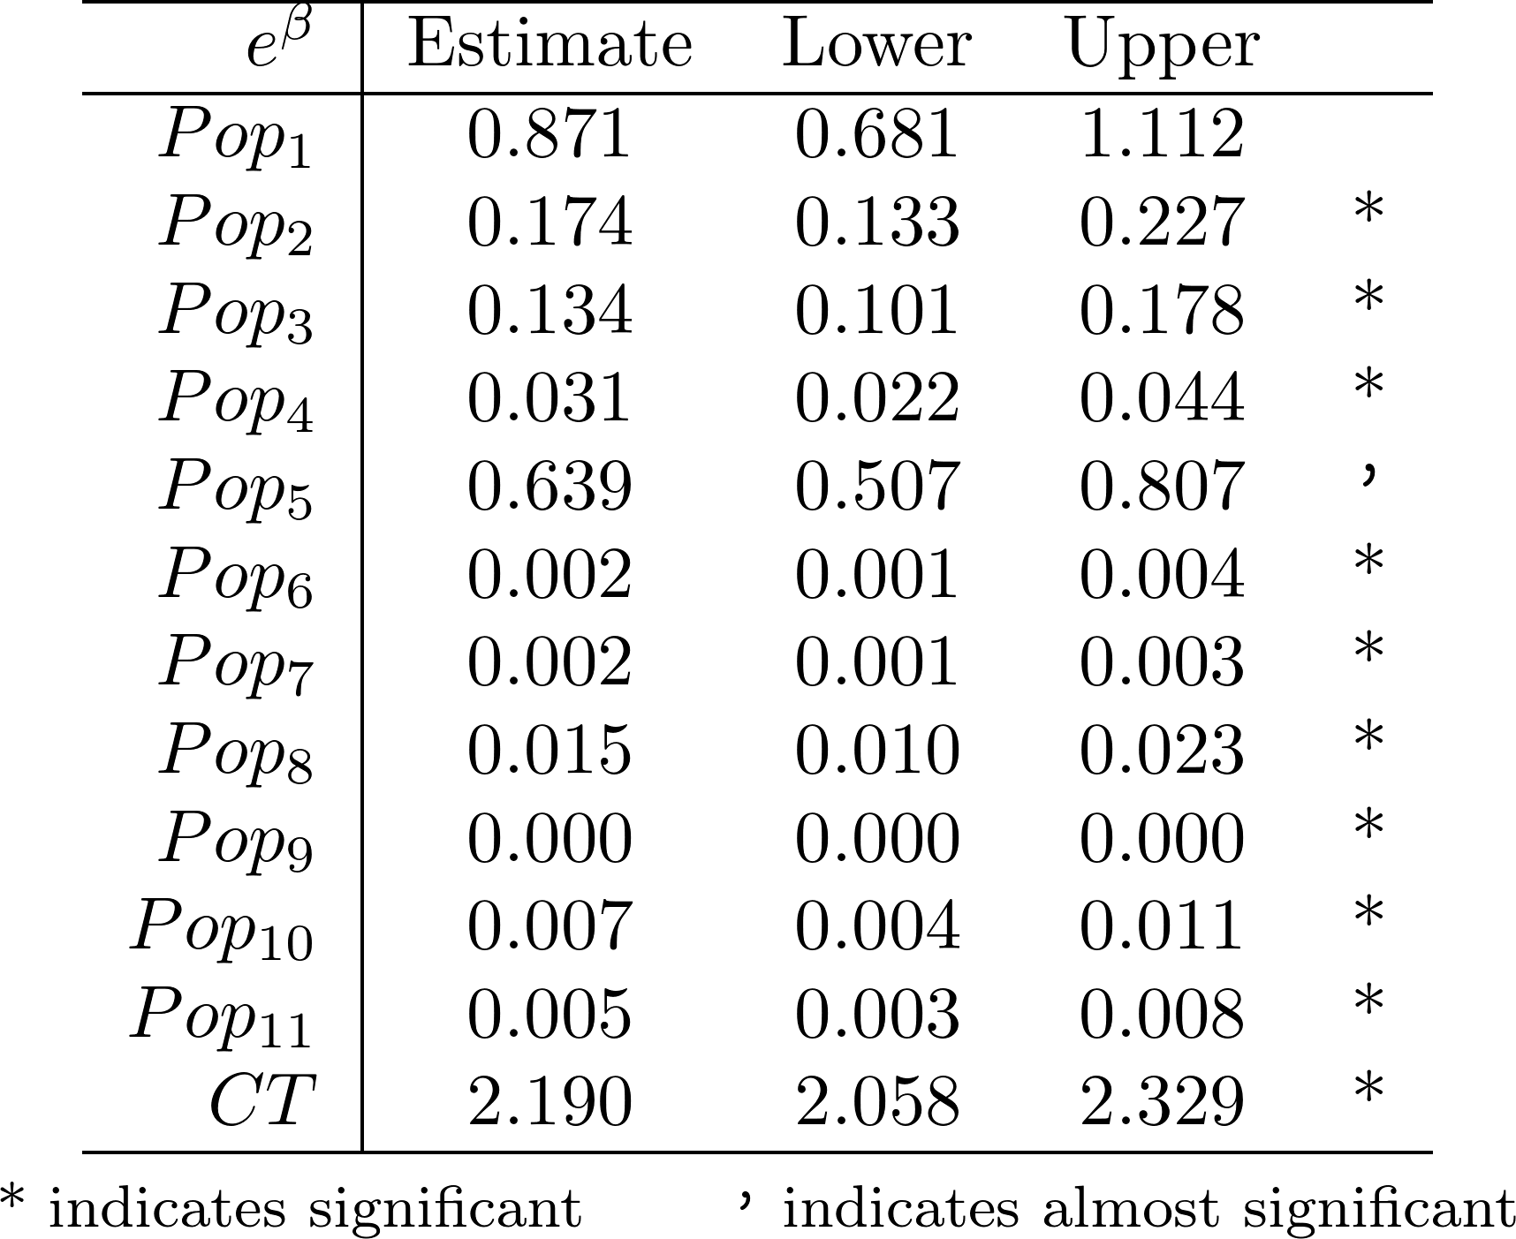
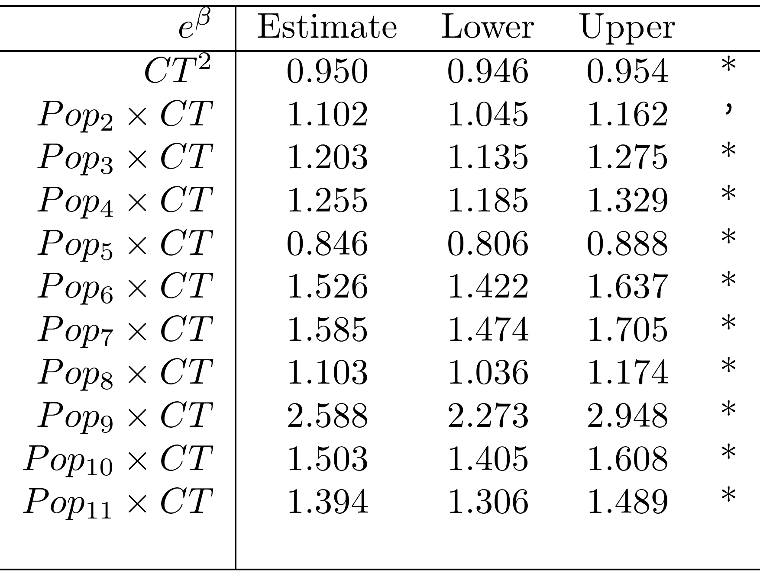
Results: Model Coefficients

Slide 16
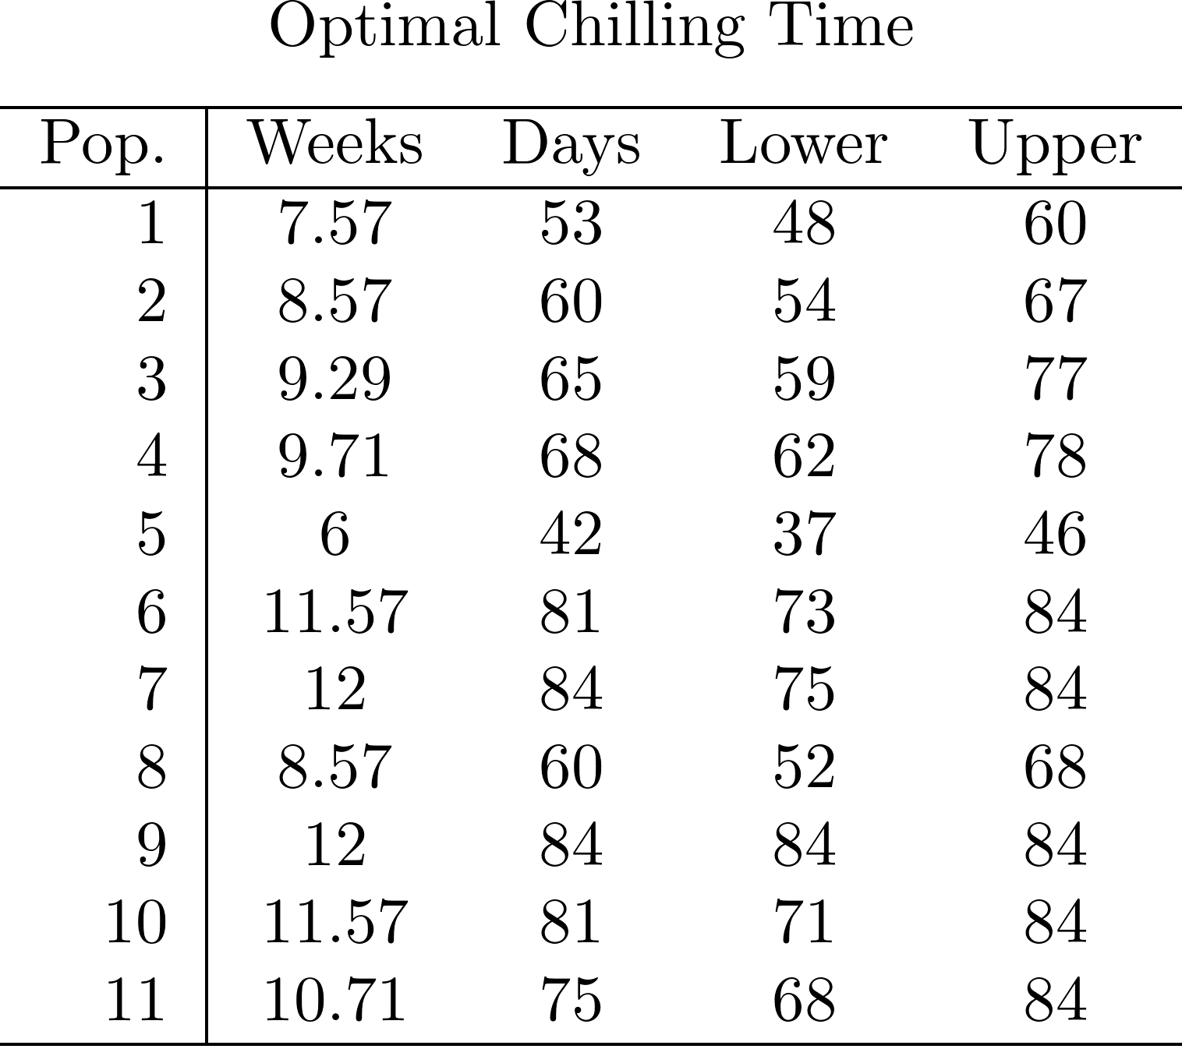
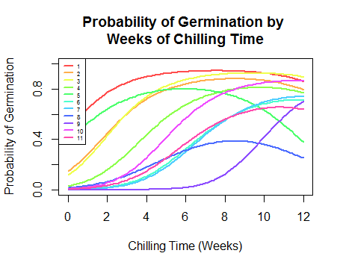
Results: Revisiting Goals
1. Measure the effect of different chilling times on tulip bulbs, and assess what amount of chilling time is optimal

Slide 17
Results: Revisiting Goals
2. Assess and compare how chilling times affect different populations of tulips
The majority of populations have similar reactions to chilling time
Chilling time has a negative effect on population 5, indicating that the longer they cool, the less likely the bulbs will germinate
Chilling time has a strongly positive effect on population 9, indicating that the longer it is cooled, the more likely they are to bloom

Slide 18
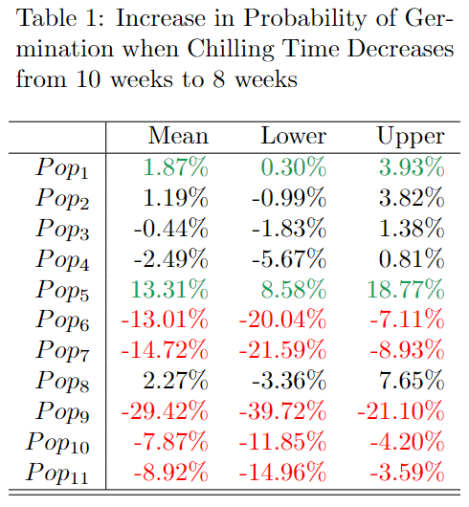
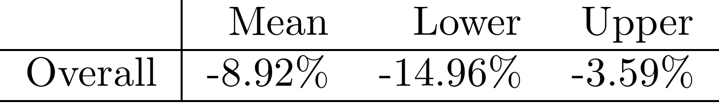
Results: Revisiting Goals
3. Determine the effect of decreasing chill times for tulip bulbs from 10 to 8 weeks
Overall, the probability of germination decreases by about 9%
Individual populations differ in the effect (this makes sense given the previously discovered results)

Slide 19
Conclusion
Strengths
This approach models tulip germination fairly well, and can accurately predict about 87% of tulip germination
The model gives flexibility in understanding the relationship of chilling time on individual tulip populations
Weaknesses
This model only explains about 37% of the best possible likelihood.
The model could be confounding population with year, as tulip populations were only tested on one collection year and day

Slide 20
Conclusion
Future Research
Identify whether the effect of chilling time is more related to the collection year or season, rather than population
Include a random effect for population

