Slide 1

Data Analysis

Slide 2
Overview
Use of visualization techniques to get an insight into the data
Create a Machine Learning Model that will classify the patients as either having heart disease or not.
Notes:
The data was obtained from https://www.kaggle.com/ronitf/heart-disease-uci
Acknowledgements
Creators:
Hungarian Institute of Cardiology. Budapest: Andras Janosi, M.D.
University Hospital, Zurich, Switzerland: William Steinbrunn, M.D.
University Hospital, Basel, Switzerland: Matthias Pfisterer, M.D.
V.A. Medical Center, Long Beach and Cleveland Clinic Foundation: Robert Detrano, M.D., Ph.D.

Slide 3
Data Overview
The dataset contains information on 303 heart disease patients under the following headings:
Age
Sex
Chest pain type (4 values)
Resting blood pressure (trestbps)
Serum cholestoral in mg/dl (chol)
Fasting blood sugar > 120 mg/dl
Resting electrocardiographic results (values 0,1,2)
Maximum heart rate achieved
Exercise induced angina
oldpeak = ST depression induced by exercise relative to rest
The slope of the peak exercise ST segment
Number of major vessels (0-3) colored by flourosopy
thal: 3 = normal; 6 = fixed defect; 7 = reversable defect
target: Whether the patient has heart disease or not
Table1 shows some descriptive statistics for the continuous variables
Table 1: Descriptive Statistics
Notes:
The data was obtained from https://www.kaggle.com/ronitf/heart-disease-uci
Acknowledgements
Creators:
Hungarian Institute of Cardiology. Budapest: Andras Janosi, M.D.
University Hospital, Zurich, Switzerland: William Steinbrunn, M.D.
University Hospital, Basel, Switzerland: Matthias Pfisterer, M.D.
V.A. Medical Center, Long Beach and Cleveland Clinic Foundation: Robert Detrano, M.D., Ph.D.

Slide 4
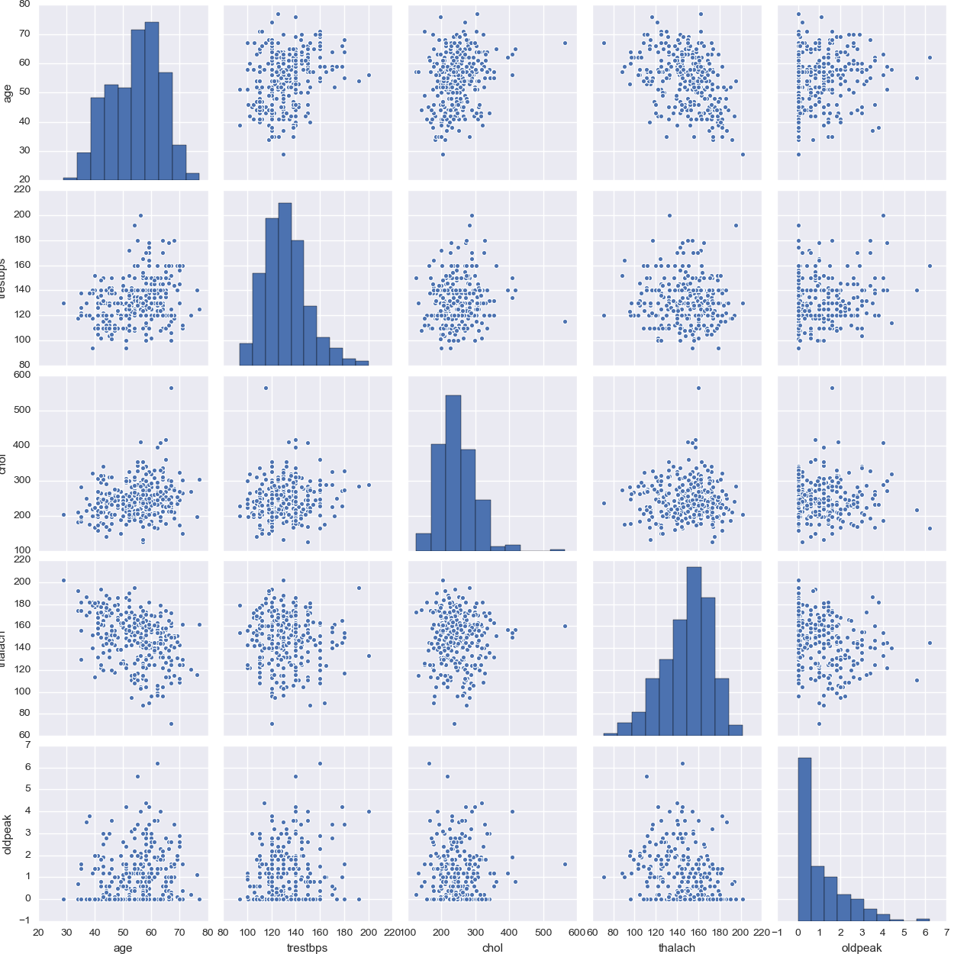
Data Visualization
Figure1 shows a scatterplot matrix of the continuous variables in the dataset.
Along the diagonal is a histogram of each of these continuous variables
When building models it is important to be aware of any relationships between predictor variables
The plot shoes low levels of linear dependency between variables
This is ideal as low correlation means each variable provides different information to the Machine Learning model.
The histograms show some skewness in the data
Figure 1: Scatter plot & histogram matrix

Slide 5
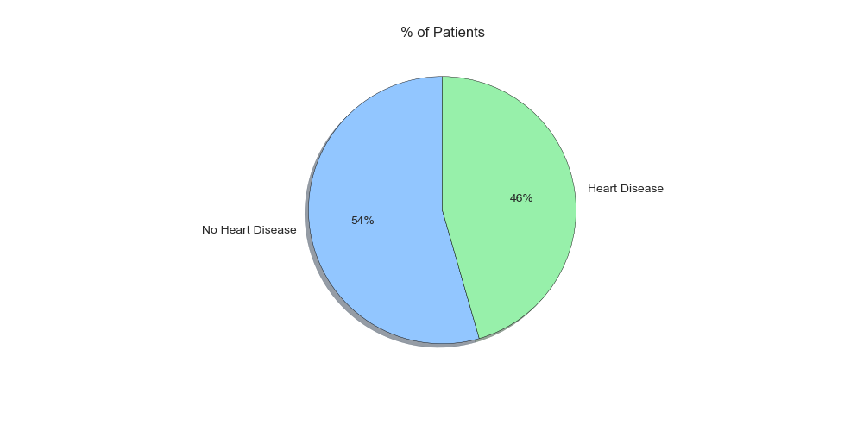
Data Visualization
Figure2 shows a pie chart representing how many patients have heart disease and how many do not
Figure 2: percentage of patients with & without heart disease

Slide 6
Pre-processing
Pre- processing is an important part of every data analysis
The first step in the pre-processing was to handle missing values
I used a kNN imputer to fill in any missing values
The second step was to scale the data.
Scaling prevents features with large magnitudes having a disproportionate effect on a Machine Learning Model
I used a scaler which used Z-score scaling
This normalizes the data as a Normal(0,1) Random variable

Slide 7
Model Building
I used the ExtremeGradientBoostingClassifier from the xgboost package to create a classification model.
It works by fitting multiple ‘weak learners’
The datapoint is then classified on a majority vote basis
I used Gridsearch Cross Validation to tune the hyperparameters of this model to improve accuracy.

Slide 8
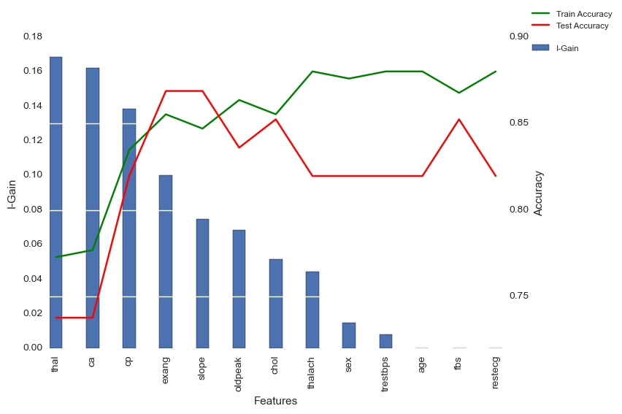
Model Building
A feature subset selection strategy was also used to increase accuracy
This reduced overfitting and led to an overall increase in test accuracy
The bars in figure 3 show which features are most important in predicting if a patient has heart disease, based off information gain
The figure shows that test accuracy is maximized when only using the 4 features that provide the most information gain
Figure 3: Information Gain on individual Features

Slide 9
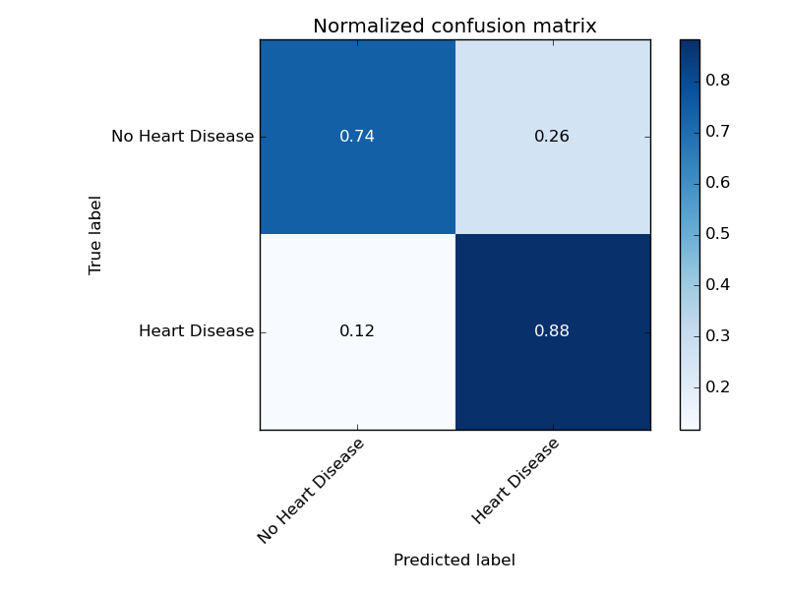
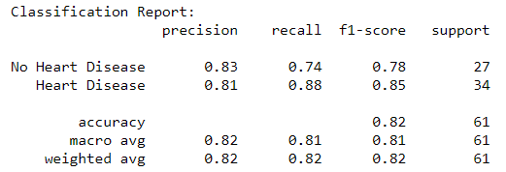
Modelling Results
The model has a 88% true positive rate
An overall accuracy score of 82% shows the model provides a good fit for the data
Figure 4: Confusion Matrix
Notes:
xgboost Documentation: https://xgboost.readthedocs.io/en/latest/

Slide 10
Conclusion
‘thal’ , ‘ca’(number of major vessels colored by flourosopy), ‘cp(chest pain type) and ‘exang’ (exercise induced angina) are the most important predictors of heart disease
The ML classifer was effective at predicting whether a patient had heart disease or not
Feature selection was an effective method of reducing over fitting

