Slide 1
Introduction to RF for Particle Accelerators
Part 3: Beam Signals
Dave McGinnis

Slide 2
Beam Signals Outline
Single Bunch in a Circular Ring
  Fourier Series
  Fourier Transforms
  Delta functions
  Power Spectral Density
  Bunch Length Monitor
M Equally Spaced Bunches in a Ring
A Burst of Bunches in a Ring
Betatron Motion
  AM Modulation
Longitudinal Motion
  Bessel Function Magic
  Frequency Modulation
Multipole Distributions
Introduction to RF – Part 3 – Beam Signals - McGinnis

Slide 3
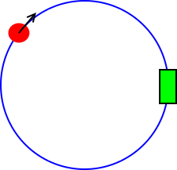
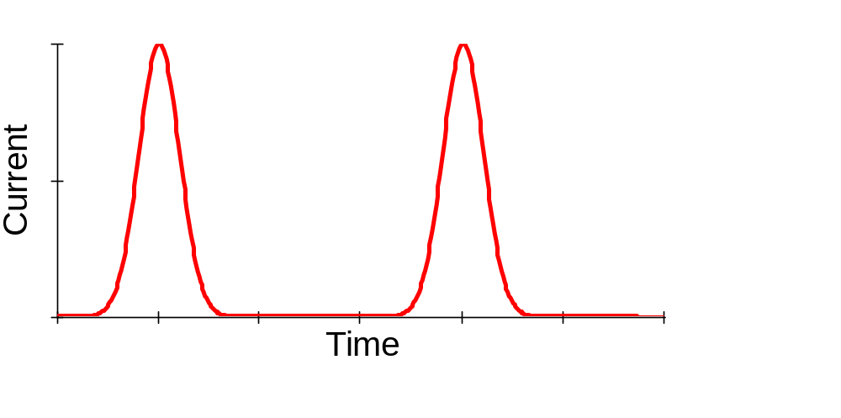
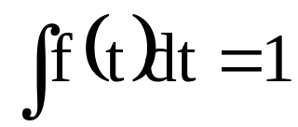
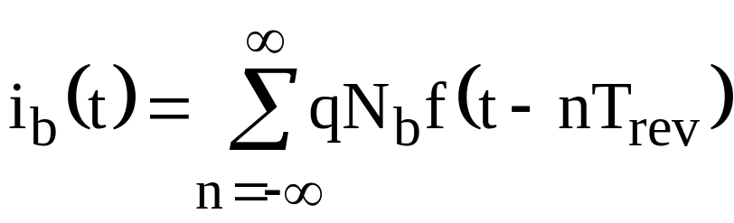
Single Bunch in a Circular Ring
N_{b} particles in a bunch
T_{rev}
Resistive Wall Monitor
Bunch shape = f(t) where
Introduction to RF – Part 3 – Beam Signals - McGinnis

Slide 4
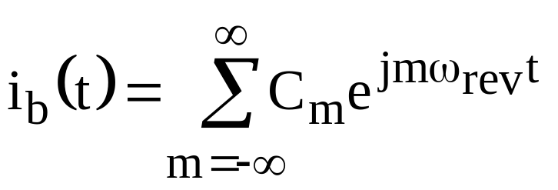
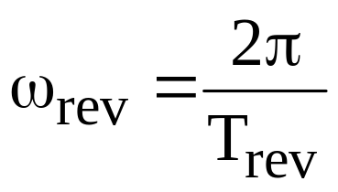
Fourier Series
This is a periodic series which can be expanded in a Fourier series
where
Introduction to RF – Part 3 – Beam Signals - McGinnis

Slide 5
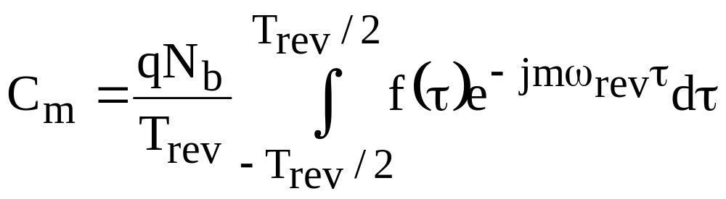
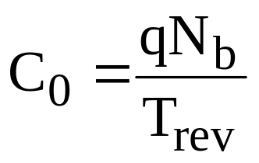
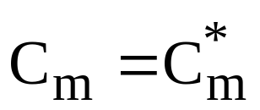
Fourier Series
Note:
C_{o} is the DC beam Current
f(t) is a real function
Introduction to RF – Part 3 – Beam Signals - McGinnis

Slide 6
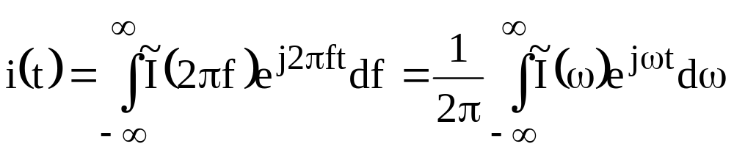
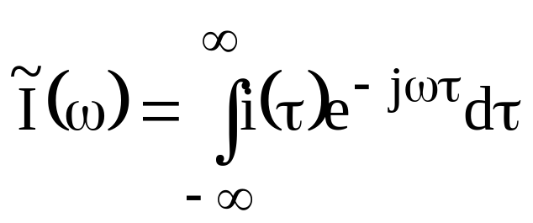
Fourier Transforms
Fourier Transform
Inverse Fourier Transform
Introduction to RF – Part 3 – Beam Signals - McGinnis

Slide 7
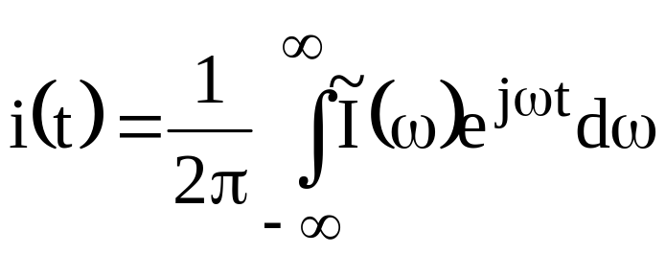
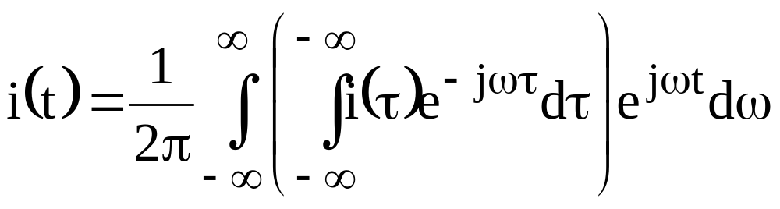
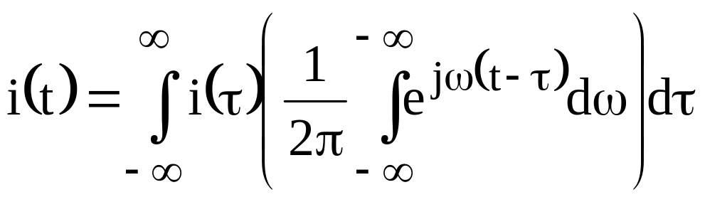
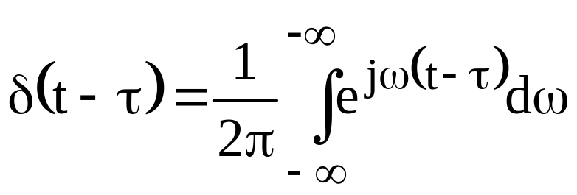
Detour on Delta functions
Introduction to RF – Part 3 – Beam Signals - McGinnis

Slide 8
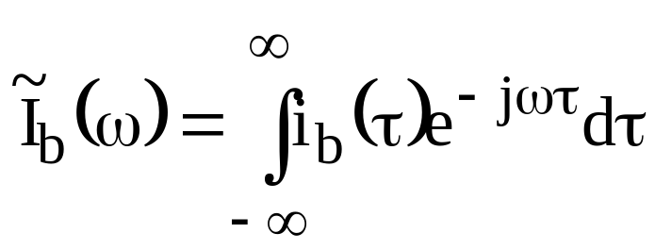
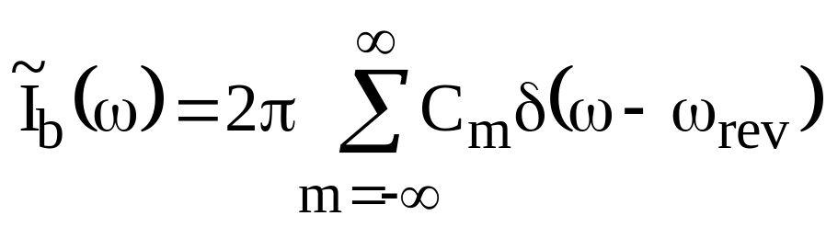
Fourier Transform of the Beam Current
Introduction to RF – Part 3 – Beam Signals - McGinnis

Slide 9
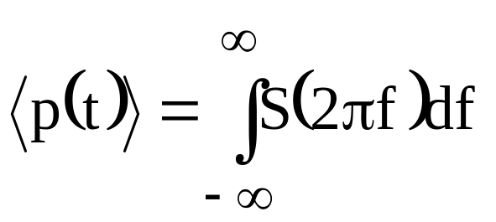
Fourier Transform of the Beam Current
But spectrum analyzers do not measure currents and voltages.
They measure POWER deposited into a filter of width df
The total power into the spectrum analyzer
S(2πf) is the power spectral density and is the power measured by the spectrum analyzer in a resolution bandwidth of 1 Hz
Introduction to RF – Part 3 – Beam Signals - McGinnis

Slide 10
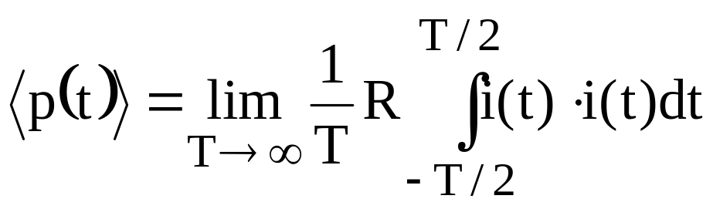
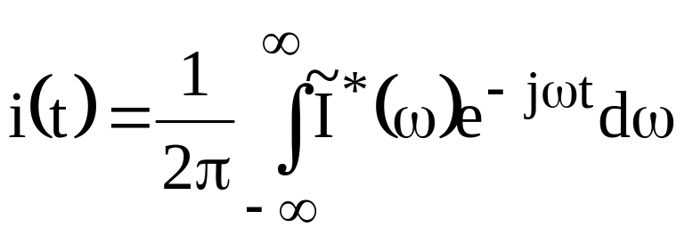
Fourier Transform of the Beam Current
Time Averaged Power
Since:
and i(t) is real
Introduction to RF – Part 3 – Beam Signals - McGinnis

Slide 11
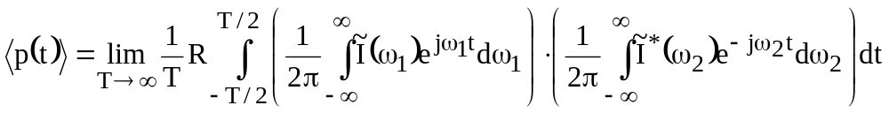
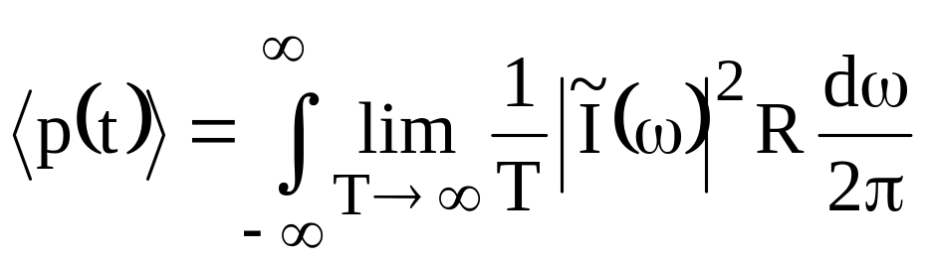
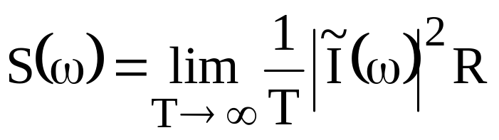
Power Spectral Density
Twizzle, Twazzle….
Introduction to RF – Part 3 – Beam Signals - McGinnis

Slide 12
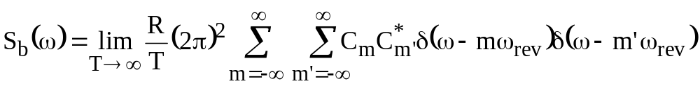
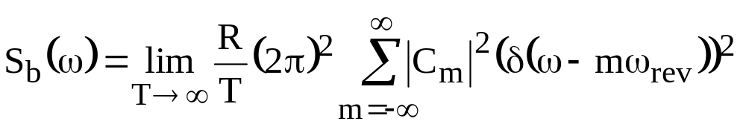
Beam Power Spectrum
Since delta functions do not overlap for m ≠ m’
Introduction to RF – Part 3 – Beam Signals - McGinnis

Slide 13
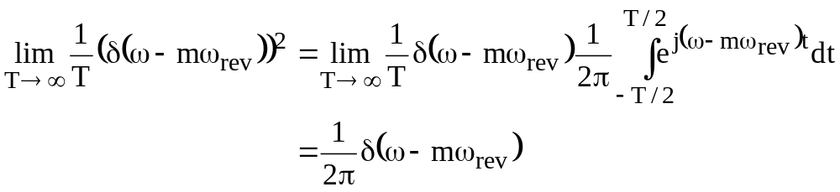
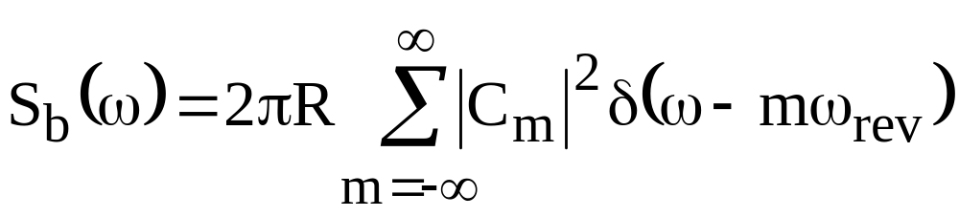
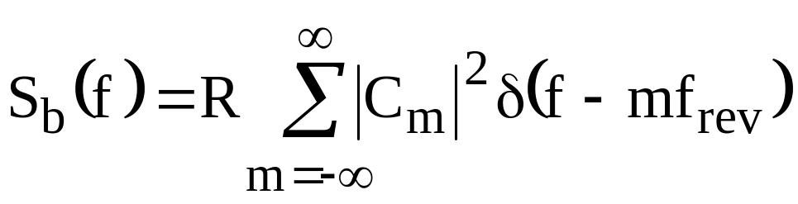
Beam Power Spectrum
Some more delta function magic…
Introduction to RF – Part 3 – Beam Signals - McGinnis

Slide 14
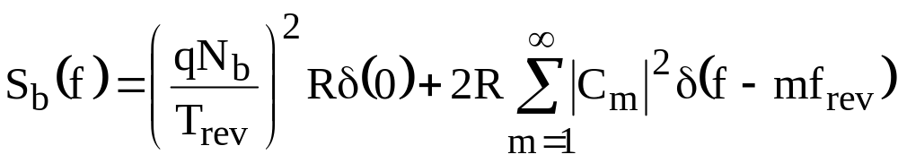




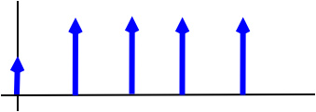

Beam Power Spectrum
Since spectrum analyzers can’t distinguish between negative and positive frequencies:
S_{b}(f)
f_{rev}
2f_{rev}
3f_{rev}
4f_{rev}
Freq.
Introduction to RF – Part 3 – Beam Signals - McGinnis

Slide 15
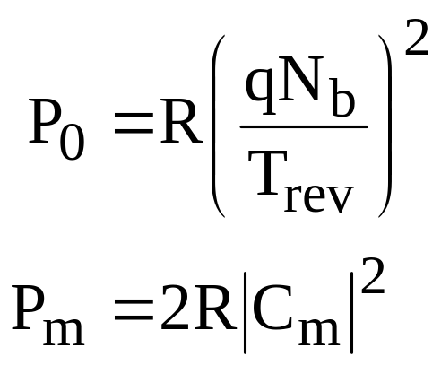
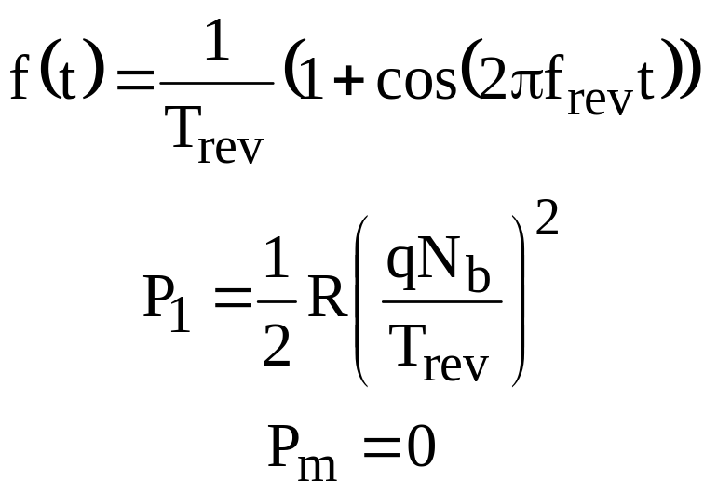
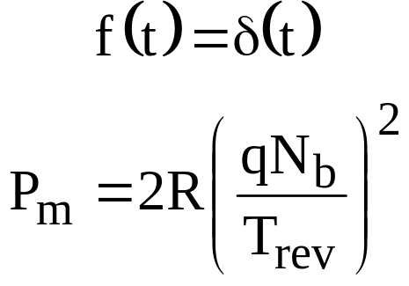
Beam Power Spectrum
The power contained in each revolution line:
m = 0
m > 0
Note that if:
Short Bunch
Long Bunch
m > 1
Introduction to RF – Part 3 – Beam Signals - McGinnis

Slide 16
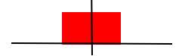
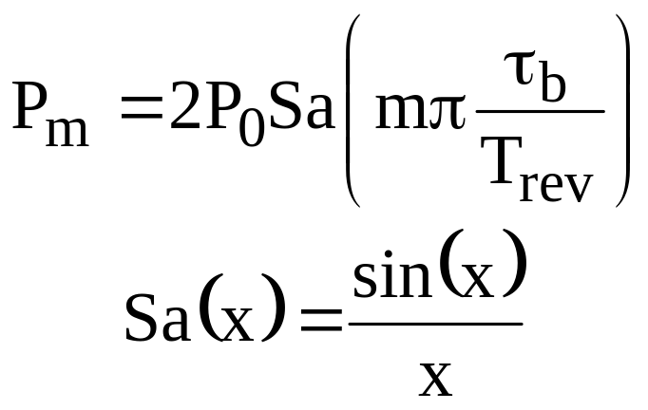
Bunch Length Monitor
Consider a square bunch with length τ_{b}
1/τ_{b}
τ_{b}
The power in spectral line m:
Introduction to RF – Part 3 – Beam Signals - McGinnis

Slide 17
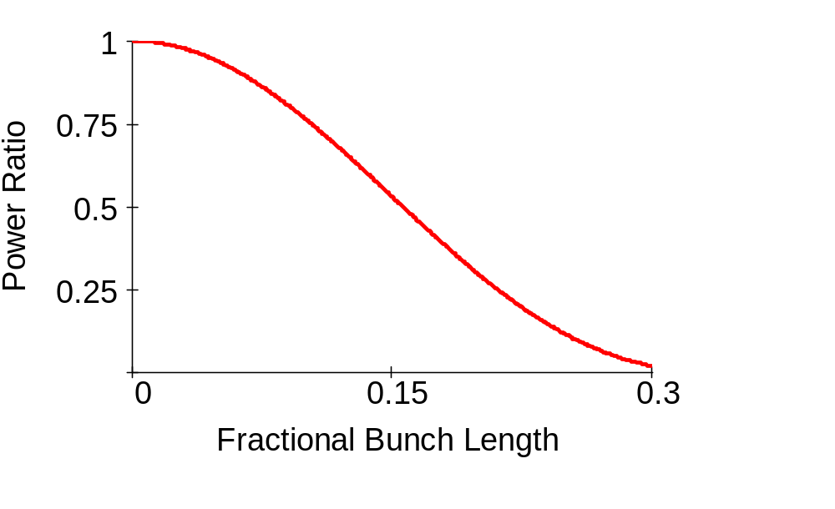
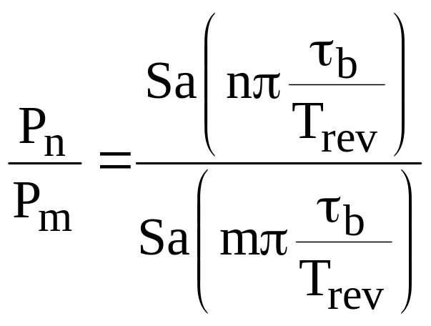
Bunch Length Monitor
The ratio of the power in line n to the power in line m is independent of the beam intensity and is a function of the bunch length.
P₃/P₁
Introduction to RF – Part 3 – Beam Signals - McGinnis

Slide 18
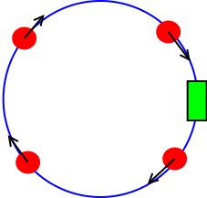
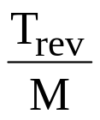
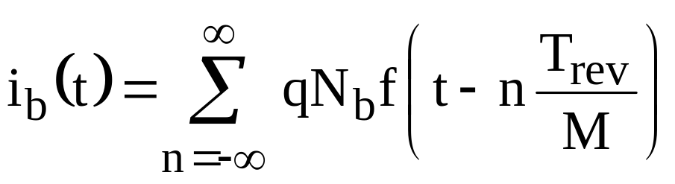
M Equally Spaced Bunches in a Ring
N_{b} particles in a bunch
Resistive Wall Monitor
This looks exactly like 1 bunch in a machine M times smaller
Introduction to RF – Part 3 – Beam Signals - McGinnis

Slide 19
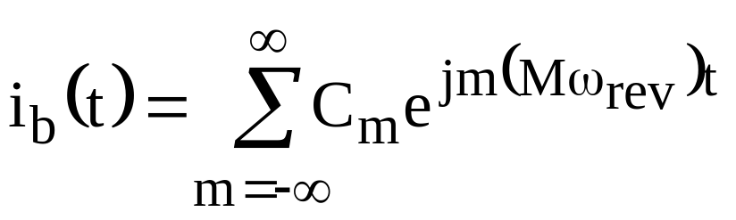
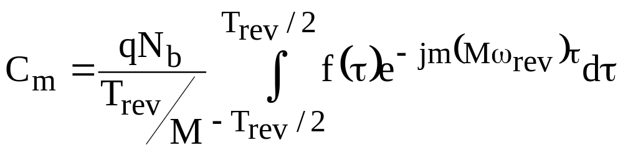
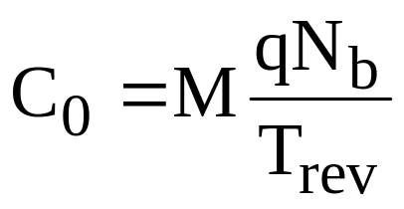
M Equally Spaced Bunches in a Ring
Note that all the coefficients are M times bigger than for a single bunch. More bunches – more power.
For Example:
Which is still the total DC current in the ring
Introduction to RF – Part 3 – Beam Signals - McGinnis

Slide 20
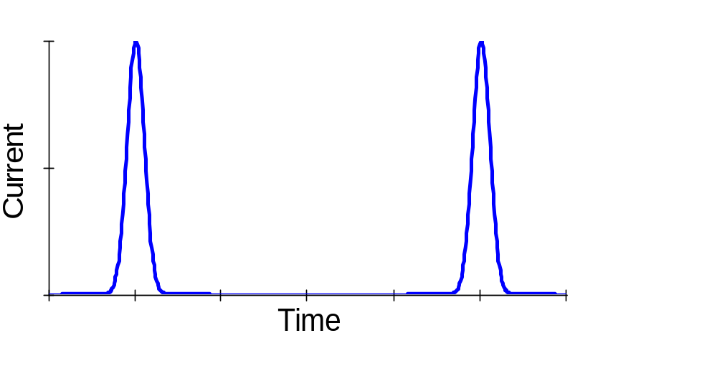

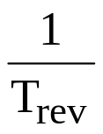

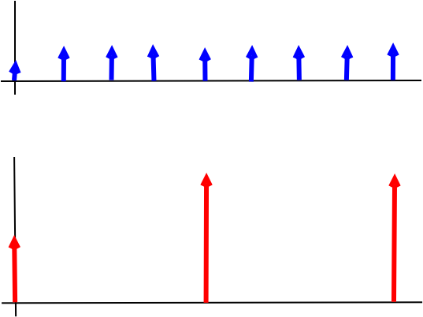
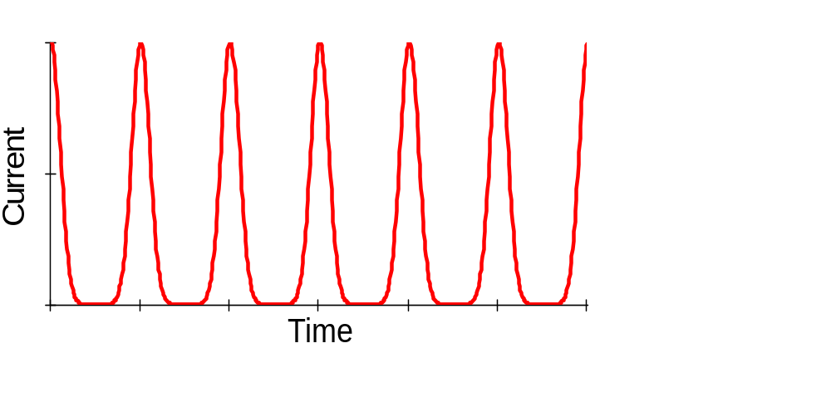
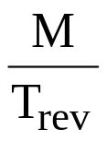
M Equally Spaced Bunches in a Ring
Freq.
Freq.
Introduction to RF – Part 3 – Beam Signals - McGinnis

Slide 21
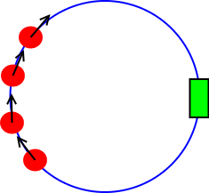
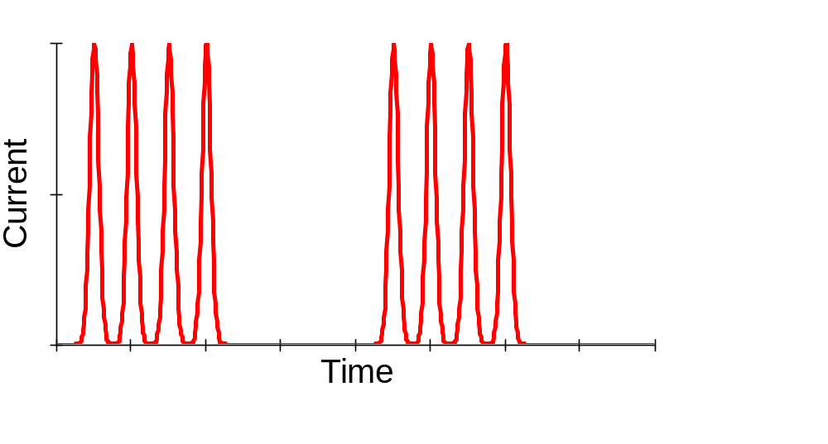
A Burst of Bunches in a Ring
M bunches separated by T_{rev}/h
Resistive Wall Monitor
T_{rev}
MT_{rev}/h
T_{rev}/h
Introduction to RF – Part 3 – Beam Signals - McGinnis

Slide 22


A Burst of Bunches in a Ring
A(t)
i(t)
=
x
B(t)
i(t)=A(t)xB(t)
Introduction to RF – Part 3 – Beam Signals - McGinnis

Slide 23






A Burst of Bunches in a Ring
h=20
M=4
Introduction to RF – Part 3 – Beam Signals - McGinnis

Slide 24


Betatron Motion
Δ
I_{u}
d
y
Δ
I_{L}
Introduction to RF – Part 3 – Beam Signals - McGinnis

Slide 25




Betatron Motion
Image current collected on the pickup plates
Ideal power combiner
For a single particle in the ring:
Introduction to RF – Part 3 – Beam Signals - McGinnis

Slide 26


Betatron Motion
For a particle going through betatron oscillations
where Q is the tune
φ_{β} is the starting phase of the betatron oscillation
y_{co} is the closed orbit position
Introduction to RF – Part 3 – Beam Signals - McGinnis

Slide 27

Betatron Oscillations
Introduction to RF – Part 3 – Beam Signals - McGinnis

Slide 28

Betatron Oscillations
Freq.
f_{rev}
2f_{rev}
3f_{rev}
n-Q line for fract Q < 0.5
n-1+Q line for fract Q > 0.5
n+Q line for fract Q < 0.5
n+1-Q line for fract Q > 0.5
From one pickup, you cannot distinguish the integer part of the tune.
You also cannot tell if the tune is greater or less than 0.5
Introduction to RF – Part 3 – Beam Signals - McGinnis

Slide 29

AM Modulation
Betatron oscillations has the same spectrum as Amplitude Modulation (AM)
ω_{m} is the modulation frequency
ω_{c} is the carrier frequency
m is the modulation amplitude
Using the trig identity
Introduction to RF – Part 3 – Beam Signals - McGinnis

Slide 30

AM Modulation
S(f)
f_{m}
f_{m}
m²/4
Freq.
f_{c}
Introduction to RF – Part 3 – Beam Signals - McGinnis

Slide 31


Longitudinal Motion
A single particle undergoes synchrotron oscillations φ_{s}
Introduction to RF – Part 3 – Beam Signals - McGinnis

Slide 32


Longitudinal Motion
The particle’s longitudinal position can be described by an azimuthal phase around the ring. The particle traverses 2π radians in one trip around the ring.
This is a periodic function which can be expanded in a Fourier series:
Introduction to RF – Part 3 – Beam Signals - McGinnis

Slide 33


Longitudinal Motion
But the longitudinal phase is a function of time which includes the time dependence of synchrotron oscillations
Where φ_{s} is the synchrotron oscillation amplitude,
Ω_{s} is the synchrotron frequency
α_{s} is the starting synchrotron phase
Introduction to RF – Part 3 – Beam Signals - McGinnis

Slide 34


Bessel Function Magic
The complex exponential of a sine function can be “simplified” by using Bessel functions
Introduction to RF – Part 3 – Beam Signals - McGinnis

Slide 35



Longitudinal Spectrum
J₀(nφ_{s})
J₁(nφ_{s})
f_{s}
J₂(nφ_{s})
J₃(nφ_{s})
nf_{rev}
Introduction to RF – Part 3 – Beam Signals - McGinnis

Slide 36



Frequency Modulation
Longitudinal oscillations has the same spectrum as frequency or phase modulation (FM or PM)
ω_{s} is the modulation frequency
ω_{c} is the carrier frequency
ω_{m} is the modulation amplitude
Introduction to RF – Part 3 – Beam Signals - McGinnis

Slide 37









Frequency Modulation
f_{s}
f_{c}
Introduction to RF – Part 3 – Beam Signals - McGinnis

Slide 38






Multipole Distributions
The current for a single particle with synchrotron amplitude φ_{s} and phase α_{s} is:
What about a collection of particles in longitudinal phase space.
Each particle has a polar phase space coordinates radius r, angle α
Introduction to RF – Part 3 – Beam Signals - McGinnis

Slide 39



Multipole Distributions
The density in phase space must be periodic in α with a period of 2π
The number of particles in phase space is given by:
Also since ψ(r,α) must be real:
Introduction to RF – Part 3 – Beam Signals - McGinnis

Slide 40



Multipole Distributions
The different values of k are multipoles. The multipoles spin around the origin at a the synchrotron frequency.
+
+
Monopole: k = 0
+
+
-
+
Dipole: k = 1
-
+
-
Quadrupole: k = 2
+
+
-
Introduction to RF – Part 3 – Beam Signals - McGinnis

Slide 41

Multipole Distributions
Monopole: k = 0
Dipole: k = 1
Time projection
Introduction to RF – Part 3 – Beam Signals - McGinnis

Slide 42

Multipole Distributions
Monopole: k = 0
Quadrupole: k = 2
Time projection
Introduction to RF – Part 3 – Beam Signals - McGinnis

Slide 43



Multipole Distributions
The total current is found by integrating the contribution of each particle in phase space.
Where F_{k}(n) is a frequency form factor
Introduction to RF – Part 3 – Beam Signals - McGinnis

Slide 44

Multipole Distributions
Each synchrotron line in the spectrum corresponds to a different multipole mode oscillation
Monopole
Dipole
Quadrapole
f_{s}
nf_{rev}
Introduction to RF – Part 3 – Beam Signals - McGinnis

