Slide 1

Noise
In
RF Systems
Ralph J. Pasquinelli

Slide 2
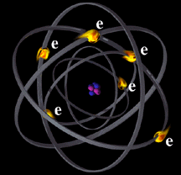
What are sources of electrical noise?
Random motion of electrons produces thermal noise
Sometimes referred to as “white noise”
R. J. Pasquinelli

Slide 3
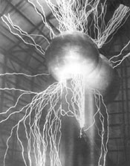
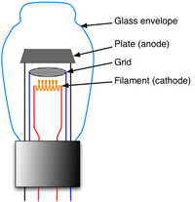
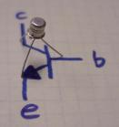
What are sources of electrical noise?
Particle Accelerator
Vacuum Tube
Transistor
R. J. Pasquinelli

Slide 4
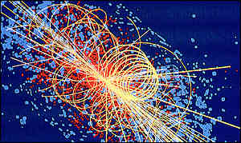
What are sources of electrical noise?
Other undesirable charged particles
R. J. Pasquinelli

Slide 5
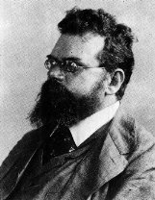
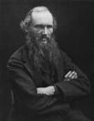
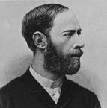
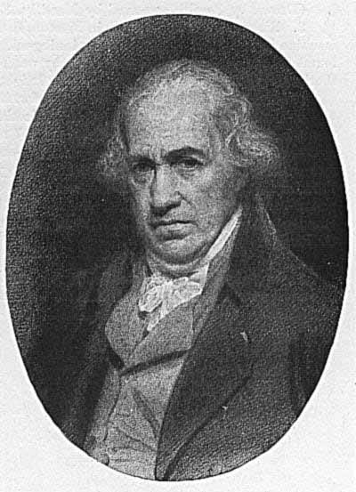
Noise Basics
Thermal Noise = kTB
Boltzmann’s constant x Temperature x Bandwidth
Watt
Seconds
1
x
Degrees K
x
Degrees K
Seconds
R. J. Pasquinelli
Notes:
Ludwig, Wiliam, Henrich….James

Slide 6

Noise Added = T_{e}
Noise Basics
Noise In
Noise Out
Gain
T_{O}
Noise unit is watts
Signal In
Noise In
Signal Out
Noise Out
Noise Figure
or
Noise Factor
=NF=
=
(Signal In)(Noise Out)
(Gain)(Signal In)(Noise In)
=
Noise Out
(Gain)(Noise In)
The Perfect Gain Box adds no noise, so NF=1 or 0 dB
R. J. Pasquinelli

Slide 7
Noise Basics
Noise Added = T_{e}
Noise In
Noise Out
Gain
T_{O}
Noise In = kTB
Noise Out = Noise In * Gain + Noise Added
Noise Added = Noise Out - Noise In * Gain
=NF * Noise In * Gain - Noise In * Gain
=(NF – 1)* Noise In * Gain
=(NF – 1)* kTBG
R. J. Pasquinelli

Slide 8
Effective Noise Temperature = T_{e}
Noise generated is temperature dependent
T_{O} = 290 ^{O} K is taken as ambient = 17^{O} C= 62.6 ^{O} F
k(T_{O} + T_{e})BG
NF =
= 1 + T_{e}/T_{O}
kT_{O}BG
T_{e} = T_{O} (NF-1)
T_{e} often used in systems where ambient is not 290 ^{O}K
Some examples, radio astronomy, space applications, accelerator physics
R. J. Pasquinelli

Slide 9

Noise Basics
Where is the noise floor?
Temperature Dependent
Noise Energy = kT = joules = watt seconds
=(1.38x10⁻²³ joules/^{O}K)x(290 ^{O}K)
=4 x 10⁻²¹ joules
=4 x 10⁻¹⁸ milliwatt seconds
=-174 dBm per Hz
Have a MHz of Bandwidth then add 60 dB for -114 dBm per MHz
R. J. Pasquinelli

Slide 10
Noise Basics
How to Measure Noise Figure
Excess
Noise
D.U.T
Gain
Detector
Noise In
T_{O}
Measure a ratio of powers
excess noise on
excess noise off
Excess Noise * Gain
D.U.T added Noise
D.U.T added Noise
= N2
=N1
Noise In * Gain
Noise In * Gain
R. J. Pasquinelli

Slide 11
Noise Basics
How to Measure Noise Figure
Excess
Noise
D.U.T
Gain
Detector
Noise In
T_{O}
Measure a ratio of powers
ENR
kT₀BG + k(T₂-T₀)BG + (NF-1)kT₀BG
Y = N2/N1 =
kT₀BG + (NF-1)kT₀BG
R. J. Pasquinelli

Slide 12

Noise Basics
How to Measure Noise Figure
Excess
Noise
D.U.T
Gain
Detector
Noise In
T_{O}
Measure a ratio of powers N2/N1=Y
1
NF = ENR x
Y - 1
R. J. Pasquinelli

Slide 13
Noise Basics
How to Measure Noise Figure
Excess
Noise
D.U.T
Gain
Detector
Noise In
T_{O}
Convert to Log notation
NF_{dB} = 10 Log((T₂-T₀)/T₀) - 10 Log(N2/N1 - 1)
= ENR_{dB} - 10 Log(N2/N1-1)
R. J. Pasquinelli

Slide 14
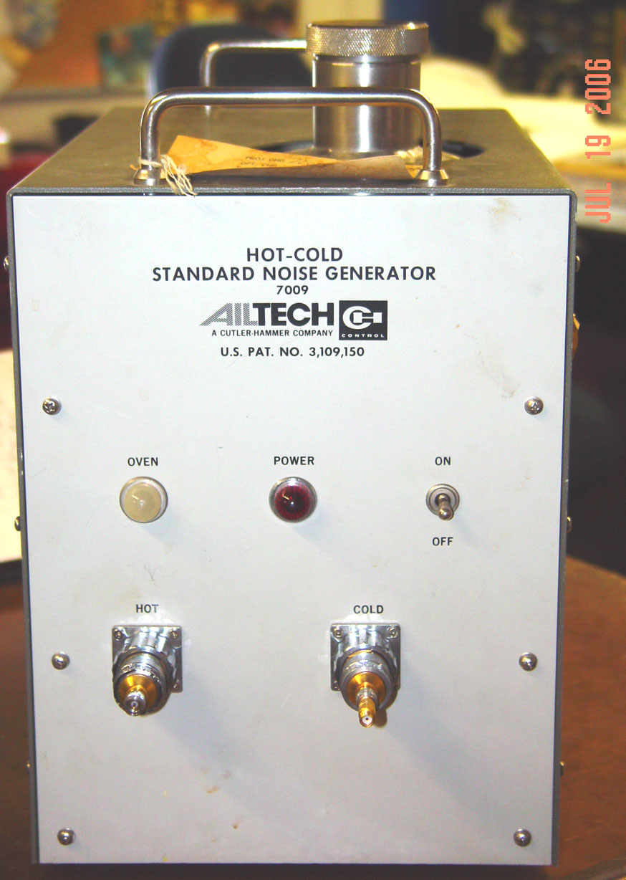

Noise Basics
How to Measure Noise Figure
Excess
Noise
D.U.T
Gain
Detector
Noise In
T_{O}
Noise Diode
Hot and Cold noise source
R. J. Pasquinelli

Slide 15
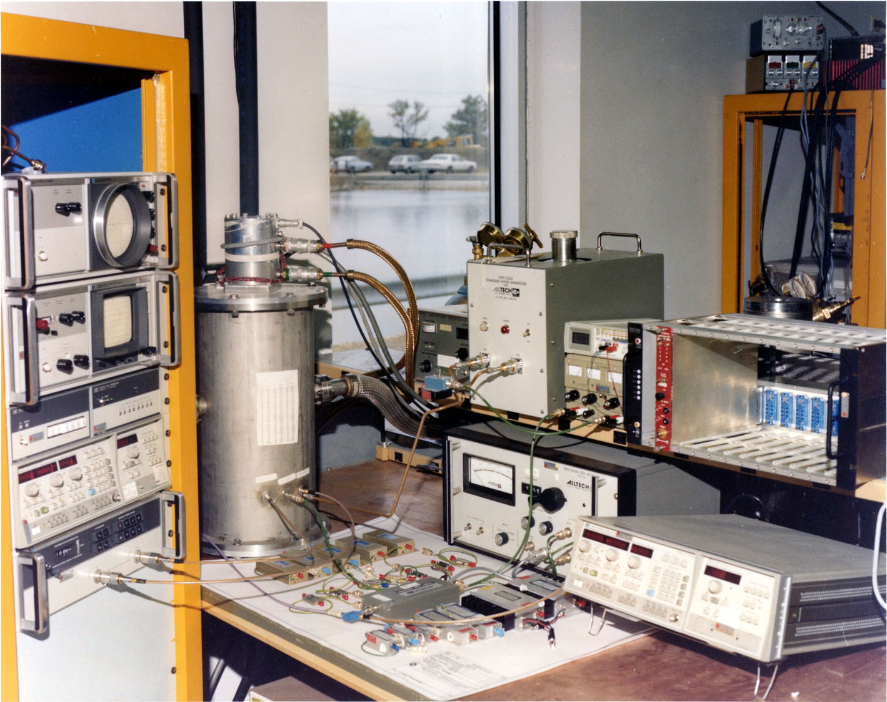
Noise Figure Test Setup
Noise
Source
Cryostat
Network
Analyzer
Detector
Local
Oscillator
Amplifiers
R. J. Pasquinelli

Slide 16
Noise Basics
System Noise Figure
G₁
NF₁
G₂
NF₂
G₃
NF₃
Noise Out
Noise In
T_{O}
Noise Out
(Noise In) G₁G₂G₃
NF_{system} =
NF_{system} =
kTBG₁G₂G₃ + (NF₁-1) kTBG₁G₂G₃
kTBG₁G₂G₃
+
(NF₂-1)kTBG₂G₃
kTBG₁G₂G₃
+
(NF₃-1)KTBG₃
kTBG₁G₂G₃
NF₂ - 1
NF₃ -1
NF_{system} = NF₁ +
+
G₁
G₁ G₂
System T_{e} = T_{e1} + T_{e2}/G1 + T_{e2}/G1G2
R. J. Pasquinelli

Slide 17

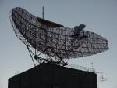
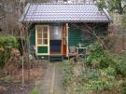
Mount Amplifier
HERE!
R. J. Pasquinelli

Slide 18
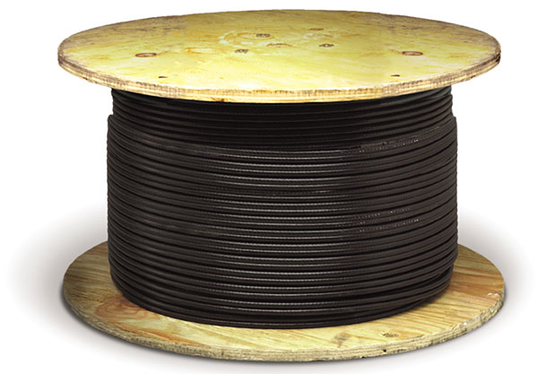

Look into these boxes
The impedance
looks the same!
R. J. Pasquinelli

Slide 19
Typical Stochastic Cooling Feedback System
Beam
Itsy bitsy signal
-80 dBm=10⁻¹¹ watts
Need 100 Watts
Of Signal
+50 dBm=10² watts
coax
Power
amp
Kicker
Pickup
preamp
Solution…gain = 10¹³ or 130 dB???
Beam
R. J. Pasquinelli

Slide 20
Typical Stochastic Cooling Feedback System
Beam
NF=4.01dB=2.52
=1.25 + (2-1)/0.794 +(10-1)/(0.794*1000)
NF=4dB=2.51
=1.25 + (2-1)/0.794
Input
signal and noise
NF=1dB=1.25
coax
Power
amp
Kicker
Pickup
preamp
300K
NF1=1 dB=1.25
Atten=1 dB=1.25
Gain=-1 dB=0.794
NF3=10 dB=10
Gain=100 dB=10¹⁰
NF2=3 dB=2
Gain=30 dB=1000
Beam
R. J. Pasquinelli

Slide 21
Typical Stochastic Cooling Feedback System
Beam
Case I
System BW= 1GHz
SNR= 0 dB
NF=4.01 dB
Teff=441 K
SNR=4 dB
-80 dBm Signal
-84 dBm noise
-81 dBm Signal
-84 dBm noise
-51 dBm Signal
-51 dBm noise
+49 dBm Signal = 79 W
+49 dBm noise = 79 W
158 W total
coax
Power
amp
Kicker
Pickup
preamp
290K
NF1=1 dB=1.25
Atten=1 dB=1.25
Gain=-1 dB=0.794
NF3=10 dB=10
Gain=100 dB=10¹⁰
NF2=3 dB=2
Gain=30 dB=1000
Beam
R. J. Pasquinelli

Slide 22
Typical Stochastic Cooling Feedback System
Beam
Case II
Buy better
preamp
System BW= 1GHz
SNR= 2 dB
NF=2 dB
Teff=168 K
SNR=4 dB
-80 dBm Signal
-84 dBm noise
-81 dBm Signal
-84 dBm noise
-51 dBm Signal
-53 dBm noise
+49 dBm Signal = 79 W
+47 dBm noise = 50 W
129 W total
coax
Power
amp
Kicker
Pickup
preamp
290K
NF1=1 dB=1.25
Atten=1 dB=1.25
Gain=-1 dB=0.794
NF3=10 dB=10
Gain=100 dB=10¹⁰
NF2=1 dB=1.25
Gain=30 dB=1000
Beam
R. J. Pasquinelli

Slide 23
Typical Stochastic Cooling Feedback System
Beam
Case III
Buy better
Preamp
& chill
front end
System BW= 1GHz
SNR= 8.6 dB
NF=1 dB
Teff=73 K
SNR=9.6 dB
-80 dBm Signal
-89.6 dBm noise
-80 dBm Signal
-89.6 dBm noise
-50 dBm Signal
-58.6 dBm noise
+50 dBm Signal = 100 W
+41.4 dBm noise = 14 W
114 W total
coax
Power
amp
Kicker
Pickup
preamp
80K
NF1=0 dB=1
Atten=0 dB=1
Gain=0 dB=1
NF3=10 dB=10
Gain=100 dB=10¹⁰
NF2=1 dB=1.25
Gain=30 dB=1000
Beam
R. J. Pasquinelli

Slide 24
$$ What’s the Cost $$
Power costs $100 per watt for this system
Case I: Warm pickup and 3 dB NF preamp
79 watts signal + 79 watts noise = 158 watts
Did not meet 100 watt signal minimum so must add
26% more total power for 200 Watts
Preamp cost……………..$500
Power cost……………$20,000
Subtotal………………$20,500
R. J. Pasquinelli

Slide 25
$$ What’s the Cost $$
Power costs $100 per watt for this system
Case II: Warm pickup and 1 dB NF preamp
79 watts signal + 50 watts noise = 129 watts
Did not meet 100 watt signal minimum so must add
26% more total power for 162 Watts
Preamp cost…………….$2000
Power cost……………$16,200
Subtotal………………$18,200
R. J. Pasquinelli

Slide 26
$$ What’s the Cost $$
Power costs $100 per watt for this system
Case III: Cold pickup and 1 dB NF preamp
100 watts signal + 14 watts noise = 114 watts
Cryogenics …………..$50,000
Preamp cost…………….$2000
Power cost……………$11,400
Subtotal………………$63,400
R. J. Pasquinelli

Slide 27
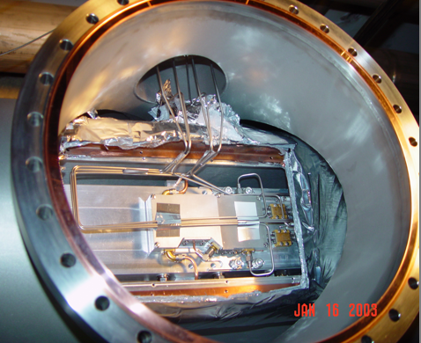
Debuncher Stochastic Cooling Cryo Preamp
R. J. Pasquinelli

Slide 28
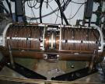



What if?
Ferrite Saturation?
Tight fit?
No room
For
More Kickers
Power Handling?
R. J. Pasquinelli

Slide 29
Noise Basics
Where is the noise floor?
Temperature Dependent
Noise Energy = kT = joules = watt seconds
=(1.38x10⁻²³ joules/K)x(290 K)
=4 x 10⁻²¹ joules
=4 x 10⁻¹⁸ milliwatt seconds
=-174 dBm per Hz
Have a MHz of Bandwidth then add 60 dB for -114 dBm per MHz
R. J. Pasquinelli

Slide 30
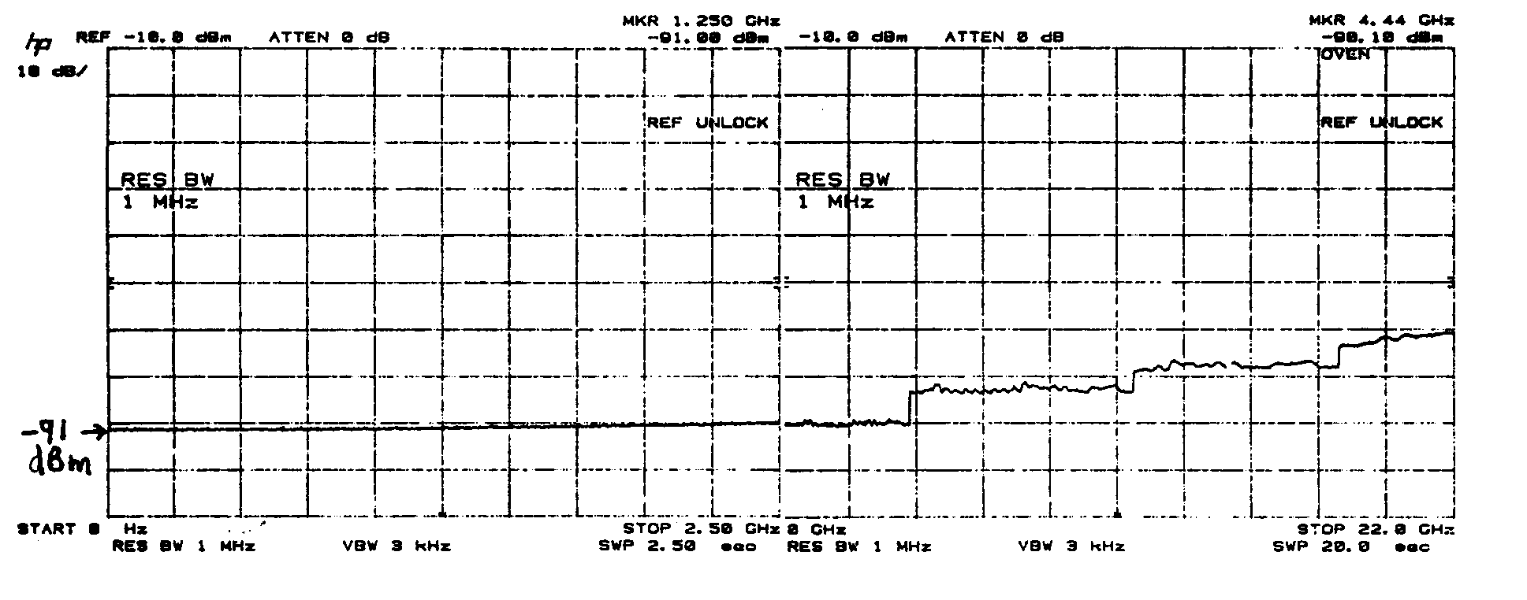
Noise Performance of Swept Frequency Spectrum Analyzer
With a Resolution Bandwidth of 1 MHz noise floor = -91 dBm
Some 23 dB worse than ideal
R. J. Pasquinelli

Slide 31
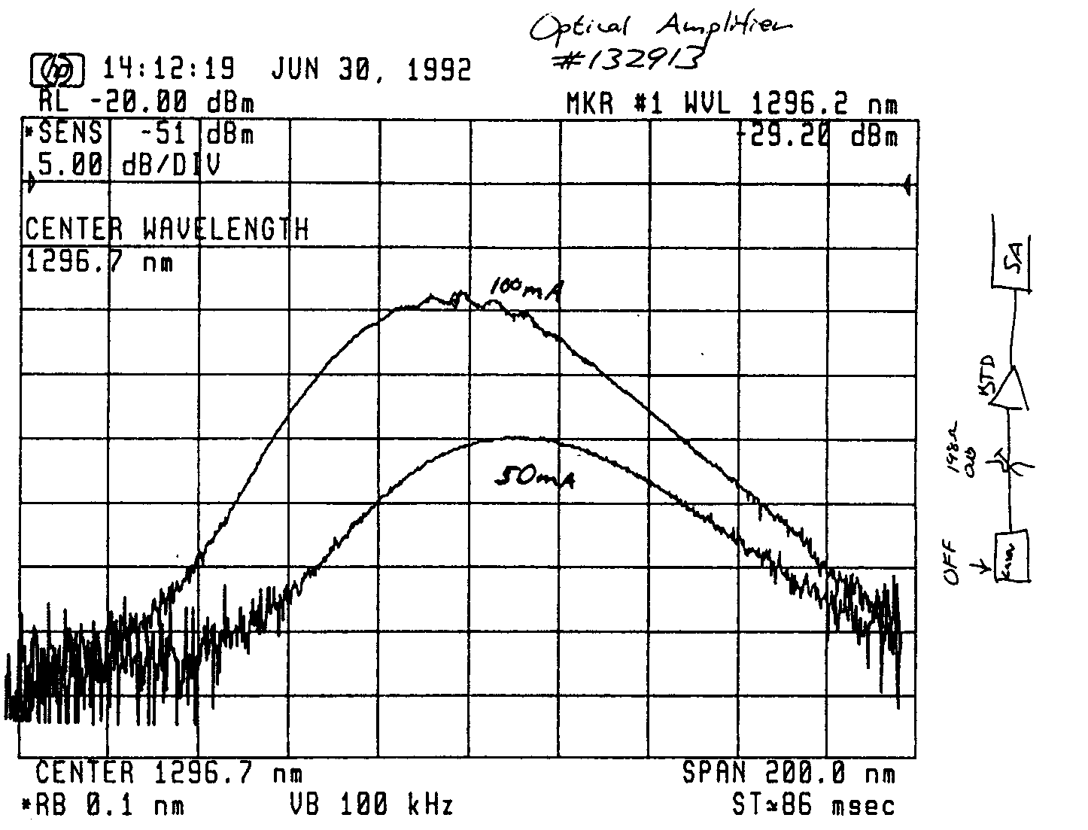
Optical Amplifier Noise Performance
R. J. Pasquinelli

Slide 32
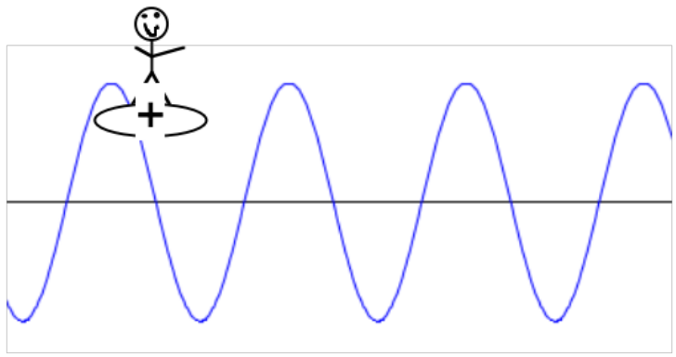
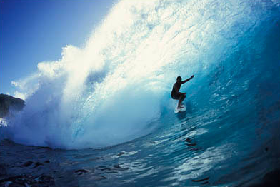
Synchronous Phase & Phase Stability
R. J. Pasquinelli

Slide 33
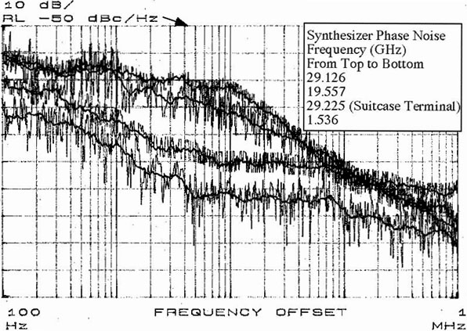
Plot of Phase Noise vs Frequency
R. J. Pasquinelli

Slide 34
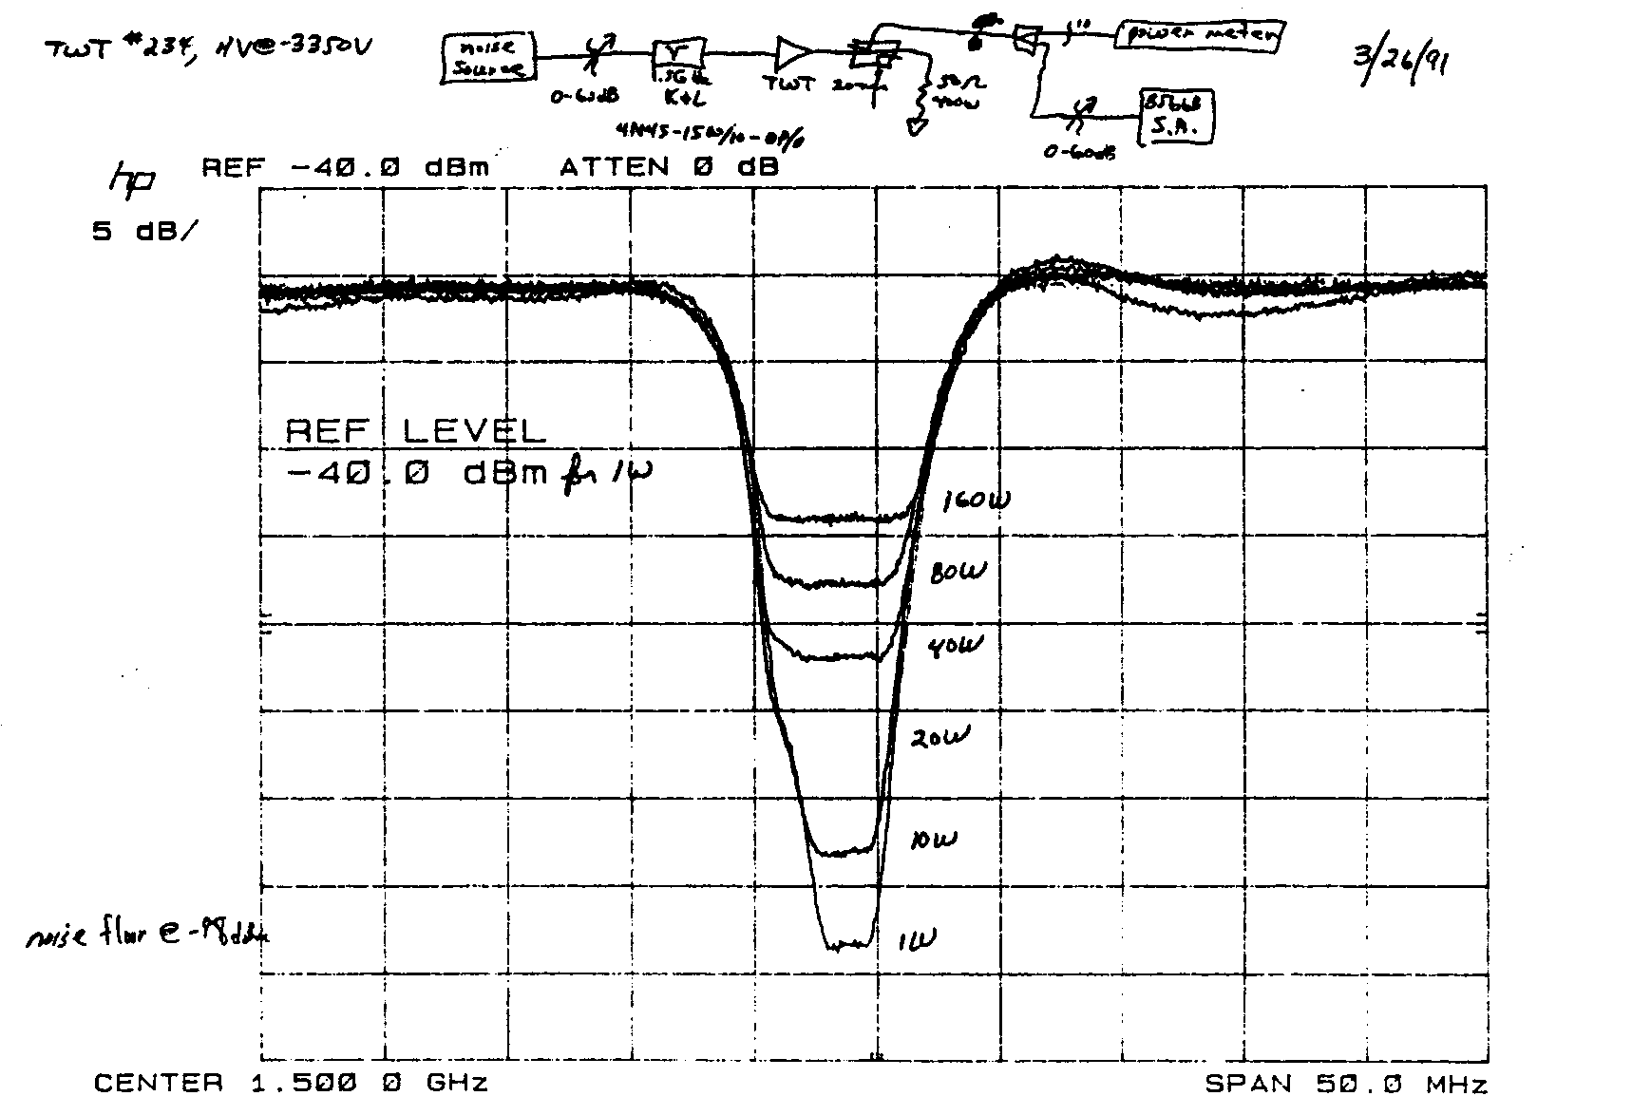
Intermodulation Noise in a Power Amplifier
R. J. Pasquinelli

Slide 35
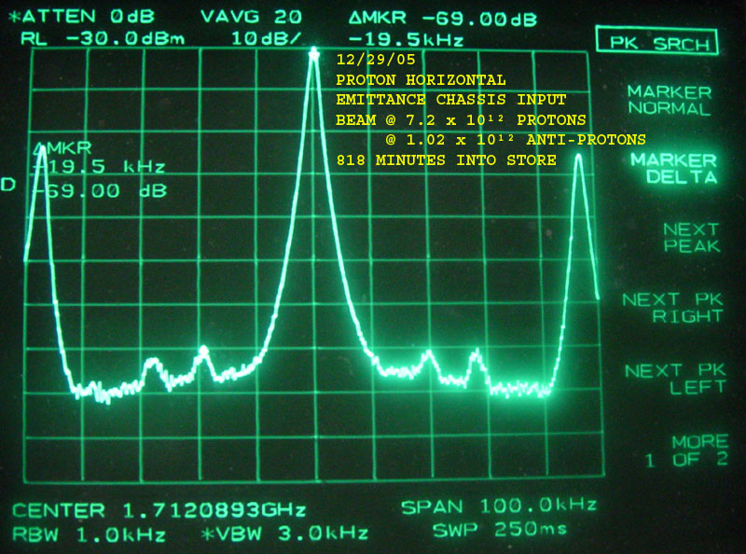
Coherent Beam Signal Noise
Tevatron Schottky Signal
70 dB
R. J. Pasquinelli

Slide 36
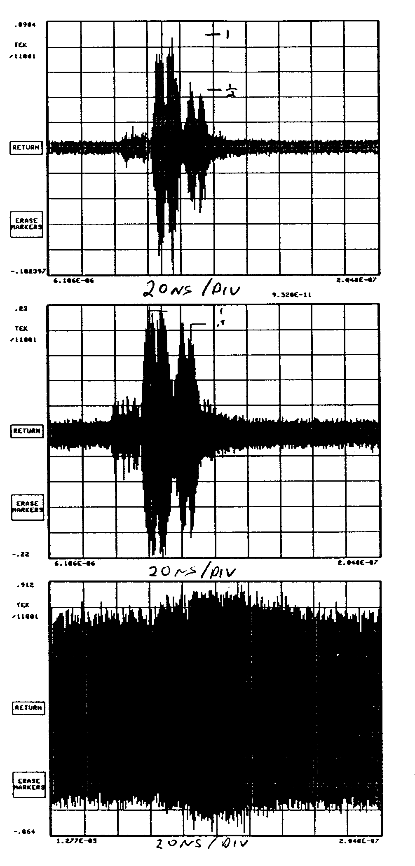
Tevatron Schottky Time Domain Signals
After pickup
Peak Power
Levels can
Saturate the system
But not be
Obvious in the
Frequency Domain
After pre-amplifier
After power amplifier
R. J. Pasquinelli

Slide 37
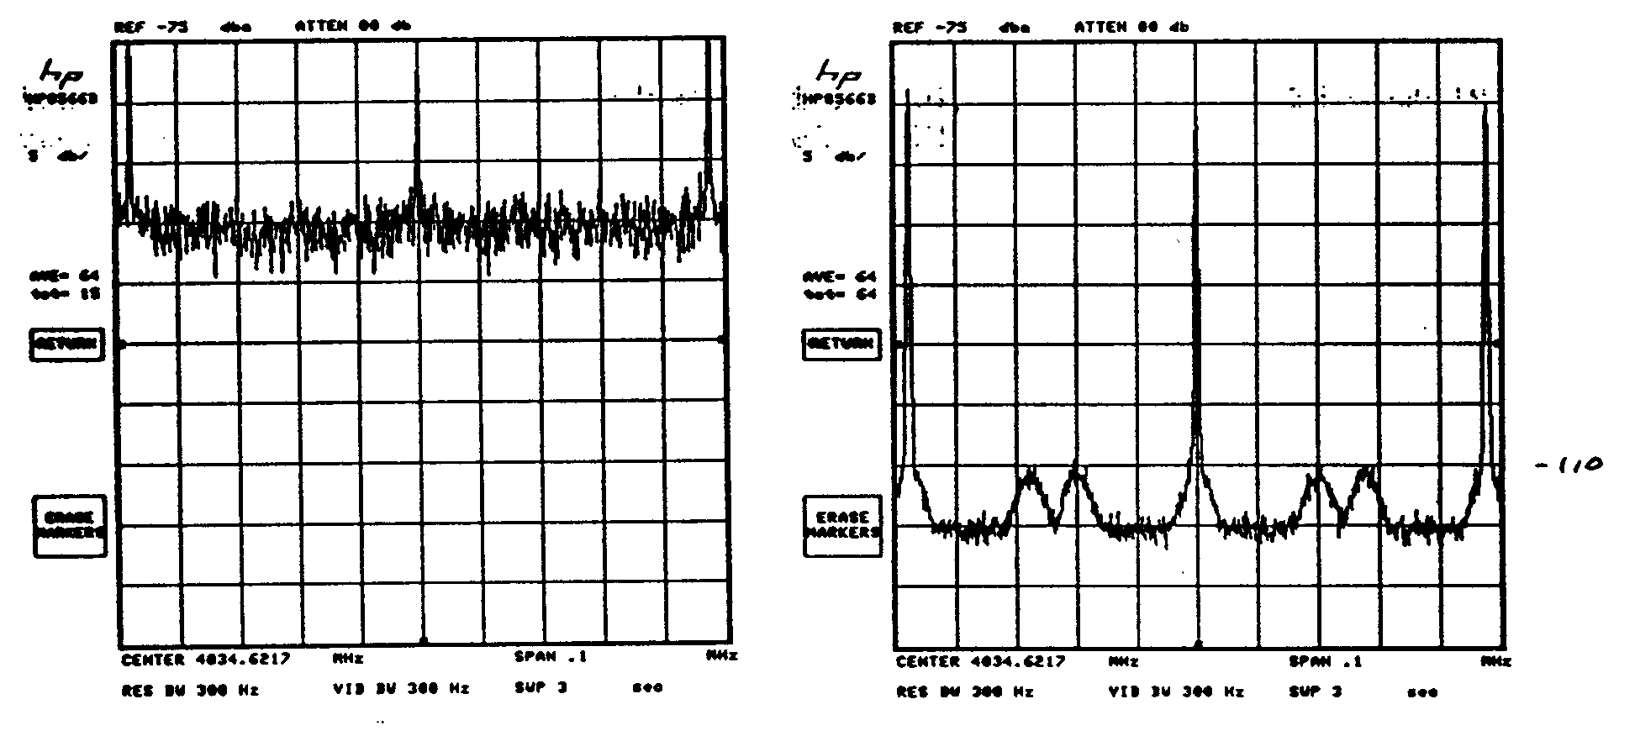
Effects by gating on Tevatron Schottky Signal
R. J. Pasquinelli

Slide 38
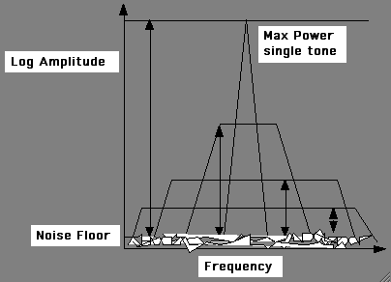
Dynamic Range = Max operable power/Noise floor power
Total Power
Is the
Integral across
Full bandwidth
R. J. Pasquinelli

Slide 39

Digital Connection
How many bits?
Digital is base two, so every
Bit is 2 x voltage or 6 dB
Take required dynamic range dB
and
Divide by 6 dB for number of bits!
R. J. Pasquinelli

Slide 40

R. J. Pasquinelli

