Slide 1
LinacLego
Dave McGinnis
Chief Engineer / Accelerator Division
www.europeanspallationsource.se
July 23, 2014

Slide 2
LinacLego
LinacLego is a software package for designing and documenting a linac lattice.
It consists of:
A set of structured XML files that describe the lattice
A dictionary (.dtd file) that describes the XML grammar
27 Java base classes and 11 extended classes to create, read, analyze, parse, and export the XML files
A Java Swing based graphical user interface
A GWT web application for viewing the XML files and data reports.

Slide 3
Origin
LinacLego was developed to aid in the ESS Linac 2013 redesign
70M€ was removed from the linac cost while still preserving beam performance.
The redesign required optimization and manipulation of large systems of beam-line components such as cryomodules
Where a large number of parameters are needed to describe the component (lengths, gradients, phases, apertures)
But only a few parameters change from instance to instance (gradient and phase)
LinacLego was designed specifically to manipulate large systems of beam-line components easily and accurately.
LinacLego was further developed to aid in the documentation of a linac lattice.

Slide 4
Overview
LinacLego is an XML based system
for describing a linear accelerator lattice
in an organized hierarchal manner.
The hierarchal structure of LinacLego can be used to develop a product break-down structure of the linac.
The XML schema makes a complicated structure
readily human readable
as well as providing a flexible input platform for computer simulations, graphical design programs, and databases.

Slide 5
Working with Lattice Design Tools
Linear accelerator lattice designers use tools such as TraceWin, Parmilla, Dynac, etc. to simulate the beam response to the design.
Once the lattice designer is happy with the lattice design,
the lattice design must be communicated to engineers
who must transform the idealized elements such as drifts, quadrupoles, bends, etc,
used in the simulation into physical engineered components such as flanges, pipes, manifolds, etc.
The input files to simulation programs are flat sequential ASCII text files
which for designs with a few number of components are easily human readable.
However, as the design becomes larger and more complex, these files get very difficult for a human to read, hence error-prone.

Slide 6
Linac Cells
The situation worsens for designs
containing large numbers of repeating cells
in which only a few parameters such as quadrupole gradients or cavity fields change from cell to cell.
The lattice designer must copy large blocks of flat text containing many parameters over and over in the file.
If the designer then wants to change a component value such as a drift length in a cell,
he must then find each instance of this component in all the cells to make this change.
This can often result in errors.

Slide 7
Engineering Reports
Finally, the component engineers would like to know
how many types of elements he needs to construct
and where these elements are located.
Since it is difficult to annotate the lattice design in the lattice input files,
it is difficult to compile the required data
without implementing some type of ad-hoc program specific, comment format in the lattice input files.

Slide 8
XML, Flat Files, & Databases
Using and XML structure to describe the lattice instead of flat files
makes it easy to group and organize the lattice so that humans can understand the lattice structure.
The XML format also readily permits the easy implementation of XML models that can be used to describe repeating structures in which only a few parameters vary from structure to structure.
Since the XML format is machine readable, data queries are straightforward to implement.
This, of course can be done with a carefully designed database
But in the design stage as for the case of ESS, developing these databases with ever changing requirements from the user can be frustrating for the developer.
The XML format is easier to work with in the design and prototyping stage
As the lattice design stabilizes The XML format can provide the upload information for a more sophisticated database.

Slide 9
Workflow
The importance of not burdening the lattice designer with new design syntax cannot be overstated.
LinacLego takes the flat ASCII lattice input file, of which the only format currently implemented is TraceWin, from the lattice designer and converts it to an XML format following an appropriate XML schema.
LinacLego then provides tools that aid the accelerator engineers into organizing the XML description of the lattice into a hierarchical form.
As a check of the conversion integrity, LinacLego returns a flat ASCII lattice input file, of which the only formats currently implemented are TraceWin and Dynac.
LinacLego provides a PBS tree view of the lattice in addition to comma separated value (.csv) reports.

Slide 10
Lattice Release WorkFlow
Baseline
TraceWin File
Linac Lego
XML
Engineering
Reports
Lattice Plots
TraceWin File
Compare
Lattice Plots

Slide 11
LinacLego Structure
The main body of a LinacLego is a linac.
A linac is comprised of sections.
For example, in the ESS Linac example of sections are the Spoke section, the Medium Beta section, etc.
A section is comprised of cells.
The boundaries of the cells can be arbitrary but is intended as a grouping of components inside a lattice focusing period such as a FODO cell.
A cell is comprised of slots.
Again, the definition of slot boundaries is arbitrary but slots are intended to represent an engineering assembly such as a cryomodule.
A slot is comprised of beam-line elements
which is the fundamental building block of LinacLego.
The beam-line elements have a one-to-one correspondence with the elements in the ASCII lattice input file. Examples of beam-line elements are drifts, quadrupoles, bends, RF cavities, thin steerers, etc.

Slide 12
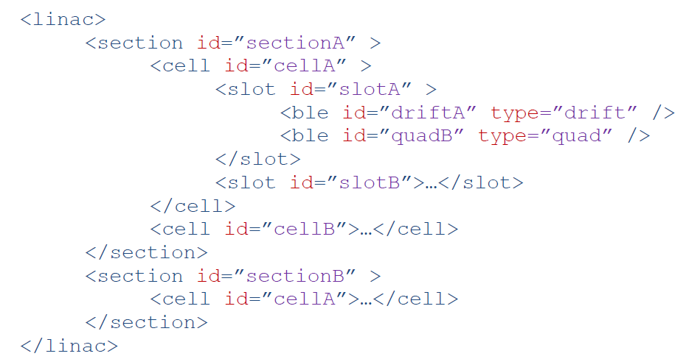
LinacLego XML Hierarchy

Slide 13
LinacLego Id’s
Each element has a user-defined identifier or id attribute.
While a single identifier does not have to be unique,
the collection of identifier attributes should give a unique id.
The quadrupole in the preceding XML example would have the composite id of:
sectionA-cellA-slotA-quadB

Slide 14
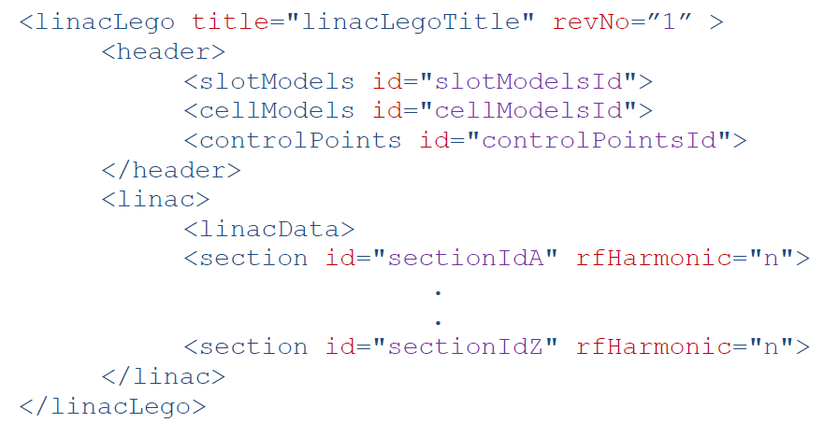
LinacLego XML components
The dictionary document (.dtd) describing the LinacLego XML file structure is LinacLego.dtd

Slide 15
Data Element <d>
Lattice files contain a large number of parameters.
Usually no description of what these parameters represent or their units can be found
unless the user looks in the user manual for the description.
Parameters in LinacLego are described in a Data Element tag that provides description about the parameter.

Slide 16
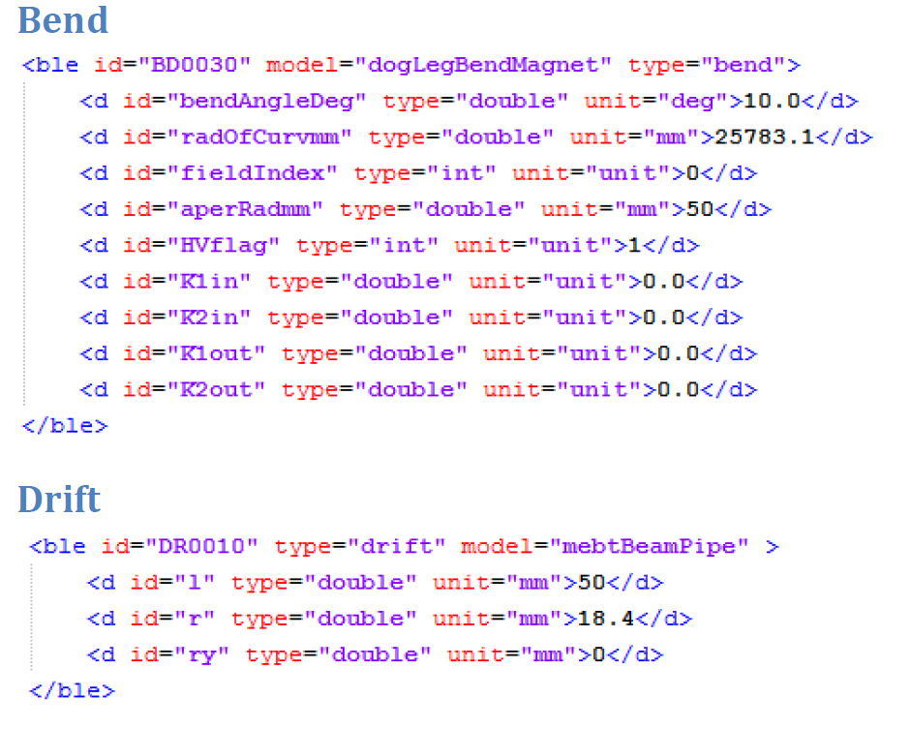
Beam-line Element <ble>

Slide 17
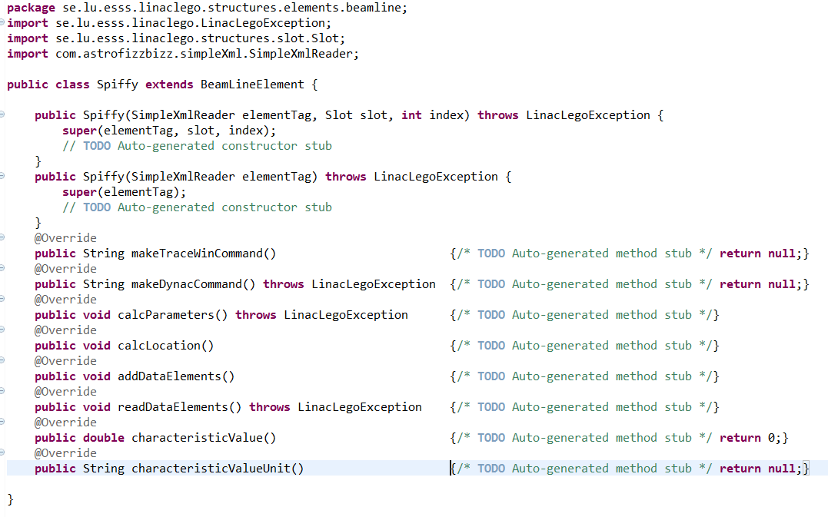
BeamLineElement Abstract Java Class

Slide 18
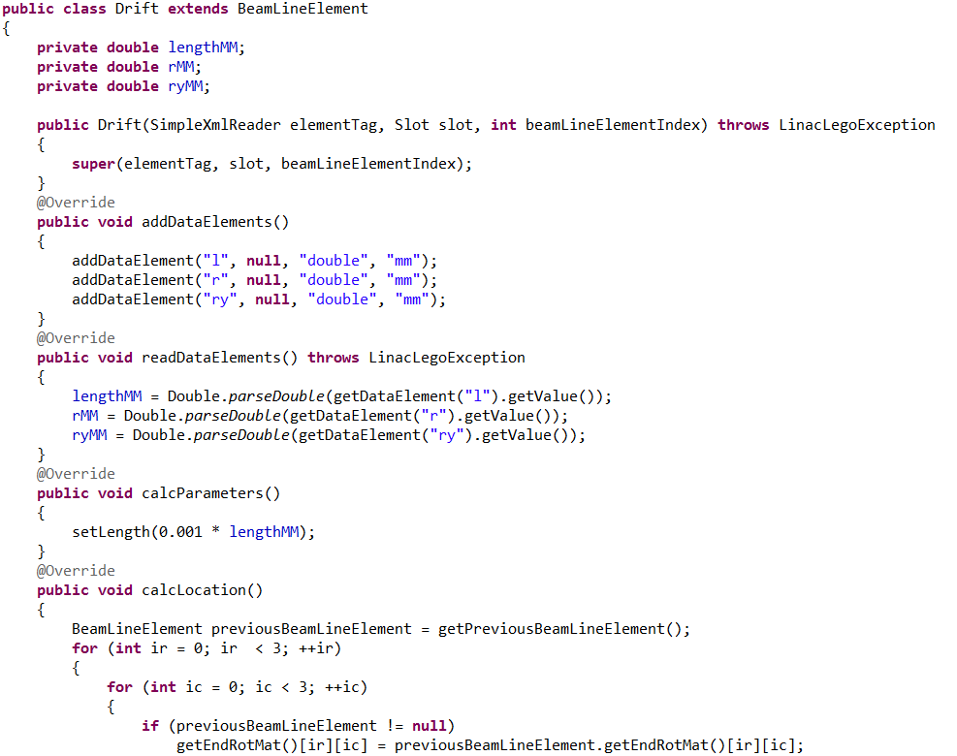
BeamLineElement Abstract Java Class

Slide 19
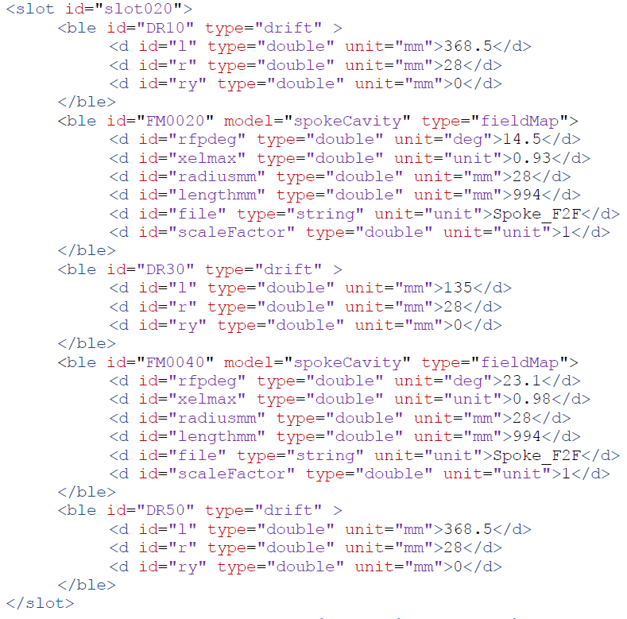
Slot <slot>

Slide 20
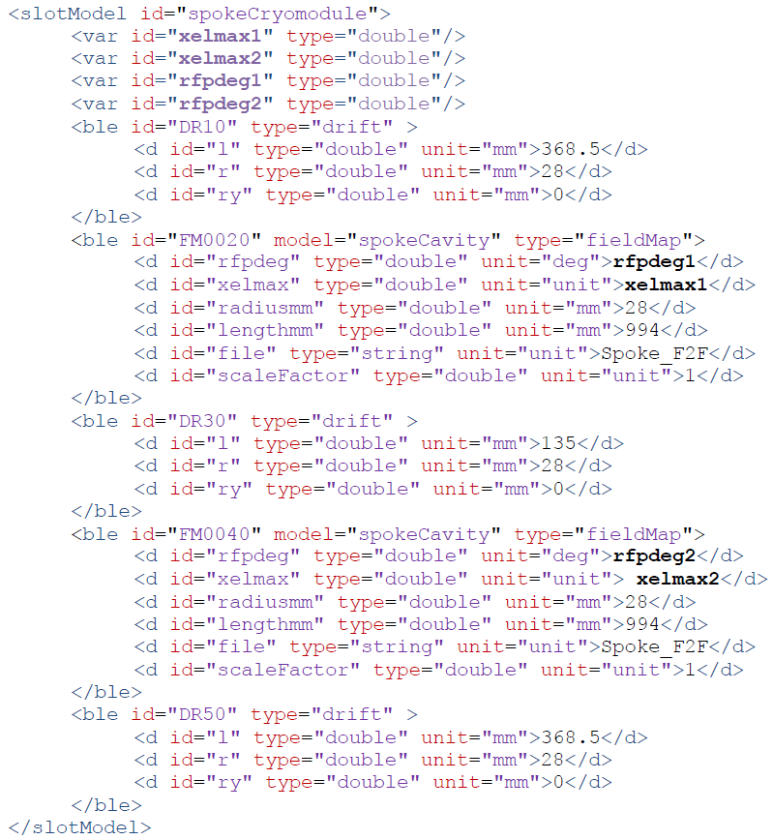
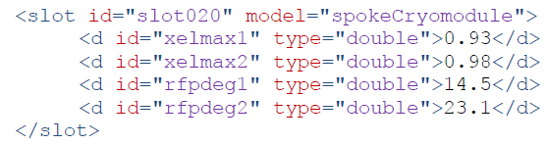
Slot Model <slotModel>

Slide 21
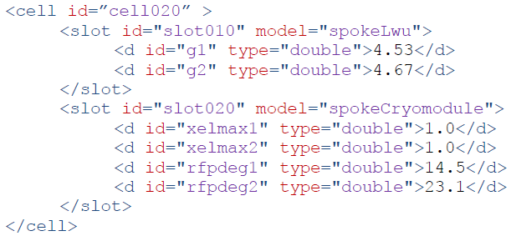
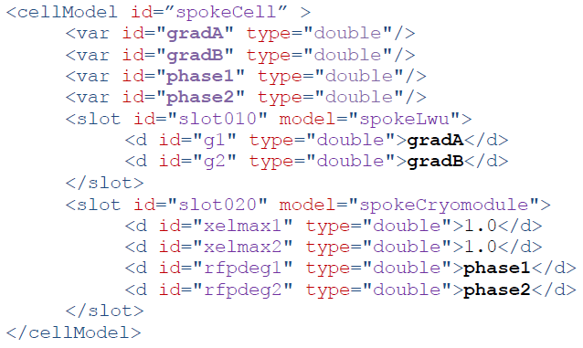
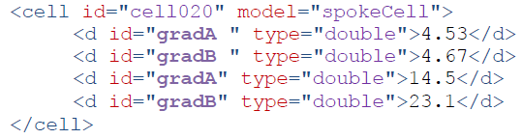
Cell <cell>

Slide 22
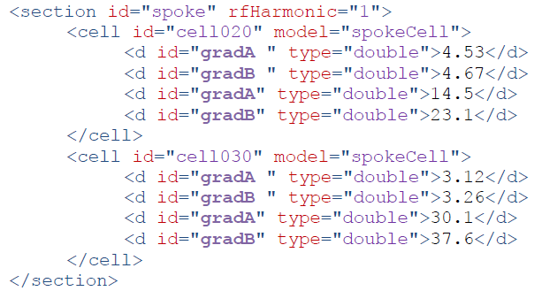
Section <section>

Slide 23
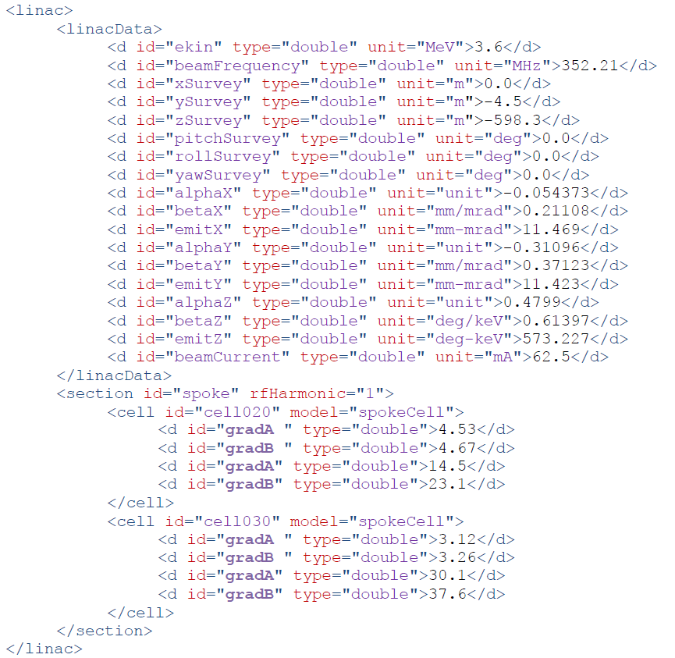
Linac <linac>

Slide 24
Control Points
Control points are LinacLego tags that describe how the lattice is to be interfaced with the control system.
A control point is attached to a beam-line element.
There can be more than one control point attached to a beam-line element.
The attributes of the <cnpt> tag contain the section-cell-slot-ble address of the beam-line element the control point is attached to.
To describe the control point, there are the type, model, and id attributes that are up to the user to define.
Inside the <cnpt> tag are three data tags to describe the x,y, and z position of the control point relative to the beam-line element.
This can be useful for describing control points that occupy the same space as the parent beam-line element such as bpm’s that are placed inside a quadrupole or cavity couplers.

Slide 25
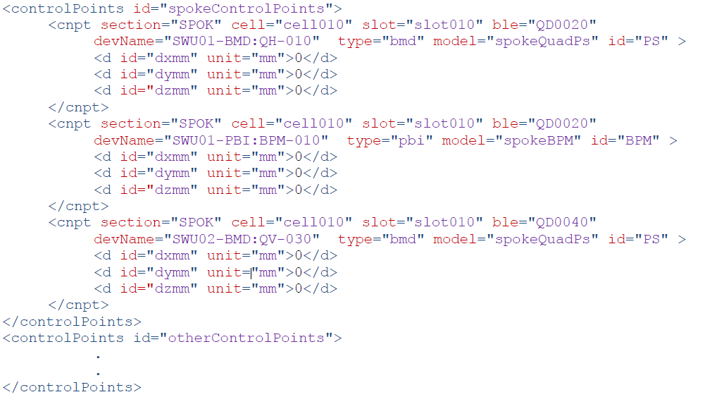
Control Points <cnpt>

Slide 26
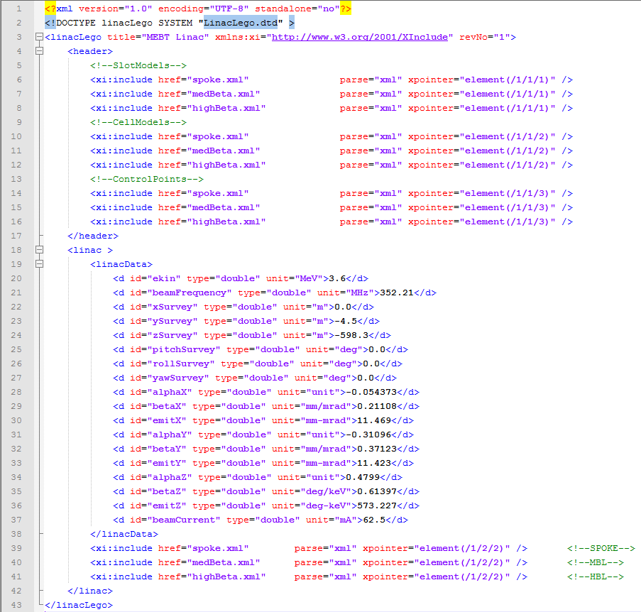
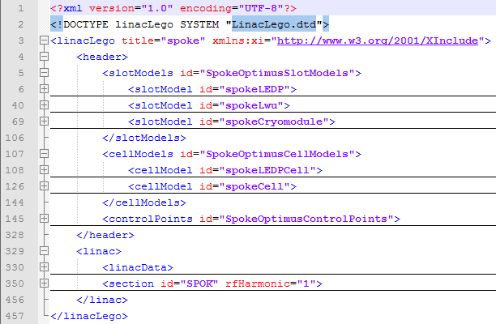
XML Include Files

Slide 27
The LinacLego Application
The LinacLego Application is a graphical user interface for reading LinacLego XML files.
The program is written in Java 1.7.
The major features of the program are:
Checking the XML grammar against the LinacLego.dtd file (File->Open XML File)
Displaying the XML document in a tree display
Parsing the XML document into a TraceWin or Dynec file (Actions->Parse XML File)
Viewing the lattice in a PBS format (Actions->Parse XML File)
Creating spreadsheet reports from the XML document (Actions->Parse XML File)
Creating an XML document from a TraceWin file (File->Open TraceWin File)
Saving a newly created XML document (File->Save XML File)
Finding and marking sections of the lattice that match slot models (Actions->Match Slot Models)
Finding and marking sections of the lattice that match cell models (Actions->Match Cell Models)
Creating XML field profiles from TraceWin field profiles (Field Bulder->Build XML Field Profile)

Slide 28
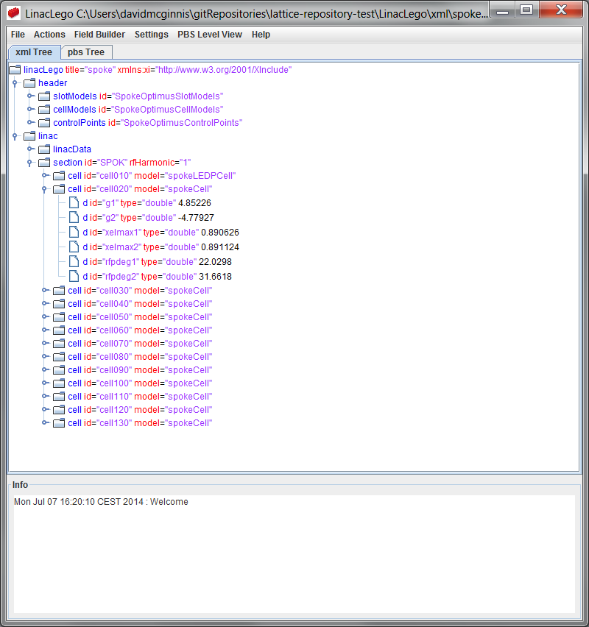
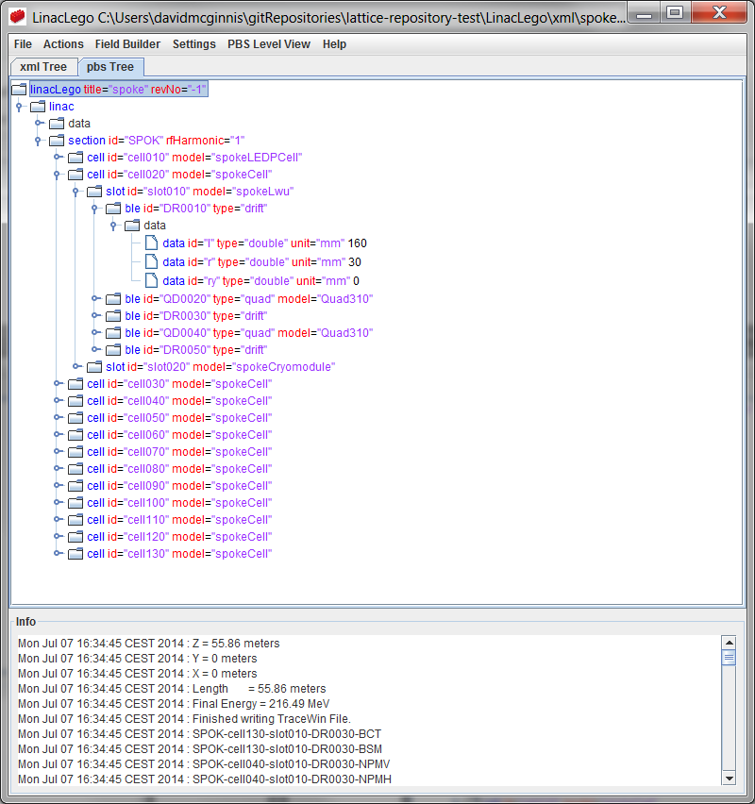
LinacLego Application Views

Slide 29
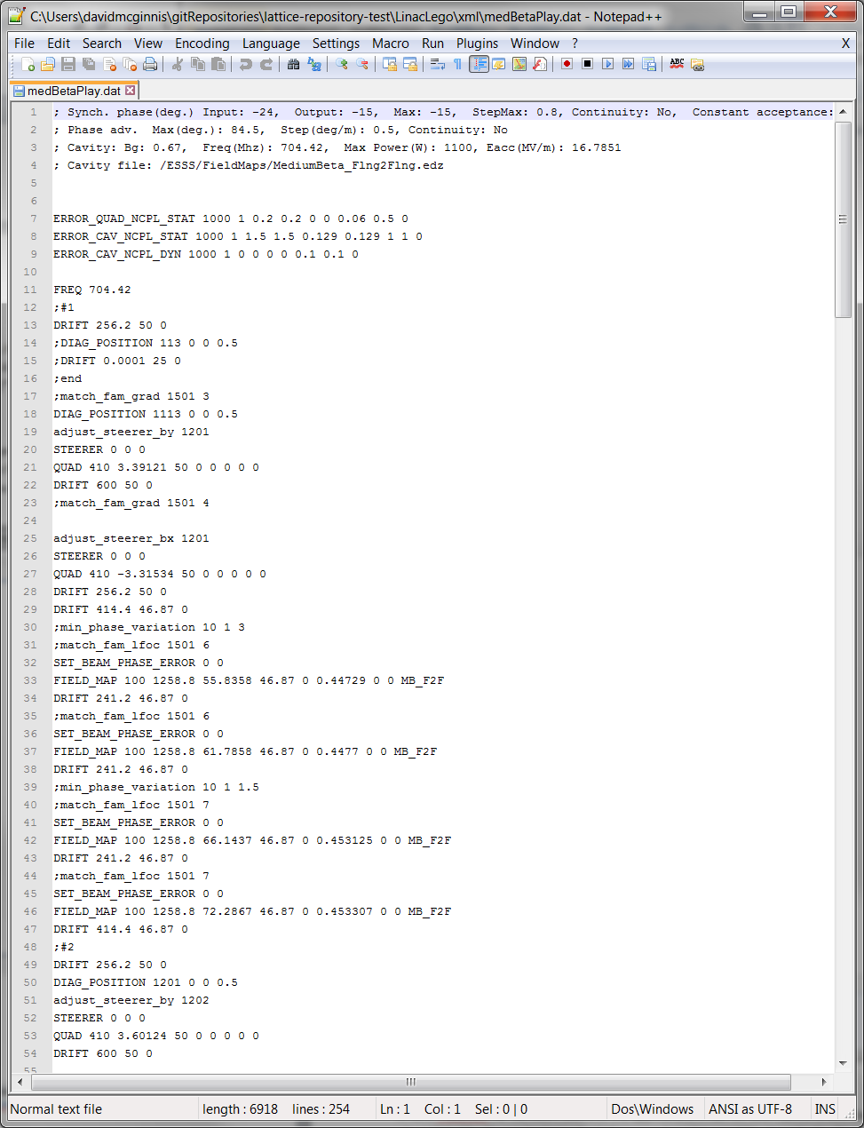
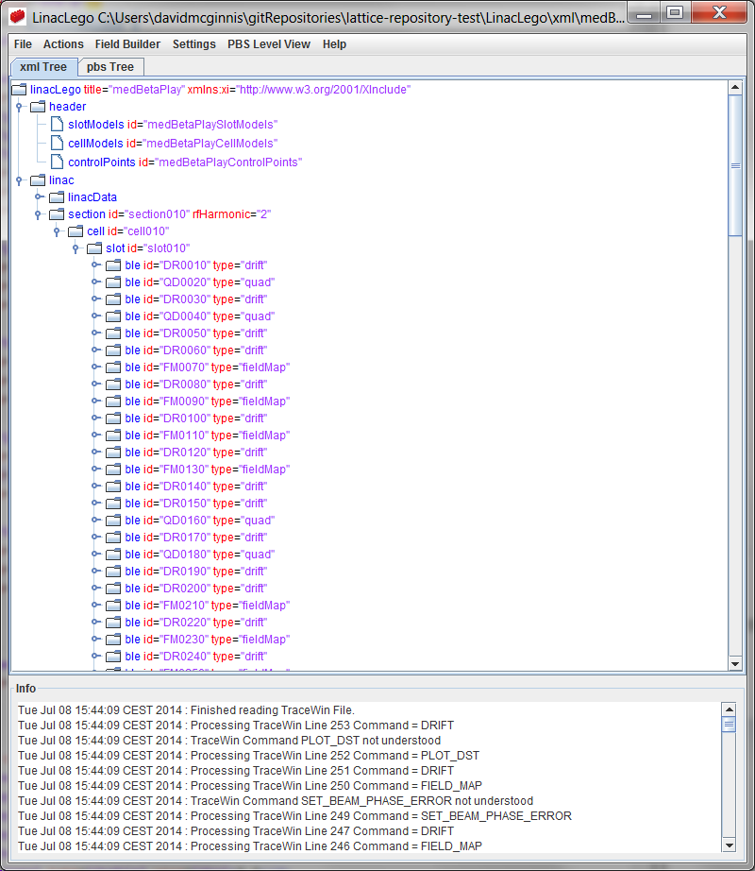
Building a LinacLego from TraceWin

Slide 30
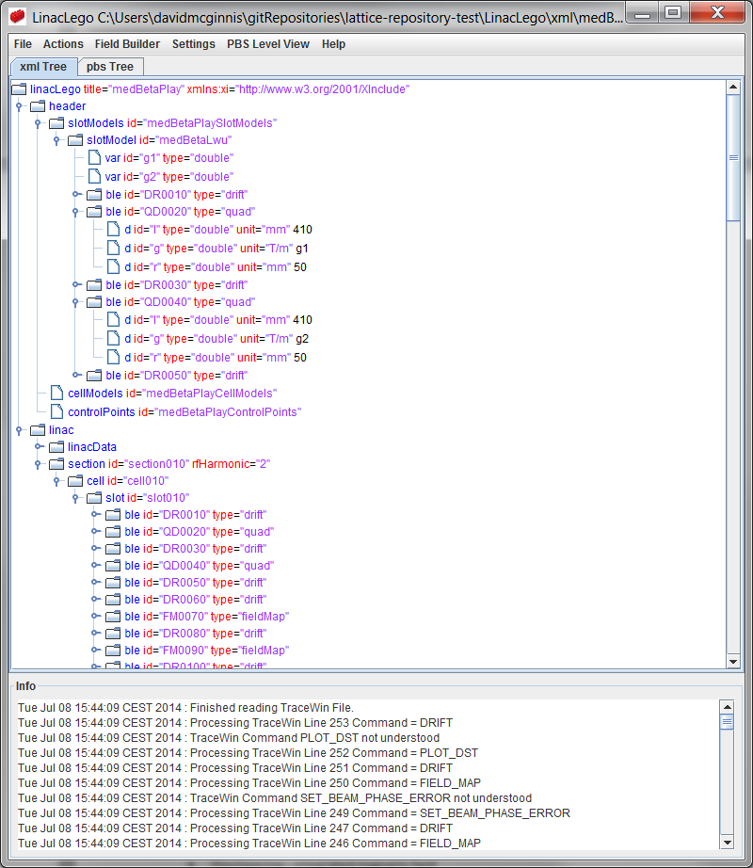
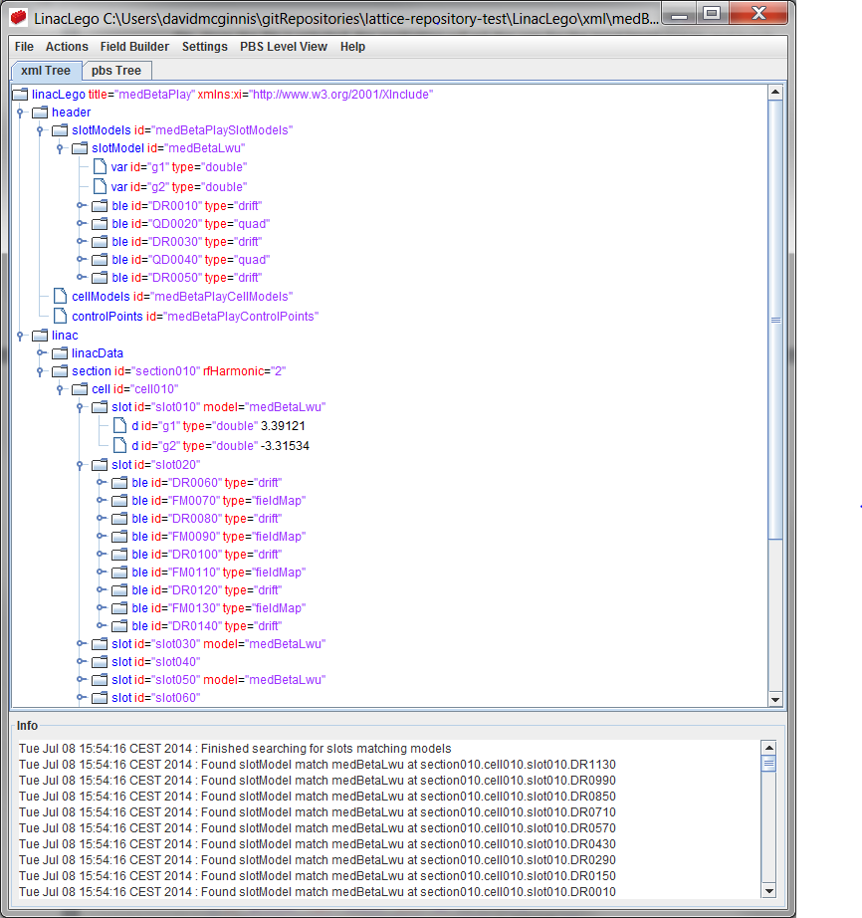
Building and Collecting Slots

Slide 31
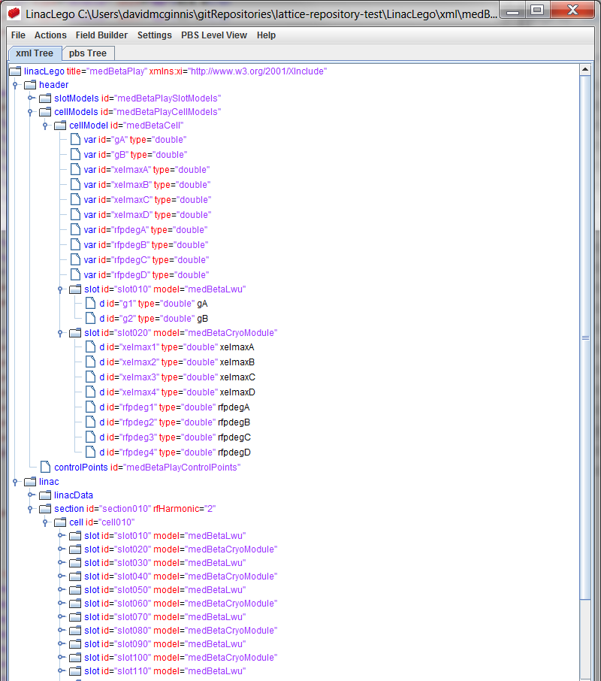
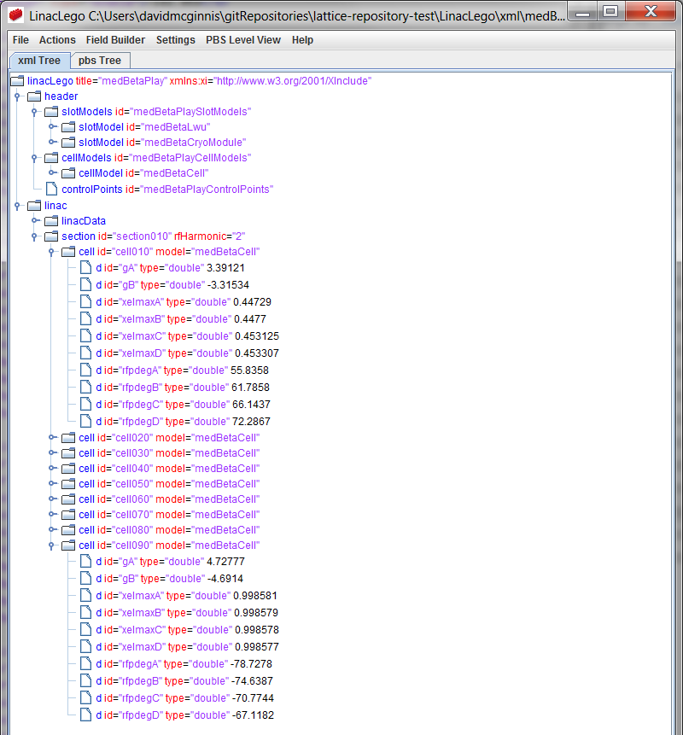
Building and Collecting Cells

Slide 32
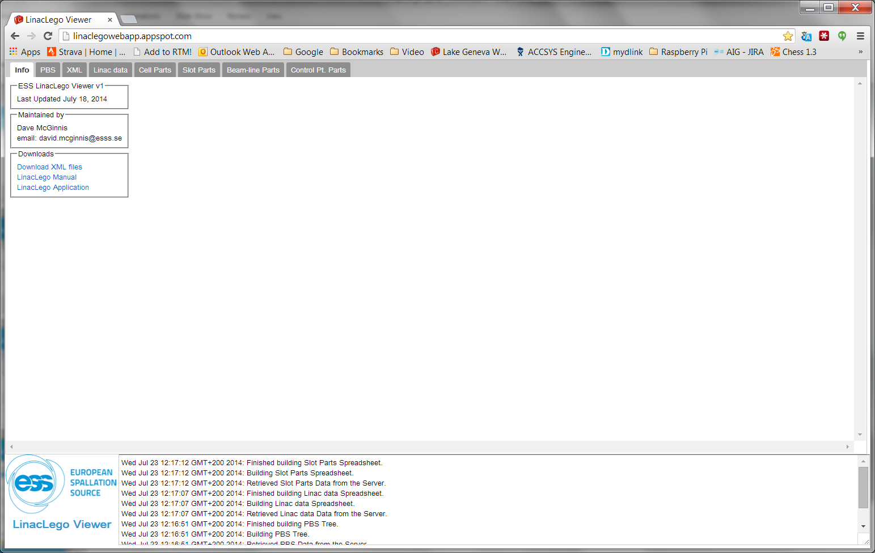
LinacLego Web Application

Slide 33
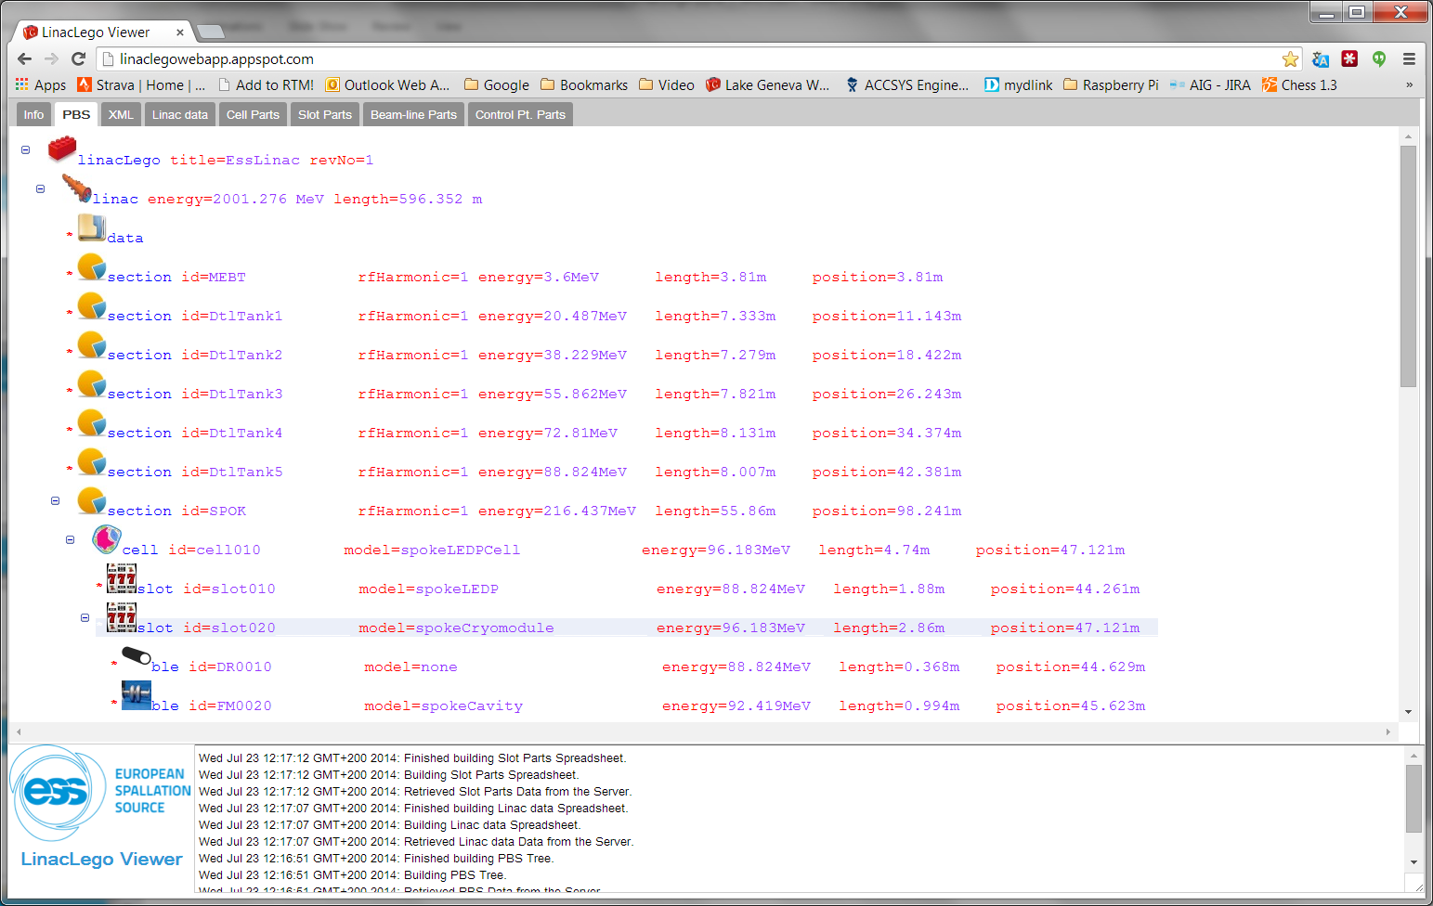
LinacLego Web Application

Slide 34
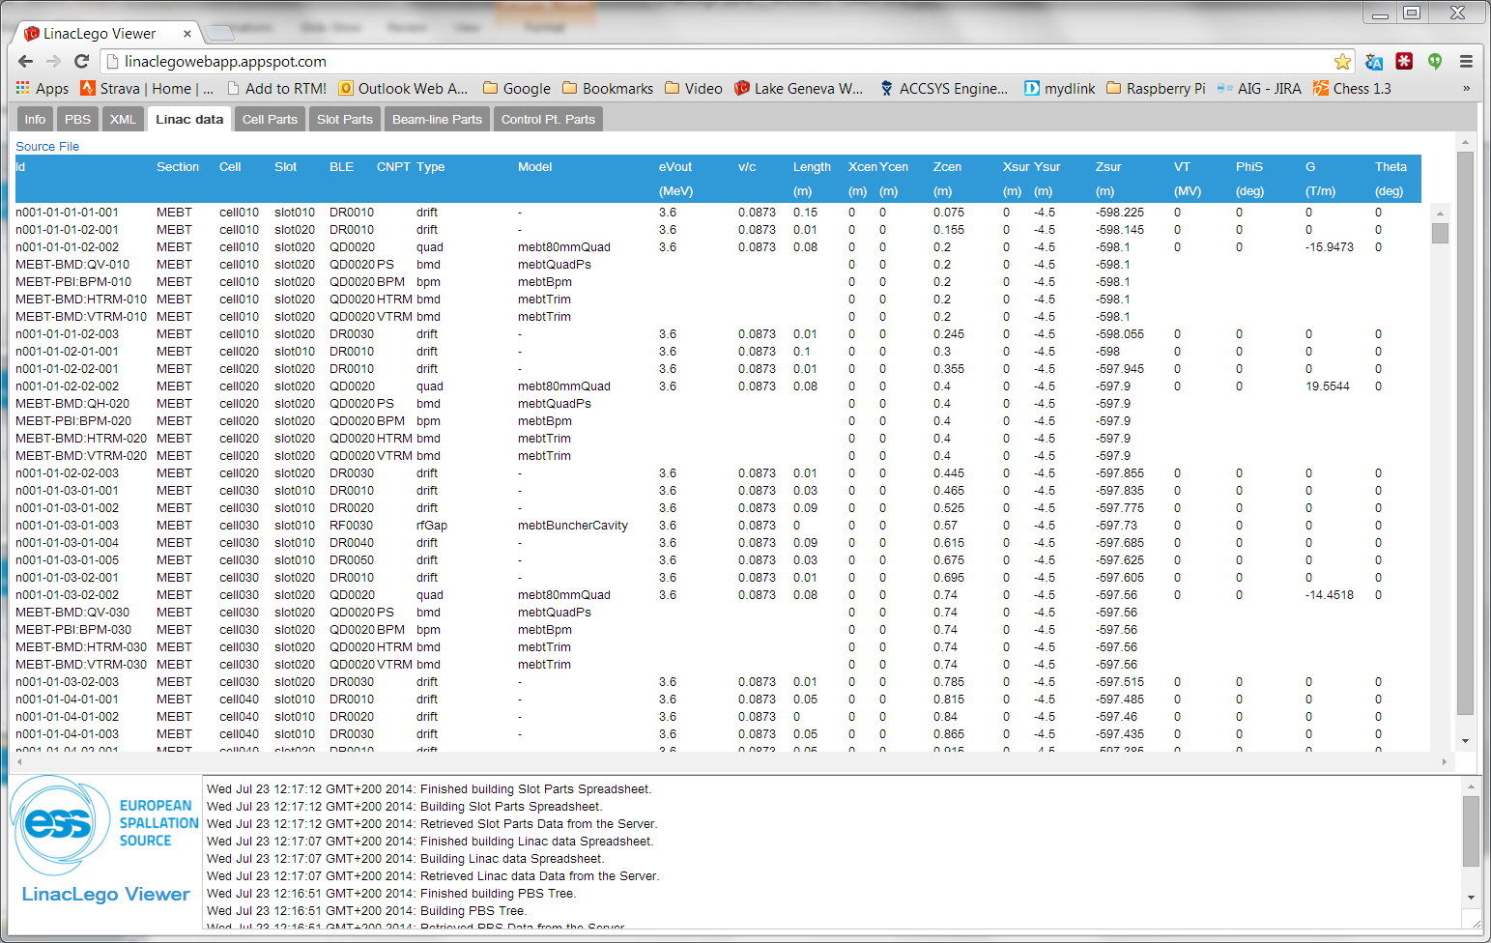
LinacLego Web Application

Slide 35
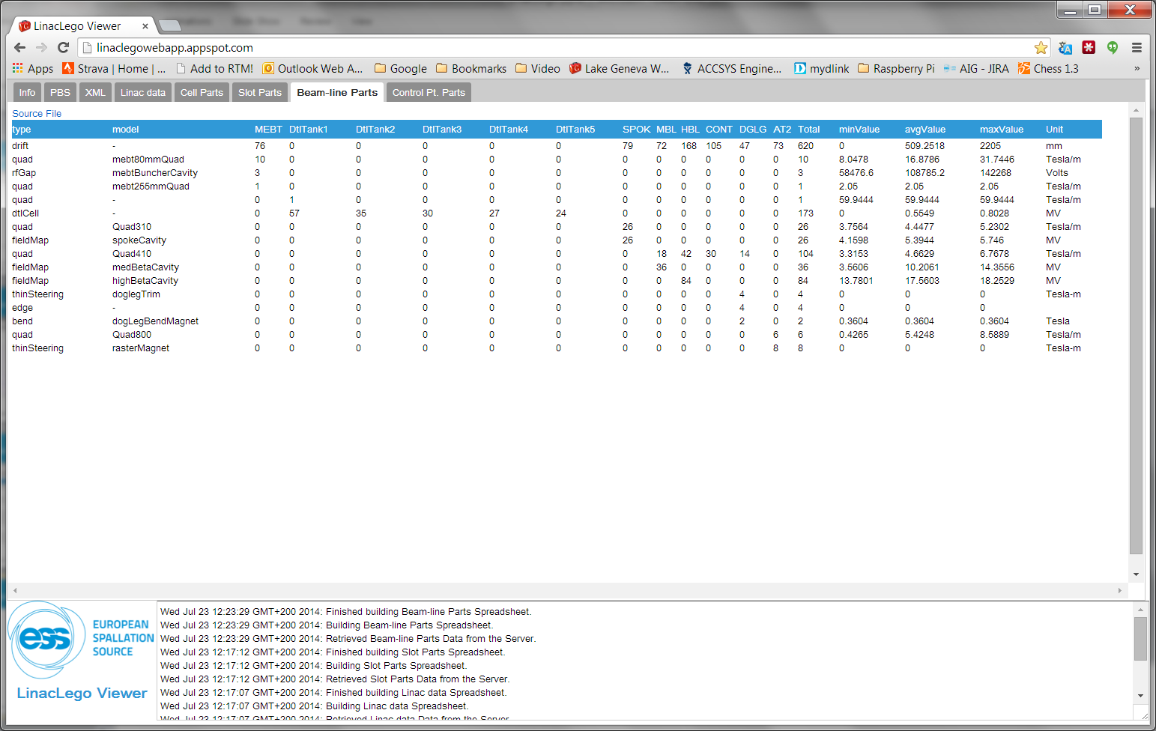
LinacLego Web Application

Slide 36
Summary
LinacLego is a software package that can be used to quickly and accurately describe a linac lattice in a hierarchical format.
It uses an XML based format that is easy for users to create and read.
It is has a fairly large set engineering views and reports.
The Java classes can be readily extended to handle many other types of beam-line elements

