Slide 1
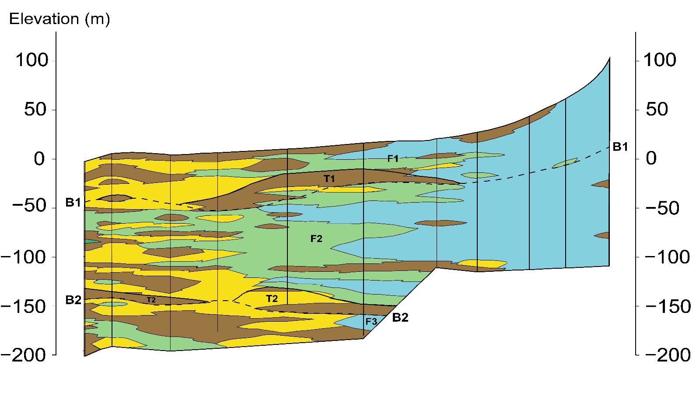
CHUKOU
WUTU
CITONG
FENGRONG
LIUHE
GANGHOU
XILUO
HAIFENG
JIULONG
HOUAN
XINGHUA
A’
A

Slide 2
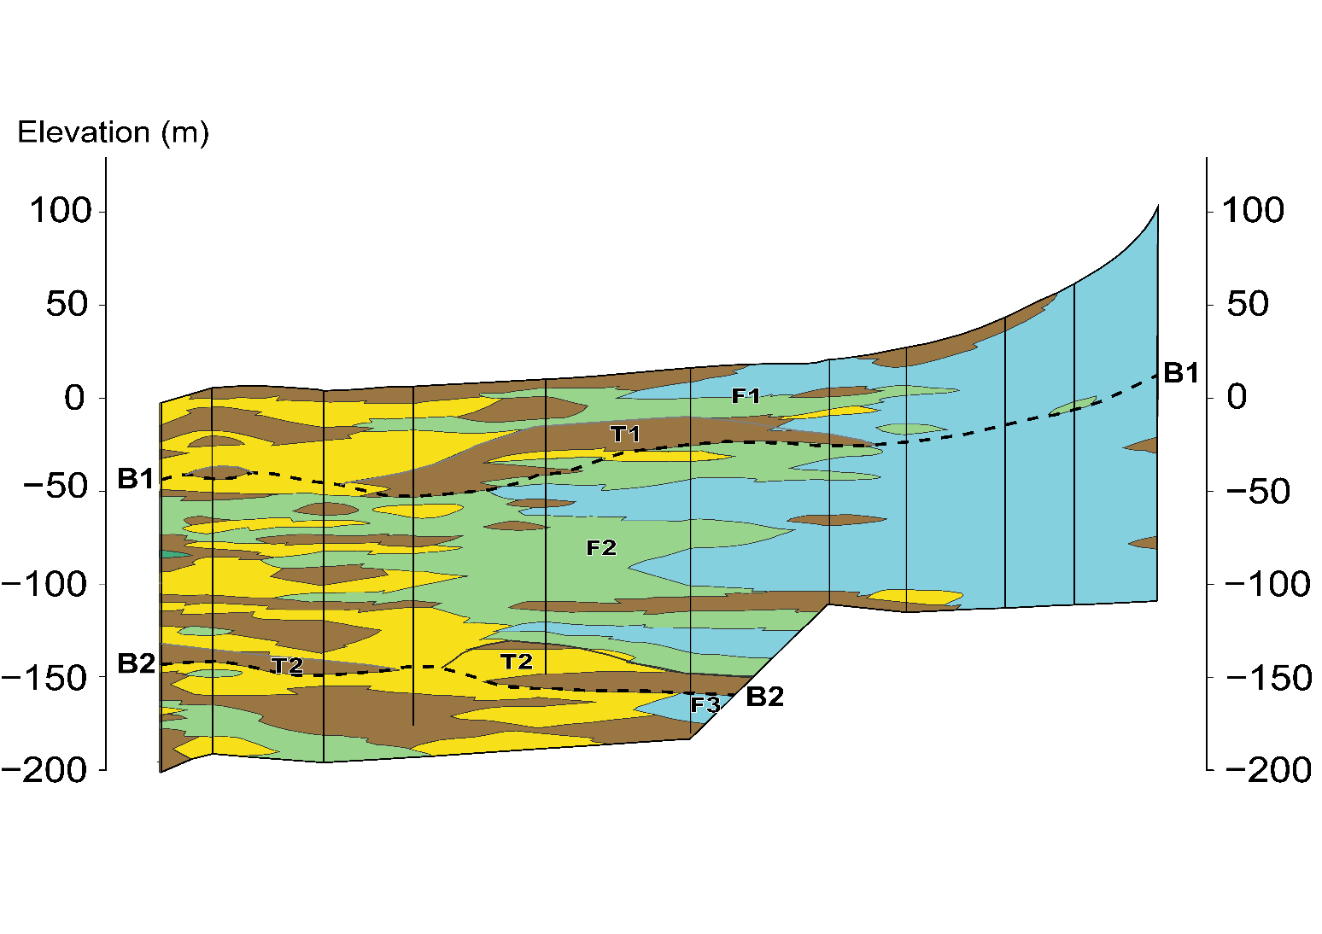
CHUKOU
WUTU
CITONG
FENGRONG
LIUHE
GANGHOU
XILUO
HAIFENG
JIULONG
HOUAN
XINGHUA
A’
A

