Slide 1
Agenda
Introducing 5 different problems with complex solutions
Without coroutines
With coroutines
What is a coroutine?
How C++ implements the coroutine pattern
Many variations are possible; we will review some common ones.

Slide 2
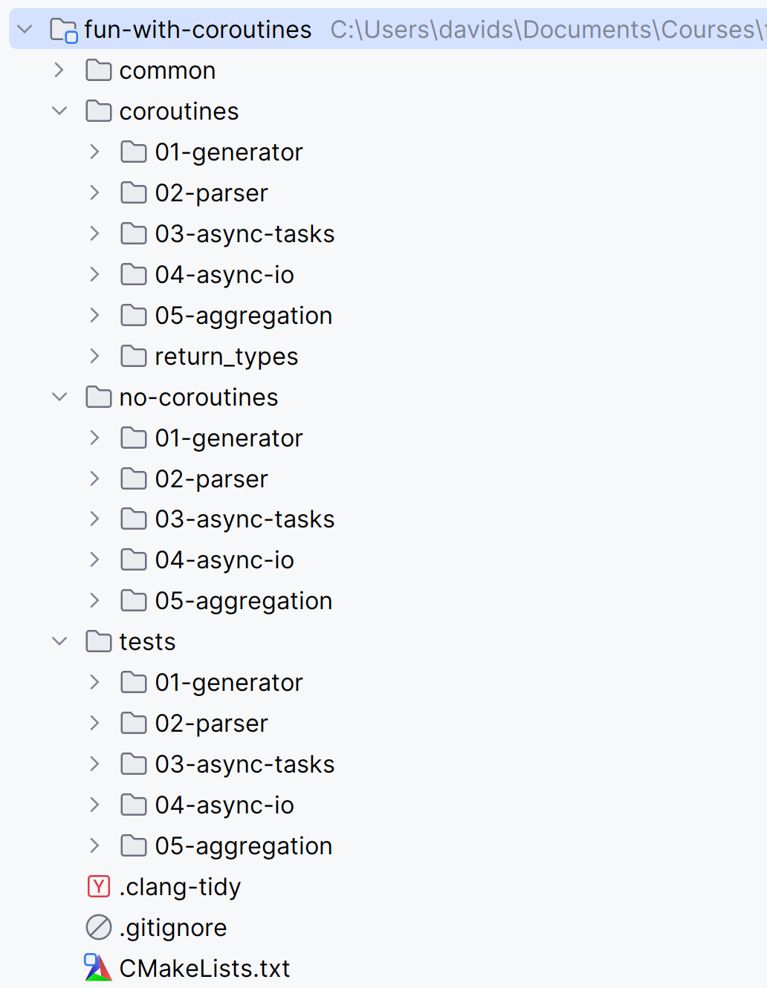
Overview of the repo
5 solutions
Without coroutines
With coroutines
Tests for both

Slide 3
1a. Generators without coroutines
Fibonacci
Needs 5 state fields
Manages a hand-written state machine
Tree DFS
Needs stack, backtracking, and phases
Code is non-intuitive
Note that for convenience, they can both be wrapped in a C++ iterator (GeneratorIterator)
Lesson: Lazy iteration hides real complexity

Slide 4
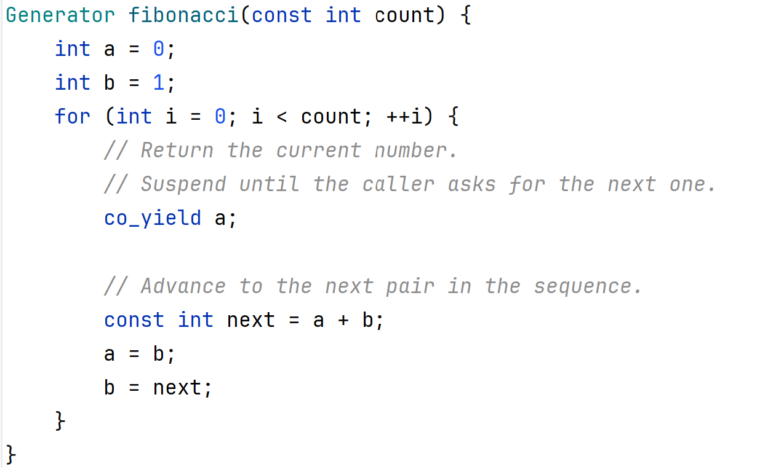
1b. Fibonacci with coroutines

Slide 5
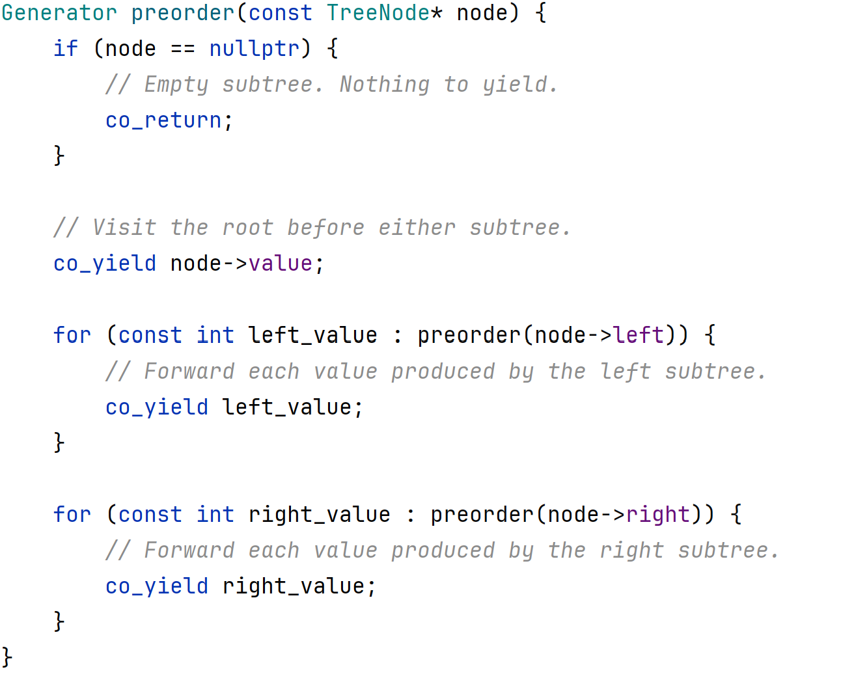
1b. Tree iteration with coroutines

Slide 6
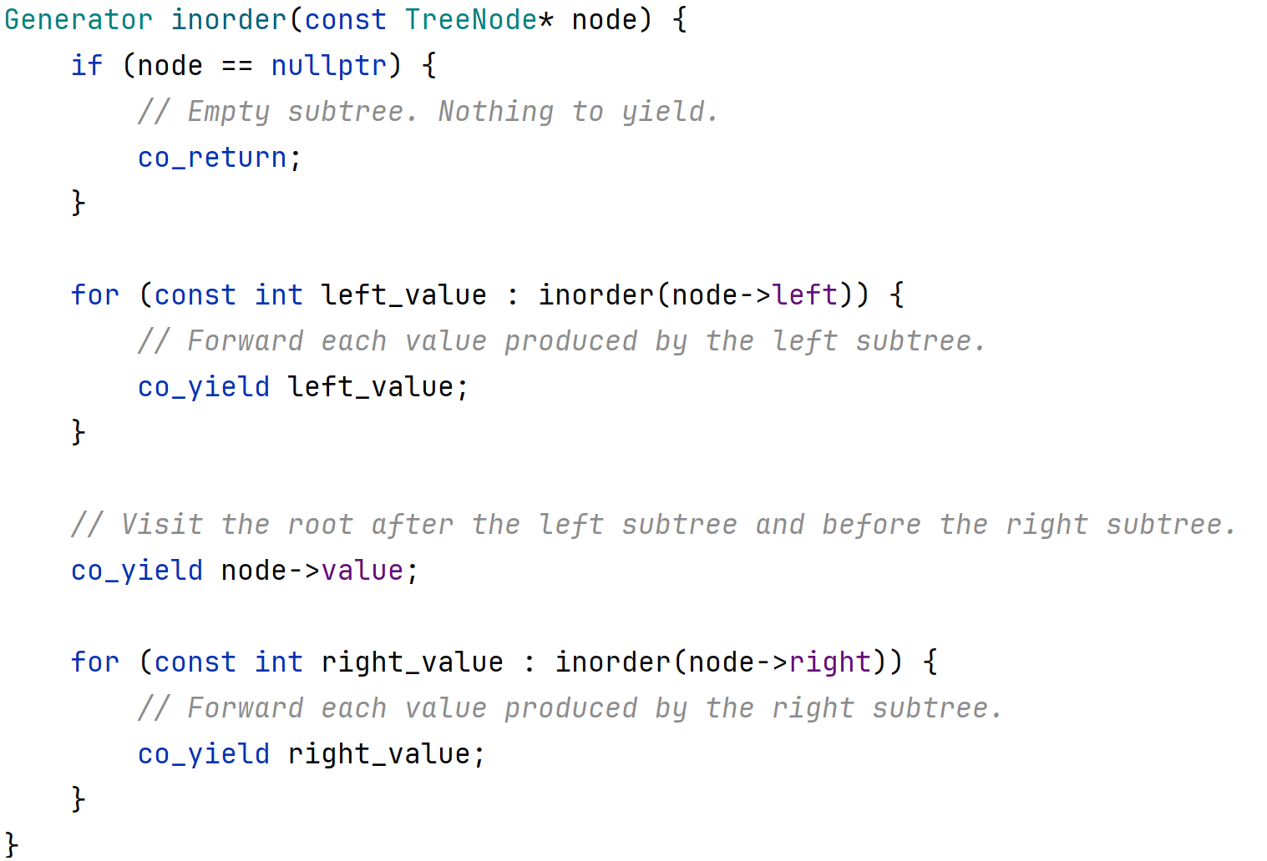
1b. Tree iteration with coroutines

Slide 7
Line protocol for parser
Line-oriented key/value protocol with two commands:
Store a pair:
SET <key> <value>
Print the value
GET <key>
Example (parser::script_lines): SET name Alice -> OK GET name -> Alice SET age 30 -> OK GET age -> 30

Slide 8
2a. Parser without coroutines
Line protocol arrives in arbitrary chunk sizes
Parser must buffer, split, and resume parsing
Callback requires switches and offset tracking
Each partial read updates continuation logic
Lesson: streaming is a reentrance problem

Slide 9
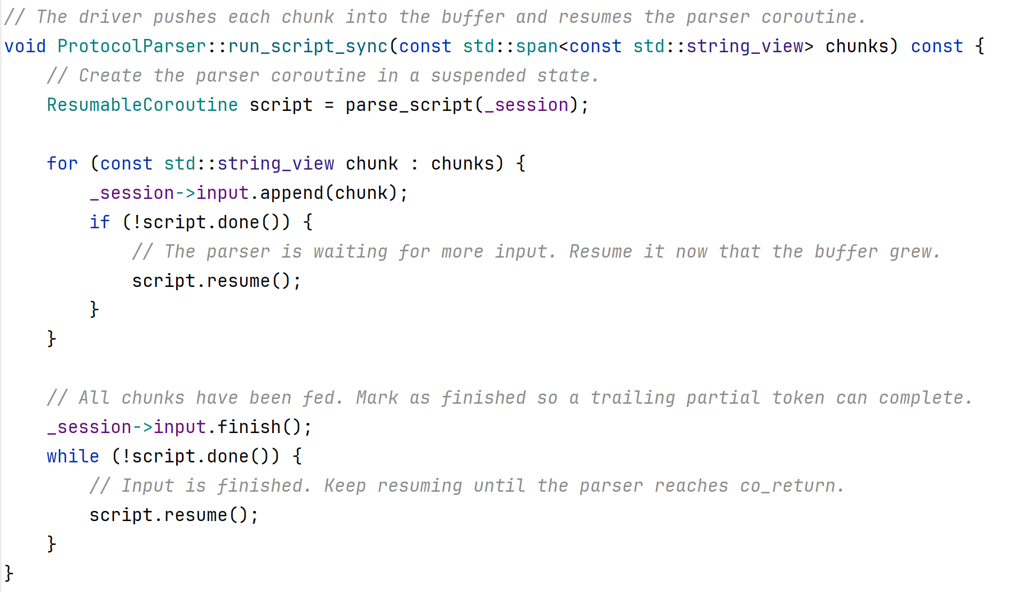
2b. Parser with coroutines

Slide 10
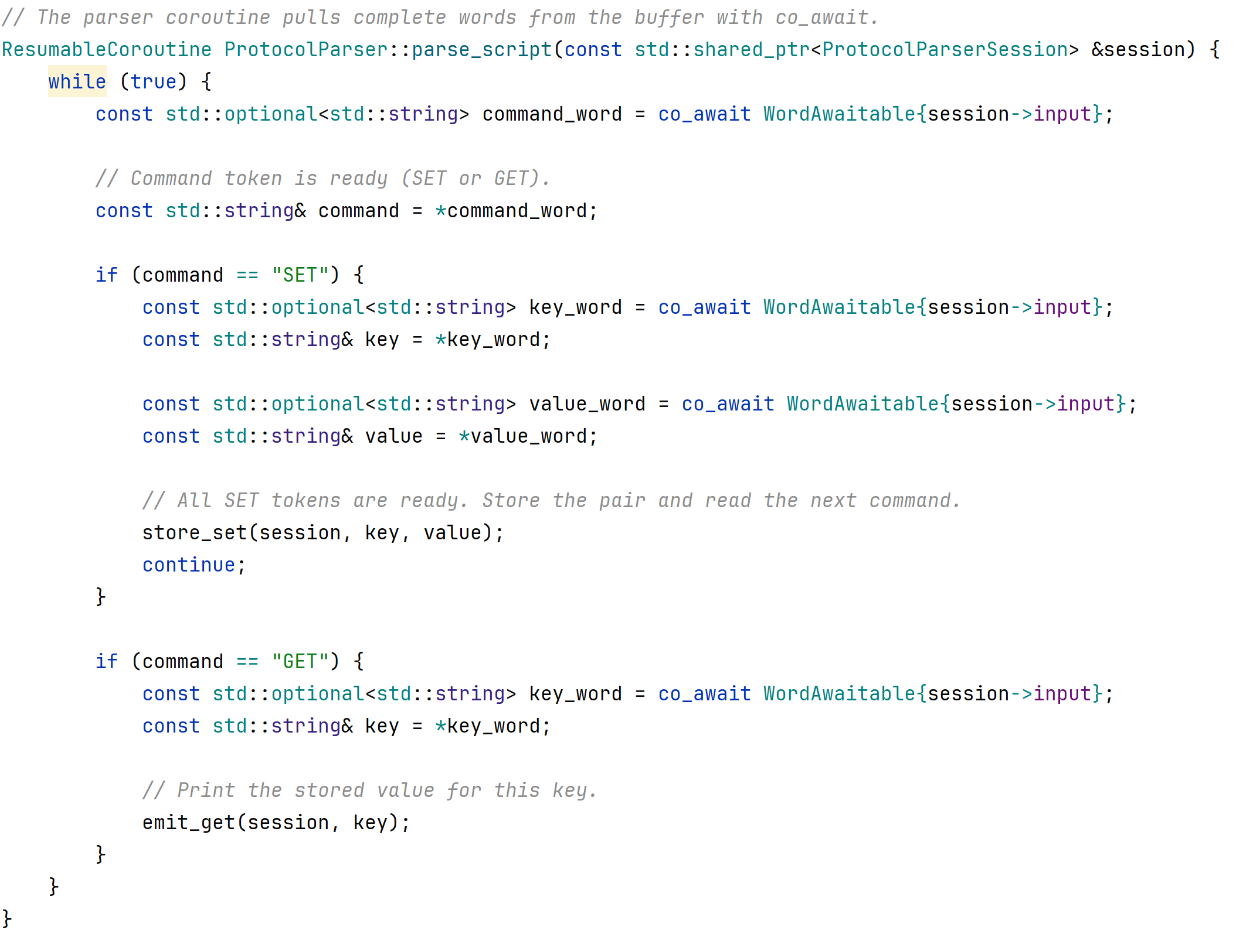
2b. Parser with coroutines

Slide 11
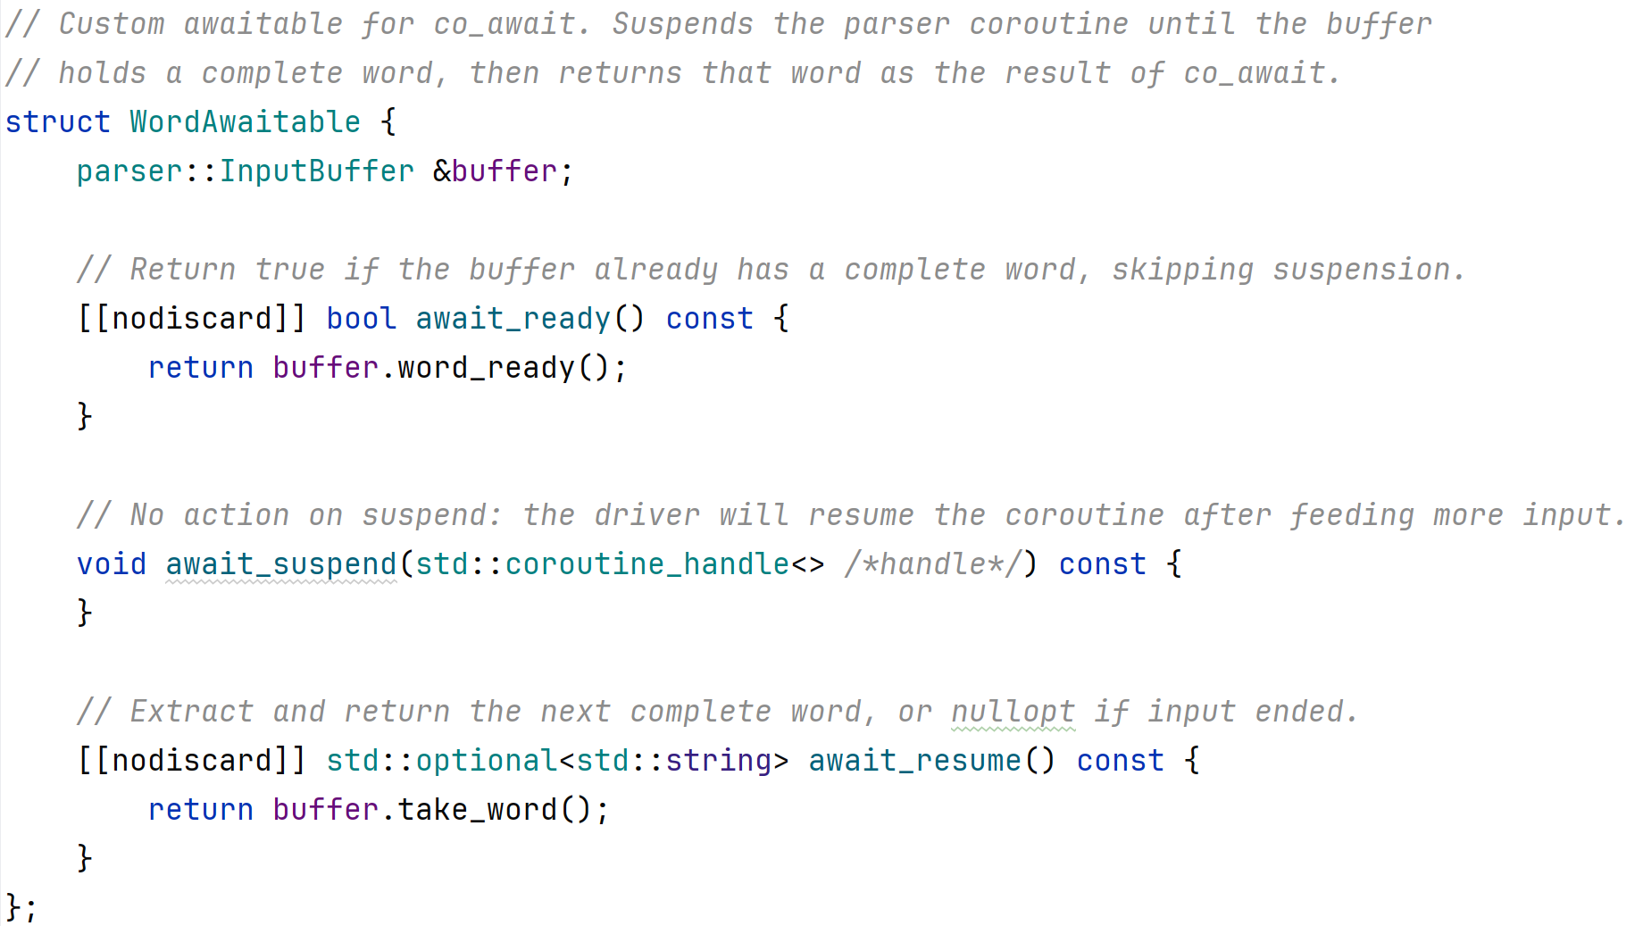
2b. Parser with coroutines

Slide 12
3a. Async Task without coroutines
Three steps with one-second delays between them
Callbacks nest - pyramid shape, hard to read
Each step needs a lambda and a continuation
Unmarshalled path resumes on the worker thread
Lesson: async composition fights linear thinking

Slide 13
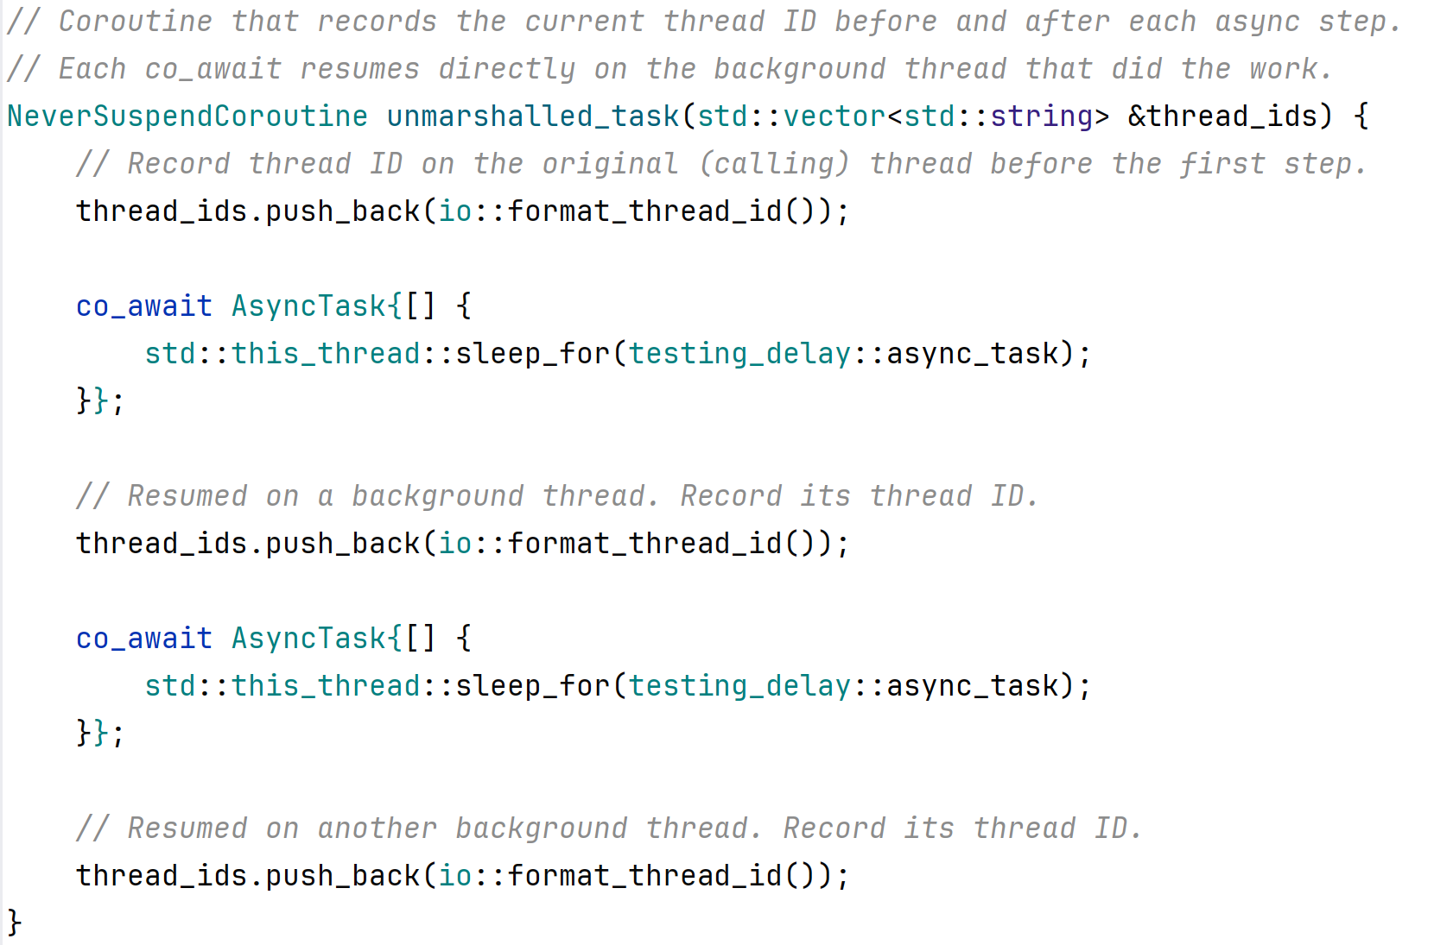
3b. Async Task with coroutines

Slide 14
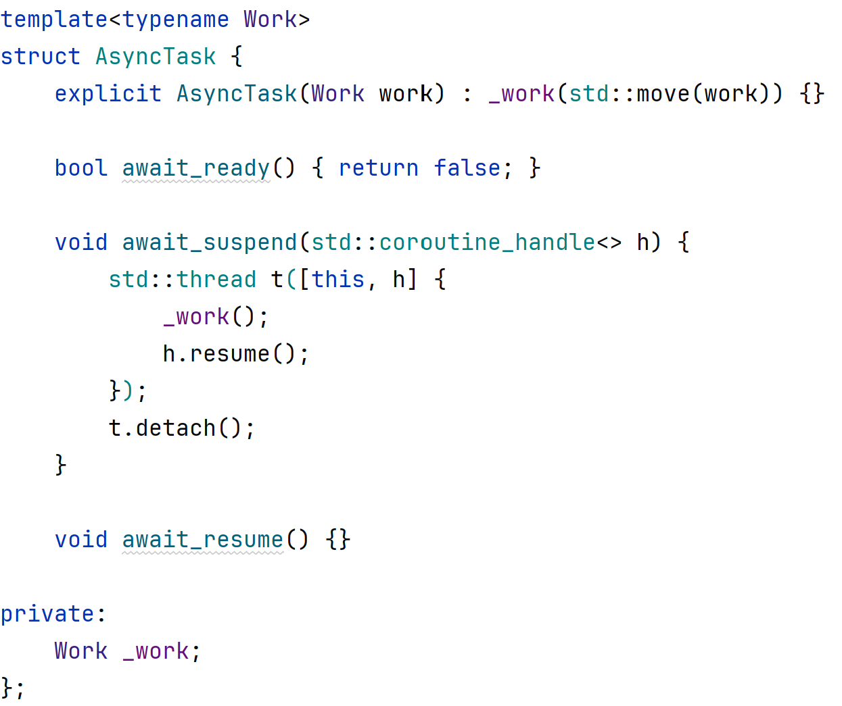
3b. Async Task with coroutines

Slide 15
4a. Async I/O without coroutines
Calculator client reads and writes on pipes
Non-blocking I/O means EAGAIN and partial transfers
Handlers chain: on_read, on_write, on_complete
shared_ptr offsets and self-recursive std::function
Lesson: reactor code becomes a state machine explosion

Slide 16
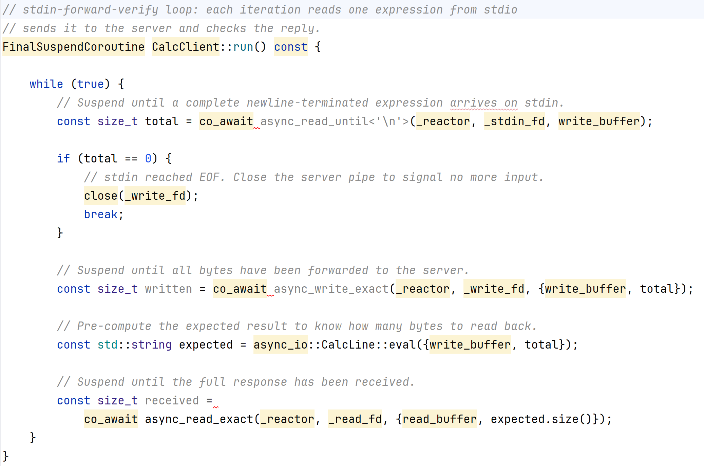
4b. Async I/O with coroutines: Client

Slide 17
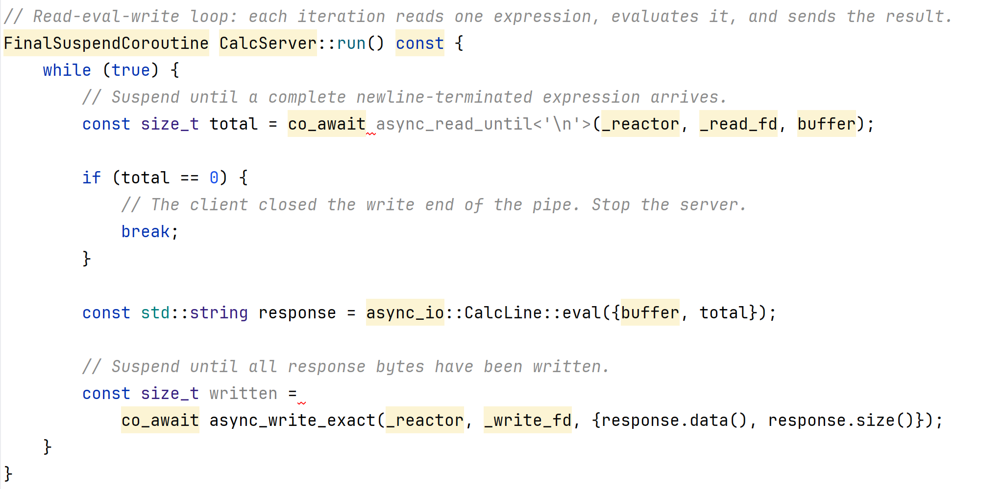
4b. Async I/O with coroutines: Server

Slide 18
5a. Aggregation without coroutines
Parse store, sum ages, return an integer result
Multiple async hops must compose into one value
Callback version threads state through each layer
Batch paths duplicate the same wiring pattern
Lesson: returning values multiplies callback pain

Slide 19
5b. Aggregation with coroutines
co_return delivers the final integer sum
Task<int> holds lazy start and final value
Async aggregate composes without callback threading
Batch calculator reuses the same Task pattern
Return type: Task - always / always plus value

Slide 20
Without coroutines
Five different application shapes
Same underlying difficulty: leave and return
State scattered across classes, enums, lambdas
Line count and bug surface grow quickly

Slide 21
With coroutines
Same five demos - coroutines/ tree only now
Read like sequential code - flat control flow
Tests still pass - behavior unchanged
Improvement is structure, not magic runtime
Now we may name what changed
We have not mentioned coroutines yet

Slide 22
With coroutines
Same reactor, event loop, and pipe infrastructure
Coroutines integrate - they do not replace your stack
Improvement comes from compiler-managed frames
Every solution still suspends and resumes somehow

Slide 23
How C++ Encapsulates It
C++20 adds three keywords
One language feature - many application shapes
Compiler creates a coroutine frame
promise_type defines the suspend policy using hooks
Return object wraps coroutine_handle for callers

Slide 24
Four Players - One Diagram
Caller drives resume, next, start, or destroy
Return object bridges caller and coroutine frame
Frame stores locals and the current suspend point
Awaitable completes async work and resumes frame
Same diagram fits every demo in this repo

Slide 25
Reentrance - Compare Flows

Slide 26
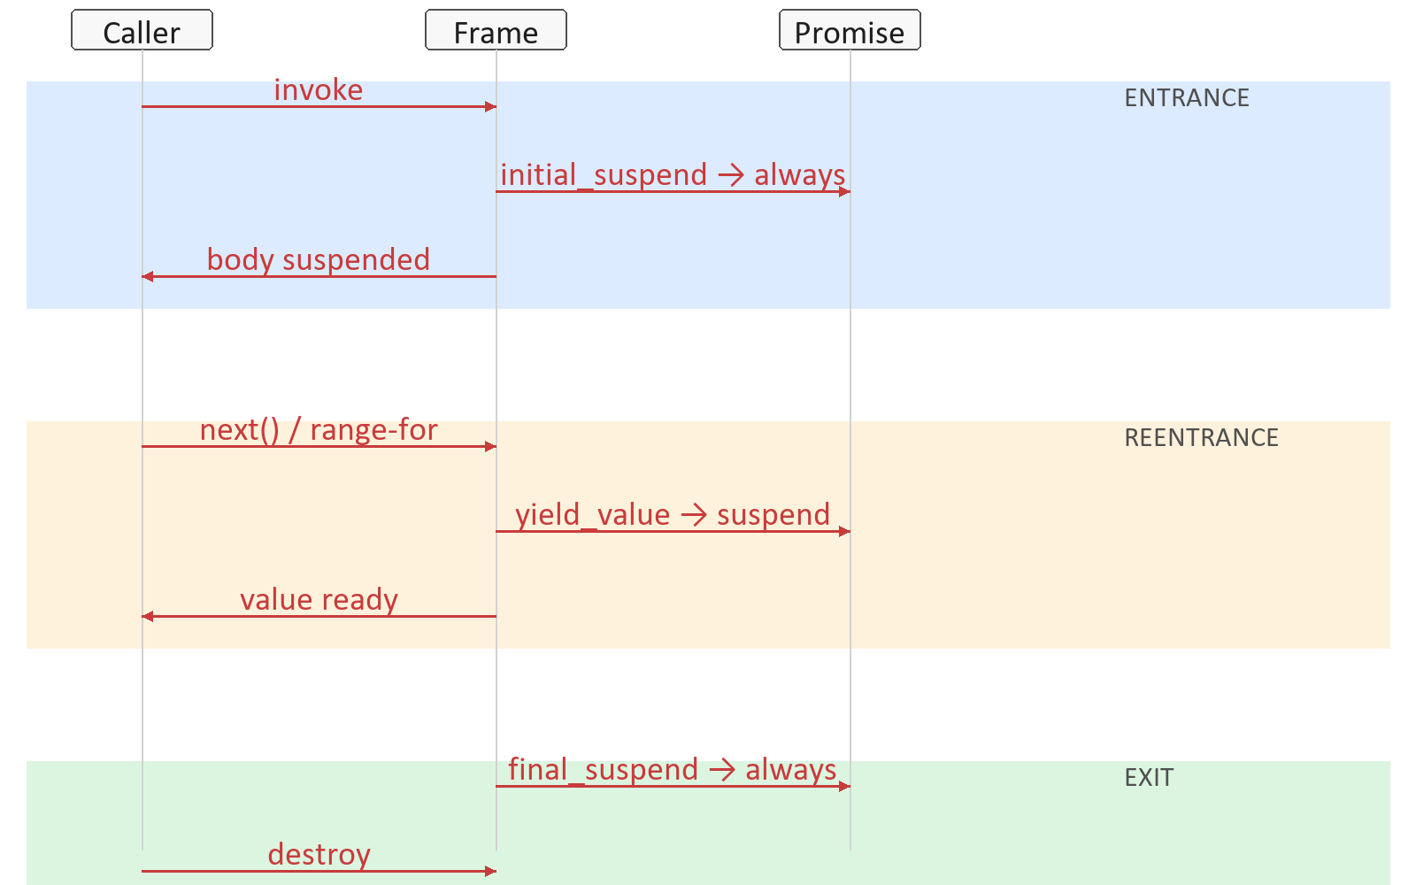
1. Generator Flow
ENTRANCE: lazy - Caller gets Ret first
• REENTRANCE: Caller resumes at each co_yield
• EXIT: frame kept until ~Generator

Slide 27
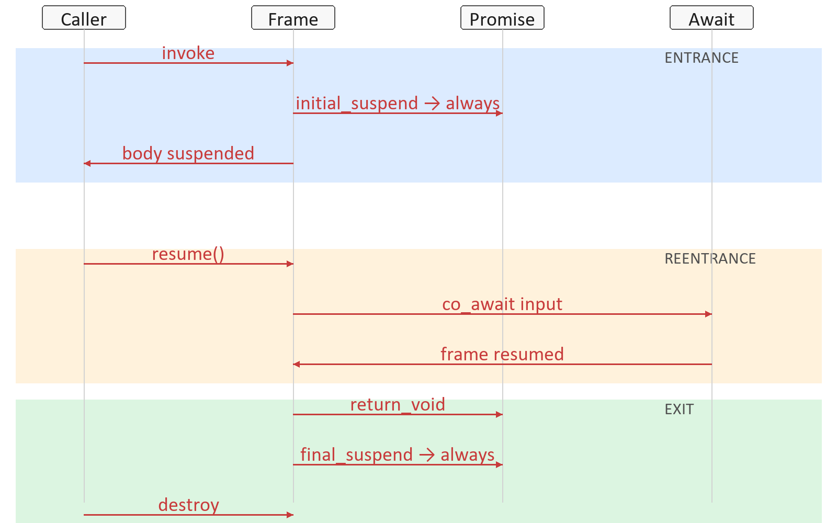
2. ResumableCoroutine<T>
ENTRANCE: lazy - same as Generator
• REENTRANCE: Caller starts; loop resumes awaits
• EXIT: co_return value; get() reads result

Slide 28
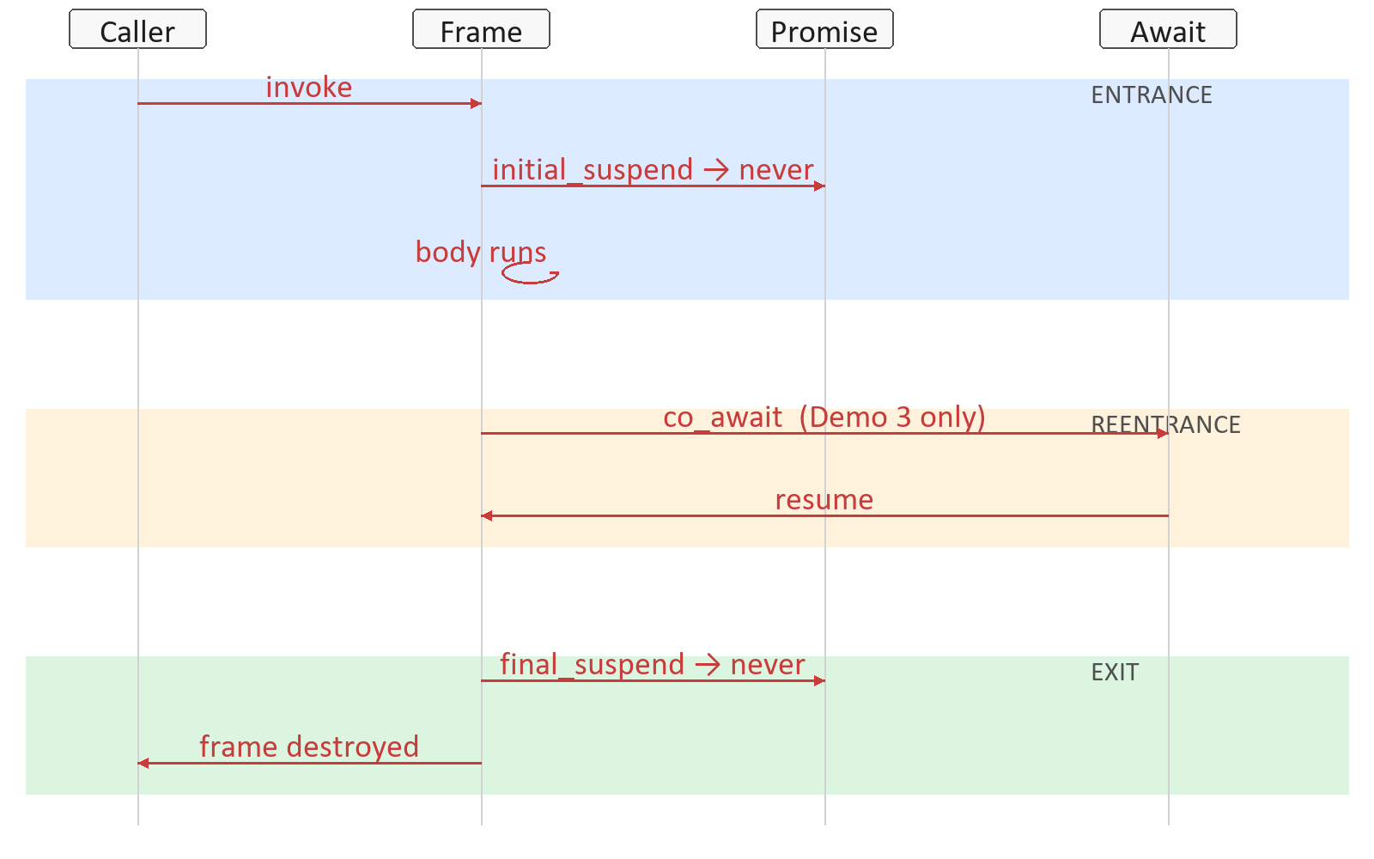
3. NeverSuspendCoroutine Flow
ENTRANCE: eager - body runs on invoke
• REENTRANCE: await resumes frame in Demo 3
• EXIT: frame destroyed at co_return

Slide 29
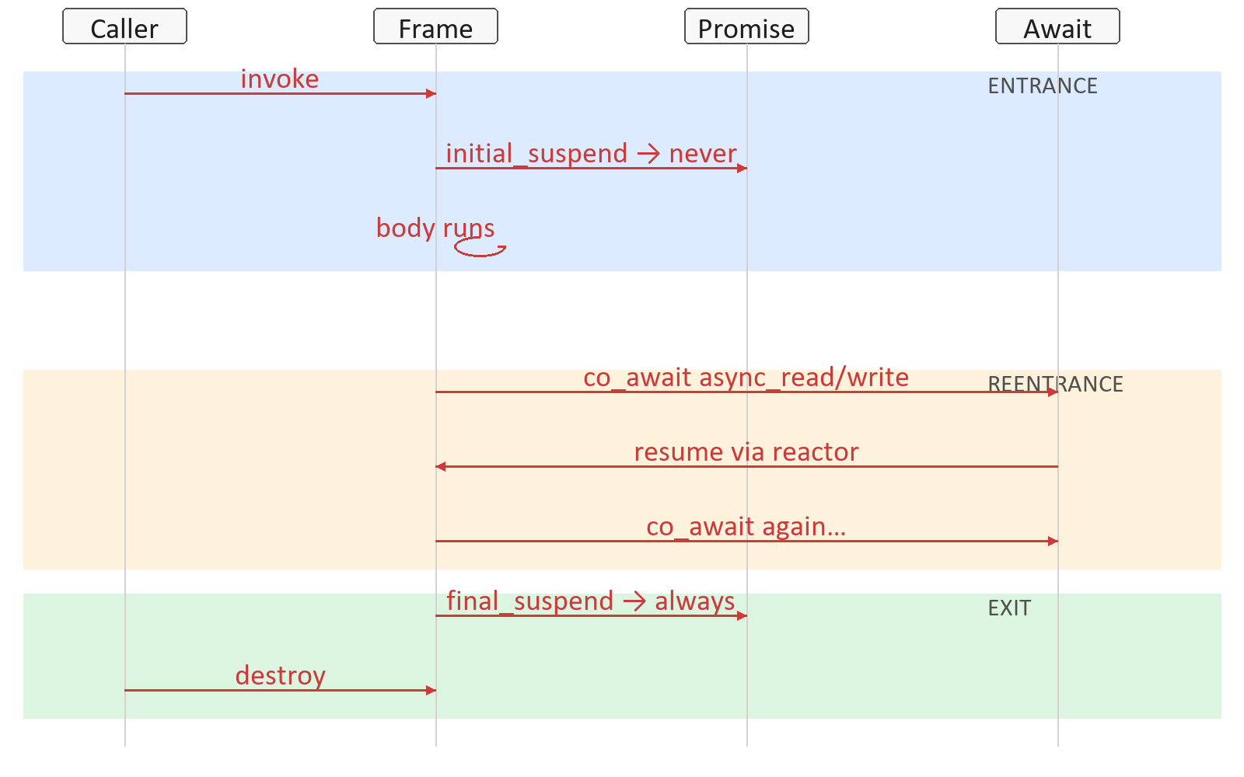
4. FinalSuspendCoroutine Flow
ENTRANCE: eager - like NeverSuspend
• REENTRANCE: reactor resumes each co_await
• EXIT: frame kept - unlike NeverSuspend

Slide 30
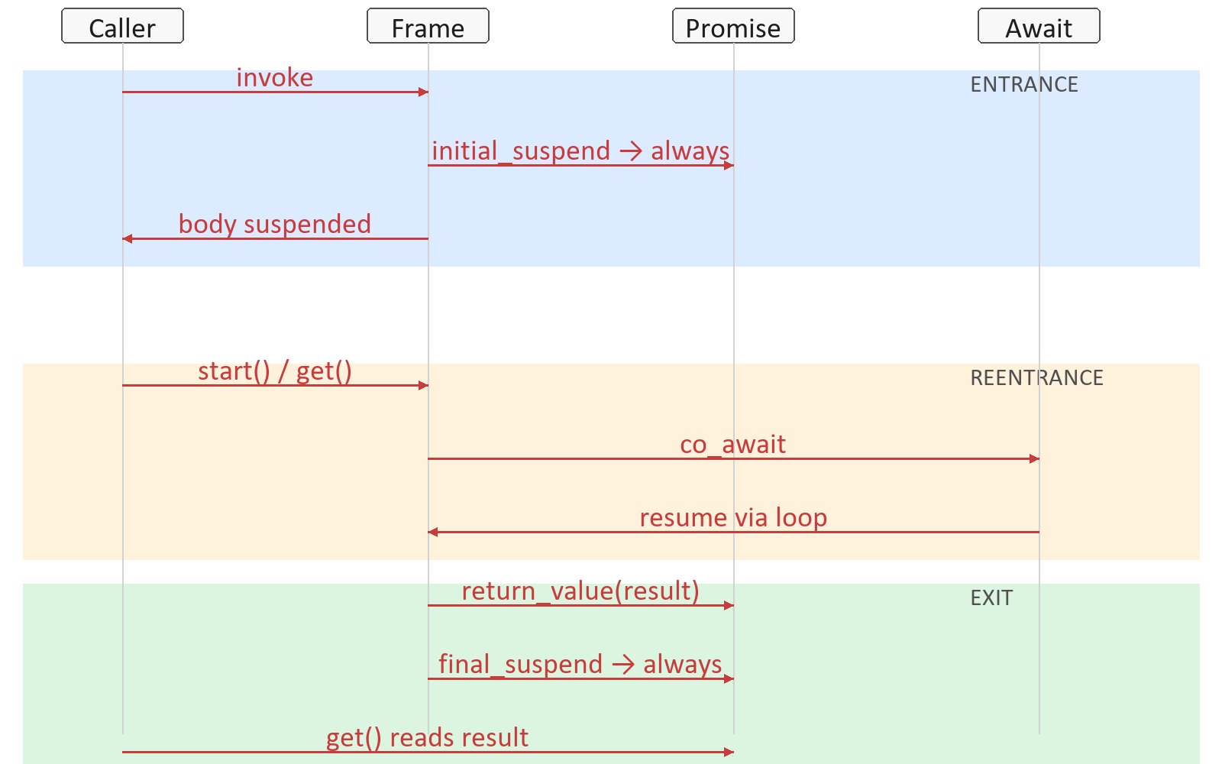
5. Task<T> Flow
ENTRANCE: lazy - same as Generator
• REENTRANCE: Caller starts; loop resumes awaits
• EXIT: co_return value; get() reads result

Slide 31
Reentrance - What Changes
Entrance: lazy always versus eager never
Reentrance: Caller, awaitable, or reactor resumes
Exit: destroy immediately versus keep frame
Demos 3 and 4: same entrance, different exit
One pattern - three policy knobs

Slide 32
Return Types - The Table
NeverSuspendCoroutine - never enter, never pause at end
Generator - lazy enter, co_yield, lazy final suspend
Task<T> - lazy enter, co_return value, lazy end
FinalSuspendCoroutine - eager enter, repeated co_await
All four: promise_type hooks differ, pattern same

Slide 33
Demo To Return Type Map
Demo 1 Generator - yield-driven lazy iteration
Demo 2 Parser - run-through, no mid-body suspend
Demo 3 Async tasks - void eager fire-and-forget
Demo 4 Async I/O - eager start, many await suspends
Demo 5 Aggregation - lazy Task with co_return value

Slide 34
Entrance And Reentrance Patterns
never / never - body runs, frame dies immediately
always / always - caller must start; frame survives end
never / always - starts at call; survives for more awaits
yield_value - reenter to produce next element
return_value - reenter later to read final result

Slide 35
Key Takeaways
Coroutine | A method that can be reentered many times
Requires C++20 | More library support is added in C++23
Write your own? | Usually no, you will use libraries
Overhead | No thread, stack allocation. Just a small heap object

