Slide 1
Agenda
Code review
Five different problems - with complex solutions.
The benefits of coroutines in each case
What is a coroutine?
How C++ implements the coroutine pattern
Applying coroutines to each problem
A little implementation detail – but not much
Best practices in development with coroutines

Slide 2
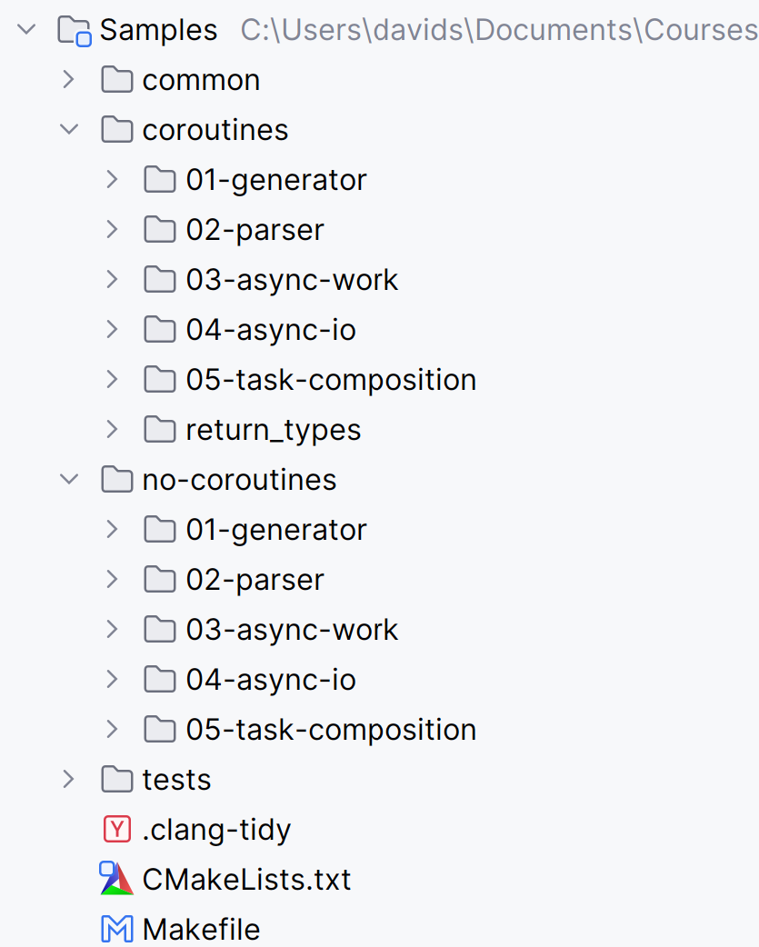
Overview of the repo
5 solutions
Without coroutines
With coroutines
Tests for both

Slide 3
1. The Generator Problem
Produces a sequence of values lazily.
Values are generated only when requested.
Preserves internal state between requests.
Elements do not need to be stored in memory.
The sequence may be finite or infinite.
Efficient processing of large or streaming data.

Slide 4
Generators without coroutines
Fibonacci
Needs 5 state fields
Requires a hand-written state machine
Tree DFS (inorder and preorder)
Needs a stack, backtracking, and a state
Code is long or split across multiple handlers

Slide 5
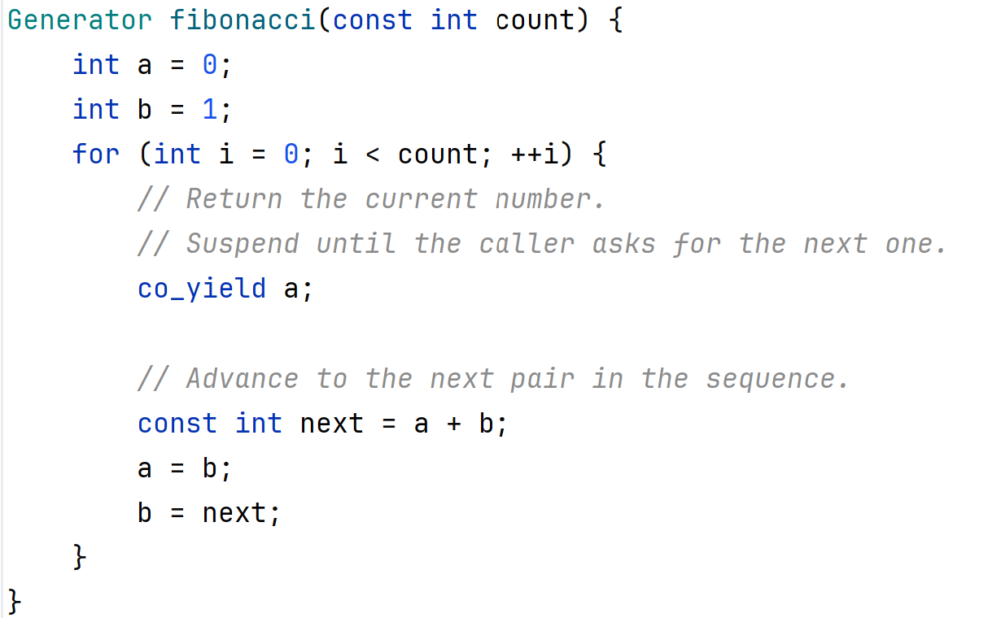
Fibonacci with coroutines

Slide 6
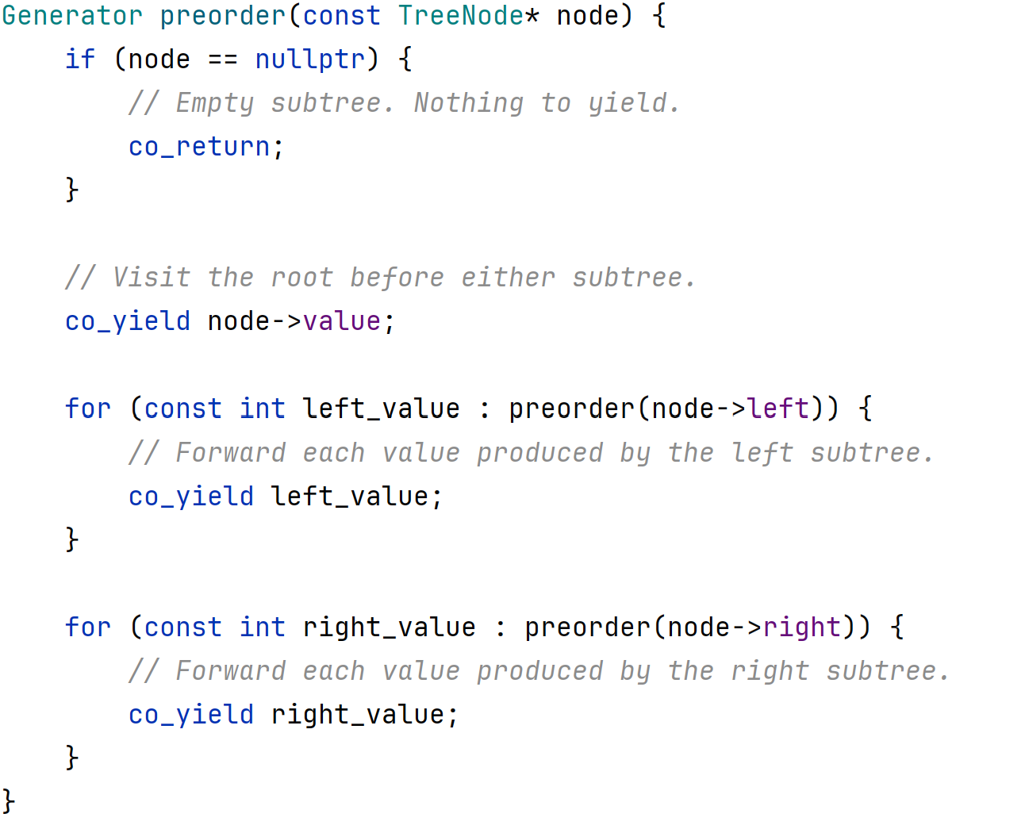
Tree traversal with coroutines

Slide 7
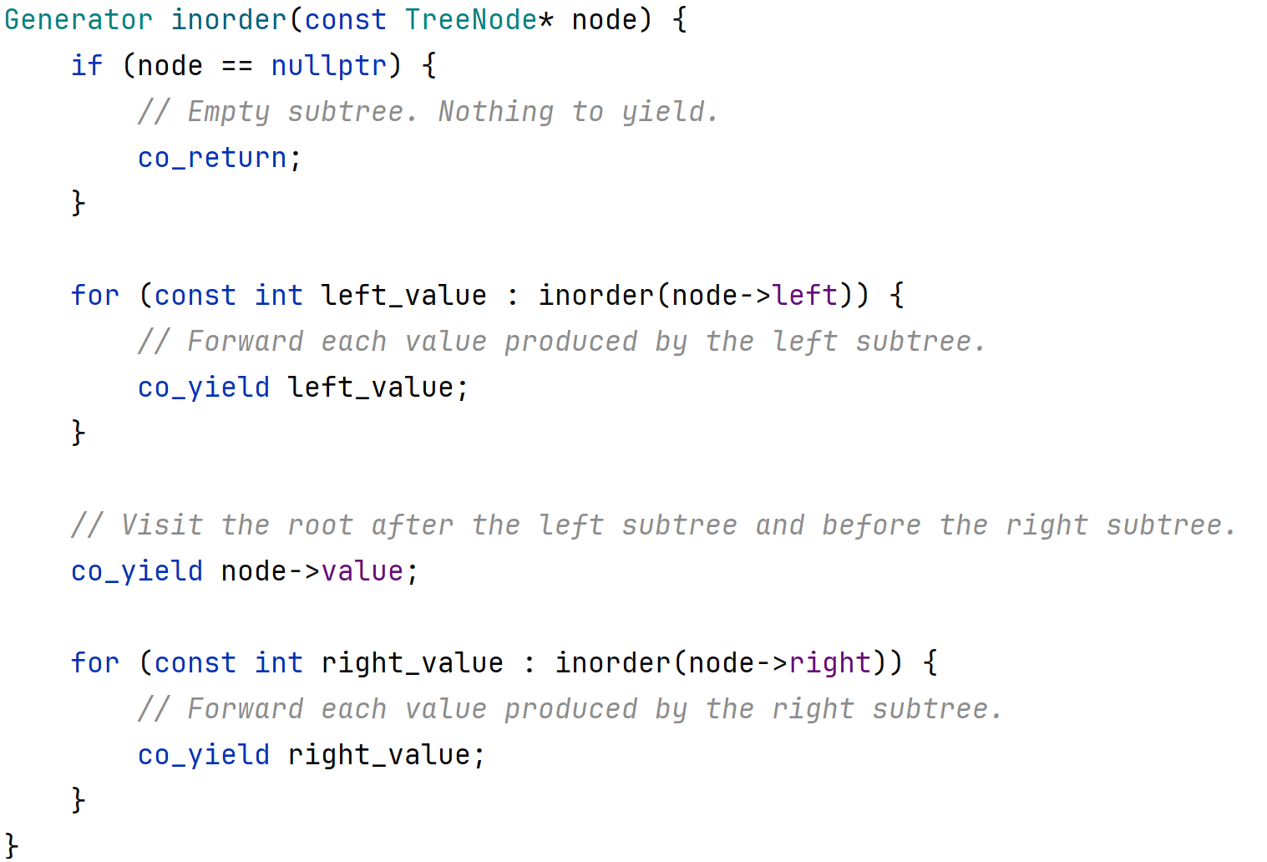
Tree traversal with coroutines

Slide 8
Command Protocol
Line-oriented key/value protocol with two commands:
Store a pair:
SET <key> <value>
Print the value
GET <key>
Example SET name Alice -> OK GET name -> Alice SET age 30 -> OK GET age -> 30

Slide 9
2. The Parser Problem
Parsing a protocol may require handling states and nested states
Pull: It may be straightforward to write a parser that pulls data (for instance from a file)
Push: It is more difficult when the data is pushed from an external source in arbitrary sized chunks.
For example:
Chunk 1: "SET na" Chunk 2: "me Alice\n" Chunk 3: "GET na" Chunk 4: "me\n" Chunk 5: "SET age " Chunk 6: "30\nGET age\n"

Slide 10
Parser without coroutines
Data arrives in arbitrary chunk sizes
Parser must buffer, split, keep track of state.
Methods include switches and offset tracking
Each partial read updates continuation logic
Sometimes nested states need to be tracked:
Which argument are we parsing in the SET command?
What portion of the argument has been received?

Slide 11
Parser with coroutines
We implement two independent flows:
Driver - pushes data in arbitrary sized chunks
Parser - pulls words and handles commands
An InputBuffer sits between the two
It is responsible for word parsing
Accepts arbitrary sized chunks
Returns whether a word is available
If so can be asked to return

Slide 12
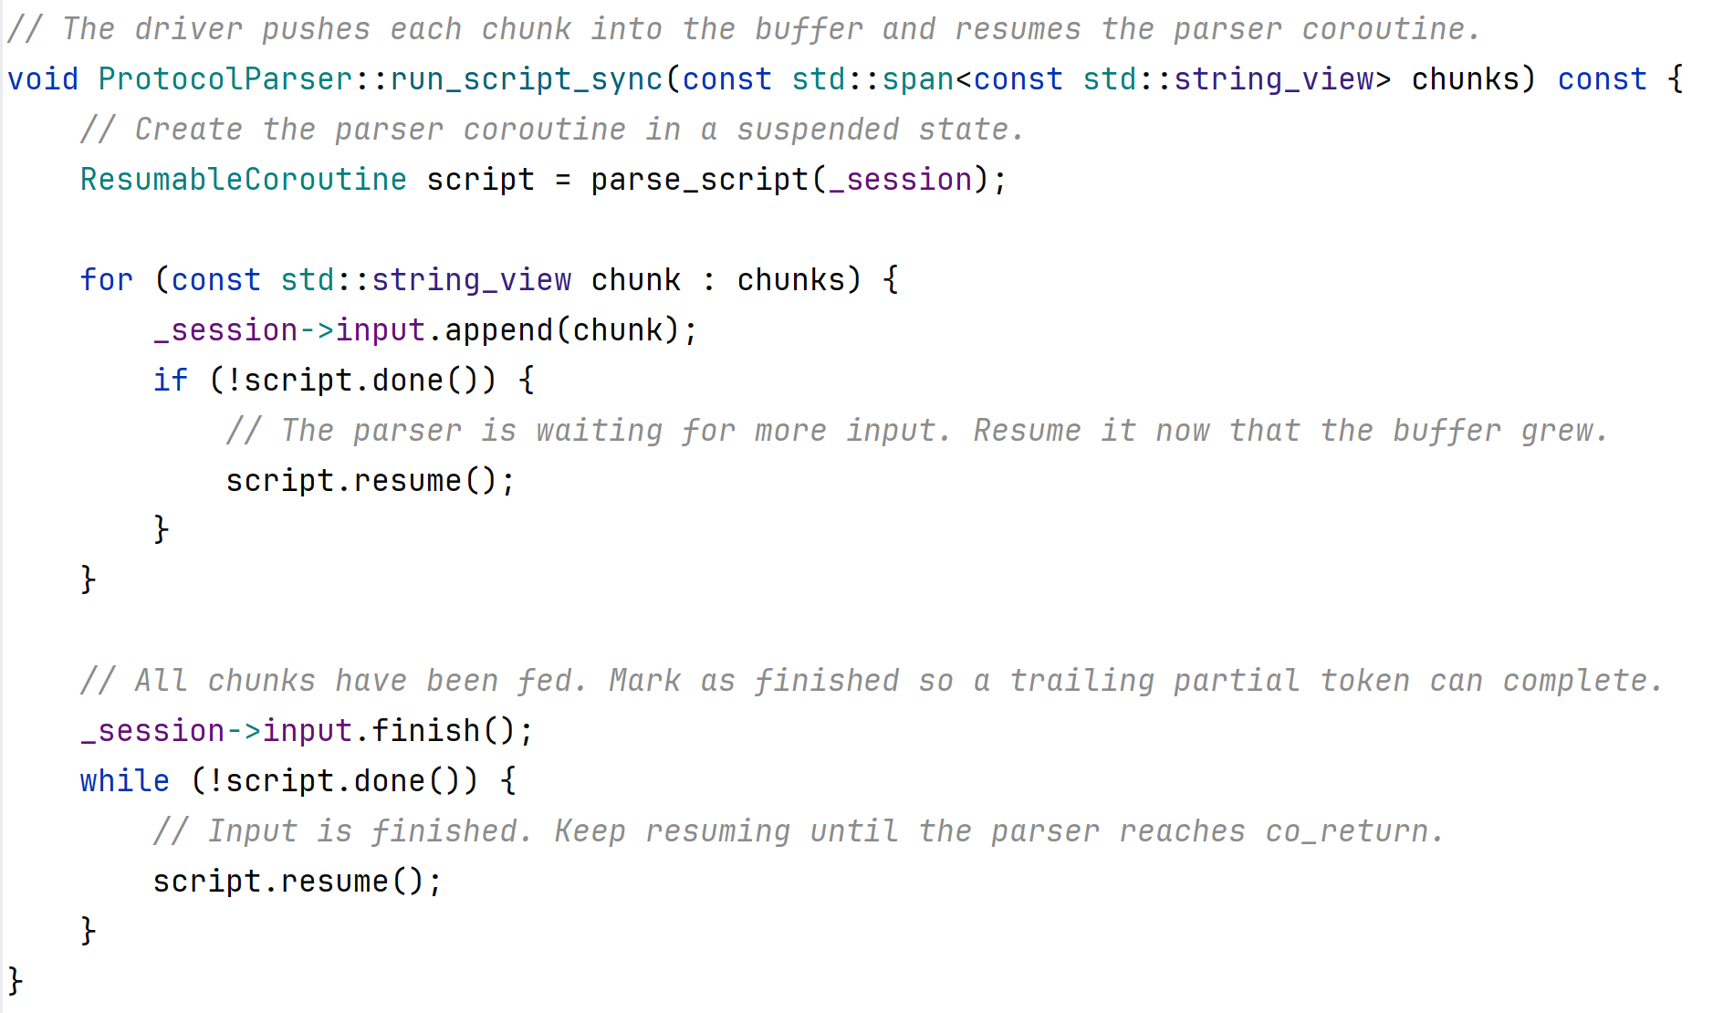
Parser with coroutines

Slide 13
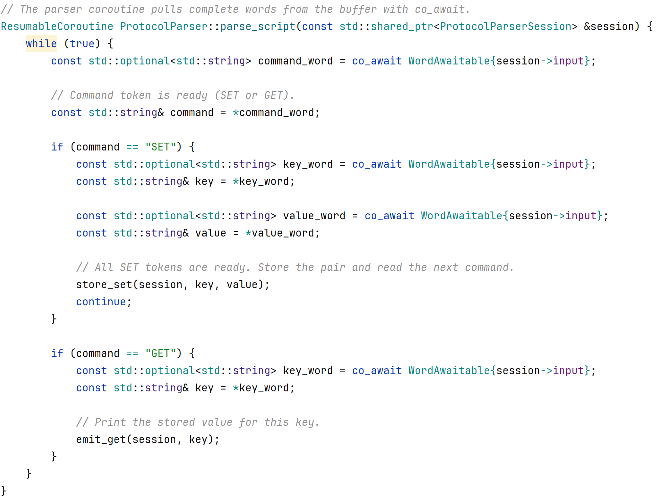
2b. Parser with coroutines

Slide 14
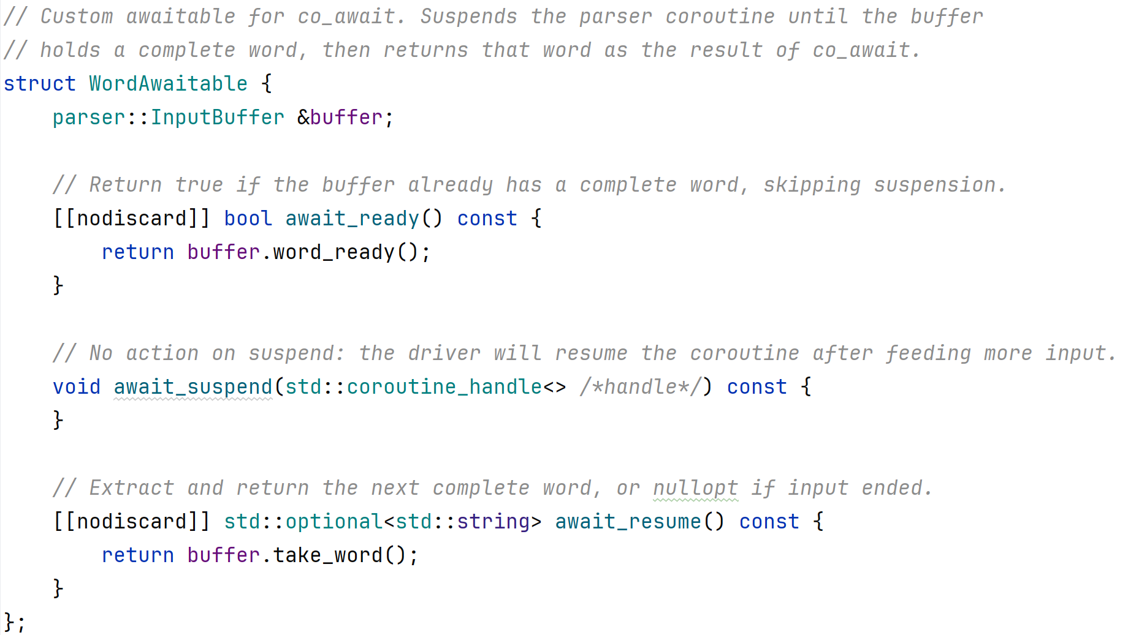
2b. Parser with coroutines

Slide 15
3. The Async Work Problem
Heavy work needs to be offloaded to a thread
We need the result on the calling thread.
Some options
Provide a completion callback
Requires thread synchronization
Post the callback invocation to an event loop
All code runs on the main event loop, no blocking
Callback hell - it is difficult to track flows across callbacks (e.g. for exception handling, debugging)

Slide 16
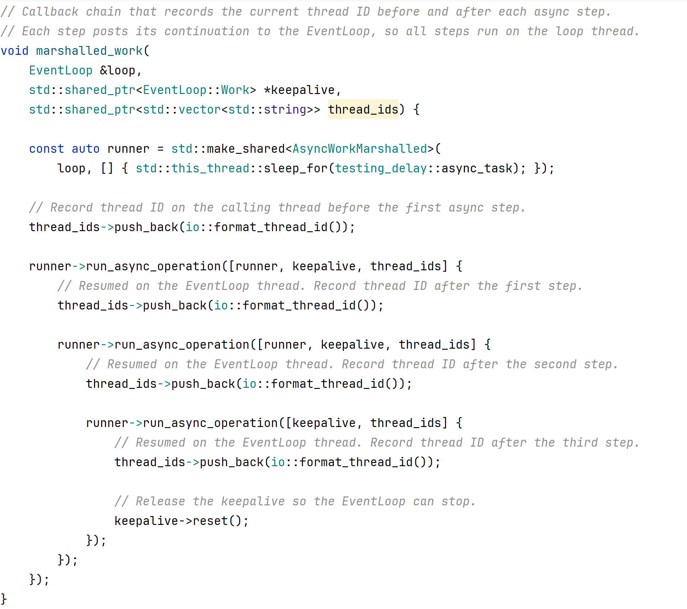

Slide 17
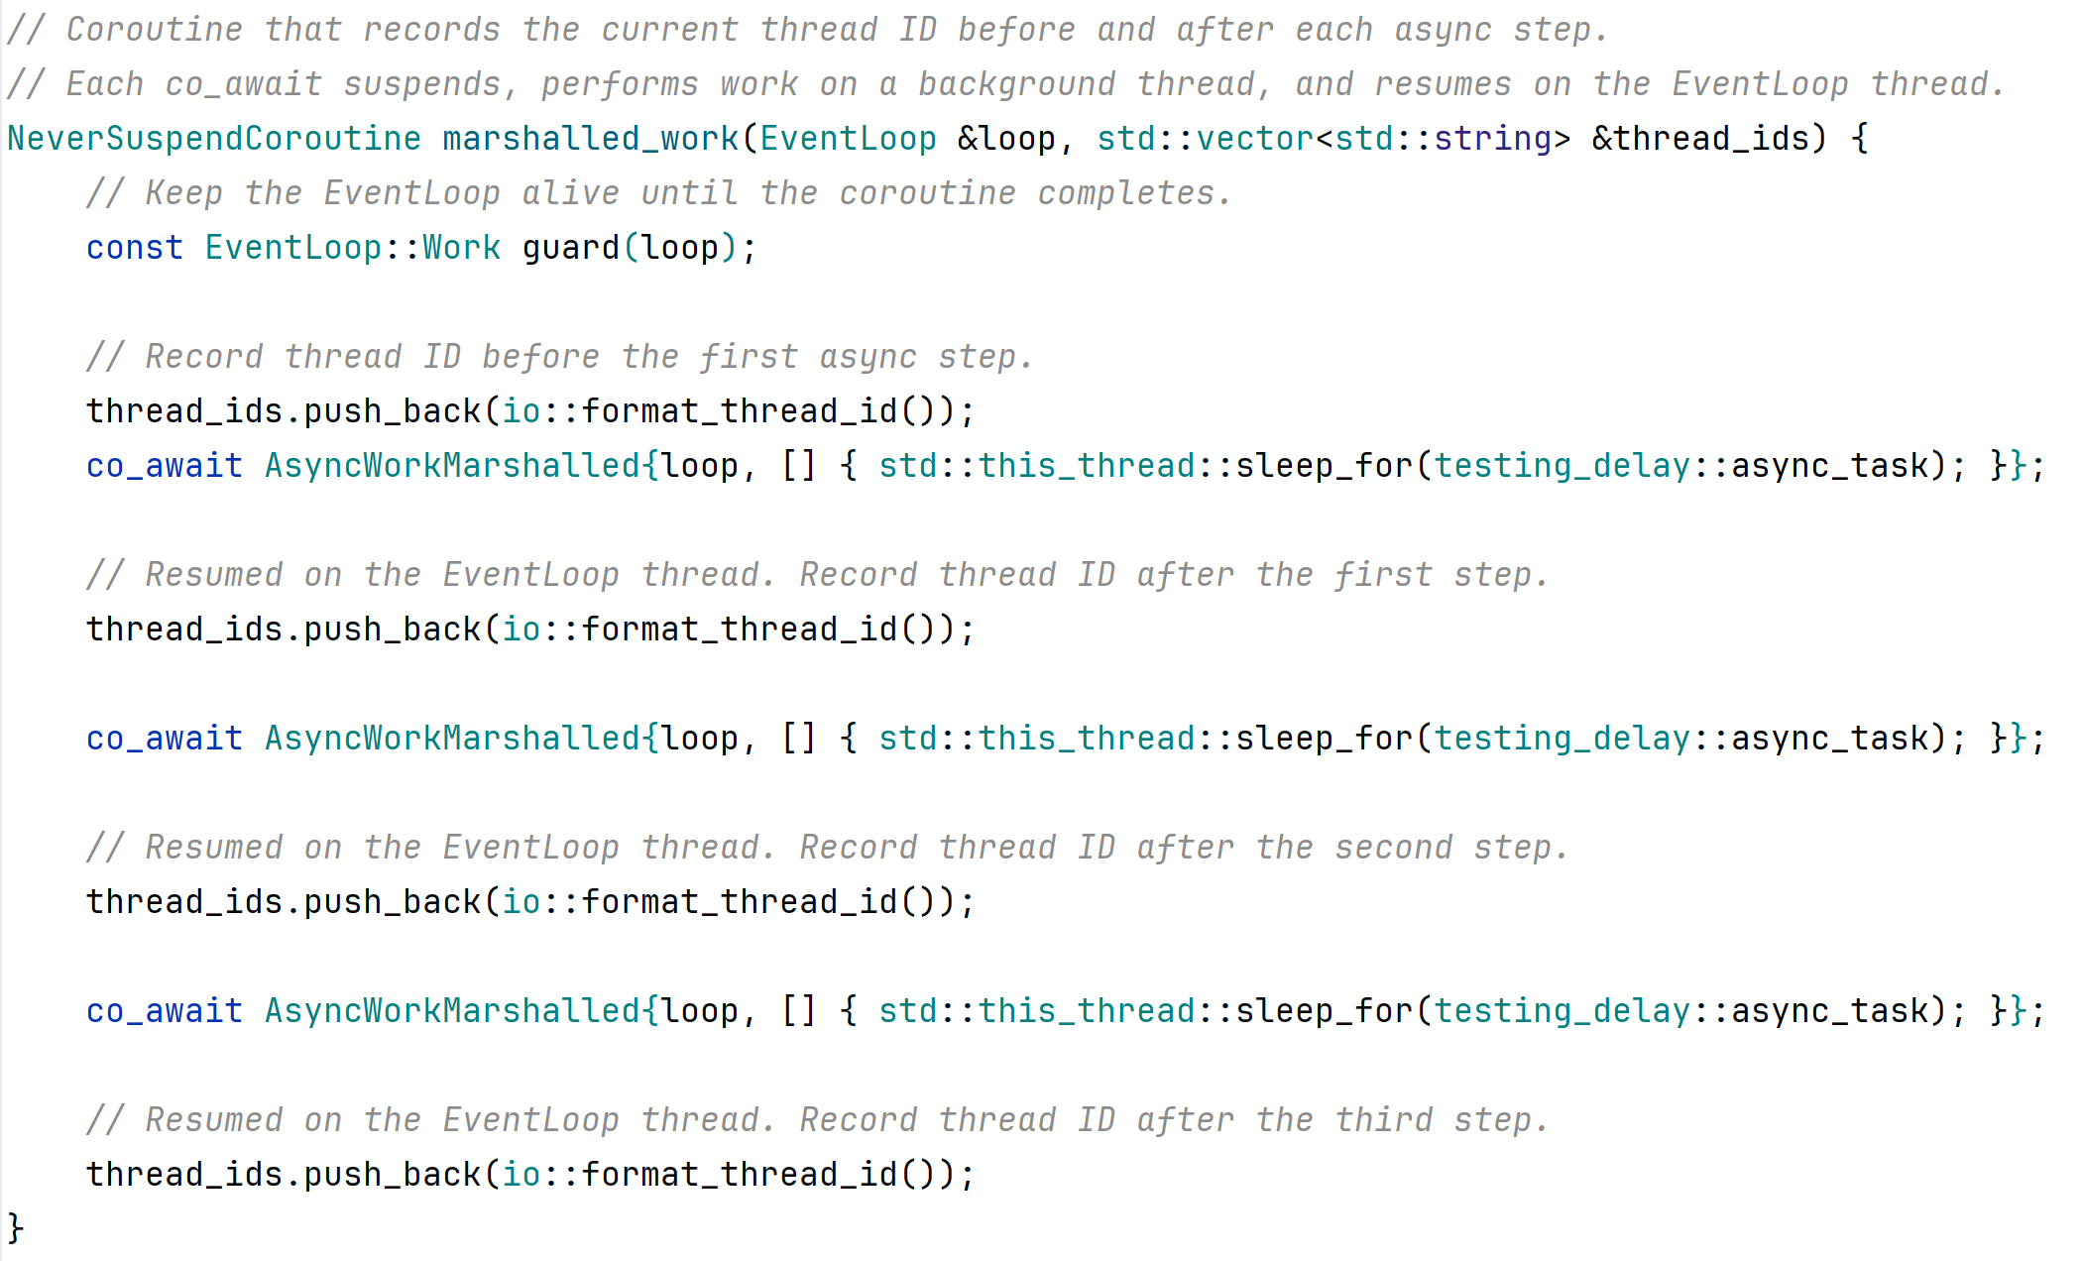
Async Work with coroutines

Slide 18
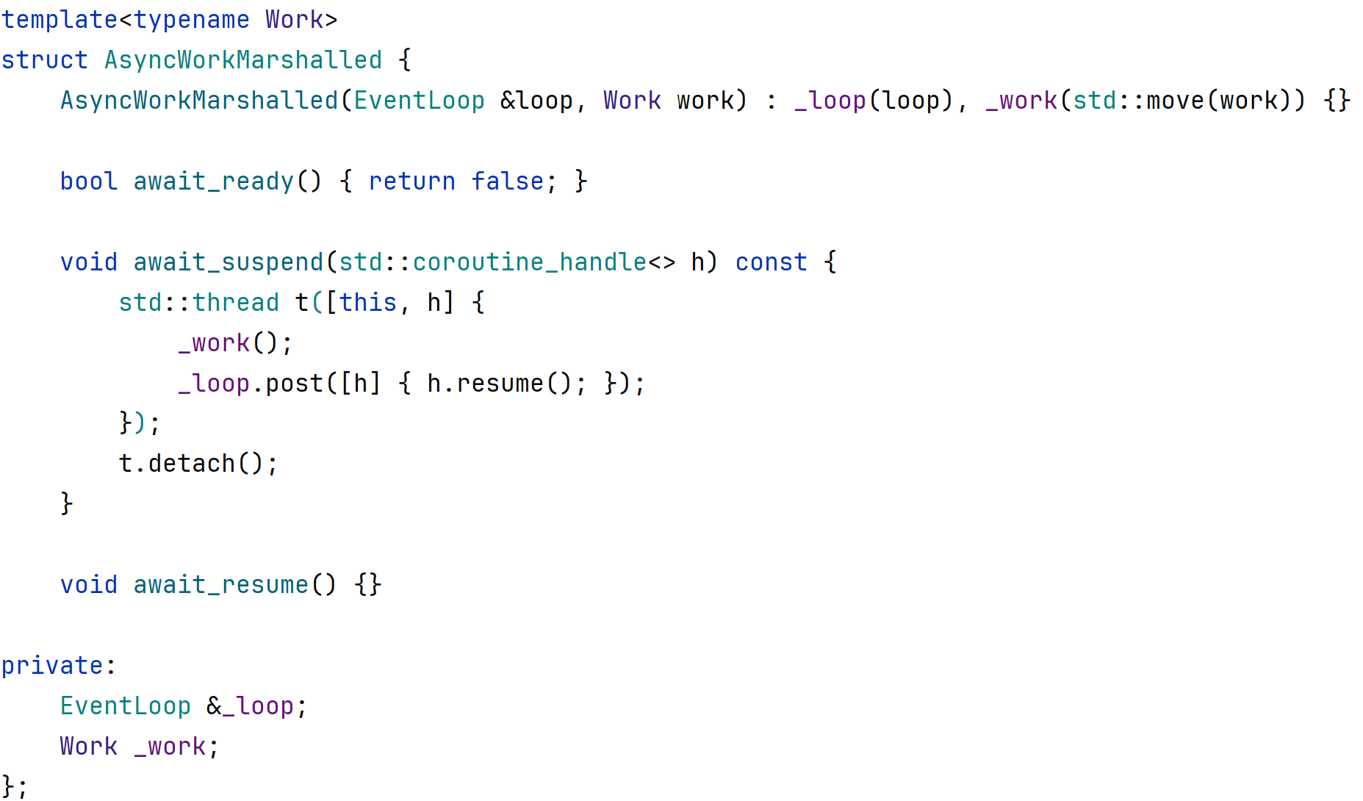
Async Work with coroutines

Slide 19
Sneak Preview: Awaitable
// co_await expr
auto&& awaitable = expr;
if (!awaitable.await_ready()) {
awaitable.await_suspend(coroutine_handle);
// ---- frame suspended ----
// ---- coroutine_handle.resume() called later ----
}
// result of co_await expression
return awaitable.await_resume();

Slide 20
The Reactor Pattern
Efficient handling of non-blocking sockets on a single thread
Callers register a callback for a file descriptor and direction (read or write)
A single thread waits on all registered fds (select / epoll)
When a fd is ready, the reactor dispatches its callback
The callback does its work, then re-registers or registers the next fd to continue the session
All logic runs on one thread — no locks needed

Slide 21
4. The Async I/O Problem
Reads and writes may be partial a single call may transfer fewer bytes than requested
The caller must track an offset and retry until the full message is transferred
A multi-step session (read request → process → write response → repeat) must be broken into separate callbacks
Each callback must save its state in the session so the next callback knows where to continue
State that would be local variables in synchronous code — buffer, offset, session phase - must be kept alive across callbacks (typically via shared_ptr)

Slide 22
Async I/O demo
The server reads line-delimited arithmetic expressions (2+2\n, 10-3\n, …)
It evaluates them, and writes back the result
The client sends expressions and reads responses in a request-response loop
Both sides run concurrently on a single thread via the Reactor
Multiple sessions can run simultaneously, all driven by the same Reactor

Slide 23
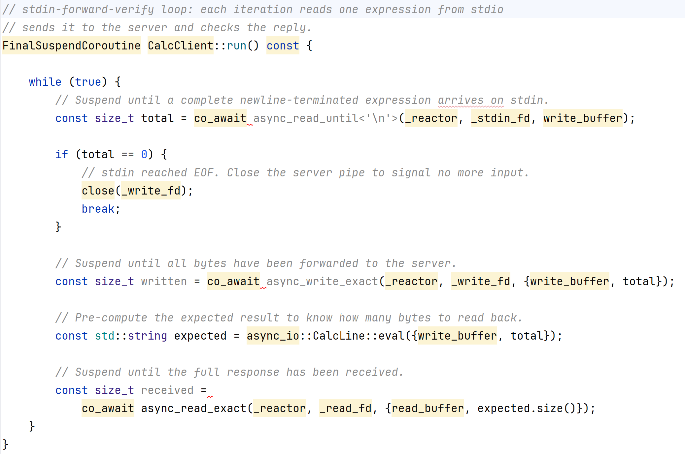
Async I/O with coroutines: Client

Slide 24
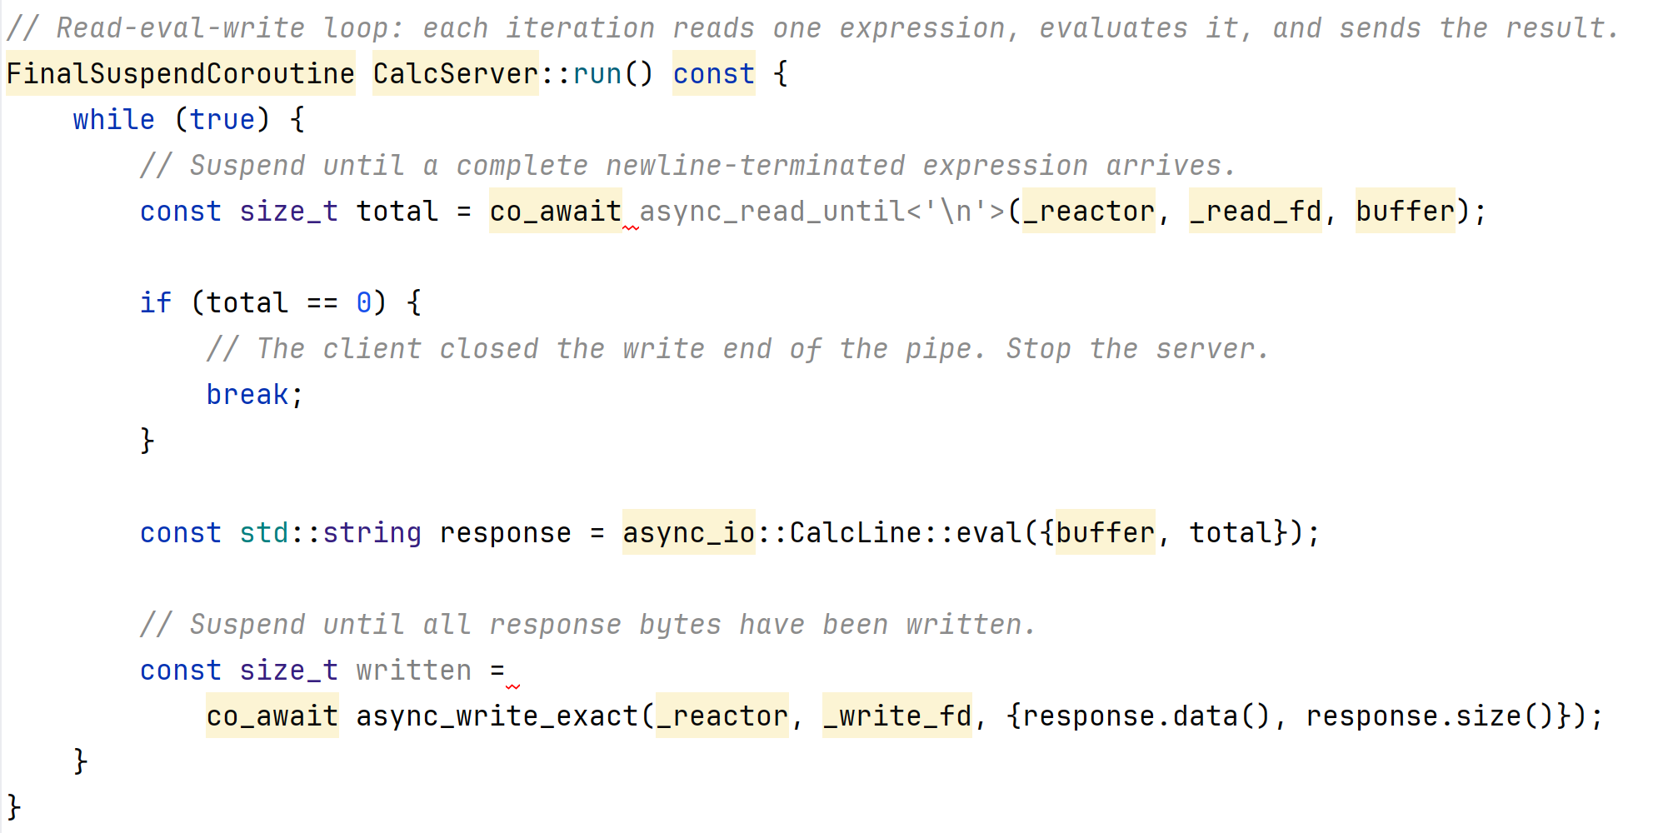
Async I/O with coroutines: Server

Slide 25
4. The Task composition problem
We want to chain async operations and collect a final result
Each step is a continuation of the previous - "when this finishes, do that"
Intermediate state
that would be local variables must be lifted into a shared object kept alive across all callbacks
Error handling
each callback must check for failure and decide whether to propagate - there is no try/catch that spans the whole chain
Reordering
inserting or removing a step means changing which callback calls. The logic is in the wiring making it difficult to maintain.

Slide 26
Task composition demo
SolveQuiz: Building on the Async I/O demo - same reactor, line protocol and CalcServer.
The client has a fixed set of questions and sends them to the server, waiting for a response before sending the next.
The client returns the accumulated answers from all questions.
The new problem: how to accumulate a result across several async steps and return it to synchronous code.

Slide 27
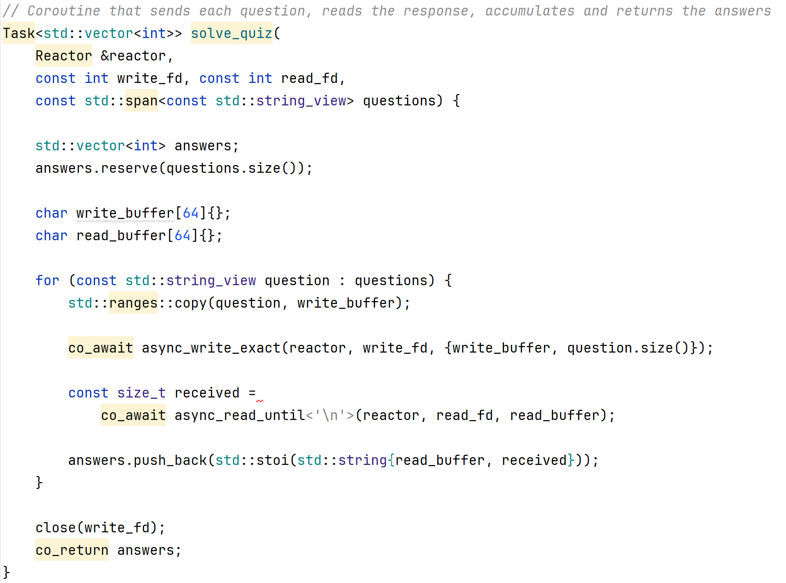
Task composition with coroutines

Slide 28
What is a coroutine?
A function that can suspend and resume later
From the caller's view it leaves and returns many times
Each return is a resume, not a fresh call - state is preserved in the coroutine frame
The compiler rewrites coroutines into a state machine -no threads and no additional stacks are involved
All locals live in a heap-allocated frame that survives suspension.

Slide 29
Coroutines in C++ 20
A function is considered a coroutine by the compiler when all of these hold:
It uses at least one of co_await, co_yield, or co_return
Its return type must have a nested promise_type
The promise_type must have certain methods. These are hooks that determine the behavior of the coroutine.

Slide 30
The promise_type hooks
get_return_object()
Called to build the return object from the frame handle
initial_suspend()
Called to determine lazy start or eager start
final_suspend()
Called to keep frame alive at end, or chain to a continuation
return_void() or return_value(T)
Called at co_return
yield_value(U)
Called at co_yield (Used by generators)
unhandled_exception()
Called if the body throws

Slide 31
Coroutines in practice
C++20 gives the language mechanism.
C++20 does not ship any implementations
C++23 adds std::generator use instead of a custom Generator
Still no standard std::task in C++23.
Tasks and async I/O remain library features

Slide 32
Common Libraries
Asio (boost or standalone)
async I/O, sockets, timers
cppcoro
tasks, generators, event loops
Libunifex
sender/receiver async pipelines
folly::coro
tasks and executors (Facebook)
Qcoro
Qt networking and signals/slots

Slide 33
Problems we addressed
Generator
lazy production of a sequence; state preserved between requests
Parser
push-style input in arbitrary chunks; buffering, splitting, and nested protocol state
Async work
offload heavy work to a thread; get the result back on the calling thread
Async I/O
partial reads/writes and multi-step sessions over non-blocking fds via a reactor
Task composition
chain async steps and accumulate a final result back to synchronous code

Slide 34
Key Takeaways
Five different problems - one underlying difficulty:
leave execution and come back later
Without coroutines:
state machines, callback chains, and shared objects replace what would be local variables and straight-line control flow
With coroutines:
the same logic reads sequentially
Efficiency
The compiler copies the body into a heap frame there is no extra thread stack
Difficult to get right
Do not write your own, use libraries

