Slide 1
Support Bundle Insight
27 Jun 2014
Tao XIE
Lei ZHOU
Sean ZHAO
Chen LI
David SHI

Slide 2
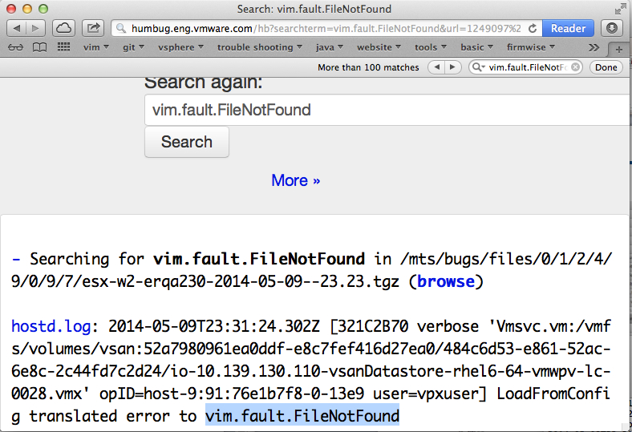
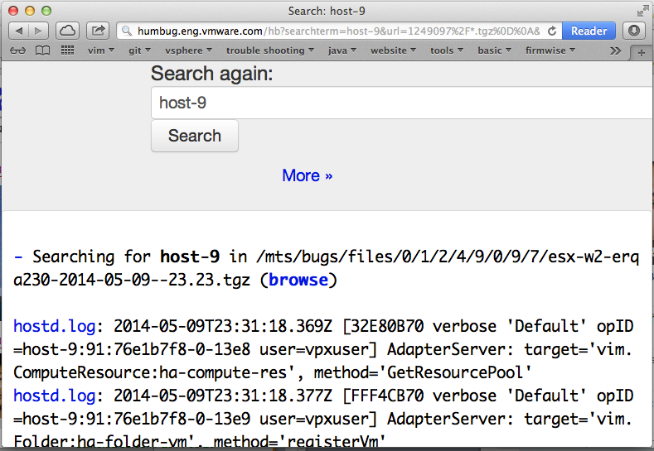
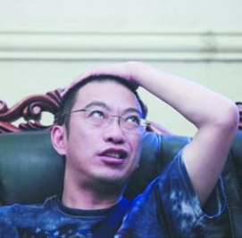
Before we have it…

Slide 3
Support Bundle Insight
Support Bundle Insight doesn’t hurt!

Slide 4
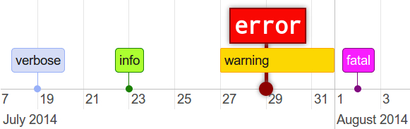


Slide 5
Demo

Slide 6
Architecture
UI
Timeline
Bootstrap
Server
Flask
Codesearch
Engweb
Bugzilla

Slide 7
Future
For QE/DEV engineers
For customer support

Slide 8
Q&A

