Slide 1

Community Health in Appalachian Coal Mining Areas
Prepared for the Journey Up Coal River
August, 2009

Slide 2
Social Disparities and Health
Social position has strong impacts on health
  Education, income, environment
  E.g., Woolf AJPH 2007
These social disparities must be reduced and eliminated
  NIH; Healthy People 2010, 2020
Appalachia has serious social disparities:

Slide 3
Appalachia and the Nation
 | Appalachia | Rest of Nation
% college education* | 13.1 | 17.1
Median household income * | $31,012 | $36,750
Unemployment rate* | 6.0 | 4.6
Poverty rate* | 17.0 | 13.1
* Differences significant at p<.0001.
Area Resource File 2005 data adjusted for age, race/ethnicity and sex

Slide 4
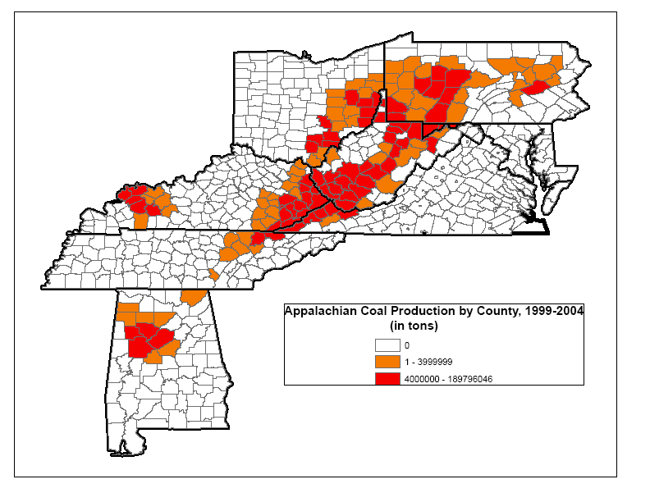

Slide 5
Industry Statements
“It’s frequently noted that “every coal mining job creates another 5 to 8 jobs somewhere in the economy.” Anyone who has ever visited a coal oriented community in West Virginia would have no hesitation in believing that statistic.”
    Friends of Coal, West Virginia Coal Association “Coal Facts 2007” report.
“Within a few years, 10,000 replacement miners will be needed…For every miner, 8 other workers are needed for support jobs. That’s 90,000 good paying jobs with good benefits…Employees with every level of education will be needed.”
    2007 Friends of Coal newspaper article
“Every coal mining job generates between 5 and 6 other jobs somewhere in the local economy.”
    West Virginia Coal Association website, accessed 08-24-08

Slide 6
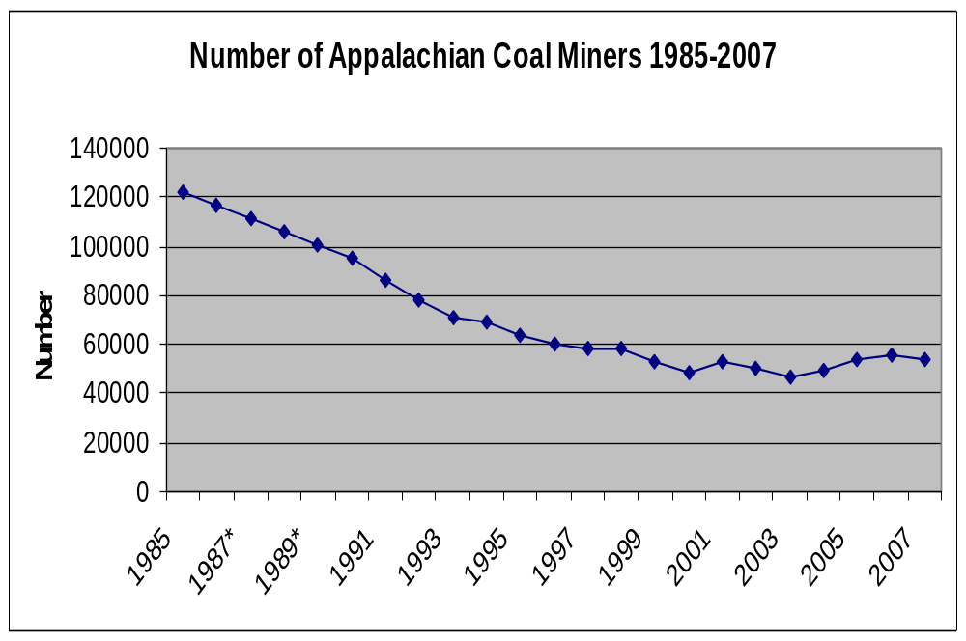
Source: Annual Coal Reports, Energy Information Administration (figures for 1986-1989 imputed)

Slide 7
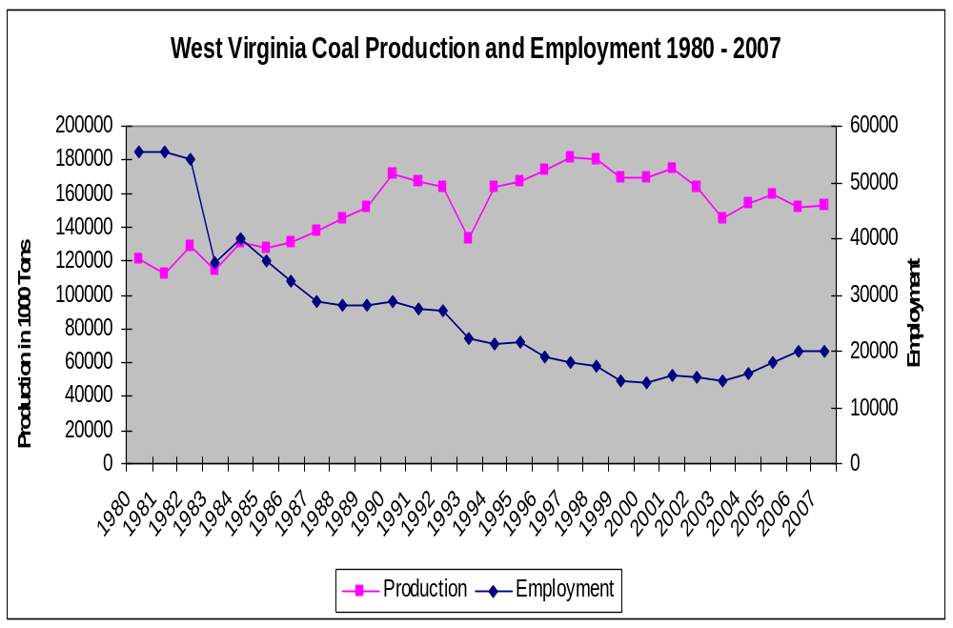
Sources: West Virginia Coal Association “Coal Facts 2007” report, and Energy Information Association

Slide 8
Independent Assessment of Coal Economy
For every mining job, 2.38 other jobs are created (not 5 to 8)
Coal mining accounts directly and indirectly for 4.4% of Appalachian employment
Source: University of Kentucky report, 2001, funded by ARC

Slide 9
Independent Assessment of Coal Economy
Expressed in 2005 dollars, the direct, indirect and induced earnings impact of coal mining, plus severence taxes, in Appalachia = $8.09 billion.
  (Dollars converted to 2005)
Source: University of Kentucky report, 2001, funded by ARC

Slide 10
Disparities in Mining Areas
 | Appalachian Coal Mining | Other Appalachian | Rest of Nation
% college education* | 11.7 | 13.8 | 17.1
Median household income * | $28,054 | $32,596 | $36,753
Unemployment rate* | 7.4 | 6.2 | 5.2
Poverty rate* | 19.6 | 15.6 | 13.1
* Group differences significant at p<.0001
Area Resource File 2005 data adjusted for age, race/ethnicity and sex

Slide 11
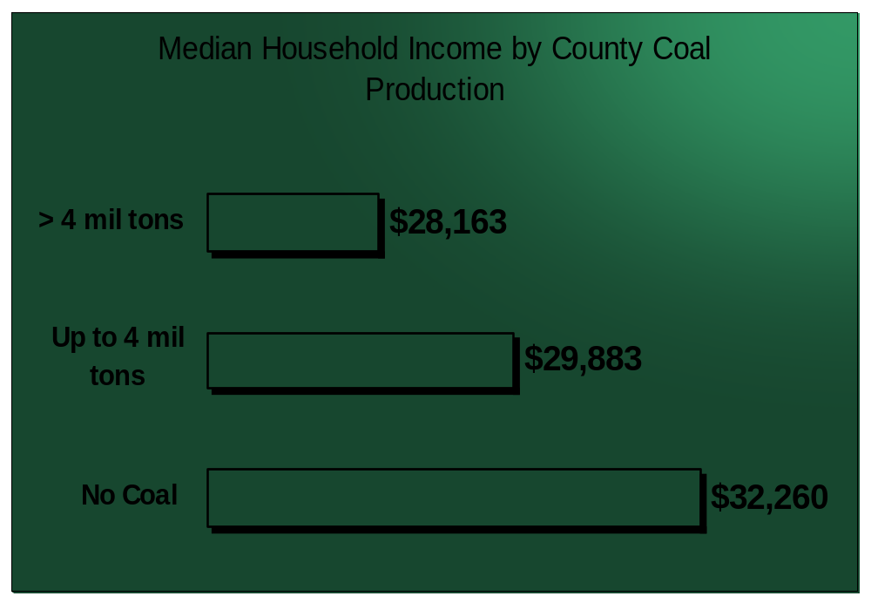
Figures are for WV counties
Sources: Area Resource File and WV Geological and Economic Survey

Slide 12
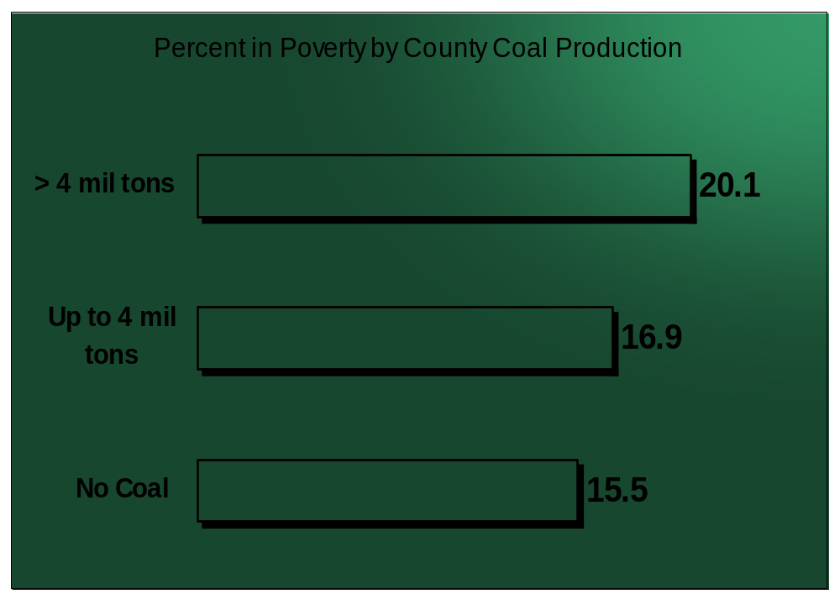
Sources: Area Resource File and WV Geological and Economic Survey

Slide 13
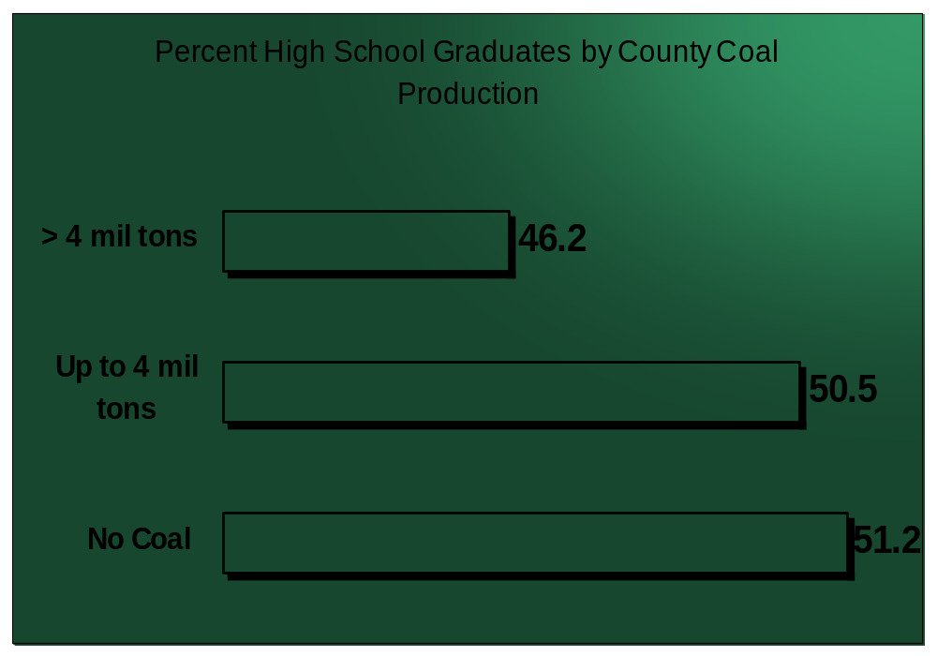
Sources: Area Resource File and WV Geological and Economic Survey

Slide 14
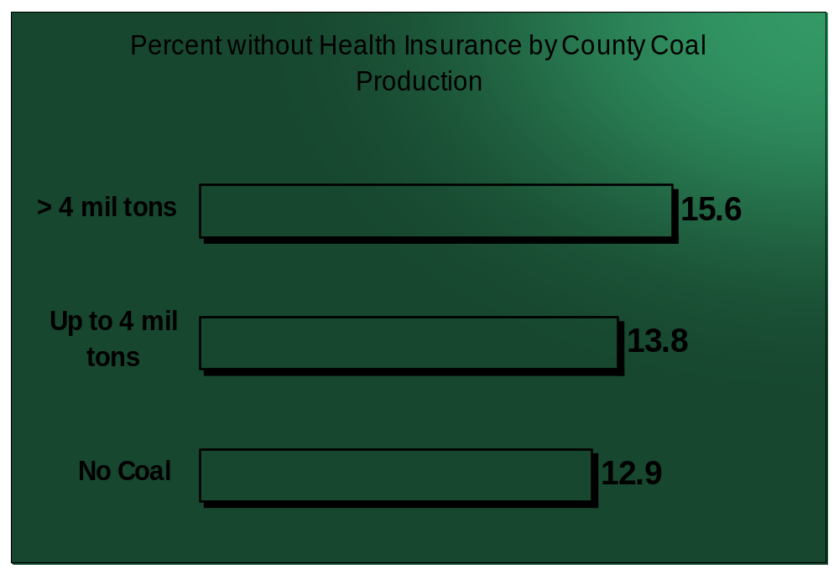
Sources: Area Resource File and WV Geological and Economic Survey

Slide 15
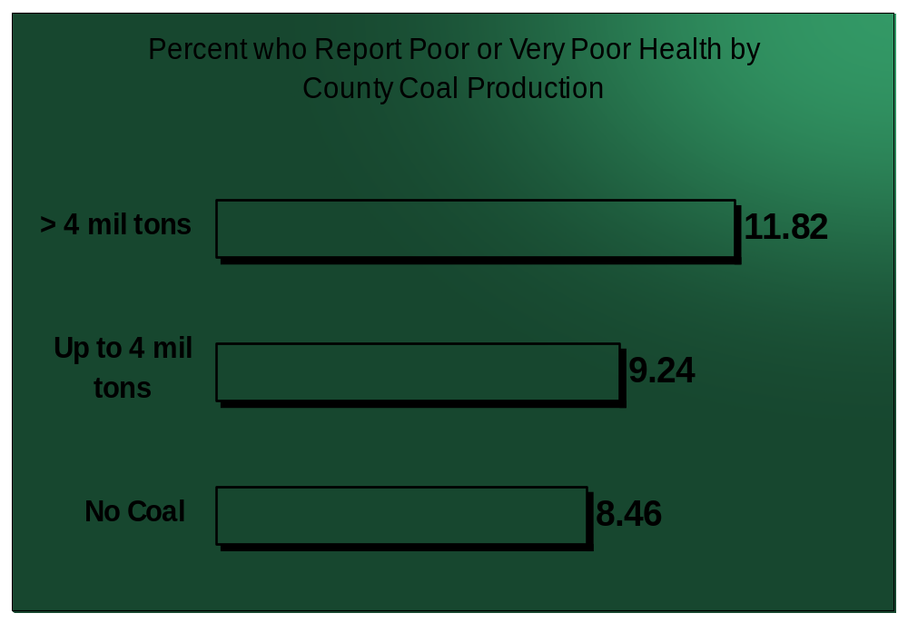
Sources: West Virginia IHPR Survey and WV Geological and Economic Survey

Slide 16
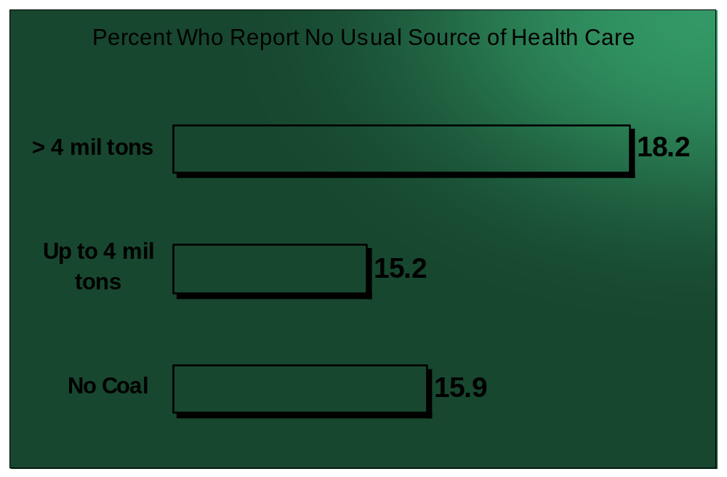
Sources: West Virginia IHPR Survey and WV Geological and Economic Survey

Slide 17
Coal Mining and Community Health: summary thus far
Social disparities contribute to poor health
Disparities are greater in coal mining portions of the region
Hypothesis: Health is worse in mining areas
  If so, what are causes and possible solutions?
Knowledge of poorer health in coal mining areas can be used to target intervention areas.

Slide 18
Is Health in Mining Areas Worse?
Yes………

Slide 19
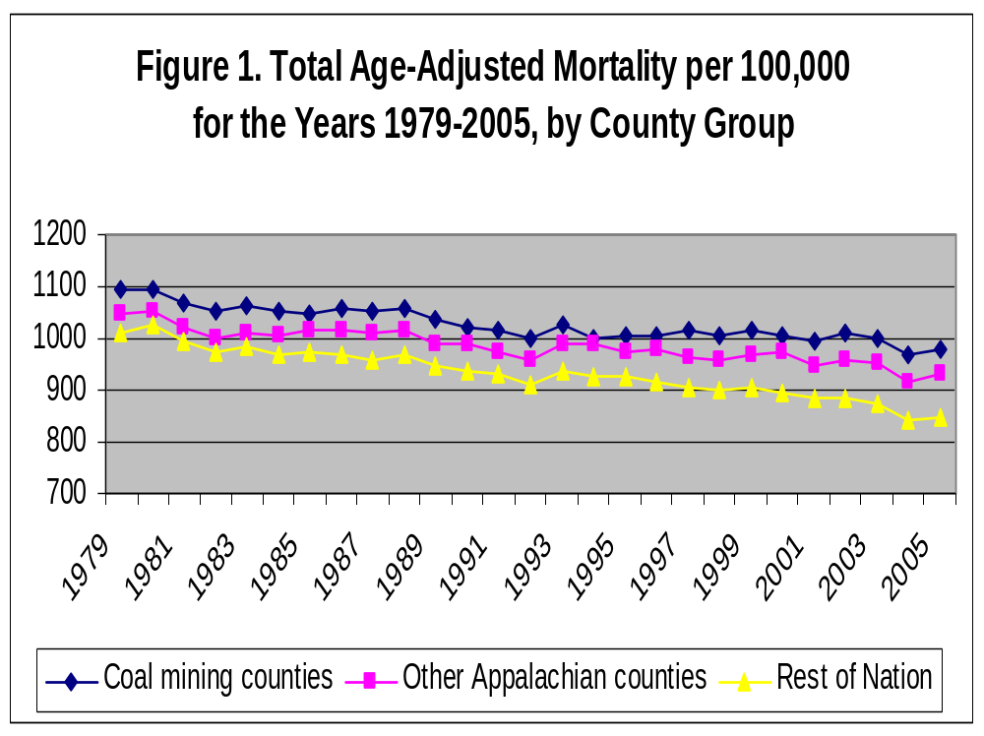
Hendryx, Environmental Justice 2008, 1, 5-11

Slide 20
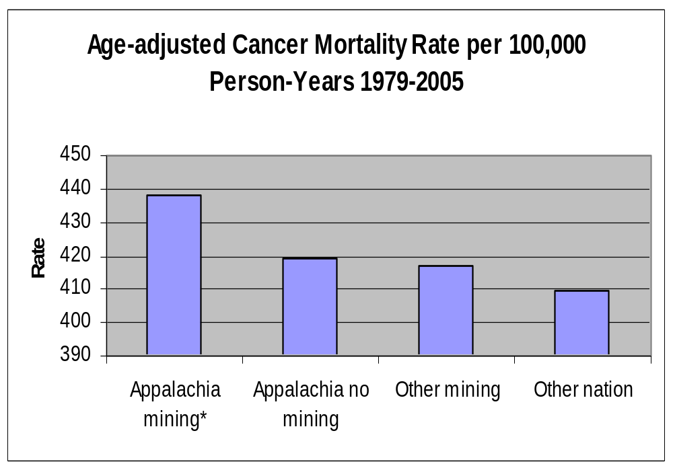
* Significantly higher than other groups, p<.0001

Slide 21
Lung cancer mortality and coal mining
CDC mortality data 2000-2004
Lung cancer mortality is higher in coal mining areas than the rest of Appalachia or the nation
  Adjustments for smoking, age, sex, race, poverty, education, rural-urban setting, insurance rates, physician supply, region
    Hendryx, Horn & O’Donnell, Lung Cancer 2008, 62, 1-7

Slide 22
Adjusted Cancer Mortality 1979-2005 for Males and Females
Elevated rates for females for:
  Total, breast, digestive, respiratory, and urinary cancers
Elevated rates for males for:
  Total and digestive cancers
Adjustments for smoking, age, sex, race, poverty, education, rural-urban setting, insurance rates, physician supply, region

Slide 23
Cardiopulmonary and renal mortality
CDC mortality data 2000-2004
Chronic heart, chronic lung, and renal failure mortality are higher in coal mining areas than the rest of Appalachia or the nation
  Adjustments for smoking, age, sex, race, poverty, education, rural-urban setting, insurance rates, physician supply, region
    Hendryx, IAOEH, 2009, 82, 243-249

Slide 24
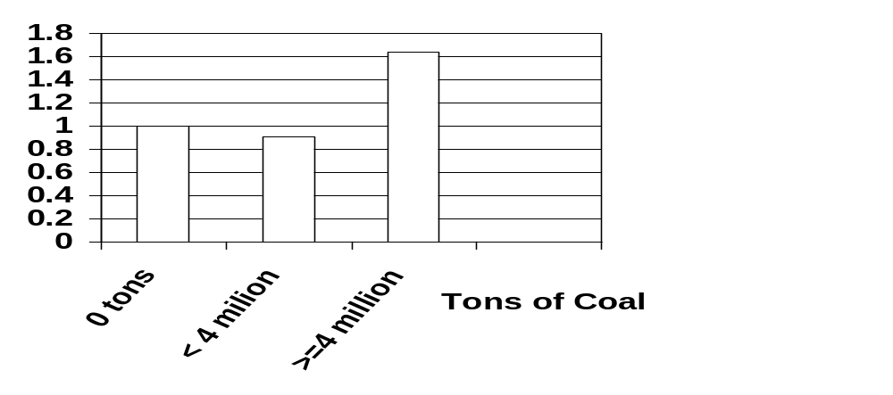
Adjusted Odds Ratios for Chronic Obstructive Pulmonary Disease
Sources: West Virginia IHPR Survey and WV Geological and Economic Survey
Hendryx & Ahern, AJPH 2008, 98, 669-671

Slide 25
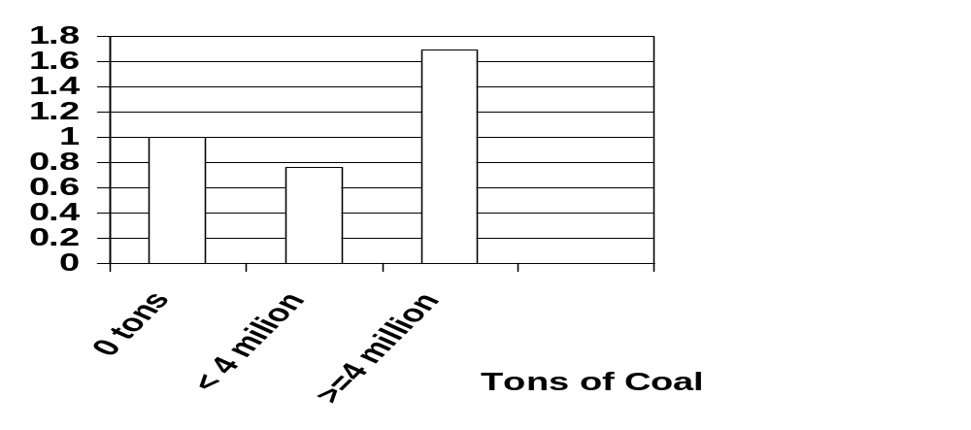
Adjusted Odds Ratios for Kidney Disease
Sources: West Virginia IHPR Survey and WV Geological and Economic Survey
Hendryx & Ahern, AJPH 2008, 98, 669-671

Slide 26
Hospitalization Rates and Coal Mining
HCUP NIS hospitalization data for 2001, for WV, KY and PA
Greater coal mining volume is associated with higher adjusted rates of hospitalization for
  Cardiovascular disease
  Respiratory disease
    Hendryx, Ahern & Nurkiewicz, Journal of Toxicology and Environmental Health, 2007

Slide 27
Low Birth Weight in Appalachia
Areas of heaviest coal mining (> 7.3 million tons 1994-2002) have an additional 6.8 LBW births per 1,000 live births.
  Also 8.7 pre-term births per 1000
Controlling for female age, poverty, education, race, smoking, supply of primary care docs and obgyns, region, and rural setting

Slide 28
Causes of poor health in mining areas
Poverty
Smoking
Education
Environment

Slide 29
Air and Water as Possible Transport Routes
Mines
  4,026 sites in WV where mining occurred 1979-2004
Slurry ponds
  WV has 105 impoundments containing >140 billion gallons of slurry
Underground injection
  270 licensed sites in WV
Cleaning, storage and transport
  76 prep facilities in WV

Slide 30
Trace Elements in WV Coal
59 trace elements listed by WVGES
  Arsenic, mercury, selenium, cadmium, chromium, manganese, nickel, beryllium, zinc, etc.
E.g. Arsenic in central Appalachian coal is reduced by cleaning (USGS samples)
  (Where does it go?)

Slide 31
Air Quality
Limited studies in Great Britain and India
  Maximum PM10 at 780 μg/m³; (maximum US standard is 150)
  Coal dust recommended maximum is 20
22 EPA air monitors in WV, none in coal mining communities

Slide 32
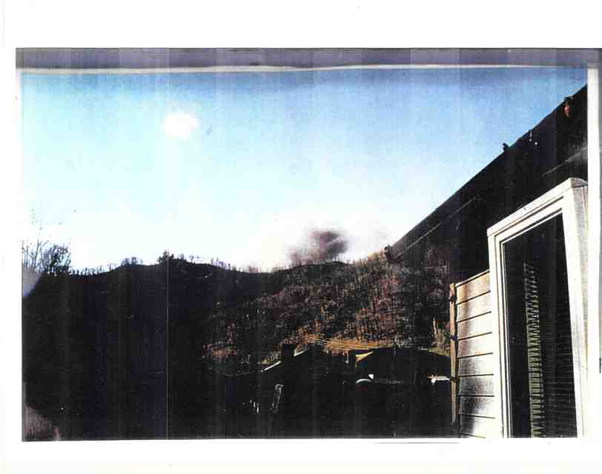
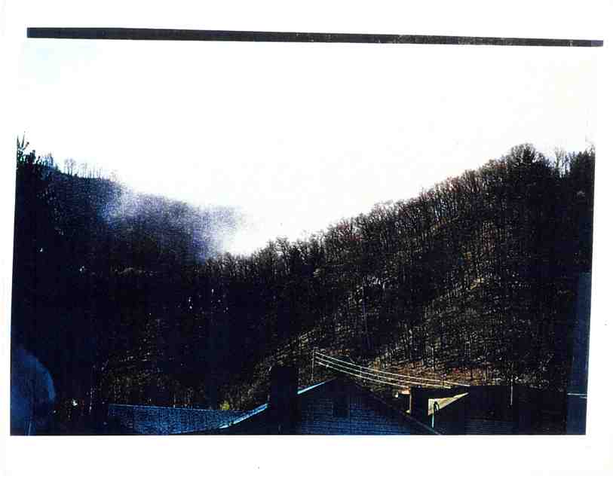
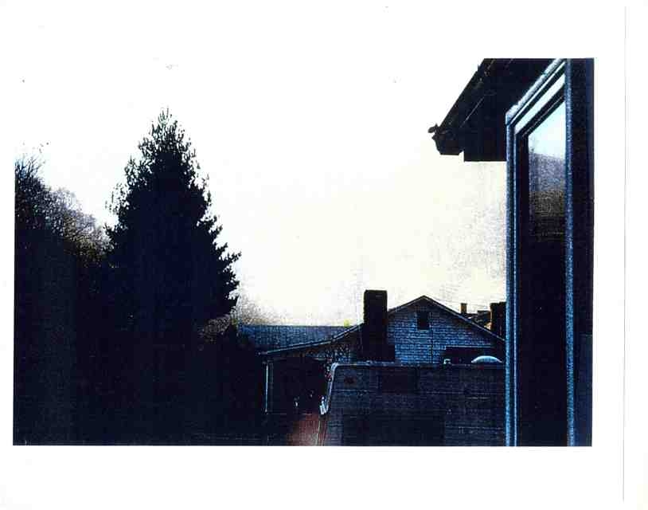
Explosion over the town of Dorothy, WV

Slide 33
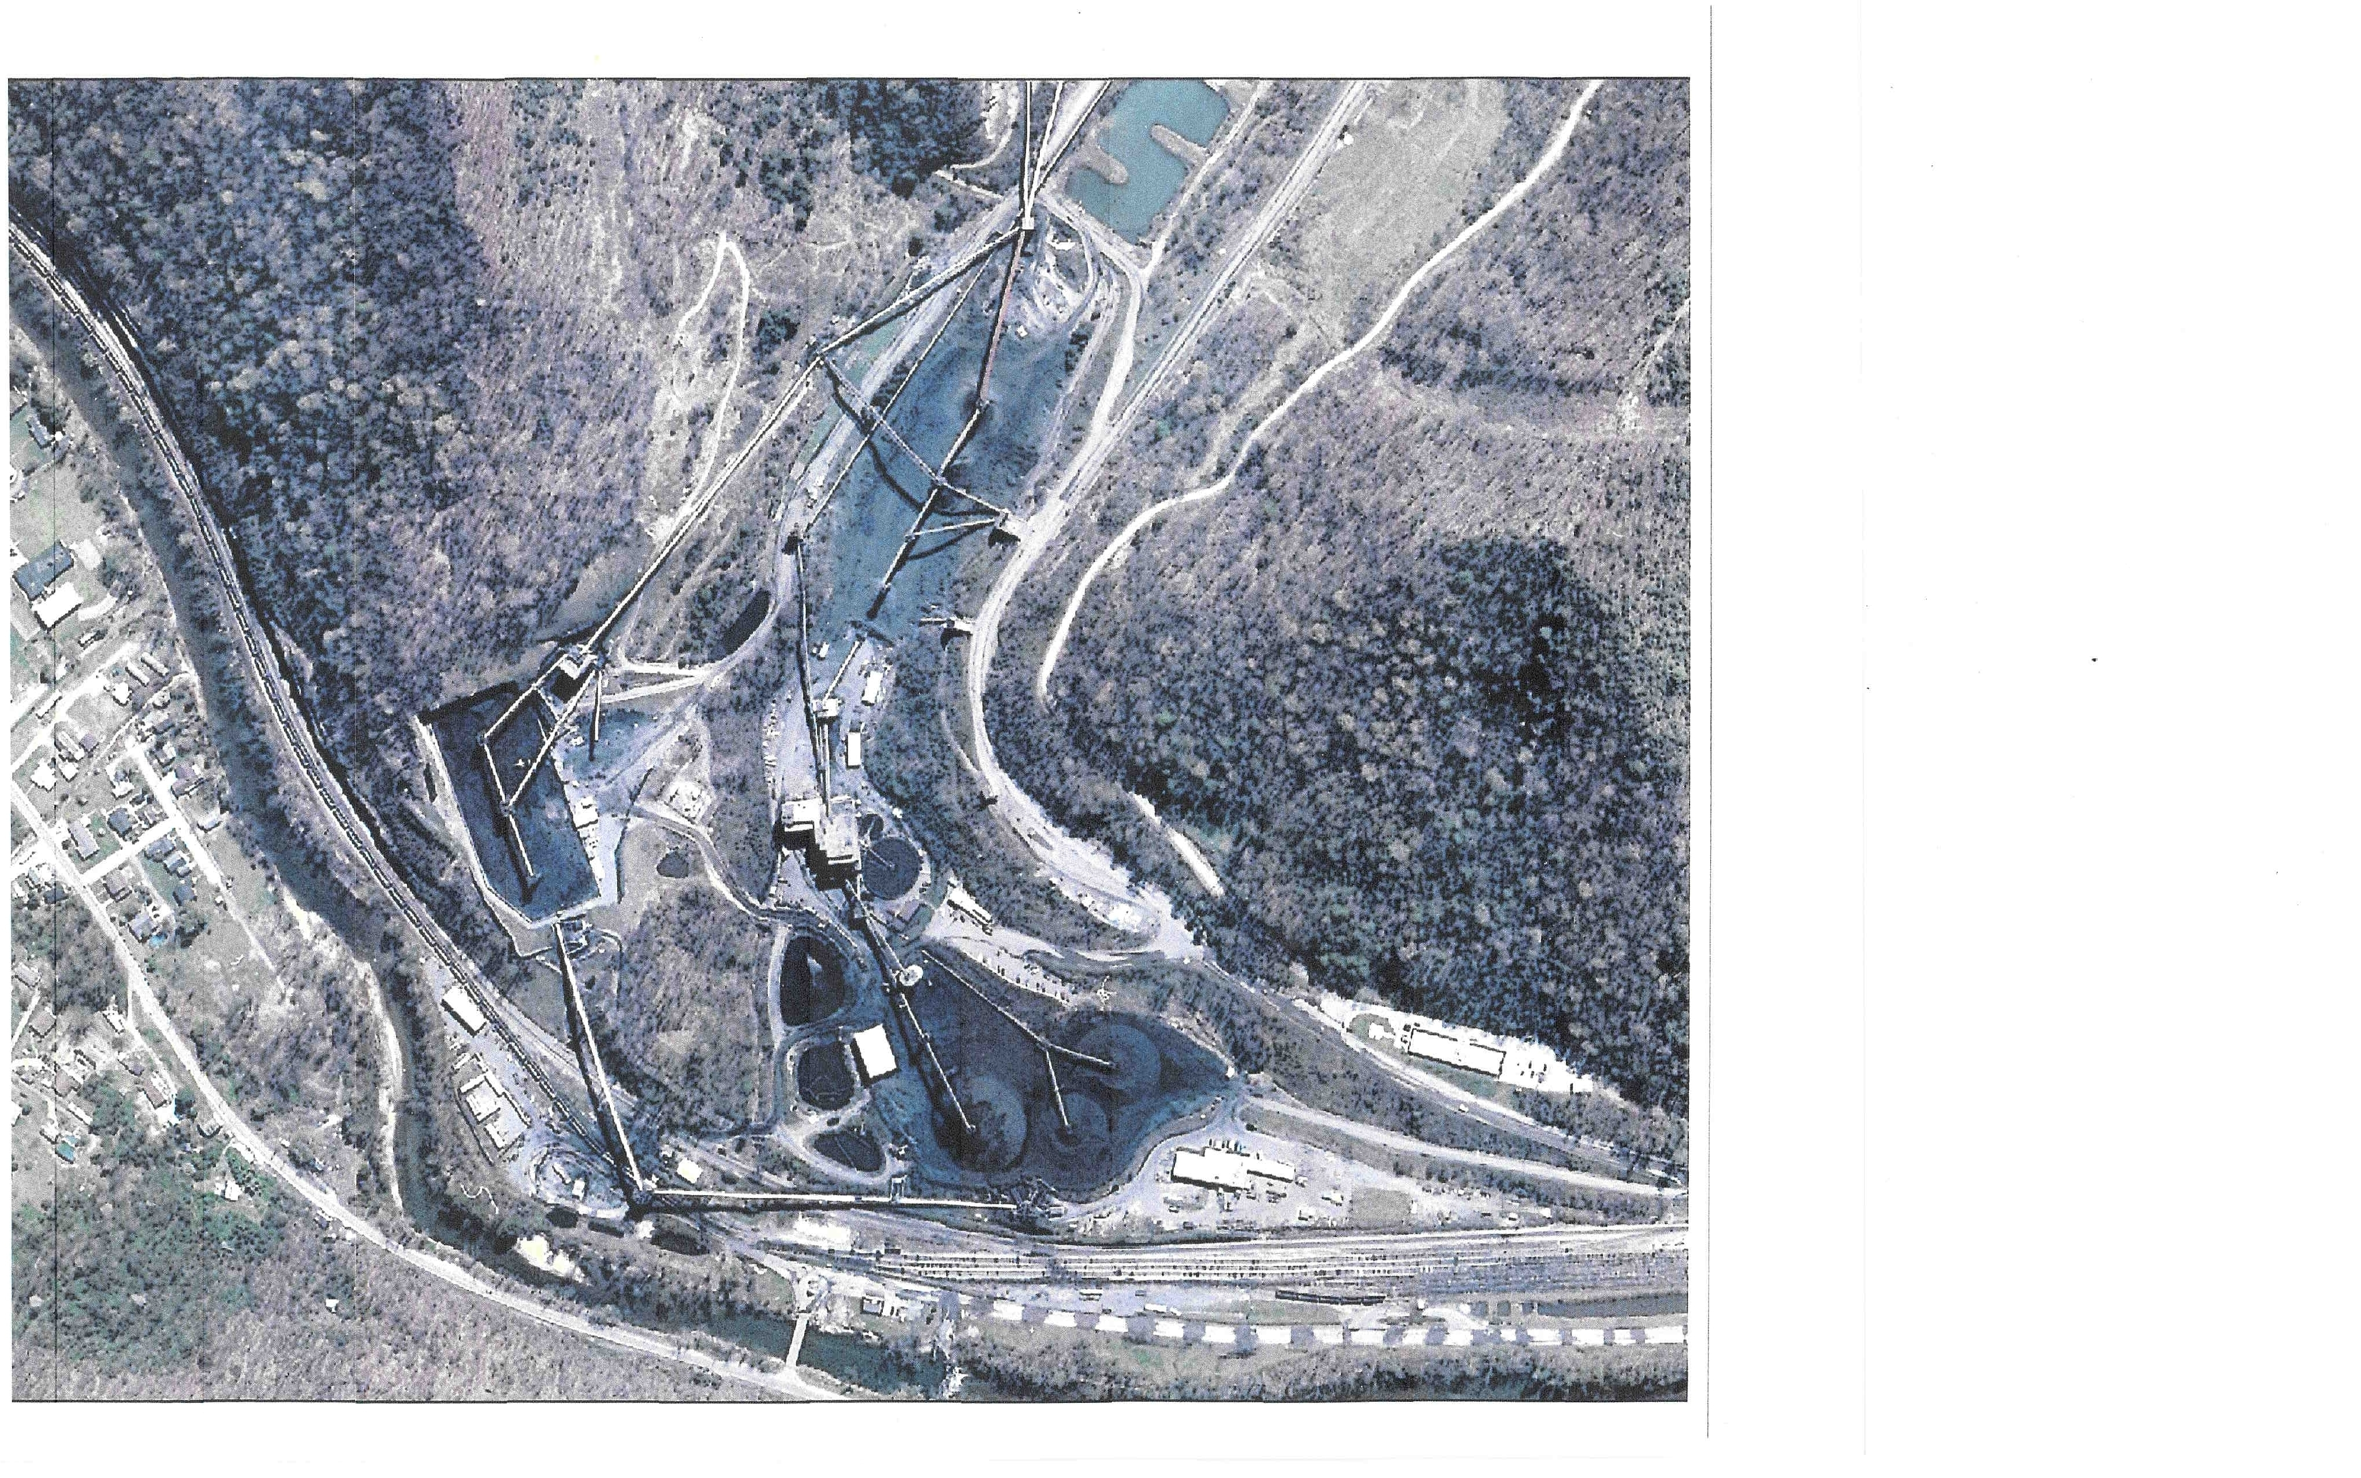
Coal Prep Plant by Sylvester, WV

Slide 34


Slide 35
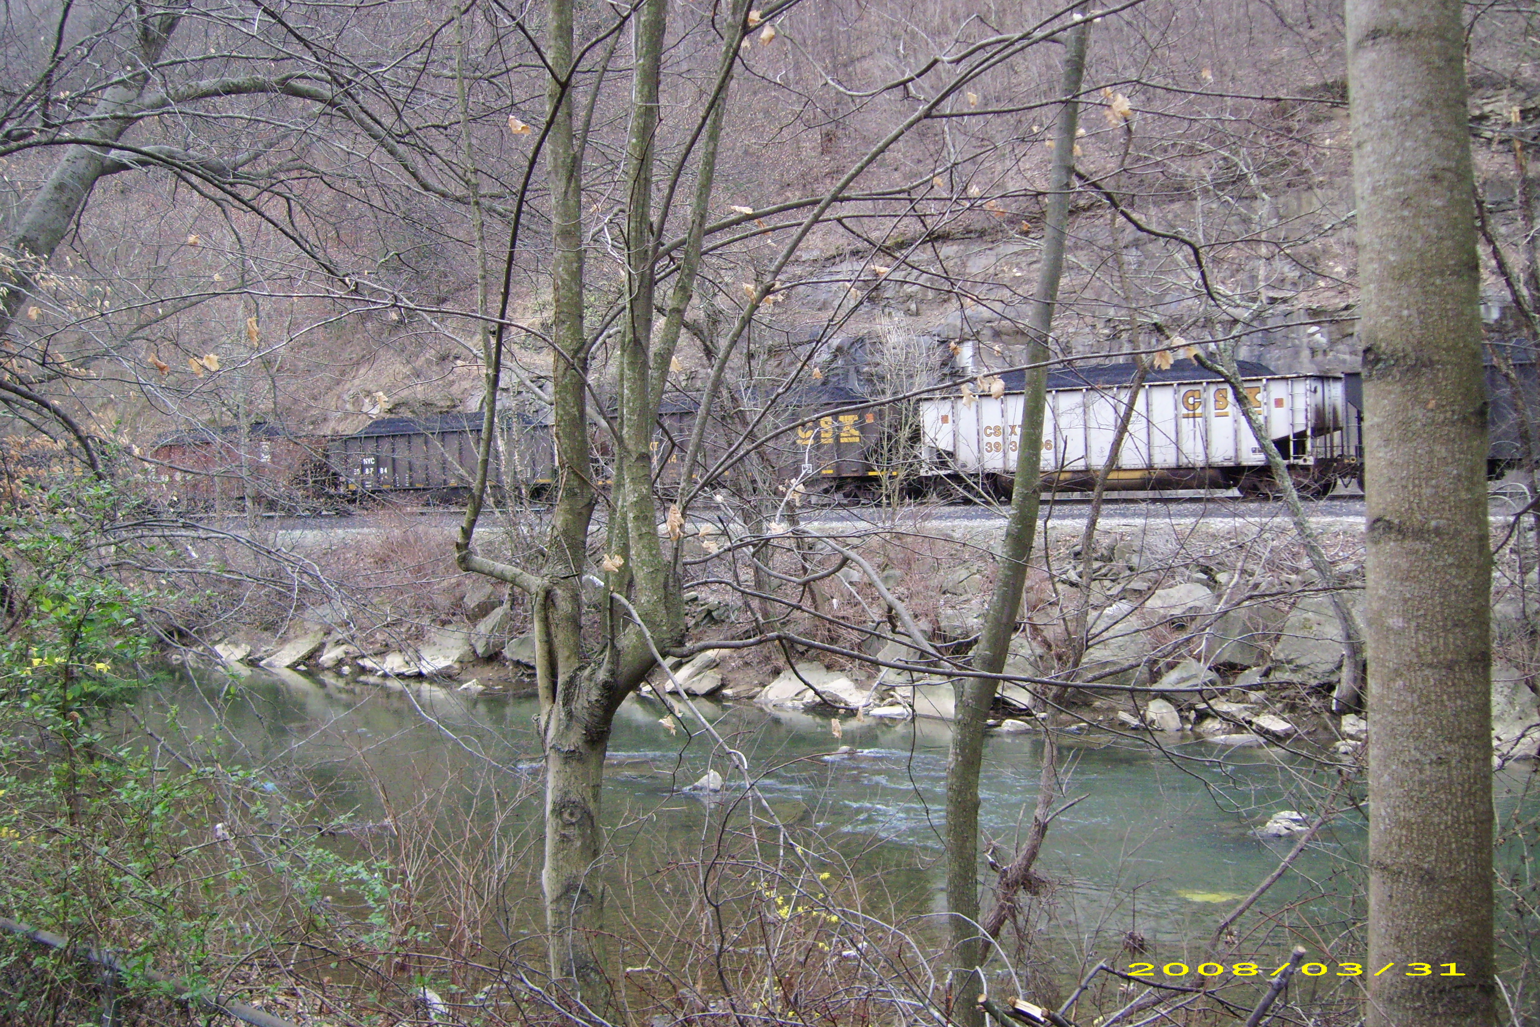

Slide 36
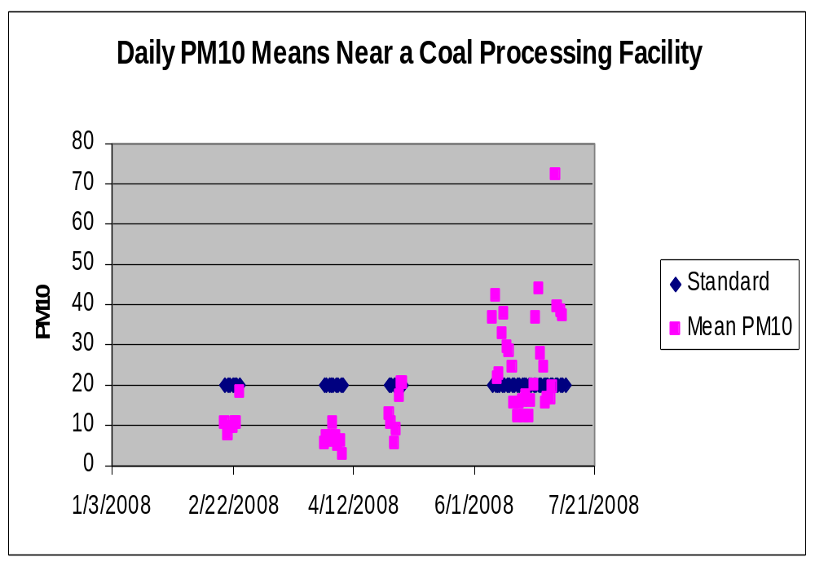

Slide 37
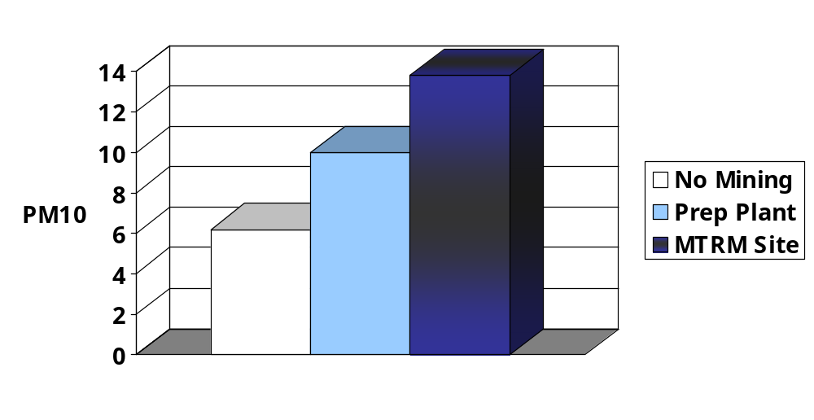
Mean Daily PM10 at 3 Sites, Feb.-May 2008
Values are least square means, adjusting for temperature and relative humidity; F=8.27 (4, 65) p<.0001

Slide 38
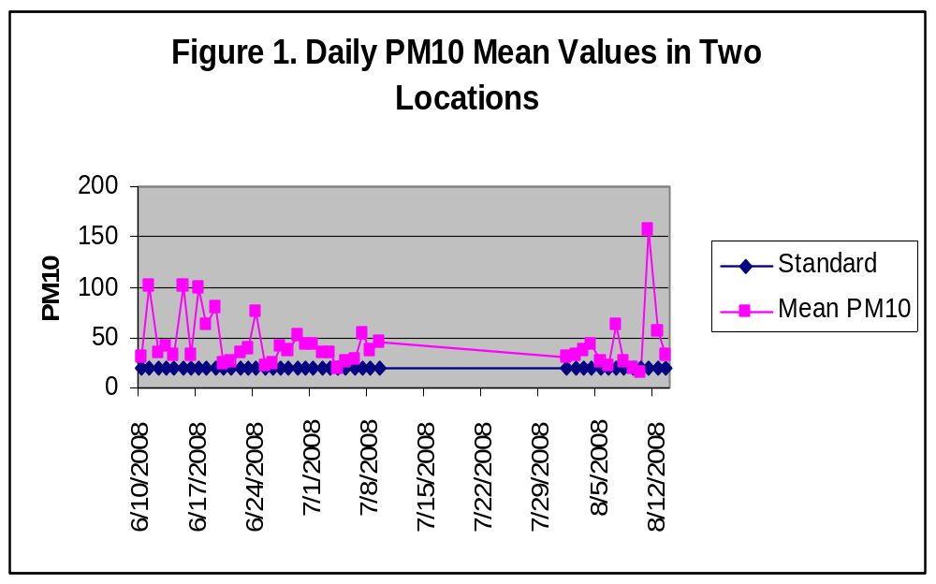
Second Prep Facility
Daily average significantly higher than the standard on 33 of 43 days

Slide 39
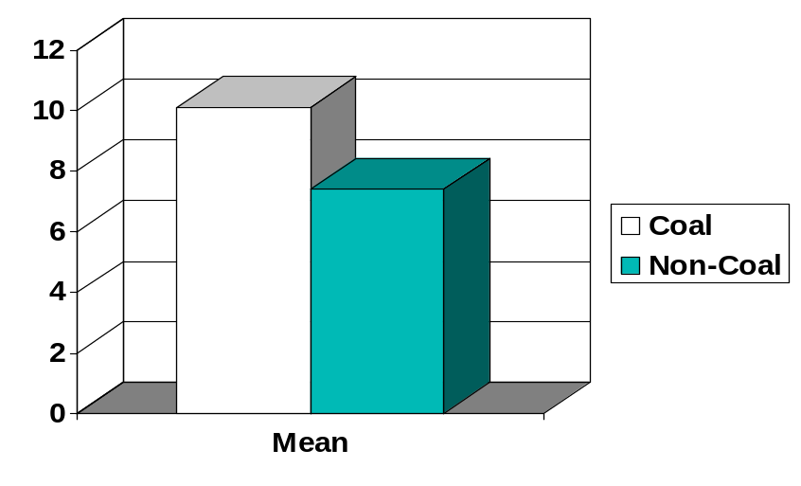
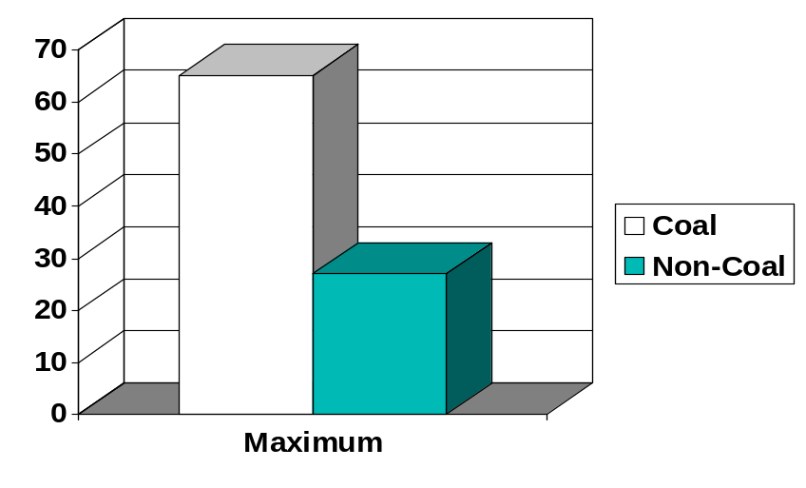
Mean and Maximum PM10 in Four WV Communities, May 2008
Coal vs non-coal significantly different p<.05, adjusting for temperature and relative humidity

Slide 40
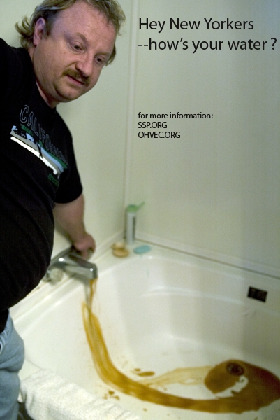
Well water in the town of Rawl, West Virginia, 2008
Photo: Antrim Casky

Slide 41
Tests of well and ground water
Arsenic in almost ½ of 179 wells in central Appalachia, most at levels known to increase cancer risk (Shiber)
Tests of 15 wells exceeded primary standards for 5 metals: lead, arsenic, barium, beryllium and selenium (Stout)
  Secondary standards exceeded for iron, manganese, aluminum, zinc
Ground water in mined and unmined areas of Appalachia: mined areas had higher sulfate, iron, manganese, aluminum, pH, calcium, magnesium, turbidity, and zinc (McAuley & Kozar, USGS report)

Slide 42
Stream Integrity, Mining, and Cancer in WV
Mining and stream integrity r = -.62 (p<.0001)
Stream integrity and total cancer mortality r = -.47 (p<.001)
    Hitt & Hendryx, 2009

Slide 43
Summary
Suggestive evidence of air and water problems
Pattern of results:
  Chronic heart, lung, and kidney
  Some forms of cancer
  Women impacted too, sometimes more
  Control for covariates

Slide 44
What is the Value of a Life (statistically speaking)?
VSL research
  If a person will pay $600 to reduce personal mortality risk by 1/10,000, then 10,000 people, jointly, will pay $6,000,000 to save 1 life
  To society, the value of that life is $6,000,000
  EPA and FDA studies place VSL at $4.67 to $7.74 million, in 2005 dollars
    Hendryx & Ahern, PHR, 2009

Slide 46
The Human Cost of Coal Mining (compare to the $8 billion coal benefit)
 | Cost estimate in billions compared to:
VSL in millions: | Appalachia 1979-2005 | Appalachia 1999-2005 | Nation 1979-2005 | Nation 1999-2005
$4.67 | $18.563 | $20.697 | $41.283 | $51.010
$7.74 | $30.766 | $34.304 | $68.422 | $84.544
Excess annual deaths: | 3,975 | 4,432 | 8,840 | 10,923

Slide 47
Other Costs
Health care
Social welfare programs
Ecological
Psychological
Opportunity

Slide 48
Mitigation Strategies
Reduce the fundamental underlying socioeconomic disparities that drive health for populations.

Slide 49
An economy for Appalachia that creates more, better, and permanent jobs
Broad based education
Restoration of coal lands
Sustainable forestry and agriculture
Renewable energy for fuel and electricity
Enterprise diversification
Technology
Redirect the coal severance tax

Slide 50
By the way…
Recoverable coal reserves in central Appalachia will peak in <20 years.*
  When that happens, jobs will become even fewer and tax revenues from coal will decline
We have no choice but to create an alternative economy
*Citation: Milici RC. USGS report

Slide 51
“My tongue, every atom of my blood, form'd from this soil, this air,
Born here of parents born here from parents the same, and their parents the same,
I, now thirty-seven years old in perfect health begin,
Hoping to cease not till death.”
Walt Whitman, “Song of Myself”

