Slide 1
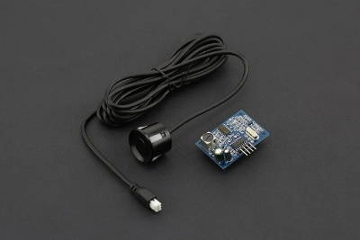
SEN208
range: 25cm to 4.5m
ECHO pin #22
TRIG pin #17
class:
int value; //cm
float val_meters; //m
config()
read_sensors()

Slide 2
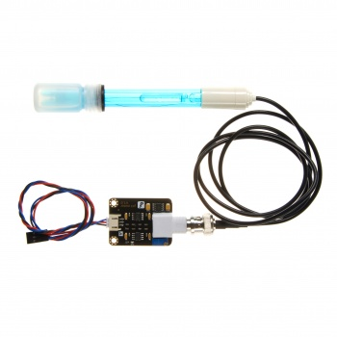
SEN0161
analogic sensor --> adc0804lcn
class:
float value;
config()
read_sensors()
Calibration:
1. Put the pH electrode into the standard solution whose pH value is 7.00，or directly shorted the input of the BNC connector. The error does not exceed 0.3. Record the pH value printed,then compared with 7.00, and the difference should be changed into the "Offset" in the code. For example,the pH value printed is 6.88,so the difference is 0.12.You should change the "# define Offset 0.00" into "# define Offset 0.12" in your program.
2. Put the pH electrode into the pH standard solution whose value is 4.00.Then wait about one minute,adjust the gain potential device, let the value stabilise at around 4.00.At this time,the acidic calibration has been completed and you can measure the pH value of an acidic solution.

Slide 3
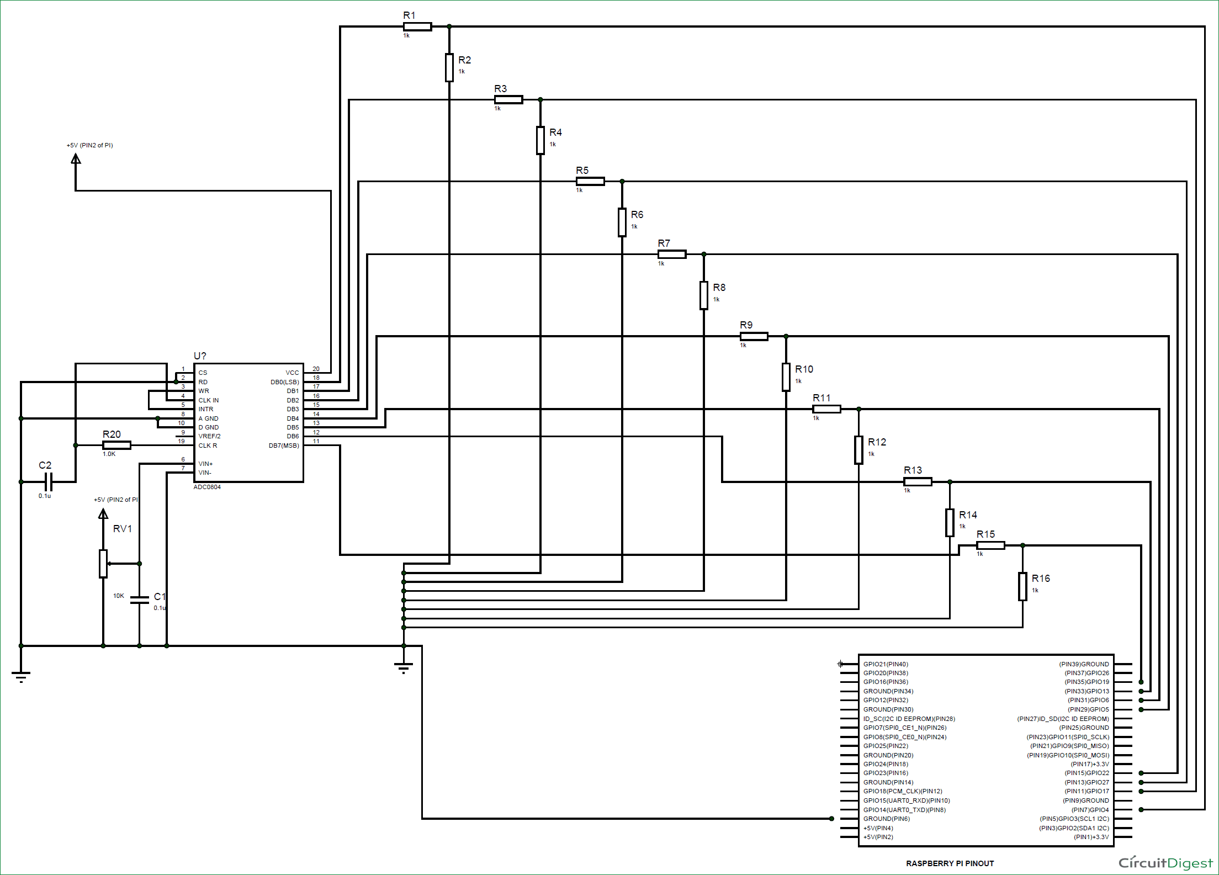
ADC | PIN
DB0 | #26
DB1 | #19
DB2 | #13
DB3 | #6
DB4 | #21
DB5 | #20
DB6 | #16
DB7 | #12
5v
Analog
GND

