Slide 1
Distributed Data Deduplication
Xu Chu, Ihab F. Ilyas, Paraschos Koutris
PVLDB 9(11), 2016
Presenter: David Liu
20428295

Slide 2
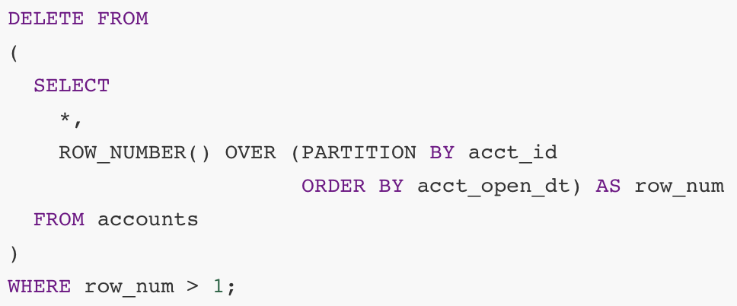

Data deduplication is costly
Data Deduplication is the process of identifying tuples that refer to the same entity
Need to compute similarity measures of each tuple pair – $O(n^{2})$ complexity!

Slide 3
Blocking is often used to reduce workload
Blocking functions divide a relation into subsets of tuples
Tuples across subsets are considered dissimilar
E.g., edit distance, Jaccard similarity, postal code
Requires familiarity with the data and hand tuning
Can also be adaptive (cluster learning)
Multiple blocking functions are often used to reduce false negatives

Slide 4
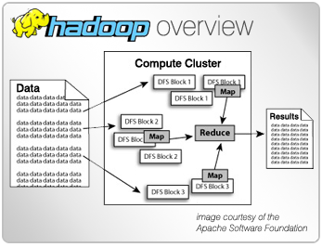
Distributed/parallel data processing is faster than running on a single machine
Multiple workers in parallel
Shared-nothing structure - each worker has own memory and disk
Trade-off between communication cost and computation cost
Challenges
Network transfer time, disk I/O time
Load-balancing
Need to handle multiple blocking functions

Slide 5
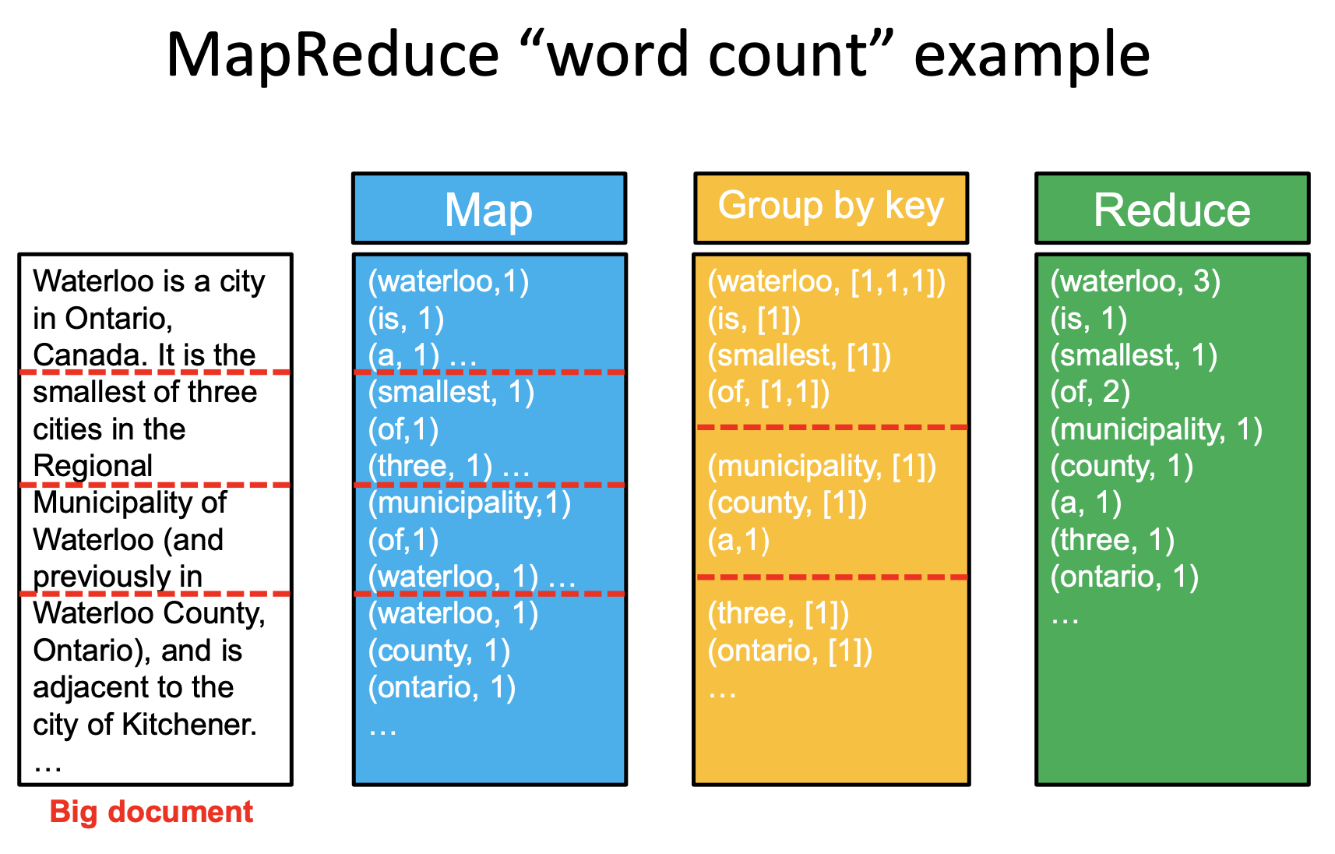
Hadoop MapReduce
Mapper
Takes in raw data
Does parsing/transformation/filtering
Outputs (key, value) pair
Partitioner
Sorts and shuffles
Outputs (key, iterable(value)) pair
Pairs with the same key gets assigned to the same reducer
Reducer
Does aggregation (in our case, compare)
Outputs results
Source: University of Waterloo, CS651, Fall 2019

Slide 6
Contributions
Formalizes a computation/memory cost model
Proposes an optimal workload distribution strategy
Small constant factor from the theoretical lower bounds
Balance between computational cost and communication cost
Handles both single and multiple blocking functions
Does NOT propose new comparison methods
Does NOT propose new blocking functions
Notes:
Developed a cost model that captures both the communication cost and the computation cost, both are important to a distributed framework

Slide 7
Problem Definition

Slide 8
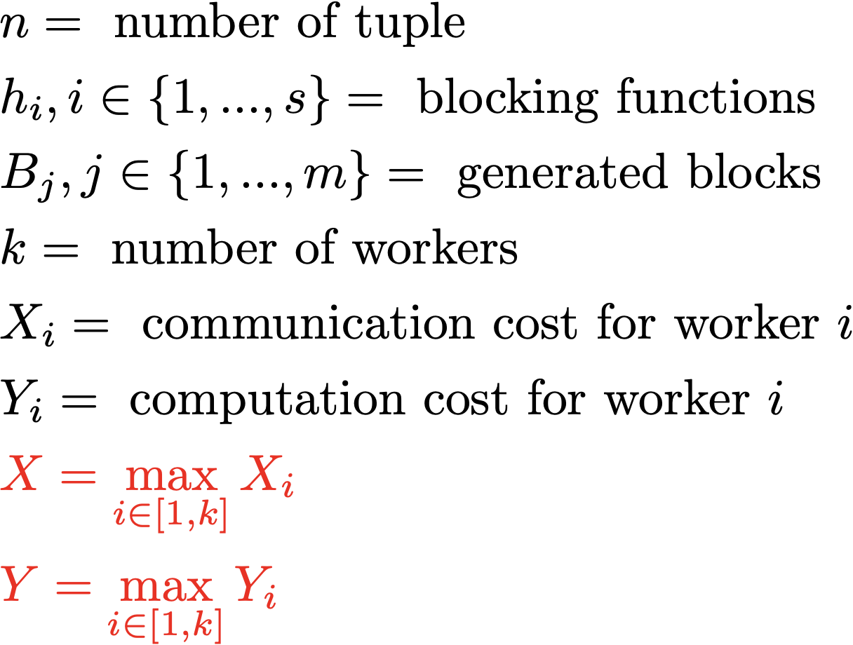
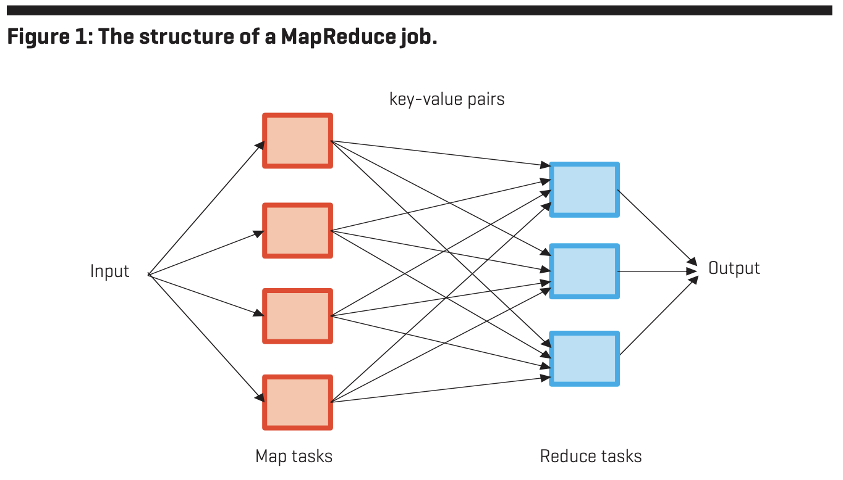
Communication cost (X) and computation cost (Y)
Communication cost is the cost of moving the data from Map tasks to Reduce tasks
Computation cost is the sum of the time needed to execute each reducer
Source: J. D. Ullman., Designing Good MapReduce Algorithms

Slide 9
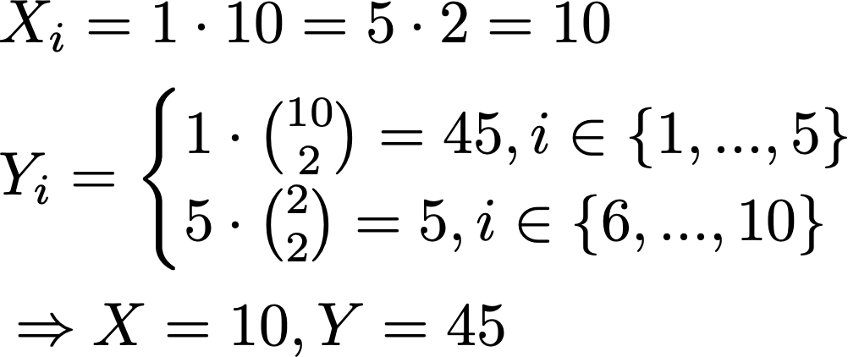
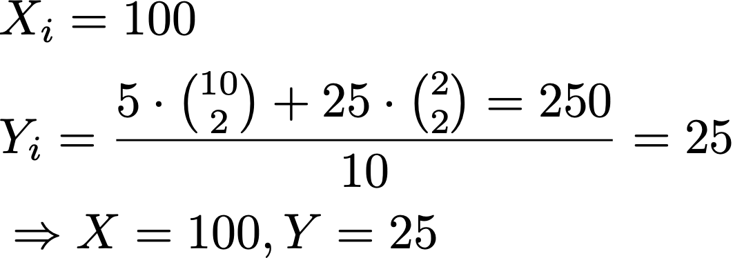
Example: n = 100, k = 10, s = 1, blocks = {5 blocks of size 10, 25 blocks of size 2}
Strategy #1
Send all 100 tuples to every reducers
Proportionally distribute tuples to compare among the reducers
Strategy #2
Assigns one block entirely to one reducer
5 blocks of size 10 – 5 workers, 1 each
25 blocks of size 2 – 5 workers, 5 each

Slide 10
Break down into three cases, progressive in complexity
Single block generated by a single blocking function
Multiple blocks generated by a single blocking function
Multiple blocks generated by multiple blocking functions

Slide 11
Case 1 – Single Block, Single Blocking Function

Slide 12
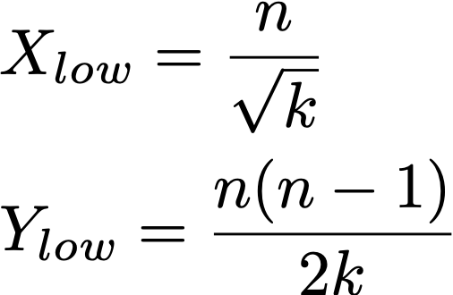
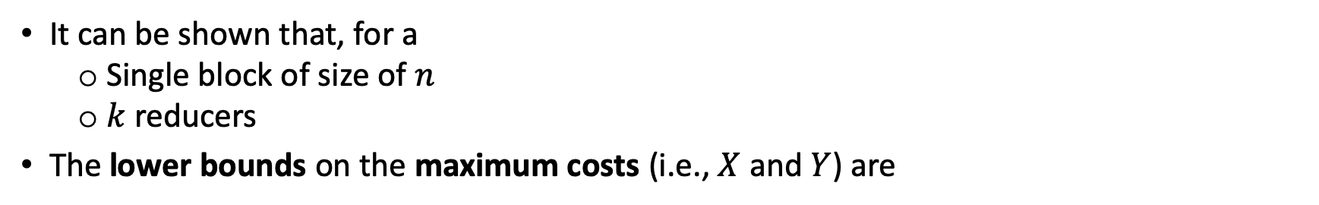
Compare every tuple with every other tuple in the block
It can be shown that, for a
Single block of size of $n$
$k$ reducers
The lower bounds on the maximum costs (i.e., $X$ and $Y$) are
We want to design a distribution strategy that gets as close to these lower bounds as possible

Slide 13
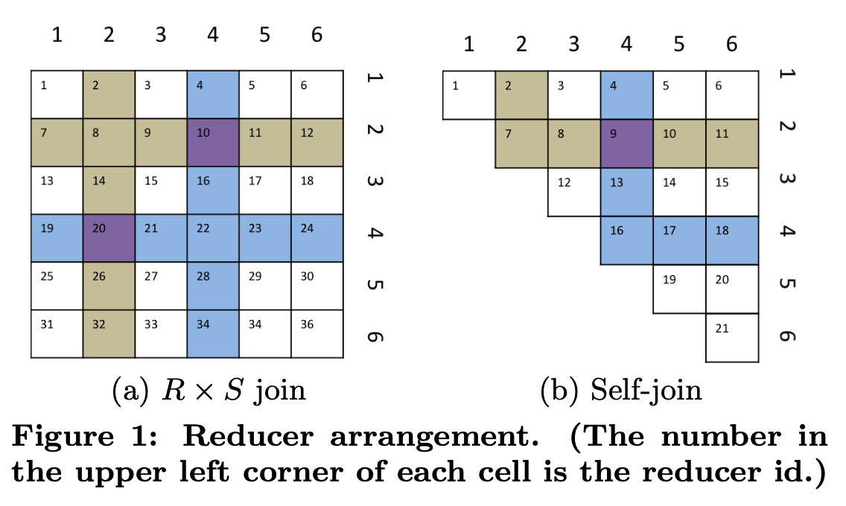

Triangle distribution strategy ensures exactly once comparison
Anchor points are used to randomly assign tuple to reducers
Flags ($L$, $R$, or $S$) are used to ensure exactly once comparison in reducer
L vs. R
S vs. S

Slide 14
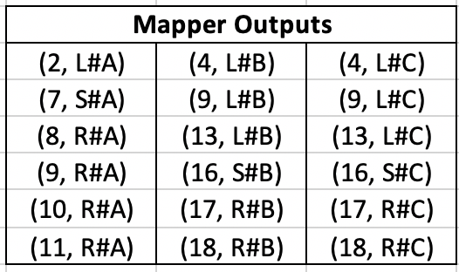
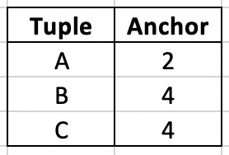
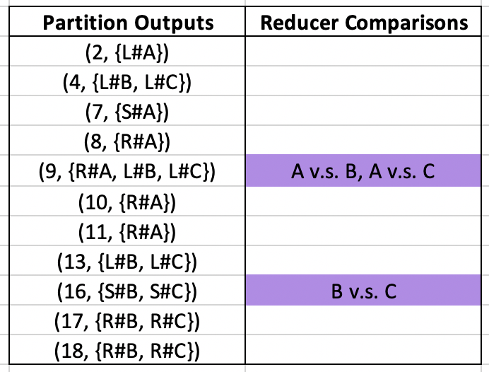
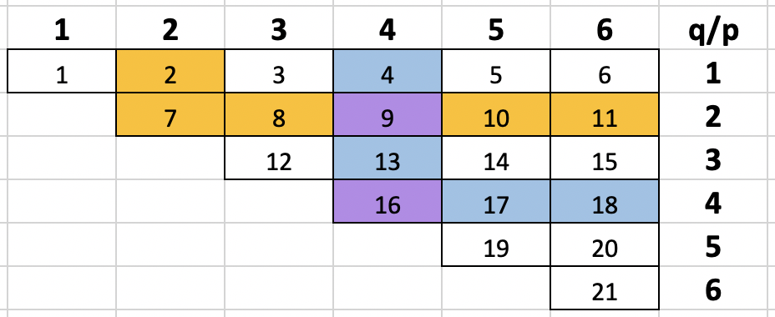
Example
Caveat?

Slide 15
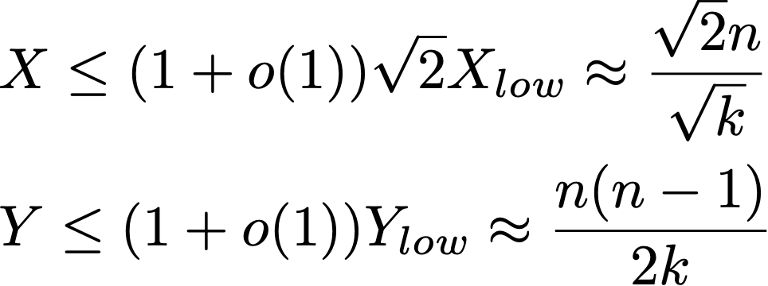
Triangle distribution strategy matches lower bound on Y, while providing a constant-factor approximation to lower bound on X

Slide 16
Case 2 – Multiple Blocks, Single Blocking Function

Slide 17
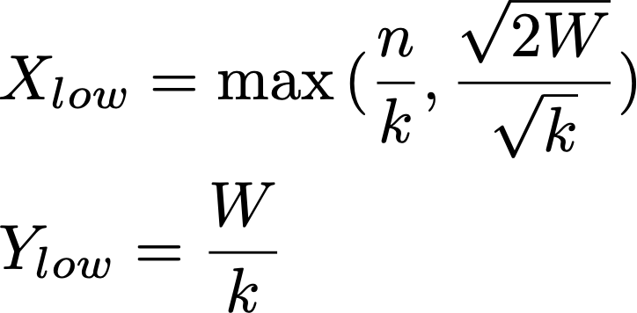
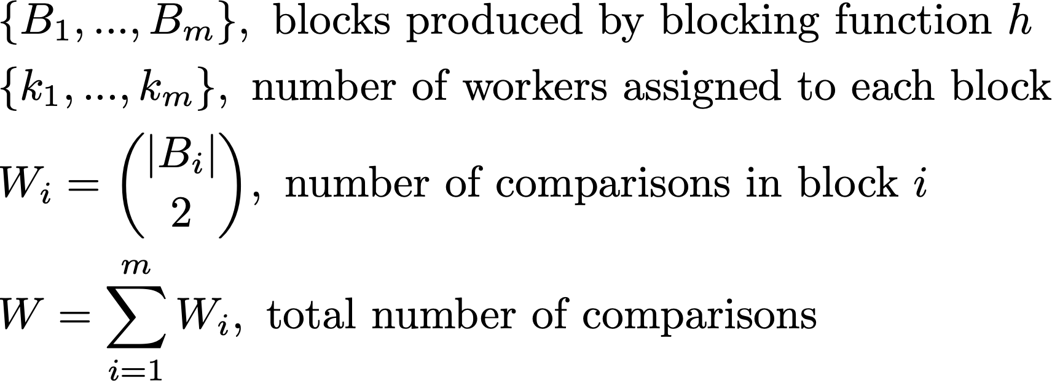
Like the single block case, we can derive lower bounds on X and Y

Slide 18
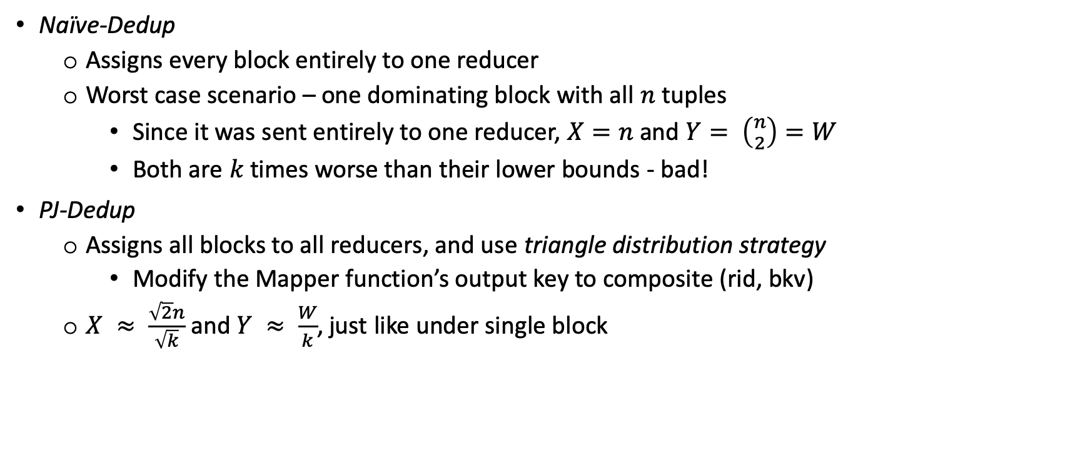
Baseline strategies – Naïve-Dedup and PJ-Dedup
Naïve-Dedup
Assigns every block entirely to one reducer
Worst case scenario – one dominating block with all $n$ tuples
Since it was sent entirely to one reducer, $X=n$ and $Y= \left({n \atop 2}\right)=W$
Both are $k$ times worse than their lower bounds - bad!
PJ-Dedup
Assigns all blocks to all reducers, and use triangle distribution strategy
Modify the Mapper function’s output key to composite (rid, bkv)
$X ≈ \frac{\sqrt{2}n}{\sqrt{k}}$ and $Y ≈ \frac{W}{k}$, just like under single block
So … PJ-Dedup?

Slide 19
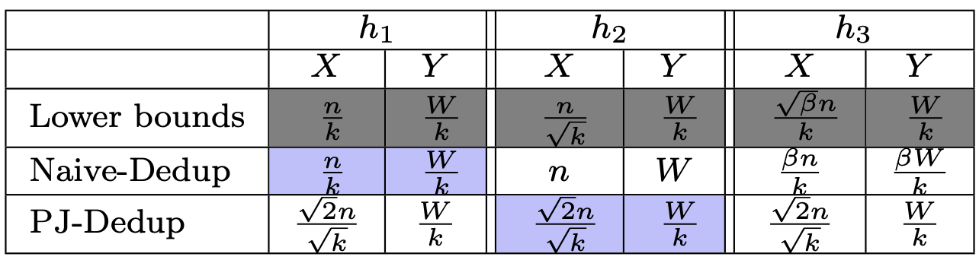
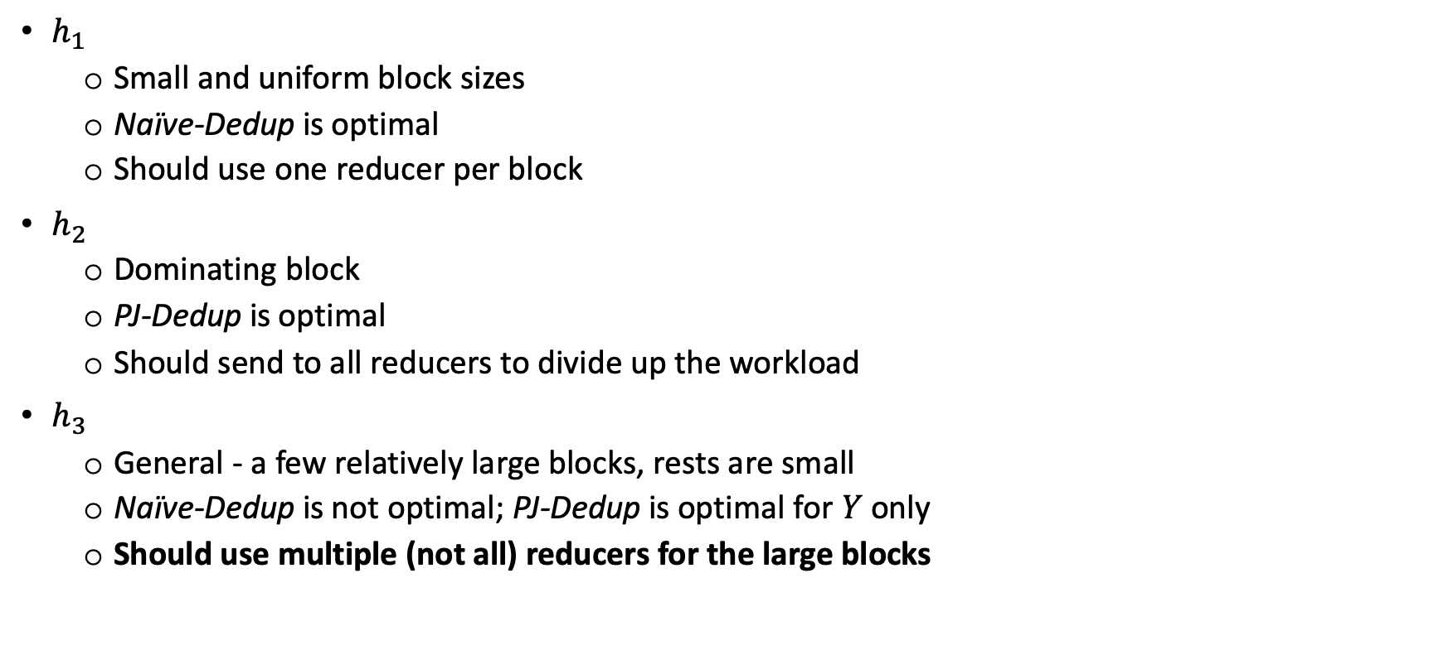
Costs vary drastically depending on the blocking function
$h_{1}$
Small and uniform block sizes
Naïve-Dedup is optimal
Should use one reducer per block
$h_{2}$
Dominating block
PJ-Dedup is optimal
Should send to all reducers to divide up the workload
$h_{3}$
General - a few relatively large blocks, rests are small
Naïve-Dedup is not optimal; PJ-Dedup is optimal for $Y$ only
Should use multiple (not all) reducers for the large blocks
Notes:
When there are multiple relatively large blocks, we should use multiple, but not all, reducers to handle these blocks, because using ALL reducers for every large blocks sends more tuples than necessary

Slide 20
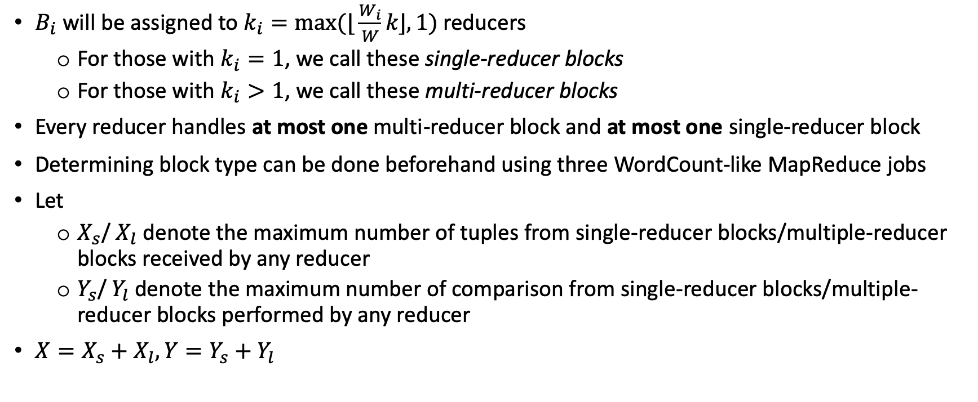
Dis-Dedup: allocate reducers to blocks in proportion to workload
$B_{i}$ will be assigned to $k_{i}=max⁡(\text{⌊}\frac{W_{i}}{W}k\text{⌋}, 1)$ reducers
For those with $k_{i}=1$, we call these single-reducer blocks
For those with $k_{i}>1$, we call these multi-reducer blocks
Every reducer handles at most one multi-reducer block and at most one single-reducer block
Determining block type can be done beforehand using three WordCount-like MapReduce jobs
Let
$X_{s}$/ $X_{l}$ denote the maximum number of tuples from single-reducer blocks/multiple-reducer blocks received by any reducer
$Y_{s}$/ $Y_{l}$ denote the maximum number of comparison from single-reducer blocks/multiple-reducer blocks performed by any reducer
$X=X_{s}+X_{l}, Y=Y_{s}+Y_{l}$

Slide 21
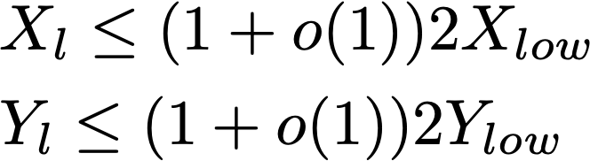
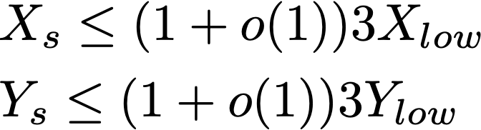
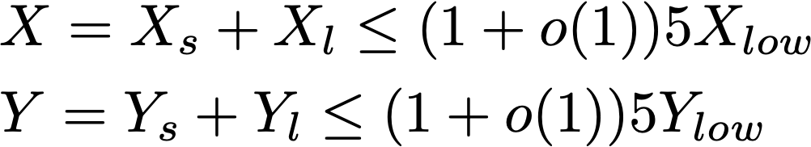
Dis-Dedup can achieve constant factor to the lower bounds, for both multiple and single reducer blocks
For multi-reducer blocks, Dis-Dedup uses the triangle distribution strategy
For single-reducer blocks, Dis-Dedup uses a hybrid distribution approach to determine which reducer each block goes to
Some are deterministic, some are randomized
Notes:
Deterministic – divide into c / g groups (c is the number of single-reducer blocks). Then, we assign to each reducer g blocks, one from each group
Problem: there can be many blocks, keeping track of the ordering is expensive in memory
Randomized – distribute using a random hash function
Problem: off by a factor of ln(k), not a constant
Hybrid – set a threshold, for blocks with workload larger than the threshold, we use deterministic, and for smaller blocks, we use randomized
Overall, 5 factor away

Slide 22
Case 3 – Multiple Blocks, Multiple Blocking Function

Slide 23
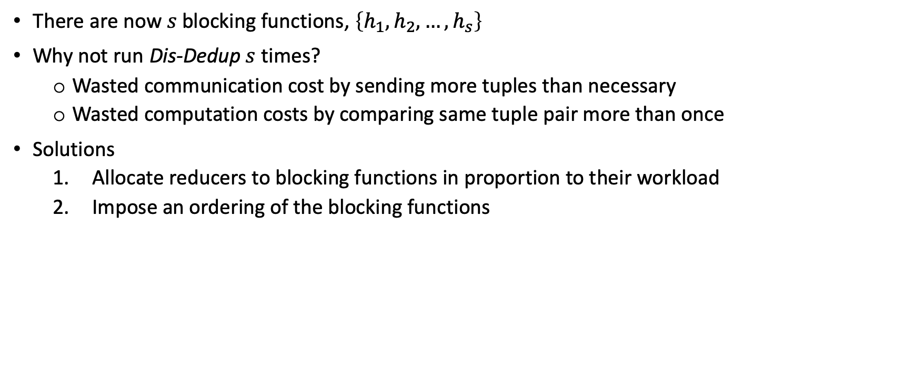
We cannot just run Dis-Dedup multiple times for multiple blocking functions
There are now $s$ blocking functions, $\left\{h_{1},h_{2},…, h_{s}\right\}$
Why not run Dis-Dedup $s$ times?
Wasted communication cost by sending more tuples than necessary
Wasted computation costs by comparing same tuple pair more than once
Solutions
Allocate reducers to blocking functions in proportion to their workload
Impose an ordering of the blocking functions
Notes:
Tuples from blocks generated by different blocking functions might be sent to same reducer, where they will not be compared, wasting communication cost
A tuple pair might be compared multiple times, if that tuple pair belongs to multiple blocks, each from a different blocking function

Slide 24
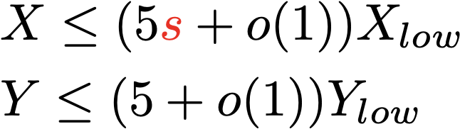
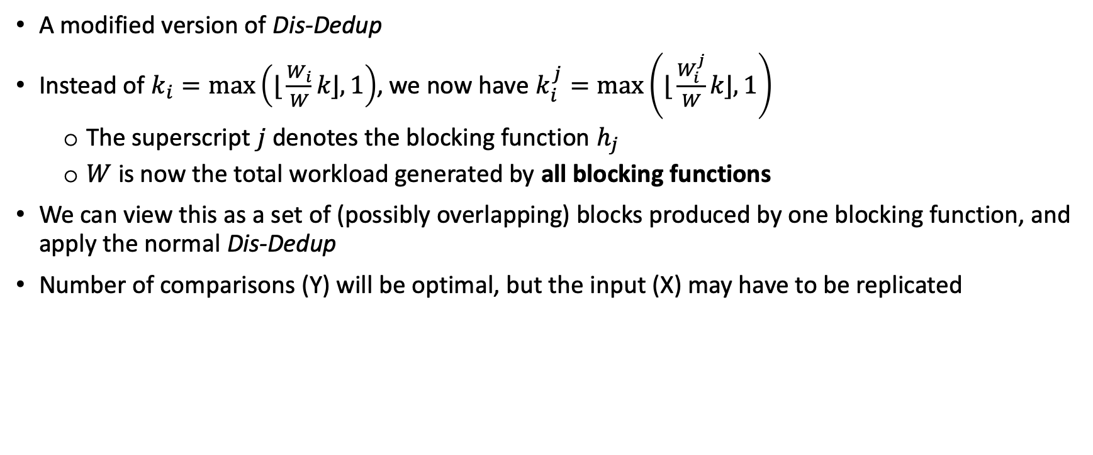
Dis-Dedup+: allocate reducers to blocks in proportion to workload of that blocking function
A modified version of Dis-Dedup
Instead of $k_{i}=\max\left(\text{⌊}\frac{W_{i}}{W}k\text{⌋}, 1\right)$, we now have $k_{i}^{j}=\max\left(\text{⌊}\frac{W_{i}^{j}}{W}k\text{⌋}, 1\right)$
The superscript $j$ denotes the blocking function $h_{j}$
$W$ is now the total workload generated by all blocking functions
We can view this as a set of (possibly overlapping) blocks produced by one blocking function, and apply the normal Dis-Dedup
Number of comparisons (Y) will be optimal, but the input (X) may have to be replicated
Notes:
Reason for s: blocks may overlap, in which case tuples that belong in multiple blocks may be replicated. Worse case: replicated s times, if blocks completely overlap

Slide 25

Dis-Dedup+: impose an ordering of blocking functions to avoid duplicate checking
Order all $s$ blocking functions, and send this order to all reducers
Before a reducer compares two tuples $t_{1}$ and $t_{2}$ generated by $h_{j}$, it checks if any lower numbered blocking functions (i.e., $\{h_{1},…, h_{j−1}\})$ also puts $t_{1}$ and $t_{2}$ in the same block
If it is the case, then there must be another reducer who is also doing that comparison
Notes:
Assumes comparison cost is more than the “checking” cost – pretty much always true in practice

Slide 26
Experimental Studies

Slide 27
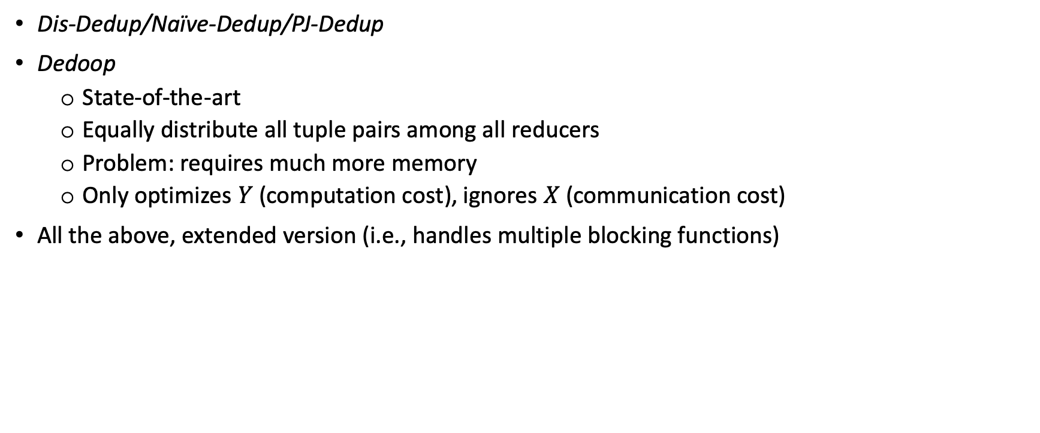
Contest participants
Dis-Dedup/Naïve-Dedup/PJ-Dedup
Dedoop
State-of-the-art
Equally distribute all tuple pairs among all reducers
Problem: requires much more memory
Only optimizes $Y$ (computation cost), ignores $X$ (communication cost)
All the above, extended version (i.e., handles multiple blocking functions)
Notes:
In order for each mapper to decide which tuples to send to which reducer, and for each reducer to decide which tuple pairs to compare, Dedoop loads into the memory of each mapper and reducer a pre-computed data structure, called Block Distribution Matrix, which specifies the number of entities for every block every mapper processes. The size of the block distribution matrix is linear w.r.t. the number of blocks.

Slide 28
Experiments
 | Description | Winner in X | Winner in Y | Winner in Time
1 | Single block: varying number of tuples | Dis-Dedup | Dedoop | Dis-Dedup
2 | Single block: Varying number of reducers | Dis-Dedup | Dedoop | Dis-Dedup
3 | Multiple blocks, single blocking function: Varying number of blocks | Dis-Dedup | Dis-Dedup | Dis-Dedup
4 | Multiple blocks, single blocking function: Varying block size distribution | Dis-Dedup | Dedoop | Dis-Dedup
5 | Multiple blocks, single blocking function: Varying number of reducers | Dis-Dedup | Dis-Dedup | Dis-Dedup
6 | Multiple blocks, multiple blocking functions: Varying number of block functions | Dis-Dedup+ | Dis-Dedup+ | Dis-Dedup+
Notes:
Two real sets of data, one synthetic data
When block size exceeds 500,000 Dedoop encounters memory error and fails
Dedoop evenly distributes the comparisons Y at the cost of an increased input size X, and has a very large memory footprint, rendering it infeasible to run for large datasets.

Slide 29
Closing Remarks

Slide 30
Key Takeaways
Both the communication and the computation costs are important when designing a distributed system
Avoid duplicate comparisons when possible
Strive for even load balancing
Reduce memory footprint
Notes:
Two real sets of data, one synthetic data

Slide 31
Evaluation
Accept
Novel
High technical details
Adequate presentations
Notes:
Two real sets of data, one synthetic data

Slide 32
Future Work
Reduce overlapping tuples sent under multiple blocking functions
Cross-reducer inference?
If A == B and A == C, then don’t need to check if B == C
Spark?
Less I/O time
Lazy execution
Notes:
Two real sets of data, one synthetic data

Slide 33
Thank you

