Slide 1
Review Dynamics in Open-Source Software: A Case Study of OpenStack
Siqi (David) Liu
M.Math. CS, University of Waterloo

Slide 2

Background
Code review is crucial in identifying bugs and maintaining standards.
In open-source software (OSS), code review is done collaboratively with activities visible to the public.
Notes:
-

Slide 3

What if …
Junior reviewers tend to agree with more experienced reviewers?
Reviewers tend to agree with prior reviewers?
Developers who collaborate more often tend to agree with each other?

Slide 4
How does visible information in a code review affect the …
Evaluation Decision?
Defect Proneness?

Slide 5
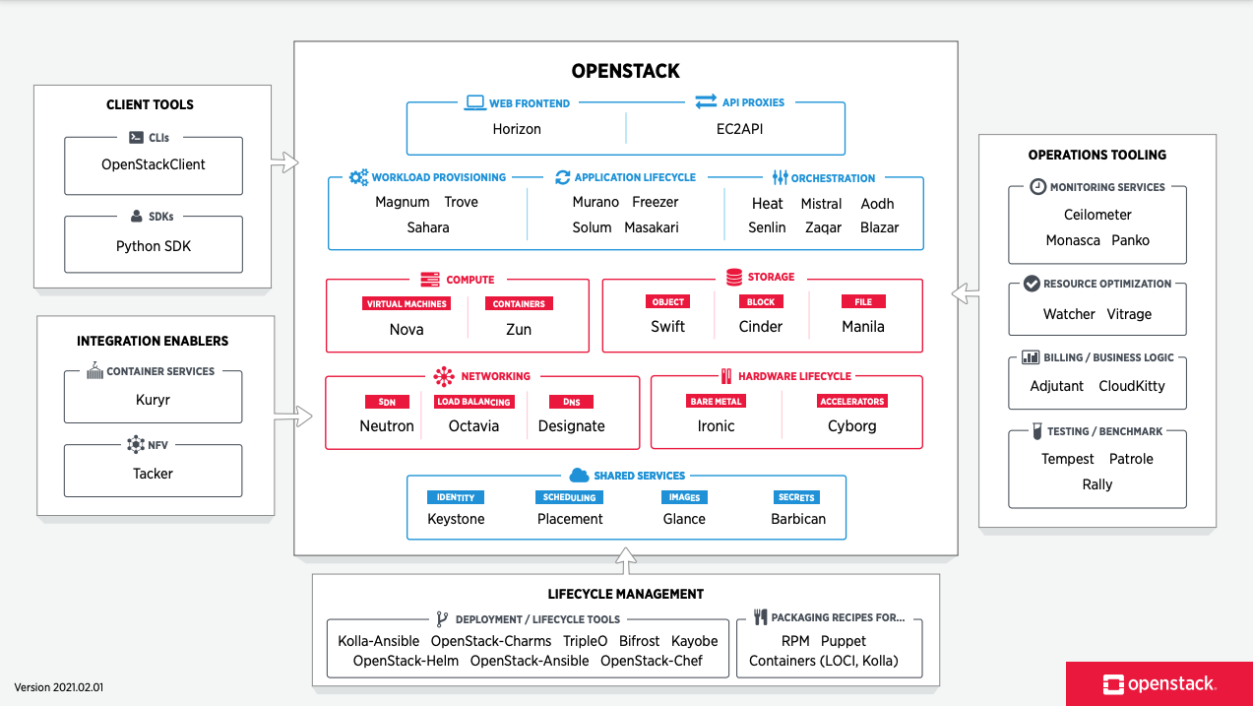
OpenStack is one of the most active open-source projects
With ~30 components, OpenStack is the most widely deployed open-source cloud infrastructure software in the world.

Slide 6
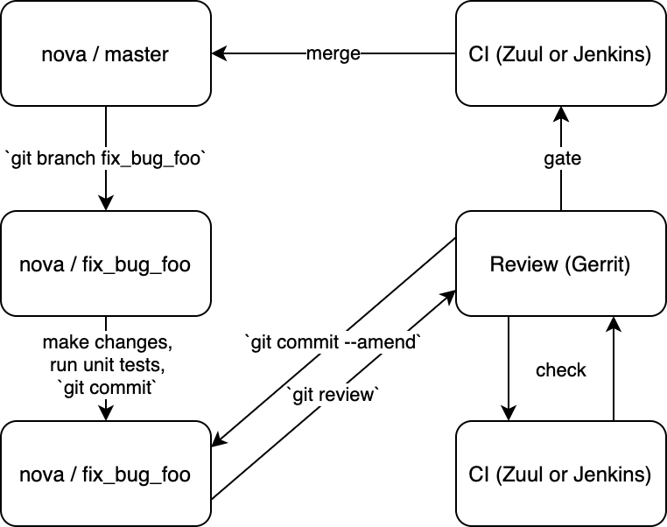
OpenStack Workflow
Notes:
The OpenDev workflow is centered around Gerrit, which uses the concept of changes rather than pull requests

Slide 7
OpenStack Workflow
1. Create a work branch
Notes:
To propose a change to a git repository, you start by cloning the repository you’re interested in, then create a branch to work in.

Slide 8
OpenStack Workflow
1. Create a work branch
2. Propose to Gerrit for review
Notes:
Then, after changes have been made, you propose it to Gerrit using the git-review tool

Slide 9
OpenStack Workflow
3. Gets reviewed/voted on by reviewers
1. Create a work branch
2. Propose to Gerrit for review
3. Runs check tests
3. Make amends and update patch
Notes:
At that point, the proposed change is picked up by our Continuous Integration tool, either Zuul or Jenkins, which runs check tests on it
The change is available for review by human reviewers
Those automated and human checks may result in you having to amend the proposed commit, then propose it again with git-review

Slide 10
OpenStack Workflow
4. Runs gate tests and merge
3. Gets reviewed/voted on by reviewers
1. Create a work branch
2. Propose to Gerrit for review
3. Runs check tests
3. Make amends and update patch
Notes:
Once the change is approved by both the CI system and the human reviewers, Zuul picks it up again and runs gate tests on it before finally merging it.

Slide 11
Example Code Review
https://review.opendev.org/c/openstack/glance/+/387660

Slide 12
Four projects from OpenStack are selected for the study
 | Glance (Training) | Cinder (Training) | Neutron (Training) | Sahara (Validation)
# Patches | 2,936 | 8,518 | 10,575 | 3,164
# Reviewers | 626 | 1,246 | 1,332 | 245
Avg # Reviewers per Patch | 3.8 | 4.5 | 5.4 | 4.4
% Patches w/ >1 Reviewer | 94% | 96% | 100% | 88%
% Reviews w/ Positive Votes | 92% | 88% | 90% | 94%
% Patches Fix Inducing | 57% | 52% | 60% | 50%
RQ1 →
RQ2 →
Notes:
Four core projects from different areas of the ecosystem have ben selected
Training set covers 22k patches from 11/2011 to 07/2019. Reason: mature patches so we know if these patches are fix inducing or not
Almost all patches received votes from more than one reviewer
Recognize class imbalances since 90% of all reviews received a positive vote. This is expected since authors work with reviewers to continuously improve and amend their patch submissions, and reviewers get to re-vote.
Note that we only consider their final vote in our study
56% of patches are fix inducing (SZZ algorithm)

Slide 13
RQ1 – Review Dynamics

Slide 14
Study Design
Data Extraction
Data Cleaning
Model Training
Model Evaluation

Slide 15
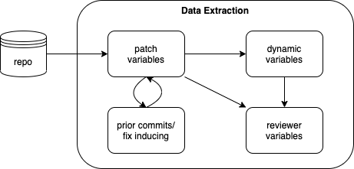
Data Extraction
PyDriller is used to mine repositories.
Gerrit API is used to extract code review comments & votes.

Slide 16
Data is divided into three dimensions
Patch | Dynamic | Reviewer
# Lines Added | # Prior Votes | Reviewer Is Core
# Files Impacted | % Prior Votes Positive | Reviewer Is Experienced Author
Entropy | % Prior Positive Votes From Core Developers | Reviewer Is Experienced Reviewer
Description Length | % Prior Negative Votes From Core Developers | % Prior Comments By Reviewer
Average Cyclomatic Complexity | # Prior Comments | Reviewer Interaction Frequency w/ Author
Is Bug Fixing
# Prior Commits
Author Is Core
… 7 more

Slide 17
Data is divided into three dimensions
Patch | Dynamic | Reviewer
# Lines Added | # Prior Votes | Reviewer Is Core
# Files Impacted | % Prior Votes Positive | Reviewer Is Experienced Author
Entropy | % Prior Positive Votes From Core Developers | Reviewer Is Experienced Reviewer
Description Length | % Prior Negative Votes From Core Developers | % Prior Comments By Reviewer
Average Cyclomatic Complexity | # Prior Comments | Reviewer Interaction Frequency w/ Author
Is Bug Fixing
# Prior Commits
Author Is Core
… 7 more
From Hassan 2009, measures the dispersion in lines changed, normalized by number of files changed

Slide 18
Data is divided into three dimensions
Patch | Dynamic | Reviewer
# Lines Added | # Prior Votes | Reviewer Is Core
# Files Impacted | % Prior Votes Positive | Reviewer Is Experienced Author
Entropy | % Prior Positive Votes From Core Developers | Reviewer Is Experienced Reviewer
Description Length | % Prior Negative Votes From Core Developers | % Prior Comments By Reviewer
Average Cyclomatic Complexity | # Prior Comments | Reviewer Interaction Frequency w/ Author
Is Bug Fixing
# Prior Commits
Author Is Core
… 7 more
Regular expression search of keywords such as “fix”, “bug” and “defect”

Slide 19
Data is divided into three dimensions
Patch | Dynamic | Reviewer
# Lines Added | # Prior Votes | Reviewer Is Core
# Files Impacted | % Prior Votes Positive | Reviewer Is Experienced Author
Entropy | % Prior Positive Votes From Core Developers | Reviewer Is Experienced Reviewer
Description Length | % Prior Negative Votes From Core Developers | % Prior Comments By Reviewer
Average Cyclomatic Complexity | # Prior Comments | Reviewer Interaction Frequency w/ Author
Is Bug Fixing
# Prior Commits
Author Is Core
… 7 more
Commits that last modified the same lines that the current commit modified

Slide 20
Data is divided into three dimensions
Patch | Dynamic | Reviewer
# Lines Added | # Prior Votes | Reviewer Is Core
# Files Impacted | % Prior Votes Positive | Reviewer Is Experienced Author
Entropy | % Prior Positive Votes From Core Developers | Reviewer Is Experienced Reviewer
Description Length | % Prior Negative Votes From Core Developers | % Prior Comments By Reviewer
Average Cyclomatic Complexity | # Prior Comments | Reviewer Interaction Frequency w/ Author
Is Bug Fixing
# Prior Commits
Author Is Core
… 7 more
If current commit is bug fixing, then its prior commits are fix inducing

Slide 21
Data is divided into three dimensions
Patch | Dynamic | Reviewer
# Lines Added | # Prior Votes | Reviewer Is Core
# Files Impacted | % Prior Votes Positive | Reviewer Is Experienced Author
Entropy | % Prior Positive Votes From Core Developers | Reviewer Is Experienced Reviewer
Description Length | % Prior Negative Votes From Core Developers | % Prior Comments By Reviewer
Average Cyclomatic Complexity | # Prior Comments | Reviewer Interaction Frequency w/ Author
Is Bug Fixing
# Prior Commits
Author Is Core
… 7 more
Reviewer has authored/reviewed the prior commits

Slide 22
Data is divided into three dimensions
Patch | Dynamic | Reviewer
# Lines Added | # Prior Votes | Reviewer Is Core
# Files Impacted | % Prior Votes Positive | Reviewer Is Experienced Author
Entropy | % Prior Positive Votes From Core Developers | Reviewer Is Experienced Reviewer
Description Length | % Prior Negative Votes From Core Developers | % Prior Comments By Reviewer
Average Cyclomatic Complexity | # Prior Comments | Reviewer Interaction Frequency w/ Author
Is Bug Fixing
# Prior Commits
Author Is Core
… 7 more
% of patches the author has written that were also reviewed by the reviewer

Slide 23
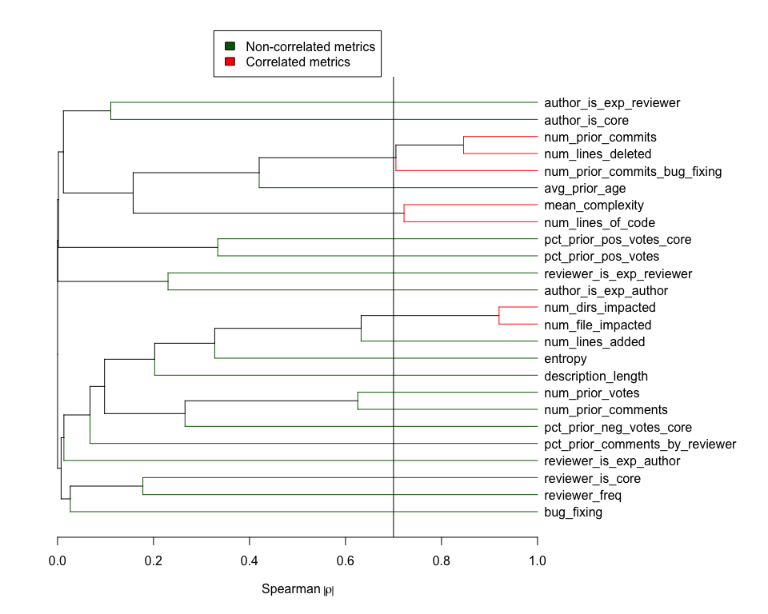
Variables that are highly correlated are removed
Spearman’s rank correlation coefficient (ρ) with threshold of 0.7 is used.
Var A | Var B | |ρ| | Survived Var
# Directories Impacted | # Files Impacted | 0.93 | #Directories Impacted
# Prior Commits | # Lines Deleted | 0.86 | # Lines Deleted
Average Complexity | # Lines of Codes | 0.73 | Average Complexity
# Prior Commits Bug Fixing | # Lines Deleted | 0.71 | # Lines Deleted

Slide 24
Linear Mixed Model (LMM) is used since our data is hierarchical
Linear Mixed Model (LMM) is an extension of simple linear model to allow both fixed and random effects.
LMMs are used when there is a hierarchical structure to the data. The variability in the outcome can be either within group, or between groups.
In our case, the random effects/groups are the reviewers.
Groups: reviewers
Dots: reviews
Notes:
Fixed effects are parameters that do not vary, while random effects are random variables themselves.

Slide 25
We train a full model, a null model, and three separate models excluding each data dimension
Since we want to understand how evaluation decision is affected, we use positive vote as our target (binary) variable.
Model | Formula | # Fixed Vars
Full | Positive Vote ~ Patch Vars + Dynamic Vars + Reviewer Vars + (1 | Reviewer ID) | 21
Ex-Patch | Positive Vote ~ Dynamic Vars + Reviewer Vars + (1 | Reviewer ID) | 10
Ex-Dynamic | Positive Vote ~ Patch Vars + Reviewer Vars + (1 | Reviewer ID) | 16
Ex-Reviewer | Positive Vote ~ Patch Vars + Dynamic Vars + (1 | Reviewer ID) | 16
Null | Positive Vote ~ 1 + (1 | Reviewer ID) | 0

Slide 26
We evaluate the model performance using AUC
Larger the AUC (closer to 1), better the discriminant ability.
Model | AUC | X of Null AUC
Null | 0.72
Ex-Patch | 0.81 | 1.12
Ex-Dynamic | 0.77 | 1.06
Ex-Reviewer | 0.82 | 1.14
Full | 0.82 | 1.14

Slide 27
We estimate the explanatory power of each data dimension by performing log-likelihood ratio tests
Log-likelihood ratio tests assess the goodness of fit of two competing models based on the ratio of their likelihoods. Large LR means the two models are different.
Model A (Less Complex) | Model B (More Complex) | Δ D.F. | LR | % of Full LR
Null | Full | 21 | 8,768
Ex-Patch | Full | 11 | 1,512 | 17%
Ex-Dynamic | Full | 5 | 5,934 | 68%
Ex-Reviewer | Full | 5 | 326 | 4%
Since reviewer characteristics do not offer significant performance increase, we use Ex-Reviewer model as our final model.

Slide 28
We estimate the explanatory power of each individual variable in the final model by calculating its Wald statistics
Patch Var | χ² | Sign
# Lines Deleted | 2,109 | +
# Lines Added | 547 | -
Entropy | 469 | -
Description Length | 239 | -
Author Is Core | 102 | +
# Directories Impacted | 86 | -
Author Is Experienced Reviewer/Author | 51/26 | +/+
Dynamic Var | χ² | Sign
% Prior Votes Positive | 4,013 | +
# Prior Votes | 39 | -
% Prior Negative/Positive Votes From Core Developers | 33/23 | -/+
Variables with p-value < 0.001 are shown
Notes:
Wald Chiq-Squared test is a rough approximation of the likelihood ratio test
A way to see if variables are significant

Slide 29
We estimate the explanatory power of each individual variable in the final model by calculating its Wald statistics
Patch Var | χ² | Sign
# Lines Deleted | 2,109 | +
# Lines Added | 547 | -
Entropy | 469 | -
Description Length | 239 | -
Author Is Core | 102 | +
# Directories Impacted | 86 | -
Author Is Experienced Reviewer/Author | 51/26 | +/+
Could be due to prior commits (removed in correlation test)
Dynamic Var | χ² | Sign
% Prior Votes Positive | 4,013 | +
# Prior Votes | 39 | -
% Prior Negative/Positive Votes From Core Developers | 33/23 | -/+
Variables with p-value < 0.001 are shown

Slide 30
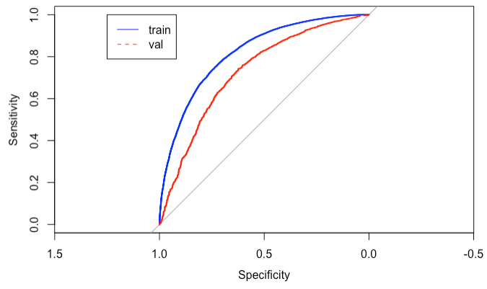
We validate the final model against the unseen project
Model | Training AUC | Validation AUC
Ex-Review | 0.82 | 0.73

Slide 31
RQ1 Conclusion
Review dynamics, particularly the proportion of prior positive votes have a significant impact on the evaluation decision of a reviewer.
Unlike in the original paper, we do not observe significant association between the relationship (interaction frequency) with the patch author and the evaluation decision of a reviewer.
The final model also does not perform well on the validation dataset. This could be due to the random effect of the reviewers.

Slide 32
RQ2 – Defect Proneness

Slide 33
Study Design
Metrics Formulation
Data Cleaning
Model Training
Model Evaluation

Slide 34
Based on results from RQ1, we formulate six “social” metrics for measuring review dynamics
Dynamic Variable | Sign | Social Metric
% Prior Votes Positive | + | % Positive Voters Consistent w/ Prior Positive Votes
% Prior Votes Negative | - | % Positive Voters Inconsistent w/ Prior Negative Votes
% Prior Positive Votes From Core Developers | + | % Positive Voters Consistent w/ Prior Core Positive Votes
% Prior Negative Votes From Core Developers | - | % Positive Voters Inconsistent w/ Prior Core Negative Votes
# Prior Votes | - | Average # Prior Votes for Positive Voters
# Prior Comments | - | Average # Prior Comments for Positive Voters

Slide 35
We also add patch characteristics from RQ1, and some aggregated review characteristics and combine each patch into one data point
Patch | Review | Social
# Lines Added | # Votes | % Positive Voters Consistent w/ Prior Positive Votes
# Files Impacted | # Comments | % Positive Voters Inconsistent w/ Prior Negative Votes
Entropy | % Positive Votes | % Positive Voters Consistent w/ Prior Core Positive Votes
Description Length |  | % Positive Voters Inconsistent w/ Prior Core Negative Votes
Average Cyclomatic Complexity |  | Average # Prior Votes for Positive Voters
Is Bug Fixing |  | Average # Prior Comments for Positive Voters
# Prior Commits
Author Is Core
… 7 more

Slide 36
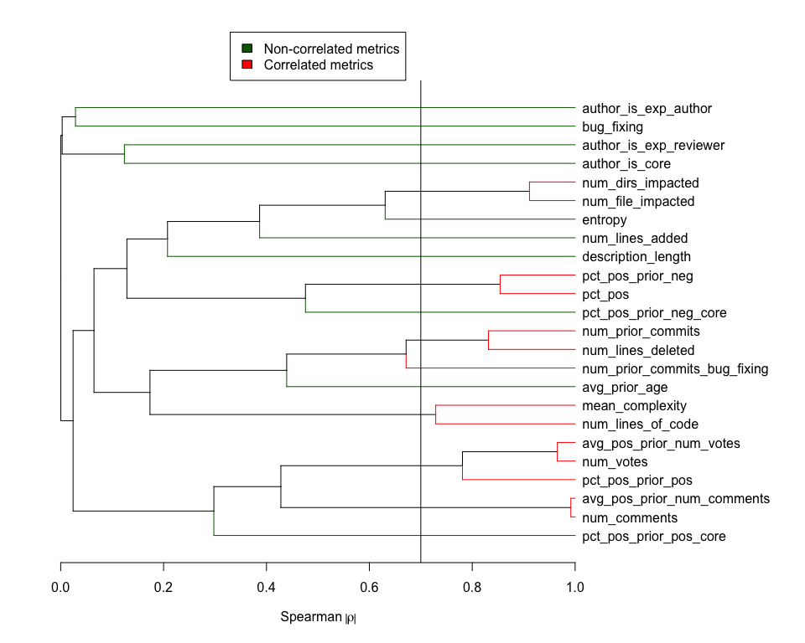
Variables that are highly correlated are removed
Dimension | Removed Vars
Patch | # Files Impacted
Patch | # Prior Commits
Patch | # Lines of Code
Review | # Votes
Social | Average # Prior Votes for Positive Voters
Social | Average # Prior Comments for Positive Voters
Social | % Positive Voters Inconsistent w/ Prior Negative Votes

Slide 37
We train a full model, a null model, and three separate models excluding each data dimension
We use fix inducing as our target (binary) variable. Note that we are using generic GLM instead of mixed-effect linear model.
Model | Formula | # Vars
Full | Fix Inducing ~ Patch Vars + Review Vars + Social Vars | 17
Ex-Patch | Positive Vote ~ Review Vars + Social Vars | 5
Ex-Review | Fix Inducing ~ Patch Vars + Social Vars | 15
Ex-Social | Fix Inducing ~ Patch Vars + Review Vars | 14
Null | Fix Inducing ~ 1 | 0

Slide 38
Model performance
Model | AUC | X of Null AUC
Null | 0.500
Ex-Patch | 0.665 | 1.33
Ex-Review | 0.783 | 1.57
Ex-Social | 0.777 | 1.55
Full | 0.784 | 1.57

Slide 39
Log-likelihood ratio tests
Model A (Less Complex) | Model B (More Complex) | Δ D.F. | LR | % of Full LR
Null | Full | 17 | 5,402
Ex-Patch | Full | 12 | 3,373 | 62%
Ex-Review | Full | 2 | 98 | 2%
Ex-Social | Full | 3 | 359 | 7%
Since review characteristics do not offer significant performance increase, we use Ex-Review model as our final model.

Slide 40
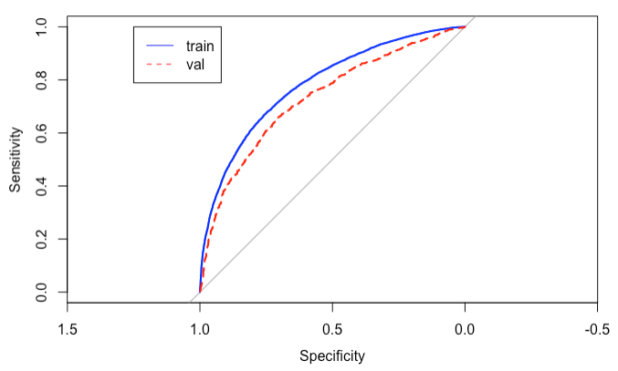
We validate the final model against the unseen project
Model | Training AUC | Validation AUC
Ex-Review | 0.78 | 0.73

Slide 41
Final model Wald statistics
Patch Var | χ² | Sign
Average Prior Commits Age | 494 | -
Entropy | 410 | +
# Lines Added | 298 | +
Is Bug Fixing | 127 | +
# Prior Commits Bug Fixing | 92 | +
Description Length | 70 | -
# Directories Impacted | 69 | +
# Lines Deleted | 31 | -
Social Metrics | χ² | Sign
% Positive Voters Consistent w/ Prior Core Positive Votes | 232 | +
% Positive Voters Consistent w/ Prior Positive Votes | 174 | -
% Positive Voters Inconsistent w/ Prior Core Negative Votes | 45 | -
Variables with p-value < 0.001 are shown

Slide 42
RQ2 Conclusion
Review dynamic metrics and the likelihood of inducing fixes do not have as strong of an association as those of patch characteristics.

Slide 43
Discussion

Slide 44
Our study shows several implications in an open code review
Dynamics
Patch
Reviewers
Reviewers tend to adhere to opinions of the community.
However, this has little impact on the patch qualities.
Reviewers tend to prefer patches with low entropy and small modifications.
High entropy is also associated with high likelihood of defects.
There is no evidence of strong association between the reviewer’s own characteristics (including past relationship with the author) and the vote outcome.

Slide 45
Some personal lessons learned
Data
Model
Always use virtual environments to ensure package consistencies and reproducibility.
Conduct thorough spot-checks on data points, covering all possible scenarios, to make sure that the data pipeline is correct.
LMM is useful in situations with random effects.
Always conduct validation against unseen datasets to check for generalizability.

