Slide 1
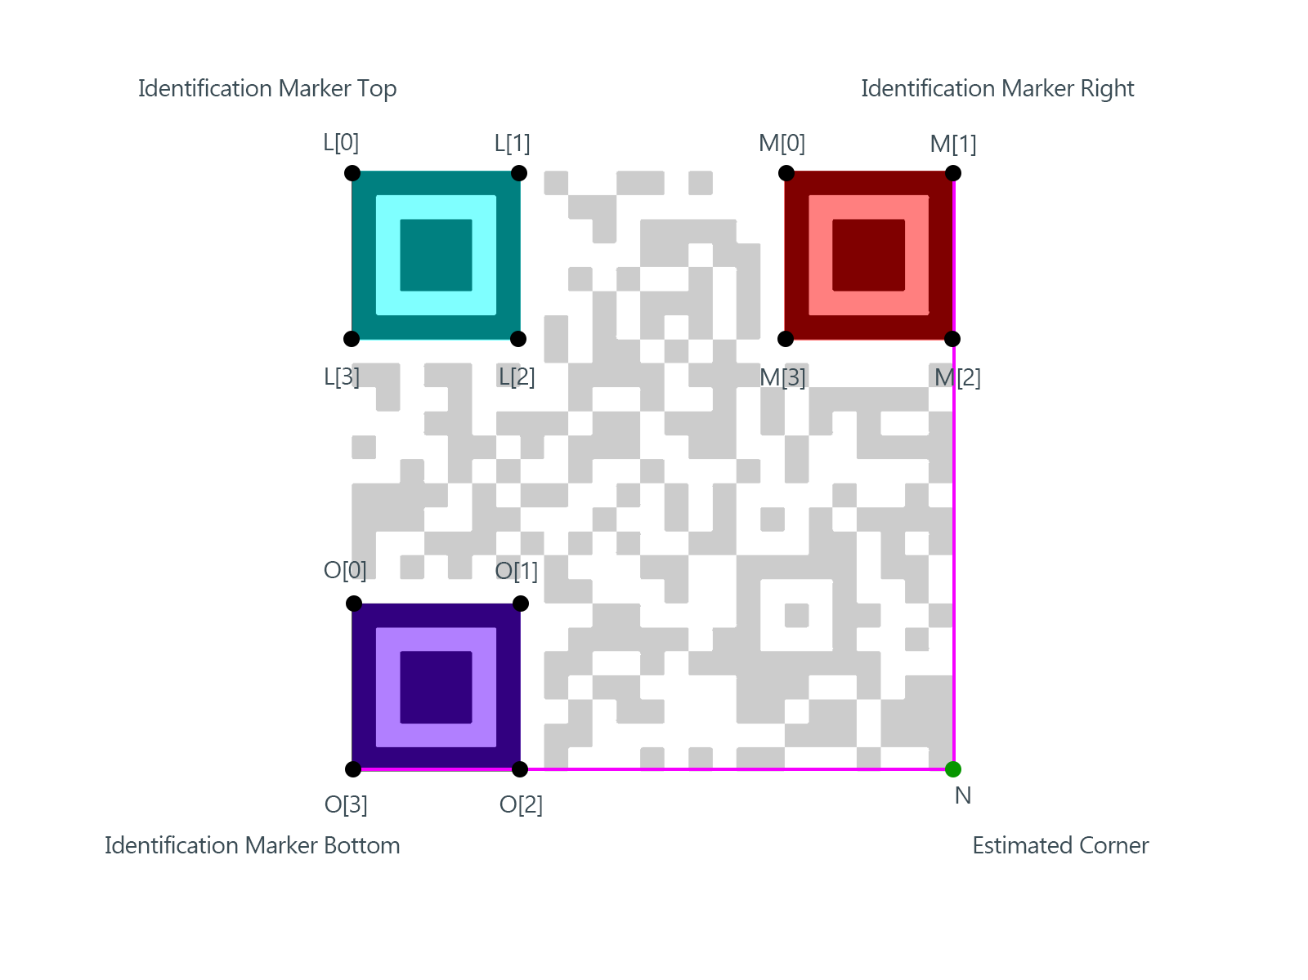
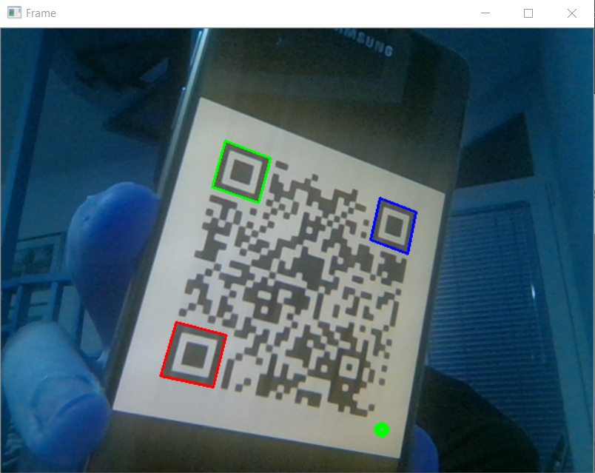
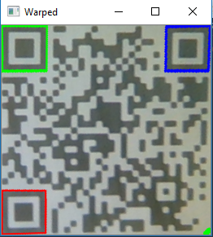
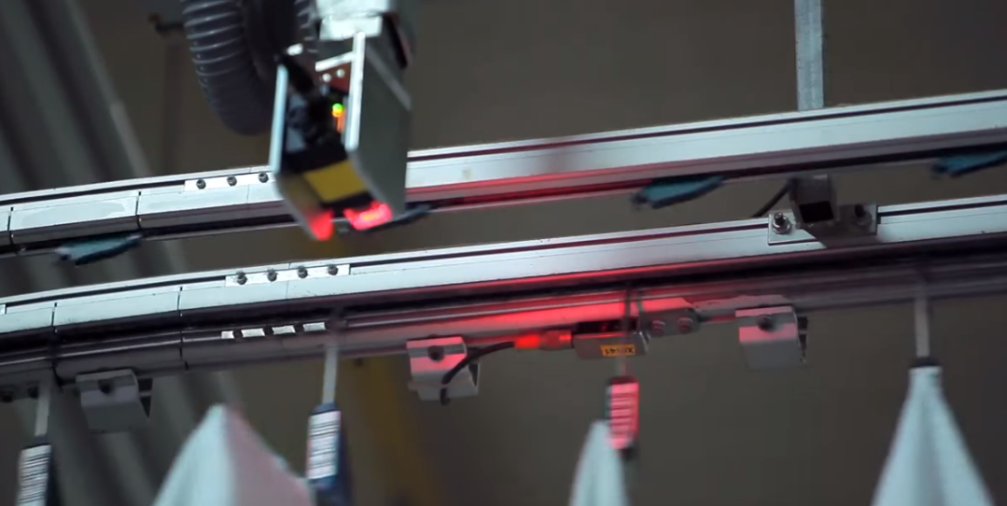
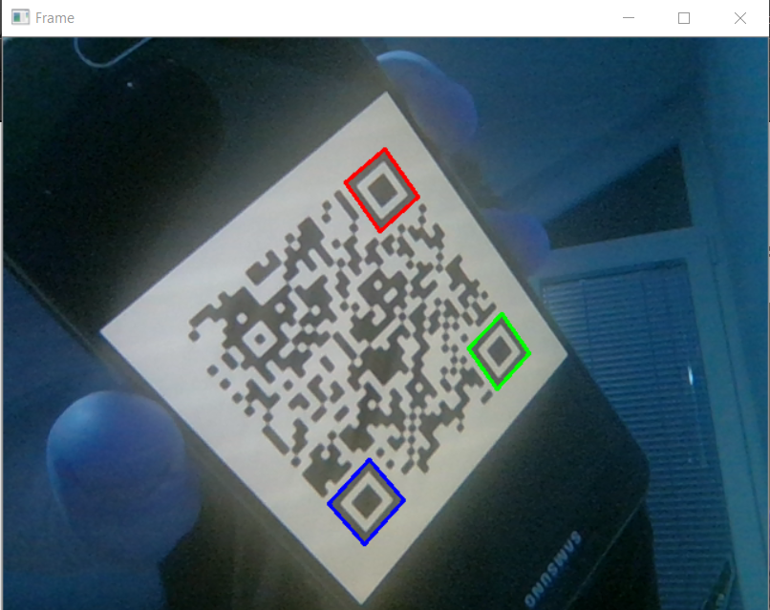
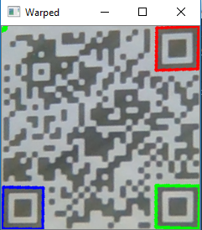
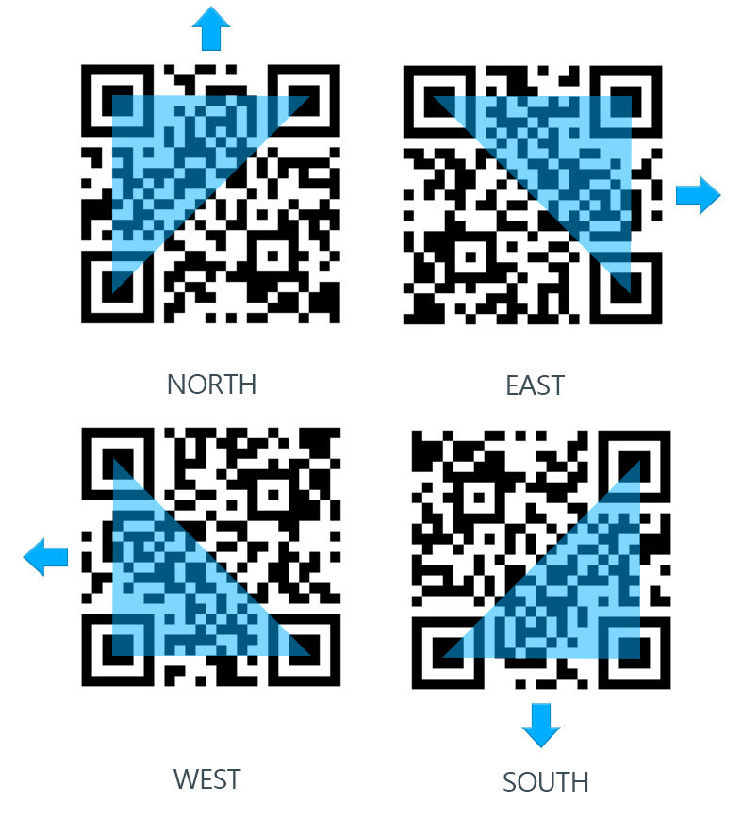
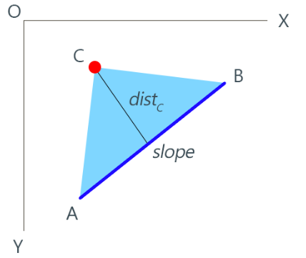

QR Code Detection Algorithm Using OpenCV
Introduction
It is often an imperative in industrial production and processes, to keep track of production components, current state of process, as well as timely ordering of new components.
A modern way of handling this problem is mapping components to appropriate Bar and QR codes.
This algorithm directly addresses the need of detecting QR codes in a production environment.
Identification Markers
QR detection algorithm depends on finding Identification Markers and determining their orientation.
Every QR code contains exactly three markers: Top, Right and Bottom
Results
Algorithm efficiency, especially the decoding aspect, while testing proved to be very subjective to camera quality and lighting when using decoding library like Zbar.
Besides that, QR code detection rate was quite satisfactory, no matter the angle and orientation.
Found markers on individual frame(left) and isolated region after transformation(right), regular orientation(NORTH)
Usage of Barcode detection in textile industry
Top marker(green), right marker(red), bottom marker(purple) and intersection point(green dot)
Method
Adaptive thresholding for contour detection on a individual frame.
Detecting “Identification marker” contours using contour hierarchy.
Determining orientation of the QR code based on previously found Pattern contours, as well as rearranging them appropriately.
Isolating the QR code from the rest of the frame and applying “Geometric Image Transfromation” on the isolated region.
Determining orientation
Finding orientation comes down to simple calculus and analytical geometry.
Imperative is finding a slope of longest side of markers BOTTOM and RIGHT.
Found markers on individual frame while QR code is turned(left) and isolated region after transformation(right), non-regular orientation(SOUTH)
References
Markers - http://qrcode.meetheed.com/question14.php
Transformation - https://docs.opencv.org/2.4/modules/imgproc/doc/geometric_transformations.html
Author
David Stanojević, Student of Faculty of Technical Sciences in Novi Sad
Calculated slope on point A(Bottom) and B(Right)

