Slide 1
EDGE INTELLIGENCE FOR CONNECTED FLEETS
Welcome! We'll begin shortly.
Apache Pulsar facts
COMPUTE ≠ STORAGE
Pulsar separates stateless brokers from durable storage (Apache BookKeeper), so each scales independently with no data rebalancing.
Grab a coffee and settle in. While you wait, here are some interesting facts about Apache Pulsar
←
→
02 / 12
STARTING IN
4:42
Notes:
Lobby slide. Leave up while attendees join; the countdown and Pulsar facts run on their own.

Slide 2
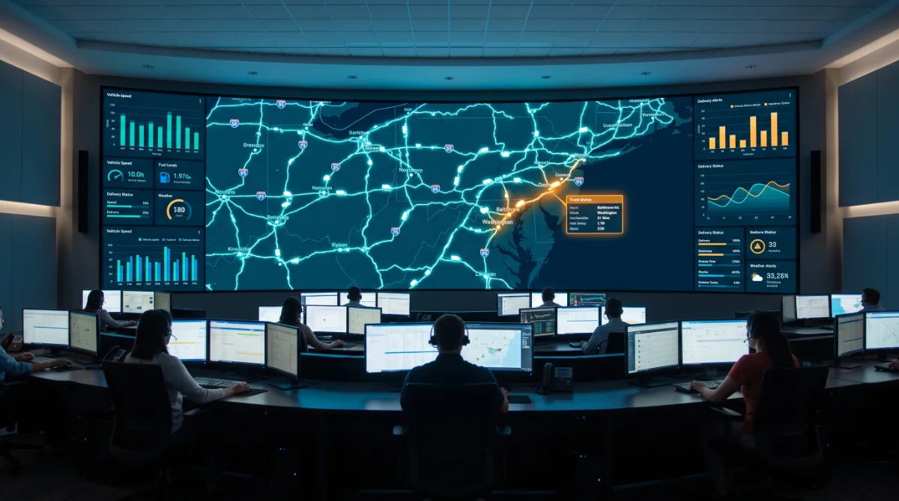
You're the Controller
Truck-47 is slowing on I-95N. You'll find out minutes from now. By then, the trucks behind it are headed into the same jam.
Notes:
You're the controller in a fleet operations center, watching every semi truck on the map at once, like air traffic control. Truck-47, a chemical tanker, starts slowing on I-95N in heavy rain. Your job is to catch that and reroute the trucks behind it before they reach the same stretch. But with today's setup you see it minutes from now, after the readings make the trip to the cloud and back. By then it is too late to reroute.

Slide 3
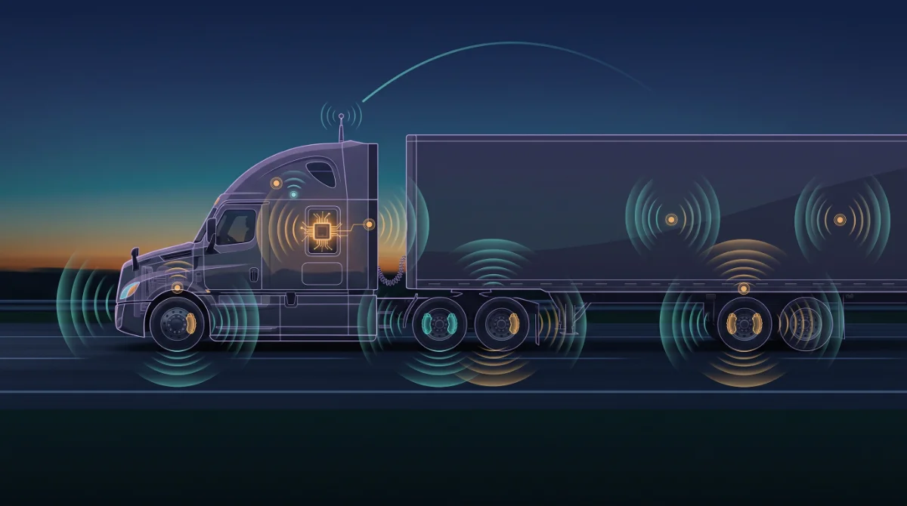
Every Truck Reports In
A small onboard computer collects sensor readings from across the rig and sends them back to the control center over cellular.
Notes:
Each rig carries a small onboard computer that collects readings from sensors across the tractor and sends them back to the control center over cellular. Everything you see on that control room map depends on what this computer sends, and how fast.

Slide 4
How would you fix it?
Edge Intelligence for Connected Fleets
Notes:
Ask the room, and wait for answers. Take two or three. Most will be one of two: put real AI compute on the truck, or send more data to the cloud, faster. Both are reasonable. Both fail, and the next two slides show why.

Slide 5
Put an AI Computer on Every Truck? Too Expensive.*
$3,000+
130W
A few years
per vehicle for a high-end AV platform
power draw, plus liquid cooling and wiring
before the hardware is obsolete
Edge Intelligence for Connected Fleets
*Thor: NVIDIA DRIVE AGX Thor developer docs (Dec 2025); chip price est. MarketResearch.com (2025). HW4: SemiAnalysis teardown (TOPS, memory); Electrek (2025, power est.); OEM service-unit listing (cost).
Notes:
The first answer: put real AI compute on every truck. Here is what that costs. A vehicle maker that wants true local intelligence treats the vehicle like a moving data center: dedicated automotive silicon like NVIDIA DRIVE Thor or Tesla's HW4 computer, thousands of dollars per vehicle, liquid cooling, and a large power budget. Multiply that across a fleet and the budget explodes. It is also why these features stay in premium tiers. Features also age with the vehicle, so they are obsolete within a few years.
Spec detail if asked: NVIDIA DRIVE Thor is 1,000 to 2,000 TOPS, a 14-core Arm Neoverse V3AE CPU, a Blackwell GPU, 64 to 128 GB of RAM, roughly 40 to 130 watts, and an estimated $600 to $1,300 per chip. Tesla HW4 is about 243 TOPS across two chips, 20 Cortex-A72 cores and 3 NPUs per chip, 16 GB of GDDR6, an estimated 80 to 100 watts, and about $3,640 as a service unit. HW4 specs are from teardown analysis; Tesla does not publish them.

Slide 6
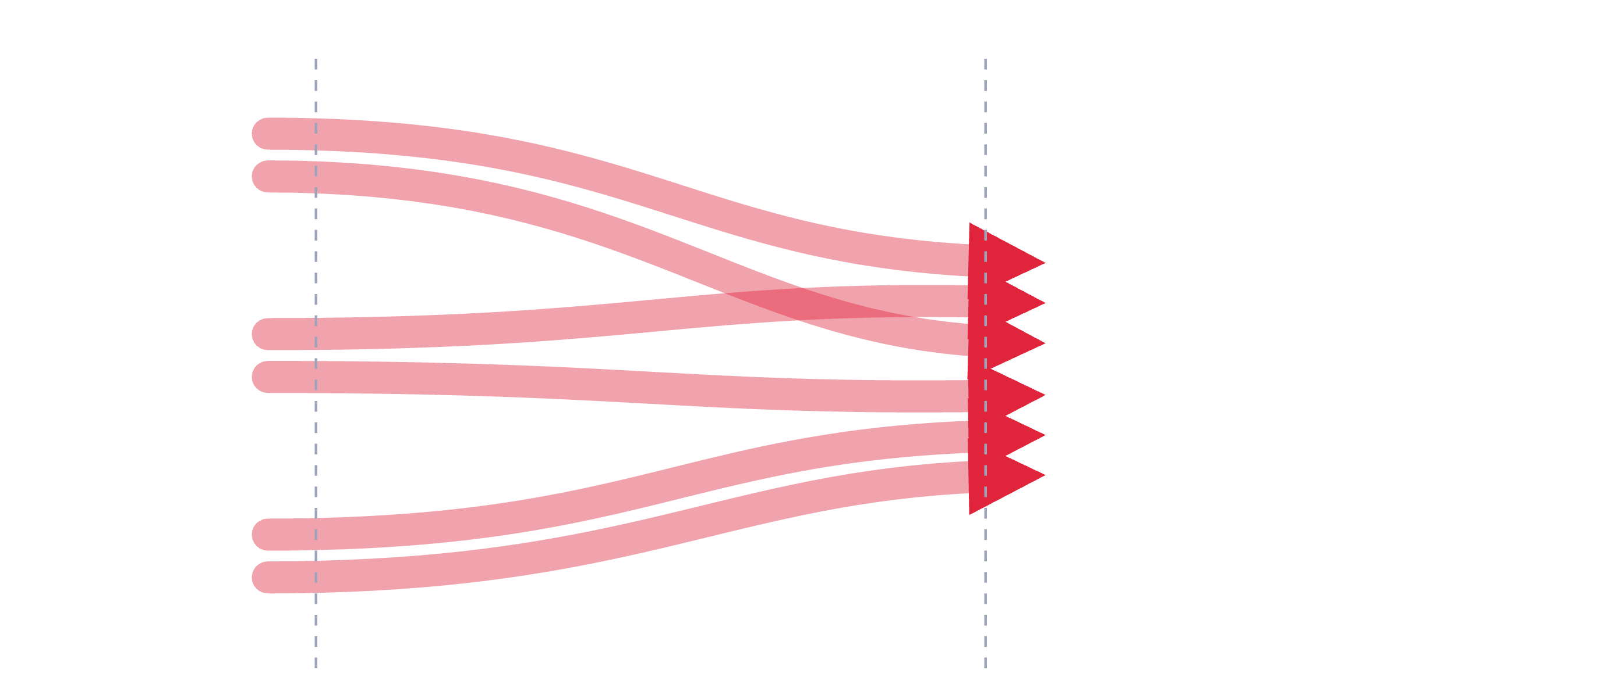







Stream Everything to the Cloud? Too Slow.
Dumb Edge
High-Latency Cellular Pipeline
Cloud Core
RPM
Overloaded
Ingestion Queues
Overloaded
GPS
Stream Processing
Lagging
Brake wear
Data Lakes
Up to 95% Noise Data
raw, unfiltered
DECISION LATENCY
DATA EFFICIENCY
NETWORK RISK
BEFORE
10s – minutes
BEFORE
Up to 95% noise data
BEFORE
Visibility lost in dead zones
AFTER
Sub-second
AFTER
Up to 90% bandwidth savings
AFTER
Offline autonomy
Edge Intelligence for Connected Fleets
Notes:
The second answer: send more to the cloud and decide there. That is how fleet observability works today. Every truck is a dumb edge: it streams raw, unfiltered telemetry, RPM, GPS, brake wear, continuously, over a high-latency cellular pipeline into one cloud core. That core has to ingest, queue, process and store all of it, and most of it is normal, repetitive readings. Three costs follow. Decision latency: a critical safety event has to make a full cloud round-trip, tens of seconds to minutes, before anyone acts. Bandwidth bleed: you pay cellular costs to ship noise. And network dependency: when a truck drives into a dead zone, you lose it entirely. That is why you, the controller, saw truck-47 minutes late.

Slide 7
Edge Intelligence for Connected Fleets: 1-Bit LLMs Inside Apache Pulsar Functions
David Kjerrumgaard
Apache Pulsar Committer
Notes:
So that's the problem. I'm David Kjerrumgaard, and I'm a committer on Apache Pulsar.
Before we go further, a quick word about the title. When I submitted this talk, the plan was to use 1-bit LLMs. When I tried them, they didn't run on Linux. So I switched to small quantized models that do run on a Raspberry Pi. By small, I mean open-weight models between about 4 and 8 billion parameters: Phi-3.5-mini, Gemma 3 4B, and Llama 3.1 8B. By quantized, I mean their weights are compressed to roughly 4 bits each, using a format called Q4_K_M, so the whole model fits in a few gigabytes of RAM and runs on the CPU. No GPU, no NPU. Everything you'll see today uses those models.

Slide 8
WHAT YOU'LL LEAVE WITH
Move the judgment onto the truck, on a CPU that costs a few hundred dollars, and send only what matters.
Edge Intelligence for Connected Fleets
Notes:
Here is what you will leave with. Both answers you just saw fail for the same reason: the judgment happens in the wrong place. In this talk you will see how to move it onto the truck, running a small LLM inside Apache Pulsar Functions on a CPU that costs a few hundred dollars, and how to decide which data never needs to leave the truck. When the hardware costs a few hundred dollars, this stops being something only the biggest fleets can afford.

Slide 9
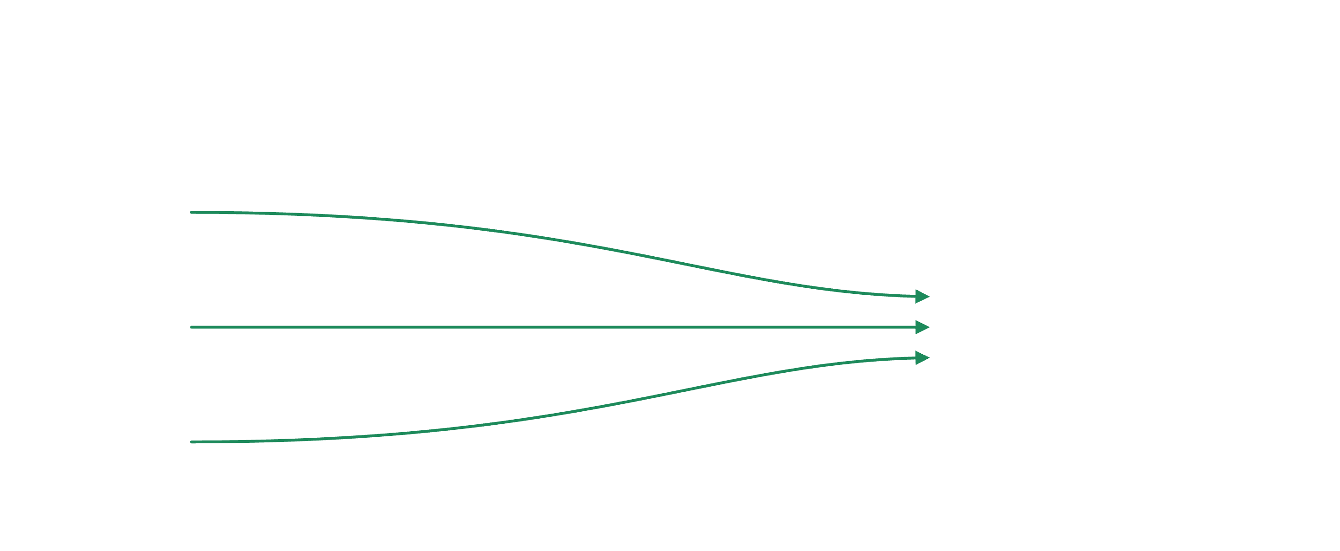












Put the Judgment on the Truck
Commodity Edge Node (Raspberry Pi 4 Class Hardware / 4GB-8GB RAM)
Small LLM · Edge Diagnostics Model
Smart Edge
Lean Cloud Core
Operations Control Center
Filtered Anomalies Only (Up to 90% Bandwidth Savings)
Sub-second Local Action
DECISION LATENCY
DATA EFFICIENCY
NETWORK RISK
BEFORE
10s – minutes
BEFORE
Up to 95% noise data
BEFORE
Visibility lost in dead zones
AFTER
Sub-second
AFTER
Up to 90% bandwidth savings
AFTER
Offline autonomy
Edge Intelligence for Connected Fleets
Notes:
Now you're the engineer who has to build the fix. Same fleet, with the judgment moved onto the truck, and it doesn't take a mobile supercomputer. Each truck gets a commodity edge node, Raspberry Pi 4 class hardware with 4 to 8 GB of RAM, running a small LLM as a lightweight diagnostics layer. The node acts as a gatekeeper: it runs inference on the truck's telematics locally, with no cloud connection required, and only filtered anomalies go over cellular. Massive compute is not what buys the bandwidth savings; putting judgment at the edge does. And because the hardware is ordinary, any fleet can do this, not just the ones that can pay for premium AI platforms. Whether it really performs on a Pi is the next question.

Slide 10




The Same Approach Fits in a Driver's Pocket
The Driver's Phone
A Plug-In Dongle
$0 Incremental Cost
$100s Retail Cost
A small LLM runs on the phone's processor and talks to the car over Bluetooth or a $15 OBD-II dongle. Source: ELM327 Bluetooth adapters, ~$5–30 retail
A small, low-power device with a Pi-class chip that plugs into the dashboard.
Test bed (stand-in for a consumer device): Raspberry Pi 4 · 4-core Arm Cortex-A72 · 8GB RAM
Works with the 1.4 billion cars already on the road. Source: ~1.475B passenger cars in use, 2024 (WhichCar)
No fans, heavy wiring, or battery drain.
Moving the decision to small LLMs on handheld hardware cuts costs significantly and reaches every driver.
Edge Intelligence for Connected Fleets
Notes:
The dream of democratization happens when we stop trying to change the car's hardware and instead change the software's footprint. Optimize the model down far enough and the compute requirement shrinks to something already in every driver's pocket, their phone, or to a small plug-in dongle in the Pi class. That's how edge intelligence moves from a luxury option toward a universal safety standard. And trucks are just the example. The same pattern fits any industrial IoT use case where devices produce a large amount of telemetry: process it where it is produced, and send only what matters.

Slide 11
Small LLMs on Ordinary CPUs
The end result of extended testing, with every lesson already built in
Edge Intelligence for Connected Fleets
Notes:
When I first heard about these small LLMs that can run on CPUs, I became intrigued. What can I actually do with them? I have deployed traditional ML models in edge environments before, and I wondered if I could build on that success to include LLMs.
So I picked a target platform: a Raspberry Pi 4. The full pipeline runs end to end on one. Some of the model screening, like the accuracy checks that decided which models suit the task, ran on a Mac to save time, because the Mac is much faster. Later in the talk you'll see the Pi numbers, and then the pipeline running.
One thing to know up front: what you'll see today is the end result of a long stretch of testing. Everything that testing taught me, which settings to use, how to prompt the models, and how to test them, is already built into this pipeline. The story of how I got there is Part 2.

Slide 12







Shrink the Model Until It Fits the Hardware
Traditional LLM
Small LLM
MODEL FOOTPRINT
Smaller LLMs deployed on the edge can solve both problems.
quantize
Large, full-precision weights
Small, dense weights
REQUIRED SILICON
GPU / NPU accelerator
General-purpose CPU loop
Edge Intelligence for Connected Fleets
Notes:
The proposed solution flips the usual approach. Instead of adding hardware until a model fits, shrink the model until it fits the hardware that's already there. Small LLMs compress what a traditional model does that needs GPU or NPU acceleration into something small and dense enough to run in a pure CPU execution loop. Removing the accelerator dependency is deliberate: it's what lets the software target ubiquitous silicon.

Slide 13
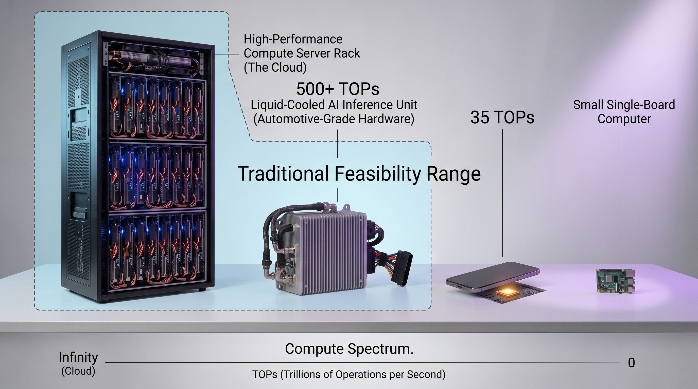
From GPU Racks to a CPU with Zero AI TOPS*
"If a small LLM reasons successfully on an unassisted Pi CPU, it can run effortlessly on consumer smartphones."
Edge Intelligence for Connected Fleets
*Sources: Apple A18 Pro Neural Engine, 35 TOPS (Apple). Pi 4 class edge node: $100s
Notes:
Cloud cores have effectively unlimited GPU clusters. Luxury edge AV platforms bring 500-plus TOPS of dedicated NPU. Smartphones sit around 35 to 80 TOPS of NPU. At the far right is the commodity test-bed: a Raspberry Pi 4, a quad-core ARM CPU with zero AI TOPS. Traditionally, running an LLM was only feasible from the cloud to the luxury edge. The bet of this talk is that small LLM architectures extend feasibility all the way to the Pi, which stands in here for a consumer electronic device. And if a small LLM reasons successfully on an unassisted Pi CPU, it can run effortlessly on consumer smartphones.

Slide 14
Apache Pulsar on the Truck
Edge Intelligence for Connected Fleets
Notes:
You're still the engineer. Here is how Apache Pulsar Functions and a small LLM fit together on the truck.

Slide 15





What are Apache Pulsar Functions?
Runs in the Broker
Topic In, Alert Out
Small Enough for a Truck
topic
ƒ(x)
one thread on an embedded node
broker
ƒ(x)
alert
One broker, multiple protocols:
MQTT
Kafka
Pulsar
Edge Intelligence for Connected Fleets
Notes:
A quick point of reference for anyone who hasn't used them. Pulsar Functions are lambda-style serverless compute that runs inside the messaging layer, so there's no separate compute infrastructure to stand up. They consume a topic, evaluate local state, and route results to another topic, which covers stream processing without an external streaming engine. And they're lightweight: an isolated execution thread small enough for resource-constrained embedded nodes. One more thing worth knowing: Pulsar speaks multiple protocols. Alongside its native Pulsar protocol, it supports MQTT and Kafka, so sensors and existing Kafka clients can publish to the same broker without changes.

Slide 16










What Runs on the Truck
ON THE VEHICLE
CAN Bus Sensors
Pulsar Topic on the Local Broker
Co-Processor
raw readings
telemetry in
anomalies only
CLOUD
ON THE VEHICLE
Cellular Uplink to the Control Center
Pulsar Function Running the Small LLM
stays in local CPU memory
Edge Intelligence for Connected Fleets
Notes:
Here's the blueprint on the vehicle. Sensor readings from the CAN bus, short for Controller Area Network, the in-vehicle network that connects a truck's sensors and control units, land on a local Pulsar ingestion topic, on a broker running on the edge device itself. First comes a filter we call the co-processor. It runs cheap math: simple arithmetic and fixed thresholds, no model at all. Only events that look like a real problem get through to the LLM, which keeps the LLM from building up a backlog. A Pulsar Function, running inside the local broker, hosts the small LLM on a CPU runtime and evaluates each filtered event. Its output goes over the cellular uplink to the control center. The processing boundary, function plus model, stays entirely inside local CPU memory.

Slide 17
Back to Truck-47
Edge Intelligence for Connected Fleets
Notes:
Remember truck-47? The chemical tanker on I-95N, in heavy rain, starting to slow down. Back in the control room, you didn't find out until it was too late to reroute anyone.
This time, let's ride along with it. We'll follow its readings, one at a time, as they move through the pipeline on the truck. Most of them go nowhere. But one of them is about to matter.

Slide 18
What Truck-47 Sends
{
"timestamp": "2026-10-14T14:32:05Z",
"truck_id": "truck-47",
"speed_mph": 33.8,
> 2k
"gps": { "lat": 33.9612, "lon": -84.4000 },
"heading": 0.0,
"brake_events": 1,
"downshift_events": 1,
sensor readings per truck
"peak_deceleration_g": 0.31,
"abs_engaged": false,
… 2,000+ more sensor readings
}
Edge Intelligence for Connected Fleets
Notes:
This is a small piece of one reading from truck-47, as it lands on the local Pulsar topic: speed, GPS position, heading, and raw braking data, like brake events, downshifts, peak deceleration, and whether ABS engaged. Each truck carries more than two thousand sensor readings like these. In the cloud-centric setup, all of it goes over cellular.
The co-processor doesn't look at all two thousand. It boils them down to three numbers, and that's the next slide.
(Values are illustrative of a truck mid-slowdown.)

Slide 19



Three Cheap Signals Spot a Slowdown
Rolling Average Speed
Stop-Go Index
ETA Slip
0 to 1: speed swings plus brake and downshift events
minutes behind the planned arrival
average over the last few readings
≤ 40 mph
≥ 0.5
≥ 2 min
All three fire together: probable slowdown.
Edge Intelligence for Connected Fleets
Notes:
From all those readings, the co-processor computes three numbers. I call them cheap signals, because each one is simple arithmetic.
The first is rolling average speed: the truck's average speed over its last few readings. If it drops to 40 miles an hour or below on a highway, that's a signal.
The second is the stop-go index. It's a score from zero to one that combines two things: how much the speed is swinging up and down, and how many brake and downshift events happen in a short window. Smooth cruising is close to zero. Stop-and-go traffic pushes it up. At 0.5 or above, that's a signal.
The third is ETA slip: how many minutes behind its planned arrival the truck is now. Two minutes or more is a signal.
When all three fire together, the co-processor treats it as a probable slowdown. Keep these three names in mind, because they're the columns on the next slide.

Slide 20




How a Slowdown Becomes High Severity
Replay
Five readings in a row from truck-47 on I-95N
Severity here means how badly a slowdown threatens the delivery window. It doesn't mean a crash.
truck-47
rolling_avg_speed
stop_go_index
eta_slip_min
peak_decel_g
abs_engaged
Co-processor result
HIGH
Truck-47's ETA has slipped 5.4 minutes and ABS has engaged. Only events that clear this gate reach the LLM.
Edge Intelligence for Connected Fleets
Notes:
Now let's watch it happen. These are five readings in a row from truck-47, covering 45 seconds of driving on I-95N. One thing first: severity here means how badly a slowdown threatens the delivery window. It doesn't mean a crash.
At zero seconds, the truck is cruising. No signals fire, and nothing is sent.
At ten seconds, the average speed drops under 40. But low speed on its own is just noise. Maybe it's a toll plaza.
At twenty seconds, stop-and-go kicks in, and all three signals fire. It's a probable slowdown. But there's one more check before anything reaches the LLM, and I call it the gate. The ETA slip has to be between 3 and 60 minutes. Under 3, it isn't worth the LLM's time. Over 60, it's already a known problem. Here, the truck has slipped only 2.4 minutes, so it stops at the gate.
You might ask why detection fires at 2 minutes and the gate is at 3. The first question is: is this a slowdown? The second is: is it worth spending LLM time on?
At thirty seconds, the ETA slip crosses 3 minutes, and the event passes the gate. Now the co-processor gives it a starting severity, which I call the baseline. It's low, medium, or high, based on how hard the truck is braking, whether ABS engaged, and the stop-go index. Moderate braking and a stop-go index of 0.74 make this one medium. The co-processor packages the event up for the LLM. That package is the triage payload, and it's the next slide.
And at forty-five seconds, ABS engages. ABS always means high, no matter what else is going on.
(Values are illustrative. The thresholds are the real ones from detection.py, coprocessor.py, and severity_classifier.py.)

Slide 21
The Co-Processor's Triage Payload
{
"truck_id": "truck-47",
medium
"metrics": { "eta_slip_min": 3.6, … },
"baseline_severity": "medium",
"contextual_triggers": {
baseline severity
"weather_condition": "Heavy rain, wet asphalt",
"cargo_type": "Liquids / Chemical Tanker",
set before the LLM runs; the LLM only raises, holds, or lowers it
"dispatch_status": "Running 20 minutes behind schedule"
}
}
Edge Intelligence for Connected Fleets
Notes:
Here's what comes out of the co-processor. The raw reading has passed the cheap-math slowdown check and the ETA-slip magnitude gate, so it's worth the LLM's time. The payload names which signals fired, restates the metrics, turns the stop-go index into a plain-language traffic pattern, and adds context a threshold can't capture: weather, cargo, dispatch status. It also carries a baseline severity, computed deterministically before the LLM runs. The LLM's only job is to raise, hold, or lower that baseline. Payload shape per coprocessor.build_triage_payload; values match the 30-second reading on the previous slide.

Slide 22
The LLM Raises It to High
{
"risk_synthesis":
medium →
"Heavy rain degrades traction, the cargo is a
high
liquid chemical tanker, and the driver is 20
minutes behind under schedule pressure.",
"escalation": "raise", // LLM decision
the LLM raised it
"baseline_severity": "medium", // from co-processor
"severity": "high", // medium + raise
final severity high, so this card goes over cellular to the control center
…
}
Edge Intelligence for Connected Fleets
Notes:
This is what comes out of the LLM for the payload on the previous slide. The model only writes two things: a risk_synthesis explaining its reasoning, and an escalation of raise, hold, or lower. Here it reads heavy rain, a liquid chemical tanker, and a driver running behind, and raises. Everything else on the card is deterministic: the final severity is the baseline moved one step, medium to high; the recommended action is a lookup on the escalation; eta_impact is the measured slip in minutes. Because the final severity is high, this card is what goes over the cellular link. Card shape per LlmTriageFunction.process; the risk_synthesis text is illustrative.

Slide 23


The LLM Decides What Crosses the Cellular Link
Replay
Only cards with a final severity of high go over cellular to the control center. Everything else is logged on the truck.
truck · time
baseline
weather_condition
cargo_type
dispatch_status
LLM
severity
Uplink
2 of 5
triaged events crossed the cellular link. None of the raw readings did.
Edge Intelligence for Connected Fleets
Notes:
Here's a variety of scenarios across the fleet, and how the LLM responds to each one. The co-processor decided what the LLM gets to see. Now the LLM decides what leaves the truck. The rule is simple: only cards with a final severity of high go over the cellular link.
Take truck-47 for example. At thirty seconds, the co-processor gave it a medium baseline. But the LLM sees the context: heavy rain, a liquid chemical tanker, and a driver running twenty minutes behind. So it raises it to high, and that card goes to the control center.
Now compare that to truck-08, which also had a high severity event. On braking alone, it's high. What was different here was the context. The roads are clear and dry, it's carrying palletized dry goods, and dispatch says the driver just completed an evasive maneuver. The hard braking was the driver avoiding something, and it's already over. So the LLM lowers it to medium, and it stays on the truck.
Same kind of physics, two different answers, because the LLM is reading the context that a threshold can't.
Out of five events, two cross the cellular link. And every raw reading before them never left the truck at all.
(If asked: the high-only uplink rule is the proposed design; the current triage_function emits a card for every payload. The other trucks' contexts are illustrative.)

Slide 24

How Three Models Ran on a Raspberry Pi 4
Edge triage pipeline, CPU only, Q4_K_M, n=45 events per model
MODEL
SEVERITY ACCURACY
TOKENS / SEC
LATENCY P50
LATENCY P95
Phi-3.5-mini-instruct
100%
0.47
35.7 s
157.8 s
Gemma-3-4B-it
97.8%
0.87
77.1 s
101.4 s
Llama-3.1-8B-Instruct
100%
0.50
74.7 s
232.3 s
Same stack on an M4: 38–200x faster, accuracy within 5.6 pp. The hardware changes the speed, not the answer.
Edge Intelligence for Connected Fleets
Notes:
These are three small quantized models running the edge triage pipeline on the Raspberry Pi 4 itself, CPU only, 45 events each. Accuracy holds up: two of the three agree with the expected severity on every event, and Gemma misses one in 45. Speed is where the Pi pays. Generation runs at roughly half a token to under one token per second, so the median decision takes 36 to 77 seconds, and the slowest five percent take up to almost four minutes. The same stack on an M4 is 38 to 200 times faster, with accuracy within 5.6 points. The hardware changes the speed, not the answer. Now watch the pipeline run.

Slide 25

See It Running, End-to-End
4× speed
Notes:
[00:00 · 1 Telemetry]
This is the Edge Triage Pipeline running end to end on one truck: truck-47, on I-95N, hauling a chemical tanker in heavy rain, twenty minutes behind schedule. Each window is one stage of the pipeline, and the number in the corner tells you which. The simulator packs about ten minutes of driving into one minute, and the video pauses on each window so you can read it.
Window 1 is raw telemetry. Truck-47 is cruising at about 67 miles an hour. None of this is worth anyone's attention, and none of it leaves the truck. Now watch the speed: it's dropping. The slowdown has started.
[00:20 · 2 Co-processor]
Window 2 is the co-processor: cheap math on every reading. This slowdown cleared its gate, so it sends the LLM a triage payload: a baseline severity of medium, plus the context a threshold can't judge: the rain, the cargo, the schedule.
[00:28 · 3 Stays on truck]
Window 3 is the LLM's answer. It lowered this one to low. The card is logged on the truck, and nothing crosses the cellular link.
[00:36 · 1 → 2 → 3]
Back on the road it's stop-and-go now, with speed bouncing between the twenties and the forties. Flagged again at medium. This time the LLM holds it at medium. That still isn't high, so it still stays on the truck.
[01:00 · the loop repeats]
And it keeps going. The co-processor decides what the LLM sees, and the LLM decides what leaves the truck. So far the answer is: nothing.
(pause — let them watch a cycle)
[01:40 · 4 LLM → uplink]
Here's the one. Window 4: the LLM raised it from medium to high. In its own words: hazardous cargo in heavy rain, driving behind schedule. Only a high card goes over the cellular link, so this one goes to the control center.
[01:48 · 3 Stays on truck]
Here's the tally for this run: most readings never got past the co-processor, almost everything it flagged stayed on the truck, and one card went over the cellular link.

Slide 26
What Worked, What Didn't
Edge Intelligence for Connected Fleets
Notes:
So let's wrap up. I'll go over what worked, what didn't, and what comes next.

Slide 27





What We Proved, and Where It Applies
Architecture Proven
Less Data Over the Network
Fits Any IIoT Gateway
A small LLM in a Pulsar Function, on a plain CPU
Only the events that matter leave the device
Connected fleets
Smart factories
Inferred from the gate design; not yet measured.
Feasible, with heavy optimization. How we got there is Part 2.
Edge Intelligence for Connected Fleets
Notes:
Here's what this project proved.
First, the architecture works. A small LLM can run inside a Pulsar Function, on an ordinary CPU, right where the data is produced. No GPU, no NPU, and no cloud round trip to make a decision.
Second, less data goes over the network. Normal, steady-state telemetry never leaves the device. Only the events that matter make it across.
Third, and this is the bigger point: none of this is specific to trucks. Anywhere you have a large amount of telemetry that needs to be processed, the same pattern applies. In a connected fleet, the edge device is on the truck. In a smart factory, it's the IoT gateway on the plant floor. Either way, you put a Pulsar Function with a small LLM on that gateway, gate it with cheap math, and send only what matters upstream.
But I want to be honest about one thing. This is feasible, but it's not free. It took heavy optimization to get here: picking the right models, the right settings, and the right way to test them. That's what Part 2 is about.
(If asked for a bandwidth number: the reduction is inferred from the two filters, co-processor then LLM. It hasn't been measured yet.)

Slide 28




But... How Well Did It Actually Perform?
Latency Under Real Load?
Quantization Trade-offs?
What happens when every event is new, and the Pi heats up under sustained load?
Is a cheaper compression format a free win, or does it quietly break accuracy?
Practitioner Lessons?
Energy per Decision?
What does each triage decision cost in joules on a CPU, compared with a phone's accelerator?
Which settings and testing habits changed results more than model size did?
Part 2
Find out in Part 2: The Greenest Token Is the One That Never Hits a GPU.
Edge Intelligence for Connected Fleets
Notes:
So it works, and you've seen the headline numbers: accuracy holds, speed is where the Pi pays. Remember, what you saw today already has every lesson from a long stretch of testing built in. Part 2 is the story of that testing: what we tried, what broke, and what we changed. Part 2, The Greenest Token, picks up from there with the question behind this whole series: can moving this work onto small devices actually cut AI's energy cost? Four things it answers. Energy: what each triage decision costs in joules on a CPU-only node versus the accelerator already in a phone, and where the energy really goes. Latency under real conditions: what happens when the hardware heats up under sustained load. Quantization: whether a cheaper compression format is a free win, or quietly breaks a model's accuracy. And the lessons for practitioners: thinking mode, chat templates, default settings and testing habits that changed the results more than model size did. All of that is Part 2.

Slide 29


Thank you
github.com/david-streamlio/fleet-trilogy
Scan for the code
David Kjerrumgaard
Apache Pulsar Committer
Notes:
The code for everything you saw today is in the fleet-trilogy repo on screen: the Pulsar Functions, the simulator, and the demo scripts. It's the tested version, with the settings and testing habits from Part 2 already in place, so you can start from where I ended up.
Thank you. I'm happy to take questions.

