Slide 1

Notes:
Hi, I'm David Kjerrumgaard, from Datadog. This is the second talk in a series. In the first one, I asked whether a small language model could run on the edge, on the truck itself. This time I'm asking a different question: what does AI cost the planet, and what can one developer actually do about it? The title is my answer: the greenest token is the one that never hits a GPU. By GPU, I mean the one in a data center. On your own device, as you'll see, using its accelerator turns out to be the efficient choice. The rest of this talk is how I got to that answer. Let's start with the bill.
======
Talk 1 and Talk 3 complete the series.

Slide 2
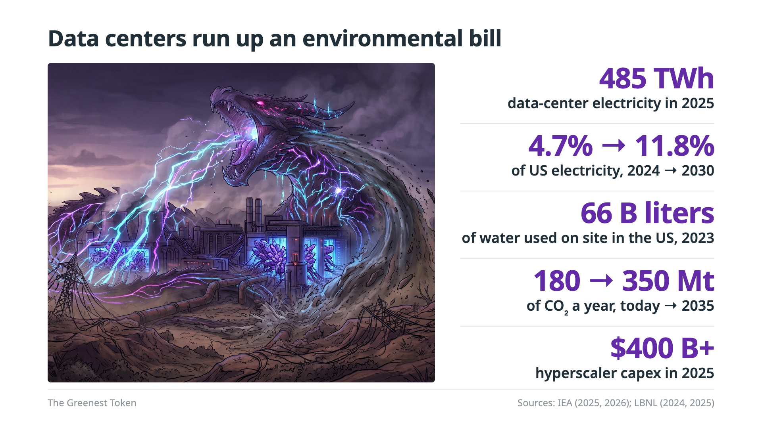
Notes:
Data centers run up an environmental bill, and it's growing. You can read the numbers on the slide. What I want you to notice is where some of that demand comes from: us. Every API call we wire into a pipeline and every model call that runs on every event adds to that bill. As developers we decide where each token runs and how big the model behind it is, so we are part of what's driving this demand, and we can do something about it.
======
Detail behind each card: 485 TWh is ~1.5% of the world's electricity, ~950 TWh (~3%) by 2030 (IEA, Key Questions on Energy and AI, 2026). US: 192 TWh in 2024, 4.7% → 11.8% projected for 2030 (LBNL 2025 Update). Water: 66 B liters on site in 2023, plus ~800 B liters at the power plants that serve them (LBNL 2024). CO₂: 180 → 350 Mt a year, today → 2035 (IEA 2025, 2026). Capex: $400 B+ in 2025, with ~75% more announced for 2026 (IEA 2026).
If asked: data centers are about a tenth of global electricity-demand growth to 2030, but where they cluster they can be 20-30% of local demand.
Backing: outline Sources (IEA-2026 pp. 9-10, 13, 18, 34; LBNL-2025 p. 8; LBNL-2024 pp. 55, 57; IEA-2025 p. 18).

Slide 3
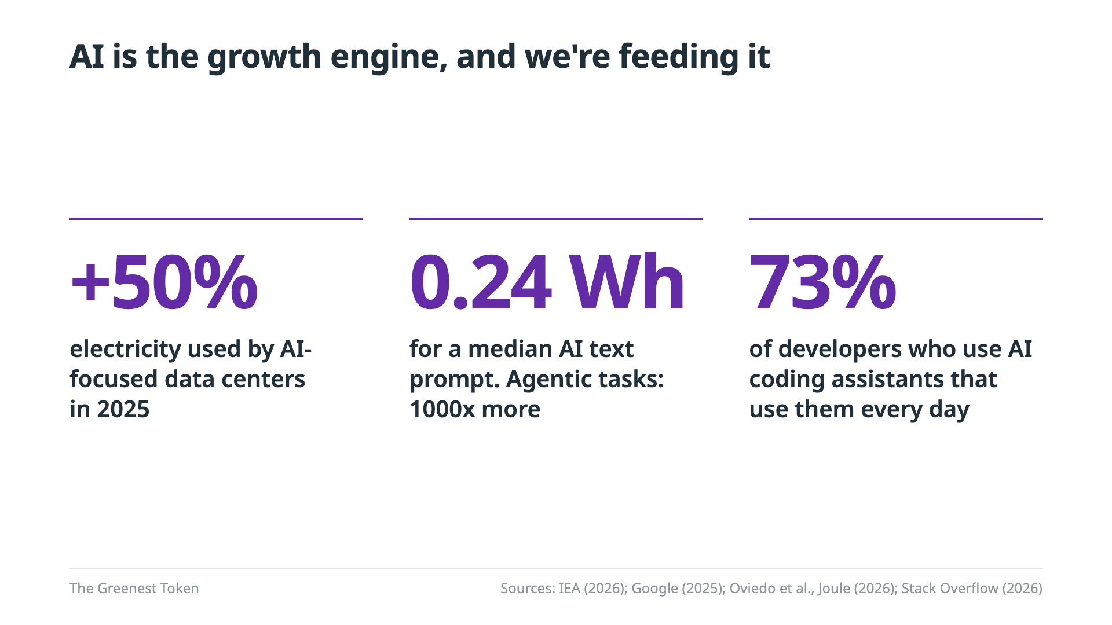
Notes:
And the fastest-growing part of that bill is AI. Electricity used by AI-focused data centers grew by half in 2025 alone. A single prompt is small: about a quarter of a watt-hour for a median text prompt. But agentic tasks can use around a thousand times more, and we don't send just one prompt. Seventy-three percent of developers who use AI coding assistants use them every day. Assistants all day, agents that loop and reason, and every call runs on someone's GPU. That's us. Developers adopting AI are feeding the dragon. This isn't a guilt trip: AI is useful, and it isn't going away. So the real question is how we use it.
======
Detail: AI-focused data-center electricity is set to triple to ~465 TWh by 2030. Reasoning that runs 15× longer uses 13× the energy. A third of daily users spend 4+ hours a day with these tools.
Backing: outline Sources (IEA-2026 pp. 9, 26; Google-2025; Oviedo-2026; SO-2026).

Slide 4
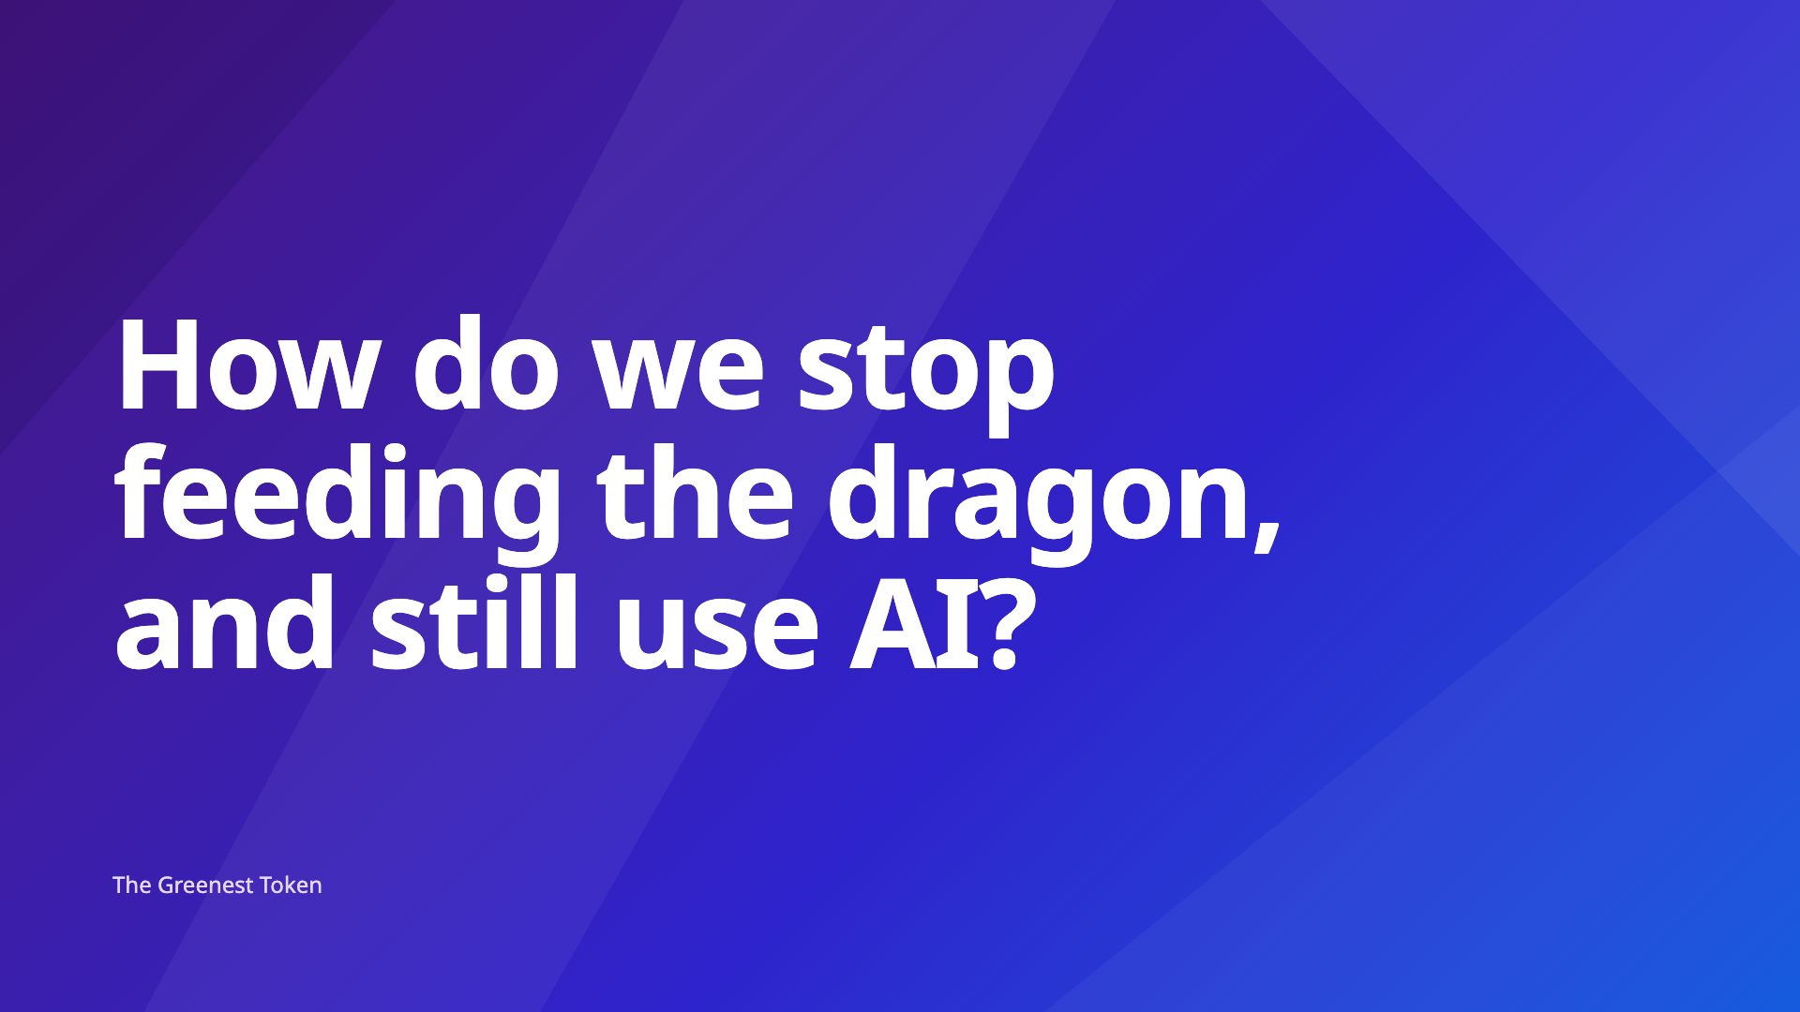
Notes:
How do we stop feeding the dragon, and still use AI? ** pause **
Not by giving AI up. By using it without sending every token to a data center.
======
Direction: read the question, then pause and let it sit before the second sentence.

Slide 5
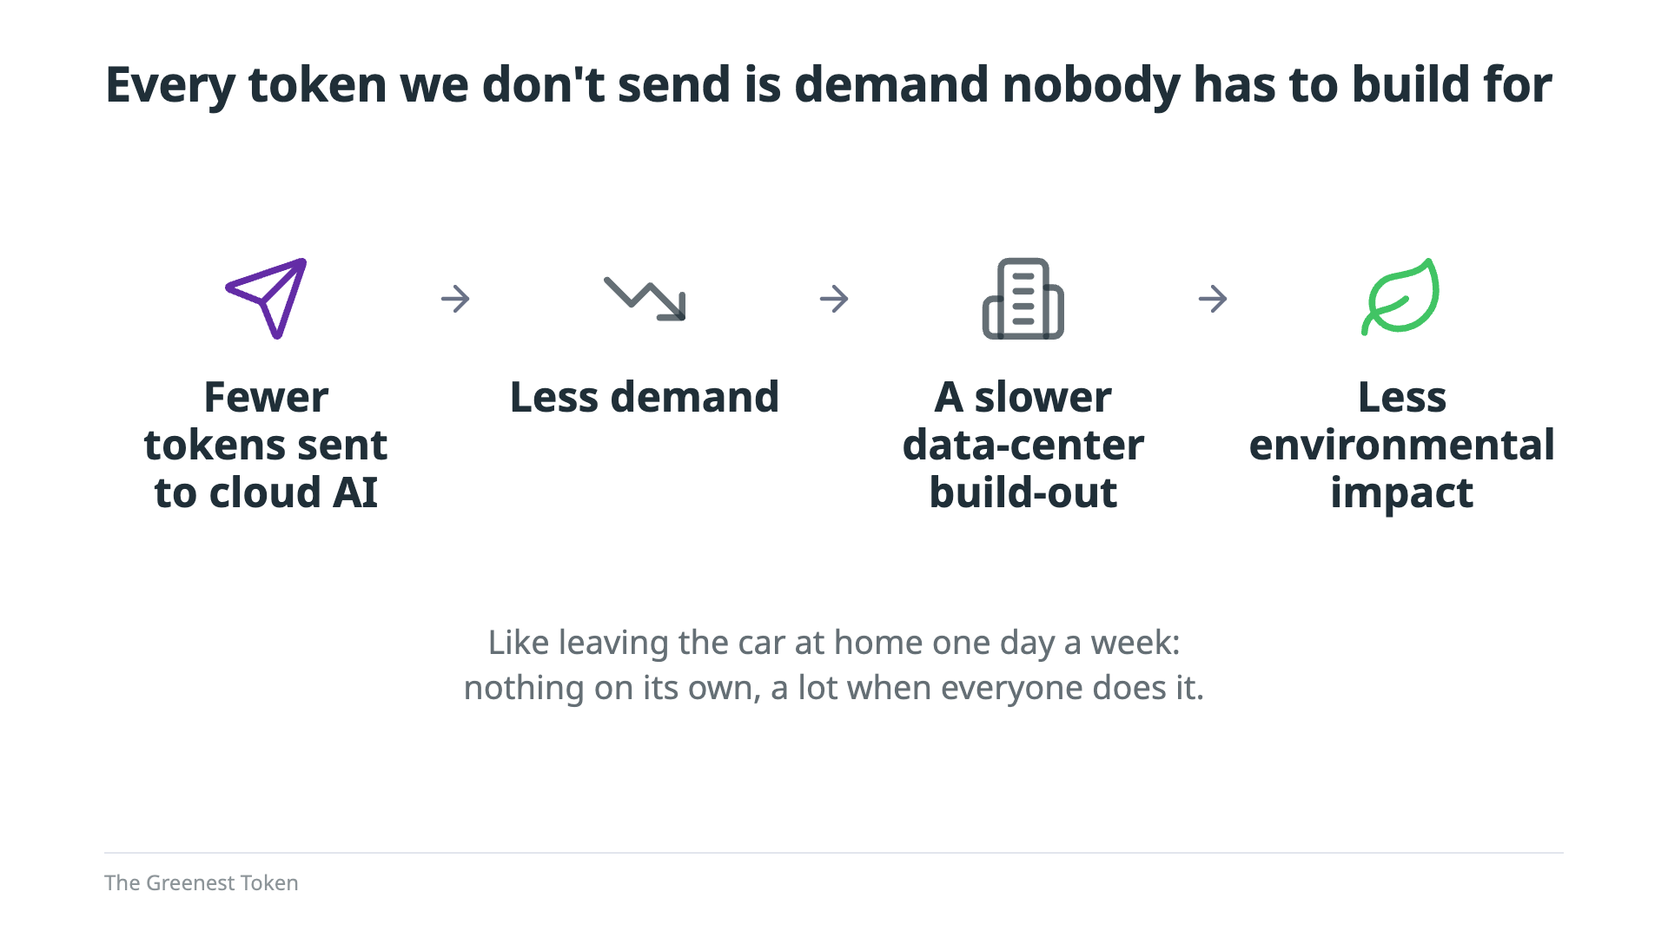
Notes:
Here's my thesis. Every token we don't send is demand nobody has to build for. Fewer tokens sent to cloud AI means less demand. Less demand means a slower data-center build-out. And a slower build-out means less environmental impact. It's like leaving the car at home one day a week: nothing on its own, but a lot when everyone does it.

Slide 6
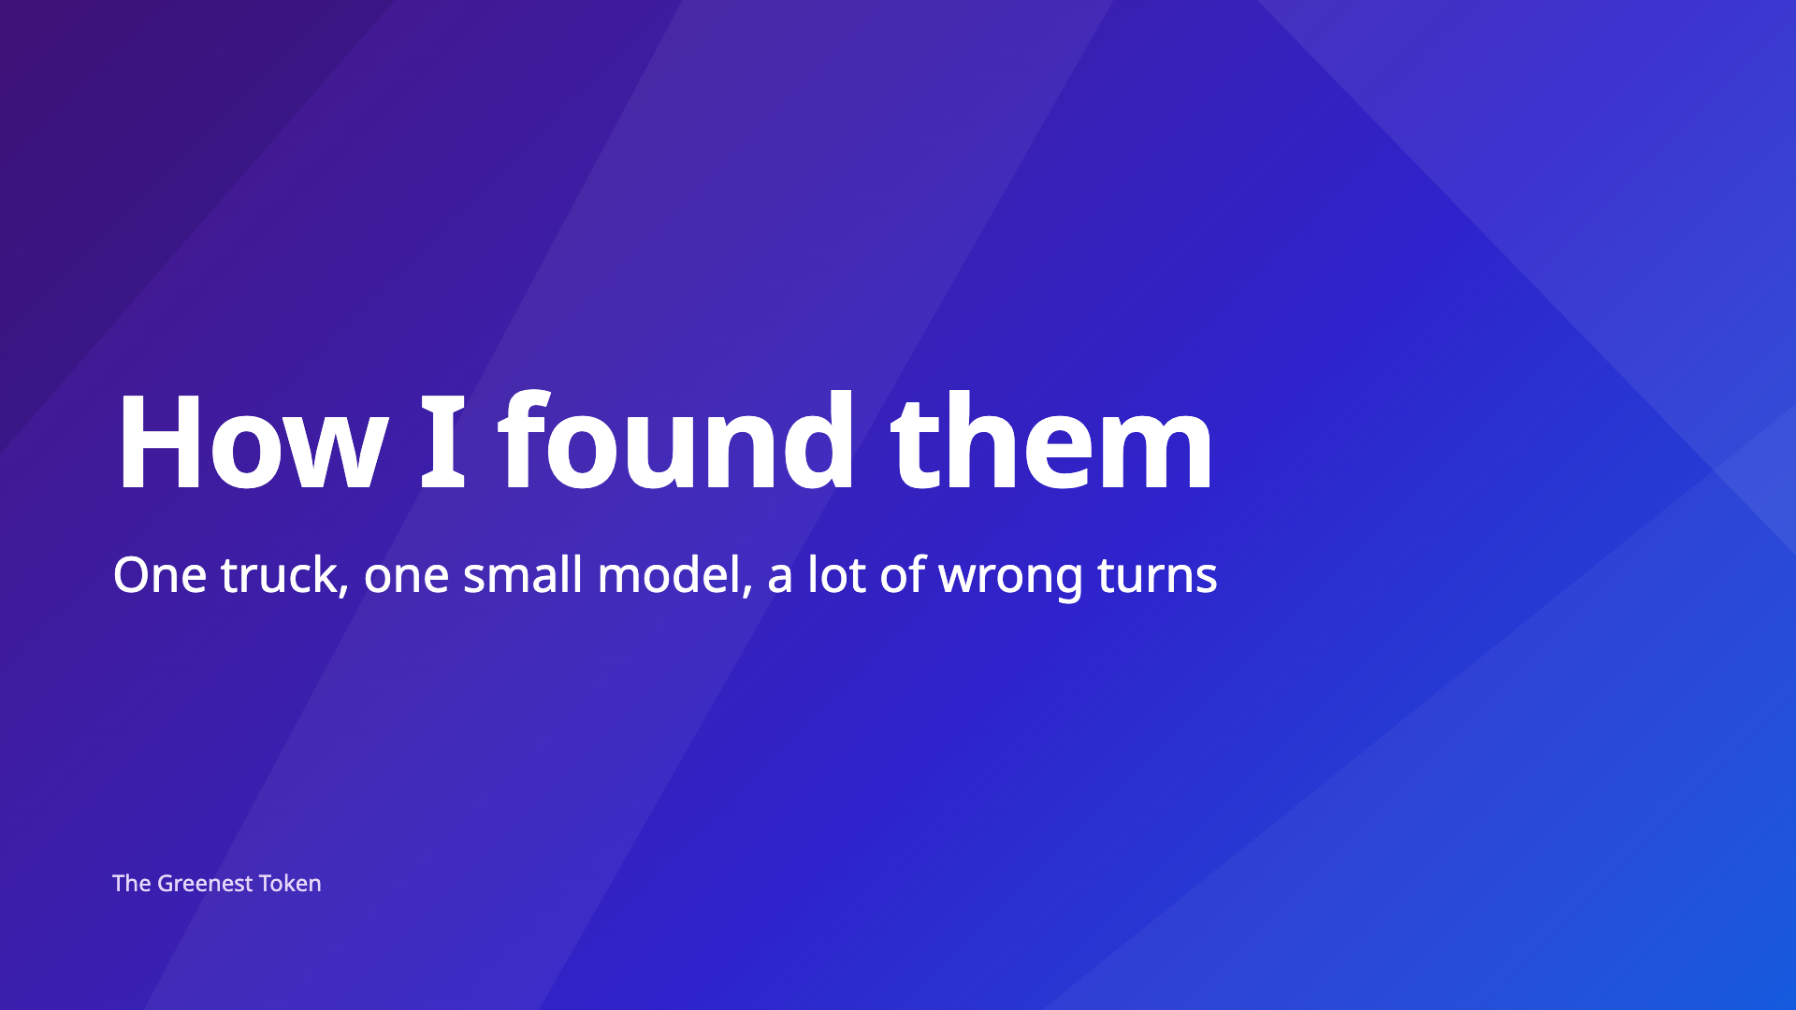
Notes:
How I found them: one truck, one small model, and a lot of wrong turns. This is the use case from Talk 1, the Edge Triage Pipeline, seen from the inside.

Slide 7
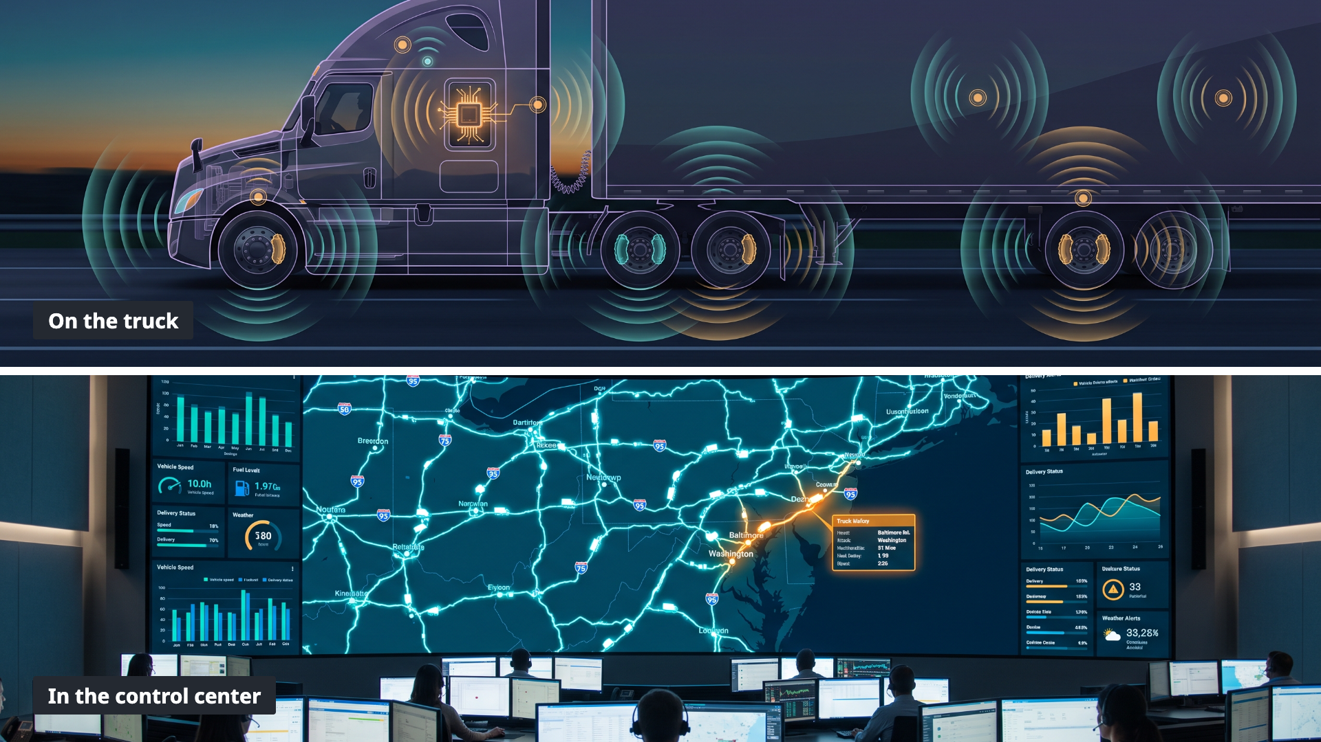
Notes:
Imagine you work for a company that dispatches a large fleet of tractor trailers across the country. You've been asked to redesign the fleet operations center to use AI to improve fleet-wide efficiency. Every truck has sensors that continuously capture and report more than 2,000 individual pieces of telemetry: speed, RPM, GPS, braking, and so on. Your job is to design a system that gathers this endless stream of data and turns it into actionable insights, so the control center can quickly spot the incidents that need attention: dangerous driving, accidents, slowdowns and delays. How would you design that system?
======
Direction: pause after the question before advancing.

Slide 8
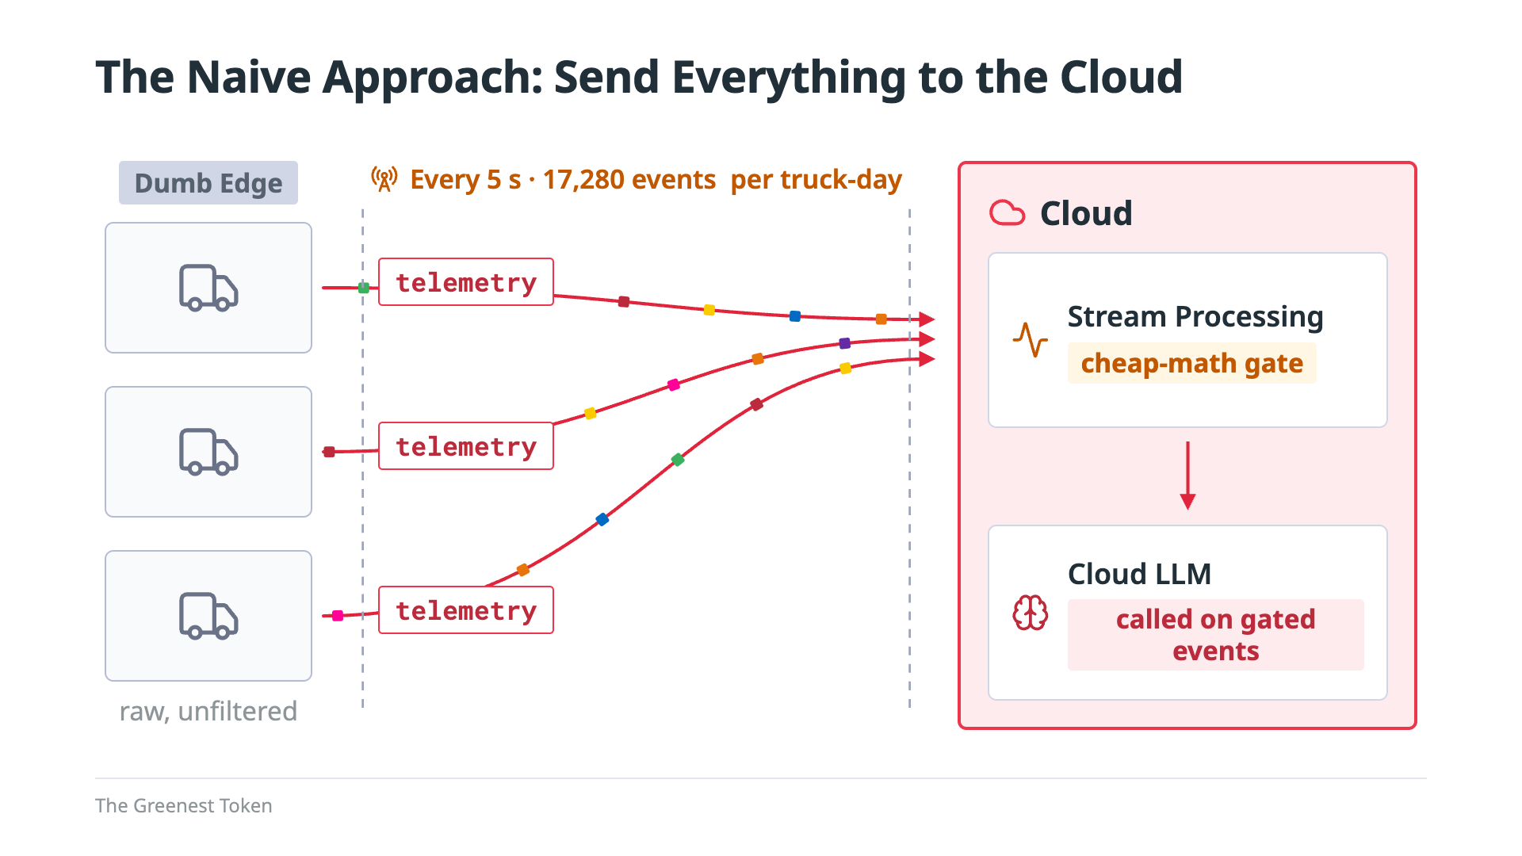
Notes:
Here's the approach most of us have used for years. Send every truck's data to the cloud, land it in the corporate data lake, and analyze it there with stream processing and cloud-hosted LLMs. Every truck sends a reading every five seconds: that's 17,280 events per truck, per day. Stream processing runs what I'll call the cheap-math gate. It's plain code, no model. It checks each reading against thresholds, computes rolling averages and the ETA slip, and sets a baseline severity from the physics. Normal readings stop there; only the events that matter go on to the LLM. But every reading from every truck still crosses the cellular link, and most of it is noise.

Slide 9
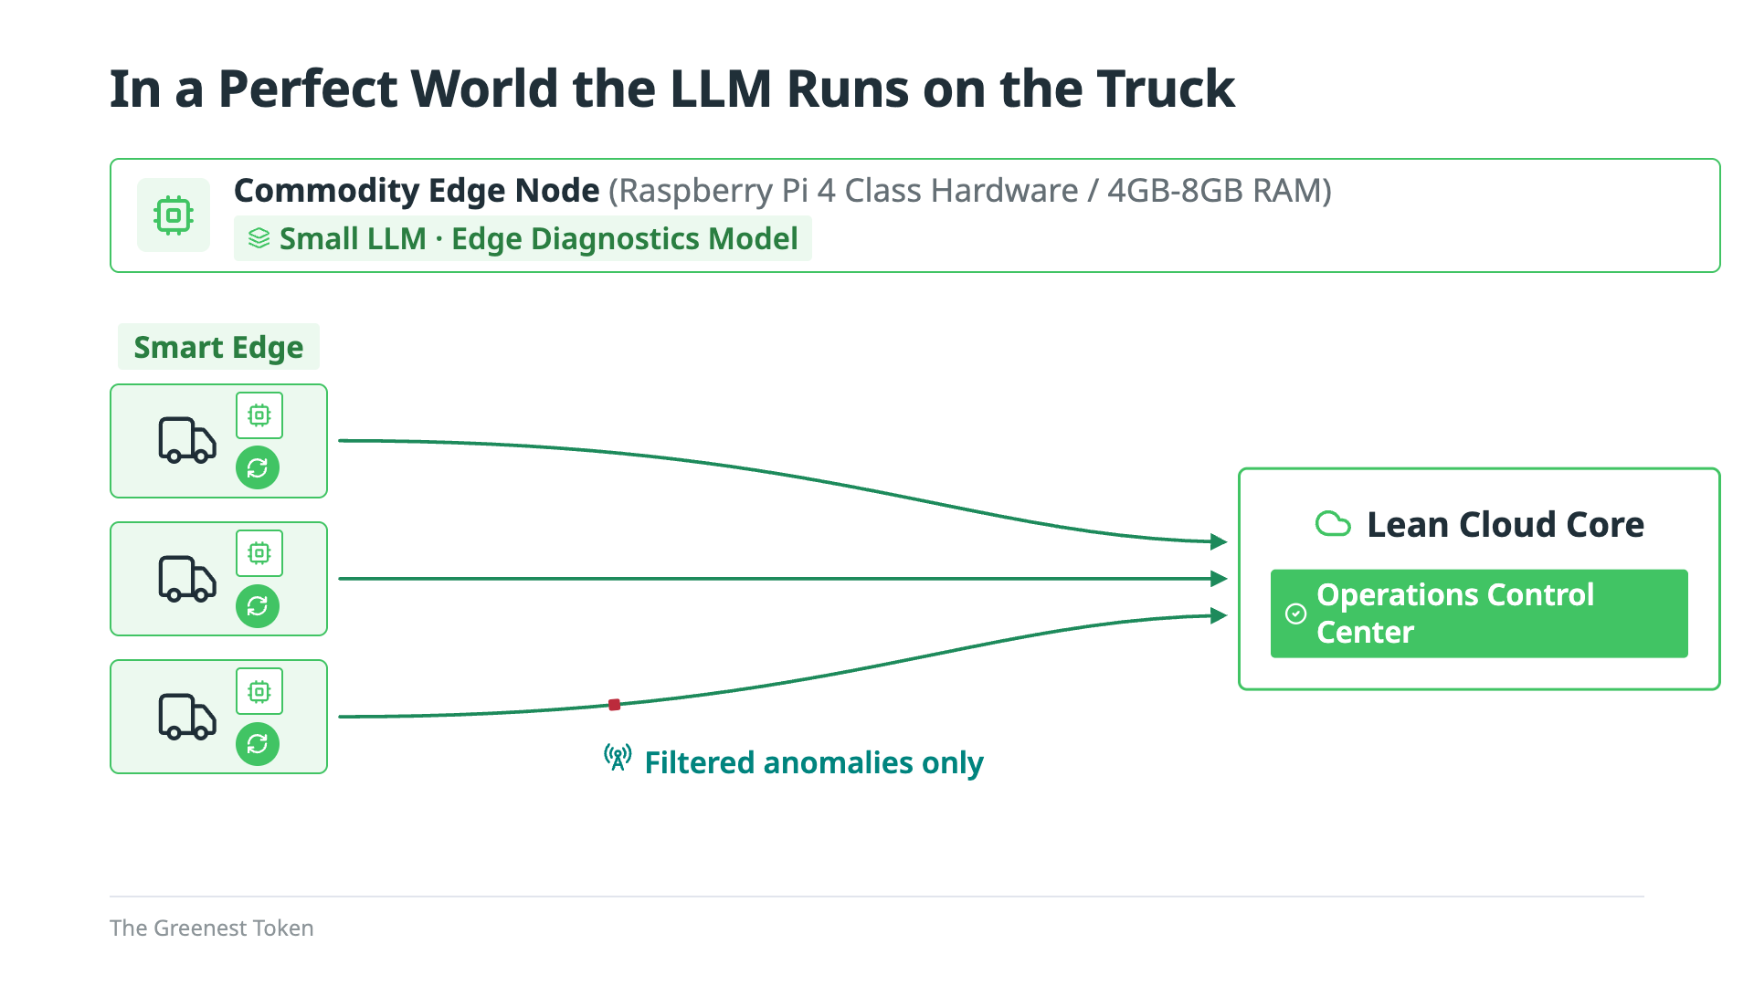
Notes:
In a perfect world, you starve the dragon by doing the processing on the truck itself, at the edge, on commodity hardware like a Raspberry Pi or a smartphone. The cheap-math gate moves onto the truck too, so the small LLM only sees the events that matter, and only filtered anomalies go to the cloud. I'd been reading about 1-bit LLMs, which replace GPU matrix math with simple additions a CPU can do, promising big theoretical energy savings per inference. I thought that was the answer. Talk 1 showed this architecture runs. This talk is about what it took to make it work well, and what each decision costs. I started on a Raspberry Pi 4, the slowest box in my study, on the idea that if it works there, it works anywhere.
======

Slide 10
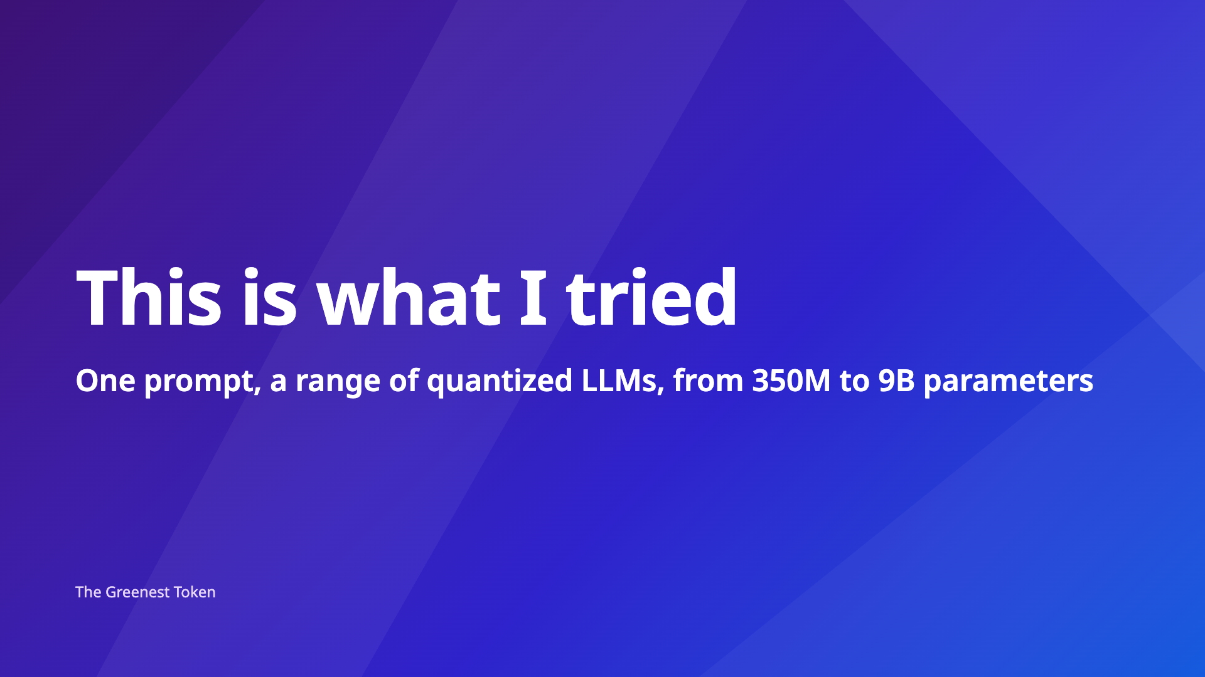
Notes:
This is what I actually tried. I ran the same prompt across a range of quantized LLMs, from 350 million to 9 billion parameters.
======
Direction: short beat, then advance to the prompt.
The 9 (eval-results/compare-COMP-J2D9D71YNJ-20260925T165011Z.json): Qwen2.5-0.5B, Qwen2.5-1.5B, Qwen3-0.6B, Qwen3-8B, Llama-3.1-8B, GLM-4-9B, LFM2.5-350M, Granite-4.0-H-350M, Ling-3.0-tiny (7.9B total / 1.3B active). All Q4_K_M except the three smallest (Q8_0).
If asked: the whole study covered 16 models (models.toml). The other 7 (Gemma-3-1B, Gemma-3-4B, Llama-3.2-1B, Llama-3.2-3B, Phi-3.5-mini, Qwen2.5-3B, Qwen3.8-27B) were added later and ran with the revised prompt that states the severity thresholds.
Backing: first attempt was 2026-09-12 ("Flow A"), eval-results/compare-COMP-J2D9D71YNJ-20260912T202854Z.json. docs/TALK2-REWORK-OUTLINE.md: "The naive raw-telemetry approach never ran."

Slide 11
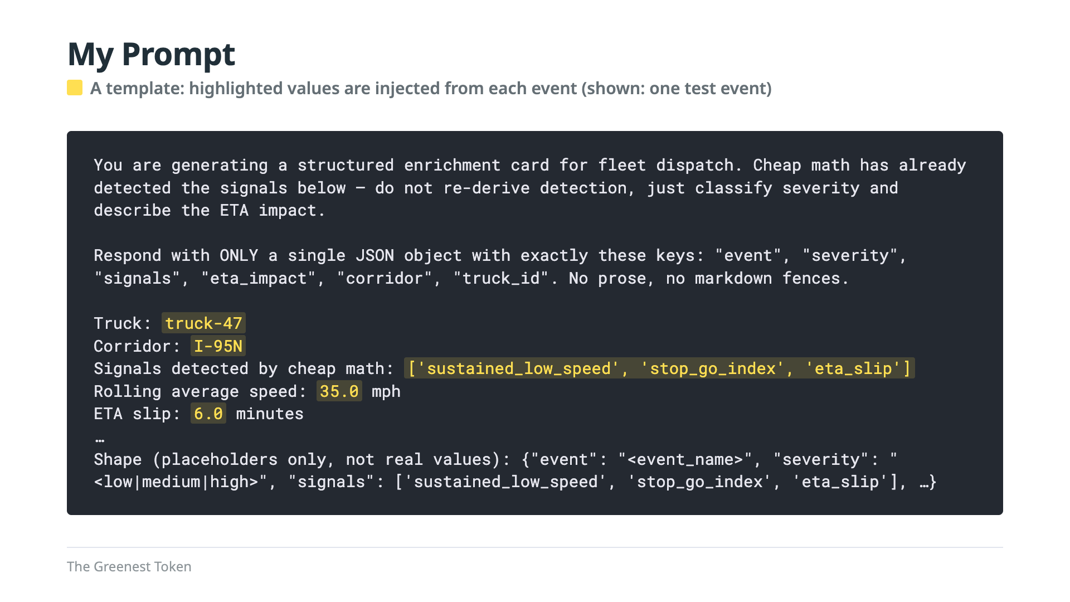
Notes:
Small LLMs are smart now, I thought, so I'd hand one the event and ask for the finished card. I never fed it raw telemetry: the cheap-math gate ran first, just like in the cloud design. But I asked the model to do everything else. This prompt is a template, and the highlighted values come from one test event. In the pipeline, the truck ID and corridor come from each event, the signal list from the cheap-math detector, and the speed and ETA slip from the truck's own rolling calculations. Six fields, one call: the model classifies, measures and writes everything. Notice the single quotes in the signal list. My code dropped a Python list straight into the prompt. Remember that; it comes back. And the results were...
======
Backing: eval-results/compare-COMP-J2D9D71YNJ-20260912T202854Z.json (prompt as the model saw it). Same prompt in the runs behind every number on the next slide: …20260925T030826Z.json (Pi 4) and …20260925T165011Z.json (severity).

Slide 12
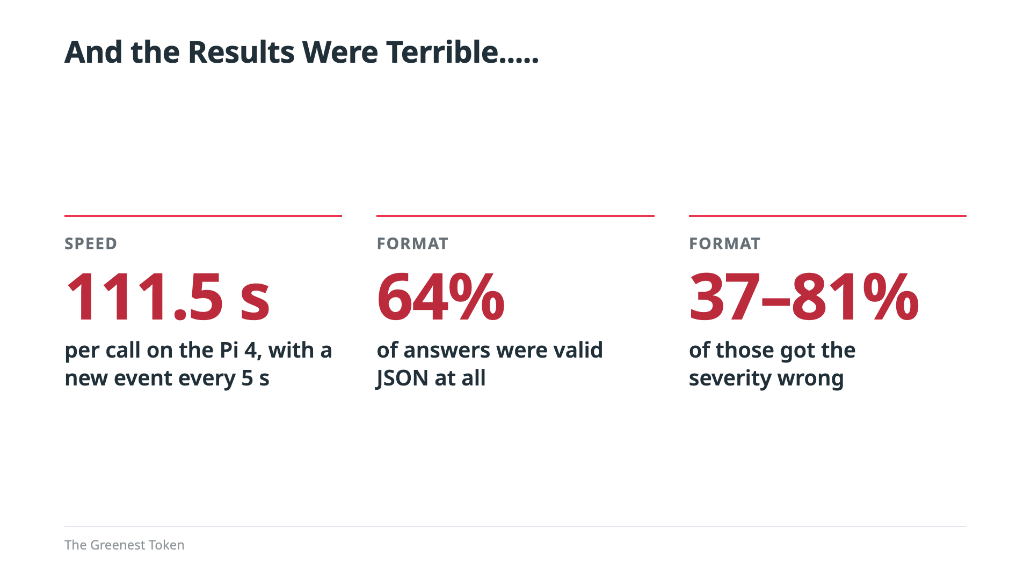
Notes:
Terrible. Speed: on the Pi, one answer took 111 and a half seconds, and a new event arrives every five seconds, so there is no way that the model could keep up. Format: across the models I tested, only 64 percent of the answers were valid JSON at all. Accuracy: of those, 37 to 81 percent got the severity wrong, depending on the model. Oh, and those 1-bit models I was so excited about? They didn't run correctly on ARM at all, so everything you'll see today uses ordinary 4-bit models. So what went wrong? Let's look at what the model actually wrote.
======
If asked (cut from slide): an even earlier prompt showed a filled-in example card. On 28 of 30 calls, Qwen2.5-1.5B wrote 4.0, the number from my example, when the real ETA slip was 18 minutes (0.5B: 13 of 30). That prompt version isn't in eval-results; the record is the v2 comment in shared/llm-inference/src/llm_inference/structured.py.
Detail: the 111.5 s is Qwen2.5-1.5B; the slowest calls hit the 180 s timeout. The 0.5B model parsed only 1 of 30. Format: 174 of 270 answers parsed (9 models × 30 on the laptop; two models parsed none). On the Pi, Qwen2.5-1.5B parsed 22 of 30 (73%). Severity: wrong on 37-81% of the parsed answers, per model, for the 7 models that produced any (3/8 to 13/16). The copying was the first version of the prompt, which showed a filled-in example card.
Backing: eval-results/compare-edge-node00-20260925T030826Z.json (Pi 4: p50 111.5 s, p95 180.3 s; parsed 22/30 and 1/30); …20260925T165011Z.json (format and severity); 6ff72a3 comment (copying); docs/BITNET-POSTMORTEM.md (1-bit on ARM).

Slide 13
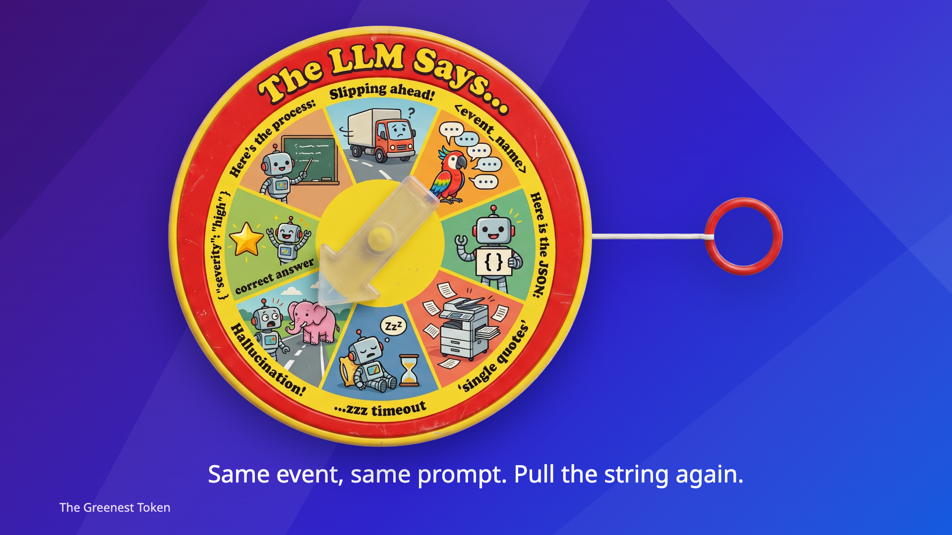
Notes:
Remember the See 'N Say? You pull the string, the arrow spins, and you find out what the cow says. Testing these models felt the same. Each one failed in one or more of the same few ways, and I never knew which I'd get. So every new round of testing was like pulling the string and hoping for the best. Let's pull the string a few times.
======
If asked: early on I thought small models were echoing my prompt back. They weren't: the command-line tool printed the prompt into the output, and the smallest models had written nothing at all.

Slide 14
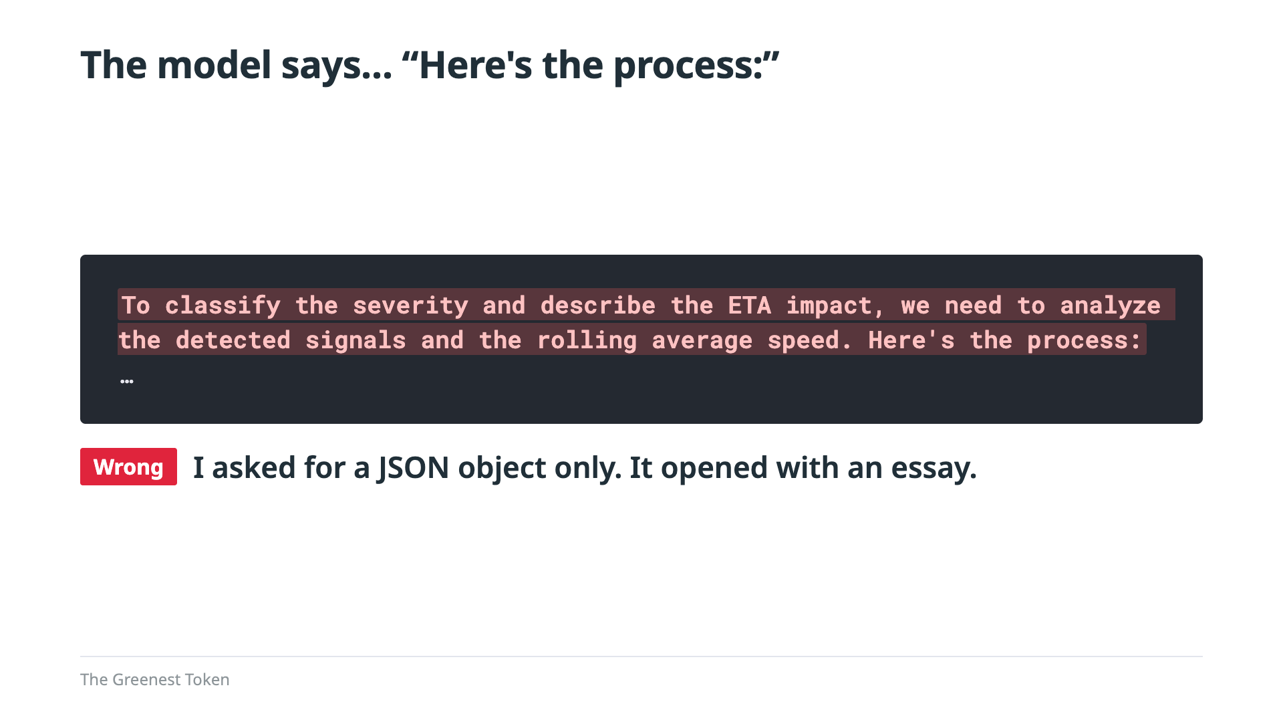
Notes:
First pull. I asked for only a JSON object, no prose. The first thing it wrote was a paragraph explaining its process.
======
Backing: …20260912T202854Z.json (1.5B, sample_failures[2]).

Slide 15
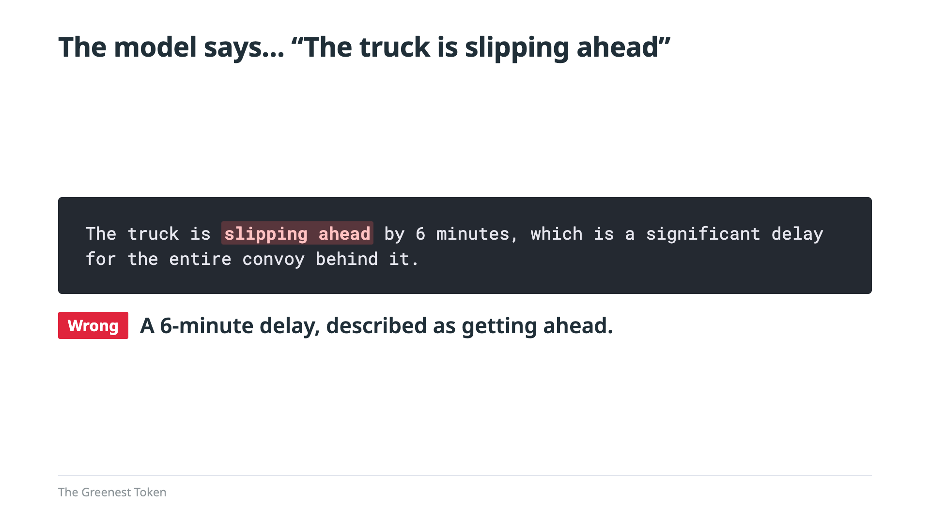
Notes:
Second pull, a few lines later in the same answer. The truck is six minutes behind schedule. The model says it's slipping ahead, and then calls it a significant delay, in the same sentence.
======
Backing: …20260912T202854Z.json (1.5B, sample_failures[2]).

Slide 16
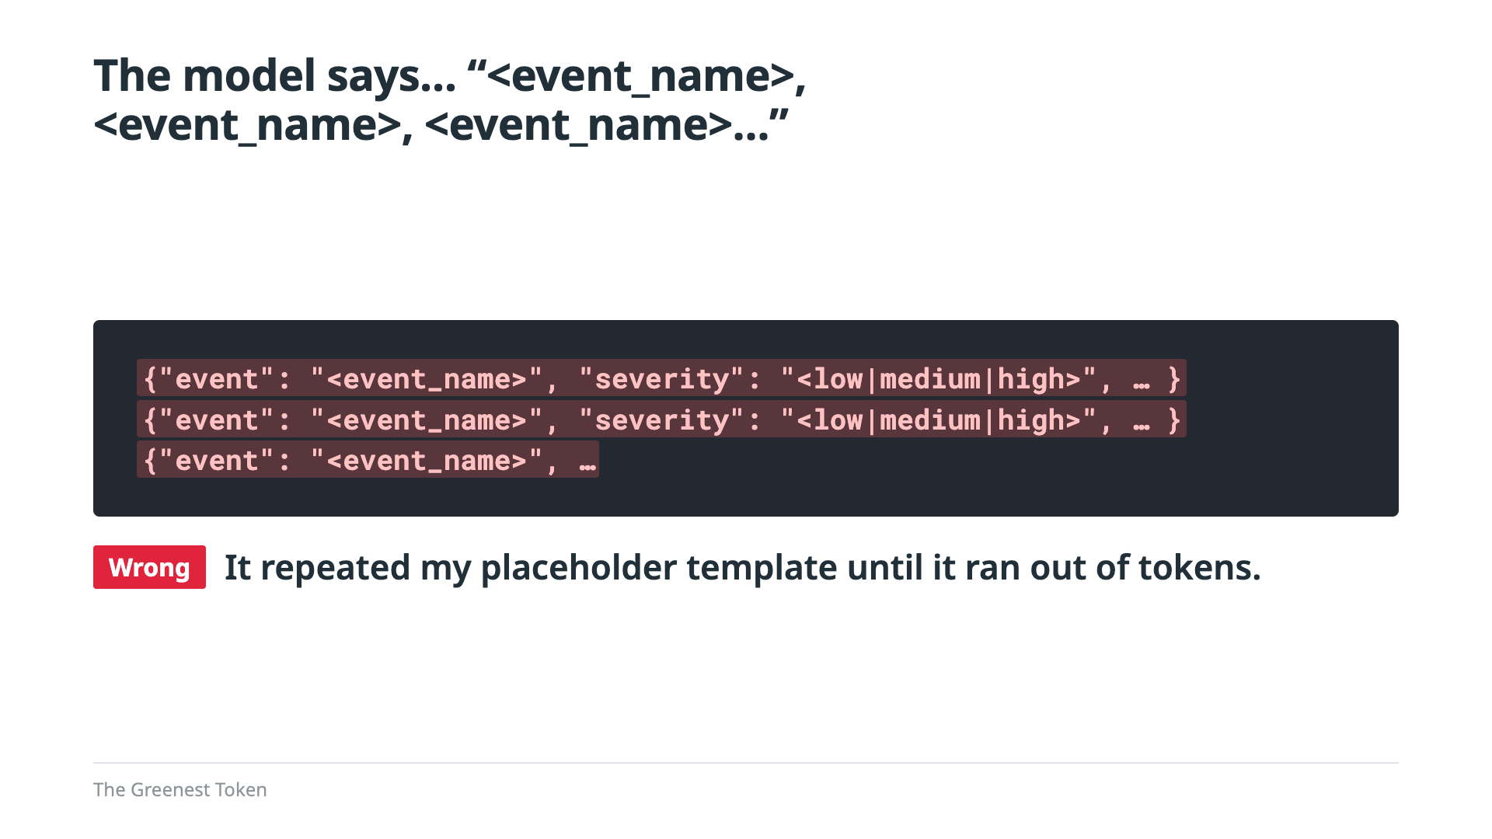
Notes:
Third pull, from the smallest models. They took the shape from my prompt, placeholders and all, and repeated it until they ran out of tokens. That's when I knew I had to change course.
======
Backing: …20260925T030826Z.json (1.5B and 0.5B, sample_failures[0]).

Slide 17
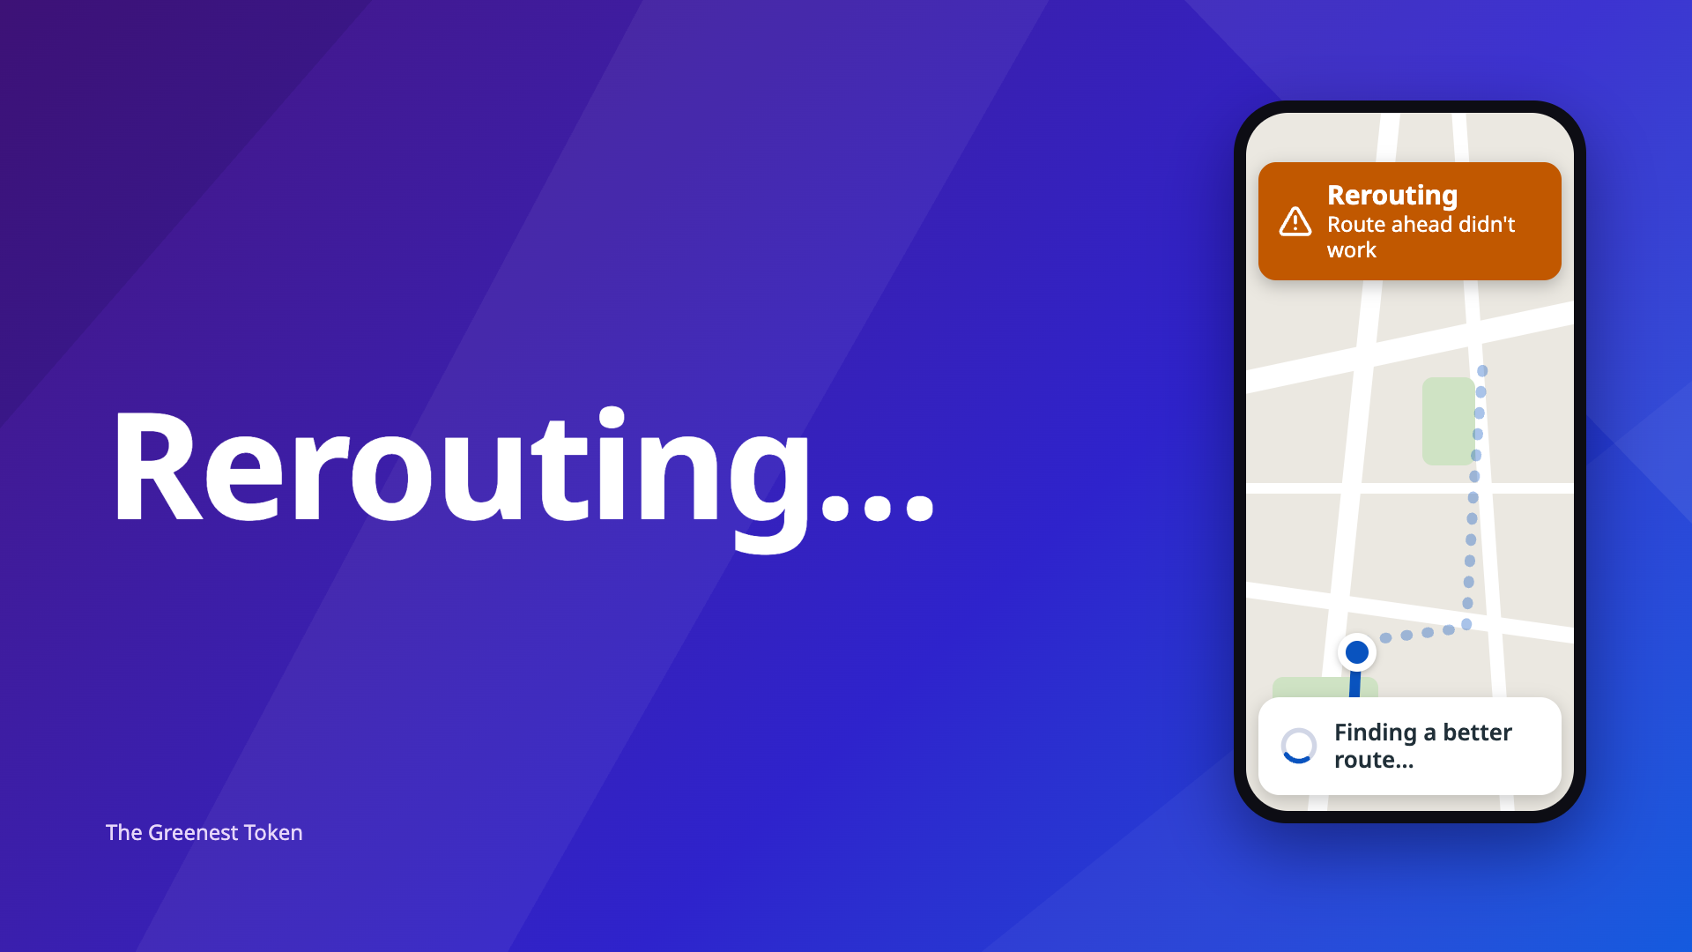
Notes:
Rerouting. I'll admit it: the easy path I'd pictured, where I just plug in a model that can run on the hardware and get a reasonable answer, wasn't going to work. I had to take a detour or two to get there. The destination didn't change: a small LLM doing real work on the edge. This next section lays out the path I took.

Slide 18
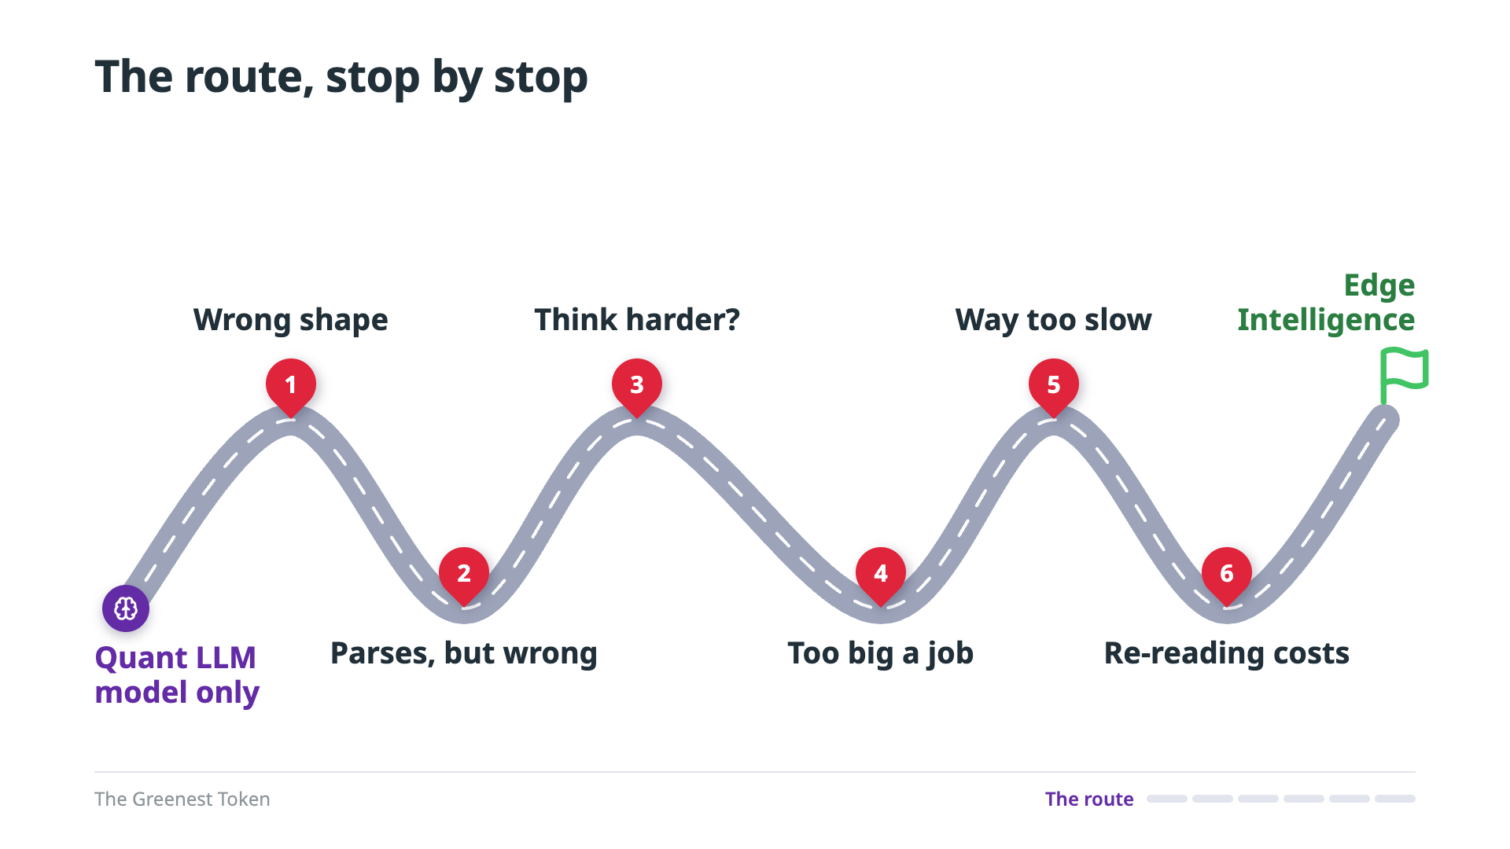
Notes:
Here's the route I actually took. I set off with a quantized model and nothing else, and I hit six road blocks before I arrived at working edge intelligence. I've put them in the order the lessons build on each other, not strictly in calendar order. Every stop gets two slides: how the problem showed up, and then the root cause and the new route. But first, two things I packed before I left.
======
If asked about order: thinking was tested later in the calendar, but it belongs where accuracy was still the problem.

Slide 19
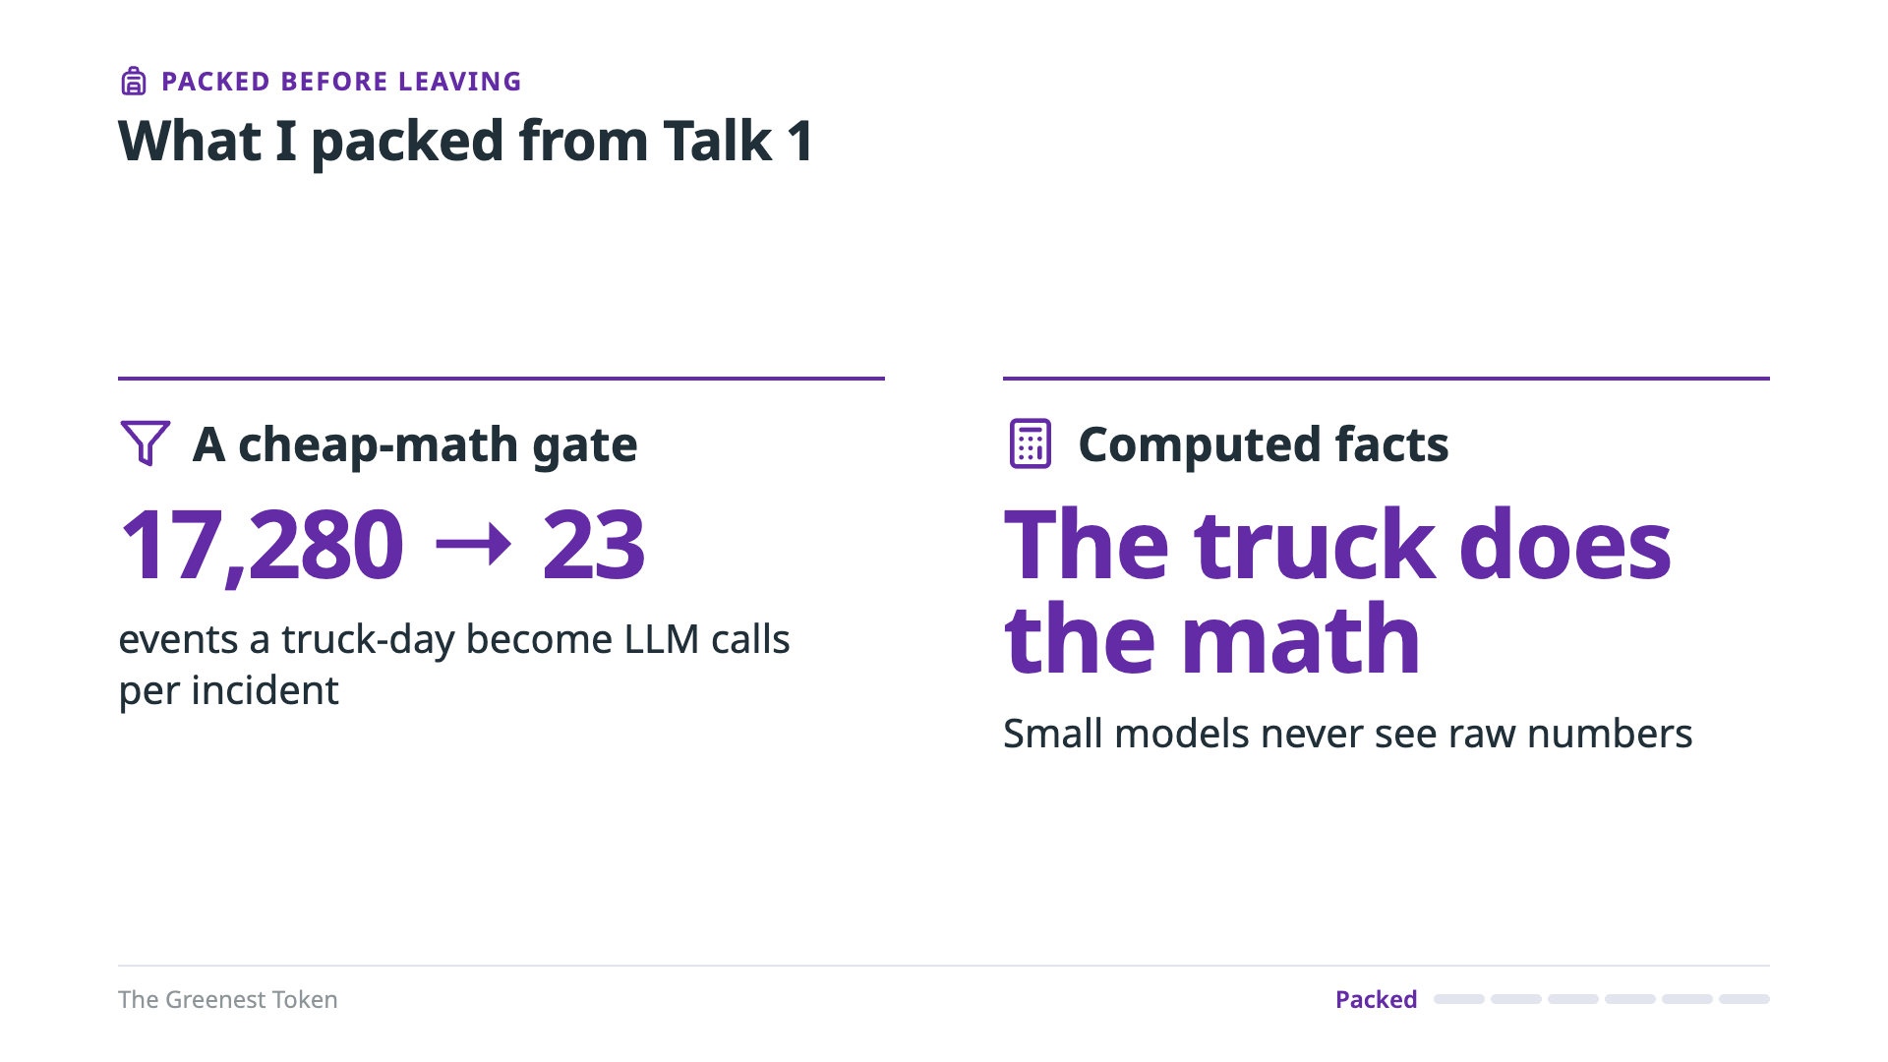
Notes:
I packed two things from Talk 1's design, so neither of them was a wrong turn. The first is the cheap-math gate. One truck produces 17,280 events a day, and a Pi 4 can answer only about 2,700 calls a day, so the gate isn't optional. With it, an incident takes about 23 LLM calls, and normal driving takes none. The second is computed facts. The truck does the math, so the model never sees raw numbers. Arithmetic is exact and nearly free in code. When I handed small models two raw numbers to compare, none of them worked out the difference.
======
Caveats: 17-28 calls per incident; the zero comes from 2.3 simulated truck-days of normal driving.
Detail: ~2,700 calls a day at 31.7 s each. The truck computes rolling averages, stop-and-go and ETA slip; the co-processor adds a baseline severity and the trip context.
Backing: paper Table II and Fig. 4; impact track (row 28; "Velocity deviation-from-plan").

Slide 20
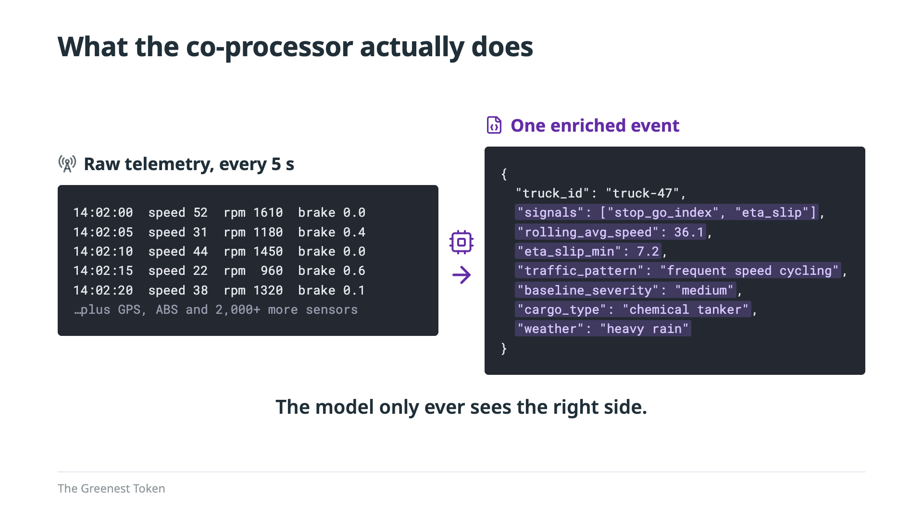
Notes:
Here's what that looks like. On the left is raw telemetry: a reading every five seconds, from every sensor. See the speed jumping between 22 and 52 miles an hour? That's stop-and-go traffic. On the right is what the co-processor produces from that window. It flags the signals, computes the rolling average speed and the ETA slip, labels the traffic pattern, sets a baseline severity from the physics, and adds trip context like cargo and weather. The model only ever sees the right side: one enriched event per call, never the stream. Now, the first road block.
======
Values are illustrative, matching Talk 1's example event.

Slide 21
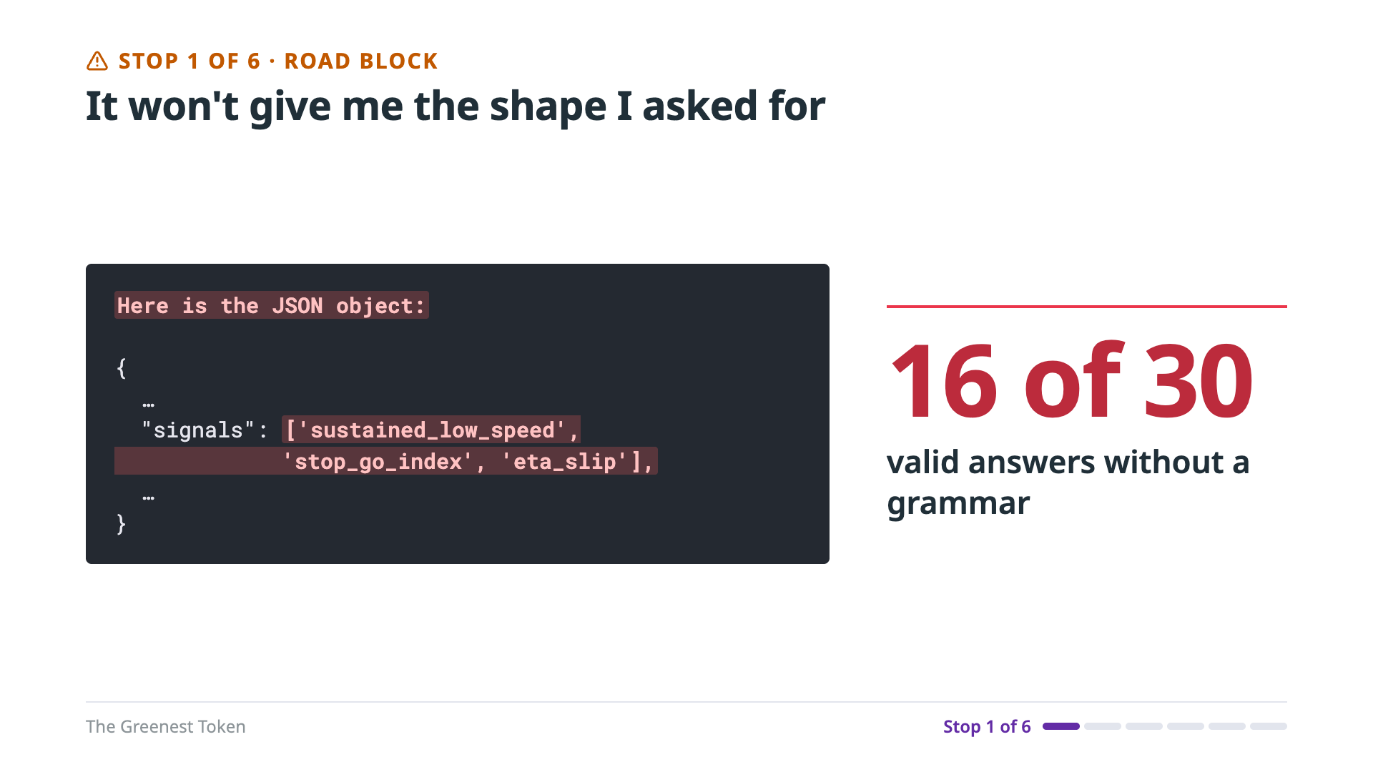
Notes:
Stop one. I asked for JSON, and I got prose in front of it, and single quotes inside it. Single quotes aren't valid JSON, so the parser can't read it. A prompt that says "no prose" doesn't stop prose. Without a grammar, a half-billion-parameter model gave me valid JSON on only 16 of 30 calls, and a 350-million-parameter model on none of them. The root cause: free text lets a small model improvise.
======
Detail: the 16 of 30 is the 0.5B model. When the template showed a filled-in example, the model copied its number on 28 of 30 calls.
Backing: …20260925T165011Z.json; git show 6ff72a3:shared/llm-inference/src/llm_inference/structured.py (lines 19-27).

Slide 22
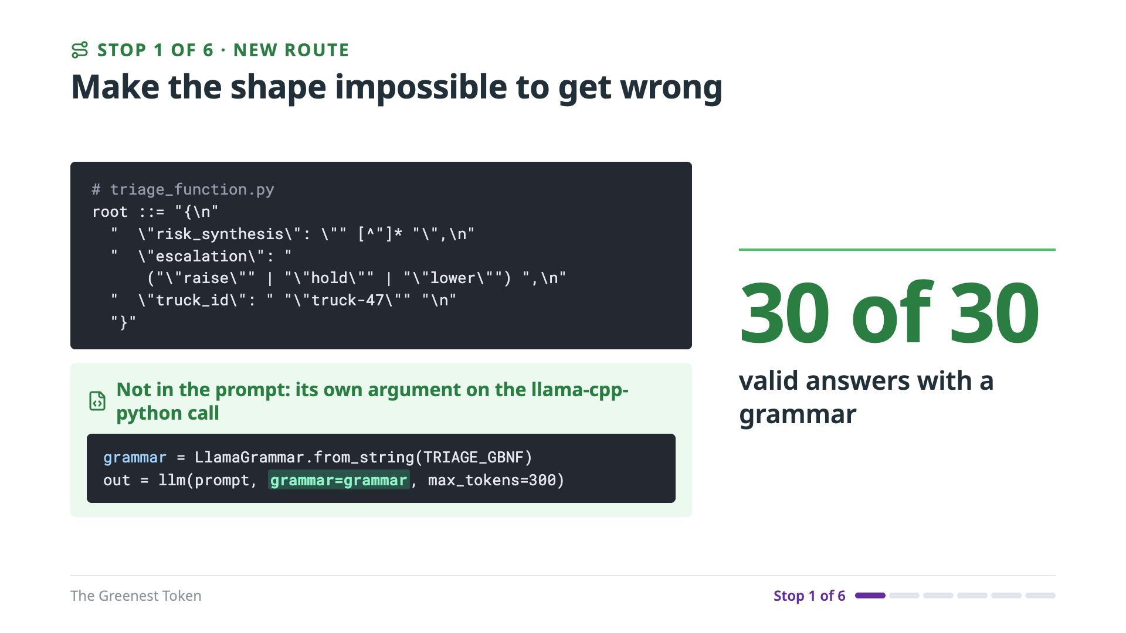
Notes:
The new route: make the wrong shape impossible. Instead of asking nicely, I give the model a grammar. This one lives in triage_function.py, and it isn't in the prompt; it's its own argument on the llama.cpp call. At every token, llama.cpp masks out anything the grammar doesn't allow, so the model can only pick a legal next token. It can't open with prose, it can't use single quotes, and it can't skip a field. Even the truck ID can't be wrong, because it's written into the grammar. And I replaced the example values with placeholders, so there's nothing left to copy. The result: 30 of 30 valid answers, even from the 350-million-parameter model that had managed zero. But a grammar fixes structure, not judgment. Every answer parsed now. Were they right?
======
Detail: same laptop: 28 → 30 of 30 valid (Qwen2.5-1.5B), 16 → 30 (0.5B), 0 → 30 (a 350M model); the second 350M model reached 25 of 30. The prompt and temperature changed too.
Code: grammar = LlamaGrammar.from_string(TRIAGE_GBNF); llm(prompt, grammar=grammar, max_tokens=300).
Backing: …20260925T165011Z.json → …20260926T153435Z.json; grammar from triage_function.py.

Slide 23
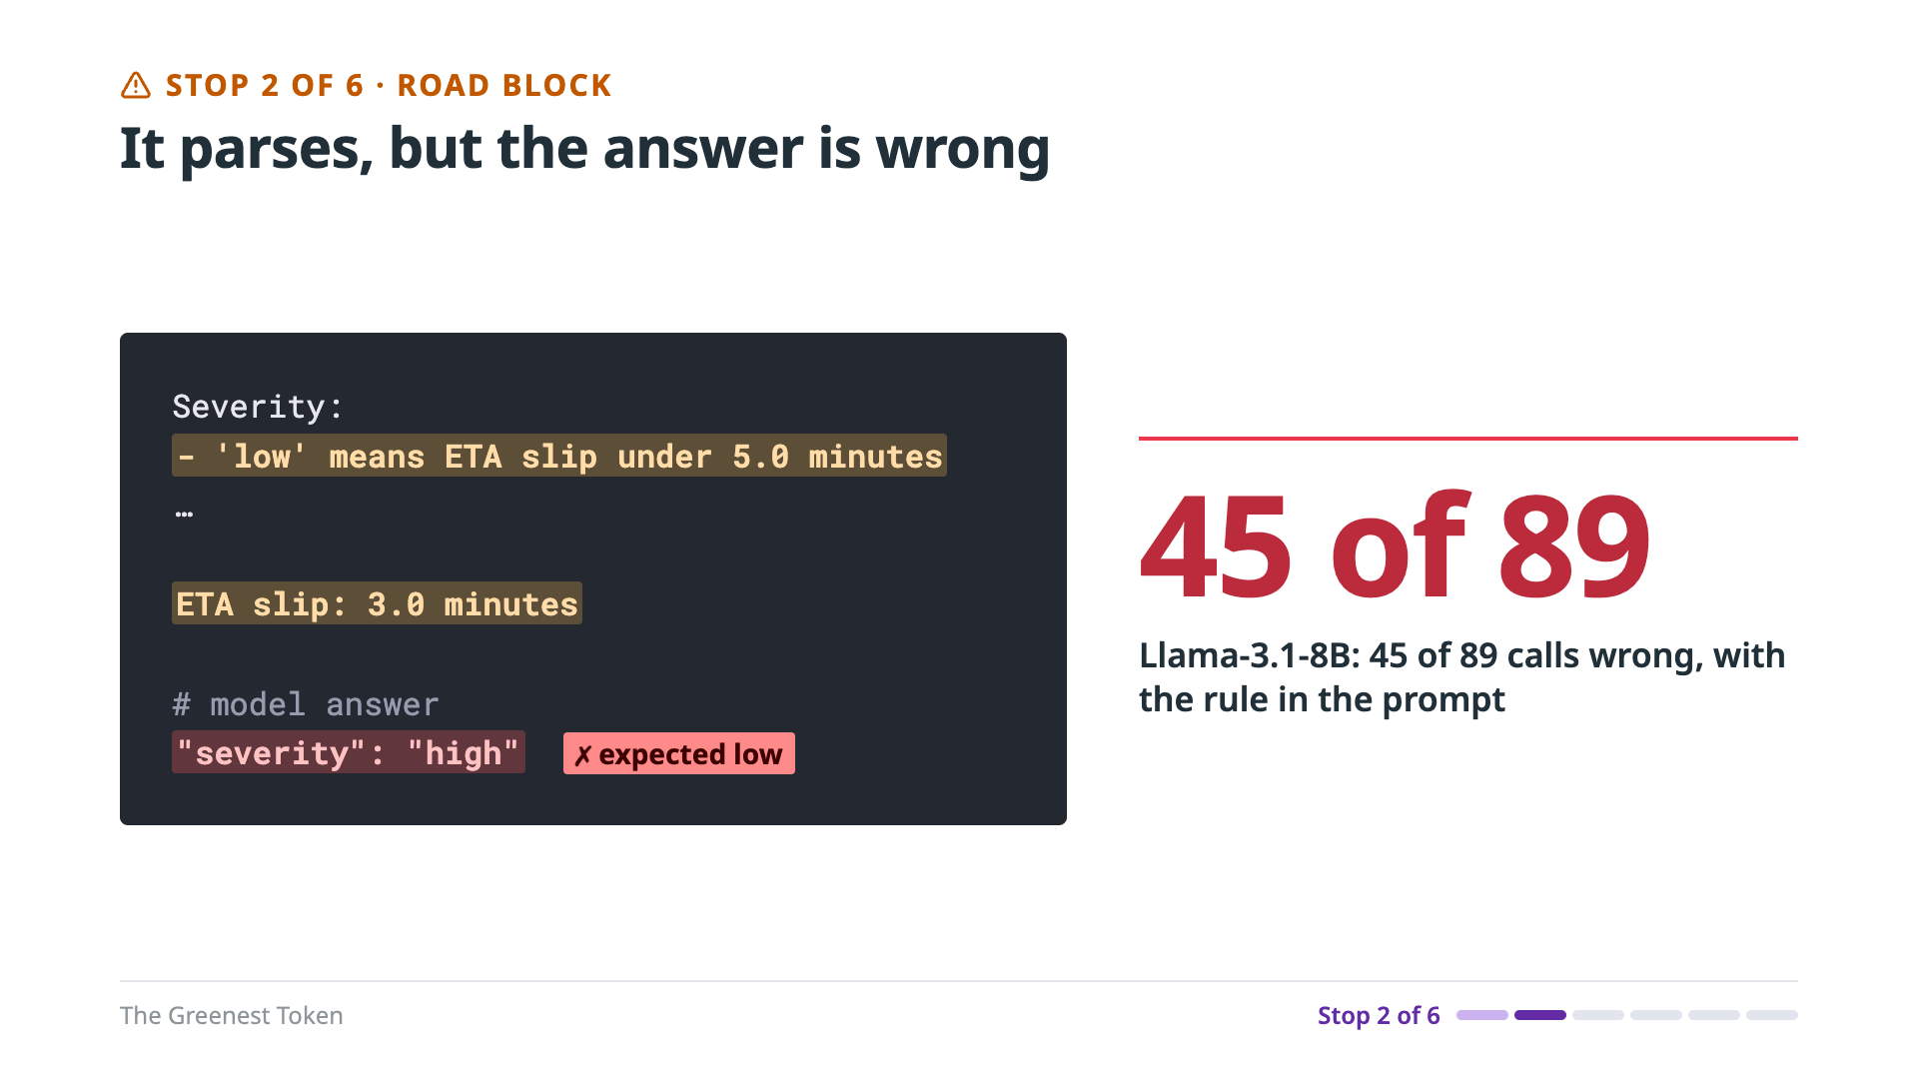
Notes:
Stop two. With valid JSON, I could finally score the answers, and they were wrong. So I wrote the severity rule into the prompt. "Low" means an ETA slip under five minutes. Here the slip is three minutes, so the answer is low. The model said high. The rule was right there. Llama 3.1 8B still got it wrong on 45 of 89 calls. Across models, 20 to 63 percent of the calls were wrong, with the thresholds spelled out.
======
Backing: …20260925T185711Z.json (Llama sample_mismatches[0], 45/89; 20-63% across models).

Slide 24
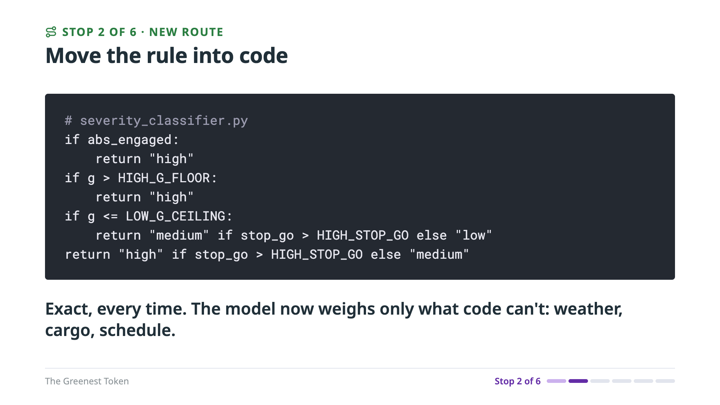
Notes:
The root cause: a threshold is exact in code and approximate in a model, even when you spell the rule out. So the new approach is to move the rule into code. This is the severity classifier. ABS engaged: high. Hard braking: high. Otherwise, it depends on stop-and-go. Exact, every time. Now the model weighs only what code can't: weather, cargo and schedule.
======
Backing: severity_classifier.classify_severity.

Slide 25
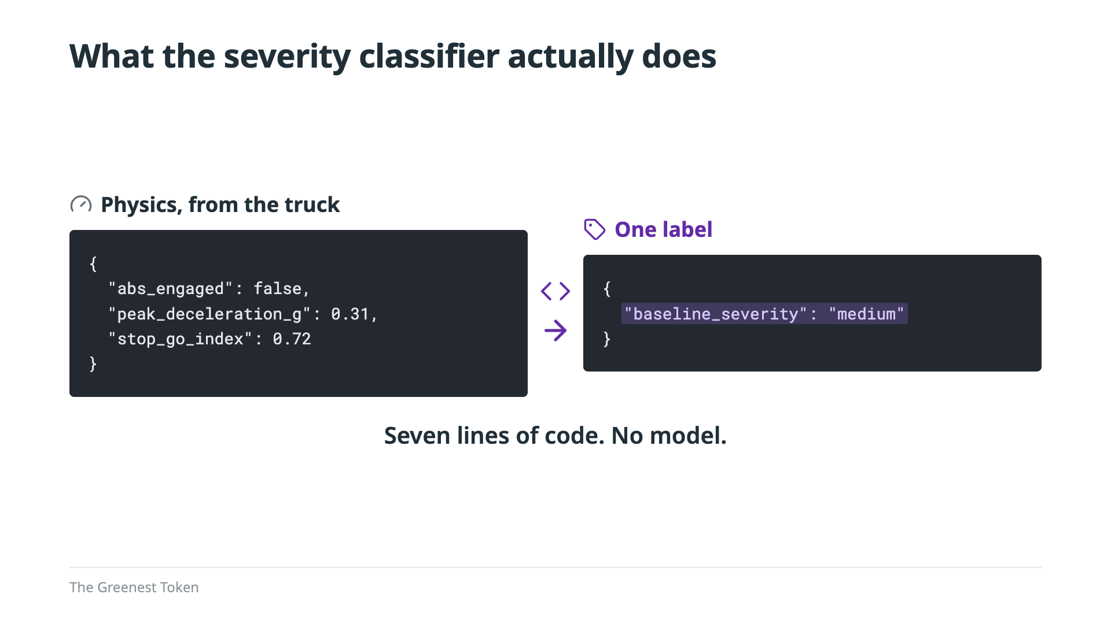
Notes:
Here's the classifier's whole job: three physics facts in, one label out. ABS didn't fire, and braking peaked at 0.31 g, below the hard-braking floor, so it isn't high. But the stop-and-go index is above the volatility line, so it isn't low either. Medium. Seven lines of code, and no model. My first design asked the LLM to be this classifier. That's slow, it costs energy on every call, and it's approximate where code is exact. The lesson: use the right tool for the job. Don't make an LLM do math. If a rule can be written down, write it in code.
======
Values are illustrative, matching the example event on slide 20; thresholds are in severity_classifier.py.

Slide 26
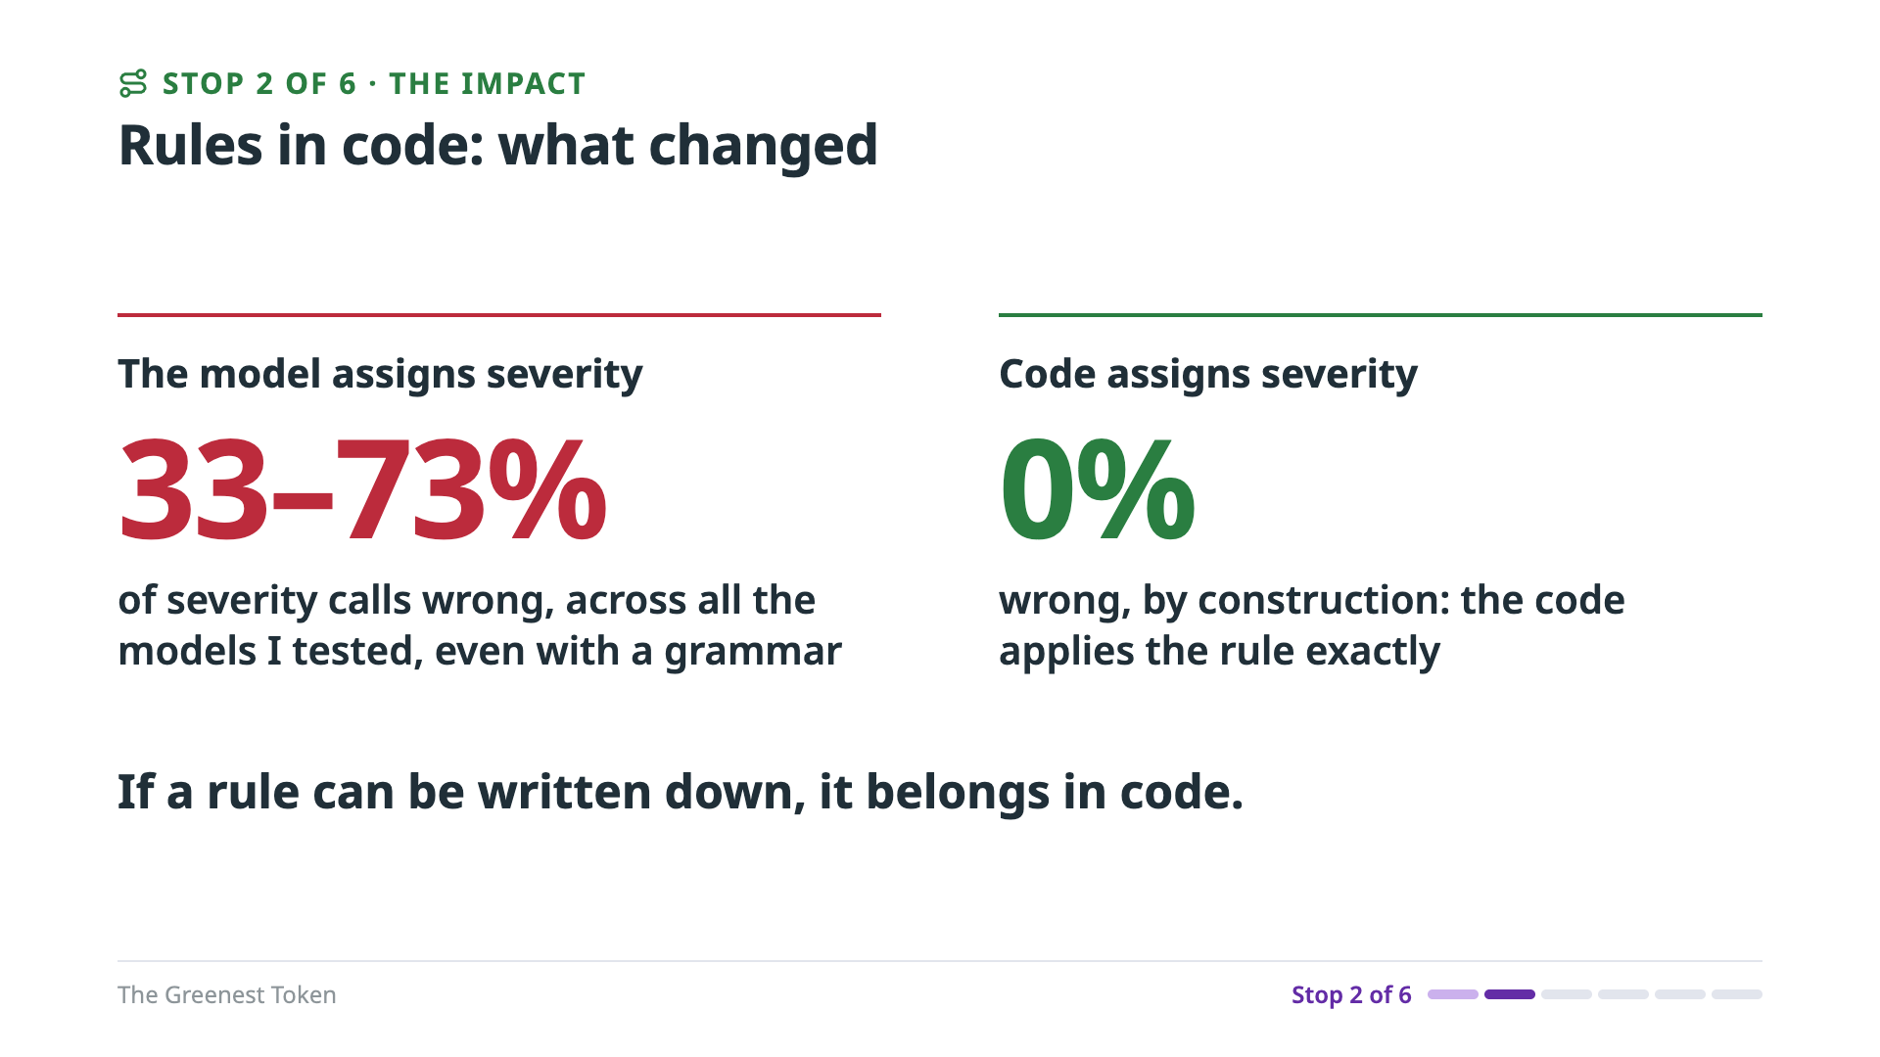
Notes:
Here's what that bought. When the model assigned severity, every model I tested got it wrong on 33 to 73 percent of calls. And that was with a grammar guaranteeing every answer parsed: the format was right, and the answer wasn't. Once code assigns severity, the error rate is zero, by construction. Code doesn't approximate a threshold, it applies it, and it doesn't cost a model call. But severity was only one field. The model still had the rest of the card to get right, and it was still missing. So, the obvious next question: could it just think harder?
======
Backing: eval-results/compare-edge-triage-COMP-J2D9D71YNJ-20260926T153435Z.json (models.<id>.severity_calibration.mismatch_rate, 15 models). Not the same test as slide 10's 9 models: that was the first free-text prompt (2026-09-25); this is the grammar-constrained pipeline (2026-09-26), after 7 more models were added. Qwen3.8-27B is excluded (Pi 4 thermal limits), so 16 in models.toml minus 1 = 15.

Slide 27
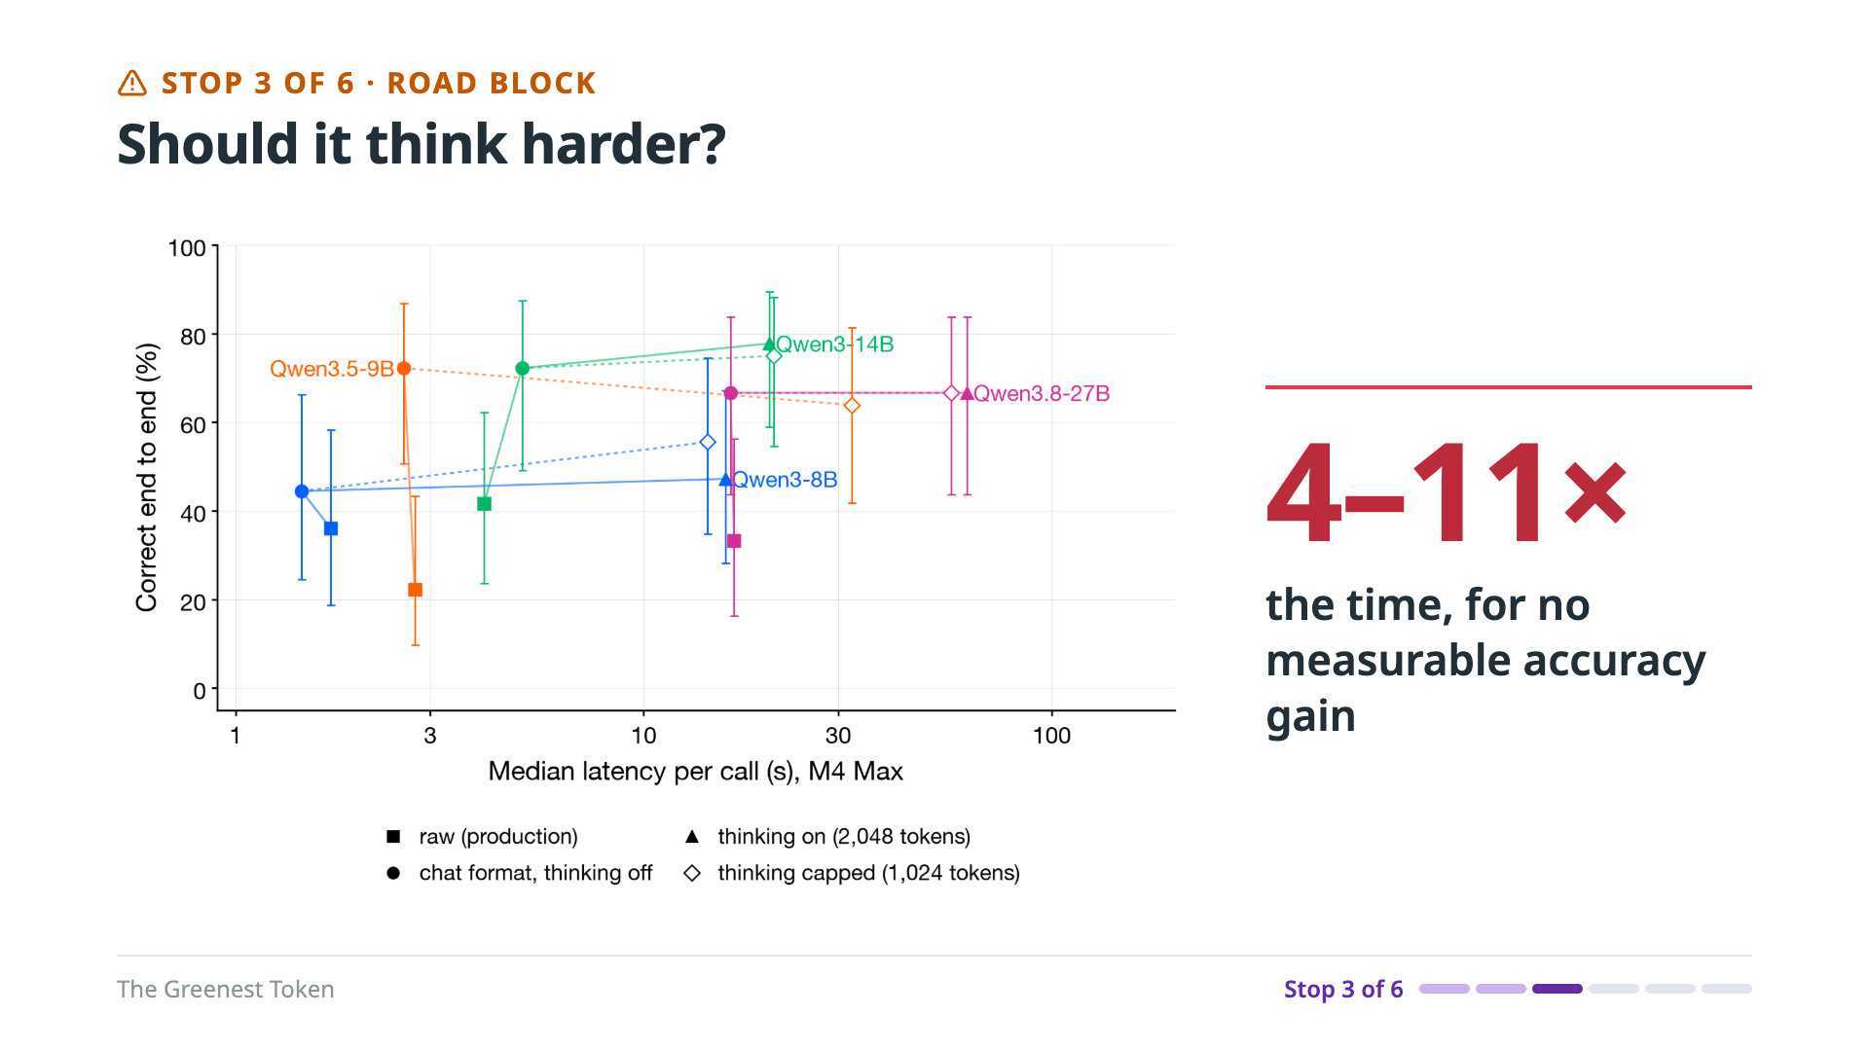
Notes:
Stop three: should it think harder? First, what thinking actually is. A thinking model was trained to write out its reasoning, inside think tags, before it answers. Same model, same weights; there's no separate reasoning engine. It's just more tokens, and every token is one more pass through the model, so time and energy grow with everything it writes. Then the answer reads that reasoning, which can fix a mistake, or talk the model into one. I tested it on the whole job with three Qwen thinking models. This chart is accuracy against time per call. Thinking cost four to eleven times the time, and four to seven times the energy, for no measurable accuracy gain. On an iPhone-class chip, Qwen3 14B went from 202 to 817 joules per call. And some models don't know when to stop: on a simpler task, one model never finished thinking on 11 of 18 calls.
======
Detail: Qwen3-8B, Qwen3-14B, Qwen3.8-27B on the whole-job prompt, on the laptop and the phone-class Macs; the Pi never ran thinking, and production never had it on. One case: Qwen3-14B wrote 125 tokens with thinking off and 449 on (349 thinking), 4.81 s → 18.55 s. Another case, thinking broke it: off 5.04 s, right (hold); on 15.71 s, 580 tokens, wrong (lower). The 11 of 18 is Qwen3.5-9B, uncapped.
How I switched it on (for Q&A): production sends the bare prompt with no chat template, so these models can't think there. For the test I built Qwen's chat format by hand. Pre-filling an empty think block switches thinking off, which is exactly what Qwen's template does for enable_thinking=false; an open think tag lets it reason; the capped mode allows up to 1,024 thinking tokens, then I close the tag and ask for the answer. Prompt, temperature and test cases were identical across modes. One bug: my thinking grammar banned the less-than sign, so whenever the model went to write 'less than 0.22 g', the grammar forced its thinking to close. Those calls are excluded. Grammars are code; test them.
Backing: paper Fig. 3 and §IV-D; round 3 files …T165312Z (call 9, off), …T171623Z (on; call 4); tests/model/round3_eval.py; test log incident 27.

Slide 28
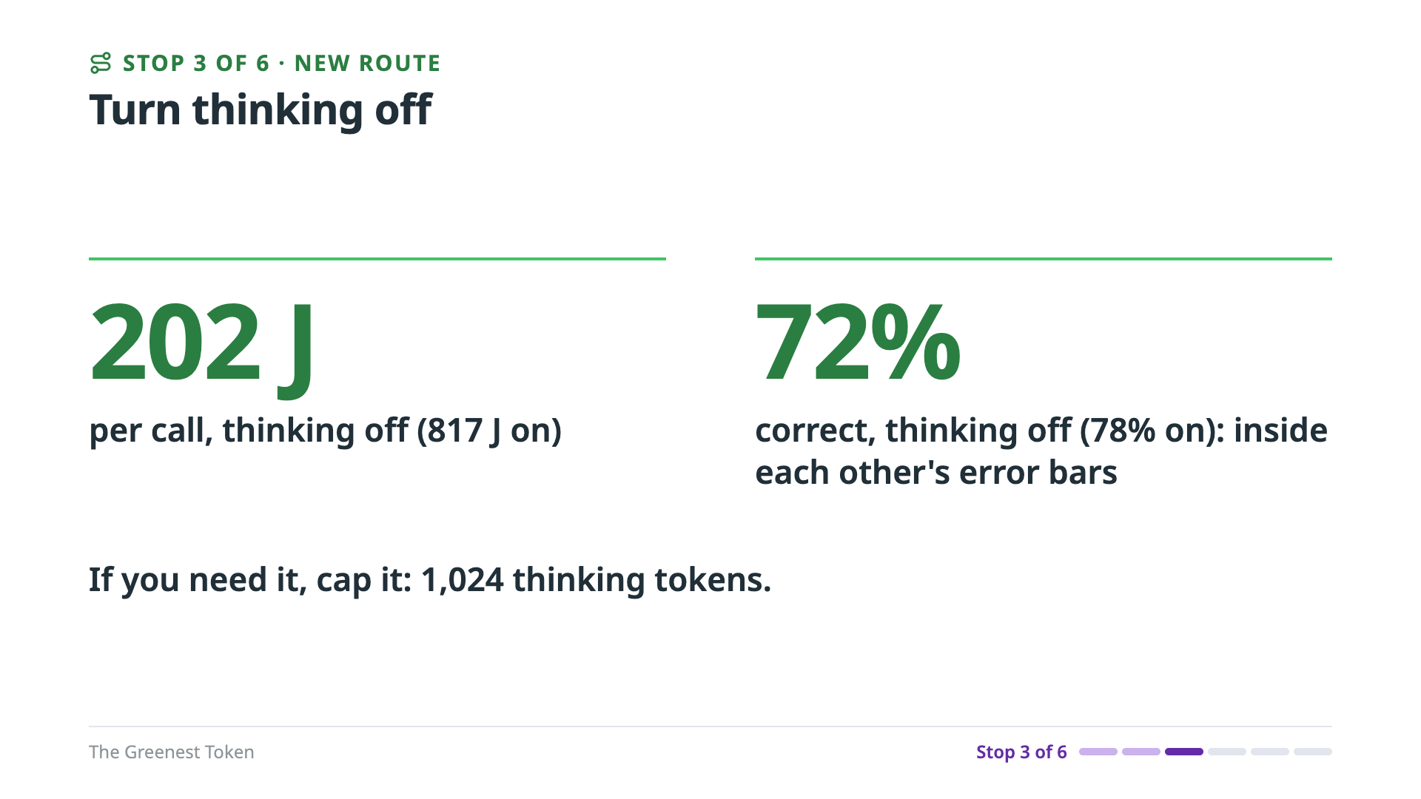
Notes:
The new route: turn thinking off. A short, bounded judgment doesn't need multi-step reasoning. With thinking off, Qwen3 14B used 202 joules per call instead of 817, and it was 72 percent correct instead of 78. Those two are inside each other's error bars, and the other two models moved even less. Thinking can fix an individual case, but across 36 cases there was no measurable gain. If you do need it, cap it: I capped it at 1,024 thinking tokens. So thinking wasn't the answer. Maybe the job itself was too big.
======
Detail: Qwen3-14B 72% → 78%, Qwen3-8B 44% → 47%, Qwen3.8-27B 67% → 67%, all within each other's ranges. 202 J vs 817 J per call is on the iPhone-class M1.
Backing: paper Fig. 3 and Table VI (§IV-D); round 3 file …T165312Z (call 9).

Slide 29
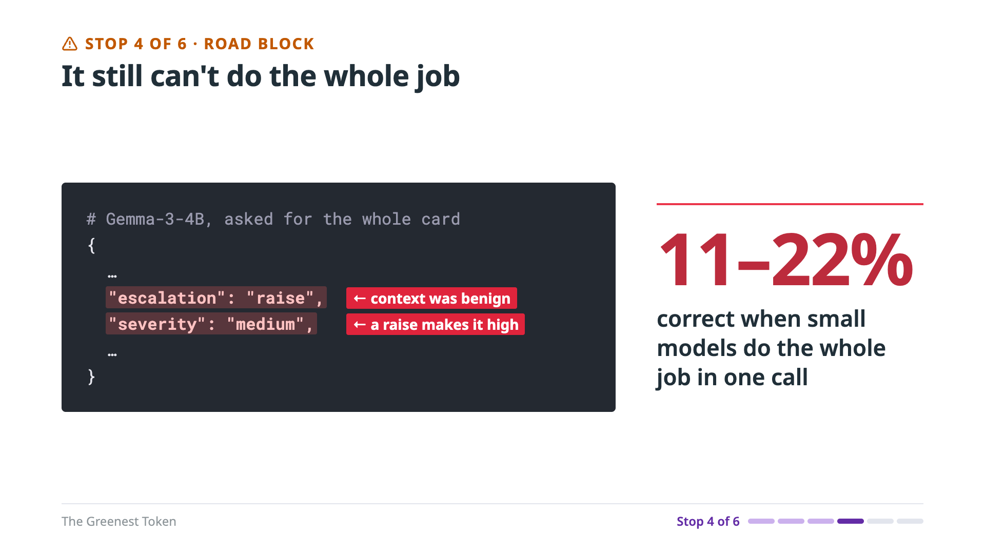
Notes:
Stop four. Even with severity computed in code, asking for the whole card in one call broke the small models. In this test, the model got the physics and the rules, and had to apply the thresholds, decide the escalation, and then derive the final severity and the action, all in one call. Here's Gemma 3 4B on a benign case. The context was harmless, but it reasoned about the physics, raised the escalation, and then wrote a severity that contradicts its own raise. Across the small models, the whole job in one call was only 11 to 22 percent correct. The root cause: three steps in one call, and small models lose consistency fast.
======
Detail: round 3's whole-job prompt, three steps in one call: STEP 1 baseline severity from the physics rules (high if ABS engaged or peak deceleration above 0.45 g; otherwise by traffic pattern), STEP 2 escalation from the context, STEP 3 final severity and action. Its baseline_severity was medium and recommended_action was escalate; correct was hold.
Backing: FULL_PROMPT_TEMPLATE (tests/model/round3_eval.py); eval-results/compare-round3-COMP-J2D9D71YNJ-20261004T154409Z.json (calls[7]); paper Table VI.

Slide 30
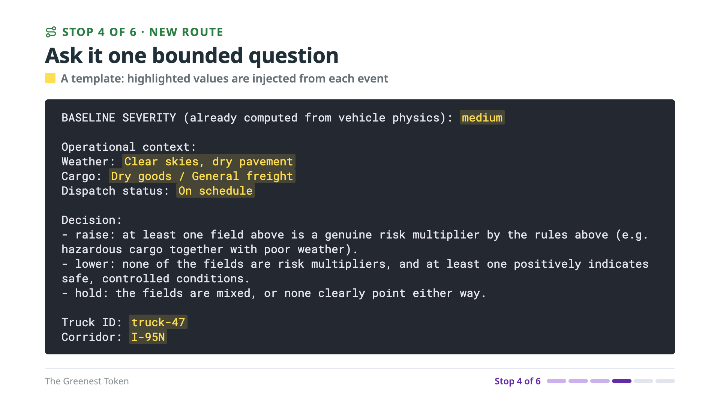
Notes:
The new route: ask one bounded question. Code has already worked out the baseline severity from the physics. The model gets that baseline, the operational context, meaning the weather, the cargo and the dispatch status, and the rules for weighing each one. Then it answers one question: raise, hold, or lower? Code adds everything else: the final severity, the action, the truck ID. Same model, same context, same rules; only the scope changed. Given one question, Gemma weighed each field, found no risk multiplier, and held. That's correct. Across the small models, accuracy went from 11 to 22 percent, up to 94 to 100 percent.
======
Detail: model writes risk_synthesis and escalation; code adds final severity, action, truck ID, ETA. Gemma-3-4B answered "escalation": "hold". The slide trims the prompt to the baseline, context, decision rules and truck ID; full prompt is DEFAULT_PROMPT_TEMPLATE in triage_function.py (it also has the field-weighing rules and the closing instruction).
Backing: DEFAULT_PROMPT_TEMPLATE (triage_function.py); …20261004T154259Z.json (calls[1]); paper Table VI (§IV-D; round 3, M4 Max, raw mode).

Slide 31
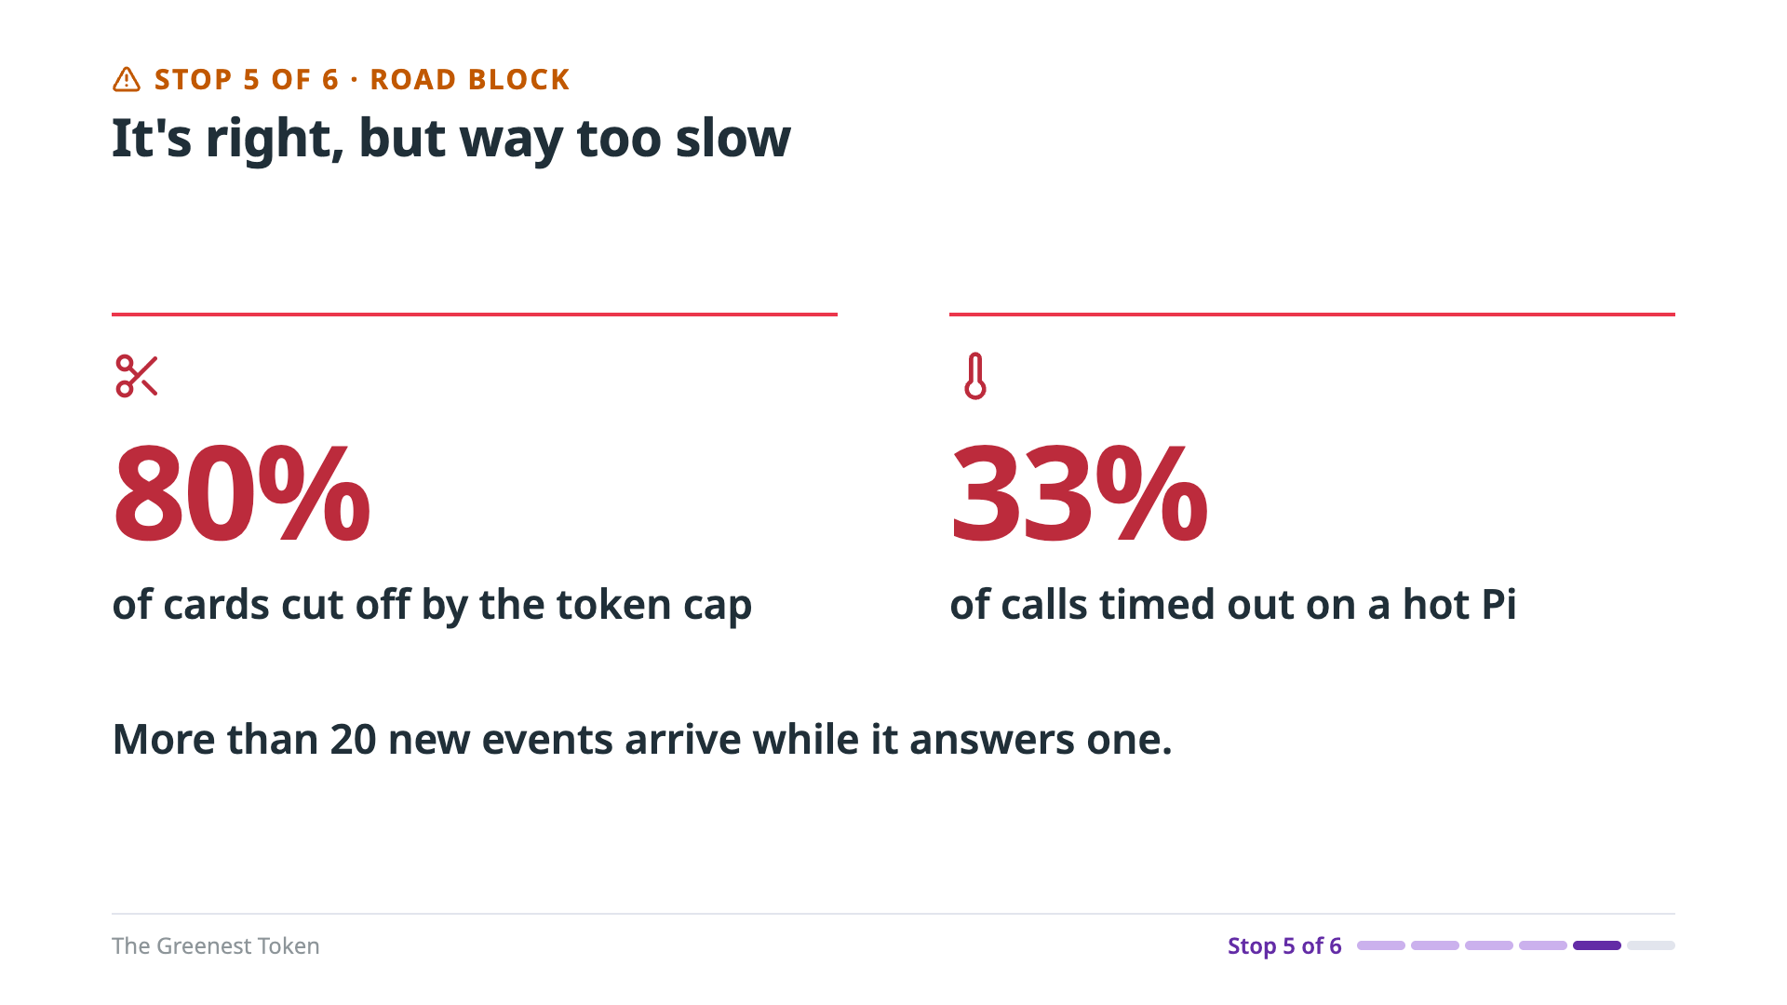
Notes:
Stop five. The answers were right, but the pipeline was far too slow, and some calls never finished. Remember, my first attempt took almost two minutes per answer on the Pi, and more than 20 new events arrive while it answers one. A 150-token cap cut off 80 percent of the cards once the model started writing its reasoning. And under sustained load, the Pi got hot and throttled, until a third of the calls hit the 300-second timeout.
======
Detail: 80% = 8 of 10 cards; 33% = 5 of 15 calls. 111.5 s per call on the Pi 4, first attempt (Qwen2.5-1.5B), shown on slide 11.
Backing: eval-results/compare-edge-node00-20260925T030826Z.json (111.5 s p50); commit 754ab57 (8 of 10 cut off); impact track (5 of 15 at 300 s).

Slide 32
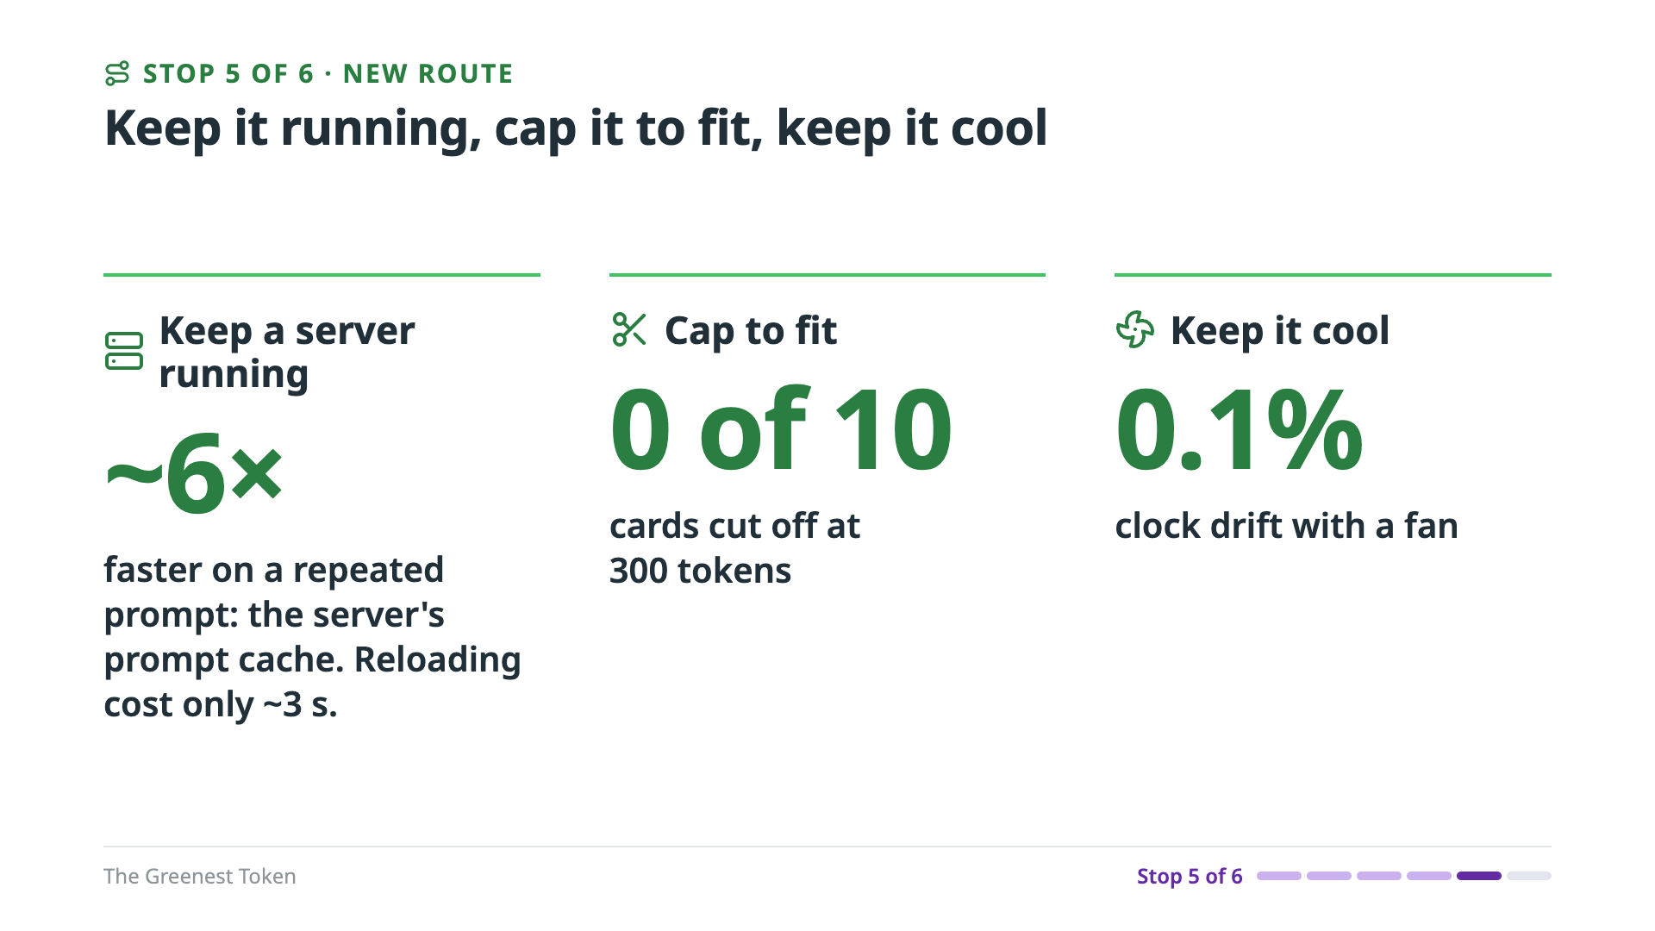
Notes:
Three causes, three fixes. First, keep the model in a long-running server instead of starting the command-line tool for every call. On the Pi, a repeated prompt went from about 196 seconds to under 32: about six times faster. But be careful about why. Reloading the model only cost about three seconds. Nearly all of the gain is the prompt cache, which only a long-running server keeps between calls. That matters at the next stop. Second, size the cap to the answer: at 300 tokens, no cards were cut off. A timeout doesn't stop a runaway model; a token cap does. Third, keep it cool. With a fan, the Pi's clock stayed within 0.1 percent of full speed. And set your timeouts from measured latency, not from defaults.
======
Detail (Pi 4, Phi-3.5-mini, production prompt, 506 tokens): command-line tool 196.0 s per call (load 3.1 s, prompt 161.4 s, generation 30.8 s); llama-server with cache off 192.7 s; with cache on 31.7 s (prompt 0.74 s). Not reloading saves ~1.7%; the prompt cache gives 6.2×. Server startup 5.6 s once; cold first load 9.1 s.
The old "~1,471 s → 233 s" laptop figure compared sweeps of different sizes and thread counts; don't use it.
Fan: clock within 0.1% of 1.8 GHz. My own function's 60 s default timeout is shorter than a changed-prompt call on the Pi.
Backing: eval-results/pi4-cli-vs-server-20261007/ (README, results-20261007T201818Z.jsonl); commit 754ab57 (300 tokens); test log, real-stream Pi run (fan, clock).

Slide 33
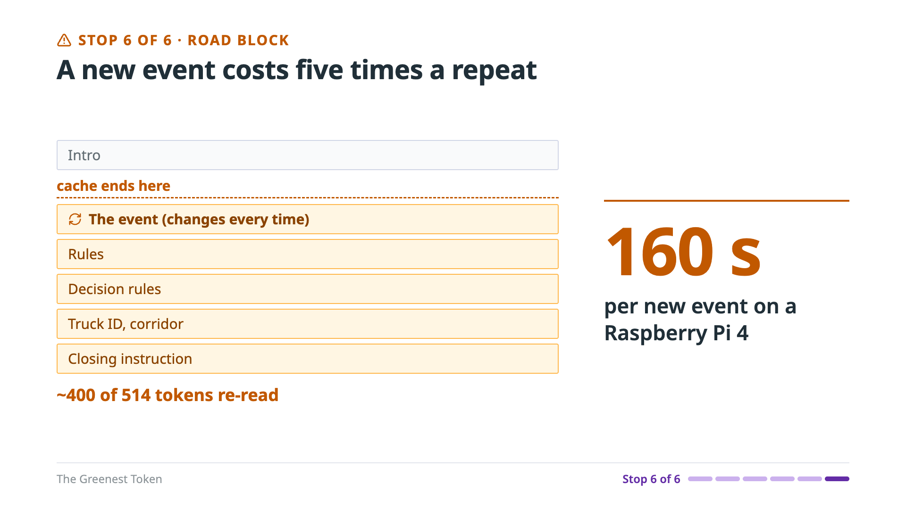
Notes:
Stop six, and I found this one while preparing this talk. My benchmark repeated one event, so the server only had to read one of the 514 prompt tokens. It measured a repeat, not a real call. A new event re-read about 400 tokens, because my prompt put the event's fields near the top, before the rules. A prompt cache reuses a prompt only up to the first token that changed. And on a CPU, reading the prompt is the slow part: 129 of the 160 seconds. So a new event cost five times as much as a repeat.
======
Detail: 160 s and 772 J per new event on the Pi 4, vs ~31.7 s and 154 J for a repeat.
Backing: paper Table IV (§IV-B, "When the prompt changes").

Slide 34
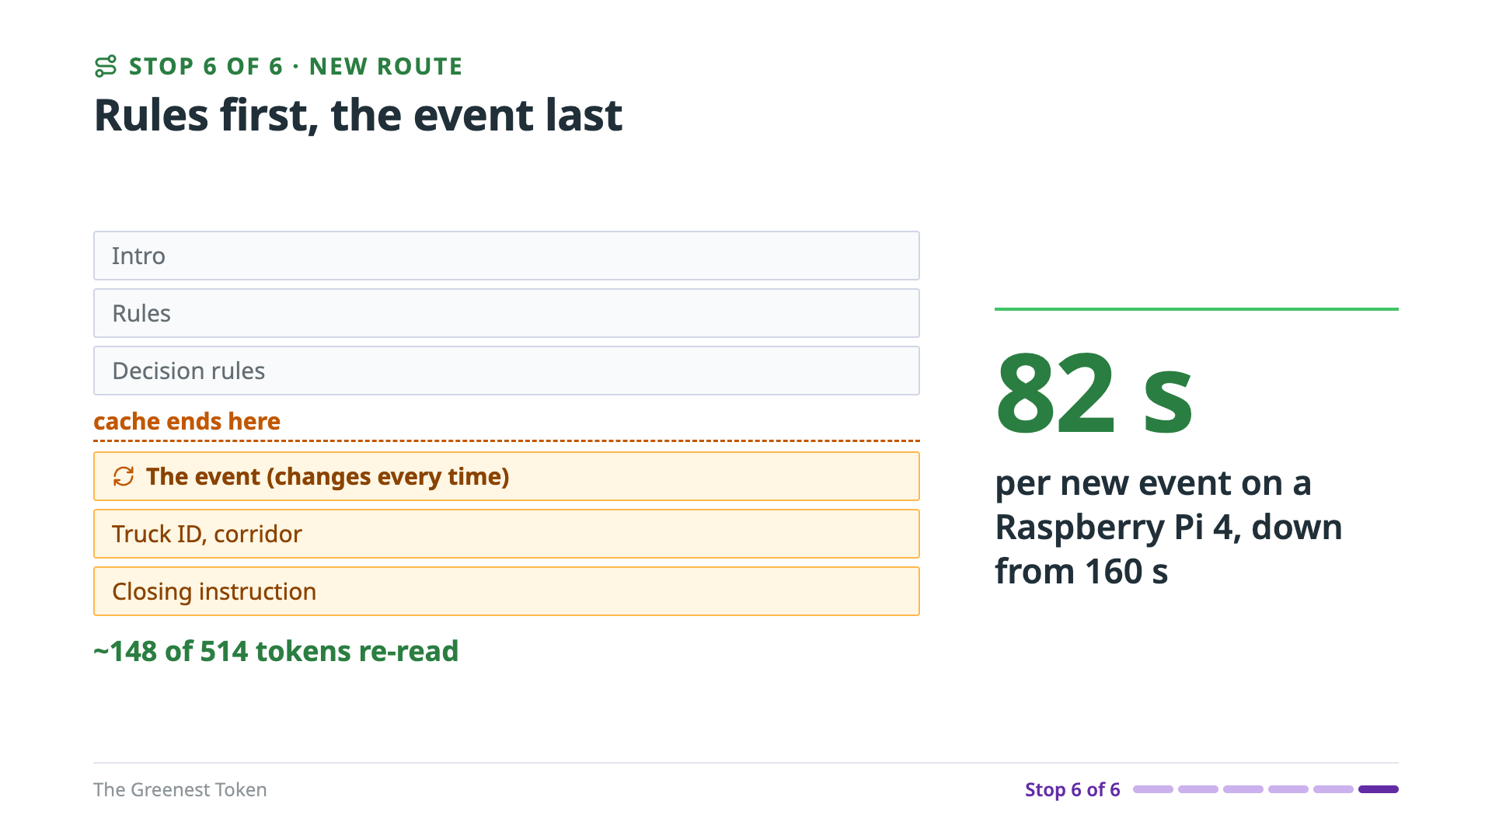
Notes:
The new route: fixed instructions first, and the event last. Same words, just reordered, so the event's fields come after the rules. Now a new event re-reads about 148 tokens instead of 400. On the Pi, a new event went from 160 seconds to 82, and from 772 joules to 416. That's a 46 percent saving from moving a few lines. On the laptop GPU, the same change saved 26 percent. One caution: re-check accuracy whenever you reorder a prompt. In one runtime, the reordered prompt tipped a borderline case.
======
Detail: it's opt-in in the code. Same words, same accuracy on llama-server; through llama-cpp-python the reordered prompt tipped a borderline case.
Backing: paper Table IV (§IV-B); eval-results/edge-triage-event-last-pi4-20261005/.

Slide 35
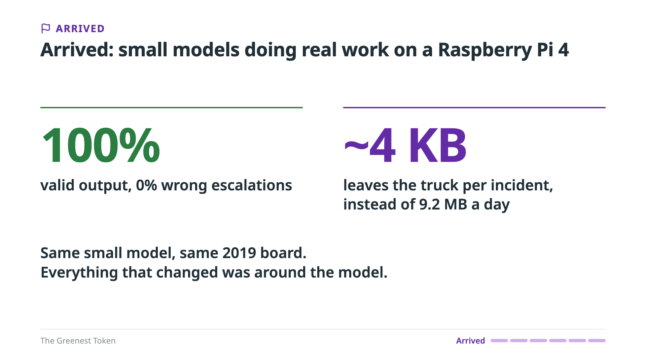
Notes:
And we've arrived: small models doing real work on a Raspberry Pi 4. With Phi 3.5 mini, every answer was valid, and none of its escalations was wrong. The model is called about 23 times per incident instead of on every event, and about 4 kilobytes leaves the truck per incident, instead of 9.2 megabytes a day. Same small model, same 2019 board. Everything that changed was around the model. To be honest, it's still slow: an incident's 23 calls take 12 to 15 minutes of LLM work on the Pi. So, what does all this keep out of the data center?
======
Detail: ~23 LLM calls per incident instead of one per event (17,280 a day); 82 s and 416 J per new event, down from 160 s and 772 J.
Backing: eval-results/edge-triage-event-last-pi4-20261005/ (100% format, 0% mismatch; 82 s, 416 J); paper Fig. 4 and Table IV; impact track row 28.

Slide 36
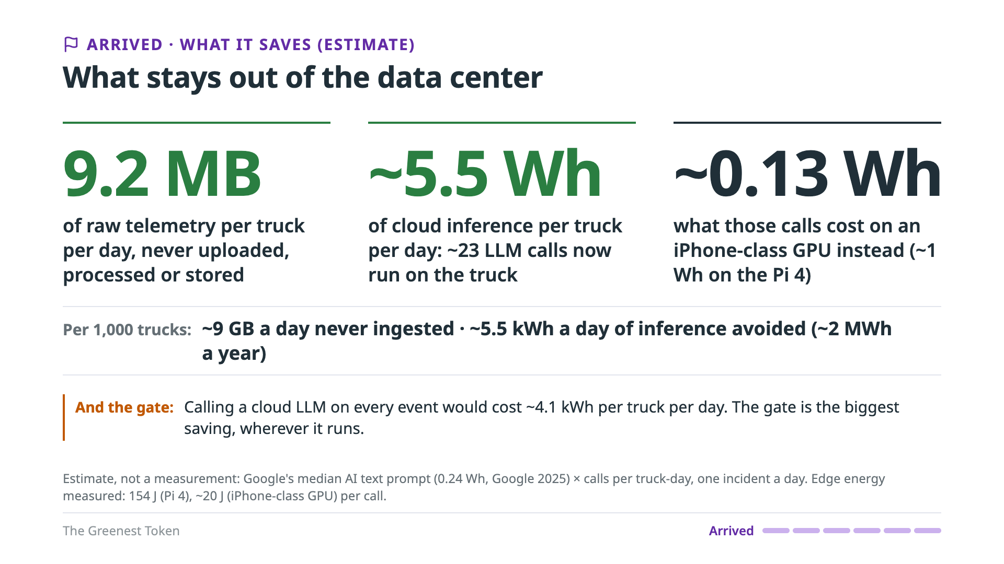
Notes:
This part is an estimate, not a measurement: I measured the truck, not a data center. I priced each cloud call at Google's published figure for a median AI text prompt, 0.24 watt-hours. The cloud design already had the gate, so moving to the edge saves two things. First, the gated LLM calls: about 23 a day per truck, or roughly 5.5 watt-hours of cloud inference. On an iPhone-class GPU, those same calls cost about a tenth of a watt-hour. Second, and bigger: the raw stream. That's 9.2 megabytes per truck per day that never crosses the cellular link, never hits an ingestion queue, and never sits in a data lake. Across a thousand trucks, that's about 9 gigabytes a day, and about 2 megawatt-hours a year of inference. But the biggest number on this slide is the gate's. Calling a cloud model on every event would cost about 4.1 kilowatt-hours per truck per day. That's why the gate was the first thing I packed.
======
Caveats if asked: Google's figure is for a large model, excludes training, and its carbon is market-based; a small batched model in a data center could cost less per call. A dedicated Pi idles at about 82 Wh a day; a phone that's on anyway adds only the ~0.13 Wh. I have no sourced energy figure per gigabyte ingested and stored, so the data stays in bytes. One incident a day assumed.
Math: 23 × 0.24 Wh ≈ 5.5 Wh; 23 × 20 J ≈ 0.13 Wh; 23 × 154 J ≈ 1 Wh; 17,280 × 0.24 Wh ≈ 4.1 kWh.
Backing: Google (2025), median Gemini text prompt, 0.24 Wh (cited on slide 3); calls per incident: paper Fig. 4; edge energy: paper Table II; 9.2 MB per truck-day: impact track row 28.

Slide 37

Notes:
So, we've landed. We got a small model doing real work, accurately and at a usable speed, on about the most constrained device you could pick. That was the hard part. Now let's expand. What happens when the same pipeline gets more room?

Slide 38
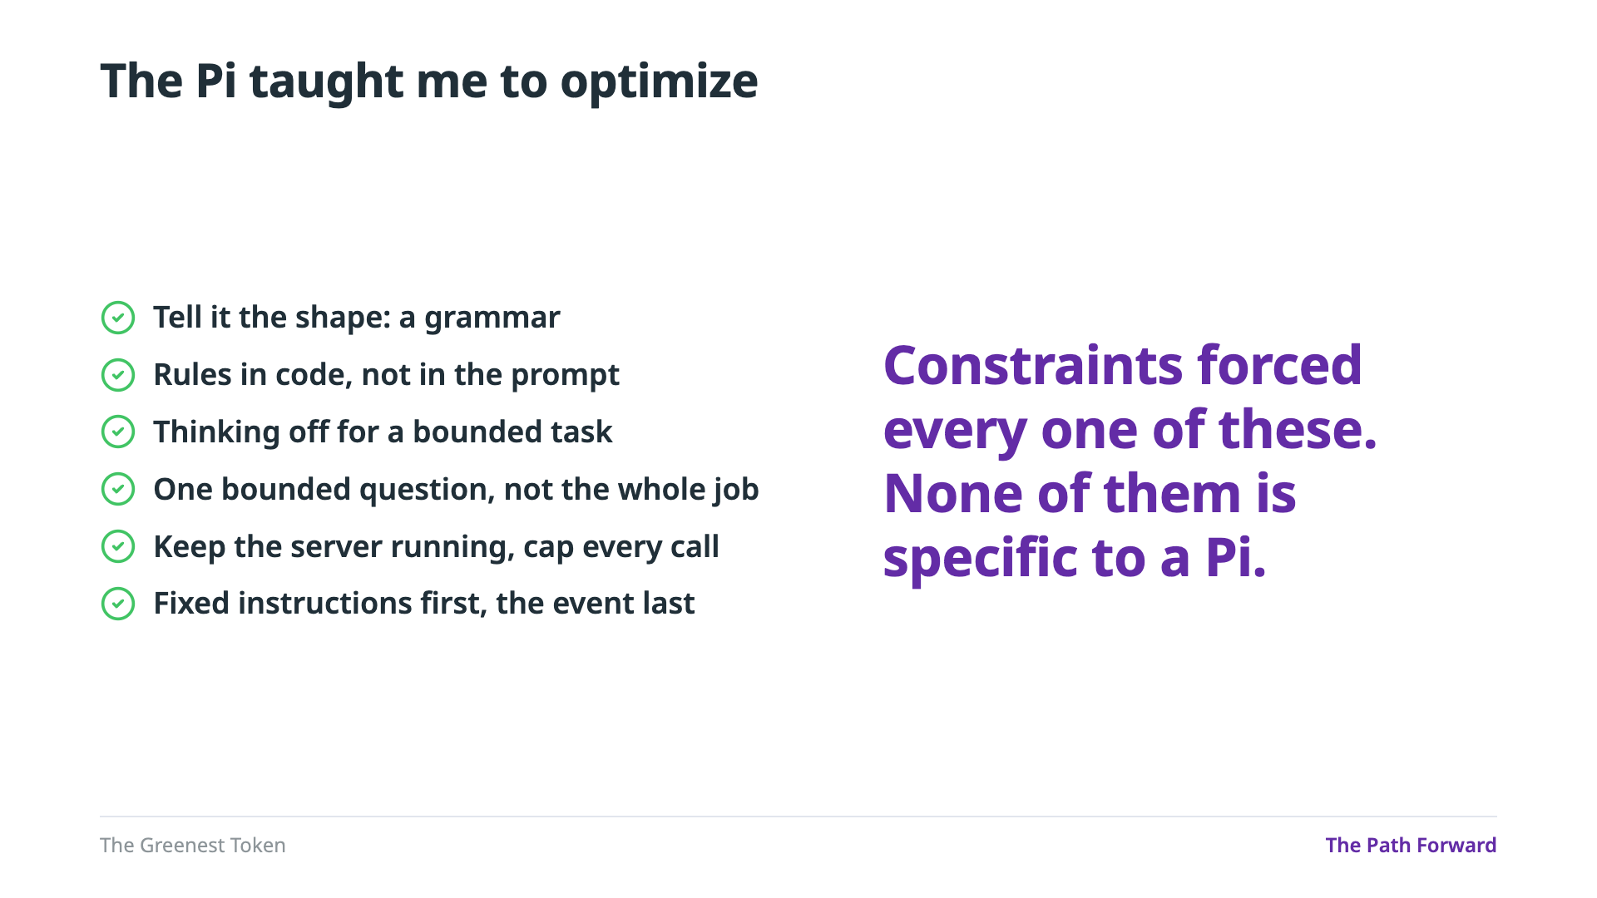
Notes:
The Pi taught me to optimize. A 2019 board with a few watts and no accelerator leaves no room for waste, so every fix on the route came from that pressure: a grammar for the shape, rules in code, thinking off for a bounded task, one question instead of the whole job, keep the server running and cap every call, and fixed instructions first with the event last. But none of them is specific to a Pi. Each one makes an LLM call cheaper, faster or more reliable on any hardware. So what does the same pipeline do on bigger hardware?

Slide 39
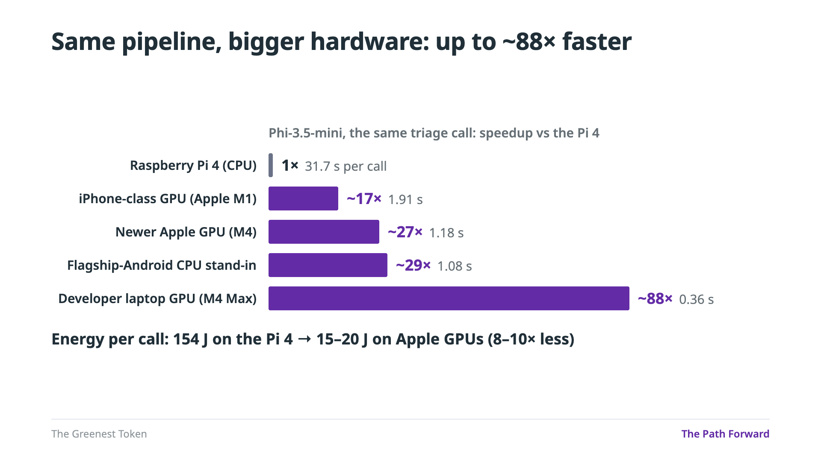
Notes:
Next, I expanded my test bed. I used different machine types as proxies for modern smartphones, to see whether the compute most of us carry around all the time would do better. I left cloud GPUs out on purpose: this is only about running the model on the hardware itself. Same model, same prompt, same pipeline. The Pi takes 31.7 seconds a call. An iPhone-class GPU takes under 2 seconds. A flagship-Android CPU stand-in takes about 1, and a laptop GPU about a third of a second: up to 88 times faster. And on the Apple GPUs, each call also takes 8 to 10 times less energy. These are stand-ins, not phones, but the M1 matches the iPhone 17 Pro's published speed within 9 percent. And speed isn't the only thing more room buys.
======
Detail: same repeated prompt on every machine, so the prompt cache applies everywhere. On the Pi, a changed prompt costs 82-160 s.
Backing: paper Table II, Fig. 1.

Slide 40
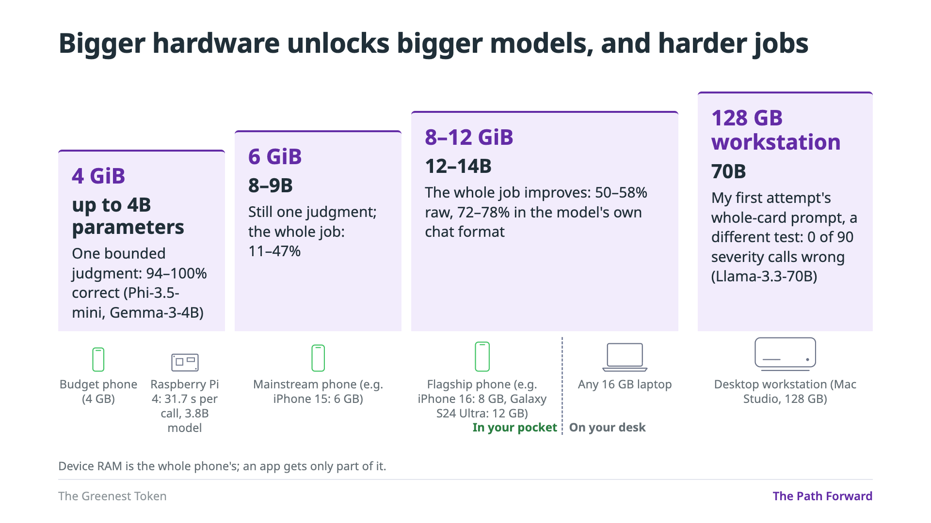
Notes:
More memory fits a bigger model, and bigger models can take back more of the job. On the first step, a device with 4 gigabytes, like a budget phone, runs models up to 4 billion parameters. That's where the Pi sits too: the whole route ran a 3.8-billion-parameter model on it. Models that size get one bounded judgment right 94 to 100 percent of the time. Mainstream phones have about 6 gigabytes, enough for 8 to 9 billion parameters. Flagships have 8 to 12, enough for 12 to 14 billion, and those start handling the whole job: up to 78 percent in the model's own chat format. All of that fits in your pocket. And in a different test, on a desktop workstation with 128 gigabytes, a 70-billion-parameter model got my very first whole-card prompt right 90 times out of 90. One caveat: those are the phone's total memory, and an app only gets part of it. But phones keep getting more memory and faster accelerators, and models keep getting more capable for their size. Every step of this staircase is moving into people's pockets. So where exactly are the boundaries?
======
Detail: the 70B run used Apple's MLX runtime with the chat template, so it's a hint, not a comparison. Memory: what fits under a hard cap at a small context; ceilings, not per-app phone budgets. The Pi only ever ran models up to ~4B (Phi-3.5-mini, 3.8B, 31.7 s per call).
Generation speed, tokens/s, Phi-3.5-mini (3.8B) vs Llama-3.1-8B: mainstream Android CPU 29.5 vs 16.3; flagship Android CPU 38.1 vs 20.0; iPhone-class GPU (M1) 24.3 vs 12.7; newer Apple GPU (M4) 40.1 vs 21.7. An 8B model generates at roughly half the speed of a 3.8B one.
Device RAM (published specs, verify before presenting): iPhone 15 6 GB; iPhone 16 8 GB; Galaxy S24 Ultra 12 GB.
Backing: paper §IV-E (memory capacity) and Table VI; Fig. 1 llama-bench runs; eval-results/compare-enrichment-http-reasoner-20261007T171911Z.json.

Slide 41
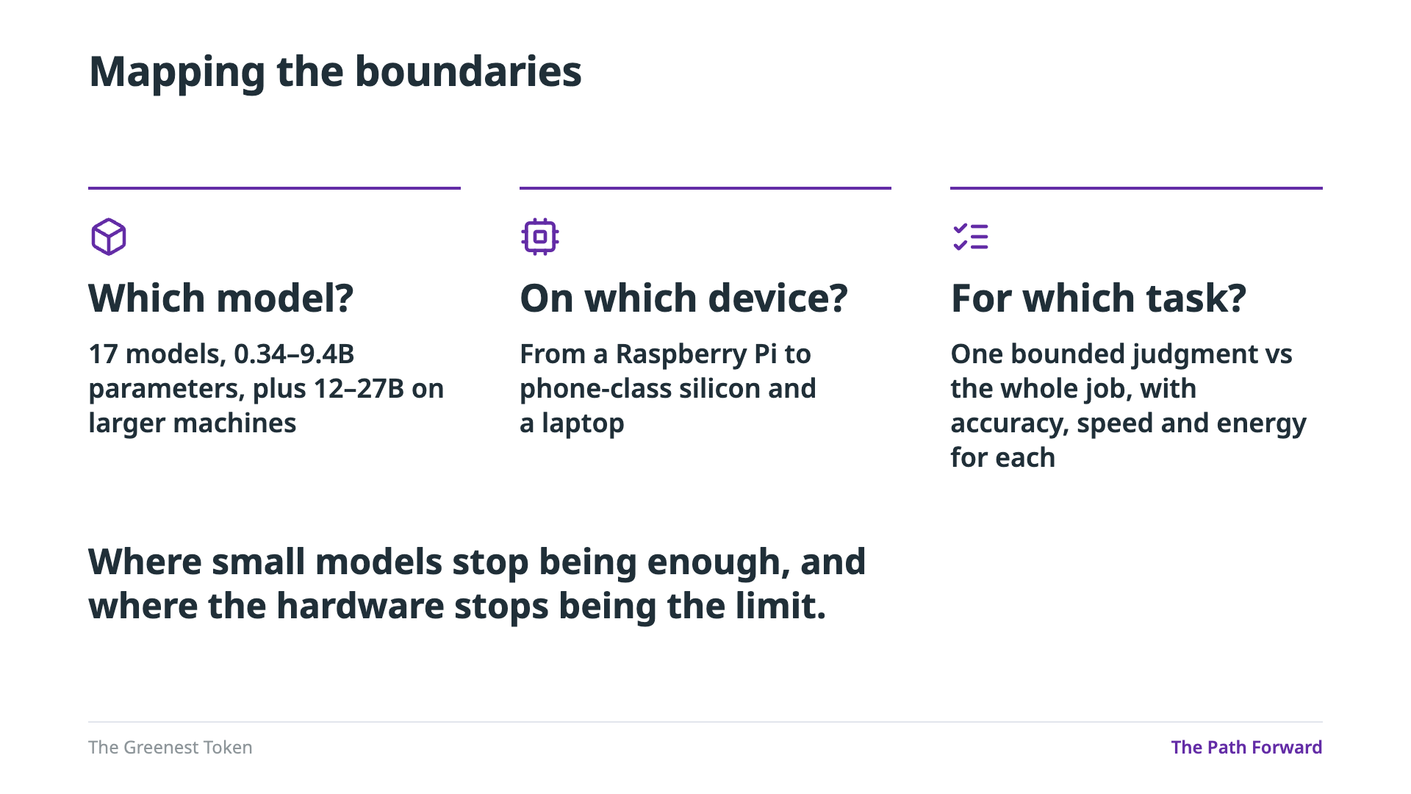
Notes:
So where exactly are the boundaries? That's what my study maps. Which model is enough? I tested 17 models, from a third of a billion to 9.4 billion parameters, plus 12 to 27 billion on larger machines. On which device? From a Raspberry Pi to phone-class silicon and a laptop. For which task? One bounded judgment versus the whole job, with accuracy, speed and energy for each. Today's talk was one point on that map, the smallest box. The goal is to find where small models stop being enough, and where the hardware stops being the limit.
======
Backing: paper §III (models and hardware), Table VI.
If asked why the model counts differ: three rounds of testing. 9 models ran the first prompt (2026-09-25, slide 10). 15 ran the grammar-constrained pipeline (2026-09-26, slide 26). 17 ran the hardware study across the Pi and phone proxies (2026-10-03, docs/TALK2-HARDWARE-SPECTRUM-TEST-CATALOG.md, Phase 1 full suite).

Slide 42
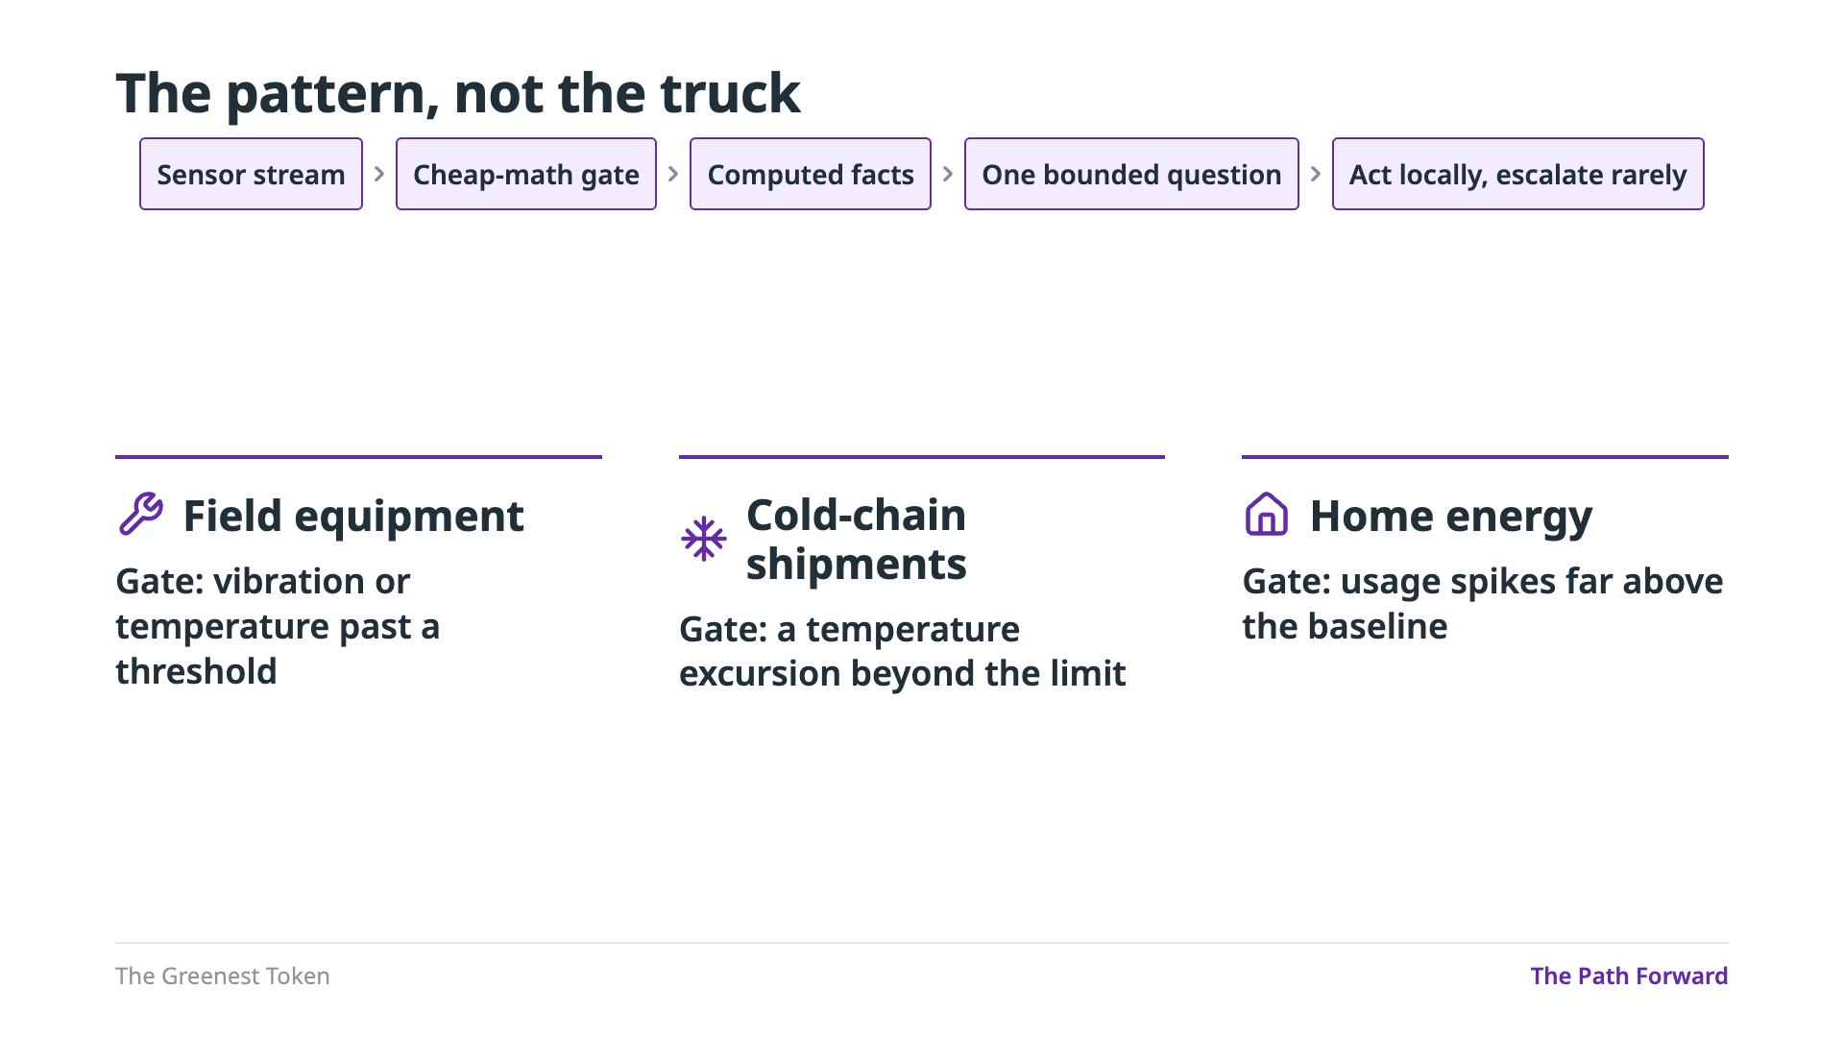
Notes:
And the pattern isn't about trucks. The truck was just my test case. The recipe is general: a stream of readings, cheap math that decides when something matters, computed facts, one bounded question for the model, and an answer that stays local unless it needs to escalate. Here are three places the same shape fits. Field equipment: the gate fires when vibration or temperature passes a threshold, and the model decides whether to service it now, schedule it, or ignore it. Cold-chain shipments: the gate fires on a temperature excursion, and the model asks whether the load is at risk of spoiling. Home energy: the gate fires when usage spikes far above the baseline, and the model decides whether it's worth alerting the homeowner. These are candidates; I only measured the truck. But every app built this way is demand the data center never sees. That's how you slay the dragon: not one heroic model, but thousands of small apps that never send a token to a data center.
======
Detail: field equipment, given the machine's history and the crew's workload; cold-chain, given the cargo, the duration and the destination; home energy, given the time of day, occupancy and weather. Candidates, not tested.

Slide 43
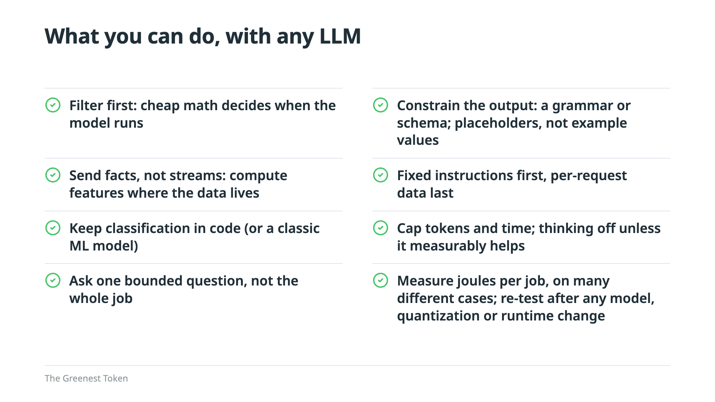
Notes:
So here's what you can do, with any LLM, whether it runs on a phone or in a data center. Filter first: let cheap math decide when the model runs. Send facts, not streams: compute features where the data lives. Keep classification in code, or in a classic machine-learning model. Ask one bounded question, not the whole job. Constrain the output with a grammar or a schema, and use placeholders, not example values. Put fixed instructions first and per-request data last. Cap tokens and time, and leave thinking off unless it measurably helps. And measure joules per job, across many different cases, and re-test after any change to the model, the quantization or the runtime. The first three decide whether a token exists at all.
======
Direction: the slide to photograph; pause on it before advancing.

Slide 44
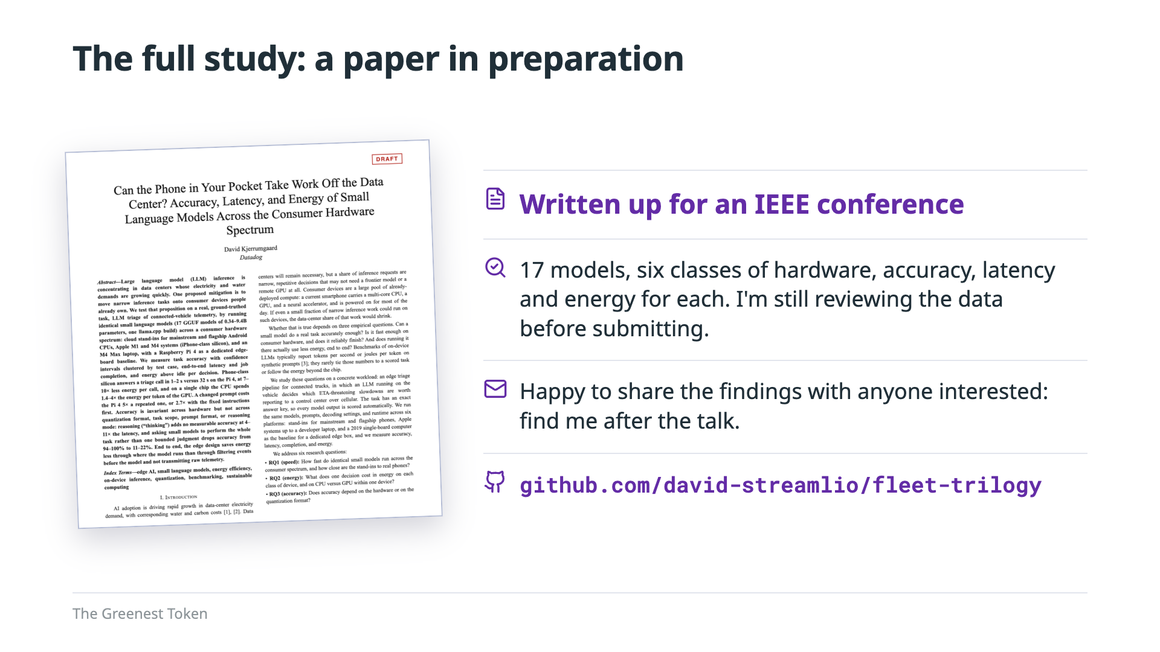
Notes:
Everything in this talk comes from a study I'm writing up as a paper for an IEEE conference: 17 models across six classes of hardware, from a Raspberry Pi to phone stand-ins and a laptop, with accuracy, latency and energy for each. I'm still reviewing the data before I submit it, so it isn't published yet. But I'm happy to share the findings with anyone who's interested, so come find me after the talk. The code is on GitHub at the link on the slide.
======
Code: github.com/david-streamlio/fleet-trilogy

Slide 45
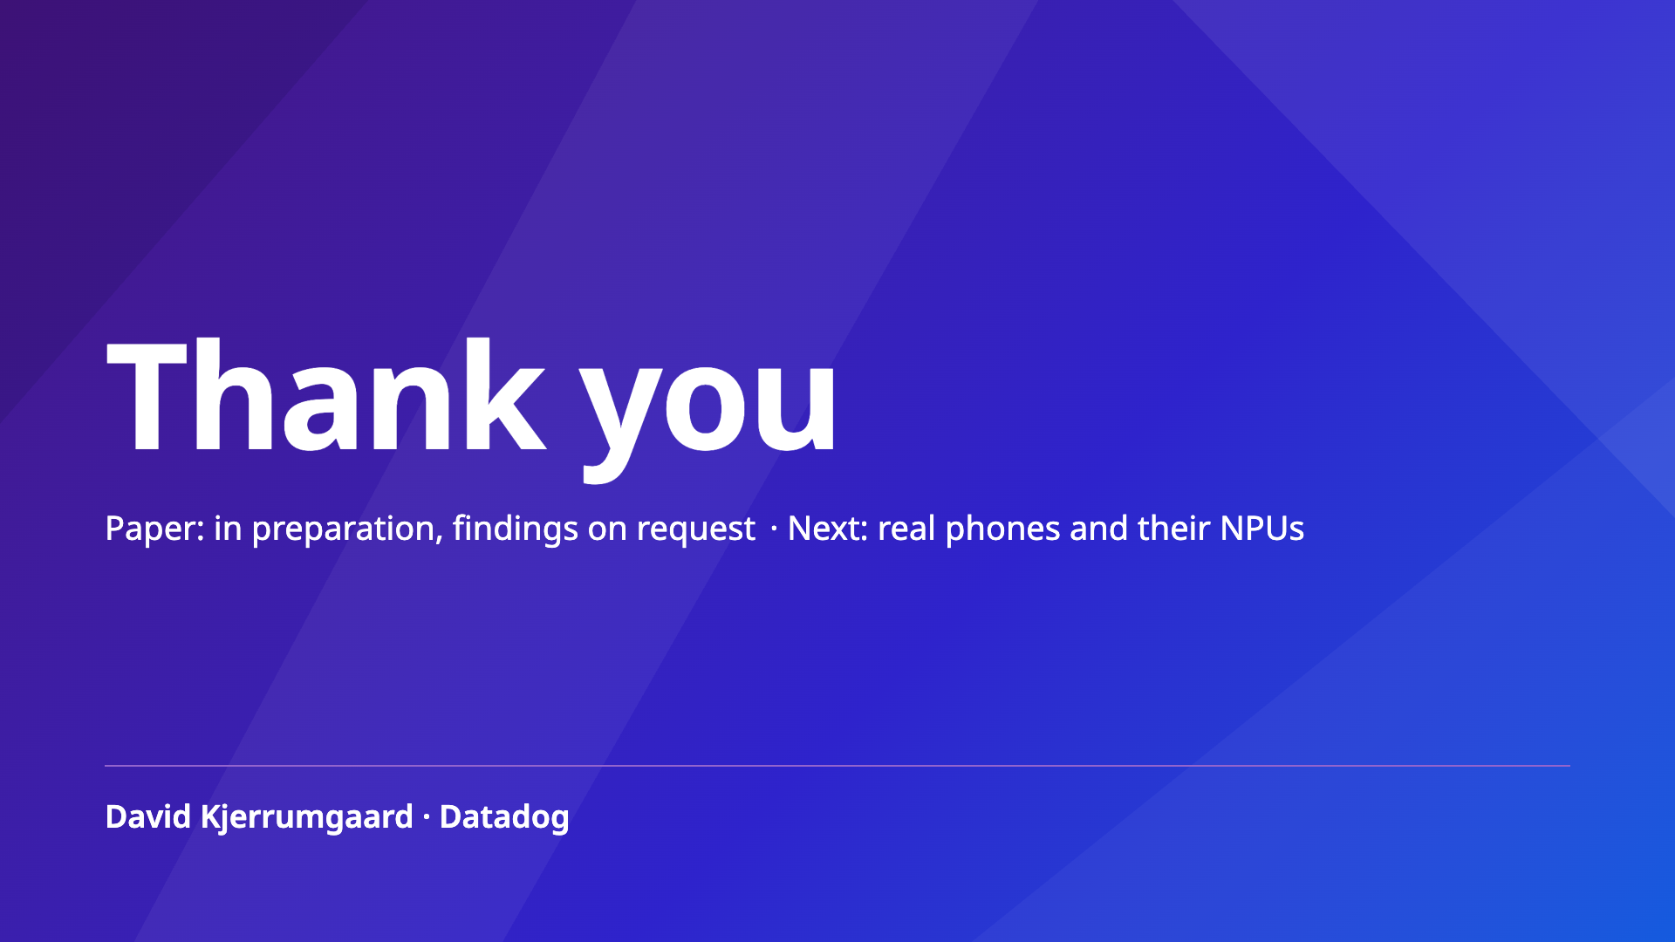
Notes:
So that's the greenest token: the one that never hits a data center's GPU. Next, I want to test real phones and their NPUs. Thank you. I'm happy to take your questions.
======
Talk 1 and Talk 3 complete the series.

