Slide 1
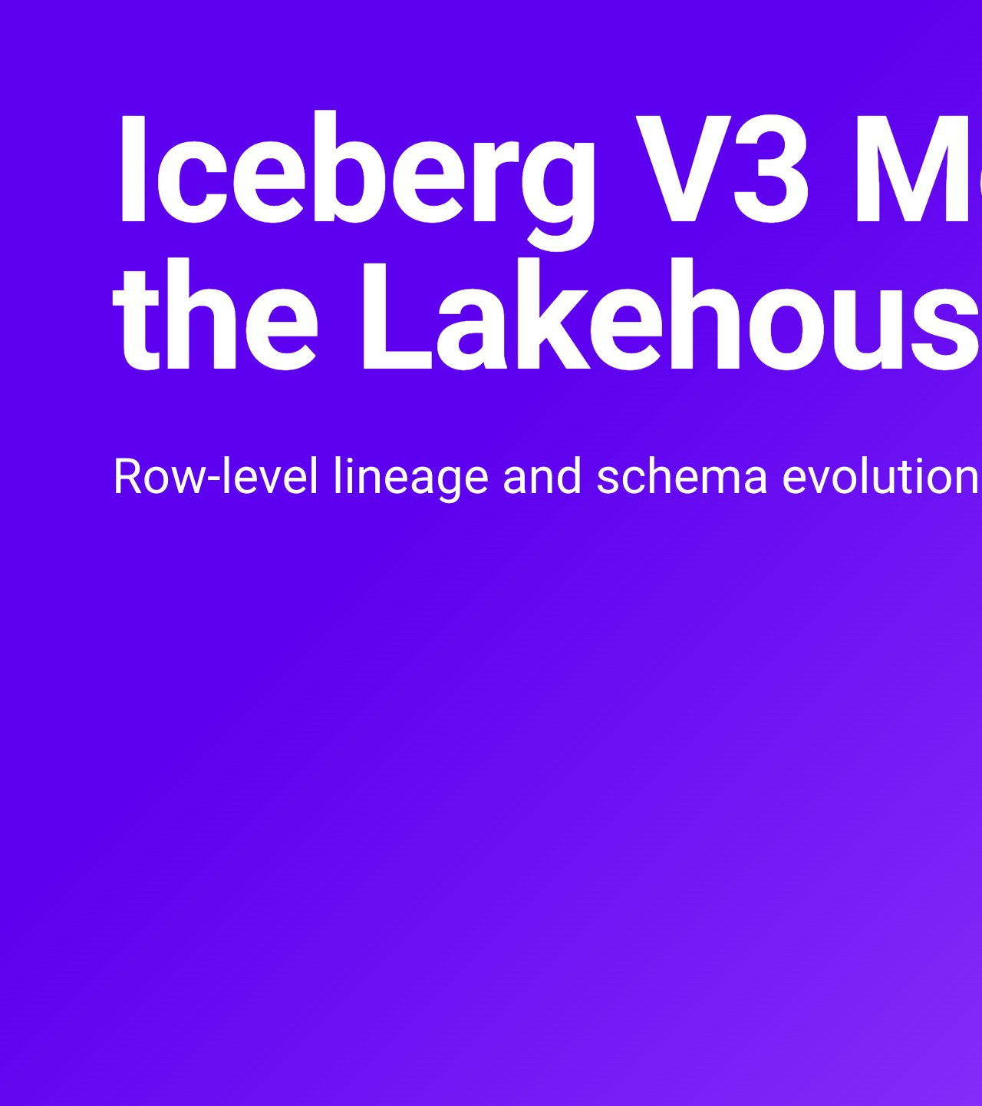
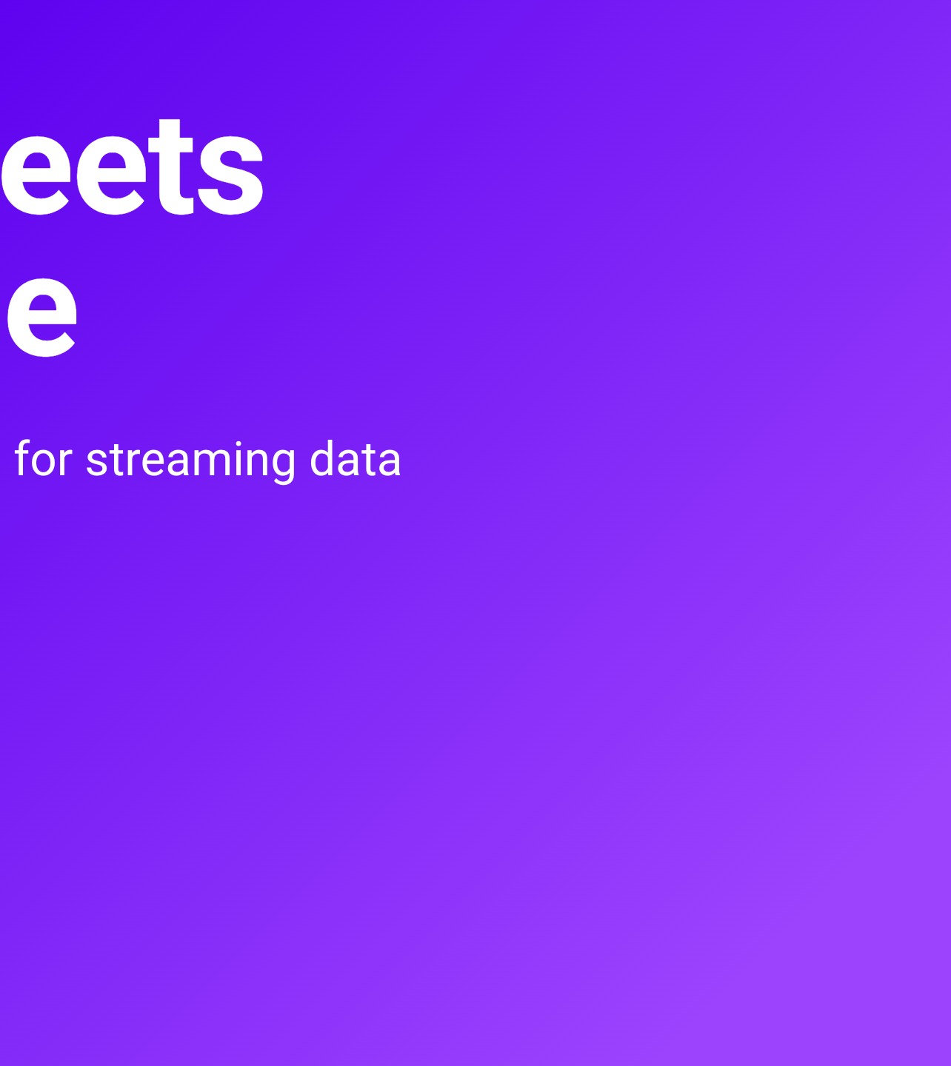
Notes:
Hi everyone, thanks for coming. This talk is a demo walkthrough: Iceberg V3 meets the lakehouse, with row-level lineage and schema evolution for streaming data. Every Iceberg V3 write-up I read pictured a batch job. We wanted to know what V3 does for a table that gets a new commit every two seconds. So we built a small streaming lakehouse on a laptop, recorded it end to end, and I'm going to walk you through what it shows. Everything you'll see is in a public repo, and the link is on the last slide.

Slide 2
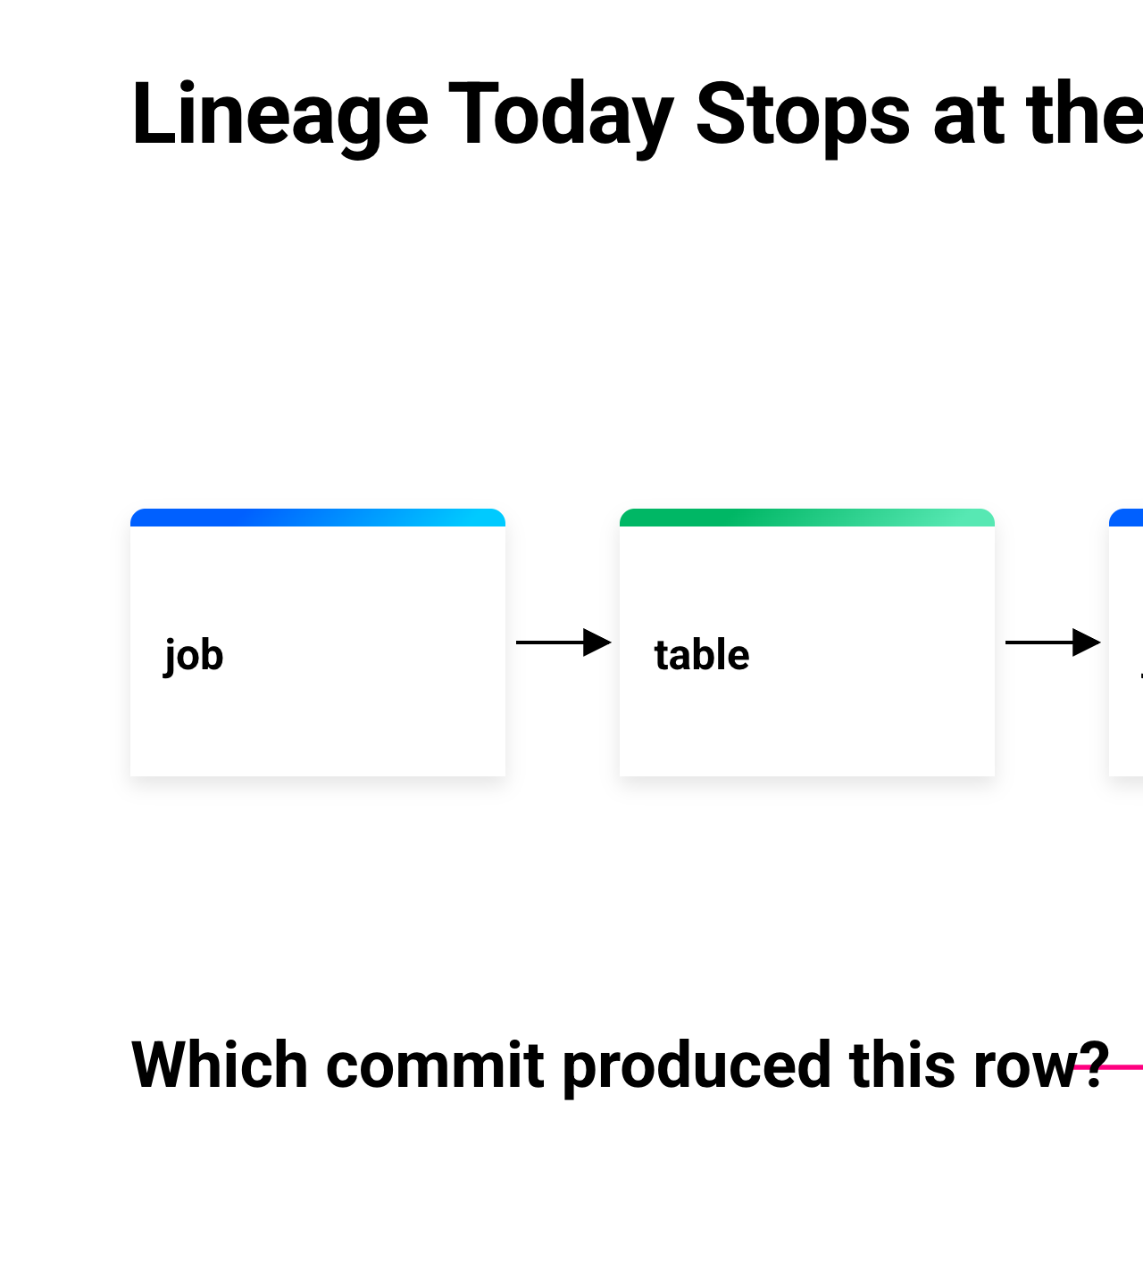
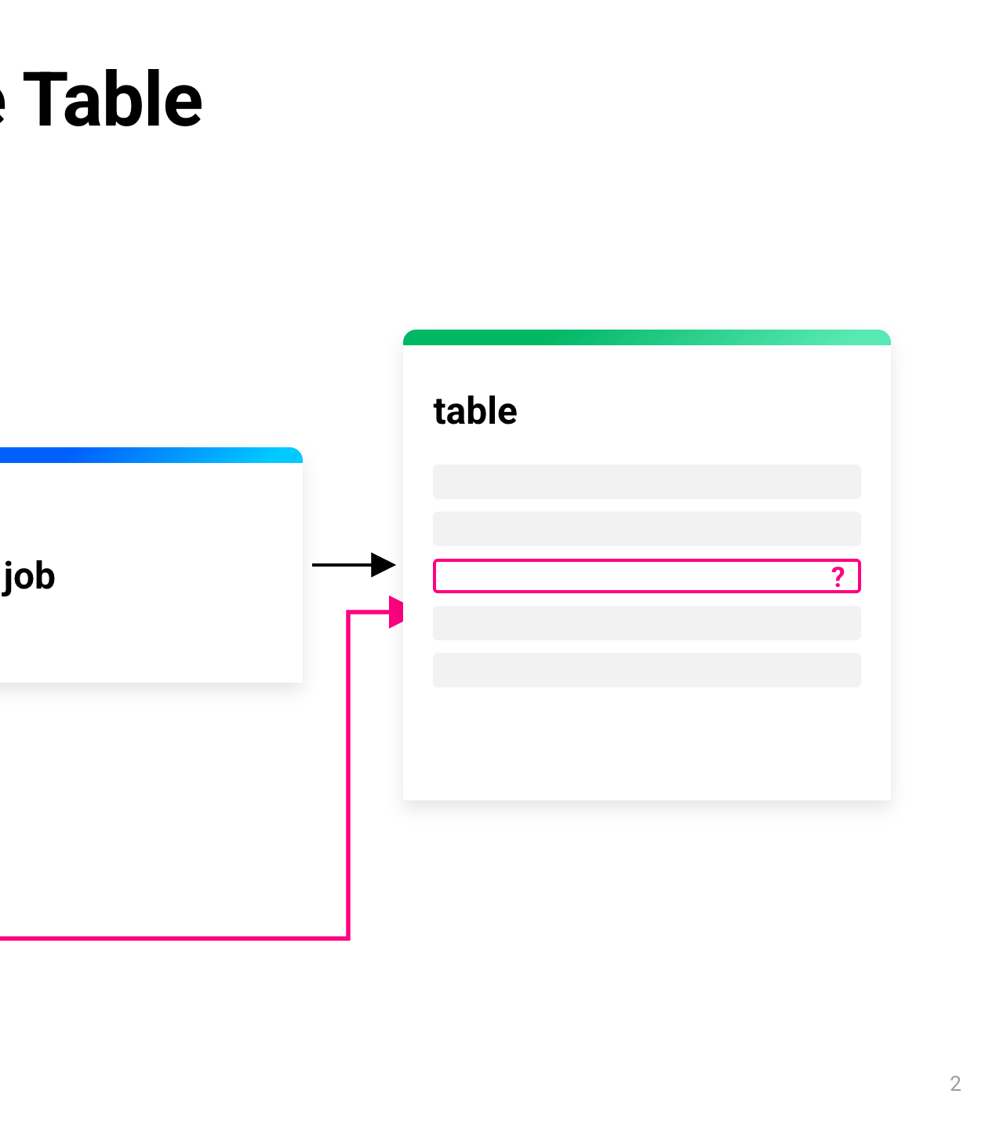
Notes:
Let's start with where lineage is today. Most lineage tools answer one question: which job read which table, and which table it wrote. That's the graph on the slide: a job writes a table, another job reads that table and writes the next one. For batch, that was usually enough. You re-ran the job, you got the same rows, and the graph told you where to look. But look at the highlighted row in the last table. Which commit produced this row? The graph can't tell you. It knows about jobs and tables; it doesn't know rows exist. That gap is small for batch. Streaming makes it big, and here's why.

Slide 3
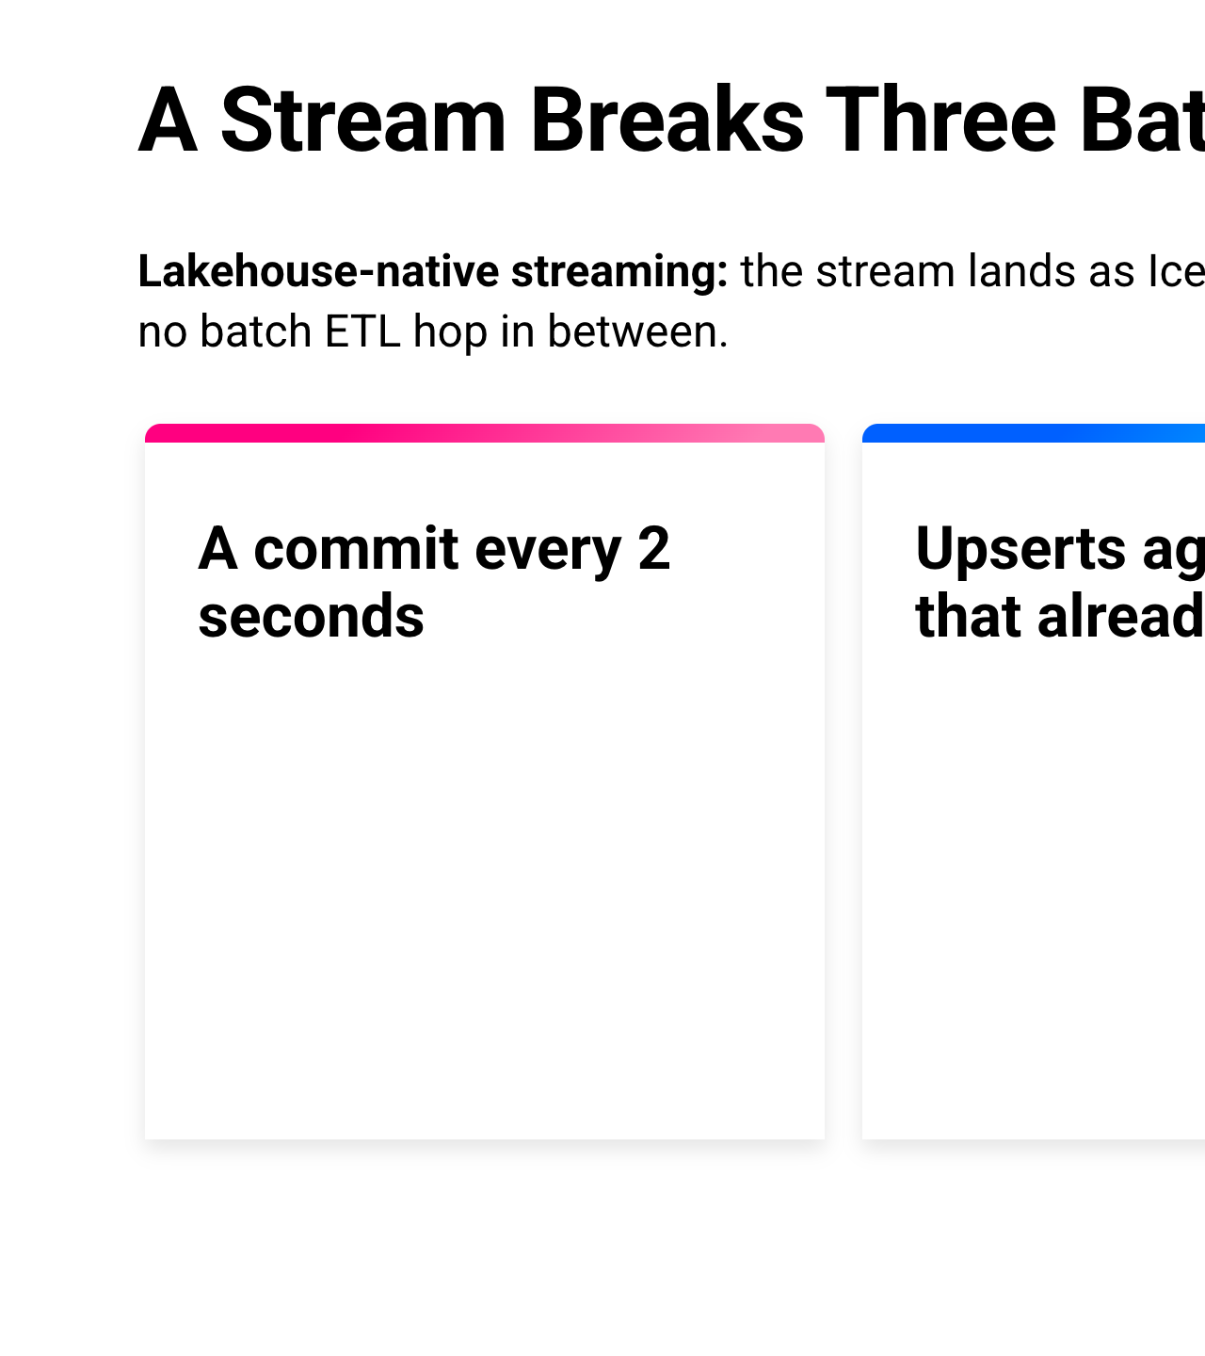
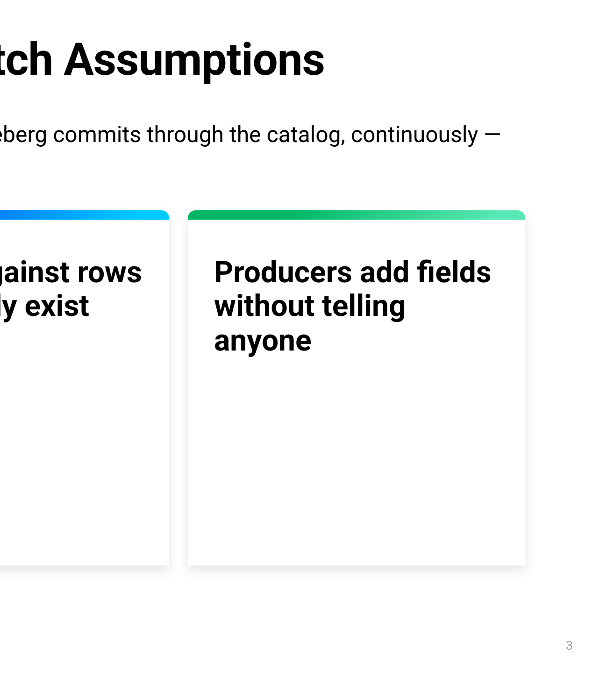
Notes:
First, a definition, because I'll use the term a lot: lakehouse-native streaming. The stream doesn't wait for a batch job to copy it into the lakehouse. It lands as Iceberg commits through the catalog, continuously. In this demo that's Kafka, written into Iceberg by the Kafka Connect Iceberg sink. A stream like that breaks three things batch lineage relied on. One: there's a commit every two seconds. That's the commit interval we gave Kafka Connect, so nothing waits for a nightly run. Two: upserts. CDC sinks rewrite rows that already exist. Three: producers add fields without telling anyone. A table-level graph has no row concept, so it can't follow any of that. We hit all three in the demo, plus some traps we didn't expect.

Slide 4
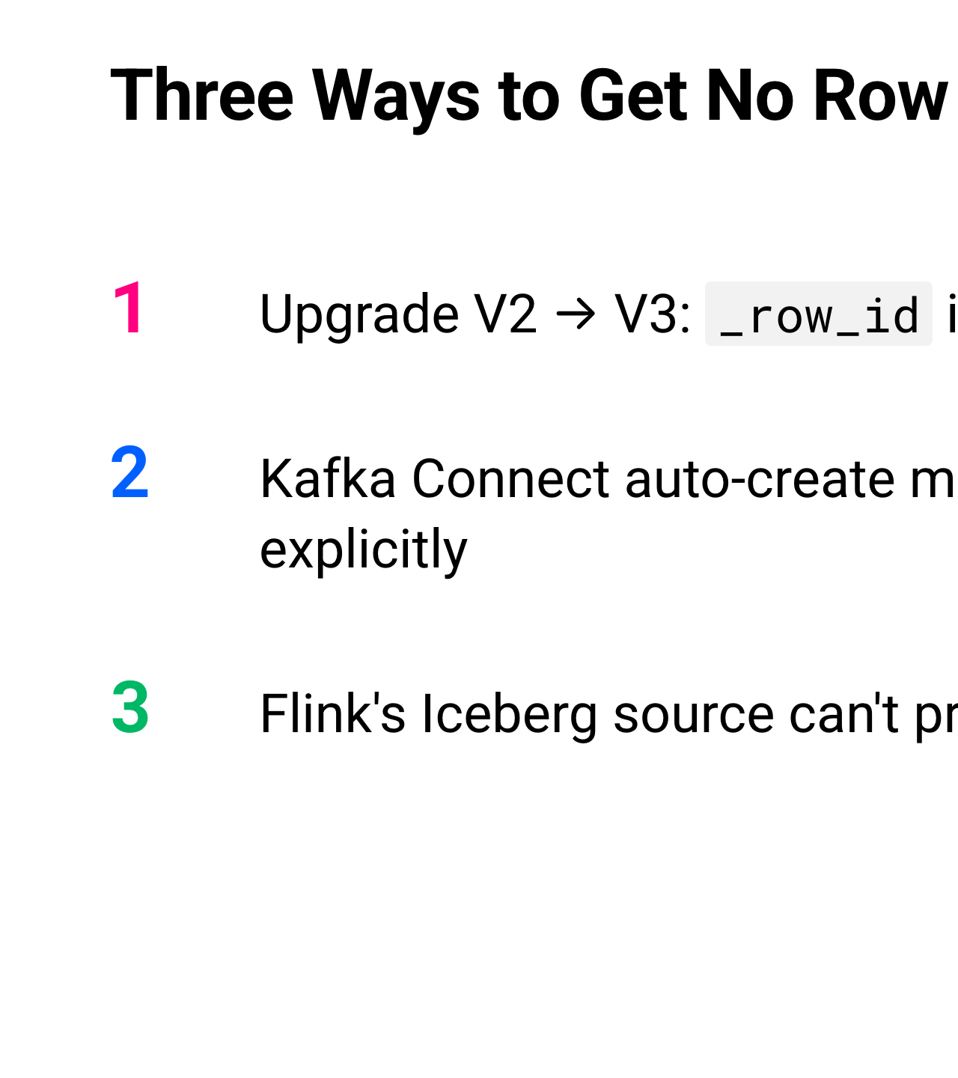
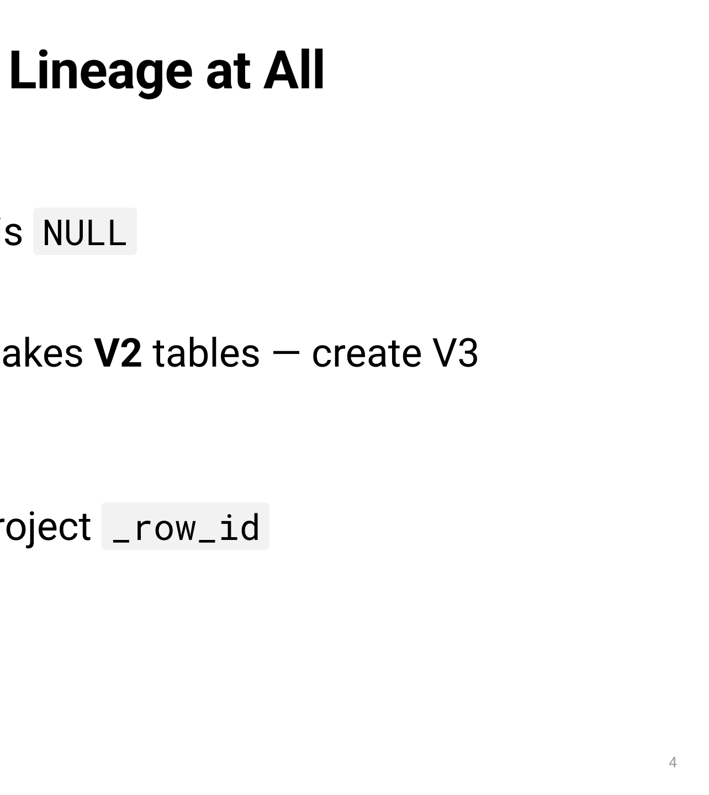
Notes:
Before the demo, three ways to end up with no row lineage at all. We took all three detours, so you don't have to. One: if you upgrade an existing table from V2 to V3, _row_id is NULL on every existing row. If you want lineage, create V3 tables from scratch. Two: the Kafka Connect sink's auto-create makes V2 tables. We turned auto-create off and created the table ourselves as V3. Three: Flink's Iceberg source can't project _row_id, so the engine many of us stream with can't even read the lineage columns. We read them with Spark and DuckDB instead. So if the writer doesn't set row identity, where does it come from?

Slide 5
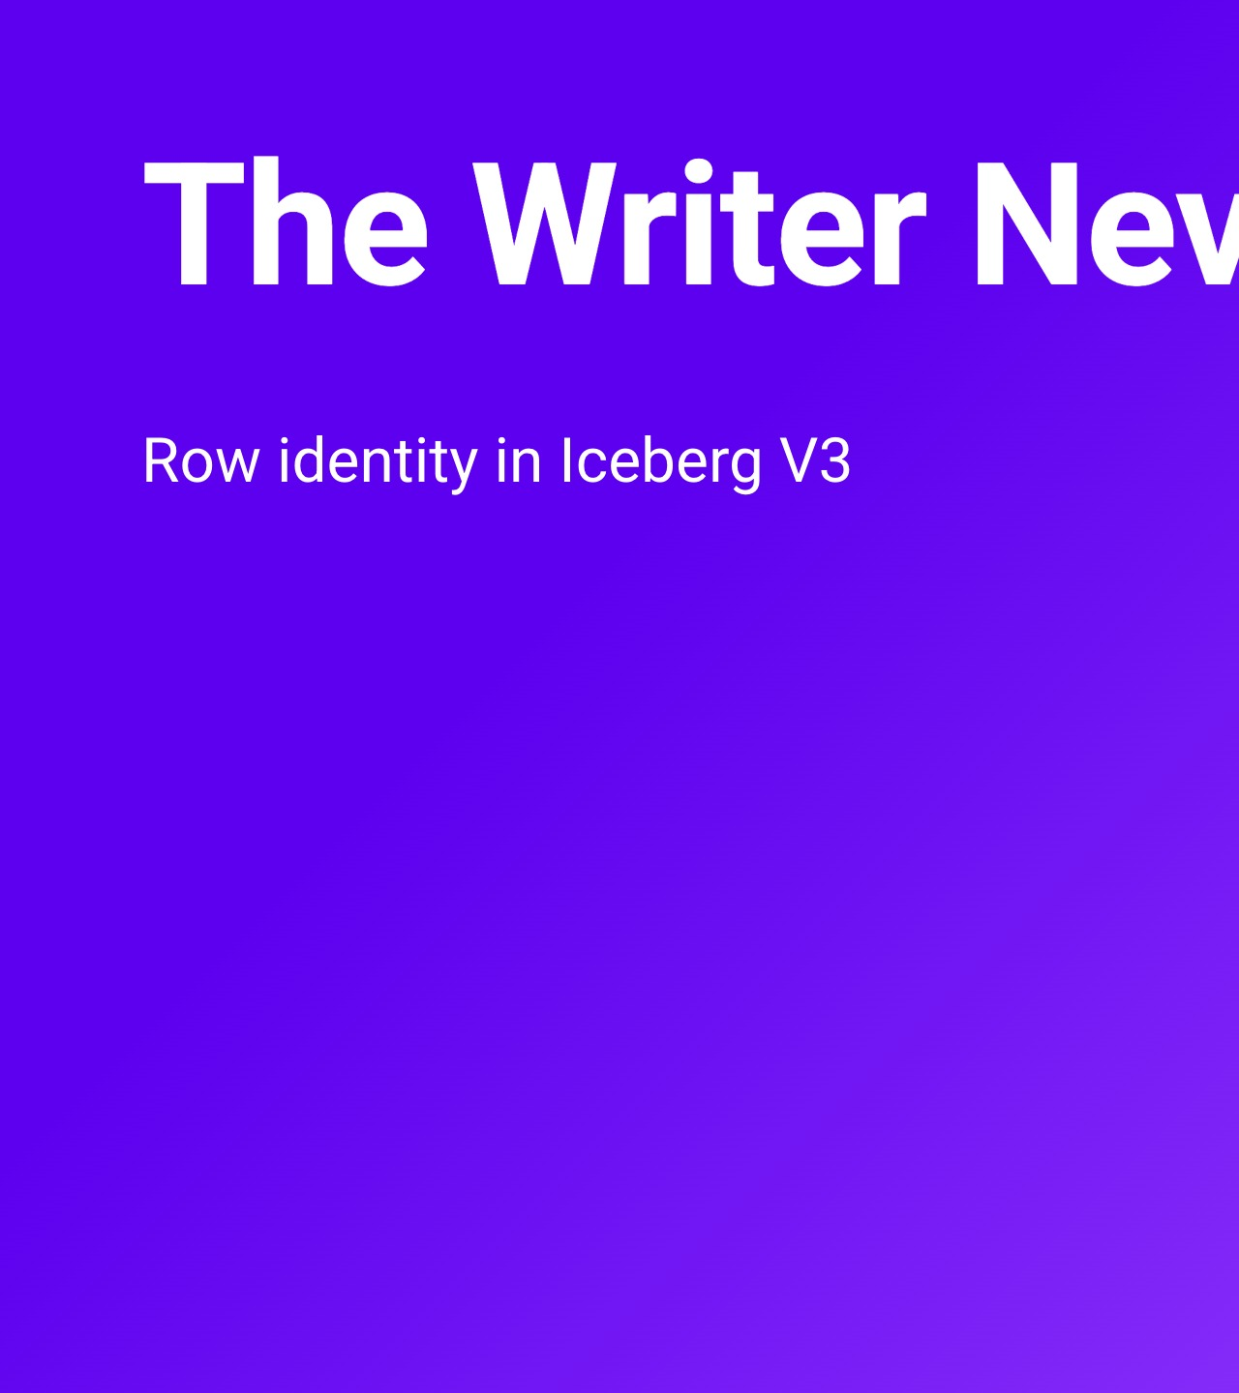
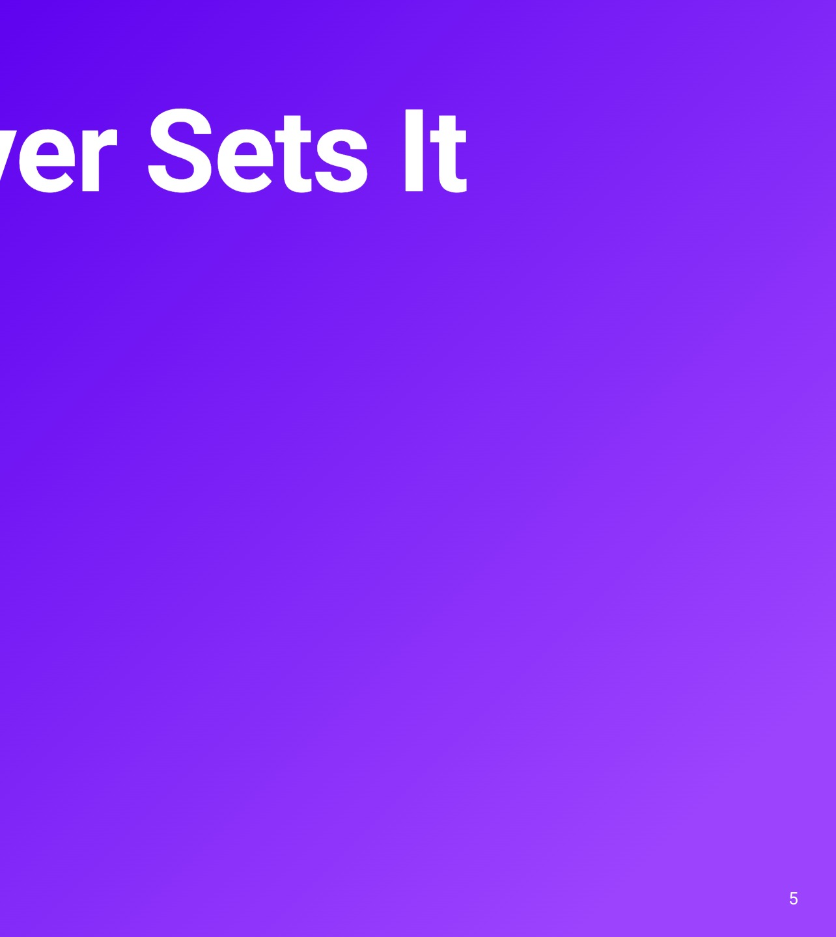
Notes:
This is where our plan changed. We assumed the writer would have to stamp an id on every row. It doesn't. In Iceberg V3, row identity is assigned by Iceberg itself, when the commit lands. Let me show you how.

Slide 6
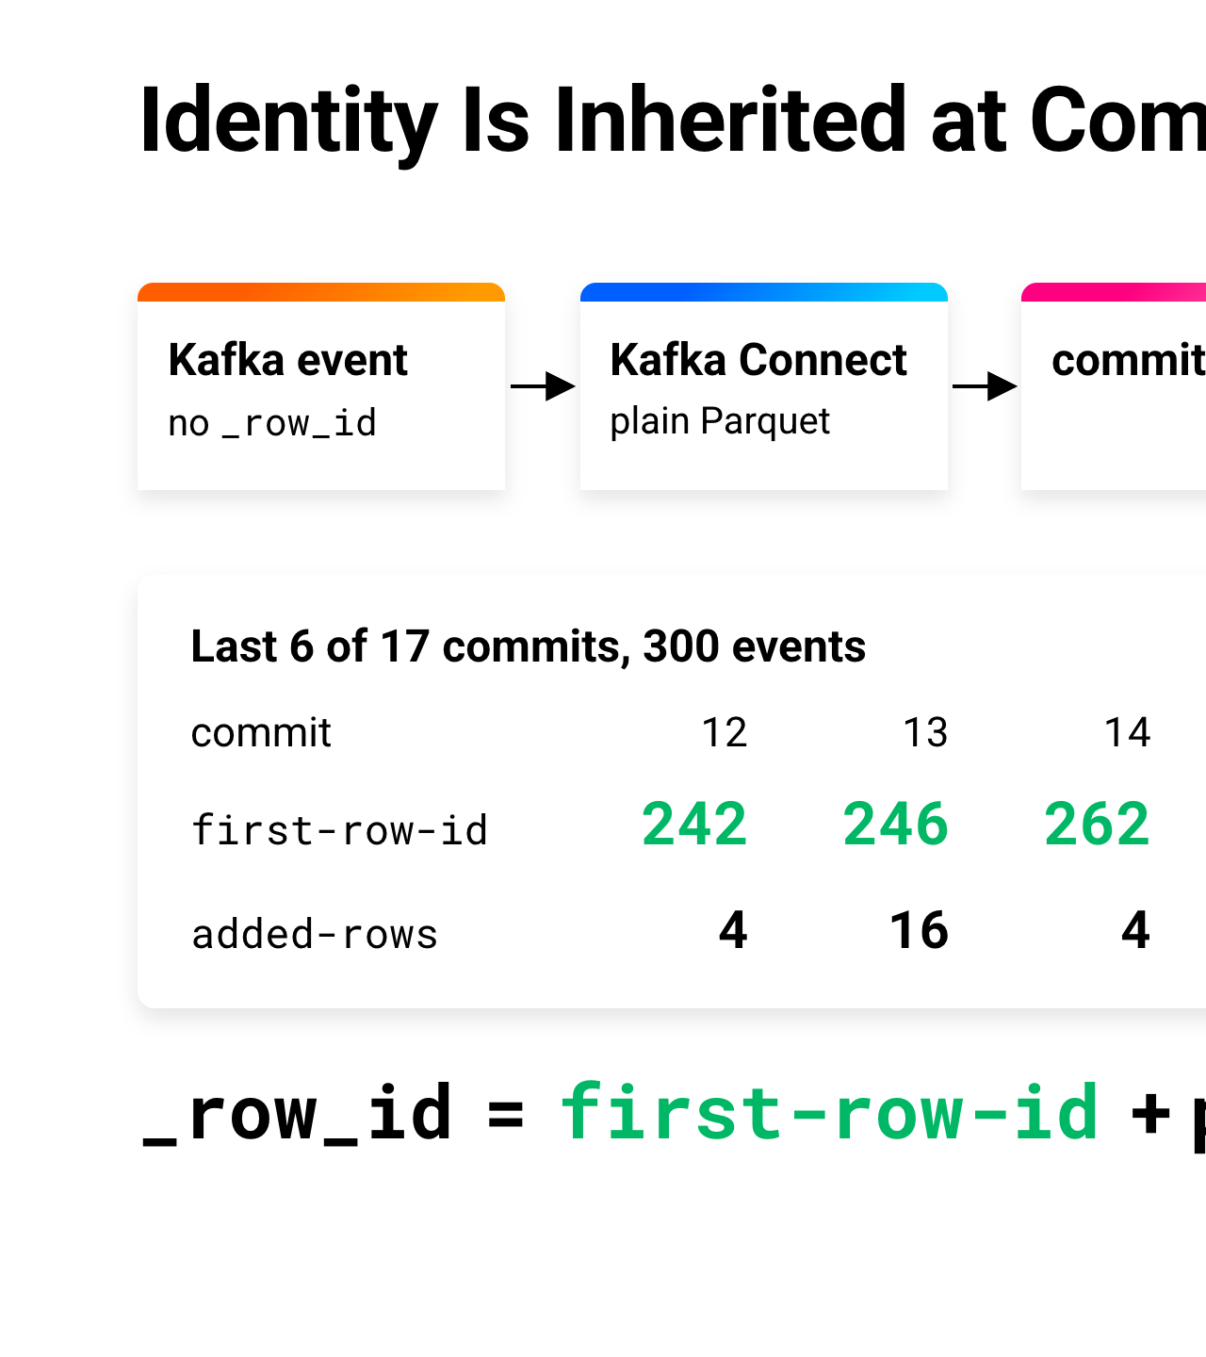
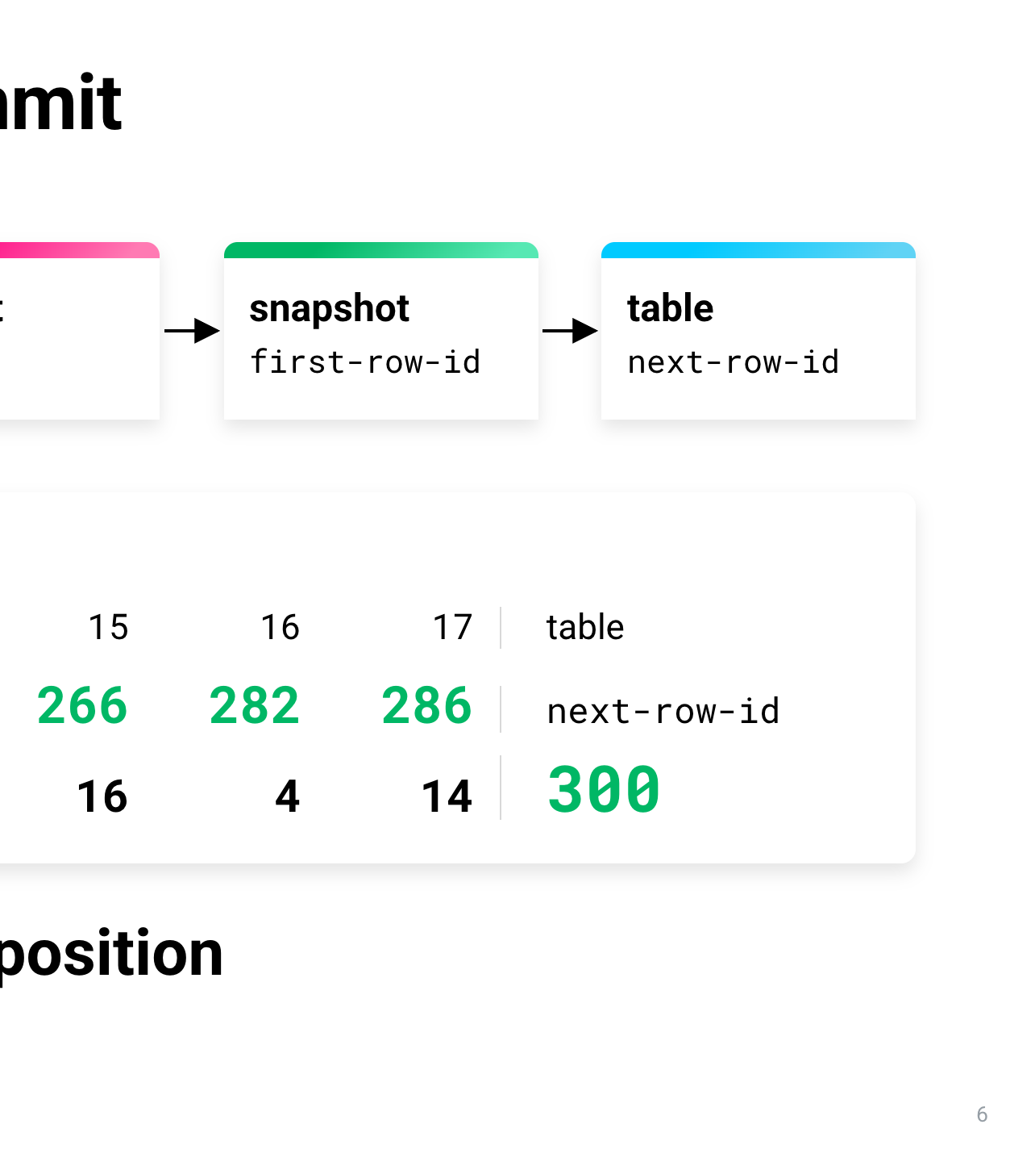
Notes:
Here's the mechanism, left to right. A JSON event arrives on Kafka, with no _row_id. Kafka Connect writes it into ordinary Parquet, still with no lineage columns. Then the snapshot commits, and that's where Iceberg assigns identity. Each commit gets a first-row-id, and the snapshot records how many rows it added. The next commit starts where the last one ended. These are the real numbers from the recording, the last six of 17 commits. The first one starts at 242 and adds 4 rows, so the next starts at 246. 246 plus 16 is 262, and so on, until 286 plus 14 leaves the table's next-row-id at 300, one for each of the 300 events. So a row's _row_id is its commit's first-row-id plus its position in that commit. The streaming writer needs zero changes. And because identity is assigned at commit, this works for any writer that commits through the catalog. Kafka Connect is just the one we used. Let's watch it happen on the stream.

Slide 7
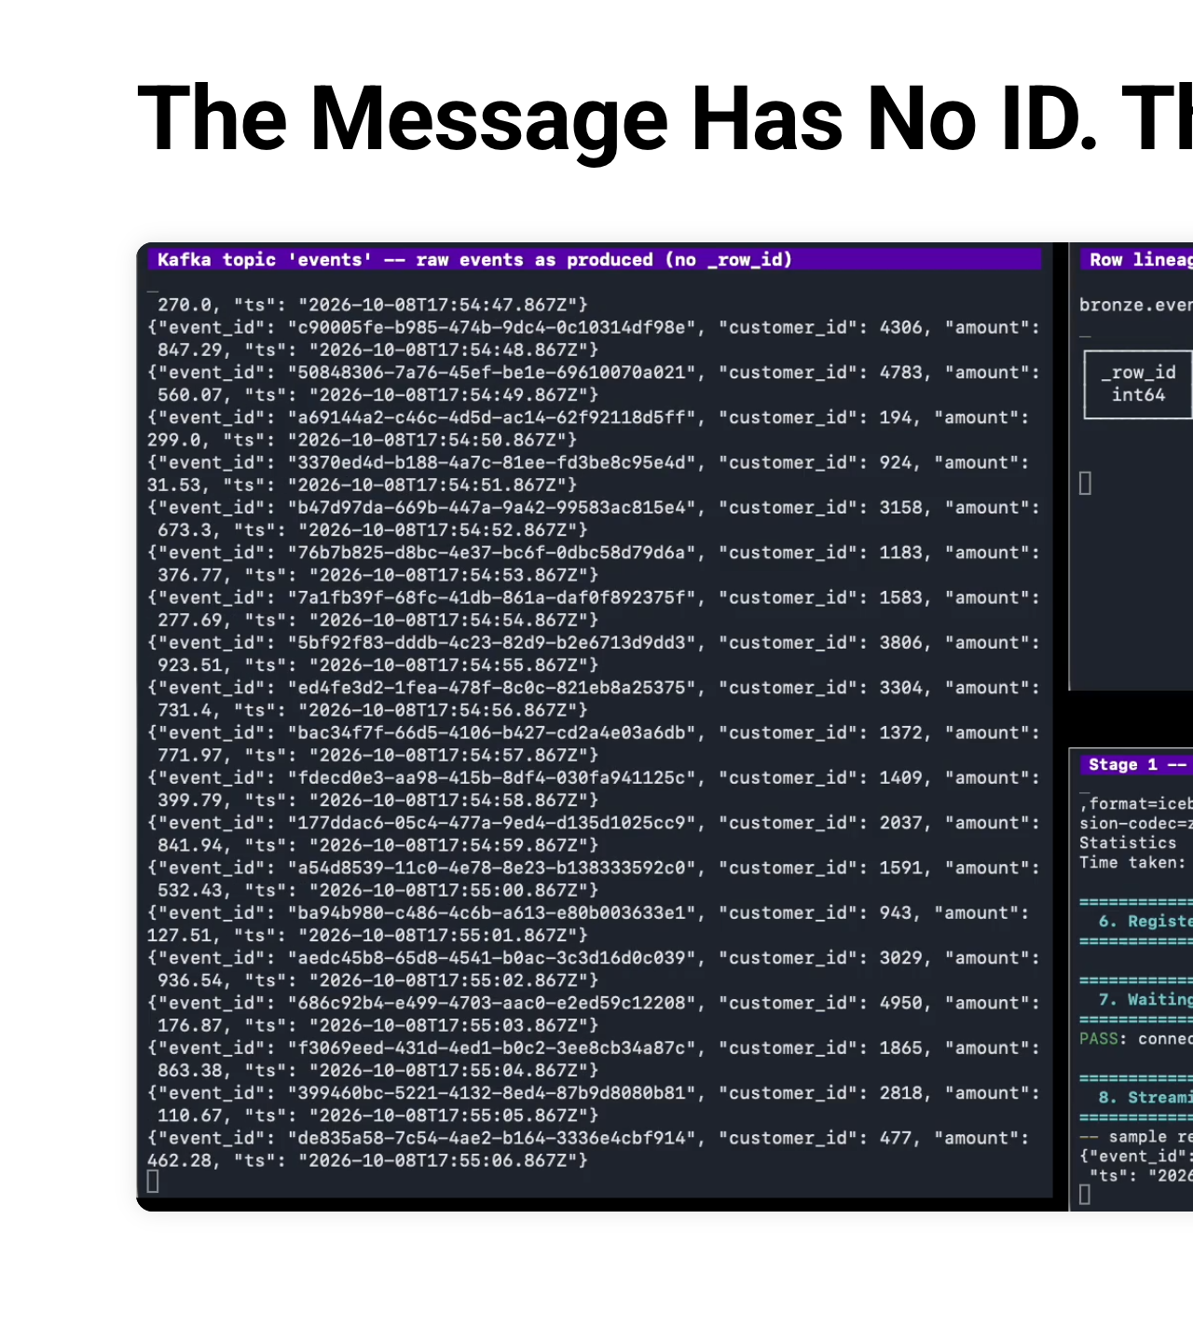
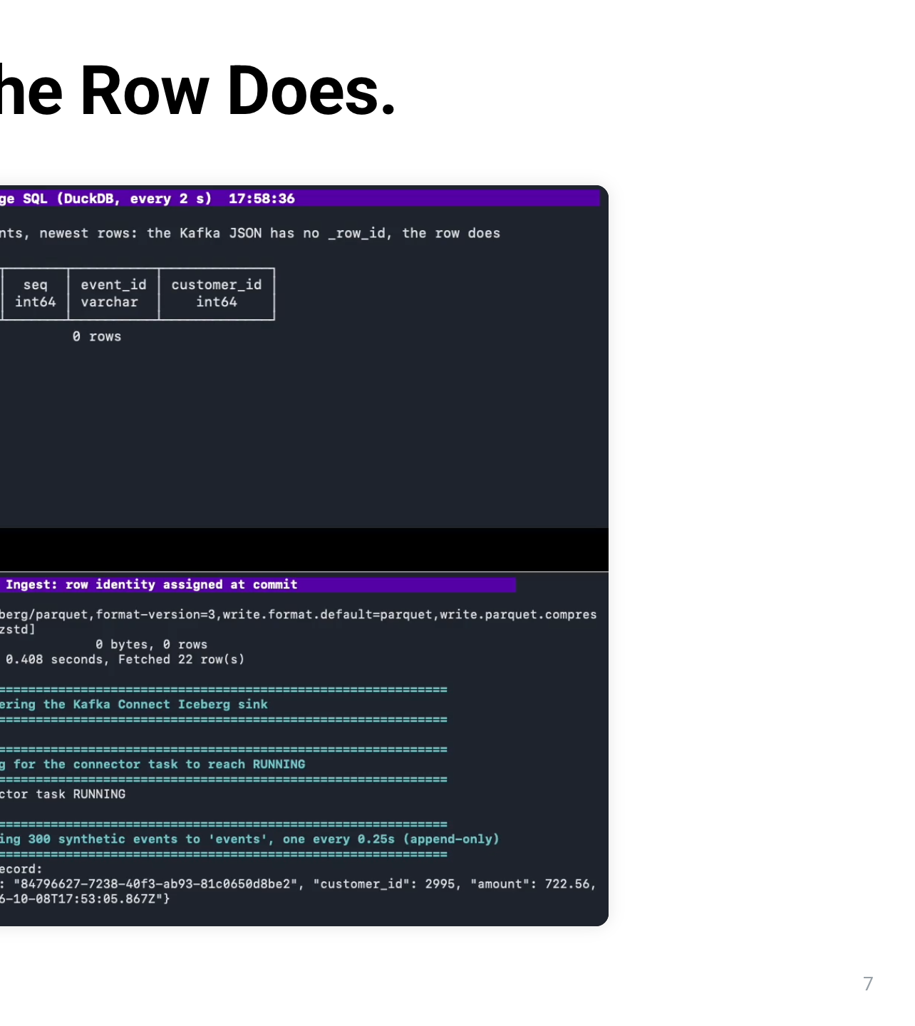
Notes:
This is stage 1 of the demo. On the left is the Kafka topic called events, showing the raw JSON exactly as the producer sends it. There's no _row_id anywhere in these messages. Top right is a SQL window that queries the Iceberg table bronze.events every two seconds. It starts empty: zero rows. Bottom right, the writer has registered the Kafka Connect Iceberg sink, waited for its task to reach RUNNING, and started streaming 300 events, one every quarter of a second. Now watch the SQL window. As commits land, rows appear, and every one of them has a _row_id and a sequence number. Nobody wrote those values; Iceberg assigned them at commit. New commits keep landing every couple of seconds, and the sequence number climbs: 6, then 13, then 17. At the end, look at the last message on the left: customer 16. On the right, that same event is row 299, in commit 17. Same event, two views. The message has no id. The row does. Underneath, the writer checks the bookkeeping, and that's the next slide.

Slide 8
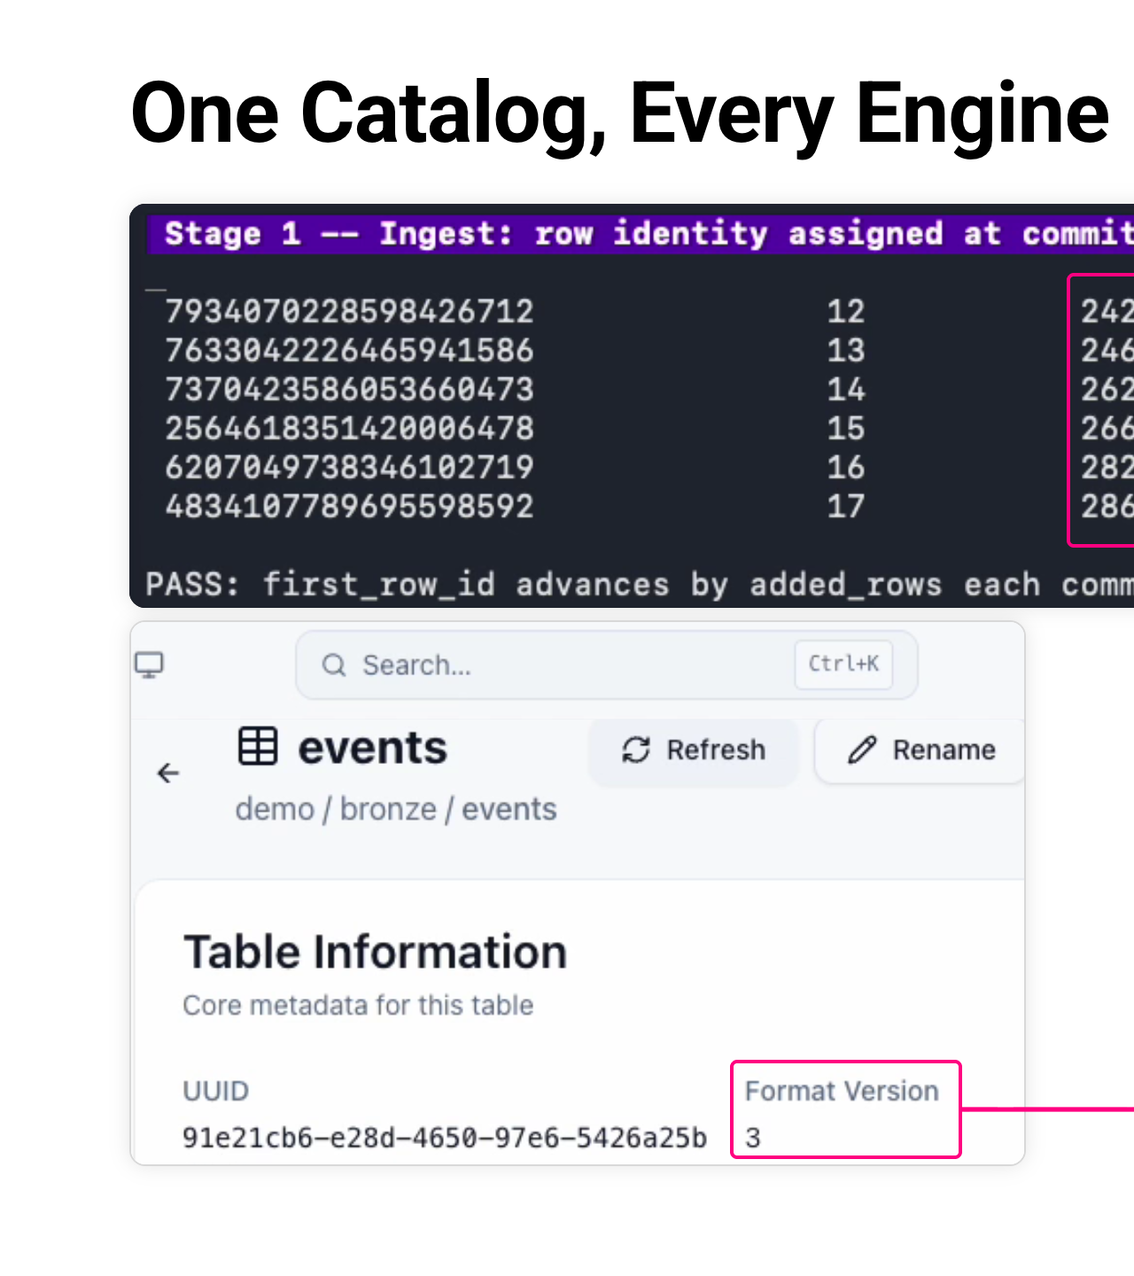
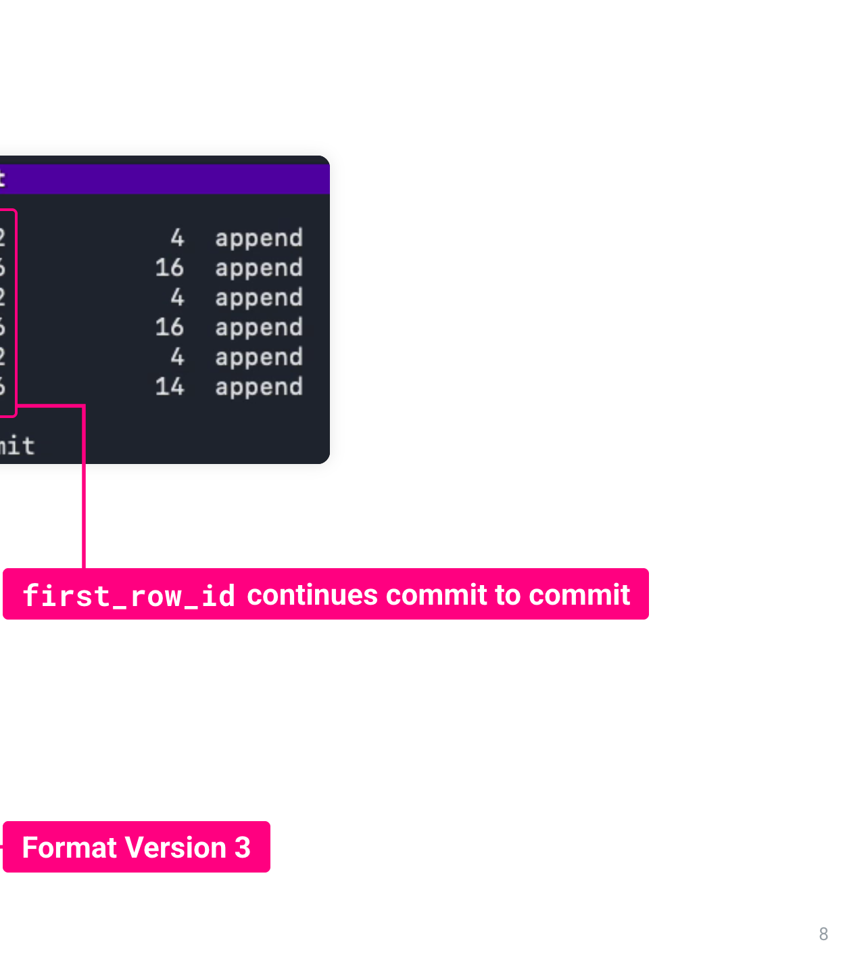
Notes:
This is the end of stage 1. On the left is the Kafka topic events: the raw JSON as the producer sent it. There's no _row_id in any message. On the right is the Iceberg table bronze.events, queried with DuckDB. The last message on the left is customer 16, and in the table it's the row with _row_id 299. You can match them on event_id. Iceberg assigned that _row_id when the commit landed, about two seconds after the message arrived. Nobody wrote it. Next, the bookkeeping behind it.

Slide 9
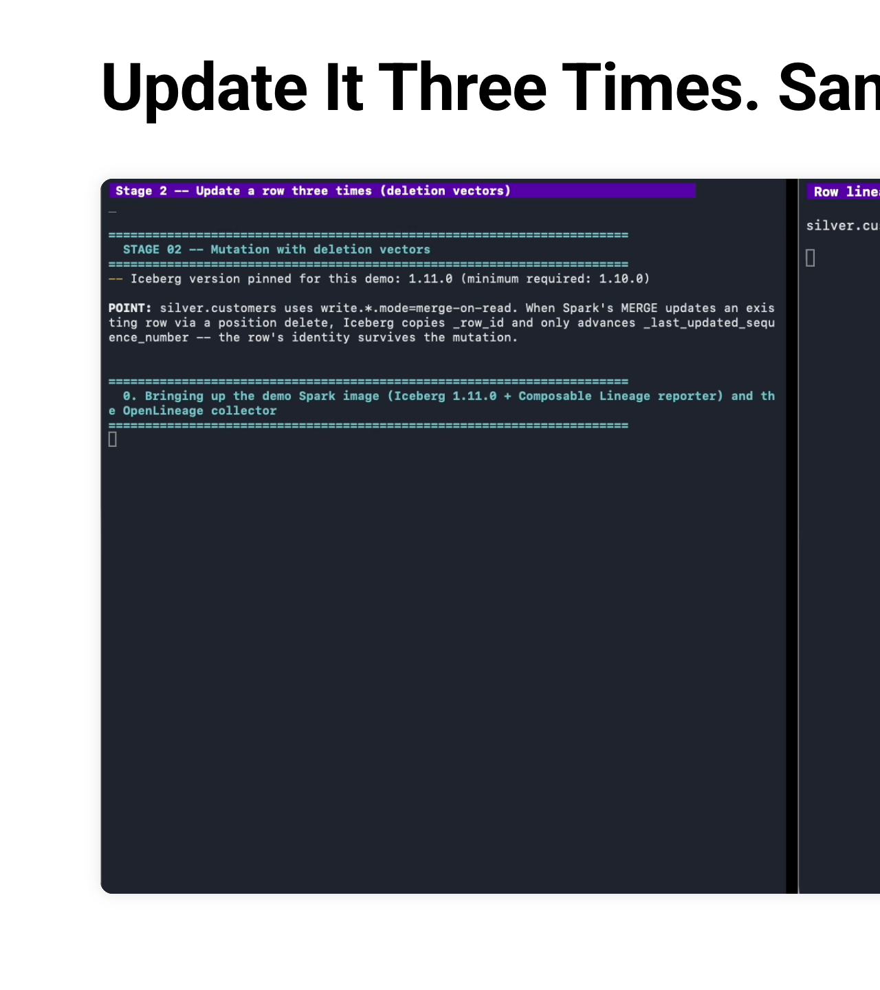
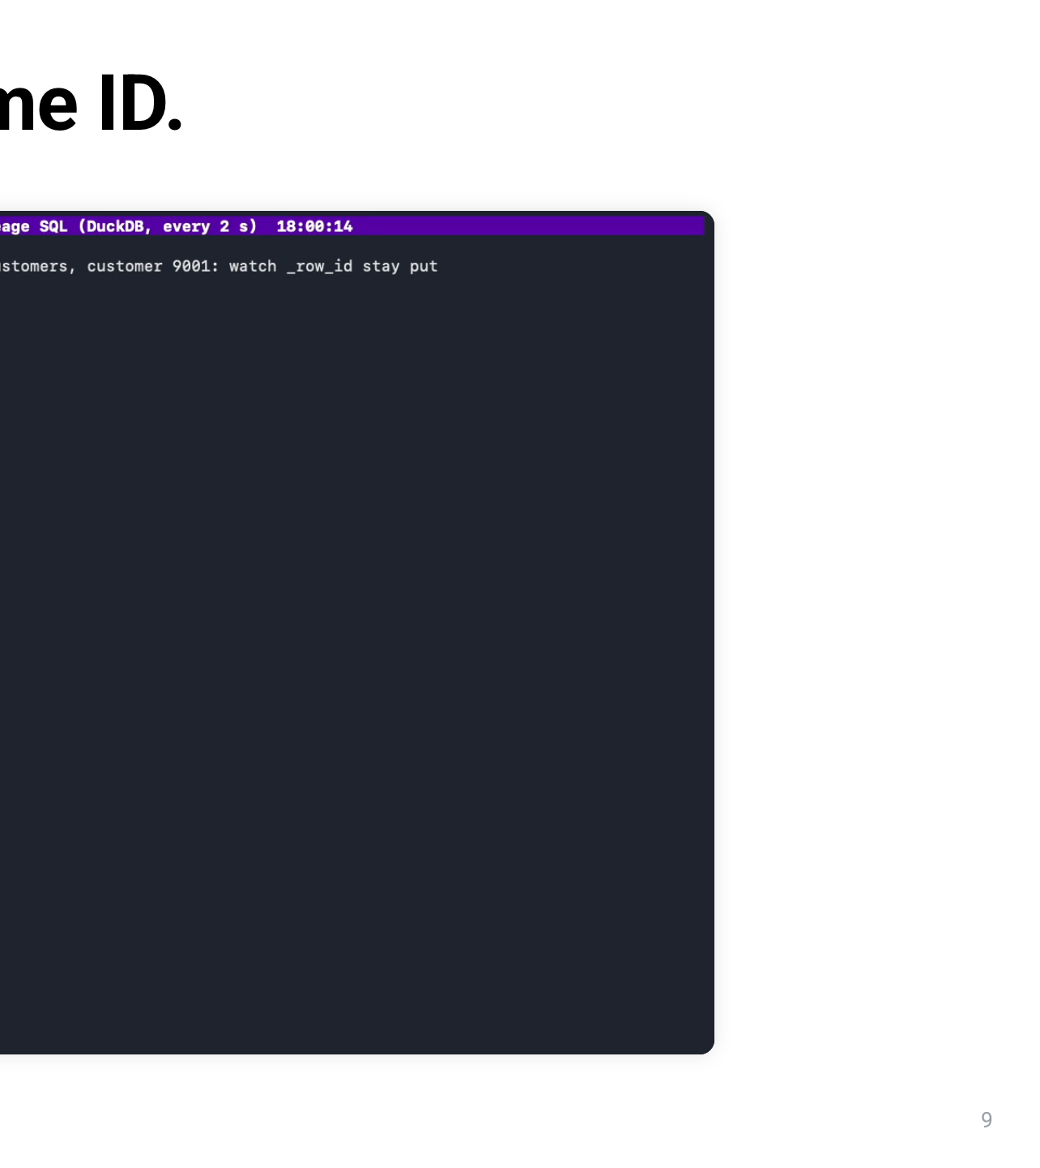
Notes:
Two things on this slide. At the top is the check from the end of stage 1. It reads the catalog's own metadata for the last six commits. Look at the first_row_id column: 242, 246, 262, 266, 282, 286. Each commit starts exactly where the previous one ended. 242 plus 4 rows is 246, plus 16 is 262, and so on: 17 commits for 300 streamed events, and the check passes. Below it is Apache Polaris, the Apache Software Foundation's Iceberg REST catalog. This is the bronze.events table in the Polaris console, and it says Format Version 3. Kafka Connect writes through this catalog, Spark writes through it, and DuckDB reads through it: one catalog, every engine. We didn't take V3 support on trust, either. The same operations through Polaris and through Iceberg's reference catalog produced identical metadata and identical row ids. Appends are the easy case, though. What happens when a row changes?

Slide 10
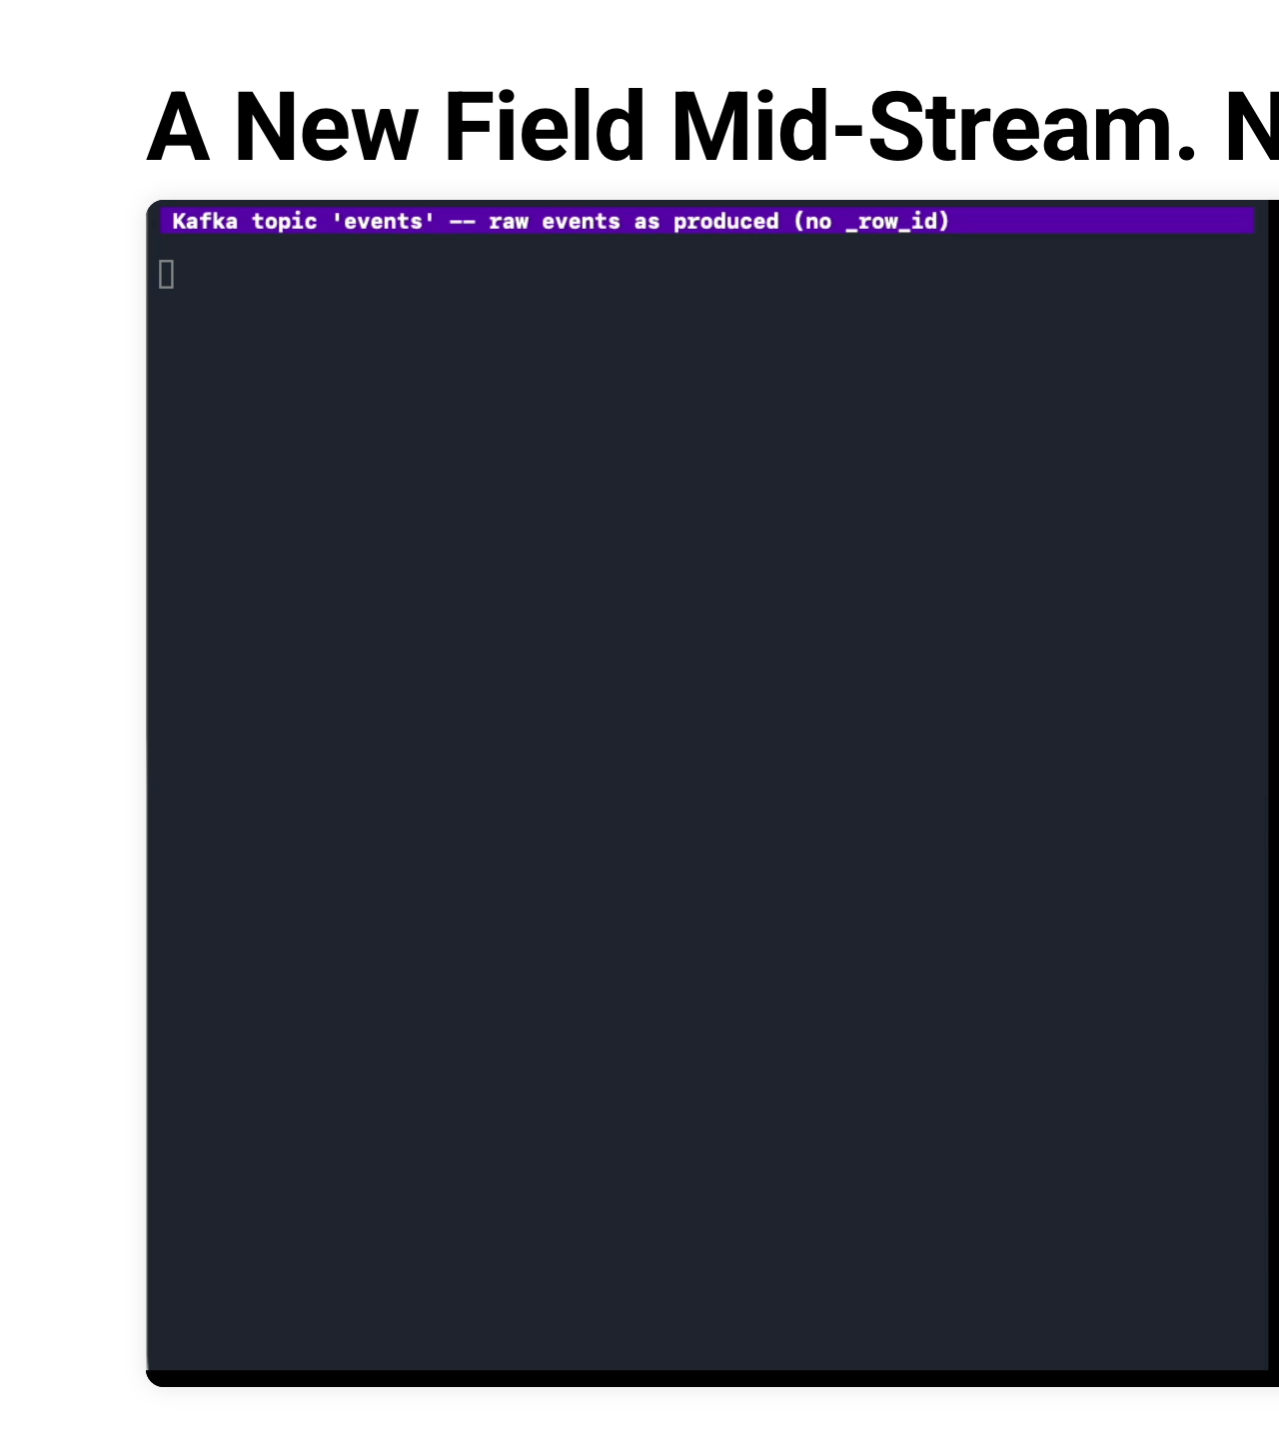
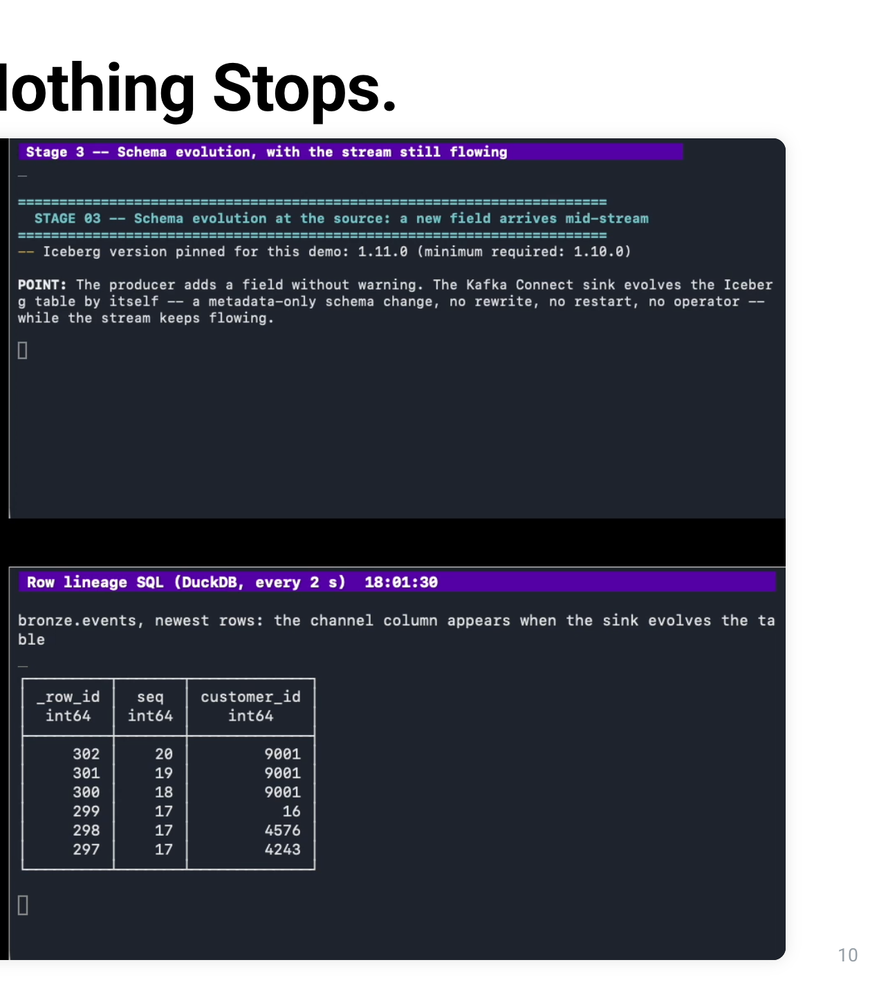
Notes:
This is stage 2: we update one row three times. On the left, the writer starts Spark and creates a V3 table called silver.customers. In the table properties, delete, update and merge mode are all set to merge-on-read. That's what makes Spark write deletion vectors instead of rewriting files. On the right, the SQL window watches customer 9001 in that table. Round 1: a new event for customer 9001 arrives, and Spark MERGEs it into the table. The row appears with _row_id 0. Round 2: another event, another MERGE. The SQL window shows _row_id 0 again, sequence number 2, and a new total amount. Round 3: same again. _row_id is still 0, and the sequence number is 3. Three updates, one identity, and the sequence number tells you which commit last touched the row. At the end we jump to MinIO, the object store, and open the table's data folder. Next to the Parquet data files are small files ending in deletes.puffin. Those are the deletion vectors. Each MERGE marks the old version of the row as deleted by its position, and Iceberg carries its _row_id forward to the new version. Remember this flat line; it comes back in a few minutes.

Slide 11
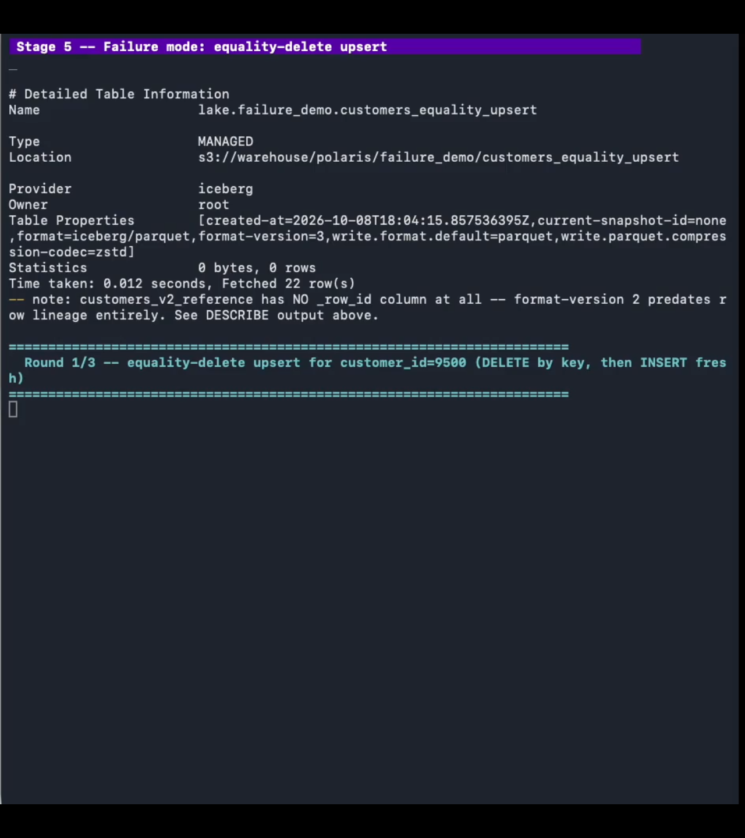
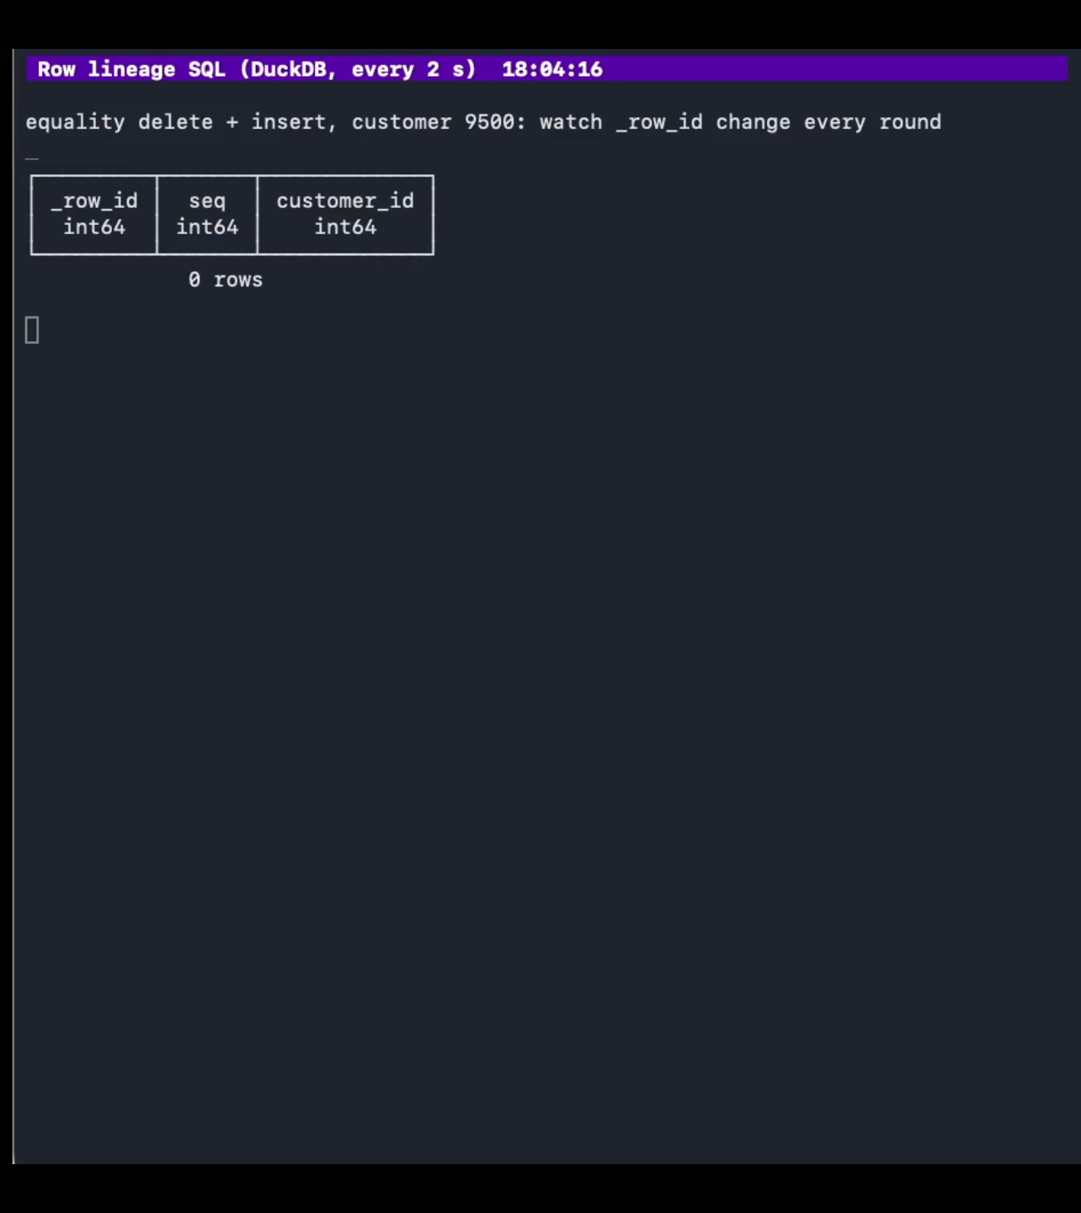
Notes:
This is stage 2, after three updates to the same customer, 9001. Top left is the writer: three MERGE commits through Spark, and the query result shows _row_id 0. Top right is the SQL window: _row_id 0, sequence number 3. The _row_id stayed at 0 through all three updates, while the sequence number went 1, 2, 3. At the bottom is MinIO, the table's data folder. Next to each Parquet data file is a small file ending in deletes.puffin. That's a deletion vector. silver.customers is merge-on-read, so each MERGE writes a deletion vector and Iceberg carries the old row's _row_id forward. Three updates, one identity. Rows change. So do schemas, without warning.

Slide 12
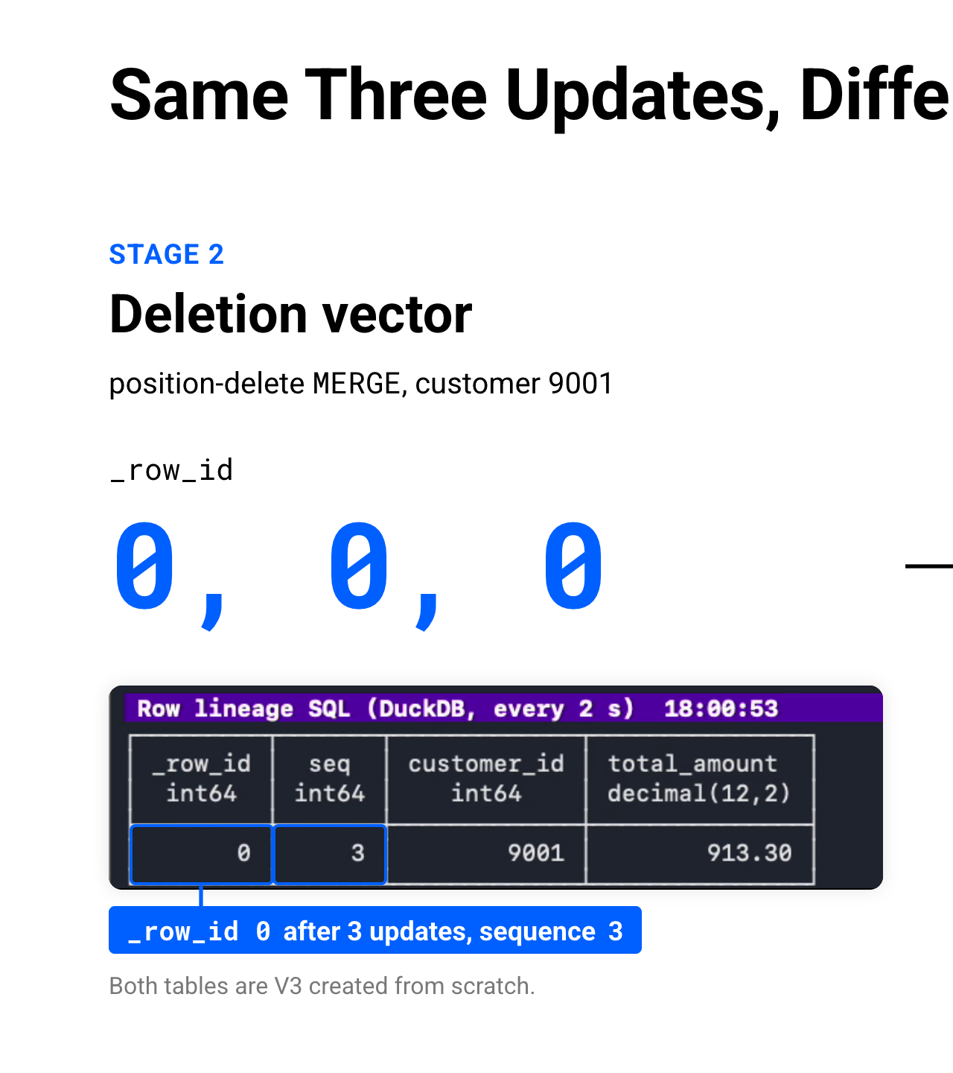
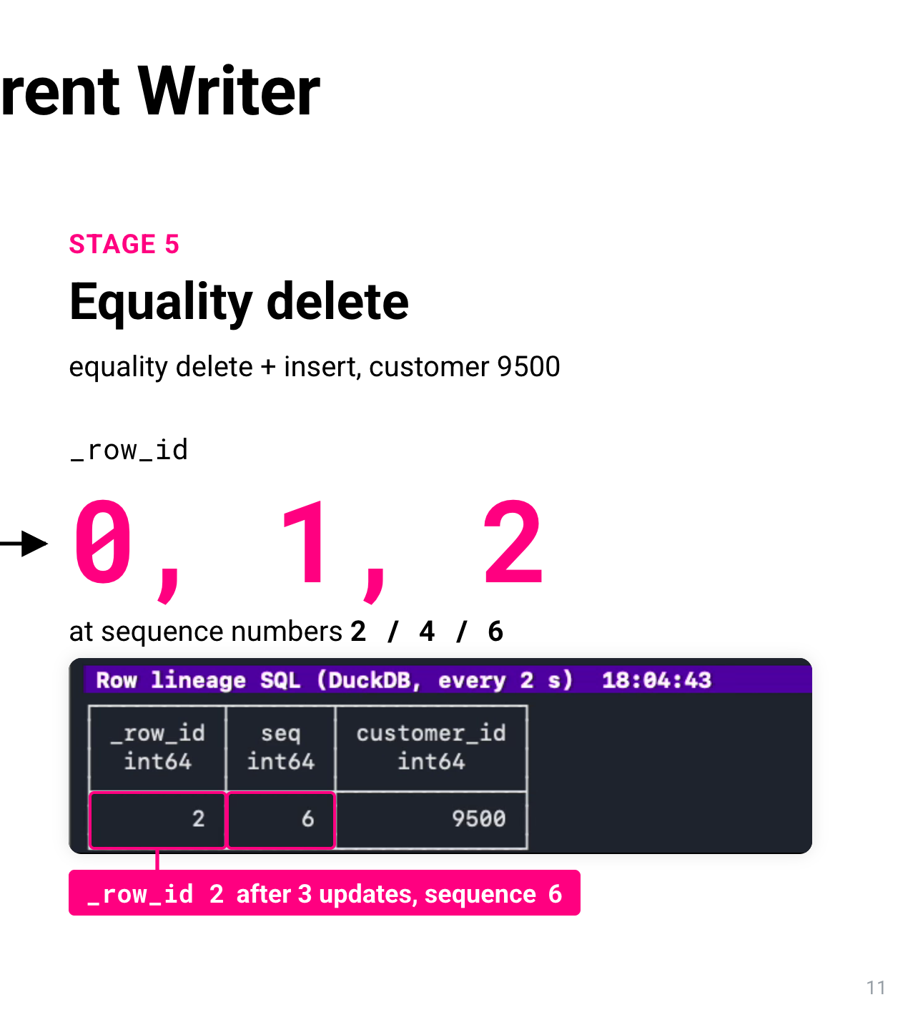
Notes:
Stage 3 is the case from the abstract: the source changes its schema without warning. Top right, the writer records the baseline. bronze.events has 303 records, one schema, and four columns: event_id, customer_id, amount and ts. Then it starts streaming five events a second. On the left, the Kafka messages have those same four fields. Next, the writer announces that the producer is about to start sending a new field called channel. Nobody touches the table. Watch the Kafka window: the messages now end with channel, set to web, mobile or store. The Kafka Connect sink sees the new field and adds the column to the Iceberg table by itself. The writer prints PASS: the sink evolved bronze.events by itself, from one schema to two. And in the SQL window, a channel column appears, with values in it. All it takes is one connector property: iceberg.tables.evolve-schema-enabled, set to true. Then the stream stops. 185 events were streamed in this stage, and all 185 landed. Nothing was rewritten, and the task never restarted. Iceberg doesn't even create a snapshot for a schema change; it's metadata only. The writer counts the rows: the 402 written before the field existed read NULL, and after it there are 31 mobile, 25 store and 30 web. Last, the Polaris console shows the table's current schema, with channel as a new string column that isn't required. Those NULLs are worth a second look, and we'll come back to them.

Slide 13
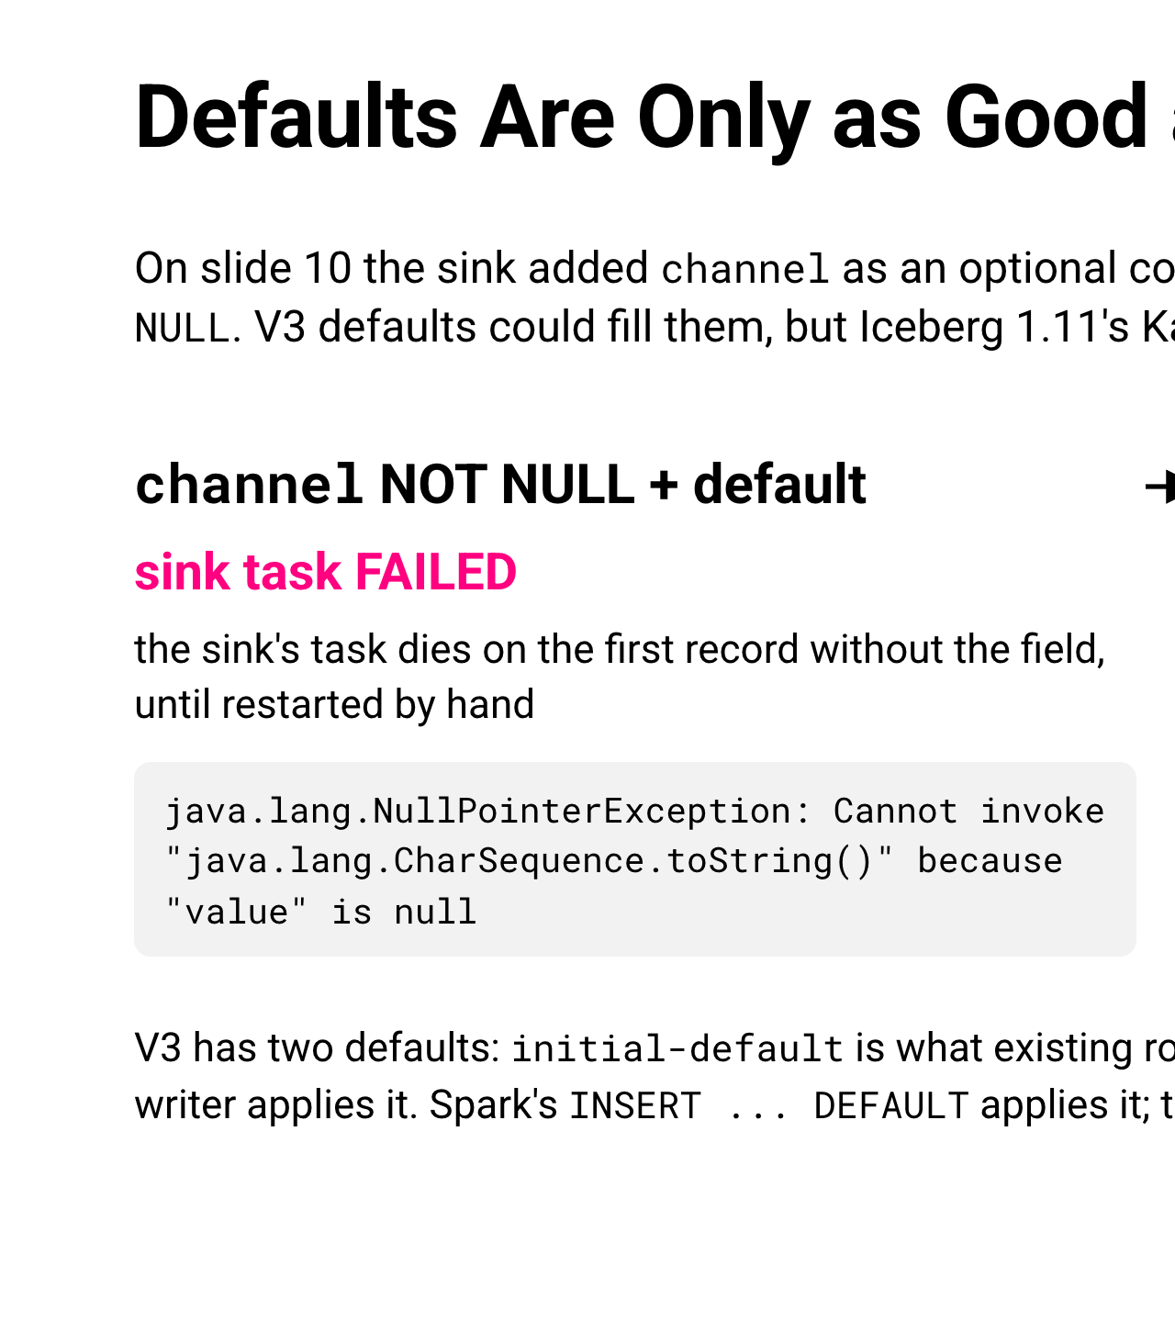
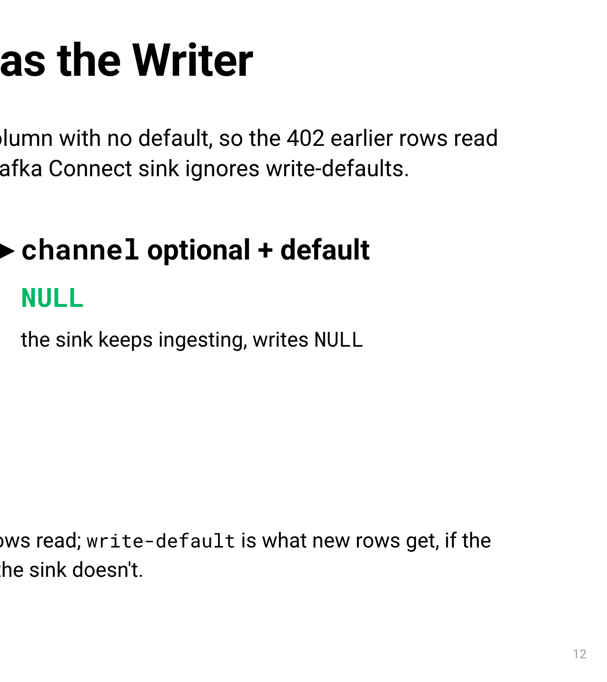
Notes:
Here's stage 3 in stills. Top left, the Kafka messages now end with a channel field: web, mobile or store. Below that, the writer's check: PASS, the Kafka Connect sink evolved bronze.events by itself, from one schema to two. Bottom left, the Polaris console shows the current schema, id 1, with channel as a string column that isn't required. On the right is the before-and-after count. 402 rows were written before the field existed, and they read NULL. After it: 31 mobile, 25 store and 30 web. The task kept running, all 185 events streamed in this stage landed, and nothing was rewritten. The change is one connector property, shown at the bottom: iceberg.tables.evolve-schema-enabled. Rows written before the change read NULL, and that NULL is worth a second look.

Slide 14
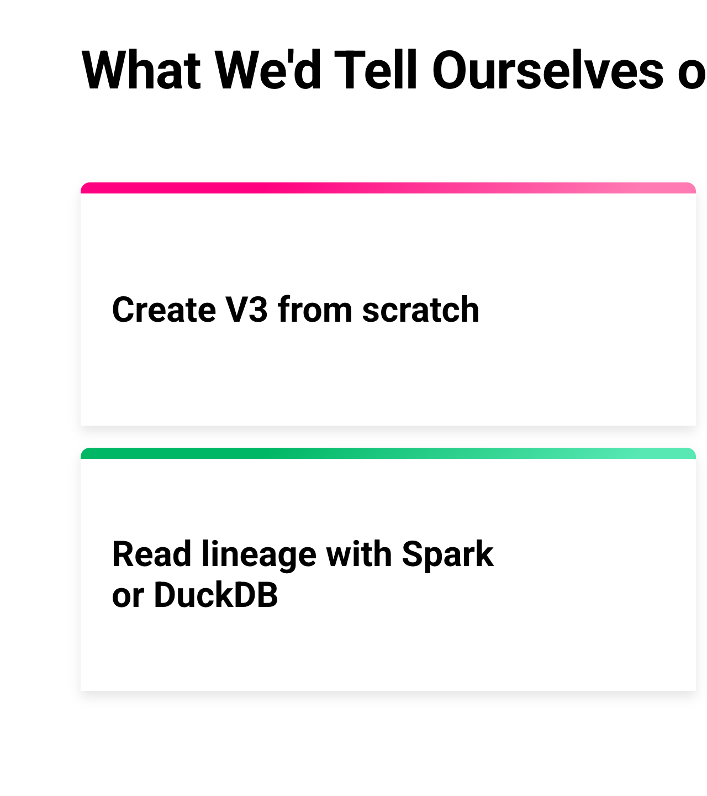
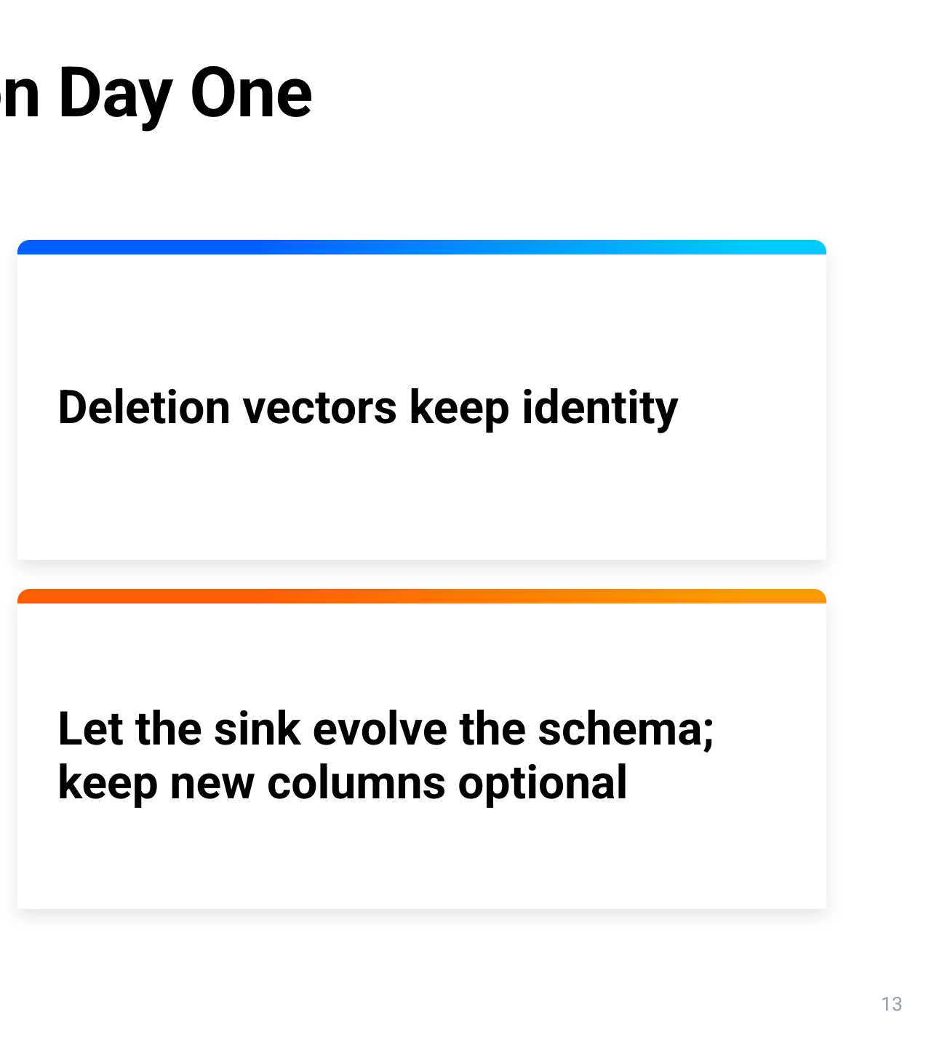
Notes:
Stage 5 is the failure mode: the same three updates, with a different writer. On the left, the writer creates another V3 table from scratch, called customers_equality_upsert. This time each update is an equality-delete upsert: delete the row by its key, then insert a fresh one. That's the pattern most CDC sinks use. On the right, the SQL window watches customer 9500. Round 1: _row_id 0, sequence number 2. Round 2: _row_id 1, sequence number 4. Round 3: _row_id 2, sequence number 6. Three updates, three different _row_ids. The row's identity is gone. The terminal is hard to read at this size, so let's put the two results side by side.

Slide 15
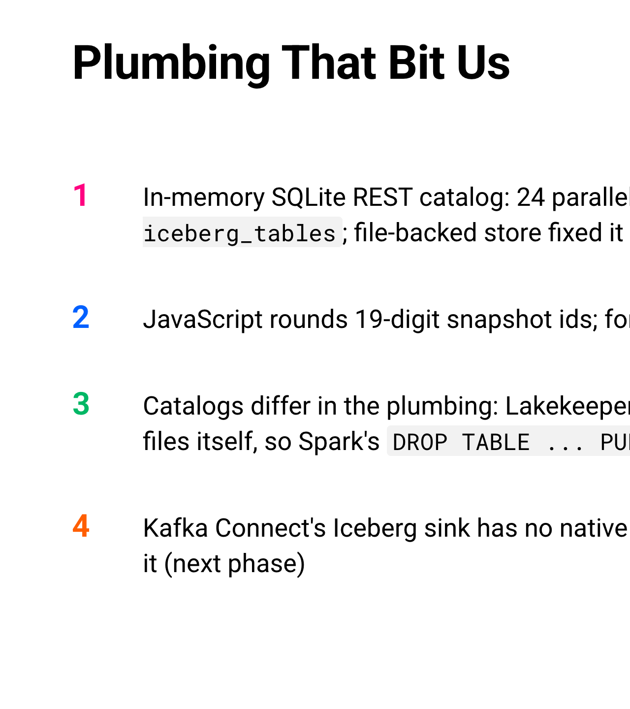
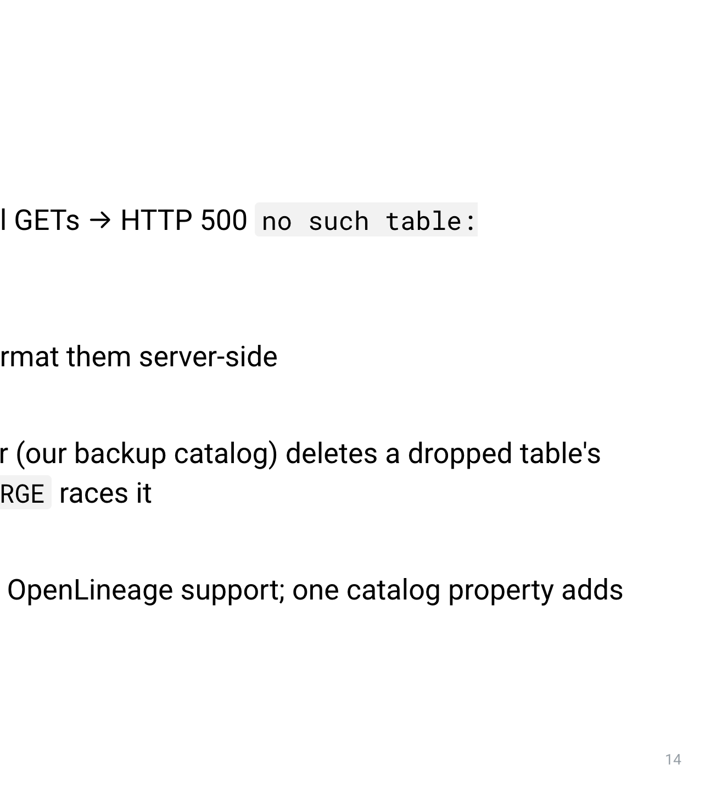
Notes:
Here are the two runs side by side. On the left, in blue, stage 2: the deletion-vector MERGE for customer 9001. After three updates the row still has _row_id 0, at sequence number 3. On the right, in pink, stage 5: the equality-delete upsert for customer 9500. After the same three updates it's on _row_id 2, at sequence number 6. Its ids went 0, 1, 2, at sequence numbers 2, 4 and 6. Both tables are V3, created from scratch, so the table format isn't the problem. The writer is. An equality delete has no positional link to the row it replaces, so the replacement gets a new id. Flink's equality-delete upsert and most CDC sinks have the same effect. To be precise, the demo reproduces it with Spark, so it's the same effect, not the same code. The writer you pick decides whether you get lineage. And the writer decides one more thing: your defaults.

Slide 16
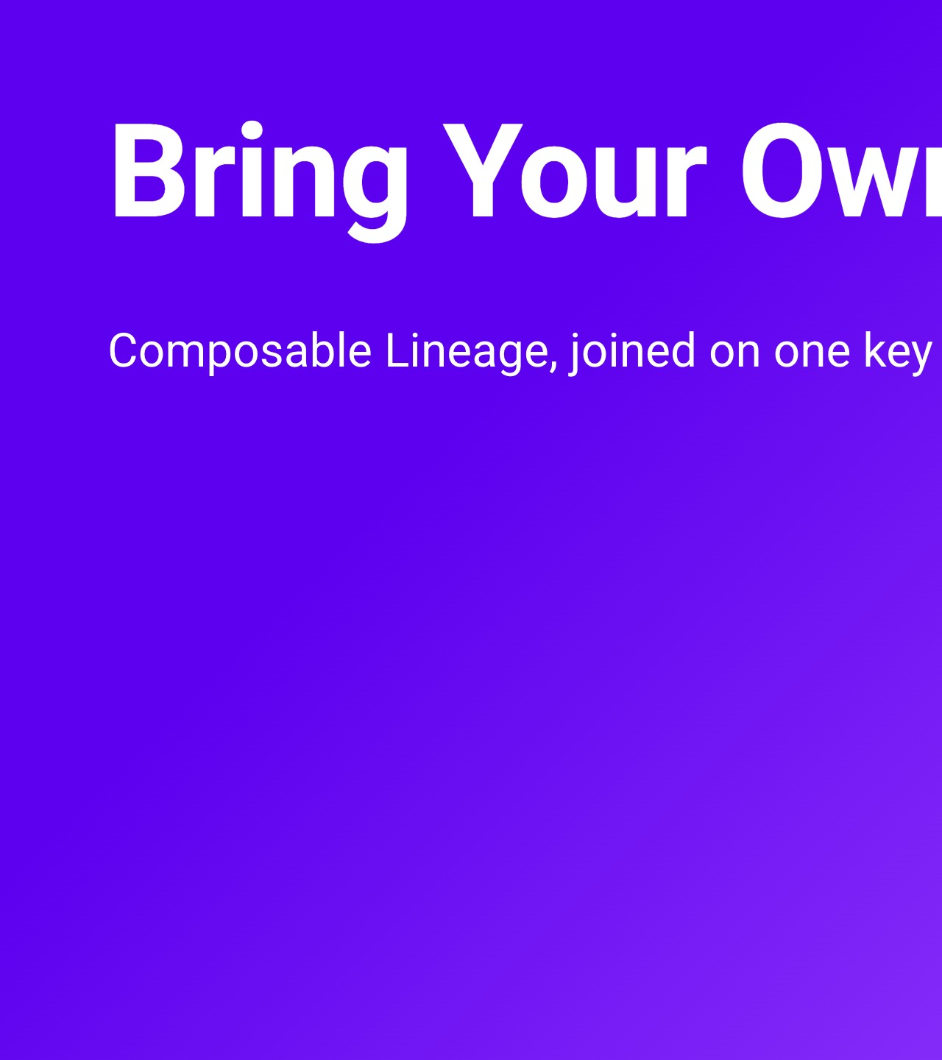
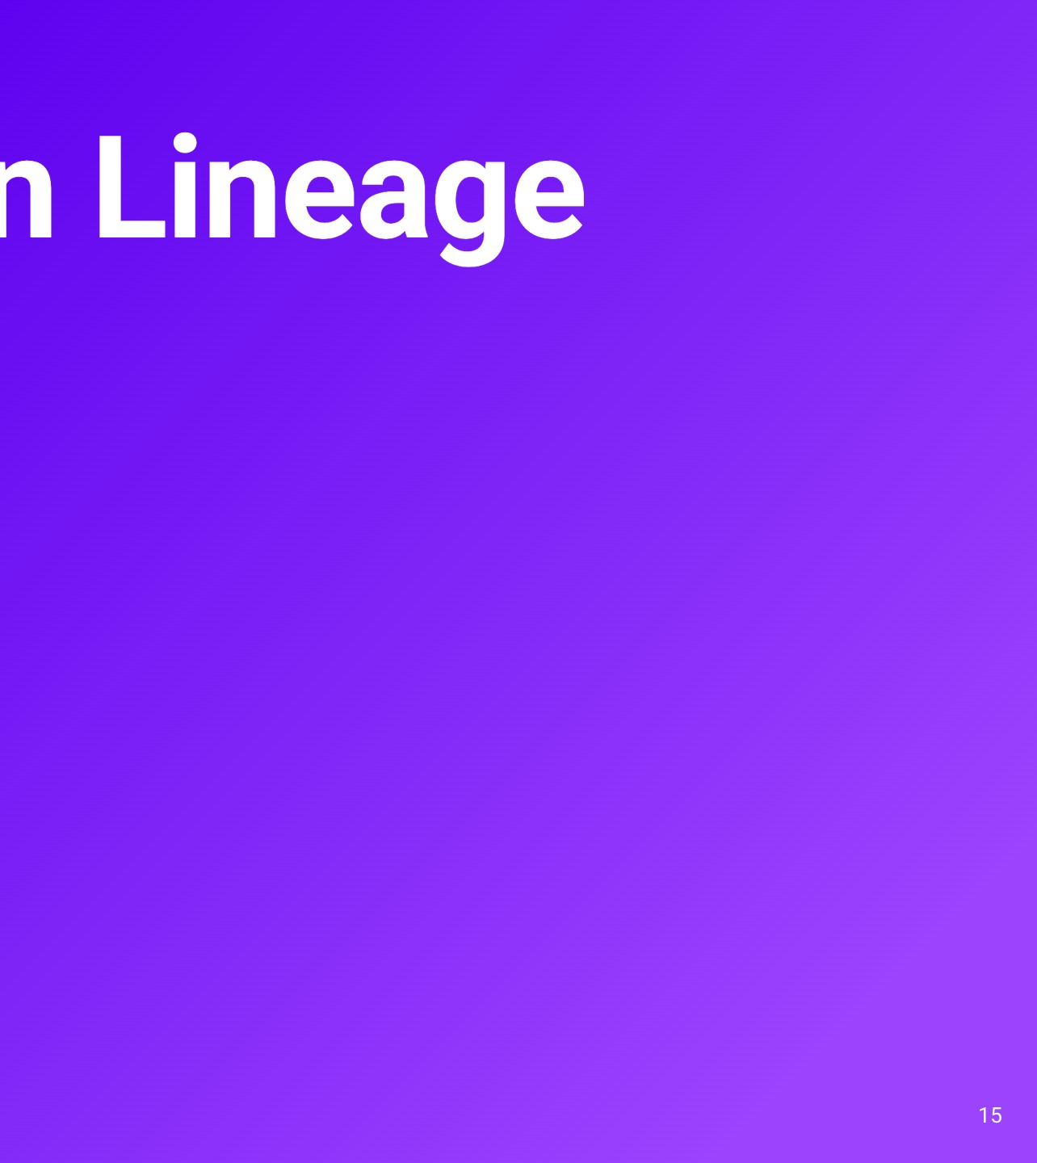
Notes:
Back to the NULLs from stage 3. The sink added channel as an optional column with no default, so the 402 rows written before it read NULL. Iceberg V3 has column defaults that could fill those in. There's an initial-default, which every existing row reads, and a write-default for new rows, if the writer applies it. We tried it while building the schema-change stage, adding the column ourselves with a default. On the left: make the column required, NOT NULL with a default, and the Kafka Connect sink dies on the very next record that doesn't have the field. That's the NullPointerException on the slide. The sink doesn't fill in the default, and it stays dead until someone restarts it by hand. That's exactly the "pipelines can't just stop" case. On the right: make the column optional with the same default. The stream keeps flowing, but the sink writes NULL. Spark's INSERT with DEFAULT applies the default; the sink doesn't. So check what your writers do with defaults before you rely on them.

Slide 17
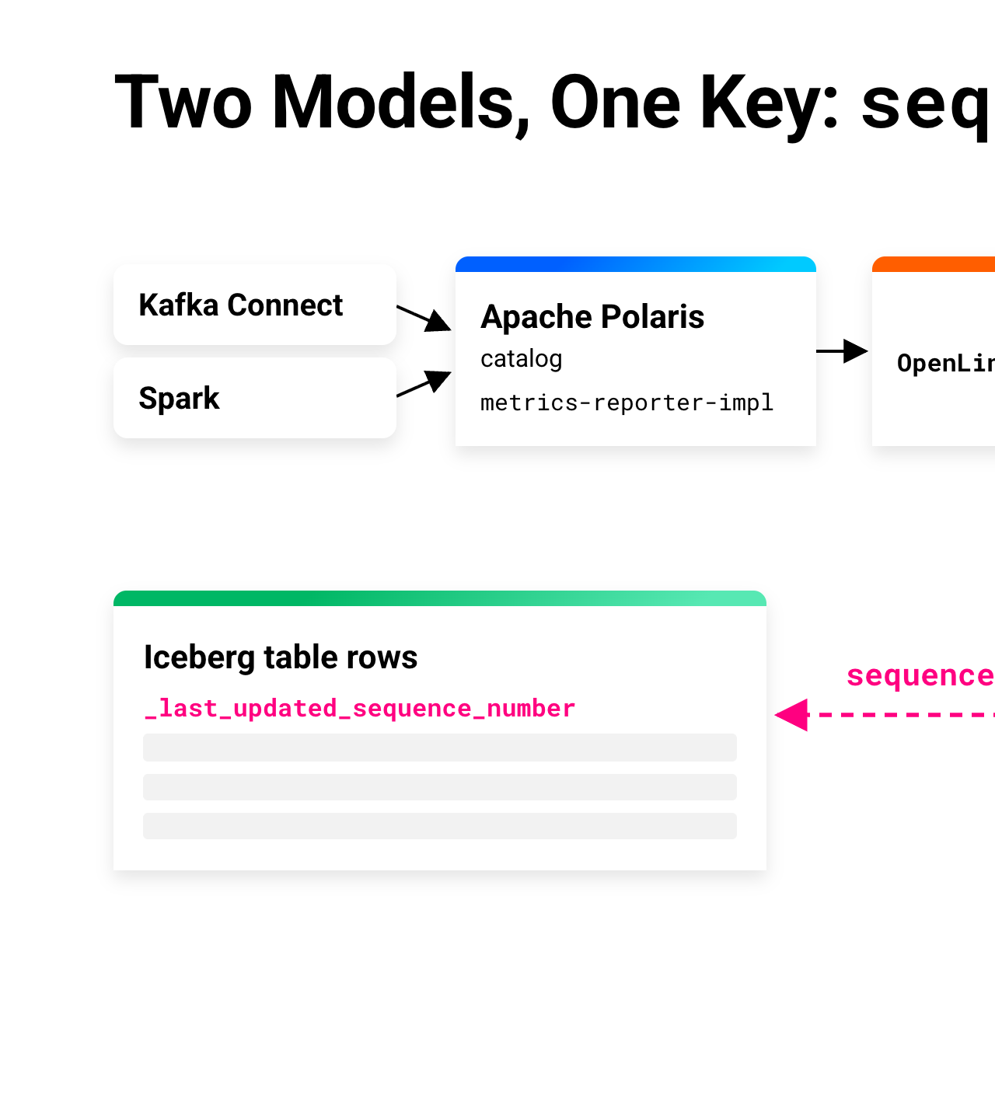
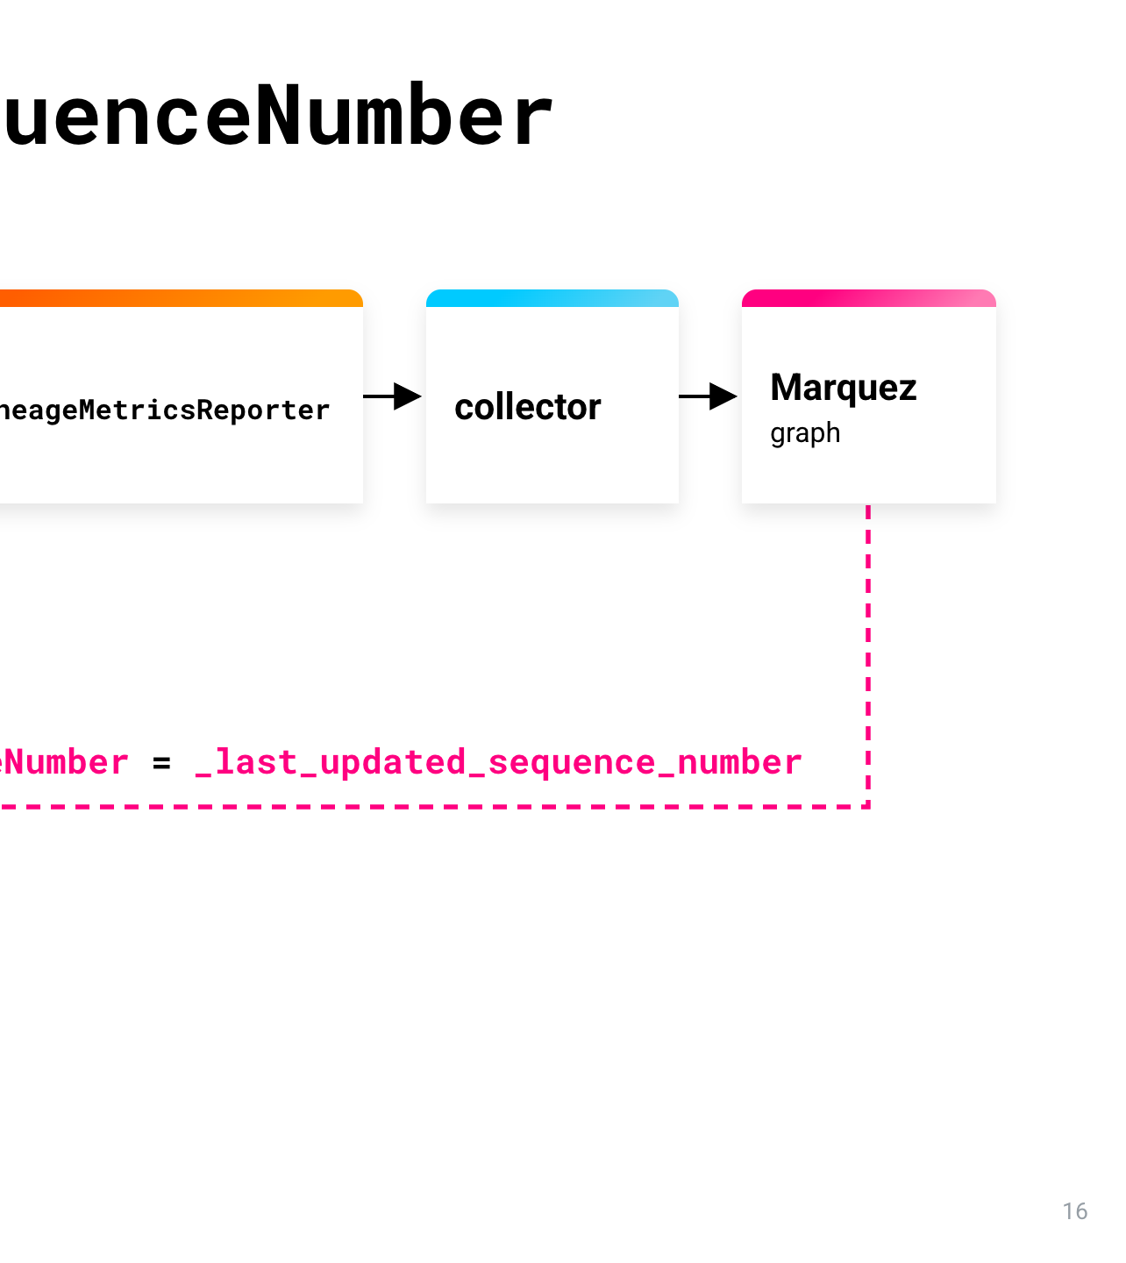
Notes:
Here's the short list we'd give ourselves on day one. Each one cost us time. One: create V3 tables from scratch. Never upgrade V2 to V3 if you want lineage. Two: deletion vectors keep identity; equality deletes churn it. Three: read lineage with Spark or DuckDB. Flink's Iceberg source can't project _row_id. We checked that Spark 4.0 with Iceberg 1.11 returns the same values as DuckDB. Four: let the sink evolve the schema, and keep new columns optional. One connector property adds new source fields as optional columns, metadata only. If you need defaults, set them through Iceberg's table API, because Iceberg 1.11's Spark SQL rejects adding a column with a default. And keep the column optional unless every writer applies defaults. The Kafka Connect sink doesn't.

Slide 18
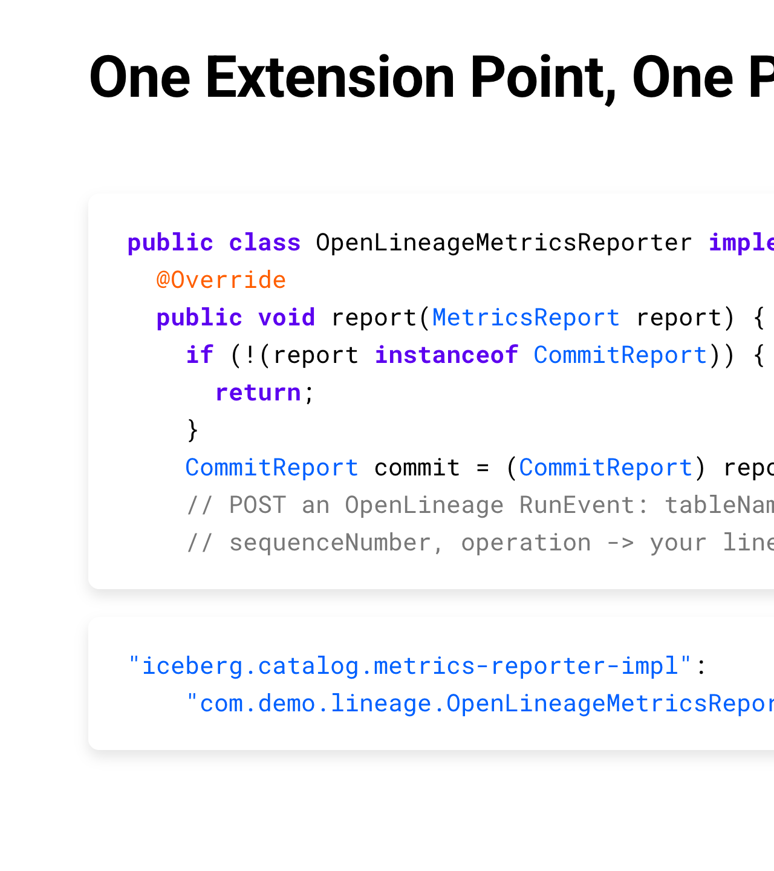
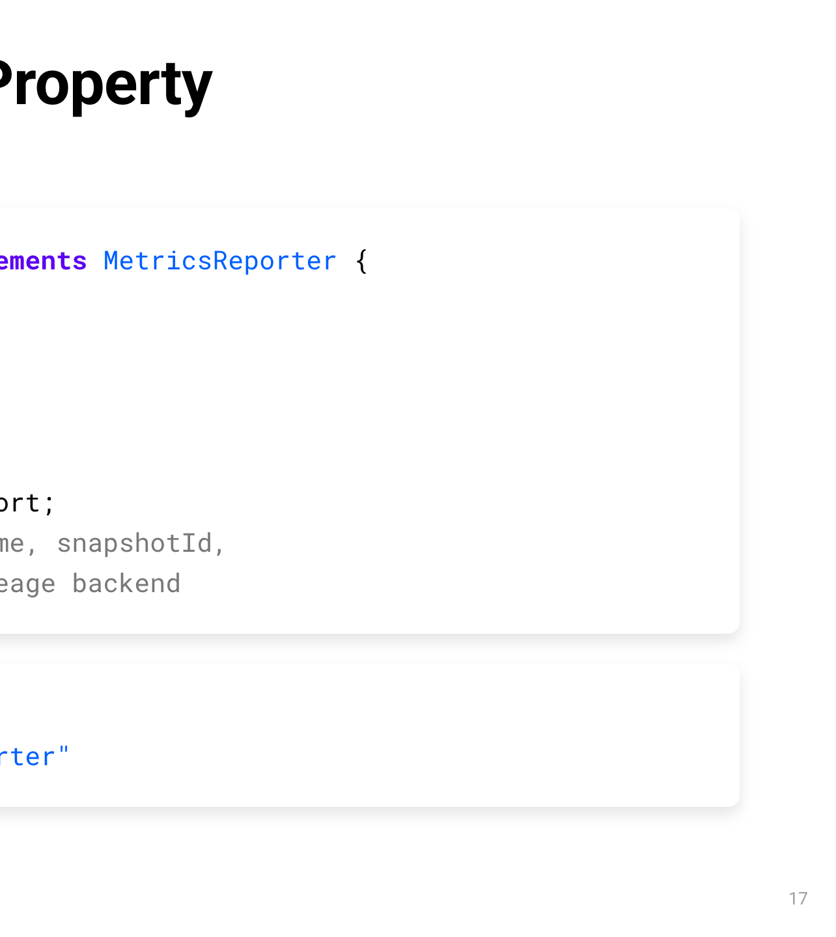
Notes:
A few things in the plumbing bit us, so quickly. One: we started with an in-memory SQLite REST catalog. Under a burst of 24 parallel requests it returned HTTP 500, no such table. Each pooled connection got its own empty in-memory database, so the catalog forgot every table. A file-backed store fixed it. Two: JavaScript rounds 19-digit snapshot ids, so format them on the server. Three: catalogs differ in the plumbing. Lakekeeper, our backup catalog, deletes a dropped table's files itself, so Spark's DROP TABLE PURGE races it. And four: the Kafka Connect Iceberg sink has no native OpenLineage support. One catalog property adds it, and that's where the next part of the talk starts.

Slide 19
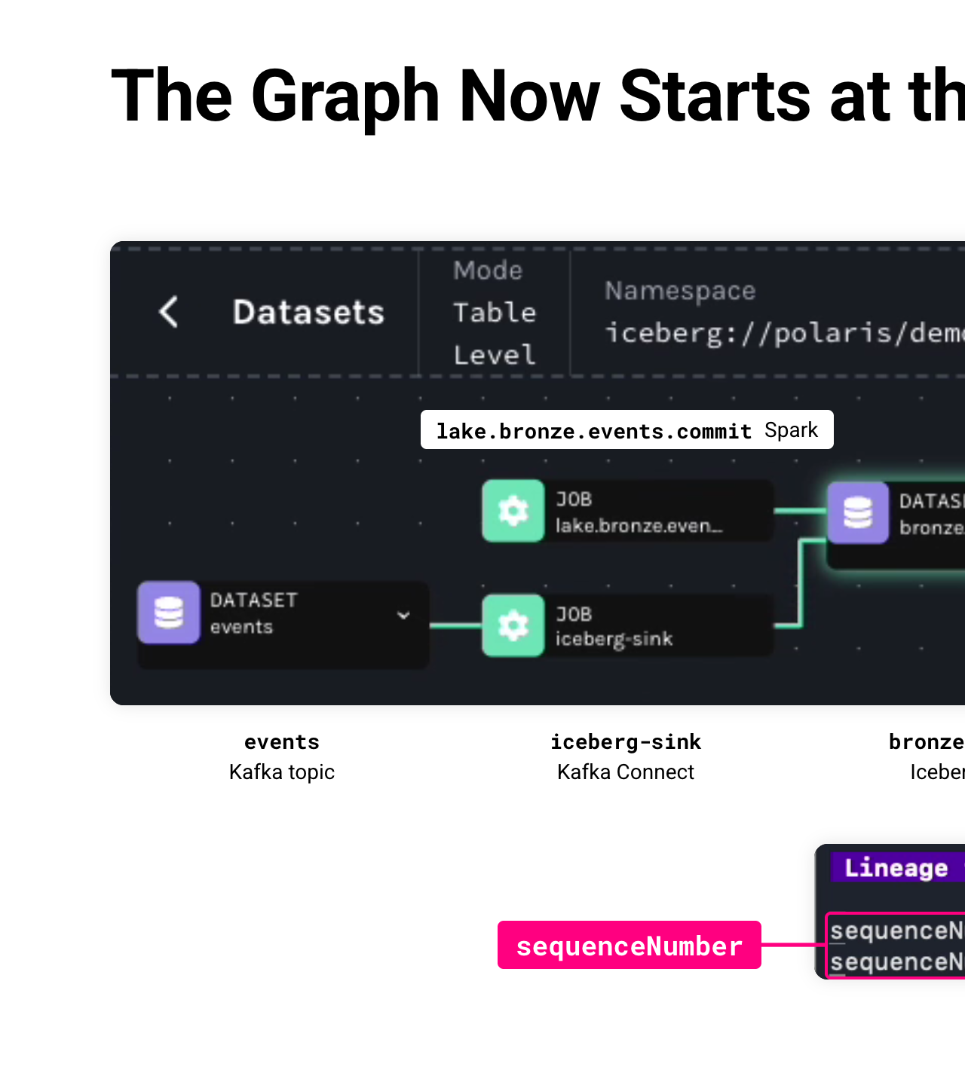
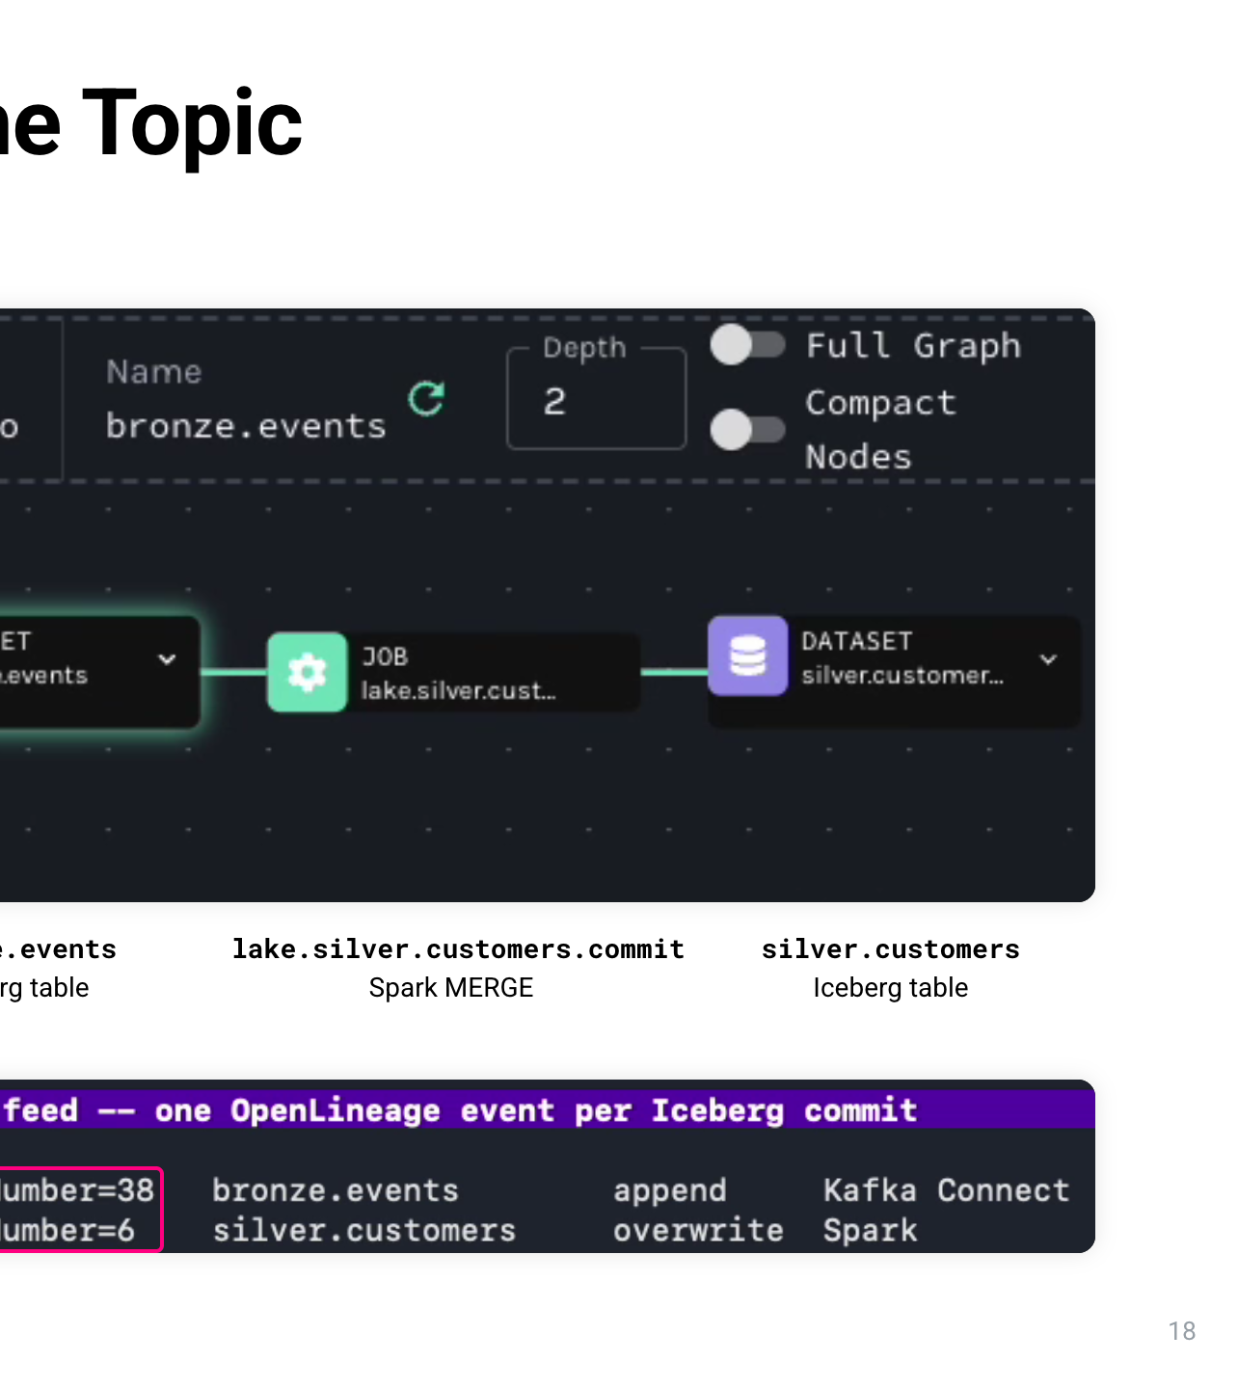
Notes:
The abstract calls this Bring Your Own Lineage, so here's what that means. You probably already run a lineage system, built on OpenLineage or something like it. It knows your jobs and datasets: which job read which table and wrote which table. Iceberg V3 now knows something that system doesn't: which rows each commit produced, through _row_id and _last_updated_sequence_number. Bring Your Own Lineage means you keep the lineage system you have, and join it to Iceberg's row identity on one shared key: the commit's sequence number. You don't replace anything, and you don't change the streaming pipeline. Your lineage graph keeps answering the job and table questions, and Iceberg answers the row questions underneath it. From here on I'll call the pattern Composable Lineage: two systems, composed on one key.

Slide 20
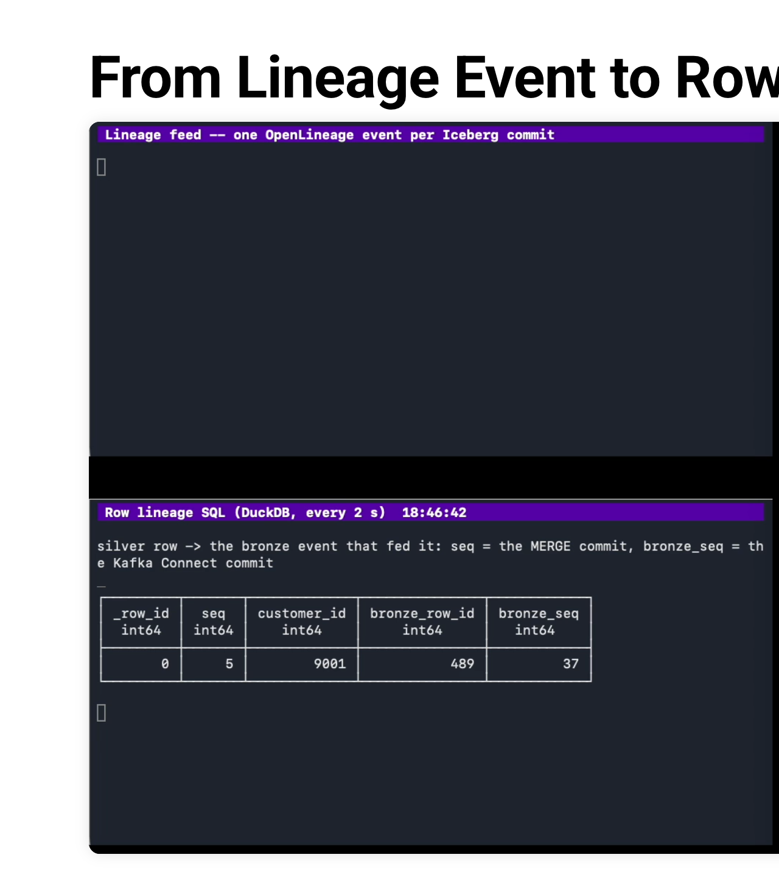
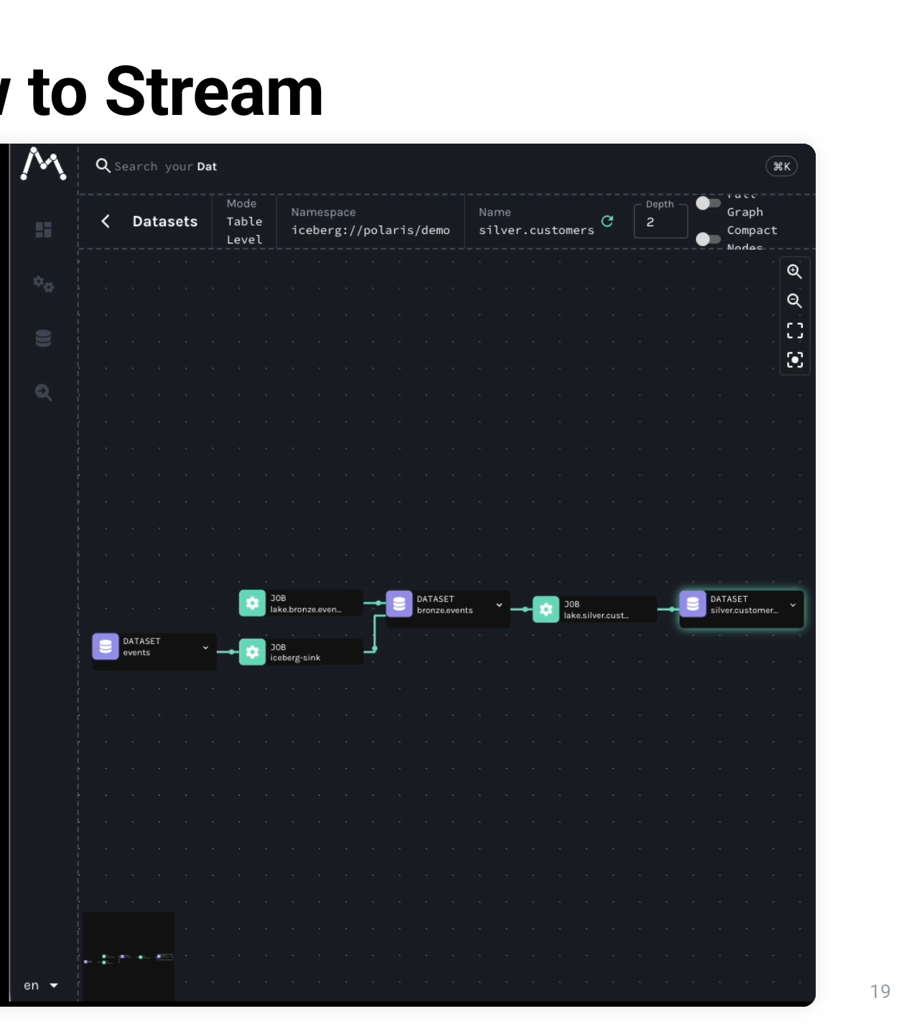
Notes:
Here's how the two models connect. Across the top: Kafka Connect and Spark both commit through the Apache Polaris catalog. The catalog has a property called metrics-reporter-impl, which plugs in our OpenLineageMetricsReporter. That sends events to a collector, and they land in Marquez, the lineage graph. Underneath, separately, the Iceberg table rows carry _last_updated_sequence_number. OpenLineage has no row concept, and Iceberg has no job concept, but they share one field. Every Iceberg commit produces a CommitReport with the table name, snapshot id, sequence number and operation, and we forward it as an OpenLineage event. Take that sequenceNumber, filter the rows where _last_updated_sequence_number equals it, and you have exactly the rows that commit produced.

Slide 21
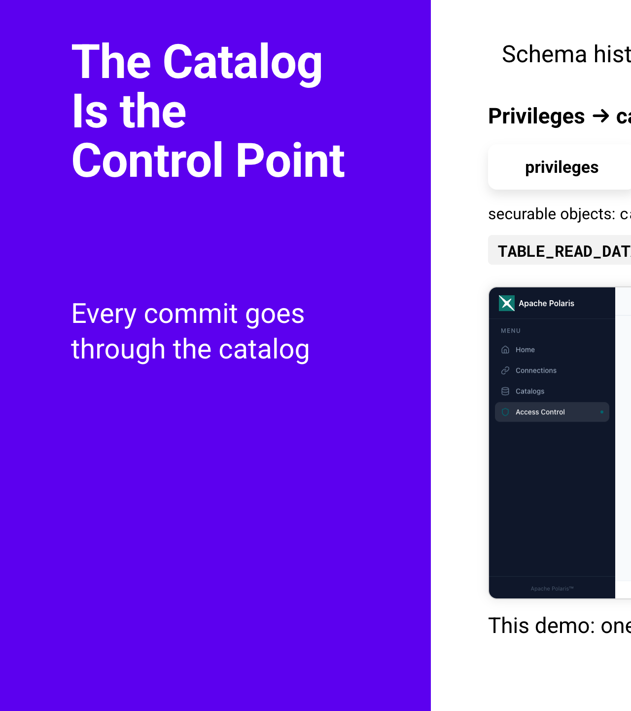
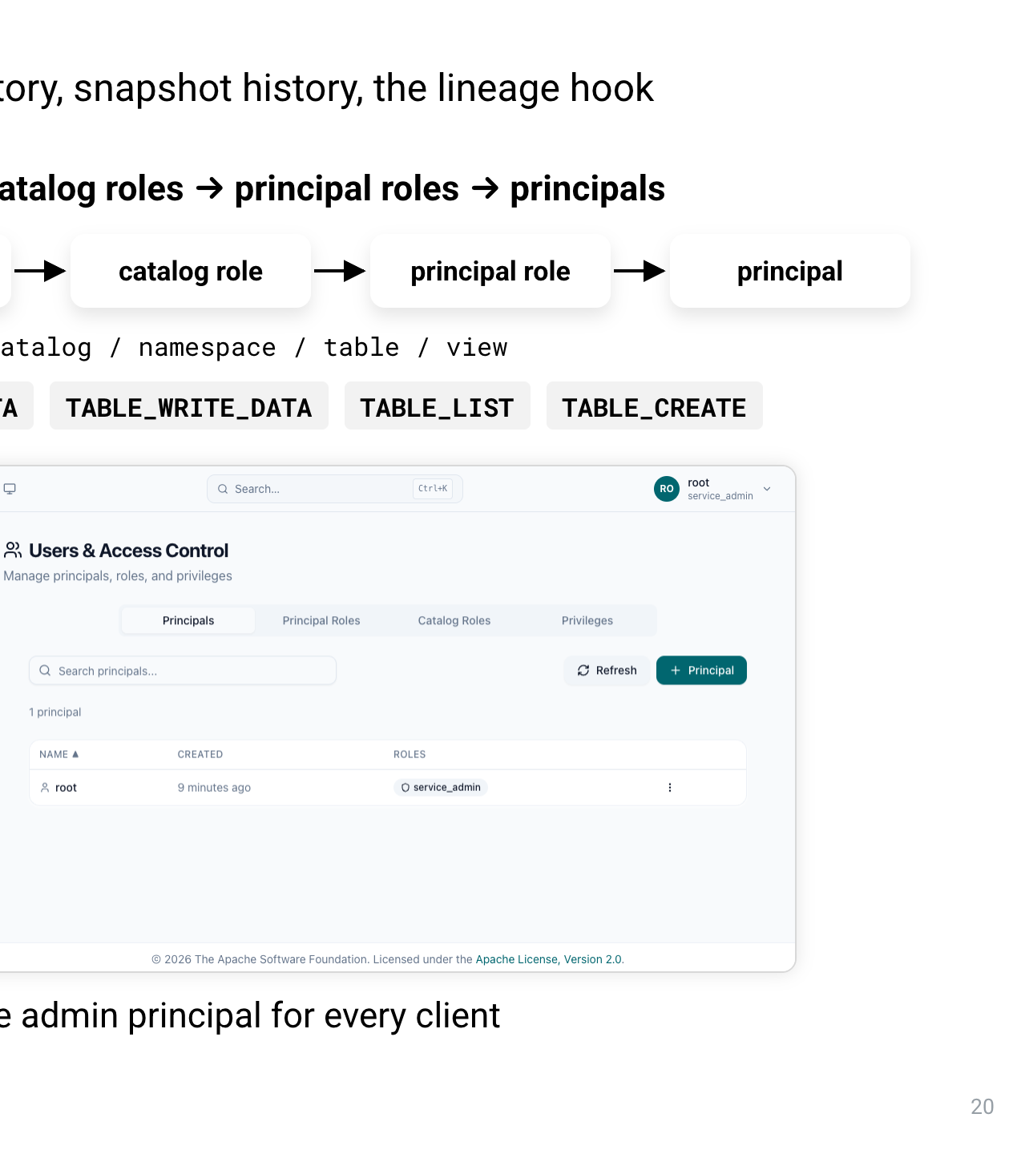
Notes:
And here's all the code it takes. Iceberg calls report after every commit. We keep only the CommitReport, and post an OpenLineage run event with the table name, snapshot id, sequence number and operation to your lineage backend. The same jar runs in Spark and in Kafka Connect. For Kafka Connect it's one connector property, shown at the bottom: iceberg.catalog.metrics-reporter-impl. There's no change to the sink itself. That's what "without disrupting streaming pipelines" means here. And because it emits standard OpenLineage events, any OpenLineage backend can take them. We show Marquez, the reference implementation, and that's the "bring your own" part. Now the graph has the ingest leg too.

Slide 22
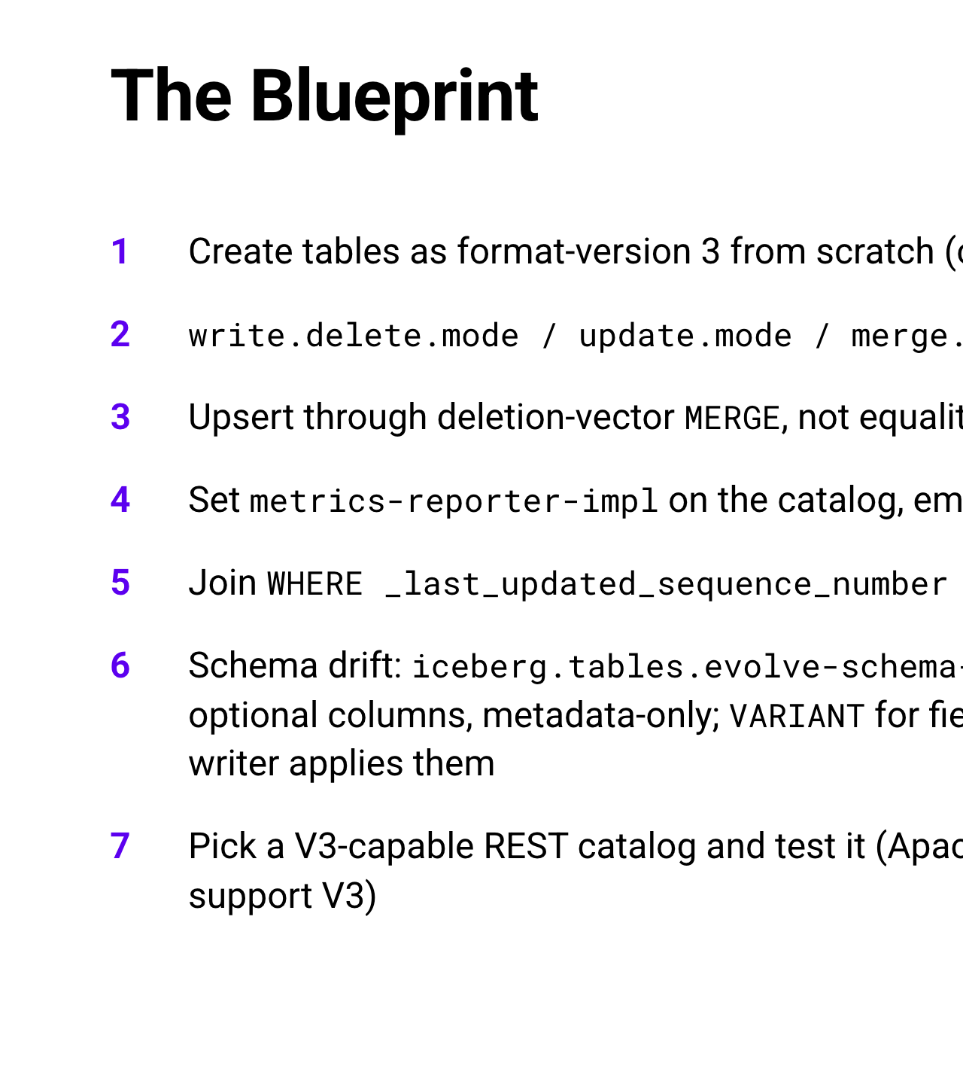
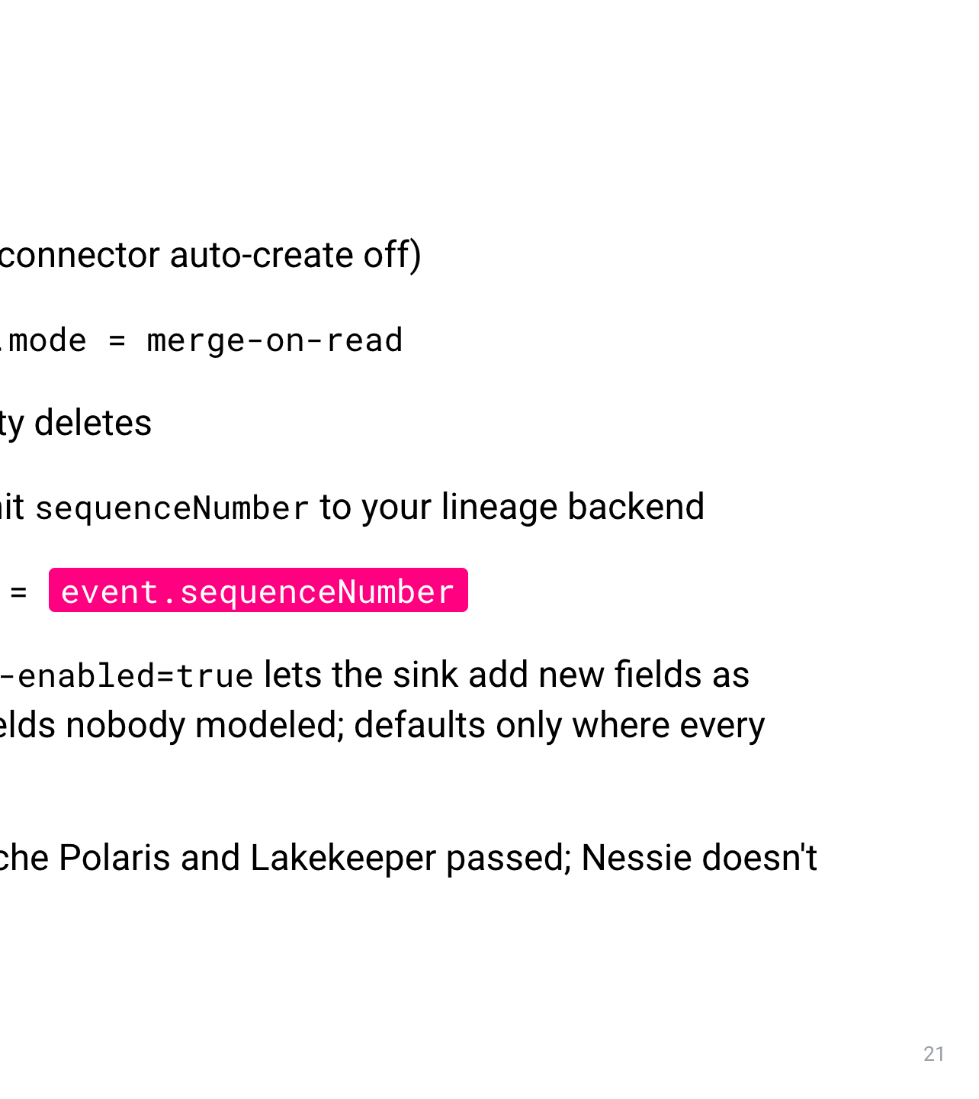
Notes:
This is Marquez, the OpenLineage reference UI, fed by that reporter. Read the graph left to right. The events dataset is the Kafka topic. The iceberg-sink job is Kafka Connect, and it writes the bronze.events table. The Spark job lake.silver.customers.commit is the MERGE, and it writes silver.customers. Above it, the Spark job lake.bronze.events.commit also writes bronze.events. So the topic, the Kafka Connect job, the bronze table, the MERGE and the silver table are one connected graph, from the stream all the way to the curated table. Bottom right is the lineage feed: one line per Iceberg commit, each with its sequenceNumber. Sequence number 38 is a Kafka Connect append to bronze.events, and sequence number 6 is a Spark overwrite of silver.customers. Hold on to those two numbers, because now we're going to use them.

Slide 23
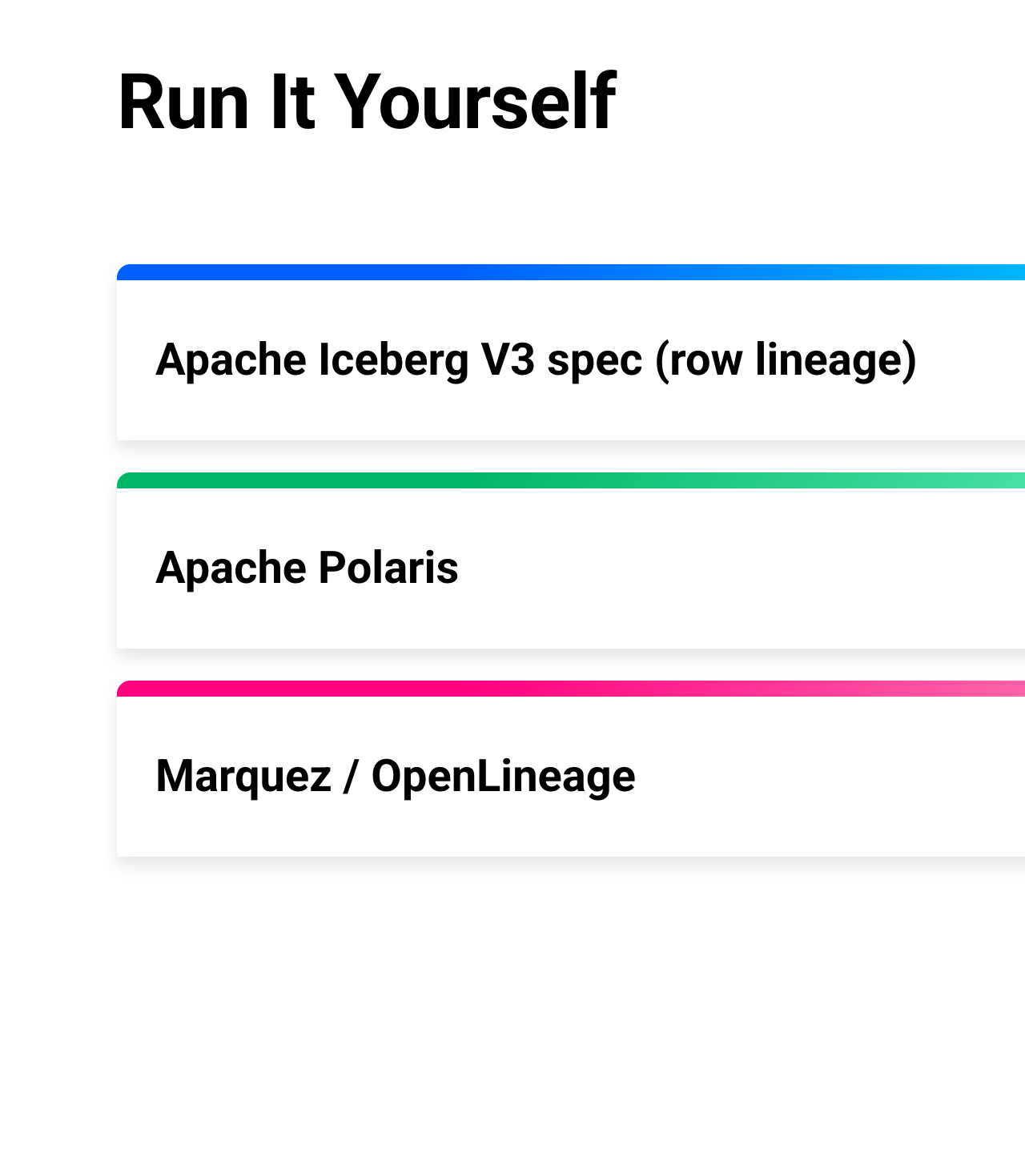
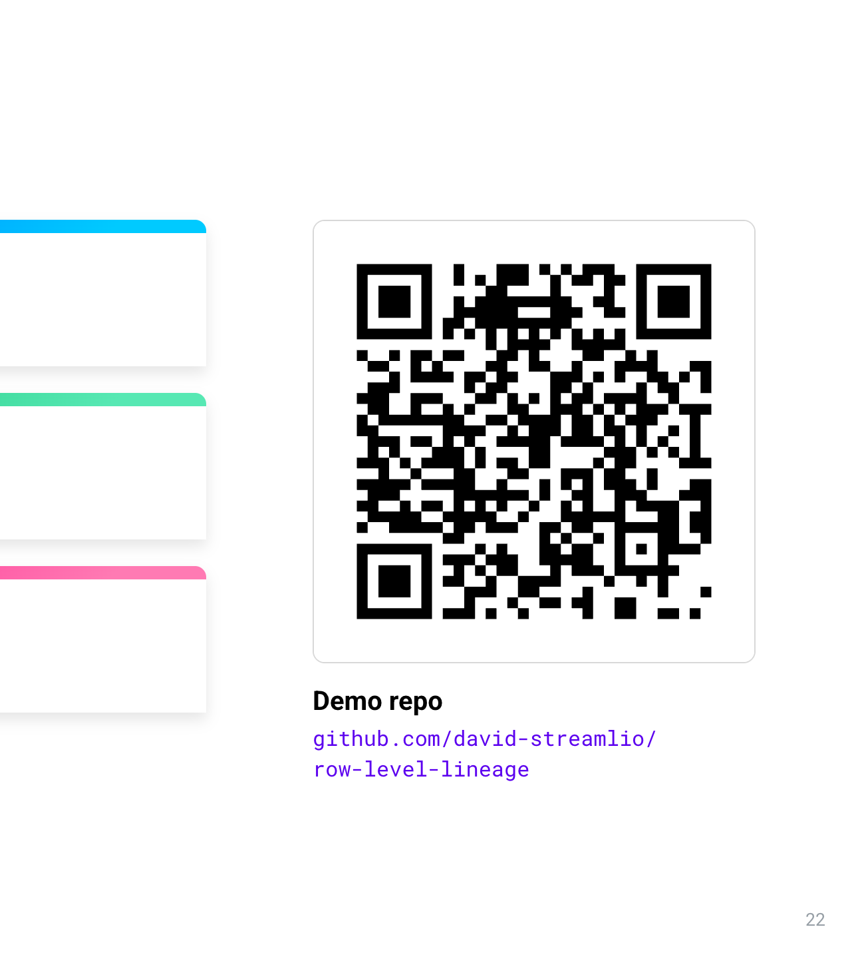
Notes:
This is stage 4, the full trace. On the right is the Marquez graph we just saw. Top left is the lineage feed, which starts empty. Bottom left is a SQL query that joins the silver row for customer 9001 to the bronze event that fed it. Right now the silver row is at sequence number 5, pointing at bronze row 489 from sequence number 37. A new event for customer 9001 now streams in through Kafka. Kafka Connect commits it to bronze.events, and the first line appears in the feed: sequenceNumber 38, bronze.events, append, Kafka Connect. Then Spark MERGEs it into silver.customers, and the second line appears: sequenceNumber 6, silver.customers, overwrite, Spark. The SQL updates: silver row 0, now at sequence number 6, fed by bronze row 490 at sequence number 38. Now read it backwards. The MERGE was sequenceNumber 6. Filter silver.customers where _last_updated_sequence_number equals 6, and you get row 0, the same row stage 2 updated. That row says which event fed it: bronze row 490, written at sequence number 38. And the feed has a line for 38: Kafka Connect, reading the events topic. So from one row in a curated table, we got to the exact input record, the commit that ingested it, and the topic it came from. Nothing in the streaming pipeline changed to make this work. That's what "auditable from the moment it's ingested" means.

