Slide 1
Equitable Public Bus Network Optimization for Social Good: A Case Study of Singapore
David Tedjopurnomo, RMIT University
Zhifeng Bao, RMIT University
Farhana Choudhury, The University of Melbourne
Hui Luo, RMIT University
A. K. Qin, Swinburne University of Technology

Slide 2
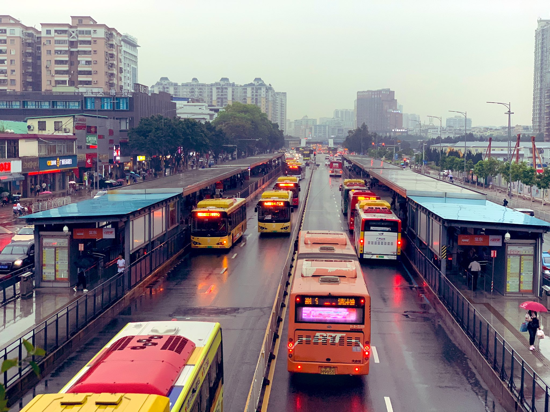
Background
Public bus transportation:
Reduces air pollution
Improves community mobility
Reduces road congestion
Public transport inequities:
In Perth, 70% of the population share only 30% of the services; with the elderly suffering the most from this inequity^{[1]}
In Melbourne, 70% share only^{[2]} 19%
In London, it is found that people with no educational qualification have negative association with public transport accessibility^{[3]}
Notes:
Image source: https://www.itdp.org/our-work/public-transport/

Slide 3
Challenges in Equitable Bus Network Optimization
Challenge 1. Defining efficiency and equity metrics
Challenge 2. Route equity-directness tradeoff
Challenge 3. Resource-constrained optimization

Slide 4
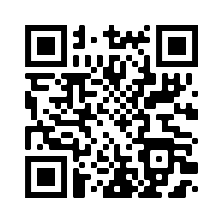
Our work
We curate and publicly release the first equitable public bus network dataset based on Singapore.
We analyse bus network equity through several choices of equity metrics
We study and discuss the efficiency of bus networks through a novel efficiency metric
We perform exploratory experiments to show the intricacies of bus network optimization.

Slide 5
Dataset
Road network¹: directed graph with road junctions and road edges
Bus routes²: bus stops and bus schedules data
Distance matrices: car and bus distances
Census boundaries³: to analyse area and demographic level efficiency and equity
Demographics data⁴: three sensitive attributes of age, income, qualification
Notes:
¹Retrieved using the Python osmnx library
²https://www.kaggle.com/gowthamvarma/singapore-bus-data-land-transport-authority
³https://data.gov.sg/dataset/planning-area-census2010
⁴://www.tablebuilder.singstat.gov.sg/

Slide 6
Efficiency Metric
Captures both travel efficiency and travel convenience
Four bus network quality factors:
Route directness
Service coverage
Network efficiency
Number of transfers required

Slide 7
Efficiency Metric – Capturing Efficiency
Comparing against a gold standard: car travel distance
Shortest possible distance calculated using A*
No waiting time nor transfers
The closer the bus travel distance to the car travel distance, the more efficient the route.
Steps to calculate:
Calculate the stop-to-stop bus travel distance
Calculate the stop-to-stop car travel distance
Aggregate both to area-level distance
Divide the car travel distance by the bus travel distance
Intuitive metric:
A value of 1 means that bus travel is as efficient as car travel
A value of 0.5 means that bus travel is half as efficient as car travel

Slide 8
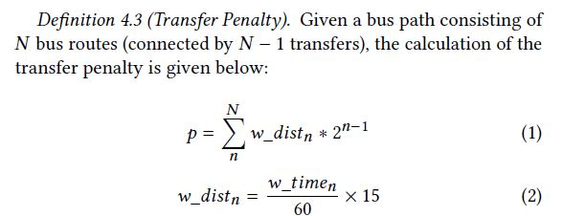
Efficiency Metric – Capturing Travel Convenience
Convenient travel = less waiting time and fewer transfers
Converting bus waiting time to “waiting distance” allows us to sum the actual travel distance, waiting time, and number of transfers into one representative value
Transfer penalty based on the waiting distance and increases for every transfer.

Slide 9
Equity Metrics – Advantaged and disadvantaged areas
Advantaged/disadvantaged areas determined by that area’s percentage of disadvantaged population compared to the countrywide percentage
Five metrics:
Population-scaled Equity (PEQ)
Area-level Equity (AEQ)
Maximum Discrepancy (MD)
Standard Deviation (SD)
Residual Difference (RD)

Slide 10
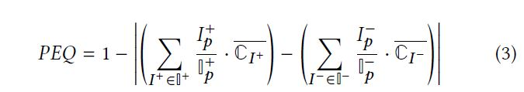
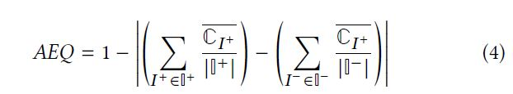
Equity Metrics
Calculates the efficiency discrepancy for advantaged and disadvantaged population
Calculates the efficiency discrepancy for advantaged and disadvantaged areas

Slide 11

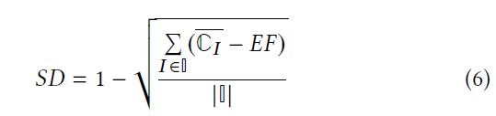
Equity Metrics
MD and SD Calculates public bus efficiency discrepancy between different areas
Spatial distribution rather than demographic distribution
Difference between the most and least efficient areas
Standard deviation of all areas’ efficiency

Slide 12
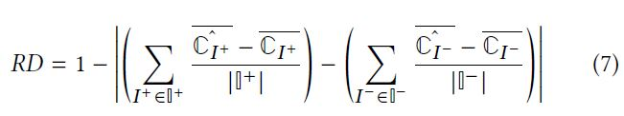
Equity Metrics
Typically used to measure the extent of over or underestimation discrepancy between advantaged and disadvantaged groups.
In our work, we use it to evaluate how equitable the bus optimization algorithms are in terms of how they improve or degrade the efficiency of advantaged or disadvantaged areas

Slide 13
Experiments
Singapore dataset:
55 planning areas
361 bus routes and 5,021 bus stops
Comparison with human-generated routes:
Use the full set of 361 routes as the ground truth network
Randomly remove 90 (25%) of the routes to output an initial network with 271 routes
Use our methodologies on the initial network to generate 90 new routes, subject to resource constraints
Compare efficiency and equity of these networks with the ground truth
Methodologies:
Direct: directly building routes between four selected bus stops
Gradual: connect a pair of bus stops by gradually adding bus stops from the start to the end
Gradual-equity: same as gradual, but takes into account the equity factors

Slide 14
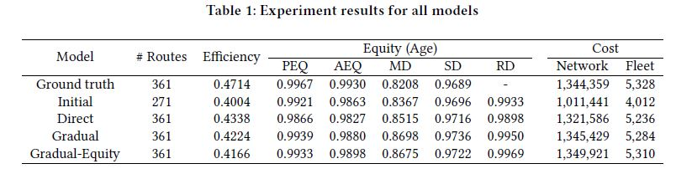
Experiment Results
Observations:
Efficiency score of baseline methods vs ground truth (human-generated)
PEQ and AEQ score of the Singapore data
MD and SD score of the baseline methods vs ground truth (human-generated)

Slide 15
End of Presentation Please read our full paper for more detailed explanation and case studies: David Tedjopurnomo, Zhifeng Bao, Farhana Choudhury, Hui Luo, and A.K. Qin. 2022. Equitable Public Bus Network Optimization for Social Good: A Case Study of Singapore. ACM Conference on Fairness, Accountability, and Transparency.

Slide 16
References
[1] Anthony Michael Ricciardi, Jianhong(Cecilia) Xia, and Graham Currie. 2015. Exploring public transport equity between separate disadvantaged cohorts: a case study in Perth, Australia. Journal of Transport Geography 43 (2015), 111–122.
[2] Alexa Delbosc and Graham Currie. 2011. Using Lorenz curves to assess public transport equity. Journal of Transport Geography 19, 6 (2011), 1252 –1259.
[3] Neil Cuthill, Mengqiu Cao, Yuqi Liu, Xing Gao, and Yuerong Zhang. 2019. The Association between Urban Public Transport Infrastructure and Social Equity and Spatial Accessibility within the Urban Environment: An Investigation of Tramlink in London. Sustainability 11, 5 (2019).
Dataset:

