Slide 1
Similar Trajectory Search with Spatio-temporal Deep Representation Learning
Notes:
a

Slide 2
Contents
Background
Challenges
Problem Definition
Methodology
Model
Data transformation
Injecting distortions
Loss 1: Representation loss
Loss 2: Point-to-point loss
Loss 3: Pattern loss
Experiments

Slide 3
Background
Trajectory data have become larger and more easily accessible, opening up many trajectory-driven research topics.
One of the most important trajectory-related operations is similar trajectory search:
Input: a database of trajectories and a query trajectory,
Output: the trajectory from the database that is the most similar to the query trajectory
Many definitions of similarity: spatial, spatial-textual, spatiotemporal
We focus on spatiotemporal trajectories in this work
Weaknesses of current work:
Classical models: inefficient
Not robust to common data errors such as minor temporal variations, inconsistent sampling rate, and GPS errors.
Not commonly applied to spatiotemporal trajectories
Notes:
Trajectory-driven research topics such as convoy identification and trajectory clustering

Slide 4
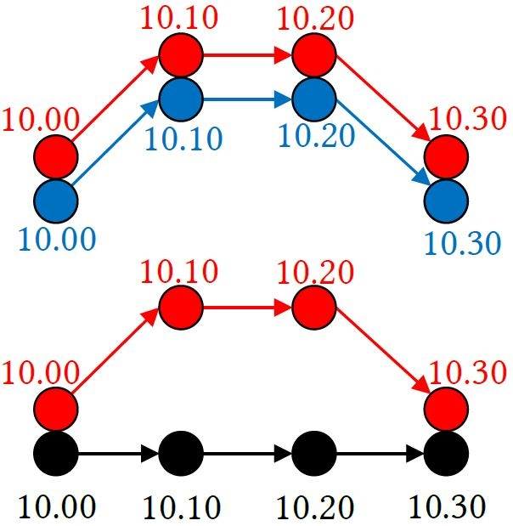
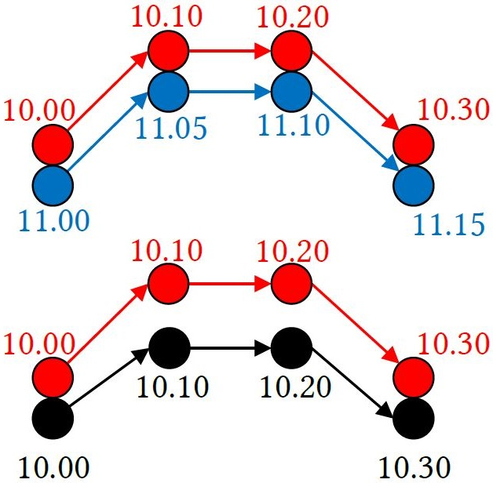
Challenge 1: Temporal difference between trajectories
Top pair: Spatially similar, temporally dissimilar
Bottom pair: Somewhat similar spatially, temporally identical
Verdict?
Top pair: Spatially similar, temporally identical
Bottom pair: Spatially dissimilar, temporally identical
Verdict: Blue trajectory is most similar to red
Interaction between spatial and temporal aspect is not straightforward and depends on application and/or dataset

Slide 5
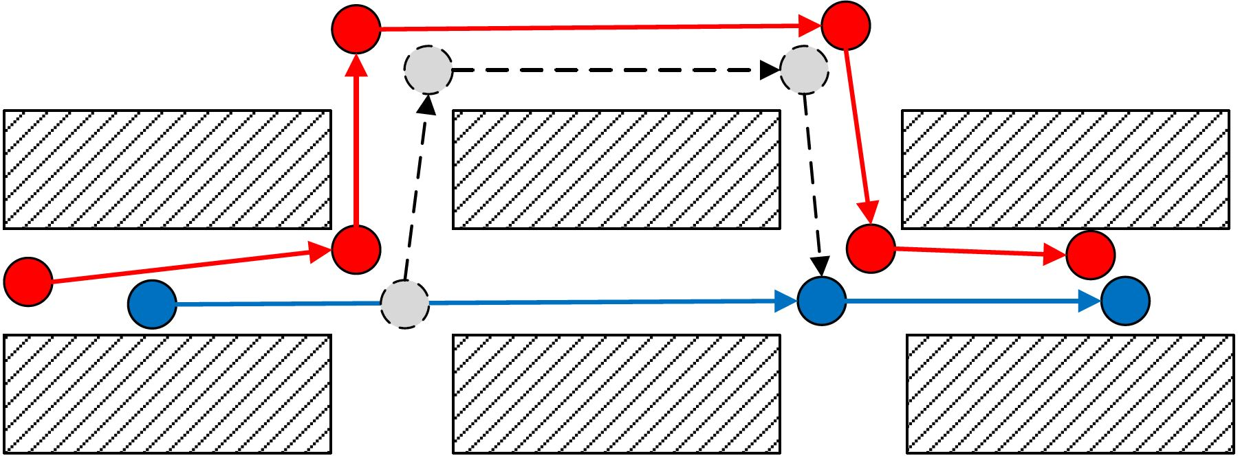
Challenge 2: Non-uniform sampling rate
Red trajectory: Query trajectory Blue trajectory: Trajectory from database (recorded)
Blue + Grey trajectory: Trajectory from database (actual)
Non-uniform sampling rate may induce information loss
Notes:
Non-uniform sampling rate may be caused by factors such as the GPS device’s power management policies and different device specifications

Slide 6
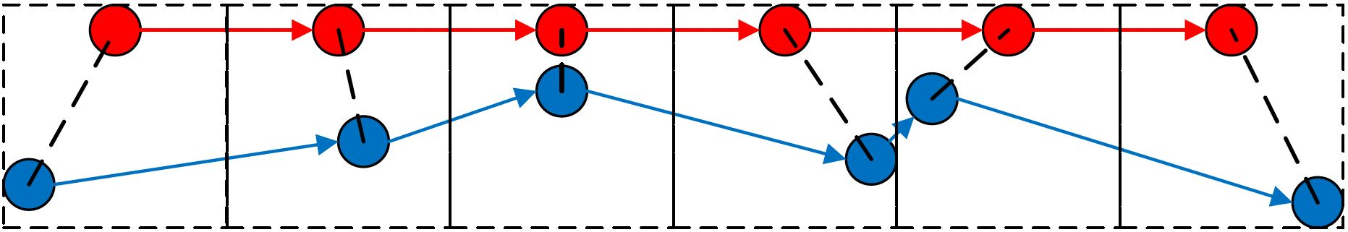
Challenge 3: GPS errors
Red trajectory: Actual trajectory Blue trajectory: Trajectory recorded by the GPS
Spatial noise from GPS errors should be ignored.
Notes:
GPS errors may be caused by several factors, such as device or data processing errors and interference from other radio signals

Slide 7
This Work
Addressing the inefficiency problem through deep representation learning
Addressing the three challenges by injecting synthetic noise and training our model to be robust to them
Three loss functions that work on different representations of the data to improve performance
Notes:
((Addressing the inefficiency problem through deep representation learning))
In the case of similar trajectory search, the most common classical methods such as DTW use dynamic programming that has a quadratic time complexity.
On the other hand, in deep representation learning, we commonly transform the input data to what is called a feature vector that represents the context of the trajectory. By using this representation, we transform the problem of calculating the similarity between a pair of trajectories to calculating the Euclidean distance between two vectors, which has a linear time complexity.
((Addressing the three challenges by manually injecting noise))
By injecting our data with synthetic noise, we can train our model to be more robust to them, improving their performance in the face of real-life data imperfections

Slide 8
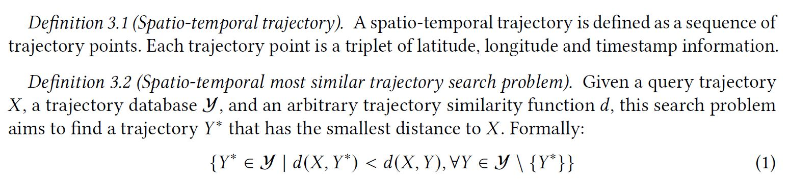
Problem Definition

Slide 9
Methodology – Model
Sequence autoencoder with attention layer
Sequence autoencoder:
Takes a sequence of values as input, outputs a sequence of values
Commonly used for machine translation
Two main components
Encoder: takes input sequence, produces a vector representation of the sequence
Decoder: takes the vector, produces the output sequence
Two recurrent neural networks (or its variants) are used, one for the encoder and one for the decoder
Attention layer:
Allows the model to focus on the salient parts of the input
Utilizes a fully-connected neural network
Notes:
((Machine translation))
As an example, we can input an English sentence and the model will output a French sentence. That is, the input is a sequence of English words and the output is a sequence of French words.

Slide 10
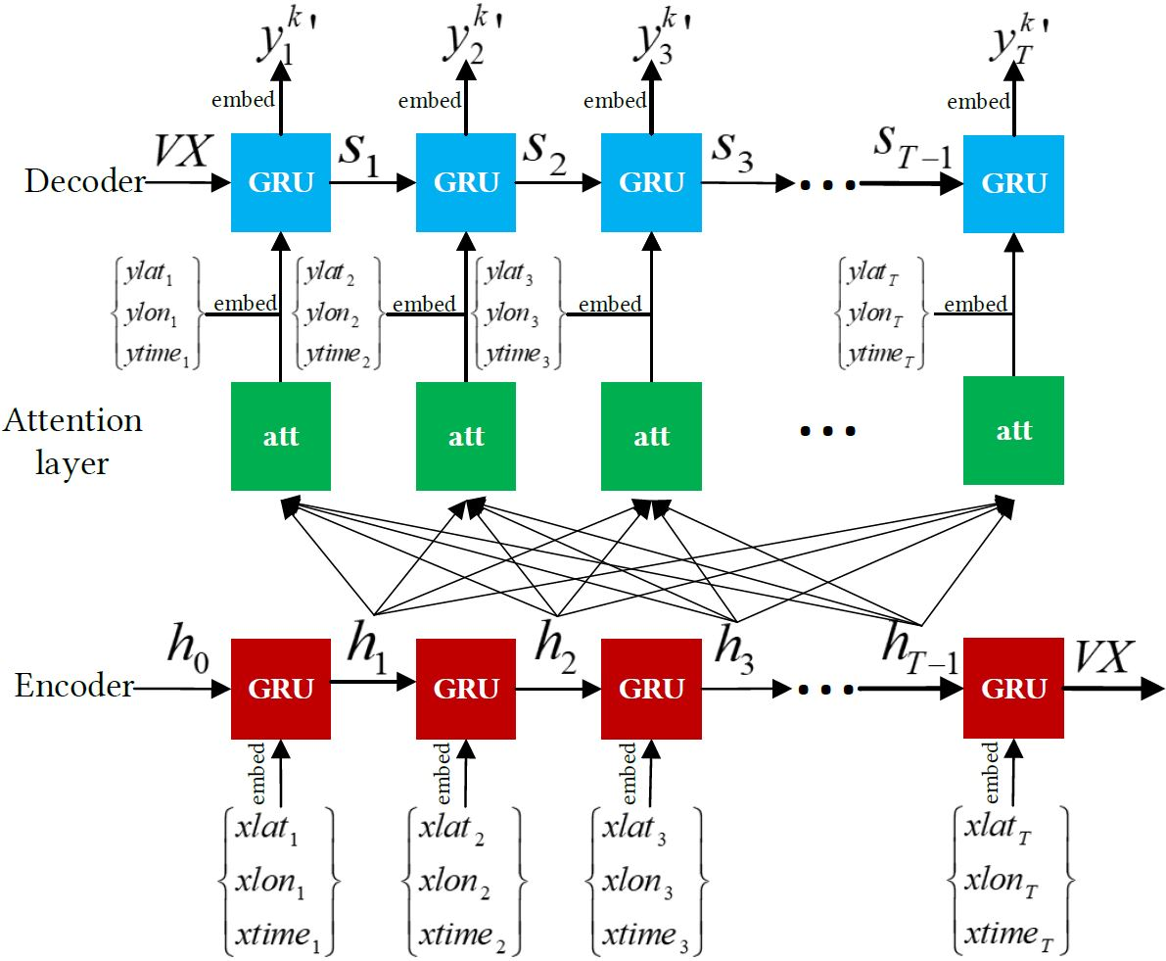
Methodology – Model
Notes:
Explain that you reconstruct the input trajectory here

Slide 11
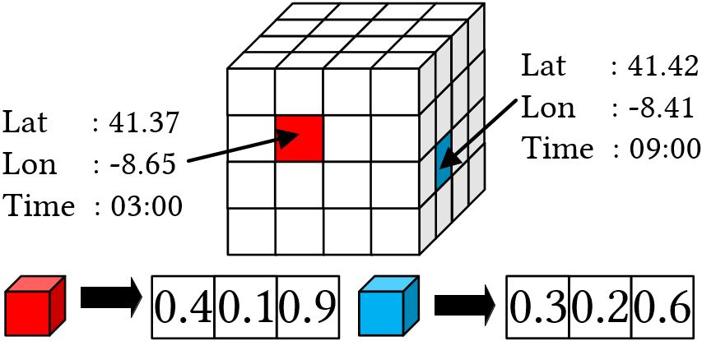
Methodology – Data transformation
Embedding: transforming raw data to vectors that store semantic information
Raw data cannot be used directly
Approach inspired by NLP
This work uses spatio-temporal instead of linguistic semantics
Vectors store the spatio-temporal semantics, i.e. how different areas and temporal segments relate to one another
Notes:
((Approach inspired by NLP))
In NLP, we want to transform words in a corpora into a vector that captures the semantic meaning of the word. For instance, the vector for the word “spaghetti” is closer to the word “food” rather than “drink”. In our work, we use spatio-temporal semantics rather than linguistic.
((Figure))
Imagine that we have a 3D grid where the X and Y coordinates relate to the spatial coordinates (i.e. a city) and the Z coordinates relate to the temporal dimension. Each cell in the grid captures a range of spatial areas and timestamp range (e.g. 3 AM to 9 AM). Each cell is represented with a trainable feature vector.
To get the feature vector for a triplet of latitude, longitude and timestamp, we perform a lookup on the grid to find the matching cell and then get the vector for that cell. We use this vector to represent the given timestamp.

Slide 12
Methodology – Injecting Distortions
No dataset available to train the model to address the three challenges, need manual noise injection
Challenge 1: Injecting temporal noise
For all points in a trajectory, we add or subtract a random number of minutes. Controlled by parameter d_{e}
Challenge 2: Downsampling trajectories
Randomly remove some points from the trajectory. Controlled by parameter d_{r}
Challenge 3: Injecting spatial noise
For all points in a trajectory, we randomly shift some points’ spatial coordinates to a random location within 30 meters. Controlled by parameter d_{s}

Slide 13
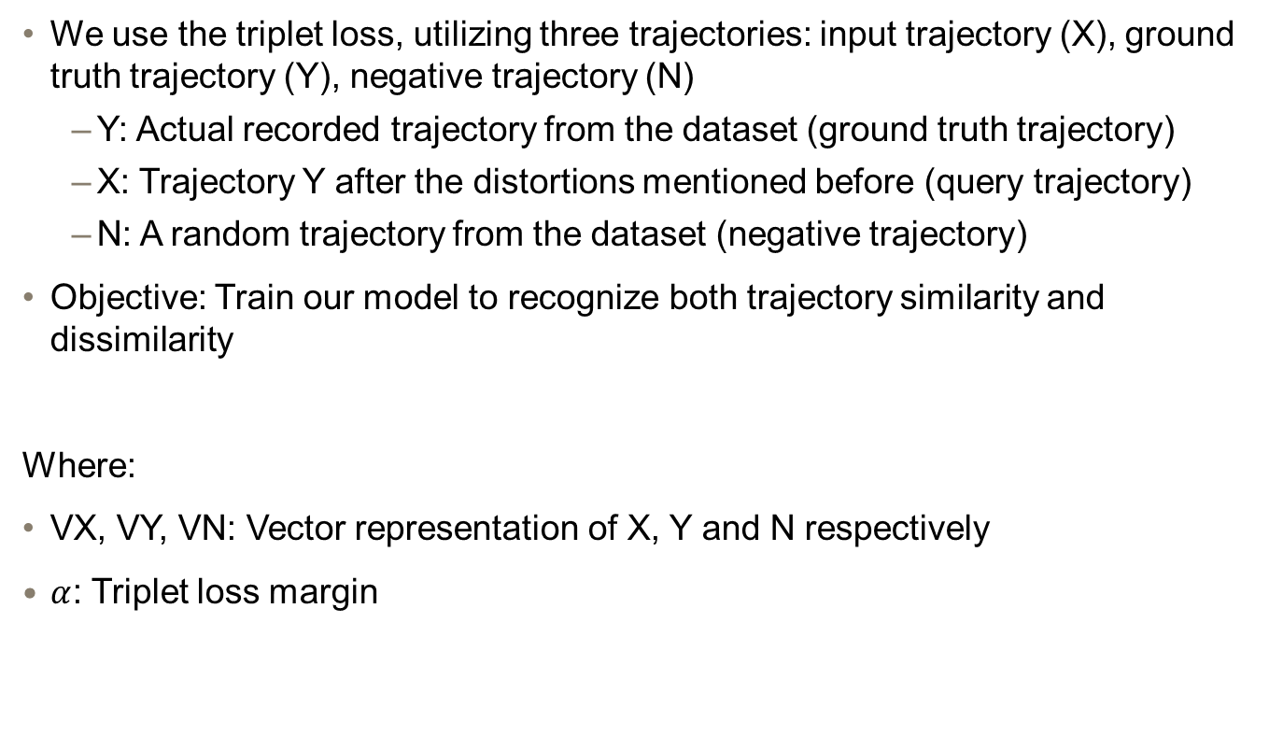
Methodology – Loss 1: Representation Loss
We use the triplet loss, utilizing three trajectories: input trajectory (X), ground truth trajectory (Y), negative trajectory (N)
Y: Actual recorded trajectory from the dataset (ground truth trajectory)
X: Trajectory Y after the distortions mentioned before (query trajectory)
N: A random trajectory from the dataset (negative trajectory)
Objective: Train our model to recognize both trajectory similarity and dissimilarity
Where:
VX, VY, VN: Vector representation of X, Y and N respectively
$α$: Triplet loss margin

Slide 14
Notes:
Explain that you reconstruct the input trajectory here

Slide 15
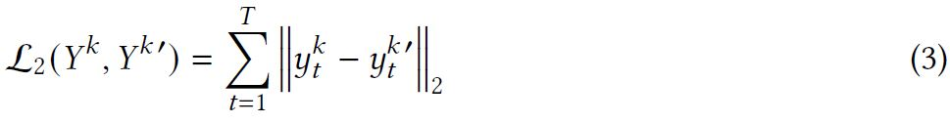
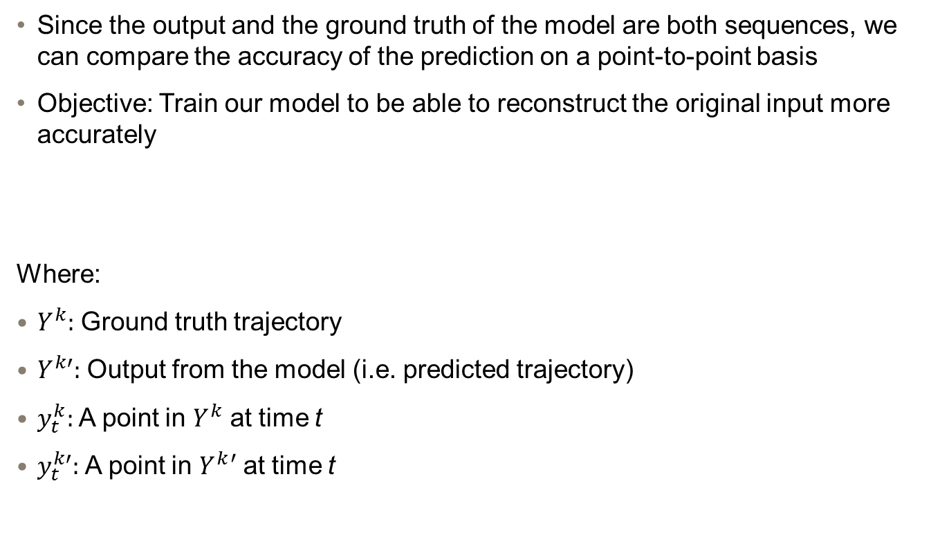
Methodology – Loss 2: Point-to-point Loss
Since the output and the ground truth of the model are both sequences, we can compare the accuracy of the prediction on a point-to-point basis
Objective: Train our model to be able to reconstruct the original input more accurately
Where:
$Y^{k}:$ Ground truth trajectory
$Y^{k′}:$ Output from the model (i.e. predicted trajectory)
$y_{t}^{k}:$ A point in $Y^{k}$ at time t
$y_{t}^{k′}:$ A point in $Y^{k}′$ at time t
Notes:
Note that at this point, every point in both trajectories are in the form of vectors, so we can take the Euclidean distance between them.

Slide 16
Notes:
Explain that you reconstruct the input trajectory here

Slide 17
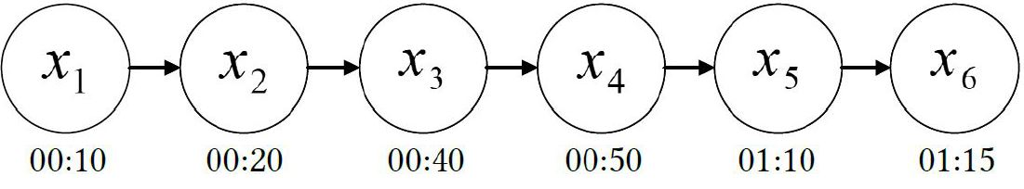
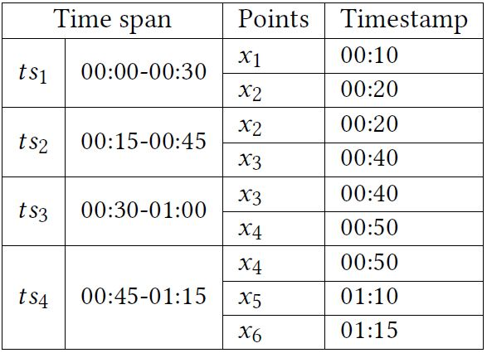
Methodology – Loss 3: Pattern loss
Modeling the concept of trajectory movement patterns and comparing the patterns of different trajectories.
Patterns: short sequence of trajectory points
Divide trajectory points to “time spans”.

Slide 18
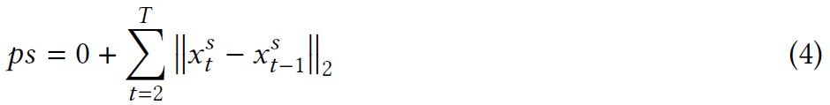
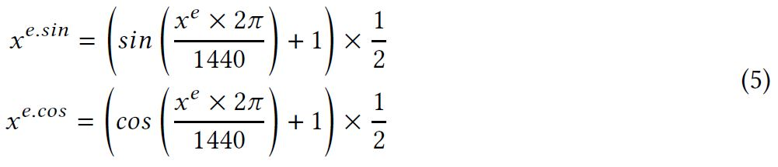
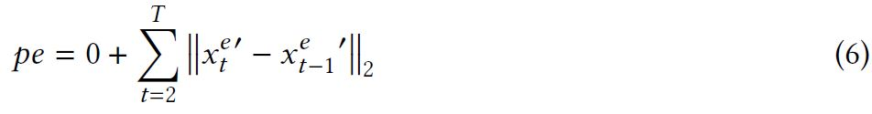
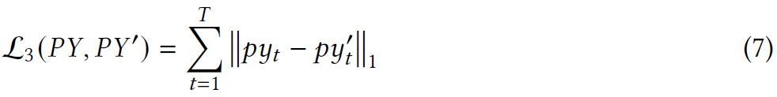
Methodology – Loss 3: Pattern loss
Spatial and temporal pattern: total distance travelled and elapsed time, respectively
Spatial pattern
Sin and cos timestamp transformation for cyclical features
Temporal pattern
Pattern loss

Slide 19
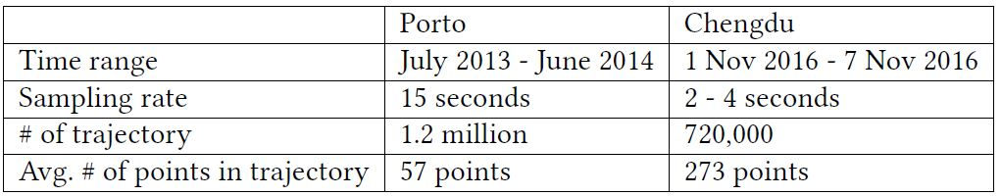
Experiments
Dataset: Porto taxi dataset and Didi Chengdu dataset
Benchmarks:
T2vec [1]: State of the art deep-neural-network-based model. Spatial-only.
Classical trajectory similarity functions adapted to spatiotemporal trajectories: DTW, EDR, ERP, LCSS
Notes:
Benchmarks
The reason we are using t2vec is because we want to observe the effectiveness of using both spatial and temporal aspects of the data
The reason we are using the classical methods is because we want to observe the effectiveness of deep neural network models in this task

Slide 20
Experiments
Synthetic query and ground truth pair:
Ground truth: trajectories from the dataset
Query: distorted and downsampled copies of the ground truth trajectories
Objective: given a query trajectory, search the database of trajectories and find the ranking of the matching ground truth. The higher the ranking the better.
Experiments:
Scalability: vary the database size
Robustness to downsampling rate: vary the downsampling rate
Robustness to spatial distortions: vary the spatial distortion rate
Robustness to temporal distortions: vary the temporal distortion rate
Querying time
Notes:
((Synthetic query and ground truth pair))
There is no dataset with the required query and ground truth pair for this experiment, we have to devise a synthetic dataset.

Slide 21
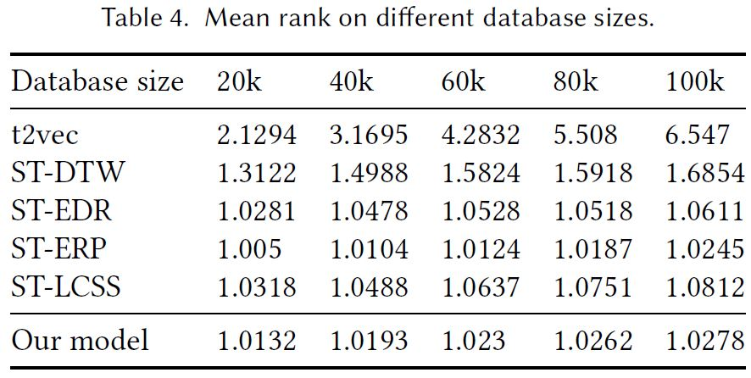
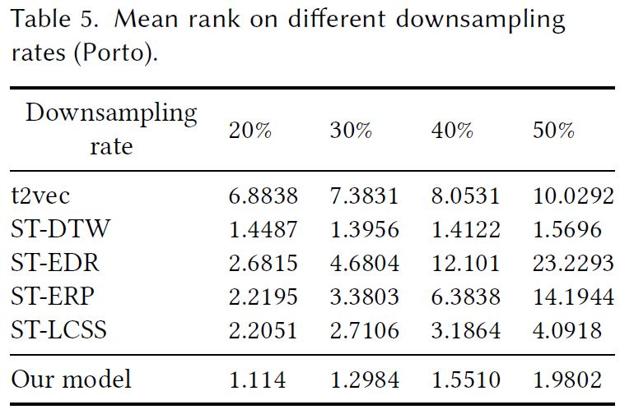
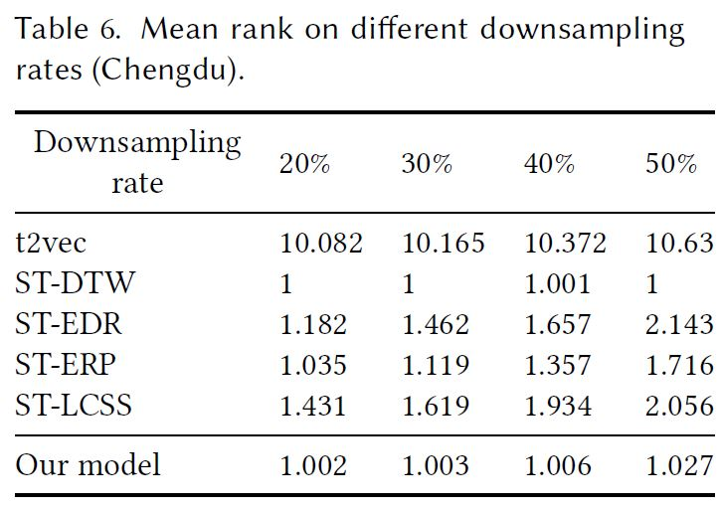
Experiments – Effectiveness

Slide 22
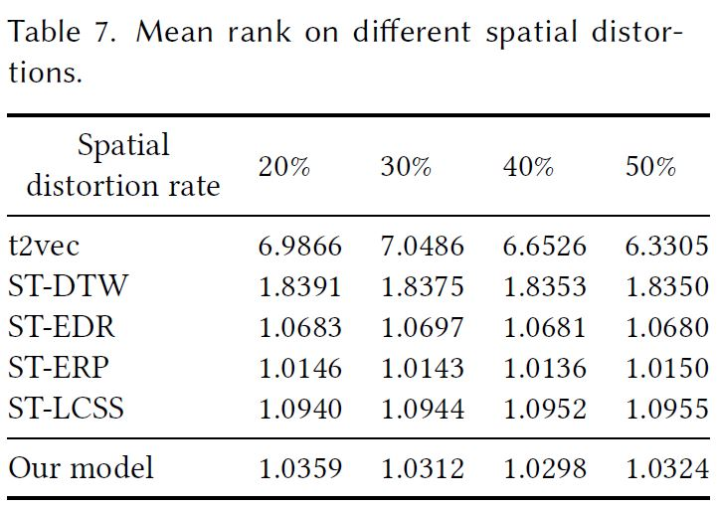
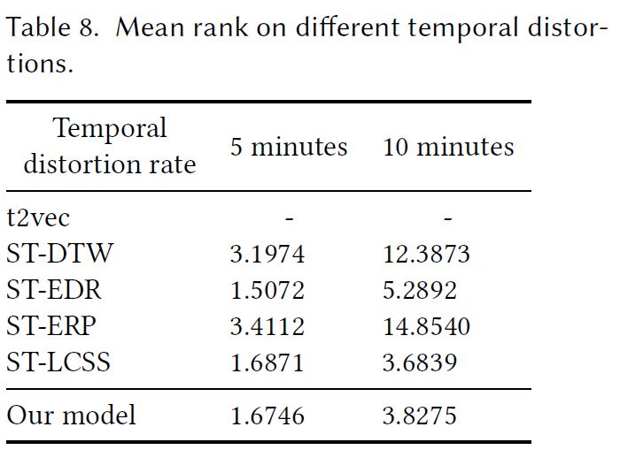
Experiments – Effectiveness

Slide 23
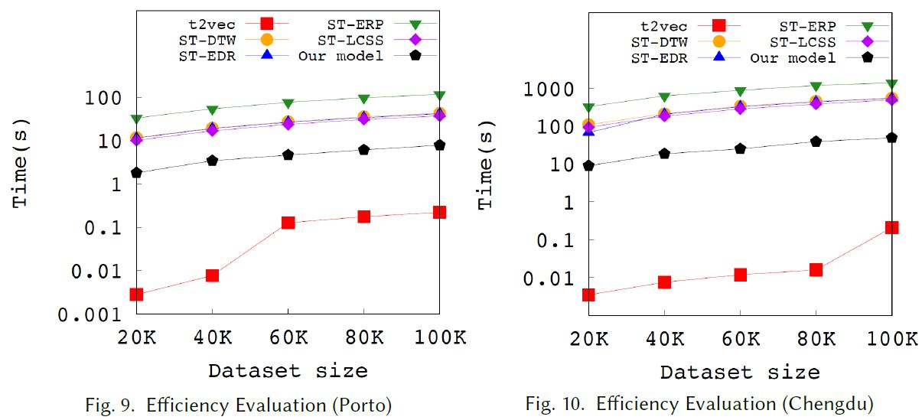
Experiments – Efficiency
Notes:
The main reason why t2vec is much more efficient than our model is that t2vec only deals with the spatial aspect of the data.

Slide 24
End of presentation

