Slide 1
Programming for Engineers in Python
Recitation 10
Fall 2021
Image Processing
Notes:
import matplotlib.pyplot as plt
import imageio
import numpy as py

Slide 2
Recap: Numpy
Creating a new array:
np.zeros((5, 3)) # only shape is specified
np.array([[0, 1, 2], [3, 4, 5]]) # a defined list of lists
np.arange(6) # like np.array(range(6))
np.random.random((4, 9)) # only shape is specified
np.random.random_integers(-3, 2, (5,5))

Slide 3
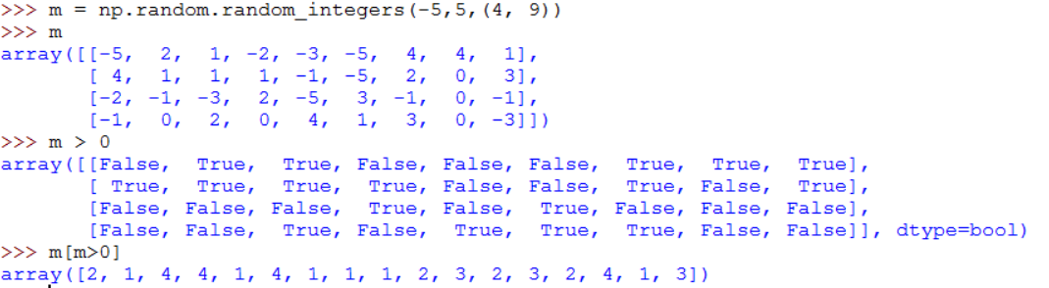
Recap: Numpy
Boolean masking

Slide 4
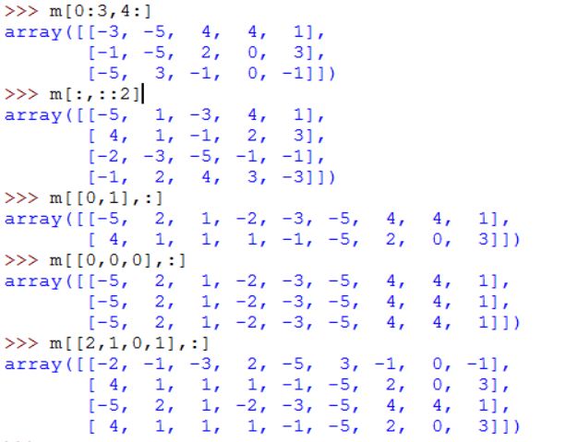
Recap: Numpy
Slicing
m
-5 | 2 | 1 | -2 | -3 | -5 | 4 | 4 | 1
4 | 1 | 1 | 1 | -1 | -5 | 2 | 0 | 3
-2 | -1 | -3 | 2 | -5 | 3 | -1 | 0 | -1
-1 | 0 | 2 | 0 | 4 | 1 | 3 | 0 | -3

Slide 5
Plan: Image Processing with numpy
Binary segmentation
Pixel>threshold -> white, else black
Image gradient
Difference between neighboring pixels
Image brightening
Making each pixel brighter
Morphological operators
Erosion – more black, less white
Dilation – more white, less black
Denoising
recovering a clean image from a noisy one
Ternary segmentation
Mapping the whole brightness range to a fixed number of values
Matrix operations!

Slide 6
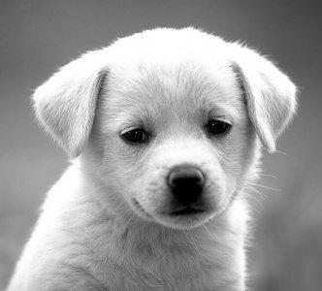
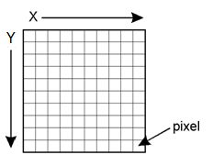
Grayscale Image
A table of values, aka pixels, each in the range of 0..255:
0 = Black
255 = White
144
145
149
155
161
171
189
205
216
225
232
231
228
227
225
222
224
223
221
Notes:
fixed

Slide 7
Image processing – basic functions
Reading an image from disk:
import imageio
im = imageio.imread('Koala.jpg')
Creating an “empty”(?) image matrix:
im = np.zeros((height,width), dtype=np.uint8)
Important: each pixel is in the range 0-255 (type np.uint8)
Numerical operations cause overflow, e.g.:
np.uint8(200) + np.uint8(100) = 44 = 300 mod 256
Therefore, before doing numerical operations on image pixels, convert the whole image or a specific pixel to int 32-bit using np.int_ :
a = np.uint8(200) ; b = np.uint8(100)
np.int_(a) + np.int_(b) = 300

Slide 8
Image processing – more functions
>>> a = np.array([[1,7,2],[6,9,3]])
>>> a
array([[1, 7, 2],
[6, 9, 3]])
Find the maximal / minimal value:
np.min(a) → 1
np.max(a) → 9
Find the average / median value:
np.mean(a) → 4.66
np.median(a) → 4.5

Slide 9
Image processing – more functions
>>> a = np.array([[1,2,3],[4,5,6]])
>>> b = np.array([[7,8,9],[1,1,1]])
>>> np.vstack((a,b))
>>> c = np.array([[50,50]])
>>> c = c.T
>>> np.hstack((a,c))
array([[1, 2, 3],
[4, 5, 6]])
array([[7, 8, 9],
[1, 1, 1]])
array([[1, 2, 3],
[4, 5, 6],
[7, 8, 9],
[1, 1, 1]])
array([[50, 50]])
array([[50],
[50]])
array([[ 1, 2, 3, 50],
[ 4, 5, 6, 50]])

Slide 10
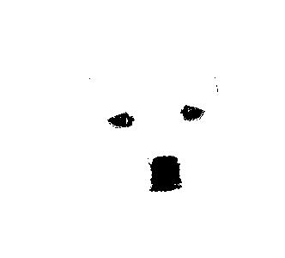
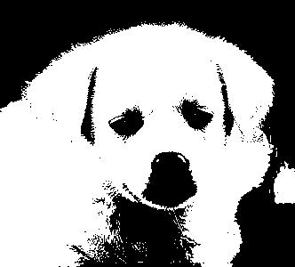
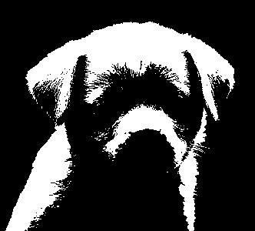
Binary Segmentation
Goal: grayscale image → black and white image
pixel > threshold → change to white (255)
pixel <= threshold → change to black (0)
Motivation: for example, save space
Threshold = 50
Threshold = 128
Threshold = 200
Notes:
fixed

Slide 11
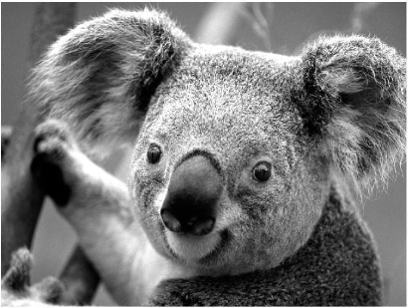
Binary Segmentation: Code
>>> import matplotlib.pyplot as plt
>>> import imageio
>>> im = imageio.imread('Koala.jpg')
>>> type(im)
<type 'numpy.ndarray'>
>>> im.shape, im.dtype
((195, 259), dtype('uint8'))
>>> np.min(im), np.max(im)
(0, 255)
>>> plt.figure() # opens a new figure window
>>> plt.imshow(im, cmap=plt.cm.gray)
>>> threshold = 128
#Later we’ll learn how to calculate this threshold
Notes:
fixed

Slide 12
Binary Segmentation: Code
153 | 212 | 219
142 | 126 | 92
137 | 128 | 75
threshold = 128
# find the pixels that are > threshold
over_threshold = im > threshold
# make them white (255)
binary_image = over_threshold * 255
T | T | T
T | F | F
T | F | F
binIdx
1 | 1 | 1
1 | 0 | 0
1 | 0 | 0
(This is the meaning: True is 1,
False is 0)
255 | 255 | 255
255 | 0 | 0
255 | 0 | 0
binIm

Slide 13
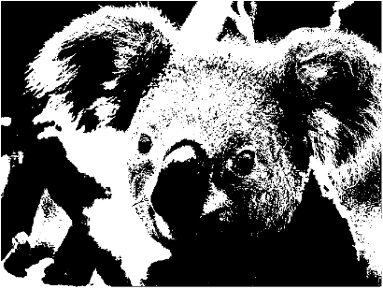
Binary Segmentation: Code
>>> import matplotlib.pyplot as plt
>>> import imageio
>>> im = imageio.imread('Koala.jpg')
>>> type(im)
<type 'numpy.ndarray'>
>>> im.shape, im.dtype
((598, 848), dtype('uint8'))
>>> np.min(im), np.max(im)
(0, 255)
>>> plt.figure() # opens a new figure window
>>> plt.imshow(im, cmap=plt.cm.gray)
>>> threshold = 128
>>> binary_image = (im > threshold) * 255
>>> plt.figure()
>>> plt.imshow(binary_image, cmap=plt.cm.gray)
>>> plt.show() # display figure windows
# TODO
More color scales can be found here
Notes:
import matplotlib.pyplot as plt
import imageio
Import numpy as py
im = imageio.imread('Koala.jpg')
plt.figure() #opens a new figure window
plt.imshow(im, cmap=plt.cm.gray)
binary_image = (im > 128) * 255
plt.figure()
plt.imshow(binary_image, cmap=plt.cm.gray)
plt.show()

Slide 14
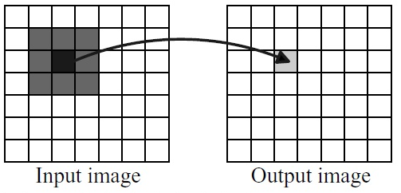
Morph by Neighbors
All the operators we’ll see have the same basic idea:
Change a pixel according to its neighborhood

Slide 15
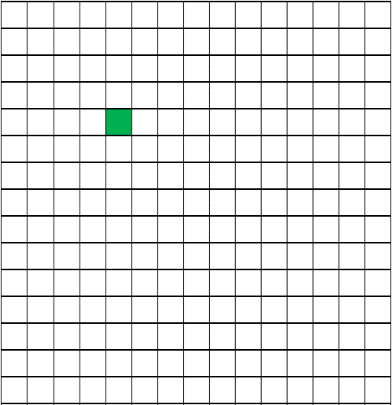
The neighborhood of a pixel
dx,dy=3
dx,dy=1
dx,dy=2

Slide 16
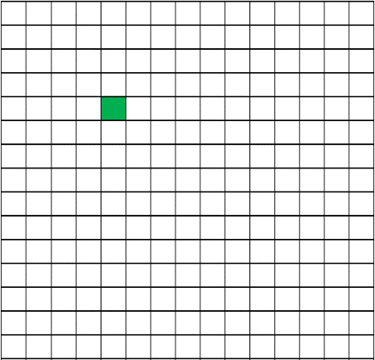
Get Neighborhood – Code
def get_neighborhood(im, x, y, dx=1, dy=1):
x_left = max(x-dx
x_right = max(x+dx+1
y_bottom = max(y-dy
y_top = max(y+dy+1
return im[y_bottom:y_top, x_left:x_right]
max(
, 0)
min(
, im.shape[1])
max(
, 0)
min(
, im.shape[0])
Default Neighborhood
Notes:
Run the code on Koala image

Slide 17


Morphological Operators
http://luispedro.org/software/pymorph
Morphology is a technique for the analysis and processing of geometrical structures
Erosion:
Take binary image ; produce more black, less white.
Edges of white areas (“foreground”) erode away.
So black areas (“background”) grow.

Slide 18
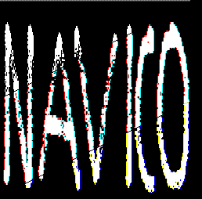
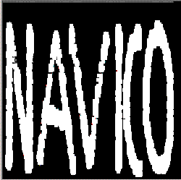
Morphological Operators
Dilation – inverse of erosion.
Boundaries of black areas erode away.
So white areas grow.
inverse of erosion.

Slide 19
Morph – Common Code
The specific morph. operator
#General framework:
def morph_by_neighborhood(im, operator, dx=5, dy=5):
new_im = np.zeros(im.shape)
for y in range(im.shape[0]):
for x in range(im.shape[1]):
neighborhood = get_neighborhood(im,x,y,dx,dy)
new_im[y, x] = operator(neighborhood)
return new_im
current pixel location
Size of neighborhood

Slide 20
Erosion and dilation using morph
def erosion(im, dx=5, dy=5):
return morph_by_neighborhood(im, np.min, dx, dy)
Black neighbor → change pixel to black
def dilation(im, dx=5, dy=5):
return morph_by_neighborhood(im, np.max, dx, dy)
White neighbor → change pixel to white

Slide 21
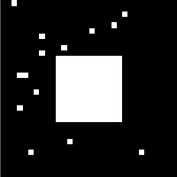


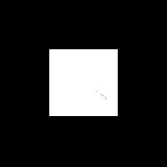
Morphological Operators - Run
erosion
dilation

Slide 22
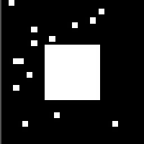
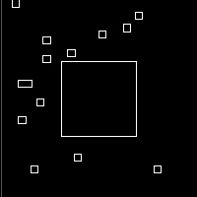
Detect Edges with Dilation
Idea:
Thicken white edges a bit, using dilation
Compute difference from original image
im2
im1
imDiff
im1 = imageio.imread('square1.bmp')
im2 = dilation(im1, 1, 1)
imDiff = im2 – im1
Notes:
Run the code on square

Slide 23
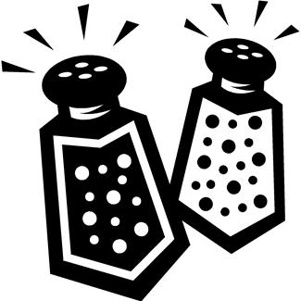
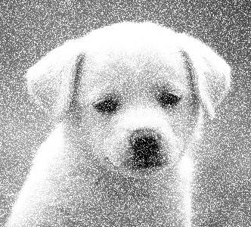
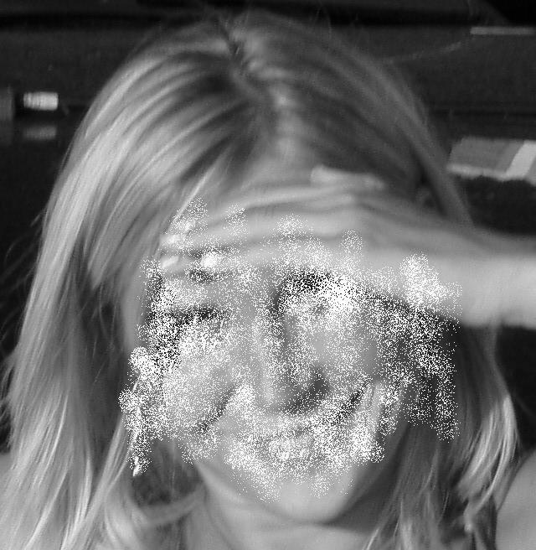
Denoising
We want to “clean” these pictures from noise
Suggestions?

Slide 24
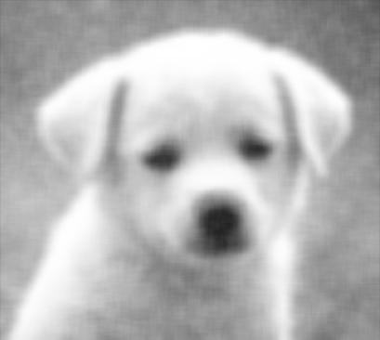
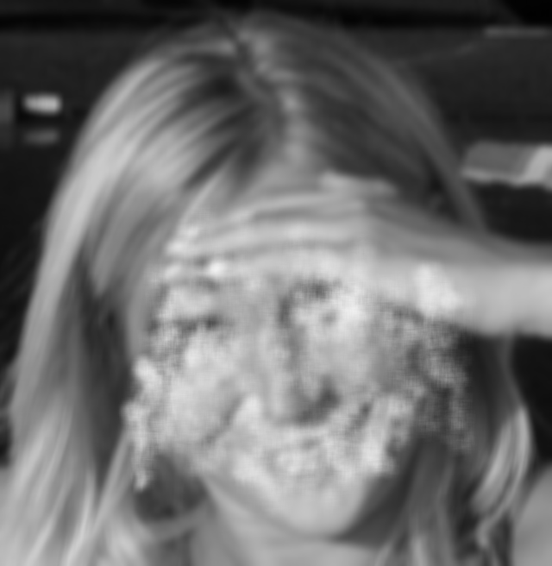
Denoising - Mean
Take 1: Smoothing
Use the morph_by_neighborhood framework with mean (average):
def denoise_mean(im, dx=5, dy=5):
return morph_by_neighborhood(im, np.mean, dx, dy)

Slide 25
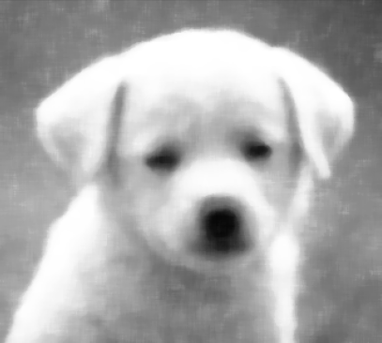
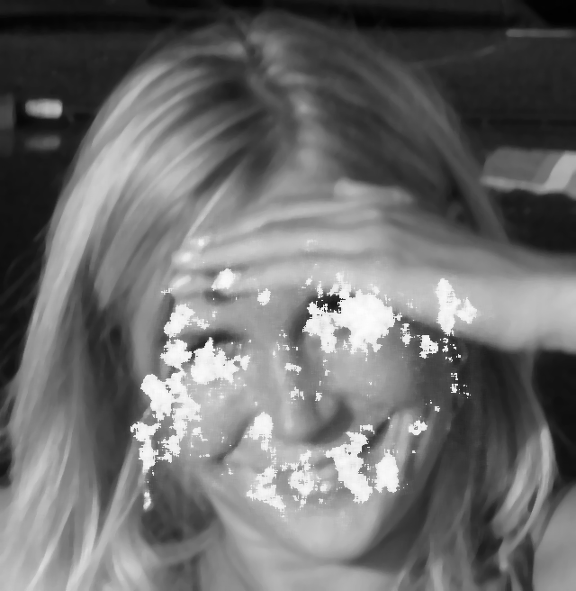
Denoising - Median
Take 2: Median
def denoise_median(im, dx=5, dy=5):
return morph_by_neighborhood(im, np.median, dx, dy)

Slide 26
Denoising - Median
Can we do better?
We did not exploit what we know about the ‘noise’
The ‘noise’ can only be
Almost white
Almost black
So change only very bright or very dark pixels!
What is very bright?
Pixel>W
What is very dark?
Pixel<B

Slide 27
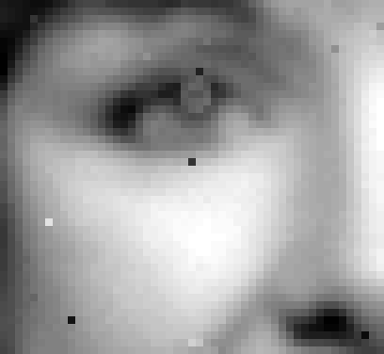
Denoising - operation
Pixels not too bright or too dark remain with no change.
Otherwise, examine the pixel’s neighborhood neighborhood.
too dark:
Get the median of neighborhood, but ignore ‘too dark’ pixels
too bright:
Get the median of neighborhood, but ignore ‘too bright’ pixels

Slide 28
Denoising – Bounded Median
def my_median(nbrs, min_val=0, max_val=255):
good_nbrs = nbrs[(nbrs > min_val) & (nbrs < max_val)]
if good_nbrs.size>0: #There are relevant neighbors
return np.median(good_nbrs)
#"else": i.e., no relevant neighbors
center = (nbrs.shape[0]//2, nbrs.shape[1]//2)
return nbrs[center]
def clear_noise(nbrs, min_val=0, max_val=255):
center = (nbrs.shape[0]//2, nbrs.shape[1]//2)
if not (min_val < nbrs[center] < max_val): #Abnormal pixel
return my_median(nbrs, min_val, max_val)
#"else": i.e., a good one, return it
return nbrs[center]

Slide 29
Denoising – Bounded Median
def denoise_bounded_median(im, dx=3, dy=3):
num_repeats = 3 for i in range(num_repeats): im = morph_by_neighborhood(im, clear_noise, dx, dy) return im

Slide 30
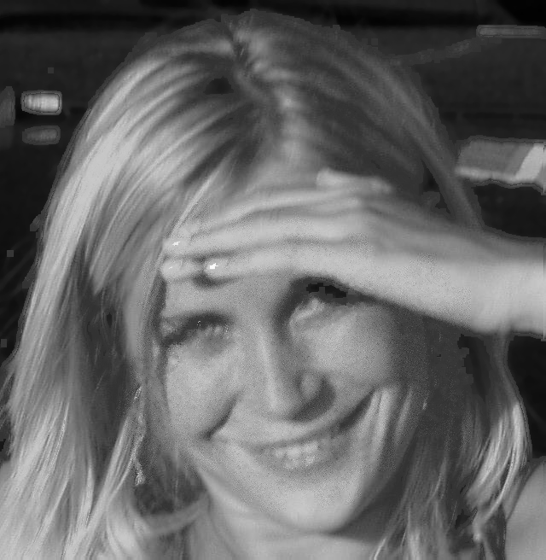


Denoising – Bounded Median
Original
Iteration number:
1
2
3

Slide 31
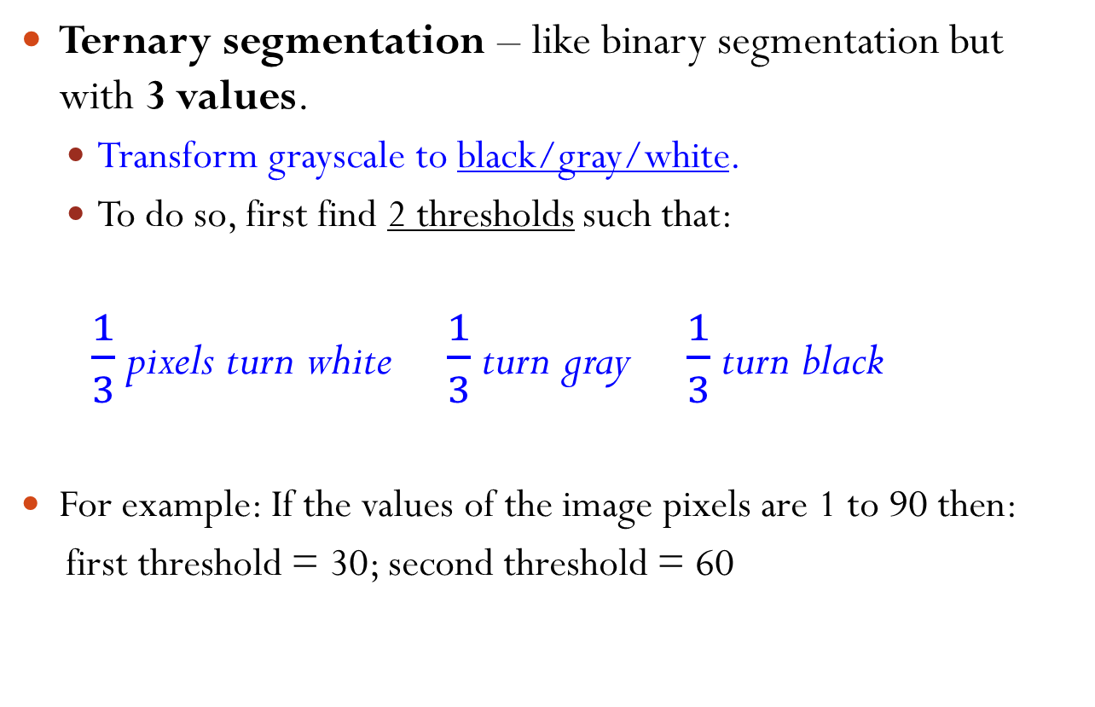
Ternary segmentation
Ternary segmentation – like binary segmentation but with 3 values.
Transform grayscale to black/gray/white.
To do so, first find 2 thresholds such that:
$\frac{1}{3}$ pixels turn white $\frac{1}{3}$ turn gray $\frac{1}{3}$ turn black
For example: If the values of the image pixels are 1 to 90 then:
first threshold = 30; second threshold = 60

Slide 32

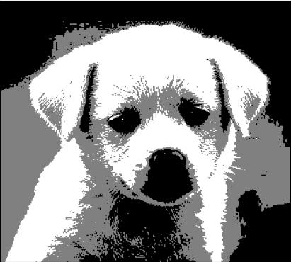
Ternary segmentation - Example
Before
After

Slide 33
Ternary segmentation
We will break the problem into smaller problems:
Find 2 thresholds from cumulative histogram.
Create a histogram.
Create a cumulative histogram.
Find the thresholds
Transform the image using the thresholds.
Step by step…
Modularize the solution

Slide 34
Ternary segmentation
Assume we have a find_thrds(im) function (we will implement it later, don’t worry).
Implement a ternary_segmentation function:
Input: a grayscale image
Output: a new image where every pixel has one of 3 gray levels:
0, 128 or 255
def ternary_segmentation(im):
th1, th2 = find_thrds(im)
newIm = np.tile(0, im.shape)
newIm[im > th1] = 128
newIm[im > th2] = 255
return newIm
input
output

Slide 35
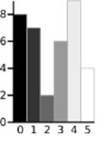
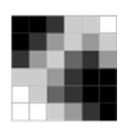
Image histogram
pic.png contains a 20x20 pixel image
Each pixel is a gray level in 0..255
Q1: Implement the function build_hist(im):
Input: grayscale image.
Output: histogram of gray levels in image.
So our histogram will be a list with 256 values:
Index = gray level
Value = number of pixels with that gray level
list with 256 values
gray level
number of pixels with that gray level

Slide 36
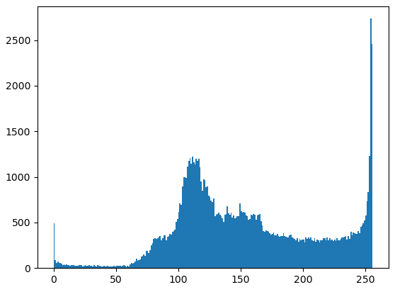
Image Histogram - Code
def build_hist(im):
hist = [0]*256
for x in range(im.shape[1]):
for y in range(im.shape[0]):
gray_level = im[y, x]
hist[gray_level] += 1
return hist
#Same as:
#return np.bincount(im.flatten())

Slide 37
Cumulative histogram
Q2: Implement the function cum_sum(nums):
Input: list of numbers
Output: list of the cumulative sums of nums
12 | 37 | 2 | 10
61 | 49 | 12 | 10

Slide 38
Cumulative sum – Code
def cum_sum(nums):
if not nums: return []
result = [nums[0]]
for i in range(1,len(nums)):
prev_sum = result[i-1]
result.append(prev_sum + nums[i])
return result
#Same as:
#return [sum(nums[:i+1]) for i in range(len(nums))]
#Or:
#return list(np.cumsum(nums))

Slide 39
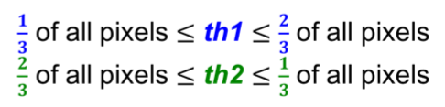
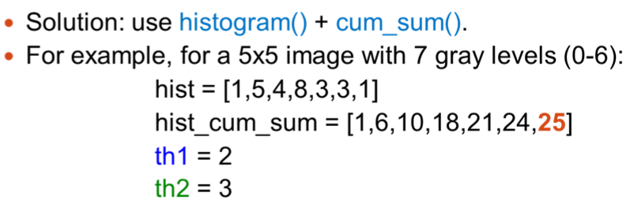
Finding the thresholds
Q3: Given an image, find two thresholds th1, th2 such that:

Slide 40
Finding the thresholds – Code
def find_thrds(im):
hist = build_hist(im)
cum_lst = cum_sum(hist)
i = 0
while cum_lst[i] / im.size < 1 / 3:
i += 1
th1 = i
while cum_lst[i] / im.size < 2 / 3:
i += 1
th2 = i
return th1, th2
#Or simply use:
#return np.percentile(im, 33), np.percentile(im, 66)
#TODO

Slide 41
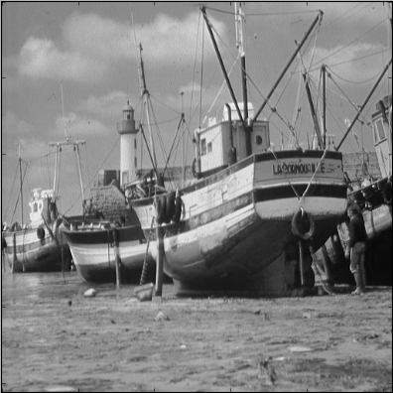
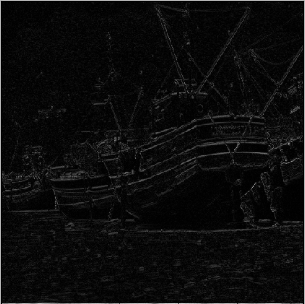
Image gradient
Given an image we may want to locate points of major change in intensity.
In the gradient image, every pixel is the difference between the corresponding pixel in the original image and a neighboring pixel.
We can compute the gradient w.r.t. each of the image dimensions.

Slide 43
Image vertical gradient: Code
How do we create the difference matrix? Ideas?
153 | 212 | 219
142 | 126 | 92
137 | 128 | 75
153 | 212 | 219
142 | 126 | 92
137 | 128 | 75
0 | 0 | 0
im
upShiftedIm
diff = |im - upShiftedIm |

Slide 44
Image vertical gradient: Code
The idea: shift up and subtract images
zeroRow = np.zeros((1,im.shape[1]), dtype=np.int_)
upShiftedIm = np.vstack((im[1:,:], zeroRow))
diff = np.int_(upShiftedIm) - np.int_(im)
abs_diff = np.abs(diff)
plt.figure()
plt.imshow(abs_diff, cmap=plt.cm.gray)
Can it also be computed using for loops?
np.int_(
)
np.int_(
)
array([[1, 2, 3],
[4, 5, 6],
[7, 8, 9]])
=>
array([[4, 5, 6],
[7, 8, 9],
[0, 0, 0]])

Slide 45
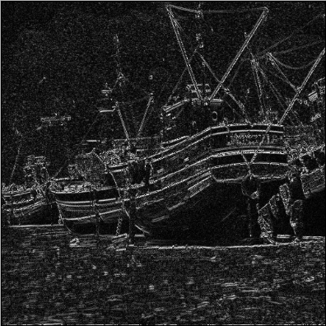
Brightening an image
We can hardly see the gradient image.
Solution: let’s brighten it.
brighten_abs_diff = abs_diff * 5
more_than_255 = brighten_abs_diff > 255
brighten_abs_diff[more_than_255] = 255
#Same as: brighten_abs_diff = np.minimum(abs_diff * 5, 255)

Slide 47
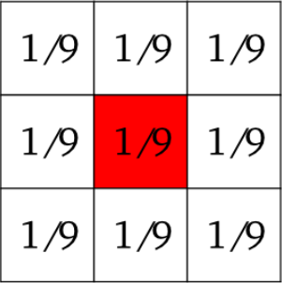
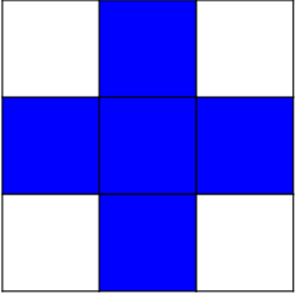
Image processing
Many more operations can be performed on images, in particular:
Geometric transformations: rotation, flipping, resizing, etc.
Filtering: replace a pixel by a function of the neighboring pixels
The neighborhood can be defined by a structuring element, e.g. square
A good survey with numpy/scipy examples can be found in:
http://scipy-lectures.github.io/advanced/image_processing/

