Slide 1
Programming for Engineers in Python
Recitation 12
Pandas

Slide 2
Why Pandas?
Calculate statistics and answer questions about the data, like
What's the average, median, max, or min of each column?
Clean the data by doing things like removing missing values and filtering rows or columns by some criteria
Visualize the data with help from Matplotlib. Plot bars, lines, histograms, bubbles, and more.
Store the cleaned, transformed data back into a CSV, other file or a database

Slide 3
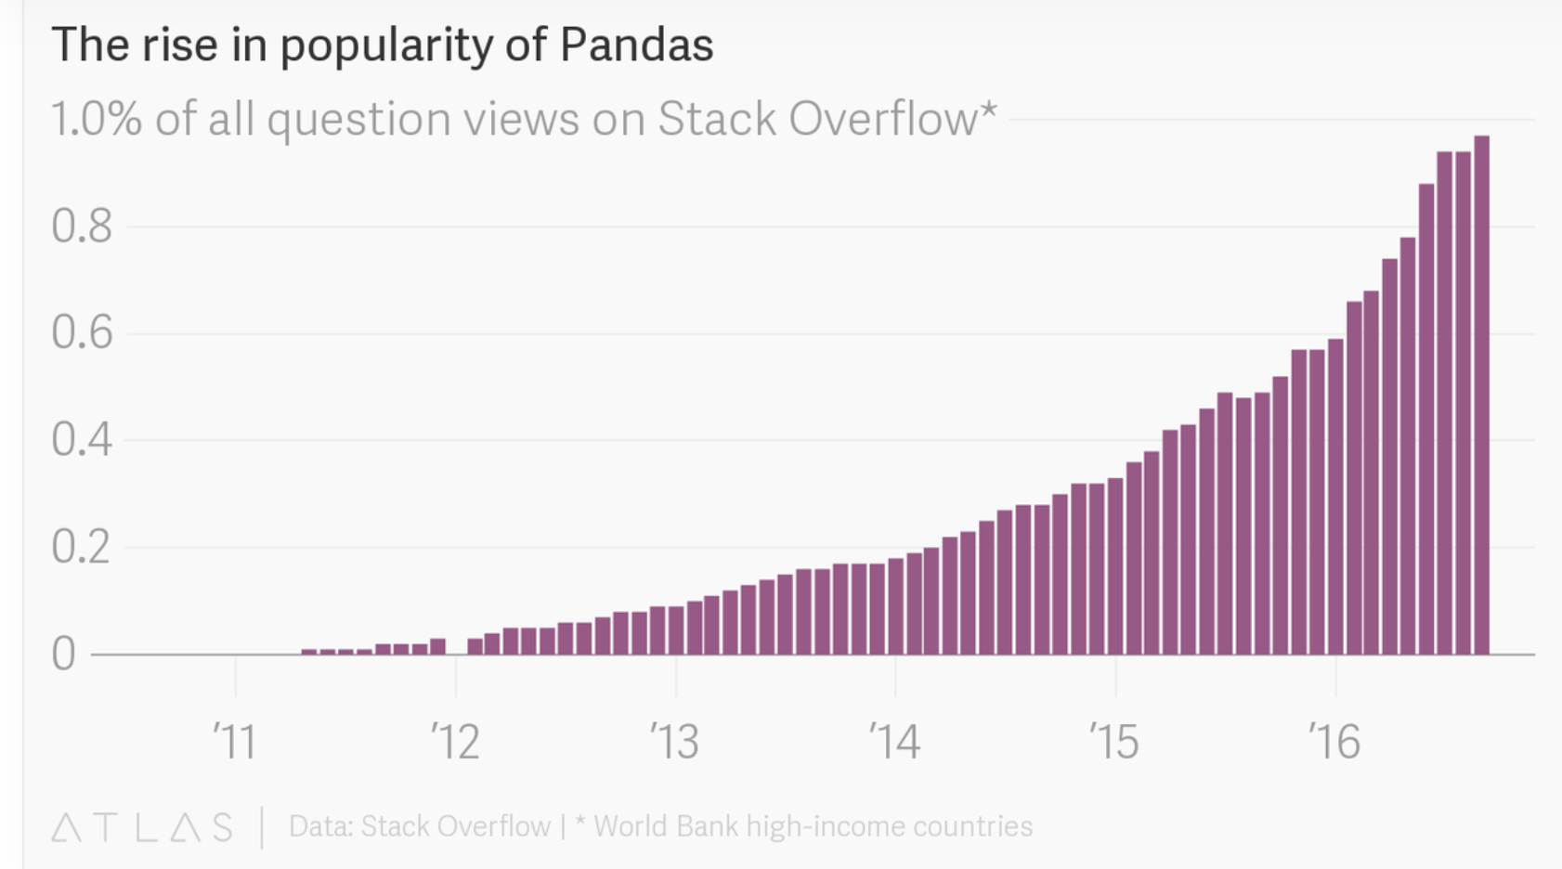

Slide 4
Pandas Dataframe
Dataframe is the primary pandas data structure.
A dataframe is a two-dimensional size-mutable, potentially heterogeneous tabular data structure with labeled axes (rows and columns).
What is the main difference from a numpy array?
Pandas enables arithmetic operations on both the rows and the columns of a dataframe.
It can be thought of as a dict-like container for Series objects.

Slide 5
Dataframe
Create a dataframe from a dictionary
d = {'col1': [1, 2], 'col2': [3, 4]} df = pd.DataFrame(data=d) print(df)
col1 col2
0 1 3
1 2 4
Headers
Indexes

Slide 6
Dataframe
Create a dataframe from a numpy array
df = pd.DataFrame(np.array([[1, 2, 3], [4, 5, 6], [7, 8, 9]]), columns=['a', 'b', 'c']) print(df)
a b c
0 1 2 3
1 4 5 6
2 7 8 9
Columns names

Slide 7
Basic operations
df = pd.DataFrame(np.array([[1, 2, 3], [4, 5, 6], [7, 8, 9]]), columns=['a', 'b', 'c'])
print(df.columns)
Index(['a', 'b', 'c'], dtype='object')
print(df["a"])
0 1
1 4
7
print(df["a"] - df["b"])
0 -1
1 -1
2 -1

Slide 8
Basic operations
df = pd.DataFrame(np.array([[1, 2, 3], [4, 5, 6], [7, 8, 9]]),
columns=['a', 'b', 'c'],index=[3, 4, 5]) print(df)
a b c
3 1 2 3
4 4 5 6
5 7 8 9
print(df.iloc[:2]) # slice the first two rows
a b c
3 1 2 3
4 4 5 6
print(df.loc[:3])# slice up to and including label 3
a b c
3 1 2 3

Slide 9
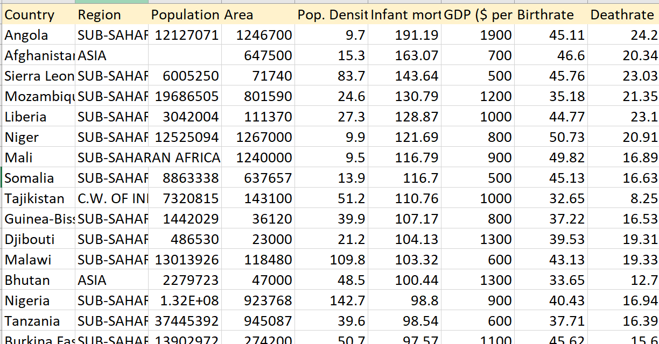
Example: Countries of the world dataset
Countries-of-the-world.csv

Slide 10
Analysis steps
Get basic information
Data cleaning – fill missing data
Basic data analysis
Data Visualization
Install pandas with anaconda on windows guide

Slide 11
Basic operations
Read the csv file into a dataframe
Write dataframe to csv
import pandas as pd df = pd.read_csv("countries-of-the-world.csv")
df.to_csv("countries-of-the-world.csv")

Slide 12
Basic operations
Print the top 3 rows using the head() function
Print the last 5 rows using the tail() function
Print random 5 rows using the sample() function
print(df.head(3))
print(df.tail(5))
print(df.sample(5))

Slide 13
Basic operations
Get statistics
print(df.info())
<class 'pandas.core.frame.DataFrame’>
RangeIndex: 224 entries, 0 to 223
Data columns (total 10 columns):
Unnamed: 0 224 non-null int64
Country 224 non-null object
Region 224 non-null object
Population 220 non-null float64
Area 224 non-null int64
Pop. Density 223 non-null float64
Infant mortality (per 1000 births) 224 non-null float64
GDP ($ per capita) 223 non-null float64
Birthrate 223 non-null float64
Deathrate 222 non-null float64
dtypes: float64(6), int64(2), object(2)
memory usage: 17.6+ KB
there are some nan values in the population column

Slide 14
Basic operations
print(df.dtypes)
Unnamed: 0 int64
Country object
Region object
Population float64
Area int64
Pop. Density float64
Infant mortality (per 1000 births) float64
GDP ($ per capita) float64
Birthrate float64
Deathrate float64
dtype: object float64

Slide 15
Data cleaning – fill missing values
Option 1: replace nan values with 0 (or any other constant value)
Option 2: replace nan values with the average of the column
Option 3: drop all rows that have any nan value
df = df.fillna(0)
df['Population'].fillna(df['Population'].mean(), inplace=True)
df = df.dropna()

Slide 16
Data cleaning: Convert Square Miles to Square Meters
Formula: 1 Square Mile =2.58 Square Kilometers
df['Area'] = df['Area'].apply(lambda x: x*2.58)
Apply this lambda function on every cell in the Area column

Slide 17
Add a new column
def get_growing_rate(row): return row["Birthrate"] - row["Deathrate"]
df["Growing Rate"] = df.apply(lambda row:
get_growing_rate(row), axis=1)
Shorter version:
df["Growing Rate"] = df.apply(get_growing_rate, axis=1)
Add a new column describing the Birthrate – Deathrate

Slide 18
Add a new row
Add a new country to the dataframe
israel = {"Country":"Israel", "Region":"ASIA","Population":.....} df = df.append(israel, ignore_index=True)

Slide 19
Delete a column
Delete the Infant mortality (per 1000 births) column
df = df.drop("Infant mortality (per 1000 births)",1)
Axes 1 for column.
Use df.drop([“A”, “B”], 1) to drop both the A and B columns

Slide 20
Delete a row
Delete the country Iran
Delete both the countries Iran and Iraq
We can use
df["Country"]
instead of
df.Country
df = df[df.Country != "Iran"]
countries = ["Iran ","Iraq"] df = df[~df.Country.isin(countries)]
~ is for not. What will happen if we remove the ~ ?

Slide 21
Join Tables
Given a new table with the same column names, merge the two tables into a single table
df1 = pd.read_csv("countries-of-the-world.csv") df2 = pd.read_csv("countries-of-the-world2.csv") frames = [df1, df2] result = pd.concat(frames)

Slide 22
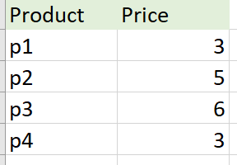
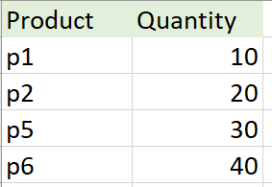
Join Tables
Inner join – consider only the intersection of the tables
How many rows are in the intersection?
Outer join – consider the union of the table, fill with Nan missing values.
How many rows are in the union?
ex1.csv
ex2.csv

Slide 23
Inner vs Outer Join
df1 = pd.read_csv("ex1.csv") df2 = pd.read_csv("ex2.csv") inner = pd.merge(df1, df2, on='Product', how = 'inner') print(inner)
Product Price Quantity
0 p1 3.0 10.0
1 p2 5.0 20.0
outer = pd.merge(df1, df2, on='Product', how = 'outer') print(outer)
Product Price Quantity
0 p1 3.0 10.0
1 p2 5.0 20.0
2 p3 6.0 NaN
3 p4 3.0 NaN
4 p5 NaN 30.0
5 p6 NaN 40.0

Slide 24
Basic data analysis
Which country has the largest population?
Find the label of the row with the maximum value in the population column (idxmax())
Get the country name of the row with the obtained label (loc)
label_max_pop = df["Population"].idxmax() print(df.loc[label_max_pop]["Country"])
China

Slide 25
Basic data analysis
How many countries have more than 1M people?
Select all rows with Population > 1,000,000
Count the number of selected rows (use len() to get the num of rows)
print(len(df.loc[df['Population'] > 1000000]))
156
Also possible:
print(len(df[df['Population'] > 1000000]))
print((df['Population'] > 1000000]).sum())

Slide 26
Basic data analysis
How many countries in Asia have more than 1M peoples?
Select all countries from Asia, with Population > 1,000,000
Count the number of selected rows (use len() to get the num of rows)
df = df[(df['Population'] > 1000000) & (df['Region'] == "ASIA")] print(len(df))
25

Slide 27
Data analysis
Get all countries in Asia which their Deathrate is > 10
df = df[(df['Region'] == "ASIA") & (df['Deathrate'] > 10)]
print(len(df))
3

Slide 28
Data analysis
Sort the countries according to the population size
break ties according to area size
df = df.sort_values(['Population'], ascending=True)
df = df.sort_values(['Population', 'Area'], ascending=True)

Slide 29
Data analysis
What is the average population in each region?
Groupby region
Get the mean of the population column in every group
print(df.groupby(['Region'])['Population'].mean())
Region
ASIA 1.354417e+08
BALTICS 2.394991e+06
C.W. OF IND. STATES 2.334013e+07
EASTERN EUROPE 9.992893e+06
LATIN AMER. & CARIB 1.305887e+07
NEAR EAST 1.219177e+07
NORTHERN AFRICA 3.222682e+07
NORTHERN AMERICA 6.633446e+07
OCEANIA 1.741803e+06
SUB-SAHARAN AFRICA 1.475440e+07
WESTERN EUROPE 1.415500e+07
Name: Population, dtype: float64

Slide 30
Data analysis
Which country in each region has the largest population?
Grouby region
Get the country with the maximum population in every group
regions = df.groupby(["Region"]) for name, group in regions: label_max = group["Population"].idxmax() print(name, df.loc[label_max]["Country"])
ASIA China
BALTICS Lithuania
C.W. OF IND. STATES Russia
EASTERN EUROPE Poland
LATIN AMER. & CARIB Brazil
NEAR EAST Turkey
NORTHERN AFRICA Egypt
NORTHERN AMERICA United States
OCEANIA Australia
SUB-SAHARAN AFRICA Nigeria
WESTERN EUROPE Germany
Notes:
regions = df.groupby(["Region"])
for name, group in regions:
id_max = group["Population"].idxmax()
print(name, df.loc[id_max]["Country"])
df.loc[df.groupby(["Region"])['Population'].idxmax()]

Slide 31
Data analysis
Print the highest mean Deathrate among all regions
Compute the mean deathrate per region
Get the maximum value
regions = df.groupby(['Region']) print(regions['Deathrate'].mean().max())
15.160000000000002

Slide 32
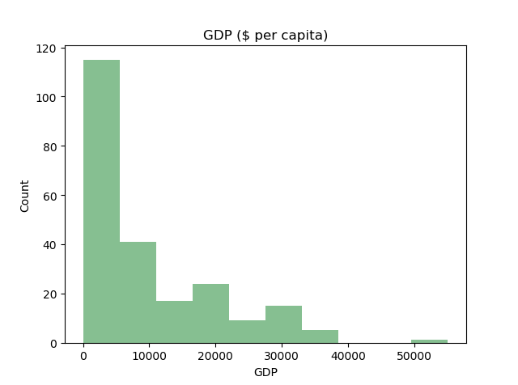
Data visualization
Plot an histogram of the GDP column
import matplotlib.pyplot as plt
axarr = df.hist(column='GDP ($ per capita)',bins=10, grid=False, color='#86bf91') for ax in axarr.flatten(): ax.set_xlabel("GDP") ax.set_ylabel("Count") plt.show()
Notes:
import matplotlib.pyplot as plt
axarr = df.hist(column='GDP ($ per capita)',bins=10, grid=False, color='#86bf91')
for ax in axarr.flatten():
ax.set_xlabel("GDP")
ax.set_ylabel("Count")
plt.show()

Slide 33
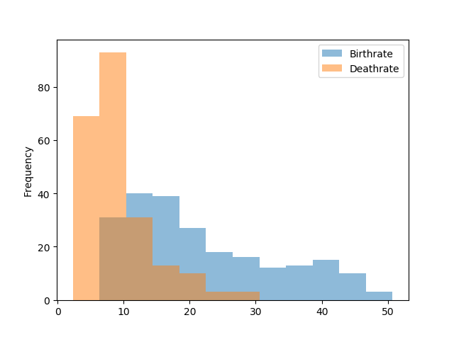
Data visualization
Plot an histogram of the Birthrate and the Deathrate columns
df = df[["Birthrate", "Deathrate"]] ax = df.plot.hist(bins=12, alpha=0.5) plt.show()
For transparent colors

Slide 34
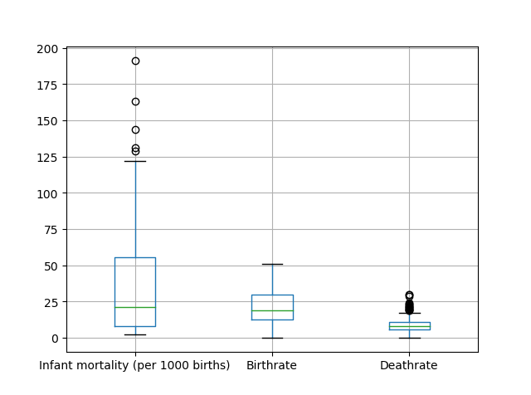
Data visualization
Create a boxplot of the Infant mortality, Birthrate and Deathrate columns
columns = ['Infant mortality (per 1000 births)', 'Birthrate','Deathrate'] boxplot = df.boxplot(column=columns) plt.show()

Slide 35
Pandas Summary
We saw how to:
Create a dataframe (from a file, dict, numpy array)
basic information (head(), tail(), dtypes, info())
Clean the data (add/remove columns/rows, fillna())
Merge tables (concat, merge)
Analyze the dataset (select rows based on a condition, groupby(), mean(), idxmax(), etc.)
Visualize the data (hist(), boxplot())
For more info visit the pandas documentation website.

