Slide 1
Programming for Engineers in Python
Fall 2020
Recitation 2: Lists and Loops

Slide 2
Plan
Strings
Lists
For loop
While loop
Break/Continue

Slide 3
Reminder: String Slicing
Think of string indexes as pointers to characters.
>>> a = 'Hello'
>>> a[1:3]
'el'
>>> a[1:]
'ello'
>>> a[1:5:2]
'el'
>>> a[-4:-2]
'el'
>>> a[-2:-4:-1]
'll'
>>> a[:-3]
'He'
>>> a[-3:]
'llo'
>>> 'hello'[1:5:2]
'el'
o | l | l | e | H
0
1
2
3
4
-5
-4
-3
-2
-1

Slide 4
Strings
>>> s = "While My Guitar Gently Weeps"
# Lowercase representation of a string
>>> s.lower()
# find the index of the first occurrence of ‘e’
>>> s.find("e")
# What does first contain?
>>> n_pos = s.find("e") + 1
>>> first = s[:n_pos]
>>> first
We can use the built in function str to convert any value of built-in types into a string
>>> str(1)
'1'
'while my guitar gently weeps'
4
'While'

Slide 5
Lists
A list is an ordered collection of elements (of any type).
To create a list with specific elements, enclose them in square brackets:
>>> my_list = [2,3,5,7,11]
>>> print(my_list)
[2, 3, 5, 7, 11]
>>> empty_list = []
>>> mixed_types = [2, "hi",3.4]
To initialize a list of n elements set to zero do:
>>> a = [0] * n # what about +?
(you may replace 0, with any other number)
int
str
float
Notes:
Highlights
ordered & not a set (elements may be repeated)

Slide 6
Indexing
Indexing and Slicing works the same as for Strings.
>>> my_list = ["George", "Paul", "John", "Ringo"]
>>> my_list[0]
>>> my_list[2]
>>> my_list[4]
0 1 2 3
"George"
"John"
Traceback (most recent call last):
File "<pyshell#7>", line 1, in <module>
my list[4]
IndexError: list index out of range

Slide 7
Slicing
0 1 2 3 4 5 6 7 8 9
>>> my_list = ['a','b','c','d','e','f','g','h','i','j']
>>> my_list[1:5] # Slicing
['b', 'c', 'd', 'e']
# Slicing does NOT change original list
>>> my_list
['a', 'b', 'c', 'd', 'e', 'f', 'g', 'h', 'i', 'j']
# Slicing an arithmetic progression
>>> my_list[0:9:2]
['a', 'c', 'e', 'g', 'i']
start stop step
Notes:
Challenge: what will my_list[0:9:-2] be?

Slide 8
Adding Elements
>>> my_list = [6, 2]
# Insert at position
>>> my_list.insert(0, 'begin')
>>> my_list.insert(1, 'here')
>>> my_list
# Append (insertion at end)
>>> my_list.append('at last')
>>> my_list
['begin', 'here', 6, 2]
['begin', 'here', 6, 2 , 'at last']

Slide 9
Adding Elements – cont’
my_list = ['begin', 'here', 6, 2 , 'at last' ]
# Extend (concatenate another list to the end)
>>> my_list.extend([15, 16])
>>> my_list
What would happen if we used append instead of extend?
>>> my_list.append([15, 16])
>>> my_list
['begin', 'here', 6, 2, 'at last', 15, 16, [15, 16]]
['begin', 'here', 6, 2, 'at last', 15, 16]

Slide 10
Changing Elements
>>> my_list = ["aa", "bb", 1, 2]
# Change an element inside a list
>>> my_list[0] = my_list[1] + "b"
>>> my_list[2] = my_list[2] + 5
>>> my_list
# Replace elements
>>> my_list[0:2] = [1, 12]
>>> my_list
['bbb', 'bb', 6, 2]
[1, 12, 6, 2]

Slide 11
Removing Elements
>>> my_list = [2, 3, "in", 4]
# Remove by value (first occurrence only)
>>> my_list.remove("in")
>>> my_list
# Remove by position (slice)
>>> my_list[0:2] = []
>>> my_list
[4]
What if we try my_list.remove(1) ?
[2, 3, 4]
Notes:
Last line will fail b/c element not in list

Slide 12
In
Use in to check for the existence of an element inside a collection:
>>> my_list = [2, 3, "in", 4]
# Element exists
>>> 2 in my_list
>>> "in" in my_list
# Element does not exist
>>> 5 in my_list
True
True
False
Notes:
Last line will fail b/c element not in list

Slide 13
Length
Use len to get the number of elements in a collection:
>>> len([1,2,3,4,5])
>>> len([])
>>> len("abc")
5
0
3

Slide 14
Range
range(a, b) creates an iterator with ordered integers.
All k values satisfying a ≤ k < b
# Examples:
>>> list(range(6,10))
[6, 7, 8, 9]
>>> list(range(5)) # same as range(0,5)
[0, 1, 2, 3, 4]
>>> list(range(4,2))
[]
>>> type(range(3))
<class 'range’>
range(a, b, d) - all integers from a (including) to b (not including) taking a “step” of d in between
>>> list(range(10, 0, -2))
[10, 8, 6, 4, 2]

Slide 15

Range – Cont.
How can we create an Arithmetic progression of n elements:
$$a_{i}=a_{0}+d∗i$$
# Examples:
>>> a_0 = 4
>>> d = 2
>>> n = 6
>>> list(range(a_0, a_0 + d * n, d))
[4, 6, 8, 10, 12, 14]
What if we try n=0? n=1? n=10?

Slide 16
Other useful functions
Reversing list:
>>> l = list(range(10))
>>> l.reverse() #What’s the difference from l[::-1]?
>>> print(l)
Sorting list:
>>> l = list(range(10, 0,-1))
>>> l.sort() #What’s the difference from sorted(l)?
>>> print(l)
For other useful functions: list - useful functions
[9, 8, 7, 6, 5, 4, 3, 2, 1, 0]
[1, 2, 3, 4, 5, 6, 7, 8, 9, 10]
Notes:
Reverse() and sort() are in place functions (modify the list itself instead of creating a new list)

Slide 17
For Loop
Say we want to print each element of our list:
lst = [3, 1.24, "gorilla"]
print (lst[0])
print (lst[1])
print (lst[2])
print (lst[3])
This is very repetitive and relies on us knowing the number of elements in the list.
Error
Notes:
Iterable needs to be list-like – has collection of values and fixed length
Statements can be commands/expressions/assignments or control flow (if/else, for loops, while)

Slide 18
For Loop
for element in iterable:
statement1
statement2
lst=[3, 1.24, "gorilla"]
for elem in lst:
print(elem)
Indentation determines the
scope of the iteration.
Run in editor!
Notes:
Iterable needs to be list-like – has collection of values and fixed length
Statements can be commands/expressions/assignments or control flow (if/else, for loops, while)

Slide 19
For Loops
lst = [3, 1.24, "gorilla"]
for elem in lst:
elem =
print(elem)
3
3

Slide 20
For Loops
lst = [3, 1.24, "gorilla"]
for elem in lst:
elem =
print(elem)
3
1.24
1.24

Slide 21
For Loops
lst = [3, 1.24, "gorilla"]
for elem in lst:
elem =
print(elem)
3
1.24
gorilla
"gorilla"

Slide 22
For Loops
We can also loop over a string:
for letter in 'ACGT':
print(letter)
print('Done!')
A
C
G
T
Done!
Notes:
https://stackoverflow.com/questions/1952464/in-python-how-do-i-determine-if-an-object-is-iterable

Slide 23
For Loops
Let's go over a string and count the number of occurrences of the letter P:
seq = 'MALWMRLLPLLALLALWGPDPA'
count = 0
for letter in seq:
if letter == 'P':
count += 1 # count = count + 1
same as: seq.count('P')

Slide 24


For Loops with range
Example: print the even numbers between 0-20 (each in a new line)
l = range(0,21,2)
for num in _____________:
print(_________)
0
2
4
…
20
range(0,21,2)
l
num
Notes:
String center() method: takes width, padding arguments
Centers string in are of size width, uses padding character (default is space) to fill in blanks to that width
padding added to left first, handles case where odd number of padding characters to be used

Slide 25
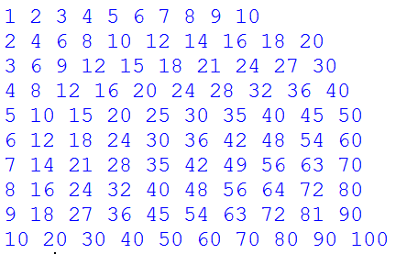
For Loops with range
Example: display the multiplication chart (לוח הכפל)
for i in ____________:
for j in ____________:
print(___________)
print("")
'end=“”' is used to accumulate output in the same line
range(1, 11)
range(1, 11)
,end=""
i*j
forces the output to be in separate lines
Notes:
String center() method: takes width, padding arguments
Centers string in are of size width, uses padding character (default is space) to fill in blanks to that width
padding added to left first, handles case where odd number of padding characters to be used

Slide 26
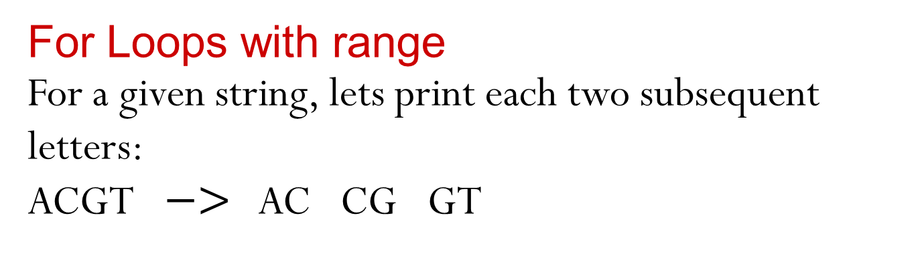
For Loops with range
For a given string, lets print each two subsequent letters:
ACGT $−>$ AC CG GT
seq = 'ATGATTCCAACGCGA'
for letter in seq:
print(letter…. )
and the next letter(?!)

Slide 27
For Loops with range
For a given string, lets print each two subsequent letters:
ACGT $−>$ AC CG GT
seq = 'ATGATTCCAACGCGA'
n = len(seq)
for i in range(n):
print(seq[i])
012345 10 14
But we want to print
subsequent letters

Slide 28
For Loops with range
For a given string, lets print each two subsequent letters:
ACGT $−>$ AC CG GT
seq = 'ATGATTCCAACGCGA'
n = len(seq)
for i in range(n):
print(seq[i]+seq[i+1])
012345 10 14
What will happen when i==14?
IndexError!

Slide 29
For Loops with range
For a given string, lets print each two subsequent letters:
ACGT $−>$ AC CG GT
seq = 'ATGATTCCAACGCGA'
n = len(seq)
for i in range(n-1):
print(seq[i]+seq[i+1])
012345 10 14

Slide 30
For Loops with / without range
lst = [3, 1.24, "gorilla"]
for elem in lst:
print(elem)
Same result in this case!
But sometimes we must use the indices (previous slide for example)
Use wisely, and according to need
for i in range(len(lst)):
print(lst[i])

Slide 31
Enumerate
For a given list, lets print all index-element pairs
lst = [3, 1.24, "gorilla"]
Desired result:
0: 3
1: 1.24
2: 'gorilla'
for i in range(len(lst)): for i, elem in enumerate(lst):
print(i, ":", lst[i]) print(i, ":", elem)

Slide 32
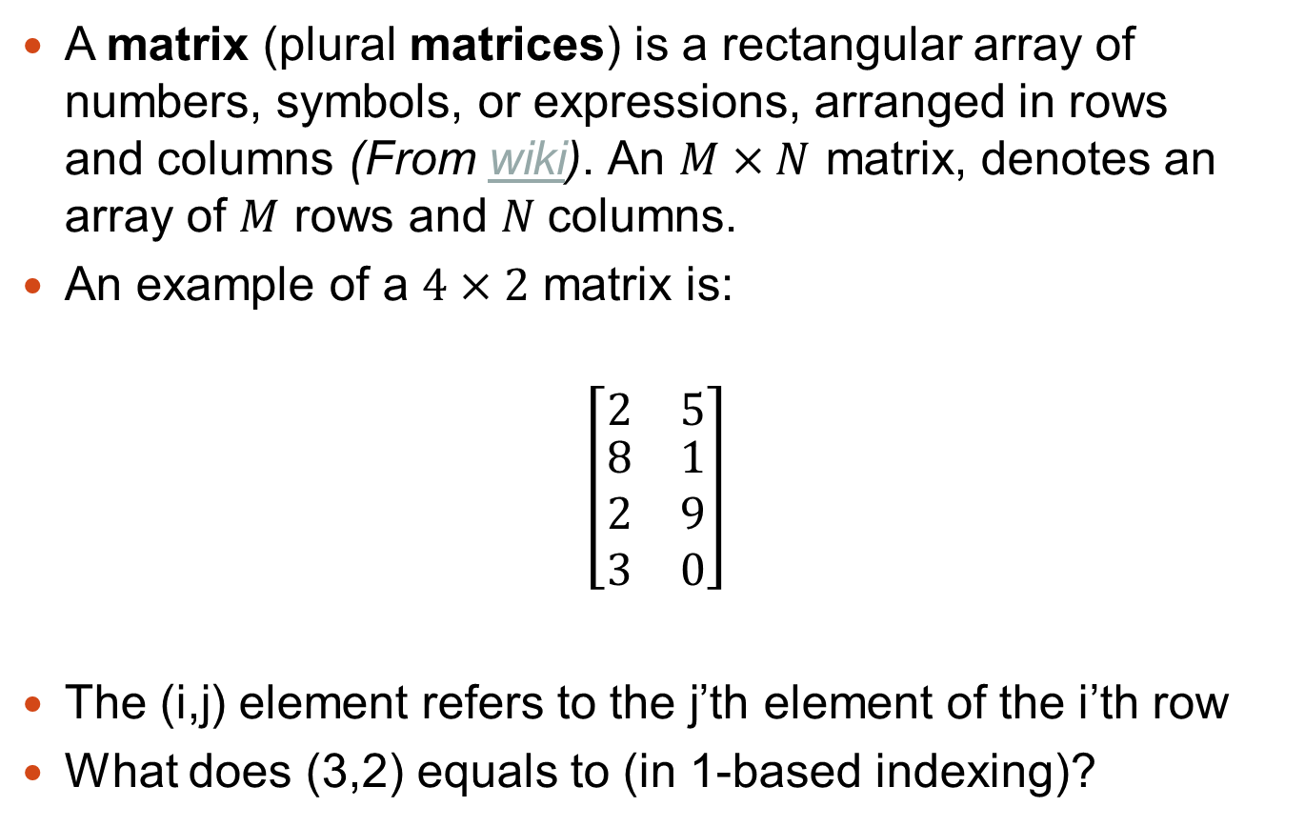
Matrix representation using lists
A matrix (plural matrices) is a rectangular array of numbers, symbols, or expressions, arranged in rows and columns (From wiki). An $M×N$ matrix, denotes an array of $M$ rows and $N$columns.
An example of a $4×2$ matrix is:
$$\left[\begin{matrix}2 & 5 \\ \begin{aligned}8 \\ 2 \\ 3\end{aligned} & \begin{aligned}1 \\ 9 \\ 0\end{aligned}\end{matrix}\right]$$
The (i,j) element refers to the j’th element of the i’th row
What does (3,2) equals to (in 1-based indexing)?
9
Notes:
Note about 0-based indexing vs 1-based indexing

Slide 33
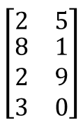
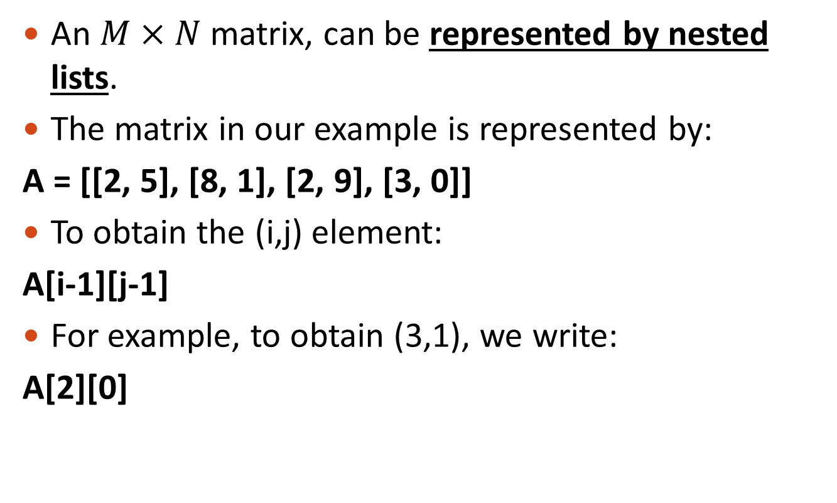
Matrix representation using lists
An $M×N$ matrix, can be represented by nested lists.
The matrix in our example is represented by:
A = [[2, 5], [8, 1], [2, 9], [3, 0]]
To obtain the (i,j) element:
A[i-1][j-1]
For example, to obtain (3,1), we write:
A[2][0]

Slide 34
Matrix representation using lists
We are given a matrix of integers, we would like to collect all even numbers into a new list.
Any ideas?
Initialize a variable, to hold the new list (initialize with what value?)
Go over each element in the matrix:
If the current element is even, update the new list
print the list

Slide 35
Matrix representation using lists
A = [[2, 4], [3, 5], [4, 1], [3, 2]]
new_list = ______________
num_rows = len(______________)
num_columns = len(______________)
for i in range(num_rows):
for j in range(num_columns):
if ____________________:
__________________________
print("The even numbers are:", new_list)
[]
A
A[0]
A[i][j] % 2 == 0
new_list.append(A[i][j])
Assumptions:
A contains at least a single row (otherwise?)
All rows A[0], A[1],…, are lists of the same length
Notes:
assumptions? (1) – its worth noting that by calling len(A[0]) we assume that:
A contains at least a single row (what would happen otherwise?)
That its first element is a list
That all rows A[0]A[1],…,A[N] are of the same length
Basically we assume that we get a valid matrix, in reality, we would often want to validate this first.
assumptions? (2)
All numbers are positive! Can you detect a possible problem with a matrix containing negative numbers as well?

Slide 36
While Loop
expr
while expression:
statement1
statement2
…
rest of code
Example:
count = 0
while count < 3:
print("The count is:", count)
count += 1 # count = count + 1
print("Goodbye!")
false
true
statement(s)
The count is: 0
The count is: 1
The count is: 2
Goodbye!

Slide 37
Break
break - terminates the nearest enclosing loop
# Write a code which prints True if all digits in a given number are smaller or equal to 5
n = 129231330
print("Number:", n)
while n > 0:
cur_dig = n % 10
if _______________:
________________
________________
____________
if _______________:
____________
cur_dig > 5
print(False)
break
n //= 10
n == 0
print(True)
Notes:
n=162
while n > 0:
cur_dig = n % 10
if cur_dig > 5:
print(False)
break
n //= 10
if n==0:
print(True)

Slide 38
Continue
continue - starts the next cycle of the nearest enclosing loop
# Example: counting spaces
in_string = "Ground control to Major Tom"
spaces = 0
for c in in_string:
if c != " ":
continue
spaces += 1
print("Number of spaces:", spaces)

Slide 39
While Loop – Example 1
Player 1
secret = int(input("Choose a number: "))
while True:
guess = int(input("Enter guess: "))
if _______________:
break
elif ______________:
print("Try a higher number")
else:
print("Try a lower number")
print("Right!")
guess == secret
Hint (sample output)
Choose a number: 34
Enter guess: 100
Try a lower number
Enter guess: 50
Try a lower number
Enter guess: 25
Try a higher number
Enter guess: 35
Try a lower number
Enter guess: 34
Right!
guess < secret
Player 2
Notes:
secret = int(input("Choose a number: "))
while True:
guess = int(input("Enter guess: "))
if guess==secret:
break
elif guess < secret:
print("Try a higher number")
else:
print("Try a lower number")
print("Right!")

Slide 40
Phone Book
We want to develop an application for managing contacts
It will contain a database
A list of contacts
Each contact is a list in the format [name, phone]
Functionality
Find contact(s) by full name or prefix
Add contact
Remove contact

Slide 41
Phone book
phone_book = [['nir','7886'],
['cohen','0123456758']]
# Retrieve the number for a given person
name = "Moshe"
found = False phone = "" for contact in phone_book: if contact[0] == name: found = True phone = contact[1] break if found: print "Name:", name , "Phone:", phone else: print "Cannot find", name , "in contact list."
Hint (sample output)
For name == "nir" the result will be:
Name: nir Phone: 7886
For name == "assaf" the result will be
Cannot find assaf in contact list.

Slide 42
Phone book
phone_book = [['nir','7886'],
['cohen','0123456758']]
# Retrieve the number for a given person
name = "Moshe"
found = False
phone = ""
for contact in phone_book:
if contact[0] == name:
found = True
phone = contact[1]
break
if found:
print("Name:", name , "Phone:", phone)
else:
print("Cannot find", name , "in contact list.")

Slide 43
Phone book
# Add a contact
name = "Dan"
num = 1454
phone_book.append([name, num])

Slide 44
Phone book
# Remove a contact
name = "Moshe"
found = False
for contact in ___________:
if __________________:
__________________________
____________
break
if not found:
print("Cannot find contact")
phone_book
contact[0] == name
phone_book.remove(contact)
found = True

Slide 45
Phone book
# Remove a contact using a for-else construct
name = "Moshe"
for contact in ___________:
if __________________: # Found it!
__________________________
break
else: # Didn't find anything..
print("Cannot find contact")
phone_book
contact[0] == name
phone_book.remove(contact)

Slide 46
Phone book
# Search for all contacts with given prefix.
# Ignore character case (aka, case insensitive).
prefix = "ni"
prefix = prefix.lower()
for contact in phone_book:
if contact[0].lower().startswith(prefix):
print("Name:", contact[0], "Phone:", contact[1])
Note that we don’t break
(otherwise we will only find the first contact)

Slide 47
One more break
# Example: find the hidden number in a string
# (a hidden number is a number which begins at the first character of the string and continues until some letter appears, e.g., 23fkd => 23)
in_string = "2346897ewrwqer"
out_string = ""
for c in in_string:
if not c.isdigit():
break
out_string += c
print("The number is:", out_string)
Notes:
A hidden number is a number which appears some

