Slide 1
Programming for Engineers in Python
Spring 2019-2020
Recitation 5: File IO and Error handling

Slide 2
Useful string commands for parsing
>>> s = "mary had, a little lamb"
>>> l1 = s.split()
>>> l1
['mary', 'had,', 'a', 'little', 'lamb']
>>> l2 = s.split(',')
>>> l2
['mary had', ' a little lamb']
split splits a string into tokens
lstrip, rstrip, strip removes leading characters, trailing characters or both
# Has two leading spaces and a trailing one.
value = " a line "
# Remove left spaces.
value1 = value.lstrip()
print("[" + value1 + "]")
# Remove right spaces.
value2 = value.rstrip()
print("[" + value2 + "]")
# Remove left and right spaces.
value3 = value.strip()
print("[" + value3 + "]")
[a line ]
[ a line]
[a line]

Slide 3
List Comprehension
Python supports a concept called "list comprehension". It can be used to construct lists in a very natural, easy way, like a mathematician is used to do. Here are some examples:
>>> [i**2 for i in range(10)]
[0, 1, 4, 9, 16, 25, 36, 49, 64, 81]
>>> [2**i for i in range(10)]
[1, 2, 4, 8, 16, 32, 64, 128, 256, 512]
>>> [1 for i in range(10)] # same as [1]*10
[1, 1, 1, 1, 1, 1, 1, 1, 1, 1]
>>> [i for i in range(10) if (i%3==0 or i%4==0)]
[0, 3, 4, 6, 8, 9]

Slide 4
List Comprehension (Cont.)
>>> l = ['The', 'quick', 'brown', 'fox', 'jumps', 'over', 'the', 'lazy', 'dog']
>>> [word.upper() for word in l]
['THE', 'QUICK', 'BROWN', 'FOX', 'JUMPS', 'OVER', 'THE', 'LAZY', 'DOG']
>>> [word for word in l if len(word) < 4]
['The', 'fox', 'the', 'dog']
>>> [[word.upper(), word, len(word)] for word in l]
[['THE', 'The', 3], ['QUICK', 'quick', 5], ['BROWN', 'brown', 5], ['FOX', 'fox', 3], ['JUMPS', 'jumps', 5], ['OVER', 'over', 4], ['THE', 'the', 3], ['LAZY', 'lazy', 4], ['DOG', 'dog', 3]]

Slide 5

File Input-Output (IO)

Slide 6

What is a file?
A block of arbitrary information
A “digital” document
Has a path (=address) in the computer
Example (Windows):
C:/Users/User/test_file.txt
We shall next show how to deal with textual files.
Files can also contain arbitrary, “binary” information.
DO NOT USE NON ENGLISH PATHS!!!(!!!)
Why do we need files?

Slide 7
Opening a file
open() returns a file object.
Most commonly used with two arguments: open(filename, mode).
filename: an address of a file.
mode:
"w" – write - overwrites (“deletes”) prior data (BEWARE!)
"r" – read
"a" – append - adds at end of prior data
What happens if the file does not exist ?

Slide 8
Remarks
In a string '\n' represents a new line
To get rid of trailing newline characters, the string method rstrip() can be used:
>>> a_line = 'This is line 1\nThis is line 2'
>>> a_line
'This is line 1\nThis is line 2'
>>> print(a_line)
This is line 1
This is line 2
>>> lines ['this is line 1\n', 'this is line 2\n', 'the end']
>>> for i in range(len(lines)):
lines[i] = lines[i].rstrip()
>>> lines
['this is line 1', 'this is line 2', 'the end']

Slide 9
Four common ways for reading from a file
f = open('test_file.txt', 'r')
lines = []
for line in f:
lines.append(line)
lines = []
line = f.readline()
while line:
lines.append(line)
line = f.readline()
lines = f.read()
lines = f.readlines()
f.close()
# releases the file lock, frees resources
'this is line 1\nthis is line 2\nthe end'
['this is line 1\n', 'this is line 2\n', 'the end']
test_file.txt
this is line 1
this is line 2
the end

Slide 10
Exercise 1: Copy a text file omitting comment lines
Write a function that copies every line from a source file to a target file, excluding lines that start with a ‘#’
def copy_file_excluding_comments(source, target):
infile = open(source, 'r')
outfile = open(target, 'w')
for line in infile:
if line[0] == '#':
continue
outfile.write(line)
infile.close()
outfile.close()
# What is returned?

Slide 11
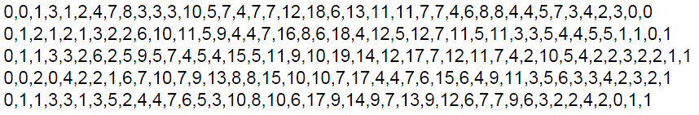
Reading a CSV file
A CSV file contains data in a tabular format using comma to separate between values
Each row holds the same number of columns

Slide 12
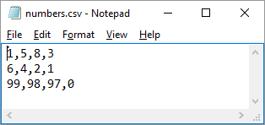
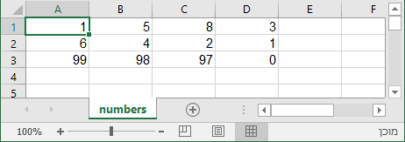
Exercise 2: Sum row of numbers read from a CSV file
Write a function that sums the numbers in each row for a given CSV file.
Input: CSV file name
Output: A list containing the line sums
As seen in Notepad
As seen in Excel
>>> sum_lines_in_csv_file('numbers.csv')
[17, 13, 294]

Slide 13
Exercise 2: Sum row of numbers read from a CSV file
def sum_lines_in_csv_file(filename):
f = open(filename,'r')
sums = []
for line in f:
tokens = line.rstrip().split(',')
line_sum = 0
for token in tokens:
line_sum += token
sums.append(line_sum)
f.close()
return sums
#Can you compute the sum #using list comprehension?
int( )
>>> sum_lines_in_csv_file('numbers.csv')
[17, 13, 294]

Slide 14
Exercise 3: 2015-6 Exam, Moed A, question 2
Given CSV file with row names in first column, return a list of row headers named row_headers, and a matrix (list of lists) named table holding the numeric values.
Wheat,10,20,30,40,50,60
Corn,12,22,32,42,52,62
Carrot,14,24,34,44,54,64
Banana,16,26,36,46,56,66
What happens if an error encountered while opening or reading the file ?
In that case, we wish to write “IO Error” to the screen and stop the program gracefully (not crash) – Use try/except !

Slide 15
Exercise 3: 2015-6 Exam, Moed A, question 2
def load_crops(filename):
row_headers = []
table = []
try:
f = open(filename,'r')
for line in f:
tokens = line.rstrip().split(',')
row_headers.append(tokens[0])
table.append([int(x) for x in tokens[1:]])
f.close()
except IOError:
print("Failed parsing the file :(")
return row_headers, table
#Is it OK to close the file here?
Wheat,10,20,30,40,50,60
Corn,12,22,32,42,52,62
Carrot,14,24,34,44,54,64
Banana,16,26,36,46,56,66

Slide 16

Error Handling in Python
(Exceptions)

Slide 17
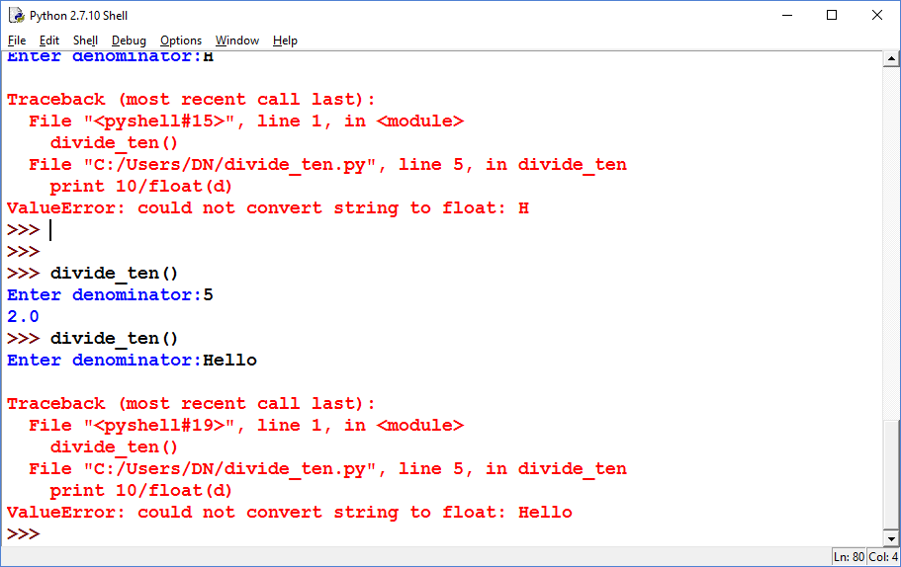
Example 1: No error handling
Defining a function that divides 10 by a number provided by the user:
def divide_ten():
d = input("Enter denominator:")
print(10/float(d))
When the user enters a valid input, the function runs successfully and terminates normally

Slide 18
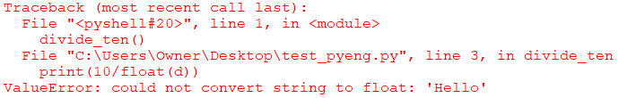
Example 1: No error handling
Defining a function that divides 10 by a number provided by the user:
def divide_ten():
d = input("Enter denominator:")
print(10/float(d))
The function float() cannot convert 'Hello' to a float and therefore raises a ValueError exception
The program crashes (terminates abnormally), as no error handling was defined.
The exception details are printed to the screen.

Slide 19
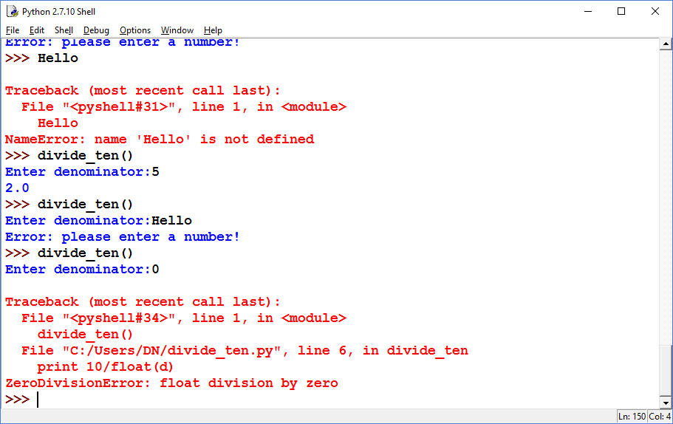
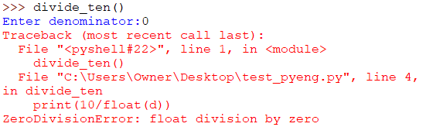
Example 2: Adding try-except to handle a specific exception
ValueError exceptions raised within the try block will be handled using the except code
def divide_ten():
try:
d = input("Enter denominator:")
print(10/float(d))
except ValueError:
print('Error: please enter a number!')
If no exceptions are raised within the try block, except block isn’t executed
If ValueError exception is raised within the try block, execution jumps to the except block. The program then continues to the next line (if exists) after the except.
Other unhandled exceptions raised within the try block will still crash the program.

Slide 20
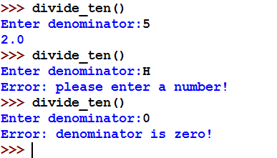
Example 3: Handling different exceptions specifically
def divide_ten():
try:
d = input("Enter denominator:")
print(10/float(d))
except ValueError:
print('Error: please enter a number!')
except ZeroDivisionError:
print('Error: denominator is zero!')
This except block will only run in case of ValueError
This except block will only run in case of ZeroDivisionError

Slide 21
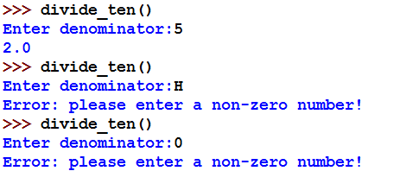
Example 4: Uniform handling of different exceptions
def divide_ten():
try:
d = input("Enter denominator:")
print(10/float(d))
except (ValueError, ZeroDivisionError):
print('Error: please enter a non-zero number!')
This except block will only run in case of either ValueError or ZeroDivisionError

Slide 22
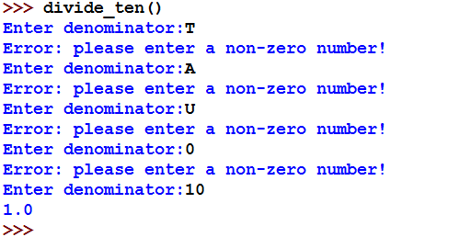
Example 5: Using try-except to re-ask for input
def divide_ten():
while True:
try:
d = input("Enter denominator:")
result = 10/float(d)
break
except (ValueError, ZeroDivisionError):
print('Error: please enter a non-zero number!')
print(result)

Slide 23
try-except is often used to handle I/O Errors
try:
f = open('testfile', 'r')
# read the file
# do something...
f.close()
except IOError:
print("Error: can't find file or read data")
IOError Exception
Raised when an I/O operation (such as a print statement, the built-in open() function or a method of a file object) fails for an I/O-related reason, e.g., “file not found” or “disk full”
Will this line run if exception is raised when reading the file or “doing something”?

Slide 24
finally always runs at the end… used to free resources
This finally block will always run after the try block (if exception occurs or not). Use it to run commands that are always required to run at the end.
f = None
try:
f = open('testfile', 'w')
f.write('This is it!!')
except IOError:
print("Error: can't find file or read data")
finally:
if f != None:
f.close()
If we use finally, we are sure that when we leave the scope the file is closed

Slide 25
With statement
To open a file, process its contents and make sure you close it, you can simply use the “with” statement
try:
with open('testfile', 'r') as f:
f.readlines()
# do something...
except IOError:
print("Error: can't find file or read data")
Still, to handle exceptions, use try-except blocks (the file will be closed either way)

Slide 26
raise an Exception
raise enables a section of code to report a specific error type to its caller, with (optionally) a custom error message.
If the caller does not handle exception it will be thrown upwards to its caller until some caller handles it. If no caller handles it, the program will crush.
>>> raise NameError('HiThere')
Traceback (most recent call last):
File "<pyshell#30>", line 1, in <module>
raise NameError('HiThere')
NameError: HiThere

Slide 27
When to raise an Exception?
Suppose you write a function, which can encounter some error cases.
Examples: invalid input ; no solution to equation ; invalid list index.
Previously, you handled this by printing an error message.
➔But the function caller can ignore this print.
Raising an exception is the more “built-in” way.
➔The function caller cannot ignore this!
def my_func(x):
…
if some_error_condition:
raise TypeOfException()

Slide 28
Exception raised and handled using try-except
def divide(a,b):
if b == 0:
raise ValueError('denominator cannot be zero!')
return a/b
def calc_divisions():
l = [3,2,1,0,5]
for n in l:
print(divide(100,n))
def calc_divisions_pretty():
l = [3,2,1,0,5]
for n in l:
try:
print(divide(100,n))
except ValueError:
print("Can’t divide 100 by", n)
# calc_divisions() calc_divisions_pretty()

Slide 29
Get/Set Working Directory (EXTRA)
Say you want to read a file on your desktop (let’s call it test_file.txt), either you give its full path or you can change your Working Directory (WD) and give only its relative path (more useful when you need to write several files from a specific directory...).
>>> f = open('test_file.txt','r')
Traceback (most recent call last):
File "<pyshell#33>", line 1, in <module>
f = open('test_file.txt','r')
FileNotFoundError: [Errno 2] No such file or directory: 'test_file.txt’
>>> import os #importing the Operating System package
>>> os.getcwd() #this is the current path of your WD
'C:\\Users\\Owner'
>>> os.chdir(r'C:\Users\Owner\Desktop') #change WD to desktop
>>> f = open('test_file.txt','r') #not an error anymore
>>> f.read()
'Hello from test_file.txt'
>>> f.close()
29

Slide 30
Summarizing Example Division Calculator
Reviewed topics:
File IO
Error Handling using exceptions
Functions
30

Slide 31
Summarizing Example – Division Calculator
Write a division calculator, the calculator should:
Obtain a divisor and a dividend from the user, and output the result
Maintain a history of its computations. The user can ask for a particular computation from the past by specifying the index of the computation
The calculator must write all its history to a file. If it fails (for any error reason), the program should raise an IOError with the following message: 'Calculator exited due to writing failure'
31

Slide 32
Division Calculator – Expected Functionality
For division type '1', for history type '2' and to exit type '3’
1
Please enter a divisor:
2
Please enter a dividend:
2
2/2 = 1.0
For division type '1', for history type '2' and to exit type '3'
2
please select an index from the history: [1]
1
2/2 = 1.0
For division type '1', for history type '2' and to exit type '3'
3
Good Bye!
32

Slide 33
Division Calculator - Skeleton
variable for history index
cur_history_id = 0
history = {}
history_file = 'history.txt'
print('This is a division calculator')
while True:
choice = input("For division type '1', for history type '2'
and to exit type '3'\n")
if choice == '1':
cur_history_id += 1
perform_division(history, cur_history_id, history_file)
elif choice == '2':
fetch_from_history(history)
elif choice == '3':
print('Goodbye!')
break
else:
print('illegal input')
dictionary for history of all computations
file storing all computation history
Use while to keep running until ‘3’ is typed
get user choice and perform relevant task
Any other input is invalid
33

Slide 34
Division Calculator - perform_division
Let’s start by implementing the division functionality
def perform_division(history, current_index, history_file):
divisor = raw_input("Please enter a divisor\n")
dividend = raw_input("Please enter a dividend\n")
res = float(dividend) / float(divisor)
res_str = str(dividend) + "/" + str(divisor) + " = " + str(res)
print res_str
history[current_index] = res_str
write_to_file(history_file, res_str) # will leave this for later
perform_division:
The function should obtain a divisor and a dividend from the user, and output the result
Store the computation in the history and into a file
34

Slide 35
Division Calculator - perform_division
Let’s start by implementing the division functionality
def perform_division(history, current_index, history_file):
divisor = input('Please enter a divisor\n')
dividend = input('Please enter a dividend\n')
res = float(dividend) / float(divisor)
res_str = dividend + '/' + divisor + ' = ' + str(res)
print(res_str)
history[current_index] = res_str
write_to_file(history_file, res_str) # will leave this for later
What could go wrong?
User inserts ‘0’ as divisor
User inserts an invalid input (e.g., a string)
How can we handle these errors?
try-except
35

Slide 36
Division Calculator – manage errors
repeat process until user inserts valid numbers
def perform_division(history, current_id, history_file):
while True:
try:
divisor = input('Please enter a divisor\n')
dividend = input('Please enter a dividend\n')
res = float(dividend) / float(divisor)
res_str = str(dividend) + '/' + str(divisor) + ' = ' + str(res)
print(res_str)
history[current_id] = res_str
write_to_file(history_file, res_str) # will leave this for later
break
except ZeroDivisionError:
print('It is illegal to divide by zero!\n')
except ValueError:
print('Calculator only supports numbers!\n')
break if computation is successful
error messages
36

Slide 37
Division Calculator – fetch_from_history
def fetch_from_history(history):
fetch_from_history:
Print indices currently stored in history
Obtain an index from the user
Print computation from the history according to the index
37

Slide 38
Division Calculator – fetch_from_history
def fetch_from_history(history):
if len(history) == 0:
print('no history yet')
return
print('please select an index from the history:', list(history.keys()))
selection = input()
print(history[int(selection)])
What could go wrong?
User may insert any string (not necessarily a number)
User may insert a value that is not in the dictionary
Again, we will use try-except to handle these errors
38

Slide 39
Division Calculator – manage errors
def fetch_from_history(history):
if len(history) == 0:
print('no history yet')
return
while True:
try:
print('please select an index from the history:', list(history.keys()))
selection = input('\n')
print(history[int(selection)])
break
except(ValueError, KeyError) as e:
print('must enter an existing history id')
multiple error handling clause:
Catching key error and invalid index value
39

Slide 40
Division Calculator - write_to_file
def write_to_file(history_file, result):
write_to_file: saves computation to a file
append mode
40

Slide 41
Division Calculator - write_to_file
def write_to_file(history_file, result):
file_writer = open(history_file, 'a')
file_writer.write(result + '\n')
file_writer.close()
append mode
What could go wrong?
Cannot open file (due to illegal file name, permissions issues and more)
write to file failure
Again, we will use try-except to handle these errors
41

Slide 42
Division Calculator - write_to_file
def write_to_file(history_file, result):
try:
file_writer = open(history_file, 'a')
file_writer.write(result + '\n')
file_writer.close()
except IOError:
print('Cannot write history to file! Exiting!')
raise IOError('Calculator exited due to writing failure')
Throw IO exception (using the raise command):
Reason: Calculator should not operate without maintaining its history!
Resolving file system errors is something that we leave for the user resolve.
42

Slide 43
Division Calculator - write_to_file
def write_to_file(history_file, result):
try:
file_writer = open(history_file, 'a')
file_writer.write(result + '\n')
file_writer.close()
except IOError:
print('Cannot write history to file! Exiting!')
raise IOError('Calculator exited due to writing failure')
Throw IO exception (using the raise command):
Reason: Calculator should not operate without maintaining its history!
Resolving file system errors is something that we leave for the user resolve.
Did we forget something?!
Yes, if write function fails, the resource is left open!
Solution: use a finally clause
43

Slide 44
Division Calculator - write_to_file
def write_to_file(history_file, result):
file_writer = None
try:
file_writer = open(history_file, 'a')
file_writer.write(result + '\n')
except IOError:
print('Cannot write history to file! Exiting!')
raise IOError('Calculator exited due to writing failure')
finally:
if file_writer != None:
file_writer.close()
44

