Slide 1
Programming for Engineers in Python
Recitation 7
Memoization and Sorting

Slide 2
Plan
Memoization
n Choose k
River Cruising
String Merge
If time permits: Sorting
Merge sort

Slide 3

Recursion+Memoization
Solve problems with sub-optimality property:
Divide problem to similar sub-problems.
Each sub-problem works on part of original input.
Combine best solutions for sub-problems.
Memoization: Save sub-problem solution and calculate only if necessary.
Next: examples.
Divide and Conquer

Slide 4


Example 1: Choose k From n
How many ways to choose k students from a class of n? (see recitation on recursion)
Recursive formula:
Termination Criteria:
k == 0 → 1
k == n → 1
k > n → 0

Slide 5
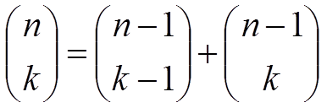


Choose k from n – Code
def choose(n, k):
if k==0 or n==k: return 1
if k > n: return 0
return choose(n - 1, k - 1) +
choose(n - 1, k)
k == 0 → 1
k == n → 1
k > n → 0
Python Tutor

Slide 6
Choose k from n – Recursion Tree
n = 4
k = 2
>>> choose(4, 2)
n = 3
k = 1
n = 3
k = 2
n = 2
k = 0
n = 2
k = 1
n = 2
k = 1
n = 2
k = 2
n = 1
k = 0
n = 1
k = 1
n = 1
k = 0
n = 1
k = 1
Note the redundant calls. How many calls in choose(100, 50)?

Slide 7
Solution – Use Memoization!
memo=None
def choose_memo(n, k, ): if k==0 or n==k: return 1 if n < k: return 0
= choose_memo(n - 1, k – 1, ) + choose_memo(n - 1, k, )
return
if memo == None:
memo = {}
mem_key = (n,k)
if mem_key not in memo:
memo[mem_key]
memo
memo
memo[mem_key]
Notes:
https://pythonconquerstheuniverse.wordpress.com/category/python-gotchas/

Slide 8
Choose k from n – Recursion Tree
n = 4
k = 2
>>> choose(4, 2)
memo
{}
{(2,1): 2,
(3,1): 3,
(3,2): 3,
(4,2): 6}
n = 3
k = 1
n = 3
k = 2
n = 2
k = 0
n = 2
k = 1
n = 2
k = 1
n = 2
k = 2
n = 1
k = 0
n = 1
k = 1

Slide 9
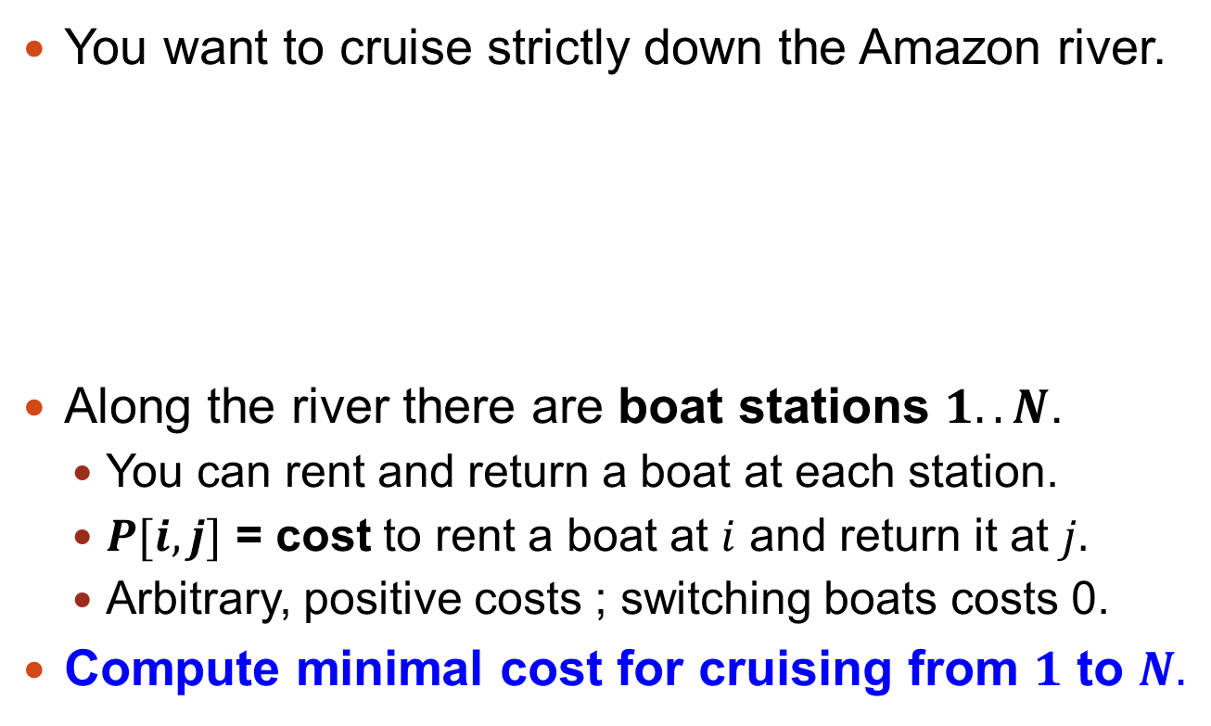
Example 2: River Cruising
1
2
3
4
5
N
100$
23$
40$
17$

Slide 10
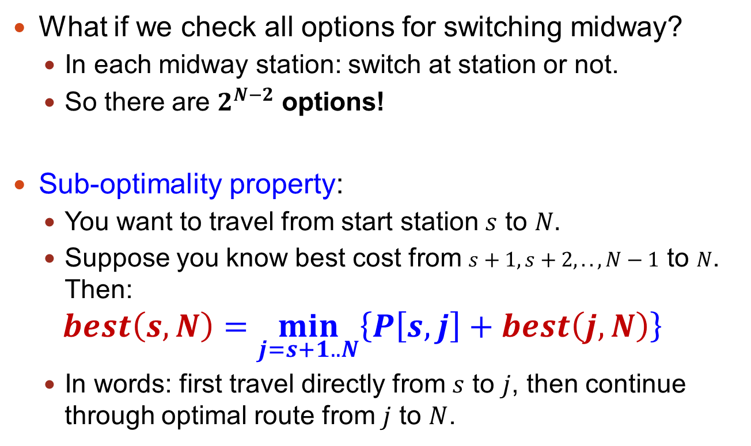


River Cruising, Take 1
$2^{320}$ atoms

Slide 11

Example for $N=4$
▼From ►To | station2 | station3 | station4
station1 | 21 | 31 | 65
station2 |  | 11 | 33
station3 |  |  | 16
Location = 1
21
65
31
Location = 2
Location = 3
Location = 4
11
33
Total path: 65
16
Location = 3
Location = 4
Total path: 21+33=54
Location = 4
16
Total path: 31+16=47
Location = 4
Total path: 21+11+16 = 48

Slide 12
Example for $N=4$
▼From ►To | station2 | station3 | station4
station1 | 21 | 31 | 65
station2 |  | 11 | 33
station3 |  |  | 16
prices = { (1,2):21, (1,3):31, (1,4):65, (2,3):11, (2,4):33, (3,4):16 }
best(4,4) = 0
best(3,4) = min( prices[(3,4)] + best(4,4)) = 16
best(2,4) = min( prices[(2,4)] + best(4,4),
prices[(2,3)] + best(3,4) ) =
min(33, 11 + 16) = 27
best(1,4) = min( prices[(1,4)] + best(4,4),
prices[(1,3)] + best(3,4) ,
prices[(1,2)] + best(2,4) ) =
min(65, 31+16, 21+27) = 47

Slide 13
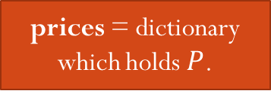
River Cruising, Take 2
prices = dictionary which holds $P$.
def optimal_cost_no_memo(N, prices, current = 1):
if current == N:
return 0
# Check if switching at station i improves the cost.
options = []
for i in range(current+1, N+1):
best_i_N = optimal_cost_no_memo(N, prices, i)
options.append(prices[(current, i)] + best_i_N)
# Take the minimum of all options
result = min(options)
return result
Takes forever for large N
Avoid re-computing suboptimal solutions, HOW?
Use MeMoIzAtIoN!
# Don’t forget N!
13

Slide 14
River Cruising with Memoization
def optimal_cost_memo(N, prices, current = 1, memo = None ):
if current == N:
return 0
if memo == None:
memo = {}
key = current # Probably the most challenging part
if key not in memo: # Compute and SAVE it!
memo[key] = result
# Check if switching at station i improves the cost.
options = []
for i in range(current+1, N+1):
best_i_N = optimal_cost_memo(N, prices, i, memo)
options.append(prices[(current, i)] + best_i_N)
# Take the minimum of all options
result = min(options)

Slide 15
River Cruising with Memoization
def optimal_cost_memo(N, prices, current = 1, memo = None):
if current == N:
return 0
if memo == None:
memo = {}
key = current # Probably the most challenging part
if key not in memo: # Compute and SAVE it!
# Check if switching at station i improves the cost.
options = []
for i in range(current+1, N+1):
best_i_N = optimal_cost_memo(N, prices, i, memo)
options.append(prices[(current, i)] + best_i_N)
# Take the minimum of all options
result = min(options)
memo[key] = result
return memo[key]

Slide 16
Example Run
def make_random_prices(N):
from random import randint
prices = {}
for i in range(1, N + 1):
for j in range(i + 1, N + 1):
prices[(i, j)] = randint(1, 10*N)
return prices
N = 25
p = make_random_prices(N)
from time import time
start = time()
print optimal_cost_no_memo(N, p) # Roughly 10 seconds
end = time()
print 'optimal_cost_no_memo %d took %f seconds' %(N, end - start)
print optimal_cost_memo(N, p) # Immediately
>>> N = 1000
>>> prices = make_random_prices(N)
>>> prices[(1, N)]
510
>>> optimal_cost_memo(N, prices)
22
import time
start = time.time()
print(optimal_cost_memo(N, prices))
end = time.time()
print(end – start)
Only 0.002 seconds!!
>>> 0.00200009346008

Slide 17
Optimal Route
1
?
?
N
Basic idea: also keep the next station under each key in memo.
This is a bit outside of course material.
>>> N = 1000
>>> prices = make_random_prices(N)
>>> prices[(1,N)] 950
>>> optimal_route(N, prices) (27, [1, 669, 687, 804, 900])
>>> prices[(1,669)], prices[(669,687)], \ prices[(687,804)], prices[(804,900)] (2, 3, 19, 3)

Slide 18
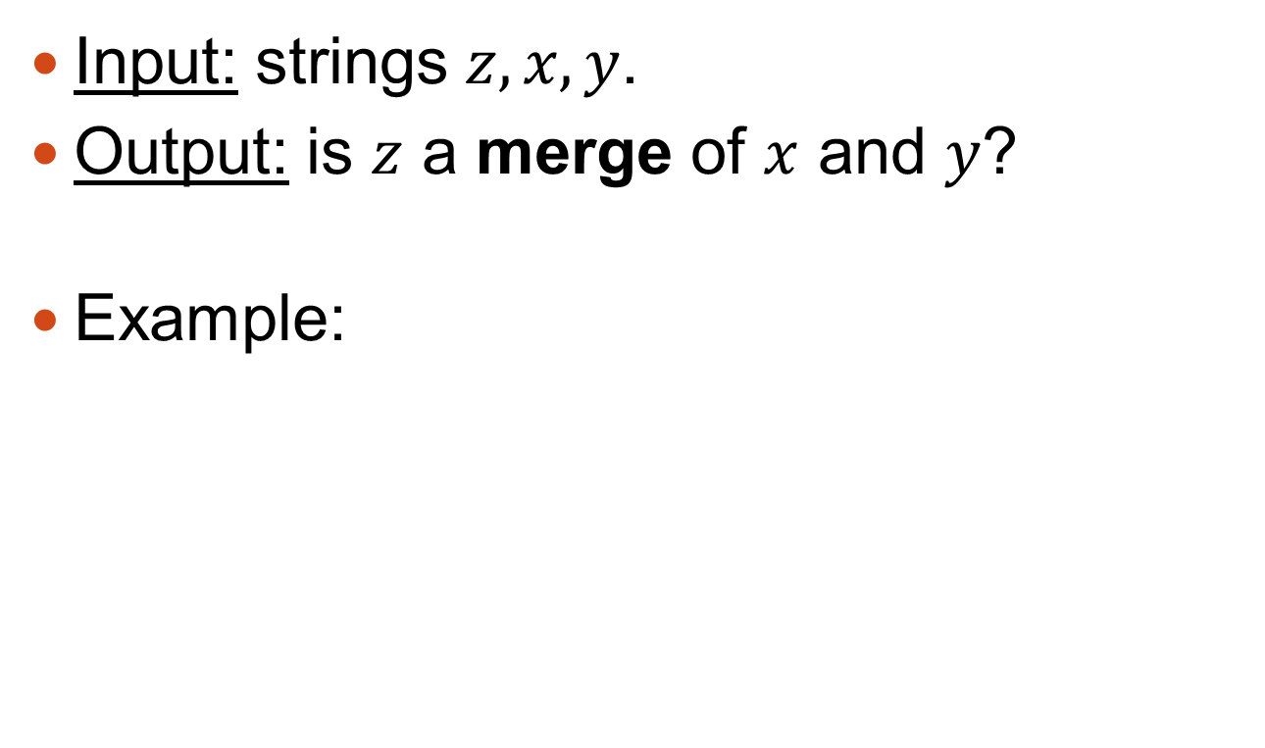
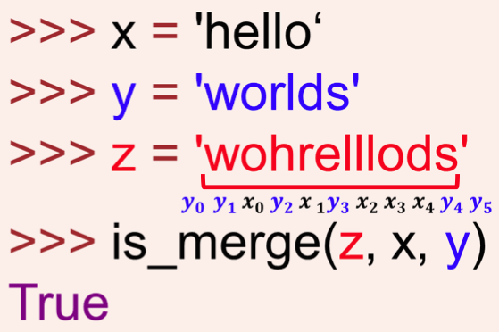
Example 3: String Merge

Slide 19
Additional example
x = “eaai”
y = “gaad”
z = “egaaaiad”
z = “egaaaiad”
Option 1
Option 2
z = “egaaaiad”

Slide 20



String Merge – Sub-optimality
Recursive formula for is_merge($z,x,y$):
If $x$ is empty, the answer is $z==y$.
If y is empty, the answer is $z==x$.
If $x,y$ aren’t empty but $z$ is, the answer is False.
For all other cases, compare first characters and solve suffix:
$$z\left[0\right]==x\left[0\right] and is_merge(z\left[1:\right],x\left[1:\right],y)$$
$$or$$
$$z\left[0\right]==y\left[0\right] and is_merge(z\left[1:\right],x,y[1:])$$
Can you give an example in which memoization saves many recursive calls?

Slide 21
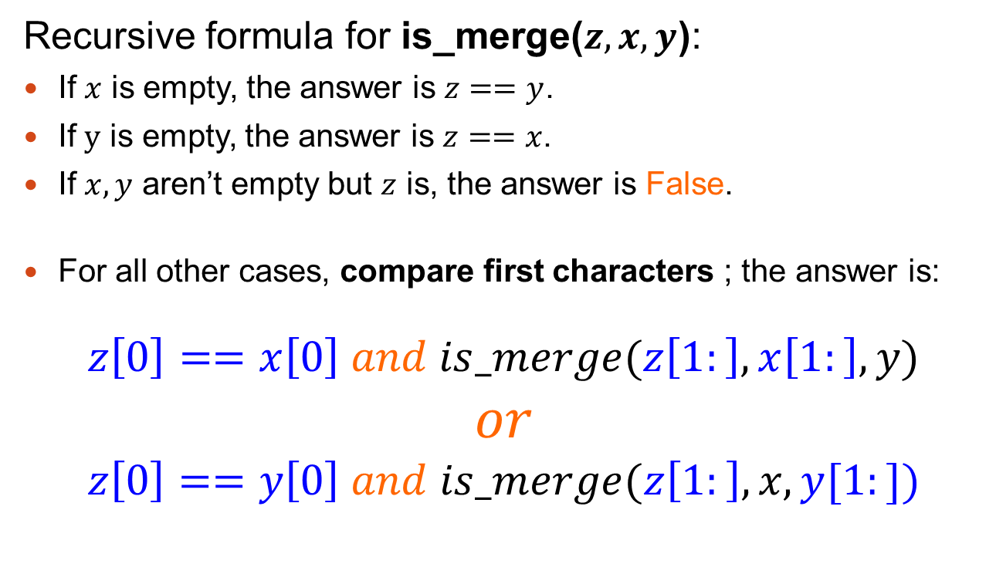
String Merge – Sub-optimality
Recursive formula for is_merge($z,x,y$):
If $x$ is empty, the answer is $z==y$.
If y is empty, the answer is $z==x$.
If $x,y$ aren’t empty but $z$ is, the answer is False.
For all other cases, compare first characters ; the answer is:
$$z\left[0\right]==x\left[0\right] and is_merge(z\left[1:\right],x\left[1:\right],y)$$
$$or$$
$$z\left[0\right]==y\left[0\right] and is_merge(z\left[1:\right],x,y[1:])$$
Can you give an example in which memoization saves many recursive calls?

Slide 22
String Merge, No Memoization
def is_merge(z, x, y):
if x == '':
return z == y
if y == '':
return z == x
if z == '':
return False
if z[0] == x[0] and is_merge(z[1:], x[1:], y):
return True
if z[0] == y[0] and is_merge(z[1:], x, y[1:]):
return True
return False

Slide 23
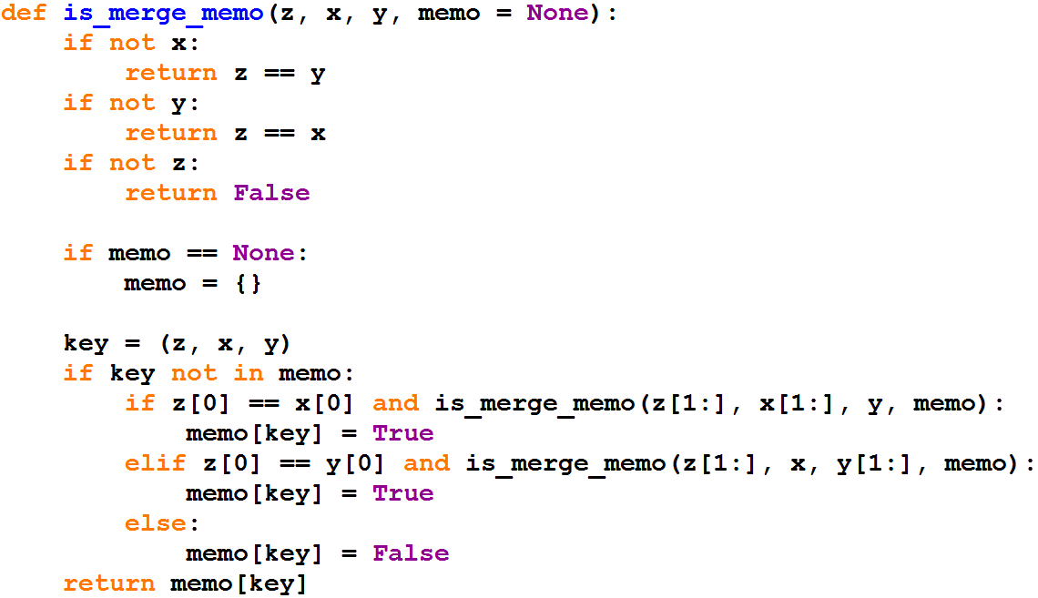
String Merge + Memo, Take 1

Slide 24
String Merge + Memo, Take 1
Key of memo is (z, x, y)
Needless memory waste!
Solution (as seen in lecture): keep only indices
Key (i,j) will map to is_merge(z[i+j:], x[i:], y[j:])

Slide 25
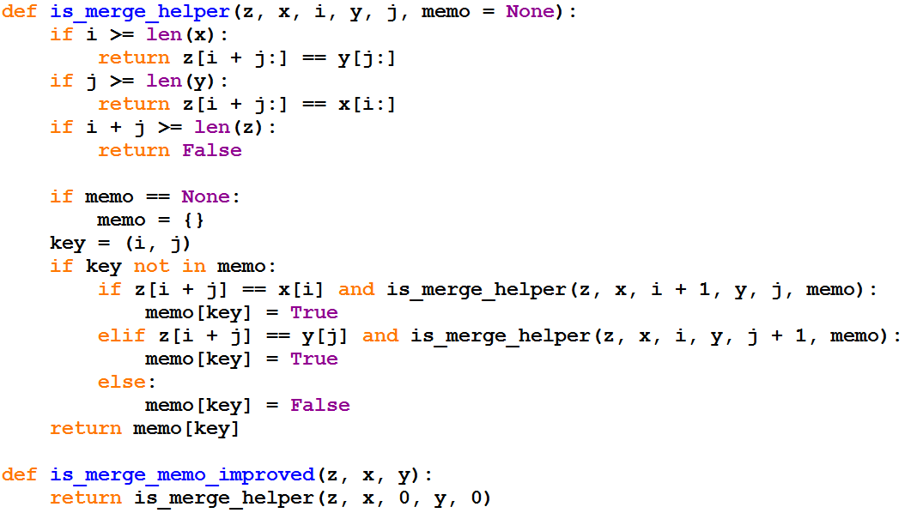
String Merge + Memo, Take 2
The user calls the wrapper function, not the recursive function

Slide 26
Sort Algorithm
Merge Sort

Slide 27
Merge Sort
The idea behind merge sort:
We can sort a list by splitting it into two shorted lists, sort each one of them, and merge them.

Slide 28
Merging Two Sorted Lists
p
p
p
p
p
p
q
q
q
q
q
9 | 7 | 5 | 2 | 1
10 | 8 | 6 | 4 | 3
u
u
u
u
u
u
u
u
u
u
1
2
3
4
5
6
7
8
9
10

Slide 29
Merging two sorted lists into a sorted list
def merge(left, right):
merged_list = []
left_i, right_i = 0, 0
while left_i < len(left) and right_i < len(right):
if left[left_i] <= right[right_i]:
merged_list.append(left[left_i])
left_i += 1
else:
merged_list.append(right[right_i])
right_i += 1
# copy remaining:
merged_list += left[left_i:] + right[right_i:]
return merged_list
Notes:
def merge(left, right): merged = [0] * (len(left) + len(right)) left_i,right_i,merged_i = 0,0,0 while left_i < len(left) and right_i < len(right): if left[left_i] <= right[right_i]: merged[merged_i] = left[left_i] left_i += 1 merged_i += 1 else: merged[merged_i] = right[right_i] right_i += 1 merged_i += 1 # copy remaining merged[merged_i:] = left[left_i:] merged_i += len(left) - left_i merged[merged_i:] = right[right_i:] return merged

Slide 30
Merge Sort Algorithm
Stop condition: a list with one element
Recursion reduction: partition the list to two halves, sort each half recursively
Recursion step: merge the sorted sub-lists to a single sorted list

Slide 31
Merge Sort – Code
def mergesort(lst):
if len(lst) <= 1:
return lst
middle = len(lst) // 2
left = mergesort(lst[ : middle])
right = mergesort(lst[middle : ])
merged_list = merge(left, right)
return merged_list

Slide 32
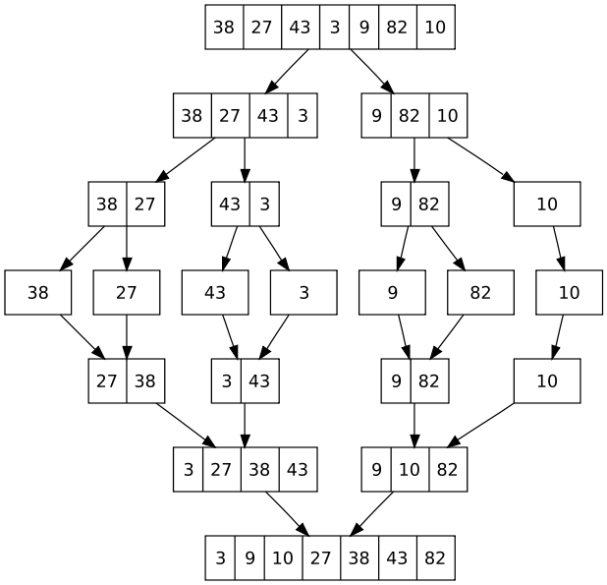

Merge Sort Example
Do you TRULY believe that your function can handle smaller problems?
Notes:
32

