Slide 1
Programming for Engineers in Python
Fall 2020
Lecture 12:
Summary

Slide 2
Plan
Pandas – last comments
Plotting
Binary search
Course summary
HW, exams and exam tips
2

Slide 3
Dataframe
df = pd.DataFrame({"a" : [1,2], "b" : [3,4], "c" : [5,6]}) print(df)
a b c
0 1 3 5
1 2 4 6
columns
Index labels
print(df.T)
0 1
a 1 2
b 3 4
c 5 6
columns
Index labels

Slide 4
Dataframe
Access by columns:
df = pd.DataFrame({"a" : [1,2], "b" : [3,4], "c" : [5,6]}) print(df["a"]) #also possible: print(df.a)
0 1
1 2
The result if of type Series – a One-dimensional array
index

Slide 5
Dataframe
Access by rows
df = pd.DataFrame({"a" : [1,2], "b" : [3,4], "c" : [5,6]}) print(df.loc[0])
a 1
b 3
c 5
index

Slide 6
Dataframe
Access by rows
df = pd.DataFrame({"a" : [1,2], "b" : [3,4], "c" : [5,6]}) print(df.T.loc["a"])
print(df.T.iloc[0])
df.T is
loc uses index labels
iloc uses index positions (only integers)
0 1
1 2
0 1
a 1 2
b 3 4
c 5 6
index
0 1
1 2
index

Slide 7
reductions
df = pd.DataFrame({"a" : [1,2], "b" : [3,4], "c" : [5,6]}) print(df.sum()) #same as df.sum(axis=0)
a 3
b 7
c 11
The result is a Series
print(df.sum(axis=1))
0 9
1 12
The result is a Series

Slide 8
reductions
df = pd.DataFrame({"a" : [1,2], "b" : [3,4], "c" : [5,6]}) print(df.sum().sum())
21
a 3
b 7
c 11
index
df.sum()
print(df.sum().idxmax())
c
print(df.sum().idxmin())
a

Slide 9
concatenation
df1 = pd.DataFrame({"a" : [1,2], "b" : [3,4], "c" : [5,6]})
df2 = pd.DataFrame({"a" : [11], "b" : [12], "c" : [13]})
a b c
0 1 3 5
1 2 4 6
a b c
0 11 12 13
df2
df1
df = pd.concat([df1, df2], axis=0) # axis=0 is not necessary
a b c
0 1 3 5
1 2 4 6
0 11 12 13

Slide 10
concatenation
df1 = pd.DataFrame({"a" : [1,2], "b" : [3,4], "c" : [5,6]})
df2 = pd.DataFrame({"a" : [11], "b" : [12], "c" : [13]})
a b c
0 1 3 5
1 2 4 6
a b c
0 11 12 13
df2
df1
df = pd.concat([df1, df2], ignore_index=True)
a b c
0 1 3 5
1 2 4 6
2 11 12 13

Slide 11
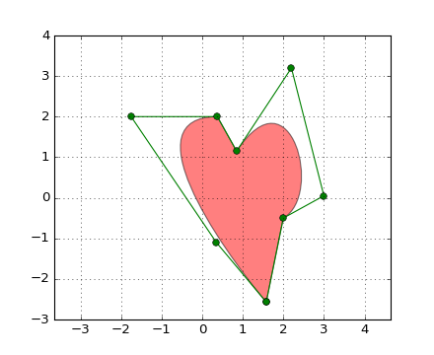
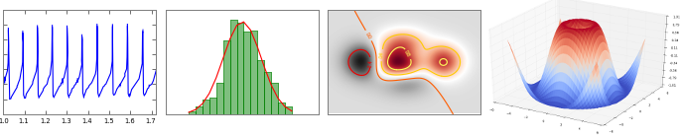
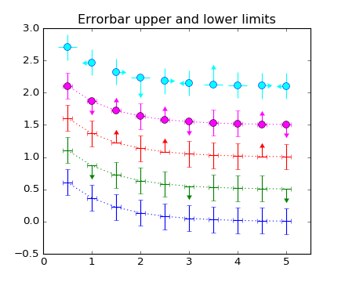

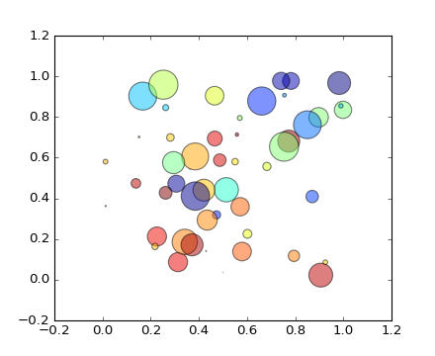
Plotting
“A plot is worth a thousand words"

Slide 12
matplotlib is a python 2D plotting library which produces publication quality figures in a variety of hardcopy formats and interactive.
You can generate plots, histograms, power spectra, bar charts, errorcharts, scatterplots, etc, with just a few lines of code.
Check this out:
http://matplotlib.org/gallery.html

Slide 13
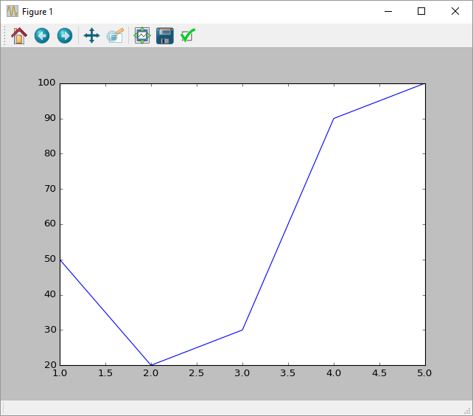
Example 1a
import numpy as np
import matplotlib.pyplot as plt
x = np.array([1, 2, 3, 4, 5])
y = np.array([50, 20, 30, 90, 100])
plt.plot(x,y)
plt.show()

Slide 14
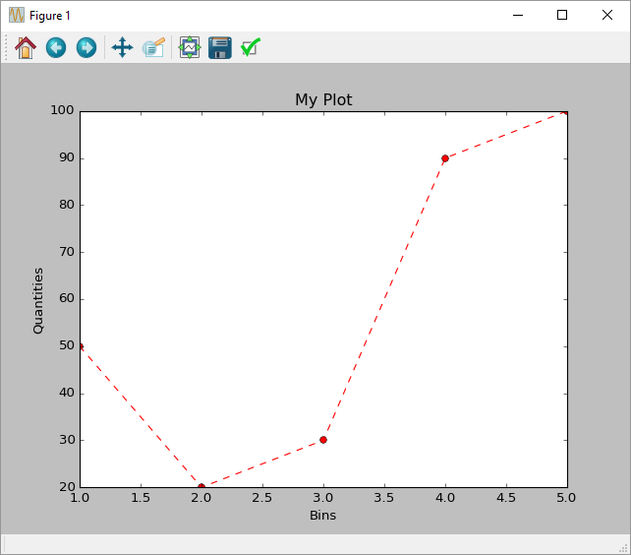
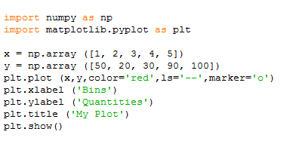
Example 1b

Slide 15
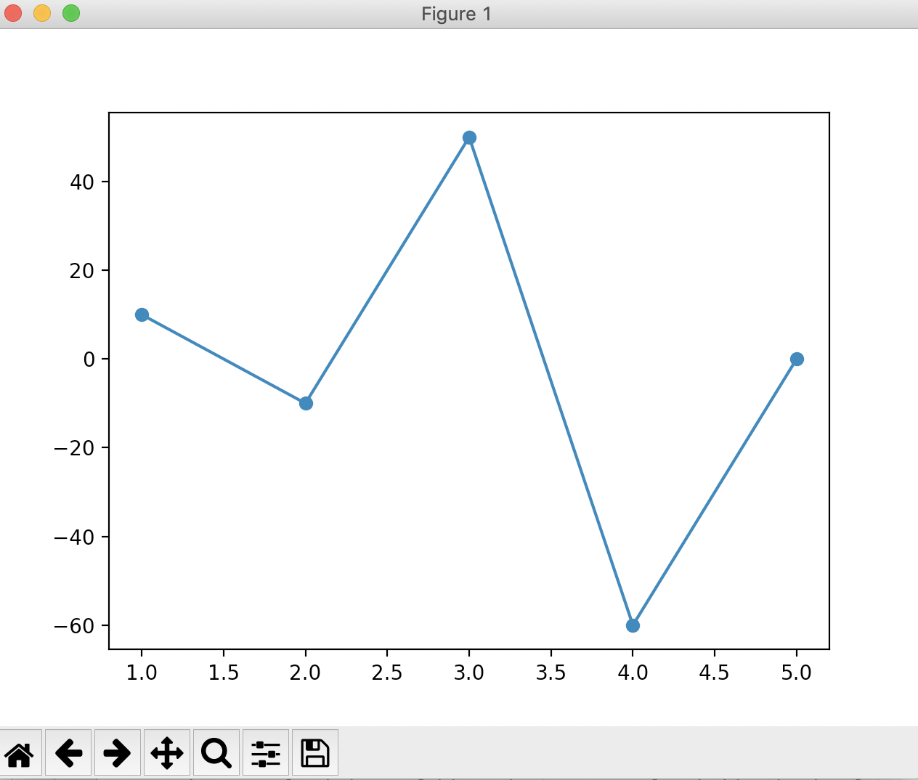
Example 2a
import numpy as np
import matplotlib.pyplot as plt
x = np.array([1, 2, 3, 4, 5])
y1 = np.array([50, 20, 30, 90, 100])
y2 = np.array([60, 10, 80, 30, 100])
y = y2 – y1 # y = [10, -10, 50, -60, 0]
plt.plot(x,y, marker=“o”)
plt.show()
y2-y1 is an elementwise subtraction.

Slide 16
Array Arithmetic
Arithmetic operators on arrays apply elementwise. A new array is created and filled with the result.
>>> x = np.array([1, 5, 2])
>>> y = np.array([7, 4, 1])
>>> x + y
array([8, 9, 3])
>>> x * y # element by element multiplication! Use np.dot(x,y) for matrix multiplication.
array([ 7, 20, 2])
>>> x - y
array([-6, 1, 1])
>>> x / y
array([0, 1, 2])
>>> x % y
array([1, 1, 0])
Note that here, x and y have the same size

Slide 17
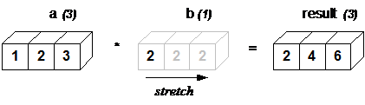
Broadcasting
NumPy operations are usually done element-by-element which requires two arrays to have exactly the same shape:
But this will also work:
>>> a = array([1.0,2.0,3.0])
>>> b = array([2.0,2.0,2.0])
>>> a * b
array([ 2., 4., 6.])
>>> a = array([1.0,2.0,3.0])
>>> b = 2.0
>>> a * b
array([ 2., 4., 6.])

Slide 18
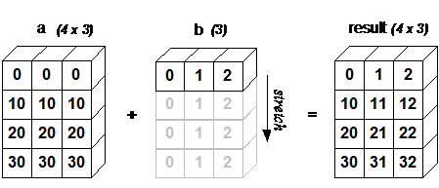
Broadcasting
Broadcasting is supported when the size of the trailing axes for both arrays in an operation is either the same or when one of them is one.
>>> a = array([[ 0.0, 0.0, 0.0],
... [10.0,10.0,10.0],
... [20.0,20.0,20.0],
... [30.0,30.0,30.0]])
>>> b = array([0.0, 1.0, 2.0])
>>> a + b
array([[ 0., 1., 2.],
[ 10., 11., 12.],
[ 20., 21., 22.],
[ 30., 31., 32.]])

Slide 19
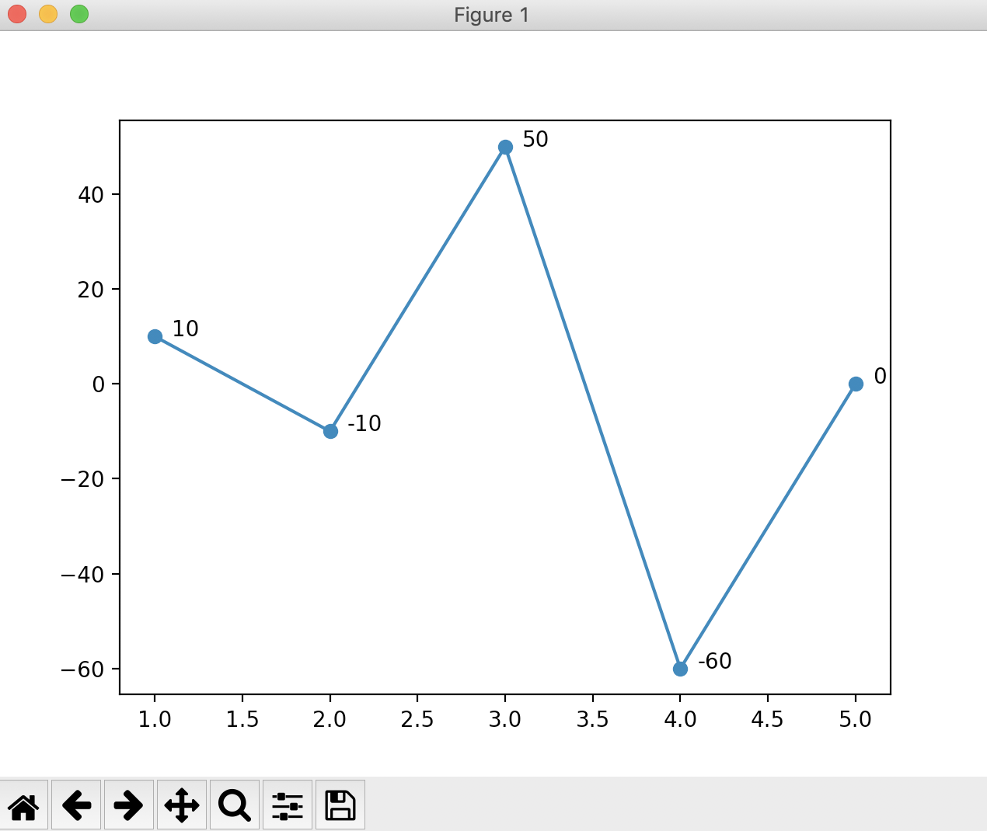
Example 2b
import numpy as np
import matplotlib.pyplot as plt
x = np.array([1, 2, 3, 4, 5])
y1 = np.array([50, 20, 30, 90, 100])
y2 = np.array([60, 10, 80, 30, 100])
y = y2 – y1 # y = [10, -10, 50, -60, 0]
for x,y in zip(x,y): plt.annotate(text=y, xy=(x,y), # the point textcoords="offset points", # text positioning xytext=(10,0)) # distance from text to the point (x,y)
plt.plot(x,y, marker=“o”)
plt.show()
Add annotations for clarity.

Slide 20
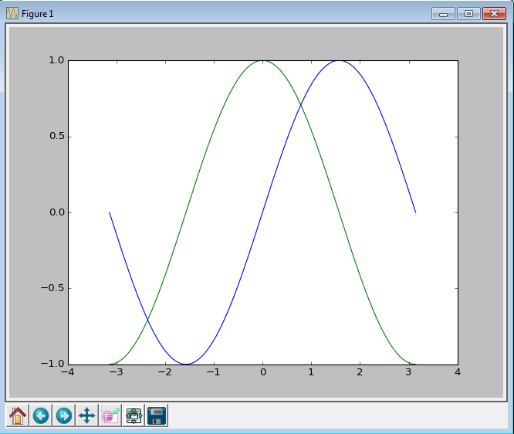
Example 3a
import matplotlib.pyplot as plt
import numpy as np
x = np.linspace(-np.pi, np.pi)
y, z = np.cos(x), np.sin(x)
plt.plot(x, y, color = 'green')
plt.plot(x, z, color = 'blue')
plt.show()

Slide 21
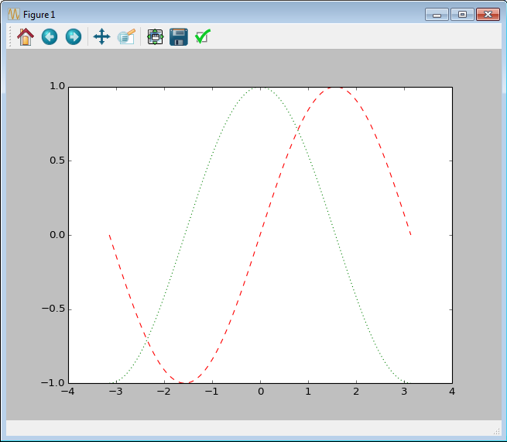
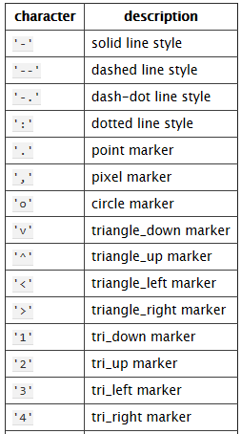
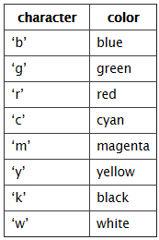
Example 3b
x = np.linspace(-np.pi, np.pi)
y, z = np.cos(x), np.sin(x)
plt.plot(x, y, color = 'green')
plt.plot(x, z, ‘r--')
plt.show()

Slide 22
Binary search exercise

Slide 23
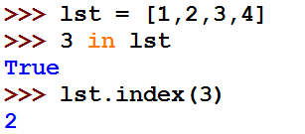
Search
What happens when we execute:
?
We somehow search the list to see if the element “3” an element of the list.
How can the search algorithm be implemented?
23

Slide 24

Naïve search in a general list
Find index of a value in a given list
def sequential_search(value, lst):
for i in range(len(lst)):
if lst[i] == value:
return i
return None
print sequential_search('a', ['b', 'a'])
1

Slide 25

Binary Search (requires a sorted list)
Input Sorted list lst, query value
Output Corresponding index / not found
Algorithm:
Check the middle value of lst
If middle == value, return the middle index
If value < middle search in lower half of lst
If value > middle search in higher half of lst

Slide 26
Example
Searching for 56
index
0
1
2
3
4
5
6
7
8
9
value
-5 | -3 | 0 | 4 | 8 | 11 | 22 | 56 | 57 | 97

Slide 27
Example
Searching for 4
index
0
1
2
3
4
5
6
7
8
9
value
-5 | -3 | 0 | 4 | 8 | 11 | 22 | 56 | 57 | 97

Slide 28
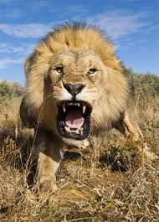
Code – Binary Search
def binary_search_rec(value, lst, start, stop): if start >= stop: return None middle = (stop + start) / 2 if lst[middle] == value: # item found return middle elif value < lst[middle]: # item cannot be in top half return binary_search_rec(value, lst, start, middle) else: # item cannot be in bottom half return binary_search_rec(value, lst, middle + 1, stop)
>>> binary_search_rec(5, [1,4,5,8], 0, 4)
2

Slide 29
Execution example – searching for 56
0
1
2
3
4
5
6
7
8
9
-5 | -3 | 0 | 4 | 8 | 11 | 22 | 56 | 57 | 97
start
middle
stop
middle | stop | start
(0+10)/2 = 5 | len(lst) = 10 | 0

Slide 30
Execution example – searching for 56
middle
0
1
2
3
4
5
6
7
8
9
-5 | -3 | 0 | 4 | 8 | 11 | 22 | 56 | 57 | 97
start
stop
middle | stop | start
(0+10)/2 = 5 | len(lst) = 10 | 0
(6+10)/2 = 8 | 10 | 6
(6+8)/2=7 | 8 | 6

Slide 31
Execution example – searching for 4
0
1
2
3
4
5
6
7
8
9
-5 | -3 | 0 | 4 | 8 | 11 | 22 | 56 | 57 | 97
start
middle
stop
middle | stop | start
(0+10)/2 = 5 | len(lst) = 10 | 0

Slide 32
Execution example – searching for 4
0
1
2
3
4
5
6
7
8
9
-5 | -3 | 0 | 4 | 8 | 11 | 22 | 56 | 57 | 97
start
middle
stop
middle | stop | start
(0+10)/2 = 5 | len(lst) = 10 | 0
(0+5)/2=2 | 5 | 0

Slide 33
Execution example – searching for 4
0
1
2
3
4
5
6
7
8
9
-5 | -3 | 0 | 4 | 8 | 11 | 22 | 56 | 57 | 97
start
middle
stop
middle | stop | start
(0+10)/2 = 5 | len(lst) = 10 | 0
(0+5)/2=2 | 5 | 0
(3+8)/2=4 | 5 | 2+1=3

Slide 34
Execution example – searching for 4
middle
0
1
2
3
4
5
6
7
8
9
-5 | -3 | 0 | 4 | 8 | 11 | 22 | 56 | 57 | 97
start
stop
middle | stop | start
(0+10)/2 = 5 | len(lst) = 10 | 0
(0+5)/2=2 | 5 | 0
(3+8)/2=4 | 5 | 2+1=3
3 | 4 | 3

Slide 35
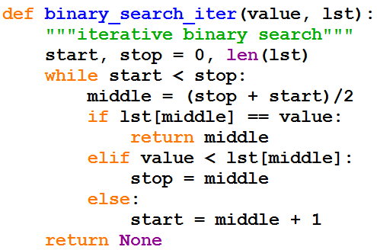
Iterative Implementation

Slide 36
Summary

Slide 37
Syllabus
Python programming basics
Variables and Memory
Loops
List, Tuples, Dictionaries
Functions
File Input/Output
Error handling
Recursions, Memoization,
Object-Oriented Programming
Scientific calculations using Numpy
Data analysis using pandas
Image processing
37
Notes:
37

Slide 38
ABOUT THE EXAM
Three Hours
Writing code on paper
One double sided A4 formula sheet is allowed.

Slide 39
How to study?
Review the presentations (both lectures and recitations)
Make sure you understand the explanations and code
Summarize important things such as syntax and methods (things that will be useful in the cheat sheet).
Review the home exercises
Solve as many exams as you can on paper, going backward in time.

Slide 40

Welcome to Programming for Engineers course!
We will learn to program in Python.
Goal: enable you to use programming as a tool to solve “real world” problems.
Hard work is required!
40
Notes:
40

Slide 41
Course Objectives
Develop basic programming and algorithmic skills
41
Notes:
41

Slide 42
Syllabus
Python programming basics
Recursion
Sort & Search algorithms
Object-Oriented Programming
Image Processing
Scientific Calculations
Simulations
Data analysis
Error Handling
42
Notes:
42

Slide 43
Our Motivation
What computational capabilities do engineers need?
Ability to write simple scripts
Ability to use existing tools (modules)
Problems solving capabilities
Understand what and how CS people do
For better collaboration
General knowledge
43

Slide 44
Good Luck and Thank you!
44

