Slide 1
Programming for Engineers in Python
Fall 2020
Lecture 3: Functions

Slide 2
Plan for today
Highlights from last week’s lesson
Functions
What are they good for
Built-in Functions
Defining New Functions
Assignment rules in Python
Global vs. Local variables

Slide 3
While Loop
Repeats a block of instructions until a stop criterion is met
while expression:
statement1
statement2
…
expr
false
true
statement(s)

Slide 4
Example - factorial
n = 10
fact = 1
i = 1
while i <= n:
fact *= i
i += 1
print(n, "! =", fact)

Slide 5
Lists
A list is an ordered sequence of elements.
Creating a list in Python:
>>> my_list = [2, 3, 5, 7, 11]
>>> my_list
[2, 3, 5, 7, 11]
>>> my_list[0]
2
>>> my_list[-1]
11

Slide 6
Slicing
>>> my_list = [1,2,3,4,5,6,7,8,9,10]
>>> my_list[1:5] # slicing returns a new sub-list
[2, 3, 4, 5]
>>> my_list[0:-1] # mixing forward/backward indexing
[1, 2, 3, 4, 5, 6, 7, 8, 9]
>>> my_list[::2]
[1, 3, 5, 7, 9]

Slide 7
Summary of List functions
Explanation | Command
Creates a new list referenced by l | l = [1, 2, 3, 4, 5]
Returns a new list containing [2,3] | l2 = l[1:3]
Adds val to the end of list l | l.append(val)
Removes the first occurrence of val in the list | l.remove(val)
Removes and returns the element at index index | l.pop(index)
Returns the index of the first occurrence of val | l.index(val)
Returns the number of occurrences of val in the list | l.count(val)
Inserts the element val to location index | l.insert(index, val)
Adds all elements in l2 to the end of l | l.extend(l2)
Sorts list l | l.sort()

Slide 8
For Loop
for element in iterable:
statement1
statement2
…
Run over all elements in the list.
Iteration 0: Assign element = a_list[0]
Execute the statements
Iteration 1: Assign element = a_list[1]
Execute the statements
…

Slide 9
For Example
numbers = [1, 4, 3, 6, 8]
even_sum = 0
for num in numbers:
if num % 2 == 0:
even_sum += num
print("Sum of even numbers is", even_sum)

Slide 10
Functions

Slide 11
Plan for today
Highlights from last week
Functions
What are they good for
Built-in Functions
Defining New Functions
Assignment rules in Python
Global vs. Local variables

Slide 12
How to Calculate 5! + 3! + 6!?
factorial5 = 1
factorial3 = 1
factorial6 = 1
for i in range(1, 6):
factorial5 *= i
for i in range(1, 4):
factorial3 *= i
for i in range(1, 7):
factorial6 *= i
print("5!+3!+6!=", factorial5 + factorial3 + factorial6)
Code Duplication

Slide 13
Code duplication is bad
Duplicated bugs (harder to fix later)
Longer programs
Copy & Paste errors
Rule of Thumb - Write the code once!
Use it several times with different arguments (Code reuse is encouraged)

Slide 14
What is a function in programming ?
A function is a block of organized, reusable code that is used to perform a single, well defined action.
Functions provide better modularity for your application and a high degree of code reusing

Slide 15
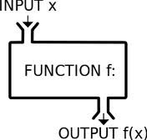
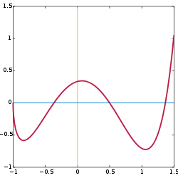
Function – Definition II
A named sequence of statements that performs a specific task independently of the remaining code.

Slide 16

Modularity enables code reuse !
Modularity is the degree to which a system's components may be separated and recombined (Wikipedia).
Top-down design
Improves maintainability
Enforces logical boundaries
between components

Slide 17
So – Why use functions?
Modularity - Break a task into smaller sub-tasks (divide and conquer), enables code reuse
Abstraction – Solve each problem once and wrap it in a function
Maintenance - Solve bugs once
Readability – Main code is shorter, implementation details are hidden within functions
Limited Variable Scope - Temporary variables are restricted to the function’s scope

Slide 18
Plan for today
Highlights from last week
Functions
What are they good for
Built-in Functions
Defining New Functions
Assignment rules in Python
Global vs. Local variables

Slide 19
Built-in Functions
http://docs.python.org/library/functions.html
We already used built-in functions:
>>> type(5)
<class 'int'>
>>> len(range(8,100, 8))
12

Slide 20
Built-in Functions
Conversion functions:
>>> str(5)
'5'
>>> int(3.2)
3
>>> float('1.41421')
1.41421

Slide 21
Math Functions
import math radius = 6378 circumference = 2 * math.pi * radius log_2_1024 = math.log(1024, 2) angle = 45 sinus = math.sin(math.radians(angle))
Pre-defined constant
Pre-defined functions contained in the imported math module

Slide 22
Plan for today
Highlights from last week
Functions
What are they good for
Built-in Functions
Defining New Functions
Assignment rules in Python
Global vs. Local variables

Slide 23

Defining a new function in Python
Function definition
Function name
Parameters
def is_over_9000(x):
if x > 9000:
return True
else:
return False
Function Body
Indentation!
Return Value

Slide 24
Defining a new function in Python
Defining the function
def is_over_9000(x):
if x > 9000:
return True
else:
return False
Using the function
>>> is_over_9000(5000)
False
>>> a = is_over_9000(15000)
>>> a
True
Short definition:
def is_over_9000(x):
return x > 9000
Indentation!

Slide 25
Defining a new function in Python
def some_func(parameters):
if some_condition:
return True
else:
return False
def some_func(parameters):
return some_condition
This is already a
Boolean object!
Indentation!

Slide 26
Functions
def function_name(parameter1, parameter2,...):
statement1
statement2
…
return result1, result2, …
# return is optional!
# if return is not specified, the function
# returns the constant None
Calling a function:
var1, var2,… = function_name(val1, val2,...)

Slide 27
Function’s Input / Output
Input: Arguments
Can be of any type - int / float / str / Boolean / list
Output: The return statement
Returns a value (of any type) to the function caller.
Multiple values are wrapped in tuple
no return or no value after return - returns None
return immediately stops the function’s execution and returns to the caller!
return is different from print!

Slide 28
Back to the factorial example… Avoiding Code Duplication
Calculate 5! + 3! + 6! using a function:
def factorial(n):
fact = 1
for i in range(1,n+1):
fact *= i
return fact
print("5!+3!+6! =", factorial(5) + factorial(3) + factorial(6))
Defining a new function
Calling the function from the main script or from another function
n, fact and i are called “Local Variables” – They exist only within the scope of the function and disappear when it ends

Slide 29
Calculate 5! + 3! + 6! using a function:
def factorial(n):
fact = 1
for i in range(1,n+1):
fact *= i
return fact
print("5!+3!+6! =", factorial(5) + factorial(3) + factorial(6))
Calling the function from the main script or from another function
n, fact and i are called “Local Variables” – They exist only within the scope of the function and disappear when it ends

Slide 30
Factorial – how does it work?
def factorial(n):
fact = 1
for i in range(1,n+1):
fact *= i
return fact
x = factorial(3)
print(“factorial(x) =“, x)
x = ?
console:

Slide 31
Factorial – how does it work?
def factorial(n):
fact = 1
for i in range(1,n+1):
fact *= i
return fact
x = factorial(3)
print(“factorial(x) =“, x)
x = ?
n = 3
fact = 2
i = 2
n = 3
fact = 2
i = 3
n = 3
fact = 6
i = 3
n = 3
fact = 1
i = 1
n = 3
fact = 1
i = 2
console:

Slide 32
Factorial – how does it work?
def factorial(n):
fact = 1
for i in range(1,n+1):
fact *= i
return fact
x = factorial(3)
print(“factorial(x) =“, x)
x = ?
x = 6
n = 3
fact = 6
i = 3
console:
factorial(x) = 6

Slide 33
What if we used print instead of return?
def factorial(n):
fact = 1
for i in range(1,n+1):
fact *= i
print(fact)
x = factorial(3)
print(“factorial(x) =“, x)
x = ?
x = None
n = 3
fact = 6
i = 3
console:
6
factorial(x) = None

Slide 34
Example - Palindromes
Palindromes are read the same way in either direction.
Examples
21.11.12
Alula
Anna
Deified
פ ר ש נ ו ר ע ב ת ן ש ב ד ב ש נ ת ב ע ר ו נ ש ר ף

Slide 35
Example - Palindromes
Pseudo-code
Translate a verbal description to code.
For every index in the string:
Check if the i^{th} letter is equal to the (n-i-1)^{th} letter
If not return False (this is not a palindrome)
If all indexes were checked – this is a palindrome

Slide 36
Palindromes – Code
def is_palindrome(text):
for i in range(len(text) // 2):
if text[i] != text[-i-1]:
return False
return True
def is_palindrome(text): return text == text[::-1]

Slide 37
Functions can call other functions
def print_lyrics():
print("The wheels on the bus go round and round") print("Round and round, round and round")
def repeat_lyrics():
print_lyrics()
print_lyrics()
>>> repeat_lyrics()
The wheels on the bus go round and round
Round and round, round and round
The wheels on the bus go round and round
Round and round, round and round

Slide 38
Passing Arguments to Functions
In a function call, before execution:
argument values are assigned to function parameters by order.
def calculator(x, y, op):
if op == '+':
return x+y
elif op == '-’:
return x-y
else:
return None
print(calculator(2, 3, '+'))
function’s caller

Slide 39
Passing Arguments to Functions
We can also pass functions as arguments to functions!
def calculator(x,y,op):
return op(x,y)
def add(x,y):
return x+y
def subtract(x,y):
return x-y
print(calculator(2,3,add)(
op should be a binary function (= accepts two parameters)
add is the name of a binary function

Slide 40
Passing Arguments to Functions
def calculator(x,y,op):
return op(x,y)
def add(x,y):
return x+y
def subtract(x,y):
return x-y
print(calculator(calculator(2,3,add),1,subtract))
2+3 = 5
5-1 = 4

Slide 41
Lambda function
Is there a shorter way to implement add and subtract?
add = lambda x, y: x+y
The function accepts two arguments, named x and y
The function returns x+y
print(calculator(2,3,add))
5
print(calculator(2,3,lambda x, y: x*y))
?

Slide 42
Lambda function (Advanced)
def first_arg_two(f):
return lambda x: f(2, x)
f1 = lambda x, y: x+3*y
f2 = lambda x, y: x**y
print(first_arg_two(f1)(5))
?
print(first_arg_two(f2)(3))
?
f is a binary function.
first_arg_two returns a unary function (one parameter only). This parameter is called x, and f is applied on 2 and x.
The function that first_arg_two returns is f1(2, x).
Then, it applied on 5 and the calculation if f1(2, 5)

Slide 43
Default Arguments For Functions
We can specify default values for the arguments of the function.
The default value will be used only when the function is called without specifying a value for the argument.
def f1(x, y=1):
return x+y
>>> f1(1, 2) # in this call: x=1, y=2
3
>>> f1(3) # in this call: x=3, y=1 (the default value)
4
>>> f1() # x doesn’t have a default value
Traceback (most recent call last):
File "<pyshell#6>", line 1, in <module>
f()
TypeError: f() missing 1 required positional argument: 'x'

Slide 44
Default Arguments For Functions
What about this case?
def f2(x=1, y=2, z=3):
return x+y+z
>>> f2() # in this call: x = 1, y = 2, z = 3
6
>>> f2(10) # in this call: x = 10, y = 2, z = 3
15
>>> f2(y=5) # in this call: x = 1, y = 5, z = 3
9

Slide 45
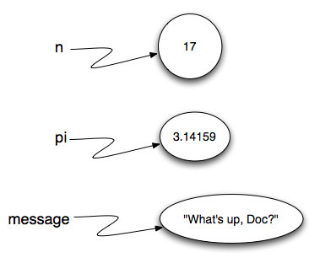
Assignment rules
in Python

Slide 46
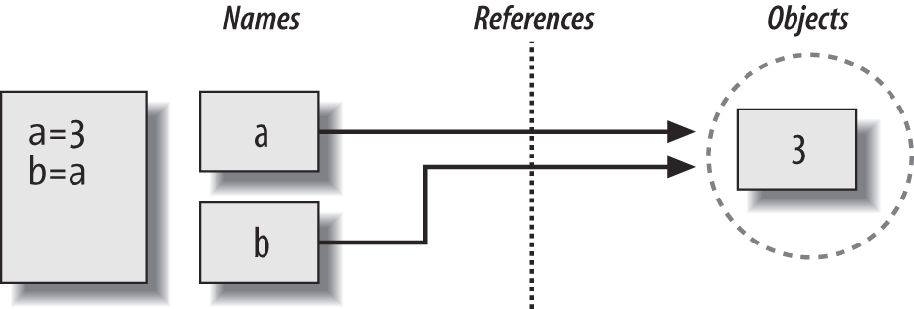
Assignment rules in Python
All information in Python is stored in objects of different types (no primitive types).
The following statement creates a new object AND a name pointing to it: a = 3
Assignment of a variable to another (like in b=a) actually copies the address in memory to which the name (variable) points.

Slide 47
Data Types: Mutable vs. Immutable
Objects of mutable types (lists etc.) can be modified after creation.
This is legal:
>>> my_list = [1, 2, 4, 5, 7, 8]
>>> my_list[4] = 500
Strings are Immutable
This is not legal (produces an error):
>>> my_string = 'aaa'
>>> my_string[2] = 'b'
Numeric types (int, float,…) are also Immutable
>>> a=5
>>> a=6 # (the variable a now references a new object)

Slide 48
Assignments of List Variables
>>> orig_list = [1,2,3]
>>> copy_list = orig_list
>>> orig_list = [6,7,8,9]
>>> copy_list
[1, 2, 3]
>>> orig_list
[6, 7, 8, 9]
So far - no surprises
Try it with pythontutor.com

Slide 49
Assignments of List Variables
>>> orig_list = [6,7,8,9]
>>> copy_list = orig_list
>>> orig_list[0] = 1000
>>> orig_list
[1000, 7, 8, 9]
>>> copy_list
[1000, 7, 8, 9]
Surprise!

Slide 50
Assignments of List Variables
List assignment orig_list = [6,7,8,9] creates:
a list object, [6,7,8,9]
a reference from the variable name, orig_list, to this object.
Memory
orig_list
[6,7,8,9]

Slide 51
Assignments of List Variables
The assignment copy_list = orig_list does not create a new object, just a new variable name, copy_list, which now refers to the same object.
Memory
orig_list
[6,7,8,9]
copy_list

Slide 52
Assignments of List Variables
The command orig_list[0] = 1000, changes the list referenced by orig_list.
These changes will also be apparent when we access the list object using another name variable referencing it – copy_list.
Memory
orig_list
[1000,7,8,9]
copy_list

Slide 53
Scope of a function Local vs. Global variables
Variables defined outside of a function are called Global variables.
Variables defined within a function are considered Local, and can be used only within the function’s block of code. Local variables disappear when the function ends.
When we send a variable to a function, the address stored in this variable is copied to the local variable of the function (Now both point to the same object in memory).
def my_func(x):
print(len(x))
a = [4, 5, 6, 7, 8]
my_func(a)
a is a global variable
x is a local variable within my_func
a
4 | 5 | 6 | 7 | 8 | 9
Function
x

Slide 54
Passing Arguments to Functions
Can functions change objects they receive as arguments ?
Functions cannot change immutable objects sent to them (like numeric types or strings).
Functions can change mutable objects sent to them (like lists). Changes made to these object will persist after the function ends.
a
4 | 5 | 6 | 7 | 8 | 9
Function
x

Slide 55
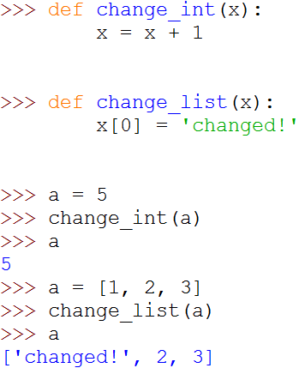
Example: Mutable vs. Immutable arguments to a function
IMPORTANT !

Slide 56
Summary: Options for returning information from a function
Using the return value of the function
By changing mutable arguments
By changing global variables (See Bonus section ahead), but this is not advised…

Slide 57
BONUS: Local vs. Global variables

Slide 58
Local vs. Global variables
A local variable is defined within a function, and exists only within that function.
A global variable is defined in the main script (outside of any function) and it is known globally (including within functions).
Global variables can be accessed within functions.
Defining a variable by the same name will create a local variable hiding the global variable
def myFunc():
localVar = 5
print(localVar)
print(globalVar)
globalVar = 10
myFunc()
print(globalVar + 1)
# print(localVar) ### Error
The scope of variable ‘localVar’
The scope of variable ‘globalVar’ is the entire program
Local variables exist only with the function in which they were defined
5
10
11

Slide 59
Local vs. Global variables
Use the global keyword
To define a global variable within a function
To state you are referring to an existing global variable, before you can change its value
def myFunc():
globalVar1 = 999
global globalVar2
globalVar2 = globalVar2 + 5
global globalVar3
globalVar3 = 30
globalVar1 = 10
globalVar2 = 20
myFunc()
print(globalVar1)
print(globalVar2)
print(globalVar3)
Defines a local variable that hides the global variable with the same name !
States that globalVar2 will refer to the existing global variable
Defined a new global variable within a function
10
25
30

