Slide 1
Programming for Engineers in Python
Fall 2020-2021
Lecture 5: I/O & Exceptions

Slide 2
Previously on
Python for engineers…
Working with variables
Different variable types:
Numbers (int, float, complex)
String
List, Tuple
Dictionary
Logic: if-elif-else, and-or-not
Loops: while and for
Functions

Slide 3
Plan for today
Input / Output
Keyboard input
Working with Files
Exceptions (Run-time exceptions)

Slide 4
Input/Output in Python
I/O operations allow our program to interact with its environment by receiving and sending information in various ways.
The print command sends output to the screen.
The input command receives input from the keyboard.
Returns a String containing text typed by the user (the program stops when the user presses ENTER).
You can specify a prompt message.

Slide 5
input: Receiving input from the keyboard
>>> s = input('Please enter a number:')
Please enter a number:
>>> s
"6"
>>> print(int(s)+5)
11
6

Slide 6
File I/O in Python
Working with files

Slide 7

File and Folders
A Computer-File is a resource for storing information; A “digital” document
Files are organized in folders (=directories).
Every file has an address (path) in the computer’s file system
Example: C:\Desktop\ta5_code\test_file.txt
The file’s extension represents its content type (txt, exe, mp3, avi, jpg)
Text files are composed of a sequence of characters
Binary files store a sequence of bytes representing any type of information (not necessarily encoding for characters)

Slide 8




The file system hierarchy
C:\
Python
←)Current directory)
analyze_data.py
Data
2020
income.txt
To access the file 'income.txt' from the code inside 'analyze_data.py' we can use:
Absolute path: C:\Data\2020\income.txt
Relative path: ..\Data\2020\income.txt

Slide 9
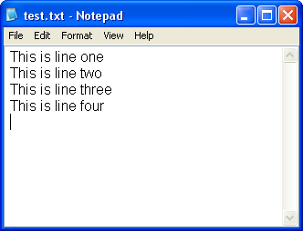
Text files
Text files are composed of lines of text.
Every line is composed of a sequence of characters.
The last character on every line is the special ‘end of line’ character ('\n'), usually hidden by most text editors.

Slide 10
Opening a connection to a file
open() returns a file object.
Most commonly used with two arguments: open(filename, mode).
filename: an address of a file.
mode:
'r' – read
'w' – write - overwrites (“deletes”) prior data
'a' – append - adds at end of prior data

Slide 11
Reading a whole file
>>> f = open('test_file.txt', 'r') # returns a file object
>>> s = f.read() # reads the entire file, returns its content as a string
>>> print(s)
'This is a file'
>>> f.close() # releases the file lock, frees resources
# in case the file is located in a different directory - use the full path
>>> f = open('C:/Users/Desktop/ta5_code/test_file.txt', 'r’)
>>> f
<_io.TextIOWrapper name='C:/Users/Desktop/ta5_code/test_file.txt' mode='r' encoding='cp1252'>
>>> f.read()
'This is a file'
>>> f.close()

Slide 12
Note about \
>>> f = open('C:/Users/Desktop/ta5_code/test_file.txt', 'r')
Be careful when using \ in strings representing file paths !
\ is normally used to indicate control characters.
For example '\n' in a string represents a new line!
Alternatives:
'C:/Users/Desktop/ta5_code/test_file.txt'
'C:\\Users\\Desktop\\ta5_code\\test_file.txt‘
r'C:\Users\Desktop\ta5_code\test_file.txt'

Slide 13
Reading line by line
The for loop is used to read line after line from a file object:
Storing read lines as a list of strings:
f = open('test_file_2.txt', 'r') for line in f: print(line, end='') f.close()
this is line 1
this is line 2
the end
f = open('test_file_2.txt', 'r') lines = [] for line in f: lines.append(line) f.close()
Or… use:
lines = f.readlines()

Slide 14
Four common ways for reading from a file
f.read() – reads an entire file as single string
f.readline() – reads the next line as a string
Relative to the current file position
f.readlines() – reads all remaining lines as a list of strings
Iterating a file using for loop:
for line in f:
…

Slide 15
Remarks
Read operations advance the file position.
To start reading a file from its beginning, we need to re-open it.
Remember to close the file using f.close() to free up resources!
In a string, '\n' represents the new line character.
>>> a_line = 'This is a line\nSecond line' >>> a_line
'This is a line\nSecond line'
>>> print(a_line)
This is a line
Second line

Slide 16
Parsing a text file – split()
Parsing: Reading a text file and breaking every line to fields based on some predefined format
The split command splits a string to tokens using a delimiter, returns a list of strings.
s = "topeka, kansas city,wichita,,olathe"
cities = s.split(',')
for city in cities:
print(city)
topeka
kansas city
wichita
olathe
If a delimiter is not specified, the string is split to words separated by a sequence of whitespaces.

Slide 17
Parsing a text file – strip(), rstrip(), lstrip()
Use strip() to remove unwanted characters from both sides of the string.
>>> ' spacious '.strip()
'spacious'
>>> 'www.example.com'.strip('comwz.')
'example'
The string method rstrip() can be used to get rid of trailing newlines (right-strip):
lines = ['this is line 1\n', 'this is line 2\n', 'the end']
for i in range(len(lines)):
lines[i] = lines[i].rstrip()
print(lines)
['this is line 1', 'this is line 2', 'the end']
What does lstrip() do?

Slide 18
Example: Printing word frequencies
Print the words appearing in a file sorted by decreasing frequencies (print most frequent word first)
f = open("input.txt", "r")
d = {}
for line in f:
for word in line.split():
d[word] = d.get(word, 0) + 1
f.close()
for w in sorted(d.keys(), key = d.get, reverse = True):
print(w + ":", d[w])
a: 23
and: 12
where: 5
I: 4

Slide 19
File output: writing to a file
Use the f.write(str)
# open a file (or create it if no such file exists)
f = open ('test_file_3.txt', 'w')
f.write("This is a test")
# newline
f.write('\n')
# to write a non-string object, first convert to string
tpl = ('string', 40)
f.write(str(tpl))
# flush data to the file and close it, unlock file, free resources
f.close()
f = open('test_file_3.txt', 'r')
print(f.read())
This is a test ('string', 40)

Slide 20
Example: Writing a list of numbers to a text file
my_list = [i**2 for i in range(1,11)]
# List comprehension !
# Generates a list of squares of the numbers 1 – 10
f = open("output.txt", "w")
for item in my_list:
f.write(str(item) + “\n")
f.close()

Slide 21
Summary
>>> fname = 'myfile.txt'
>>> f = open(fname, ’r’)
>>> lines = f.readlines()
>>> f.close()
>>> f = open(fname, ’r’)
>>> firstline = f.readline()
>>> secondline = f.readline()
>>> f = open(fname, ’r’)
>>> for l in f:
... print(l.split()[1])
>>> f.close()
>>> outfname = 'myoutput.txt'
>>> outf = open(outfname, 'w')
>>> outf.write('My very own file\n')
>>> outf.close()
lines holds a list of strings.
Each line from fname is a separate string in this list.
firstline holds the first line from fname as a string, while secondline holds the second line from fname.
The second word from each line in fname is printed.
Creates a new txt file (or overwrites, if a file with same name and path exists) with one line in it:
My very own file

Slide 22
Exceptions
Handling runtime errors

Slide 23
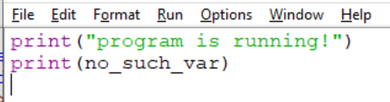
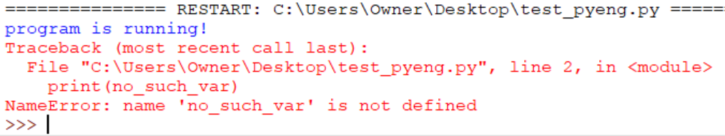
Exceptions
Exceptions are run-time errors.
A built-in mechanism for signaling problems at run-time.
No detection before the program runs, even if the error is “obvious”.
Unhandled exceptions crash (stop) our programs.
Type of Exception

Slide 24
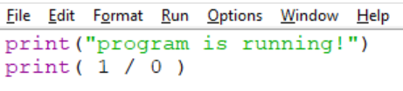
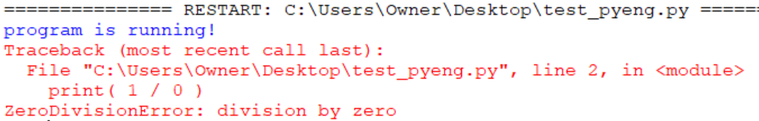

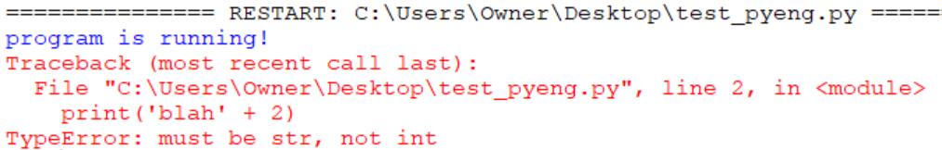
Exceptions –More Examples

Slide 25


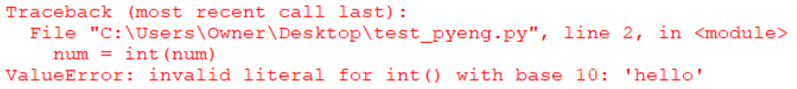
Exceptions – Not So Obvious
num = input('Number please: ')
num = int(num)

Slide 26
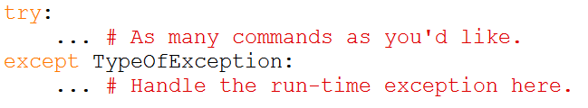
Handling Exceptions
We can define what happens when an exception occurs (error handling that will occur instead of a program crash)
Wrap your code by a try-except structure.
Commands in the try block are executed…
If no exception is raised by any command: Skip the except block.
If an exception of type TypeOfException is raised by one of the commands in the try section, leave the try section and jump to execute the except block.

Slide 27
Try/Except – example 1
x = 5
y = 0
print('before try')
try:
print('inside try')
print(x/y)
print('exiting try')
except ZeroDivisionError:
print('exception was handled')
print('continue program')
output
before try

Slide 28
Try/Except – example 1
x = 5
y = 0
print('before try')
try:
print('inside try')
print(x/y)
print('exiting try')
except ZeroDivisionError:
print('exception was handled')
print('continue program')
output
before try
inside try

Slide 29
Try/Except – example 1
x = 5
y = 0
print('before try')
try:
print('inside try')
print(x/y)
print('exiting try')
except ZeroDivisionError:
print('exception was handled')
print('continue program')
ZeroDivisionError!!!
output
before try
inside try

Slide 30
Try/Except – example 1
x = 5
y = 0
print('before try')
try:
print('inside try')
print(x/y)
print('exiting try')
except ZeroDivisionError:
print('exception was handled')
print('continue program')
output
before try
inside try
exception was handled

Slide 31
Try/Except – example 1
x = 5
y = 0
print('before try')
try:
print('inside try')
print(x/y)
print('exiting try')
except ZeroDivisionError:
print('exception was handled')
print('continue program')
output
before try
inside try
exception was handled
continue program

Slide 32
try-except Operation
1. The commands in the body of try execute…
2. If exception of type E occurs at some command:
1. Skip the rest of the try commands.
2. If E matches TypeOfException:
Run the commands in the body of except.

Slide 33
Try/Except – example 2
x = 5
y = 1
print('before try')
try:
print('inside try')
print(x/y)
print('exiting try')
except ZeroDivisionError:
print('exception was handled')
print('continue program')
output
before try

Slide 34
Try/Except – example 2
x = 5
y = 1
print('before try')
try:
print('inside try')
print(x/y)
print('exiting try')
except ZeroDivisionError:
print('exception was handled')
print('continue program')
output
before try
inside try

Slide 35
Try/Except – example 2
x = 5
y = 1
print('before try')
try:
print('inside try')
print(x/y)
print('exiting try')
except ZeroDivisionError:
print('exception was handled')
print('continue program')
output
before try
inside try
5

Slide 36
Try/Except – example 2
x = 5
y = 1
print('before try')
try:
print('inside try')
print(x/y)
print('exiting try')
except ZeroDivisionError:
print('exception was handled')
print('continue program')
output
before try
inside try
5
exiting try

Slide 37
Try/Except – example 2
x = 5
y = 1
print('before try')
try:
print('inside try')
print(x/y)
print('exiting try')
except ZeroDivisionError:
print('exception was handled')
print('continue program')
The try block didn’t raise an exception of type ZeroDivisionError, so we don’t enter the except block
output
before try
inside try
5
exiting try
continue program

Slide 38

try-except Operation
1. The commands in the body of try execute…
2. If exception of type E occurs at some command:
1. Skip the rest of the try commands.
2. If E doesn’t match TypeOfException:
Exception “goes up” to the caller of try.
If caller doesn’t handle it – program terminates.

Slide 39
Try/Except – example 3
x = 5
y = 'abc'
print('before try')
try:
print('inside try')
print(x/y)
print('exiting try')
except ZeroDivisionError:
print('exception was handled')
print('continue program')
output
before try

Slide 40
Try/Except – example 3
x = 5
y = 'abc'
print('before try')
try:
print('inside try')
print(x/y)
print('exiting try')
except ZeroDivisionError:
print('exception was handled')
print('continue program')
output
before try
inside try

Slide 41
Try/Except – example 3
x = 5
y = 'abc'
print('before try')
try:
print('inside try')
print(x/y)
print('exiting try')
except ZeroDivisionError:
print('exception was handled')
print('continue program')
TypeError!!!
output
before try
inside try

Slide 42
Try/Except – example 3
x = 5
y = 'abc'
print('before try')
try:
print('inside try')
print(x/y)
print('exiting try')
except ZeroDivisionError:
print('exception was handled')
print('continue program')
The except block doesn’t handle TypeError, so the exception is not handled and the program stops.
output
before try
inside try
…
print(x/y)
TypeError: unsupported operand type(s) for /: 'int' and 'str'

Slide 43
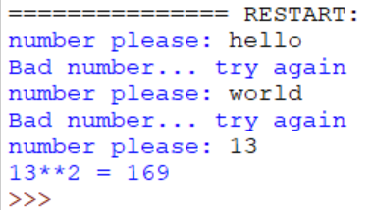
Example for using try/except
while True:
try:
num = input('number please: ')
num = int(num)
break
except ValueError:
print('Bad number... try again')
print(str(num) + '**2 =', num**2)

Slide 44
Handling Different Exceptions Differently
try:
# Something dangerous
except TypeError:
# Handle type error
except IndexError:
# Handle index error
except:
# Handle all other types

Slide 45
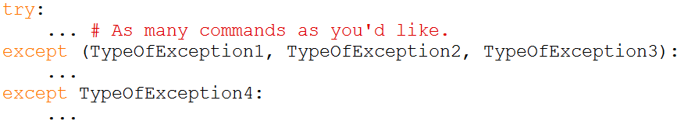
Handling Several Exception Types
Actually, why not catch and ignore all exception types?
→ Our program would never terminate due to error.
→ But we’d also miss run-time problems and logical errors.

Slide 46
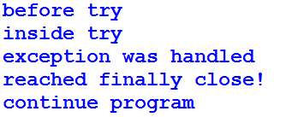
finally code is always executed
x = 5
y = 0
print('before try')
try:
print('inside try')
print(x/y)
print('exiting try')
except ZeroDivisionError:
print('exception was handled')
finally:
print('reached finally close!')
print('continue program')
No matter what happens, the finally block will be executed!

Slide 47
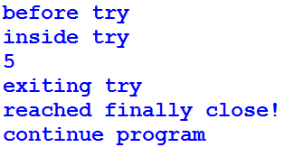
try/except/finally
x = 5
y = 1
print('before try')
try:
print('inside try')
print(x/y)
print('exiting try')
except ZeroDivisionError:
print('exception was handled')
finally:
print('reached finally close!')
print('continue program')
No matter what happens, the finally close will be executed!

Slide 48
try/except/finally
x = 5
y = 'abc'
print('before try')
try:
print('inside try')
print(x/y)
print('exiting try')
except ZeroDivisionError:
print('exception was handled')
finally:
print('reached finally close!')
print('continue program')
No matter what happens, the finally close will be executed!
before try
inside try
reached finally close!
...
print(x/y)
TypeError: unsupported operand type(s) for /: 'int' and 'str'

Slide 49

How can YOU raise an exception?
How can you signal something went wrong in your code by raising an exception ?

Slide 50
raise an Exception
Suppose you write a function, which can encounter some error cases.
Examples: invalid input ; no solution to equation ; invalid list index.
Previously, you handled this by printing an error message.
➔But the function caller can ignore this print.
Raising an exception is the more “built-in” way to signal something went wrong in your function.
➔The function caller cannot ignore this!
➔ raise stops the code’s execution and signals that specific runtime error was encountered
def my_func(x):
…
if some_error_condition:
raise TypeOfException()

Slide 51

raise Example – Quadratic Equation
Find real solutions of $ax^{2}+bx+c=0$ for given $a,b,c$.
Possible error conditions:
$a=0$ → Not a quadratic equation.
$b^{2}−4ac<0$ → No real solutions.
In these cases, we’ll raise an exception of type ValueError.
def solve_quadratic(a, b, c):
if a == 0:
raise ValueError('Not quadratic')
delta = b**2 - 4*a*c
if delta < 0:
raise ValueError('No real solution')
sol1 = (-b + delta**0.5) / (2*a)
sol2 = (-b - delta**0.5) / (2*a)
return (sol1, sol2) # possibly sol1 = sol2

Slide 52
raise Example – Quadratic Equation
Executing the function with certain inputs will trigger a runtime error
def solve_quadratic(a, b, c):
if a == 0:
raise ValueError('Not quadratic')
delta = b**2 - 4*a*c
if delta < 0:
raise ValueError('No real solution')
sol1 = (-b + delta**0.5) / (2*a)
sol2 = (-b - delta**0.5) / (2*a)
return (sol1, sol2) # possibly sol1 = sol2
>>> solve_quadratic(0,3,4)
Traceback (most recent call last):
File "<pyshell#38>", line 1, in <module>
solve_quadratic(0,3,4)
File "C:\Users\Owner\Desktop\test_pyeng.py", line 3, in solve_quadratic
raise ValueError('Not quadratic')
ValueError: Not quadratic

Slide 53
Handling exceptions – Quadratic Equation
What if we want to handle runtime exceptions and then continue running the program (avoid program crashing)?
def solve_quadratic(a, b, c):
if a == 0:
raise ValueError('Not quadratic')
delta = b**2 - 4*a*c
if delta < 0:
raise ValueError('No real solution')
sol1 = (-b + delta**0.5) / (2*a)
sol2 = (-b - delta**0.5) / (2*a)
return (sol1, sol2) # possibly sol1 = sol2
print('START')
try:
a, b, c = 2, 3, 1
s1, s2 = solve_quadratic(2, 3, 1)
print(s1, s2)
except ValueError:
print('Problem!')
print('Next commands')
Notes:
def solve_quadratic(a, b, c):
if a == 0:
raise ValueError('Not quadratic')
delta = b ** 2 - 4 * a * c
if delta < 0:
raise ValueError('No real solution')
sol1 = (-b + delta ** 0.5) / (2 * a)
sol2 = (-b - delta ** 0.5) / (2 * a)
return (sol1, sol2) # Possibly sol1 == sol2
print ('START')
try:
a, b, c = 0, 3, 1
s1,s2 = solve_quadratic (a, b, c)
print s1,s2
except ValueError:
print ('Problem !')
print ('Next commands')

Slide 54
Handling exceptions – Quadratic Equation
print('START')
try:
a, b, c = 2, 3, 1
s1, s2 = solve_quadratic(a,b,c)
print(s1, s2)
except ValueError:
print('Problem!')
print('Next commands')
print('START')
try:
a, b, c = 0, 3, 1
s1, s2 = solve_quadratic(a,b,c)
print(s1, s2)
except ValueError:
print('Problem!')
print('Next commands')
Output:
Output:
START
-0.5 -1.0
Next commands
START
Problem!
Next commands

Slide 55
Resource Cleanup
Run-time errors are very common in programs conducting I/O operations
The file we try to open does not exist
The disk runs out of space while we write to a file
Catching IO-Exceptions allows proper handling of such cases.

Slide 56
try/except/finally - Example
fhandle = open('file1.txt', 'w')
try:
fhandle.write('File for exception handling')
except IOError:
print('Error')
finally:
print('closing file')
fhandle.close()
Note: Exceptions raised by the open command are not handled in the code above.

Slide 57
finally always runs at the end… used to free resources
f = None
try:
f = open('testfile.txt', 'w') # f remains None if open fails
f.write('This is it!!')
except IOError:
print("Error: can't find file or read data")
finally:
if f != None: # closing f only if it was successfully opened
f.close()
This finally block always runs after the try block (whether exception was raised or not). Use it to run commands that are always required to run at the end – like closing open files.
We will use this recipe for handling IOErrors in most cases

Slide 58
with automatically closes the file
The following two code blocks are equivalent:
try:
f = open('file.txt', 'w')
try:
f.write('Hello World!')
finally:
f.close()
except IOError:
print('oops!')
------------------------------
try:
with open('file.txt', 'w') as outfile:
outfile.write('Hello World!')
except IOError:
print('oops!')
Note: The code in this page includes error handling for both the open and the following IO commands, and also ensures closing of the opened file.
USE ONE OF THESE TWO VERSIONS IN REAL LIFE FOR FULL PROTECTION AGAINST IO ERRORS…

Slide 59
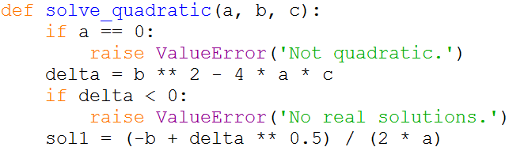

Bonus: Extracting the exception’s error message
We raised an exception with an error message using raise E(‘String with more info').
The caller can then extract the string for more info.
try:
a, b, c = 2, 3, 10
solve_quadratic(a, b, c)
except ValueError as err:
print('Problem for a,b,c =', a, b, c, ':', err.args[0])

