Slide 1
Programming for Engineers in Python
Fall 2020-2021
Lecture 6: Recursion

Slide 2
Function calls
What happens when a function calls another functions ?
def f():
s = "f "
print(s + "start")
g()
print(s + "done")
def g():
s = "g "
print(s + "start")
h()
print(s + "done")
def h():
s = "h "
print(s + "start")
print(s + "done")
f()
When a function terminates, its call frame is removed from the stack
A new function call opens a new frame to store local variables
h()
s
"h "
g()
s
"g "
f start
g start
h start
h done
g done
f done
f()
s
"f "
Call Stack
(LIFO)

Slide 3
Calculating Factorial
n! = 1*2*3*…(n-1)*n
An iterative implementation:
def iterative_factorial(n):
result = 1
for i in range(2, n+1):
result *= i
return result
An alternative Recursive definition:
n! = n * (n-1)!
0! = 1
Can we use this approach to implement another version of factorial calculation in Python ?

Slide 4
Iterative Versus Recursive
Step by step (iteratively):
n! = 1*2*3*….*n
4! = 1*2*3*4 = 2*3*4 = 6*4 = 24
n iterations
Recursively:
n! = n*(n-1)!
0! = 1
4! = 4*3!
= 4*(3*2!)
= 4*(3*(2*1!))
=4*(3*(2*(1*0!)))
=4*(3*(2*(1*1)))
=4*(3*(2*1))
= 4*(3*2) = 4*6 = 24

Slide 5
Recursive Definition
Factorial
Calculate result using a recursive call
n! = n * (n-1)!
0! = 1
Smaller instance
Base condition

Slide 6



Recursive Implementation of Factorial in Python
def factorial(n):
if n == 0:
return 1
return n * factorial(n-1)
stop condition
calculate the result using a recursive call
advance towards base case

Slide 7
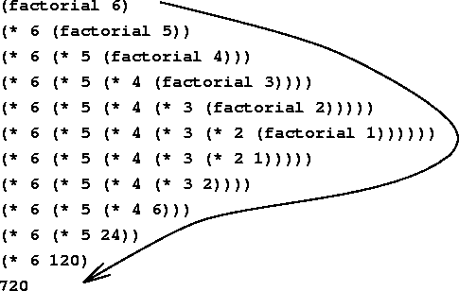
Recursion
Recursive function:
A function whose implementation calls itself (with different arguments).
Recursive Solution
A solution to a “large” problem using solutions to “small” problems that assemble it.

Slide 8
Recursive factorial – step by step
def factorial(n):
if n == 0:
return 1
return n * factorial(n-1)
factorial(4)
n
4
Returns…

Slide 9
Recursive factorial – step by step
def factorial(n):
if n == 0:
return 1
return n * factorial(n-1)
factorial(4)
n
4
Returns…

Slide 10
Recursive factorial – step by step
def factorial(n):
if n == 0:
return 1
return n * factorial(n-1)
factorial(4)
n
4
Returns…
4*…

Slide 11
Recursive factorial – step by step
def factorial(n):
if n == 0:
return 1
return n * factorial(n-1)
factorial(4)
factorial(3)
n
n
4
3
Returns…
Returns…
4*…

Slide 12
Recursive factorial – step by step
def factorial(n):
if n == 0:
return 1
return n * factorial(n-1)
factorial(4)
factorial(3)
n
n
4
3
Returns…
Returns…
4*…

Slide 13
Recursive factorial – step by step
def factorial(n):
if n == 0:
return 1
return n * factorial(n-1)
factorial(4)
factorial(3)
n
n
4
3
Returns…
Returns…
4*…
3*…

Slide 14
Recursive factorial – step by step
def factorial(n):
if n == 0:
return 1
return n * factorial(n-1)
factorial(4)
factorial(3)
factorial(2)
n
n
4
n
3
2
Returns…
Returns…
4*…
Returns…
3*…

Slide 15
Recursive factorial – step by step
def factorial(n):
if n == 0:
return 1
return n * factorial(n-1)
factorial(4)
factorial(3)
factorial(2)
n
n
4
n
3
2
Returns…
Returns…
4*…
Returns…
3*…

Slide 16
Recursive factorial – step by step
def factorial(n):
if n == 0:
return 1
return n * factorial(n-1)
factorial(4)
factorial(3)
factorial(2)
n
n
4
n
3
2
Returns…
Returns…
4*…
Returns…
3*…
2*…

Slide 17
Recursive factorial – step by step
def factorial(n):
if n == 0:
return 1
return n * factorial(n-1)
factorial(4)
factorial(3)
factorial(2)
n
factorial(1)
n
4
n
3
n
2
Returns…
1
Returns…
4*…
Returns…
3*…
Returns…
2*…

Slide 18
Recursive factorial – step by step
def factorial(n):
if n == 0:
return 1
return n * factorial(n-1)
factorial(4)
factorial(3)
factorial(2)
n
factorial(1)
n
4
n
3
n
2
Returns…
1
Returns…
4*…
Returns…
3*…
Returns…
2*…

Slide 19
Recursive factorial – step by step
def factorial(n):
if n == 0:
return 1
return n * factorial(n-1)
factorial(4)
factorial(3)
factorial(2)
n
factorial(1)
n
4
n
3
n
2
Returns…
1
Returns…
4*…
Returns…
3*…
Returns…
2*…
1*…

Slide 20
Recursive factorial – step by step
def factorial(n):
if n == 0:
return 1
return n * factorial(n-1)
factorial(4)
factorial(3)
factorial(2)
n
factorial(1)
n
4
n
3
n
2
Returns…
1
Returns…
4*…
Returns…
3*…
Returns…
2*…
1*…

Slide 21
Recursive factorial – step by step
def factorial(n):
if n == 0:
return 1
return n * factorial(n-1)
factorial(4)
factorial(3)
factorial(2)
n
factorial(1)
n
factorial(0)
4
n
3
n
2
n
Returns…
1
Returns…
0
4*…
Returns…
3*…
Returns…
2*…
Returns…
1*…

Slide 22
Recursive factorial – step by step
def factorial(n):
if n == 0:
return 1
return n * factorial(n-1)
factorial(4)
factorial(3)
factorial(2)
n
factorial(1)
n
factorial(0)
4
n
3
n
2
n
Returns…
1
Returns…
0
4*…
Returns…
3*…
Returns…
2*…
Returns…
1*…
1

Slide 23
Recursive factorial – step by step
def factorial(n):
if n == 0:
return 1
return n * factorial(n-1)
factorial(4)
factorial(3)
factorial(2)
n
factorial(1)
n
4
n
3
n
2
Returns…
1
Returns…
4*…
Returns…
3*…
Returns…
2*…
1*1

Slide 24
Recursive factorial – step by step
def factorial(n):
if n == 0:
return 1
return n * factorial(n-1)
factorial(4)
factorial(3)
factorial(2)
n
n
4
n
3
2
Returns…
Returns…
4*…
Returns…
3*…
2*1

Slide 25
Recursive factorial – step by step
def factorial(n):
if n == 0:
return 1
return n * factorial(n-1)
factorial(4)
factorial(3)
n
n
4
3
Returns…
Returns…
4*…
3*2

Slide 26
Recursive factorial – step by step
def factorial(n):
if n == 0:
return 1
return n * factorial(n-1)
factorial(4)
n
4
Returns…
4*6

Slide 27

Recursion
In every recursive call the problem is reduced.
When the problem is small enough - solve directly (base case).
A divide and conquer
strategy

Slide 28

Pros and Cons
Pros
Short
Natural for some problems
Cons
Computationally inefficient
Hard to understand

Slide 29
General Form of Recursive Algorithms
def factorial(n):
if n == 0:
return 1
return n * factorial(n-1)
Recursive case - decomposable problem.
Must be:
at least one base case (the stop condition)
at least one recursive call.

Slide 30
Short Summary
Design a recursive algorithm by
Breaking of big problems to smaller problems
Solving base cases directly.
Recursive algorithms have
1. Stopping criteria
2. Recursive call(s)
3. A solution that uses solutions of smaller cases

Slide 31

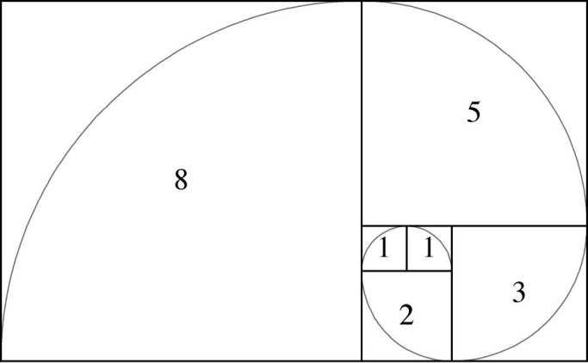

Slide 32
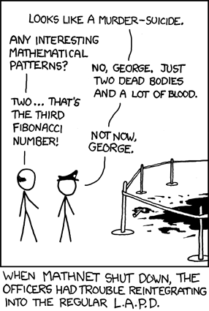
Example: Fibonacci Series
Fibonacci series
0, 1, 1, 2, 3, 5, 8, 13, 21, 34
Definition:
fib(0) = 0
fib(1) = 1
fib(n) = fib(n-1) + fib(n-2)
en.wikipedia.org/wiki/Fibonacci_number

Slide 33
Fibonacci
“Naturally” recursive
Therefore, the recursive definition is:
fib(0) = 0
fib(1) = 1
fib(n) = fib(n-1) + fib(n-2)
Base case
Base case
Recursive calls
+
def fibonacci_rec(n):
if n < 2:
return n
return fibonacci_rec(n-1) + fibonacci_rec(n-2)

Slide 34
Example: Modulo
Given the following iterative version of modulo calculation - find the recursive definition
def modulo_iter(a, b):
while a >= b:
a -= b
return a
Base case?
What is the recursive call?
How do we use the result of the recursive call to calculate the value for n?

Slide 35
Solution: Recursive Modulo
def modulo_rec(a, b):
if a < b:
return a
else:
return modulo_rec(a-b, b)

Slide 36
Recursive List sum
Given a list of numbers, calculate their sum using a recursive function.
Now write an alternative implementation that does not use slicing..
def rec_sum_list(lst):
if len(lst) == 1:
return lst[0]
return lst[0] + rec_sum_list(lst[1:])
>>> rec_sum_list([1,3,5,7])
16

Slide 37
Recursive List sum
def rec_sum_list(lst):
if len(lst) == 1:
return lst[0]
return lst[0] + rec_sum_list(lst[1:])
# A more efficient version that does not uses slicing
# (slicing create a copy of the sliced sub-list)
def rec_sum_list_idx(lst, idx):
if idx == len(lst)-1:
return lst[idx]
return lst[idx] + rec_sum_list_idx(lst, idx+1)
myList = [3,7,2,1]
print(sum(myList)) # using Python's built-in sum function
print(rec_sum_list(myList)) # using our own recursive implementation
print(rec_sum_list_idx(myList, 0)) # using efficient recursive implementation
Even better: idx=0
13
13
13

Slide 38
Recursive Nested-lists Sum
Input: a list of lists, each internal list contains only numbers
Output: a list that contains the sums of each internal list from the input.
For example:
For [ [1,2,3], [4] ] the result is [6, 4]

Slide 39
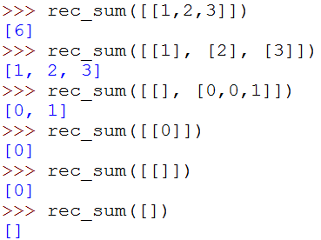
Recursive Nested-lists Sum
More examples:
In this call, the input contains only one list. The list has no elements, so its sum is 0.
In this call, there are no lists to sum, so the output would be an empty list
The number of elements in the returned list equals to the number of lists in the input list

Slide 40
Recursive Nested-lists Sum
The recursive implementation has 3 steps:
Stop condition
Advance toward the base case
Solve the problem using a recursive call

Slide 41
Recursive Nested-lists Sum – base case
Easy!

Slide 42
Advancing towards the base condition
The input is a list
The base condition is an empty list
A recursive call with a shorter list is considered to be an easier case.
Usually take off the first or last element
In addition, we advance toward the base list: if we take elements off the list, eventually we’ll get an empty list.

Slide 43
Using the recursive call
Having an actual example may help
let’s consider this example [[1,2,3], [5],[6,1]]
 | input | result
Our problem | [[1,2,3], [5],[6,1]] | [6, 5, 7]
Recursive call | [[5],[6,1]] | [5,7]
How can we use the result of the recursive call?
If we got [5,7], we need to insert 6 to the list.
How do we get the item 6?
It’s the sum of the list [1,2,3]

Slide 44
Using the recursive call
rec_sum( [ [1,2,3] , [5] , [6,1] ] )
sum([1,2,3])
rec_sum([[5] , [6,1]])
6
[5 , 7]
return:
[6] + [5,7]
Our plan:
Given a list:
First element in the resulting list: sum of the first sublist
To get the rest of the elements – a recursive call with a shorter list

Slide 45
Recursive Nested-lists Sum
def rec_sum(lst):
if len(lst) == 0:
return []
return [sum(lst[0])] + rec_sum(lst[1:])
l = [[1,2,3], [5], [6,1]]
print(rec_sum(l))
[6, 5, 7]

Slide 46
def rec_sum(lst):
if len(lst) == 0:
return []
return [sum(lst[0])] + rec_sum(lst[1:])
rec_sum([[1,2,3],[5],[6,1]])
return: [6] + rec_sum([[5],[6,1]])
return: [5] + rec_sum([[6,1]])
return: [7] + rec_sum([])
return: []

Slide 47
def rec_sum(lst):
if len(lst) == 0:
return []
return [sum(lst[0])] + rec_sum(lst[1:])
rec_sum([[1,2,3],[5],[6,1]])
return: [6] + [5,7]
return: [6] + rec_sum([[5],[6,1]])
return: [5] + [7]
return: [5] + rec_sum([[6,1]])
return: [7] + []
return: [7] + rec_sum([])
return: []

Slide 48

Thumb rules for using the recursive call result
Let’s assume:
The recursive call result is stored in rec_res
The returned value of the function is stored in res
how do we use rec_res to get res | The type of rec_res | The type of res
+, *, max, min | numeric | numeric
or, and, not | boolean | boolean
res will contain all values from rec_res, another value of type X will be computed and appended to res | List of values of type X | List of values of type X
This applies to most cases, but not to all the possible cases !

Slide 49
Example: Odd-Even
Given a function odd(n)
Odd n - return True, Even n – return False
Write a function even(n) that:
Even n - return True, Odd n – return False
This is easy!
49

Slide 50
Odd-Even
def even(n):
if n == 0:
return True
else:
return odd(n-1)
def odd(n):
if n == 1:
return True
else:
return even(n-1)
>>> even(4)
True
>>> odd(5)
True
Is this implementation correct?
50

Slide 51
Odd-Even
>>> even(3)
Traceback (most recent call last):
File "<pyshell#20>", line 1, in <module>
even(3)
File "C:\Users\Owner\Desktop\test_pyeng.py", line 5, in even
return odd(n-1)
File "C:\Users\Owner\Desktop\test_pyeng.py", line 11, in odd
return even(n-1)
…
…
…
File "C:\Users\Owner\Desktop\test_pyeng.py", line 11, in odd
return even(n-1)
File "C:\Users\Owner\Desktop\test_pyeng.py", line 5, in even
return odd(n-1)
File "C:\Users\Owner\Desktop\test_pyeng.py", line 8, in odd
if n == 1:
RecursionError: maximum recursion depth exceeded in comparison
51

Slide 52
Odd-Even
def even(n):
if n == 0:
return True
else:
return odd(n-1)
def odd(n):
if n == 1:
return True
else:
return even(n-1)
We never return False!
52

Slide 53
Odd-Even
def even(n):
if n == 0:
return True
else:
return odd(n-1)
def odd(n):
if n == 0:
return False
else:
return even(n-1)
>>> even(4)
True
>>> even(3)
False
>>> odd(4)
False
>>> odd(3)
True
53

Slide 54
Is the solution for recursive sum of nested-lists the most efficient?
def rec_sum(lst):
if len(lst) == 0:
return []
return [sum(lst[0])] + rec_sum(lst[1:])
In each recursive step we use slicing, which creates a new (shorter) list
Can we avoid slicing?

Slide 55
Recursive sum of nested-lists Alternative solution
We can use the same list for all the recursive calls.
But how do we generate an “easier” problem?
Add another parameter – the index of the current item

Slide 56
Recursive sum of nested-lists Alternative solution
Our plan:
Given a list(lst) + the index of the current item (i):
Put aside the first element lst[i]
Recursive call with the shorter list the same list and the index i-1 and save the result (also possible to use i+1 – we can move in both directions)
Add to this result the sum of the element we put aside.
Return the result.

Slide 57
Recursive sum of nested-lists Alternative solution
The stop condition:
Previously: stop when len(lst) == 0
Now:
What about i==0?
Not good! When i == 0 we still have one element to consider: lst[i]
The corrent condition is: i == -1:
This indicate that we went over all the elements in the list

Slide 58
Recursive sum of nested-lists Alternative solution
First call:
rec_sum(lst, len(lst)-1)
def rec_sum(lst, i):
if i == -1:
return []
return [sum(lst[i])] + rec_sum(lst, i-1)
Also possible:
def rec_sum(lst, i=0):
if i == len(lst):
return []
return [sum(lst[i])] + rec_sum(lst, i+1)
First call:
rec_sum(lst)

Slide 59
Example: Sort Dictionary Values By Key
We wish to write a function that given a dictionary returns a list of its values, sorted by the keys (in descending order of the keys)
This can be done in several ways, let’s try a recursive solution.
>>> d = {1 : 'a', 2 : 'b', 5 : 'c', 4 : 'e'}
>>> sort_by_keys(d)
['c', 'e', 'b', 'a']

Slide 60
Sort a Dictionary Values By Key
base case:
For an empty dictionary we return an empty list (no values)
Recursive call:
Select the maximum key and add its value to the result list as the first element.
Recursive call for the rest of the dictionary and add the results to the list of values.

Slide 61
Sort a Dictionary Values By Key
Find the max key
def sort_by_keys(d):
res = []
if d == {}:
return res
max_key = max(d.keys())
max_val = d.pop(max_key)
res.append(max_val)
res.extend(sort_by_keys(d))
return res
Find value for max key, and remove the key from the dictionary
Add max_val to the result list
Recursive call for d after max_key is removed (a smaller problem).
The result list is extended with the result of the recursive call

Slide 62
Towers of Hanoi
Extra Example:

Slide 63
Towers of Hanoi
Objective:
Move the entire stack of disks from rode S (source) to T (target) using A (auxiliary)
S
A
T

Slide 64
The Rules
Only one disk may be moved at a time
Each move consists of taking the upper disk from one of the rods and sliding it onto another rod
No disk may be placed on top of a smaller disk
S
A
T

Slide 65
Examples
S
A
T
S
A
T
1 disk – very easy!
2 disks – very easy!
S
A
T
S
A
T
3 disks – easy
4 disks?

Slide 66
Solution for 4 Disks
S
A
T
S
A
T
S
A
T
S
A
T

Slide 67
For n Disks?
S
A
T

Slide 68
Assume We Have a Solution for n-1 Disks
S
A
T

Slide 69
Solution: Step 1
S
A
T

Slide 70
Solution: Step 2
S
A
T

Slide 71
Solution: Step 3
S
A
T

Slide 72
How to Solve for n-1 Disks?
Easy!

Slide 73
Algorithm for n Disks
S
A
T
If there is only a single disk – easy!
Move n-1 disks from S to A (T is the auxiliary rode)
Move disk from S to T
Move n-1 disks from A to T (S is the auxiliary rode)
Let us write it in Python…

Slide 74
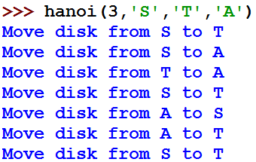
A Python Program for Towers of Hanoi
def hanoi(n, S, T, A):
'''
n - number of disks
S - source, T - target, A - auxiliary
'''
if n == 1: # 1
print('Move disk from', S, 'to', T)
return
hanoi(n-1, S, A, T) # 2
print('Move disk from', S, 'to', T) # 3
hanoi(n-1, A, T, S) # 4
S
A
T
If there is only a single disk – easy!
Move n-1 disks from S to A (T is the auxiliary rode)
Move disk from S to T
Move n-1 disks from A to T (S is the auxiliary rode)

Slide 75
Remember the Calling Stack?
def hanoi(n, S, T, A):
''' n - number of disks
S - source, T - target, A - auxiliary
'''
if n == 1:
print('Move disk from', S, 'to', T)
return
hanoi(n-1, S, A, T)
print('Move disk from', S, 'to', T)
hanoi(n-1, A, T, S)
hanoi(3,'S','T','A')
hanoi(2,'S','A','T')
hanoi(2,'A','T','S')
hanoi(2,'S','A','T')
hanoi(1,'S','T','A')
move disk from S to T
hanoi(1,'T','A','S')
move disk from S to A
move disk from T to A
hanoi(1,'S','T','A')
hanoi(1,'T','A','S')
move disk from S to T
And so on…

