Slide 1
Programming for Engineers in Python
Fall 2019-2020
Lecture 8:
Object Oriented Programming 1

Slide 2
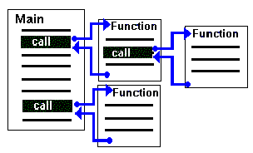
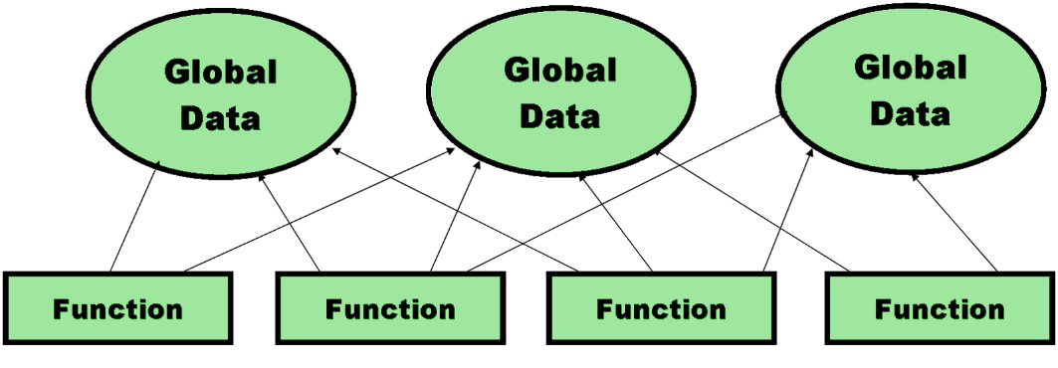
Procedural Programming
Up until now, we only used functions to organize our code into modular code blocks.
Why is this important ?
How would we implement a software system for managing students’ grades that way?
By this approach, data is usually being stored in global data structures and accessed by many different functions.

Slide 3
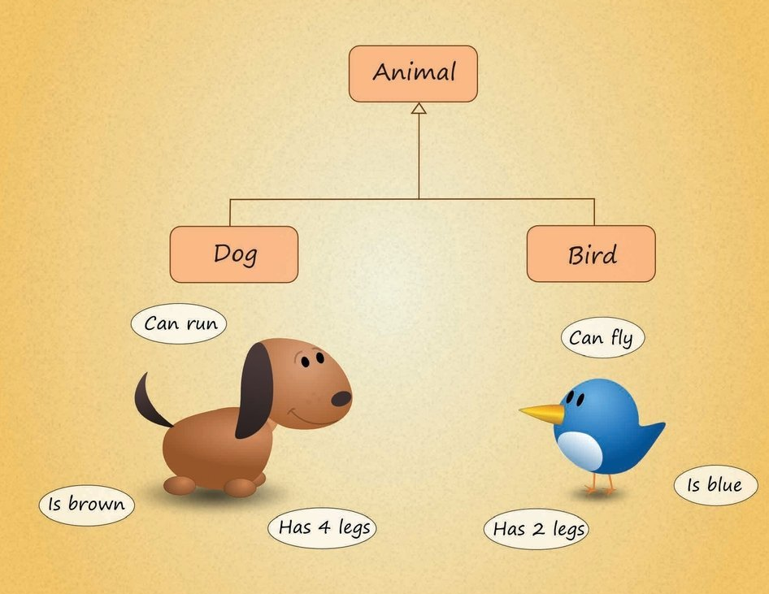
Object-Oriented Programming
In Object Oriented Programming, we model the entities of the real world using objects.

Slide 4
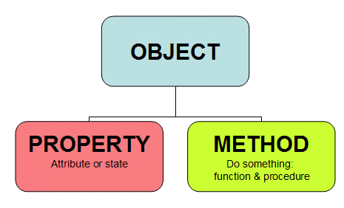
Object-Oriented Programming
In Object Oriented Programming, we model the entities of the real world using objects.
Objects holds both code (functions) and data for the entities they represent.

Slide 5
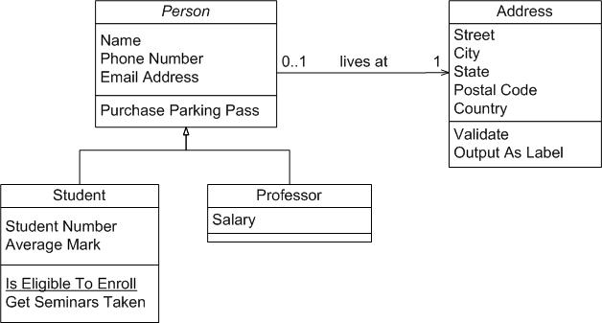
Object-Oriented Programming
Wikipedia:
An object-oriented program may be viewed as a collection of interacting objects, as opposed to the conventional model, in which a program is seen as a list of tasks (subroutines) to perform.
5

Slide 6
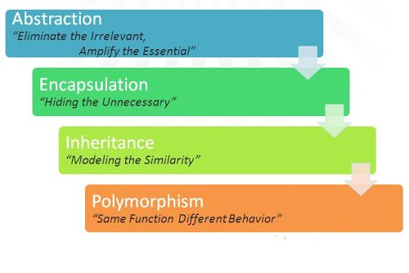
Characteristics of the Object-Oriented Paradigm

Slide 7
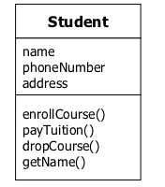
Example: An object that represents a Student
Data: Attributes (==Variables/Fields)
Functionality: Methods (==Functions)

Slide 8

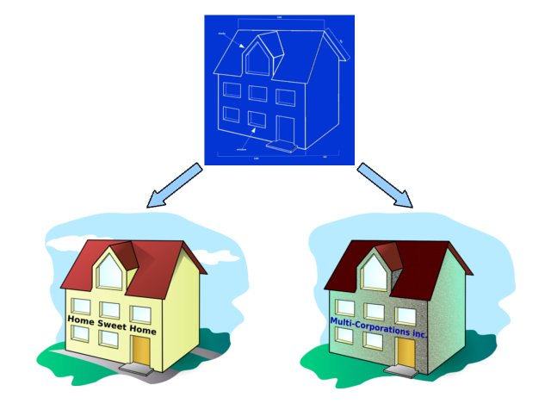
Classes are user-defined types
In OOP, a Class is a piece of code that defines a new object type.
A class defines which attributes (fields) will be allocated in memory for each object (instance) of the class.
A class contains the code for the functions of a given object type.
Classes can viewed as a blueprint for creating objects.

Slide 9
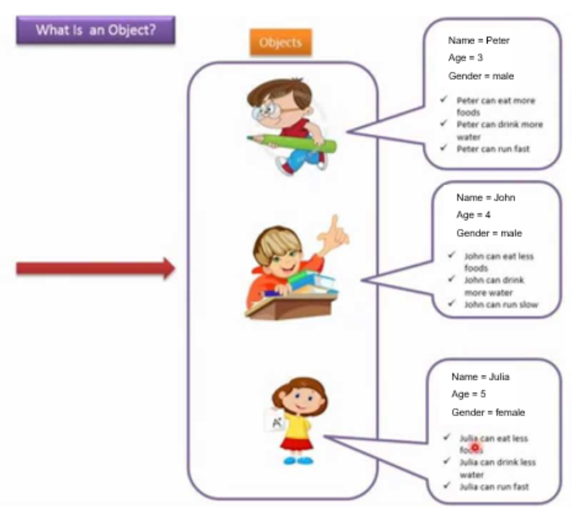
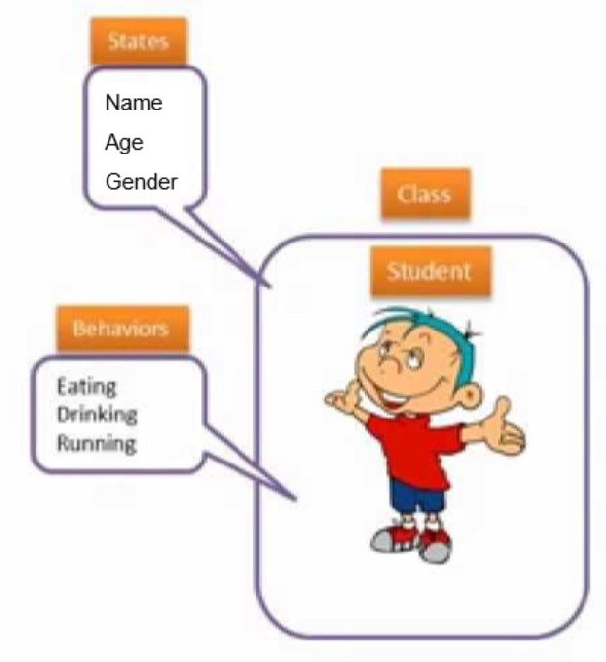
Classes and Objects
A class defines a new type of which many objects (instances) can be created.
Each object may hold different values for the class fields.

Slide 10
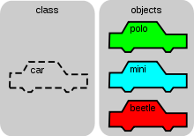
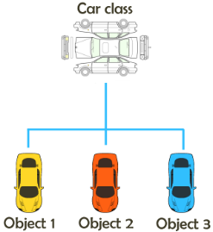
Classes as Data Types
Classes define types that are:
a composition of other types
have unique functionality
Every class may contain:
Attributes (fields)
Methods
Constructor (Initialization function)

Slide 11



Car Example
Attributes 4 wheels, steering wheel, horn, color etc.
Unique for every car instance
Methods drive, turn left, honk, repaint etc.
Constructor by color, by engine type etc.

Slide 12
Classes in Python
Class deﬁnition looks like this:
class ClassName:
"""documentation string"""
def __init__(self):
# constructor
def method_name(self, arg1, arg2):
# method code
def method_name(self, arg1, arg2):
# method code
...

Slide 13
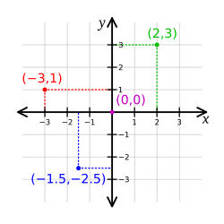
How to Represent a Point in 2D?
Alternatives
Two variables x, y
Elements in a list / tuple
A new data type
Creating a new type is a (little) more complicated,
But has advantages (to be apparent soon)
So - How should we represent
a point?

Slide 14
Creating a new Point (instantiation)
In the shell:
>>> blank = Point()
What happens if we try:
>>> print(blank)
<__main__.Point object at 0x000001E2AE7E5F28>
class Point:
"""represents a point in a 2D space.
Attributes: x, y """
blank is an instance of a point
Later!

Slide 15
But Where is the Point?
>>> blank = Point()
>>> blank.x
Traceback (most recent call last):
File "<pyshell#5>", line 1, in <module>
blank.x
AttributeError: 'Point' object has no attribute 'x'
Currently, blank does not hold any data, so x does not exist (nor does y)
We want to be able to initialize and access x, y via Point instance

Slide 16
Object initialization
There are two ways to initialize an object:
Explicitly
Using a constructor, which is a special function in charge of initializing the object’s variables
>>> blank = Point()
>>> blank.x = 3.0
>>> blank.y = 4.0
>>> blank.x
3.0
>>> blank.y
4.0

Slide 17
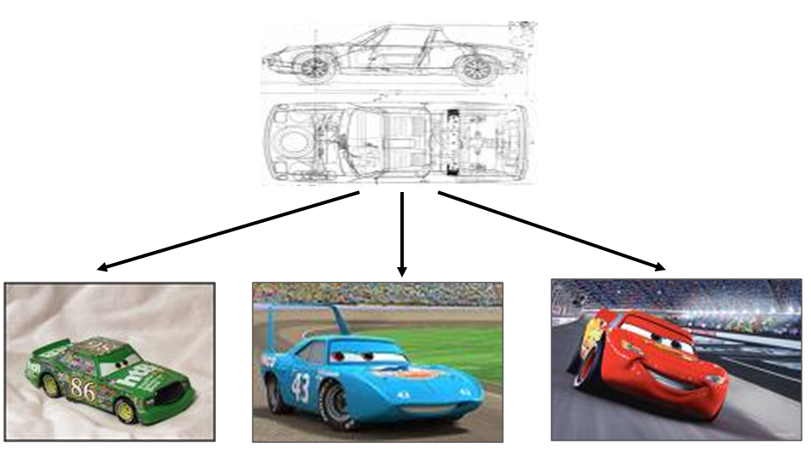
Constructors
Definition in the class’ code that “produces” instances
Invoked automatically when an object is created
Input: whatever is required to produce a new instance
What would a Point constructor accept as input?

Slide 18
Constructors – More Technically
class Point:
"""represents a point in a 2D space.
Attributes: x, y """
def __init__(self, x, y):
self.x = x
self.y = y
Definition within the class’s scope:
Always named __init__
2 underscores, followed by the word init, followed by 2 more underscores.
The first parameter is self
A reference to the particular current instance of the class.
When calling the constructor, self is not passed, it is created by Python.
Default constructor - If a constructor was not implemented for a class, Python assumes that the class has a default empty constructor (no arguments, no attribute initialization)

Slide 19
Attributes
>>> p1 = Point(3.0, 4.0)
>>> p1.x
3.0
>>> p1.y
4.0
Point
x → 3.0
y → 4.0
p1
The variable p1 refers to a Point object
p1.x means “get the value of x from object p1”
There is no conflict between a variable x and the attribute x
>>> x = p1.y
>>> print(x)
4.0
>>> print(p1.x)
3.0

Slide 20
Instances and Functions
Objects can be passed as arguments to functions:
def print_point(point):
print('<', point.x, ',', point.y, '>') >>> print_point(p1)
< 3.0 , 4.0 >
Objects are mutable:
def move_point(point, dx, dy):
point.x += dx
point.y += dy
>>> move_point(p1, 2, -1) >>> print_point(p1) < 5.0 , 3.0 >
Will now “print(p1)” work?
Next week!

Slide 21
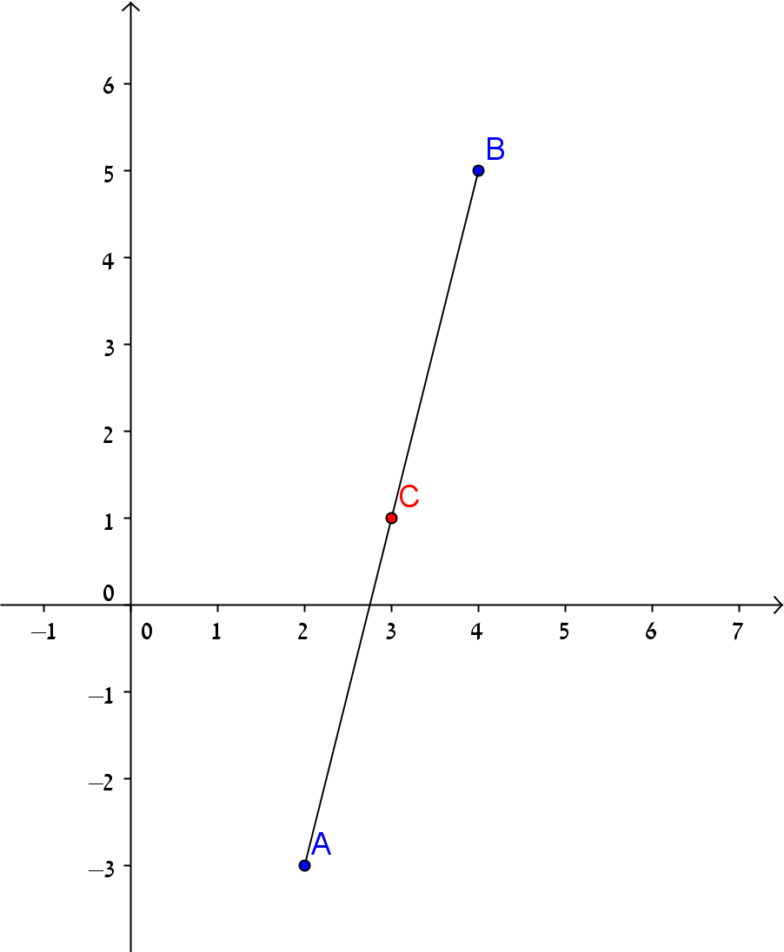
Instances and Functions
Objects can be returned by functions:
def middle_point(p1, p2):
return Point((p1.x + p2.x)/2, (p1.y + p2.y)/2)
>>> p1 = Point(1,1)
>>> p2 = Point(3,5)
>>> p3 = middle_point(p1,p2)
>>> print_point(p3)
< 2.0 , 3.0 >

Slide 22
Object Oriented Programming
Programs are made of
object definitions
function definitions
Most of the computation is in operations on objects
An object definition corresponds to objects or concepts in the real world.
The functions that operate on that objects correspond to the ways real-world objects interact.

Slide 23
Methods
Method
a function that is associated with a particular class.
Examples in strings, lists, dictionaries, tuples:
list.append(), str.upper(), dict.items()
Difference between methods and functions:
Methods are defined inside a class definition
The syntax for invoking a method is different:
A method is called through an instance

Slide 24
Methods
The first argument of each method is self. It’s not passed as an argument in the call – self is actually the object that invoked the method.
Access the attributes of the class – only with self.
class New_Class: """documentation string""" def __init__(self, att1): self.att1 = att1 def method_name(self, arg1, arg2):
do_something_with(self.att1)

Slide 25
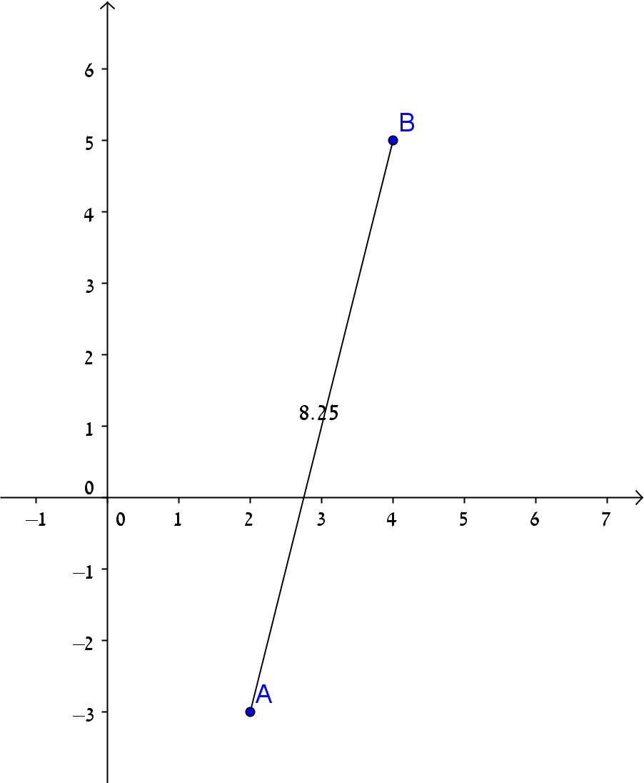
Example: Distance Between Two Points (method)
from math import sqrt
class Point:
…
def distance(self, other):
return sqrt((self.x-other.x)**2 + (self.y-other.y)**2)
>>> p1 = Point(2,-3)
>>> p2 = Point(4,5)
>>> p1.distance(p2)
8.246211251235321

Slide 26
Example: Distance Between Two Points (method vs. function)
from math import sqrt
class Point:
…
def distance(self, other):
return sqrt((self.x-other.x)**2 + (self.y-other.y)**2)
…
def distance(p1, p2):
return sqrt((p1.x-p2.x)**2 + (p1.y-p2.y)**2)
>>> p1 = Point(2,-3)
>>> p2 = Point(4,5)
>>> p1.distance(p2)
8.246211251235321
>>> distance(p1, p2)
8.246211251235321
Method call
function call

Slide 27
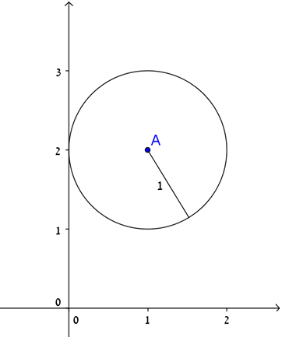
A Circle
How would you represent a circle object?
Attributes:
center (Point)
radius (int/float)
Methods:
Composition of other user defined types
Method name | description | arguments | return value
__init__ | The constructor | Center(Point), radius(int/float) | -
print_circle | Prints circle | - | -
in_circle | Checks if a point is located inside the circle | a point object | True/False

Slide 28
A Circle
class Circle:
""" represents a circle shape
attributes: center, radius"""
def __init__(self, center, radius):
self.center = center
self.radius = radius
def print_circle(self):
print('center:', self.center.x, self.center.y, \
', radius:', self.radius)
Next week – make str(center) work!
>>> c = Circle(Point(1,2), 1)
>>> c.print_circle()
center: 1 2 , radius: 1

Slide 29
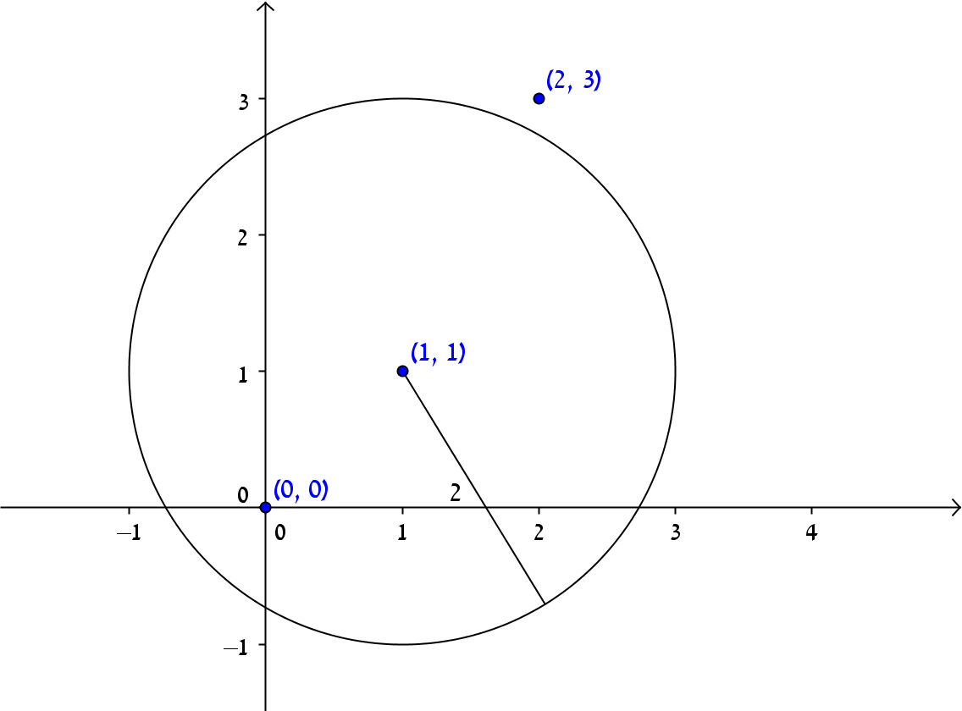
Example: In Circle
class Circle:
…
def in_circle(self, point):
return self.center.distance(point) < self.radius
Point.distance method call
Boolean value
>>> c = Circle(Point(1,1), 2)
>>> c.in_circle(Point(0,0))
True
>>> c.in_circle(Point(2,3))
False

Slide 30
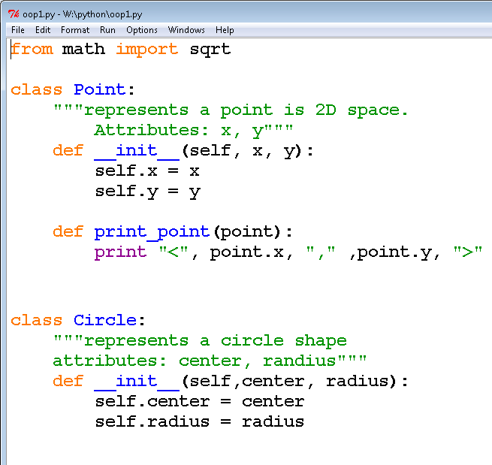
Code – Define Classes
….
….

Slide 31
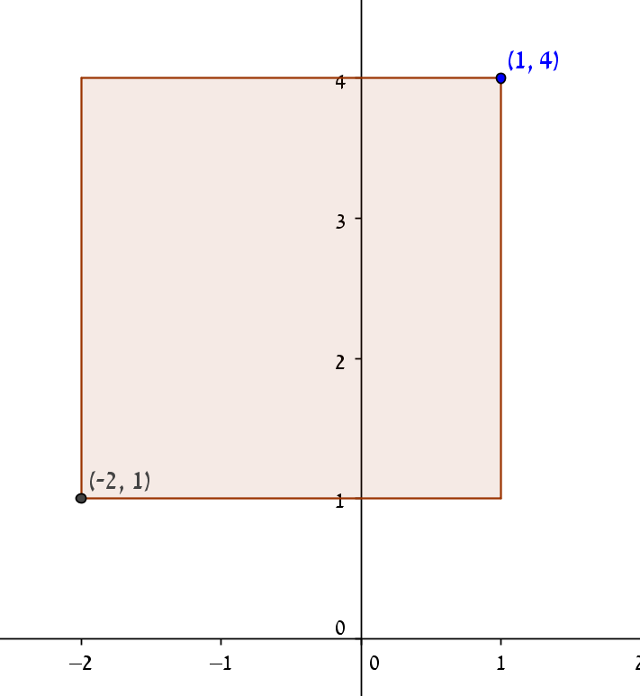
A Rectangle (design options)
How would you represent a rectangle?
For simplicity ignore angle, assume the rectangle is vertical or horizontal
Several possibilities:
Two opposing corners
One corner + width and height

Slide 32
Rectangle - Design
Attributes:
width (int/float)
height (int/float)
corner (Point)
Methods
Method name | description | arguments | return value
__init__ | The constructor | width, height, corner | -
print_rec | Prints the rectangle | - | -
get_center | Returns the center of the rectangle | - | A Point object that represents the center.

Slide 33
A Rectangle - Implementation
class Rectangle:
"""represents a rectangle in a 2D space.
attributes: width, height, lower-left corner"""
def __init__(self, width, height, corner):
self.width = width
self.height = height
self.corner = corner
def print_rec(self):
print('Width:', self.width, ', Height:', \
self.height, ', Lower-left corner:', \
self.corner.x, self.corner.y)
>>> rect = Rectangle(100, 200, Point(0,0))
>>> rect.print_rec()
Width: 100 , Height: 200 , Lower-left corner: 0 0

Slide 34
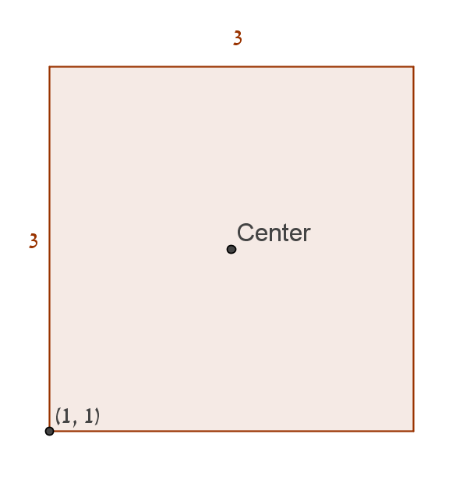
Find Center
class Rectangle:
def get_center(self):
center_x = self.corner.x + self.width/2
center_y = self.corner.y + self.height/2
return Point(center_x, center_y)
>>> rect = Rectangle(100, 200, Point(0,0))
>>> center = rect.get_center()
>>> center.print_point()
< 50.0 , 100.0 >

Slide 35
is and ==
is will return True if two variables point to the same object.
== will return True if the objects referred to by the variables are equal
>>> a = [1, 2, 3]
>>> b = a
>>> b is a
True
>>> b == a
True
>>> b = a[:]
>>> b is a
False
>>> b == a
True
1
2
3
1
2
3
a
b

Slide 36
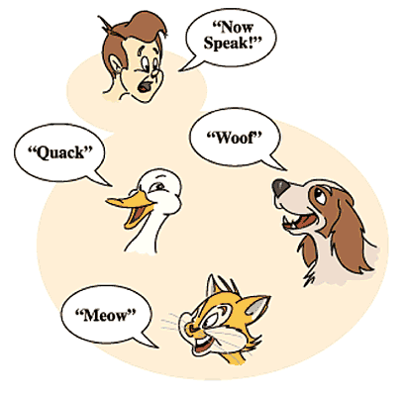
Polymorphism
Definition
Objects of various types define a common interface of operations for users.

Slide 37
Polymorphism - Example
class Cat:
def talk(self):
return 'Meow!'
class Dog:
def talk(self):
return 'Woof! Woof!'
animals = [Cat(), Dog()]
for anim in animals:
print(anim.talk())

