Slide 1
Programming for Engineers in Python
spring 2019-2020
Lecture 9:
Object Oriented Programming 2

Slide 2
Lecture 8 Highlights
Object Oriented Programming
Enables representing real world entities by adding new data types – do this by defining new Classes.
Each class holds both data (attributes) and functions (methods) of the entity it represents.
Classes are blueprints for creating Objects.
Instantiation is the process of creating new objects (memory allocation) from a certain class.
Example: the string class is a predefined python class from which we create distinct string objects every time we create a string variable.
IMAGINE ! What data types would YOU need in your future programs ?

Slide 3
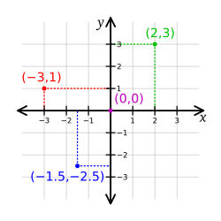
Representing a Point in OOP
Attributes (Fields/Variables/Properties):
x
y
Methods (Functions):
constructor
distance
print_point

Slide 4
The Point Class
from math import sqrt
class Point:
"""represents a point in a 2D space.
Attributes: x, y """
def __init__(self, x, y):
self.x = x
self.y = y
def print_point(point):
print('<', point.x, ',', point.y, '>')
def distance(self, other):
return sqrt((self.x-other.x)**2 + (self.y-other.y)**2)

Slide 5
Attributes hold the object’s data
>>> p1 = Point(3.0, 4.0) >>> p1.x 3.0 >>> p1.y 4.0
Point
x → 3.0
y → 4.0
p1
The variable p1 refers to a Point object
p1.x means “get the value of x from object p1”

Slide 6
Methods implements the object’s functionality
Method
a function that is associated with a particular class.
Examples in strings, lists, dictionaries, tuples:
list.append(), str.upper(), dict.items()
Difference between methods and functions:
Methods are defined inside a class definition
The syntax for invoking a method is different:
A method is called through an instance

Slide 7
Example: Distance Between Two Points (method vs. function)
from math import sqrt
class Point:
...
def distance(self, other):
return sqrt((self.x-other.x)**2 + (self.y-other.y)**2)
...
def distance(p1,p2):
return sqrt((p1.x - p2.x)**2 + (p1.y - p2.y)**2)
>>> p1 = Point(2,-3)
>>> p2 = Point(4,5)
>>> p1.distance(p2)
8.246211251235321
>>> distance(p1,p2)
8.246211251235321
Method call
function call

Slide 8
Adding a Circle class which uses Point
from math import sqrt
class Point:
"""represents a point in a 2D space.
Attributes: x, y """
def __init__(self, x, y):
self.x = x
self.y = y
def print_point(self):
print('<', self.x, ',', self.y, '>')
def distance(self, other):
return sqrt((self.x-other.x)**2 + (self.y-other.y)**2)
class Circle:
""" represents a circle shape
attributes: center, radius"""
def __init__(self, center, radius):
self.center = center
self.radius = radius
def print_circle(self):
print('center:', self.center.x, self.center.y, \
', radius:', self.radius)
def in_circle(self, point):
return self.center.distance(point) < self.radius

Slide 9
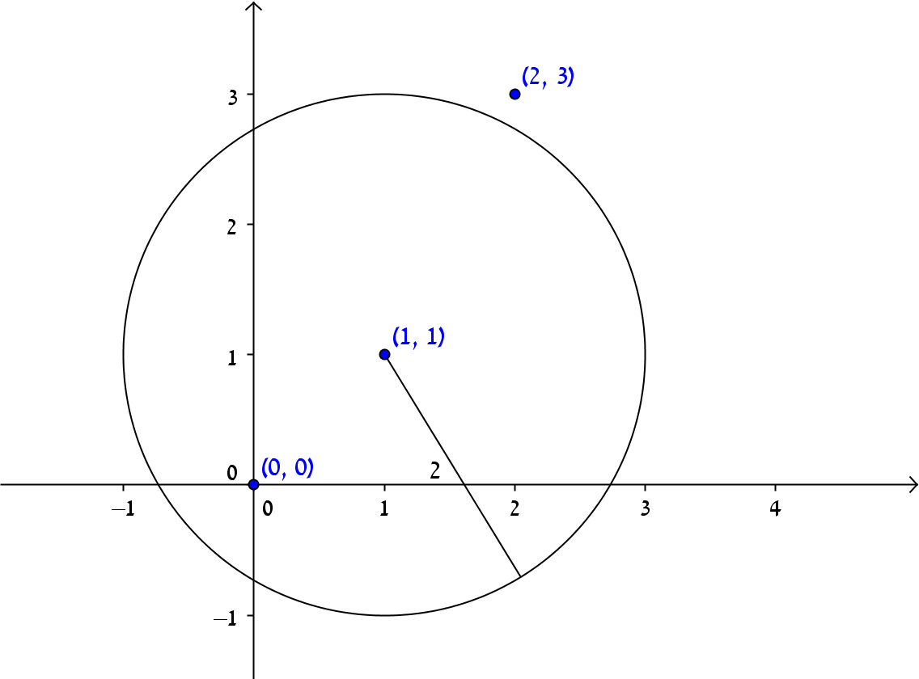
Usage example
>>> c = Circle(Point(1,1),2)
>>> c.in_circle(Point(0,0))
True
>>> c.in_circle(Point(2,3))
False

Slide 10
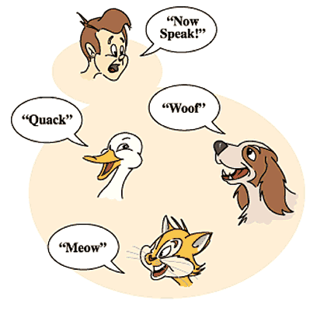
Polymorphism
Enables working uniformly with objects of different types.
Executing the same method on objects of different types will invoke the right version of the method !
Assume you have a list that contains objects of different types, but all types implement a method named m().
If you run over the list and invoke m() on each object, Python will execute the version of m appearing in the class defining the type of the current object.

Slide 11
Polymorphism - Example
class Cat:
def talk(self):
return 'Meow!'
class Dog:
def talk(self):
return 'Woof! Woof!'
animals = [Cat(), Dog(), Cat()]
for anim in animals:
print(anim.talk())

Slide 12
Polymorphism example II
>>> lst = [1, 2, 'A', 'B']
>>> print([item*2 for item in lst])
[2, 4, 'AA', 'BB']
>>> print([item.__str__() for item in lst])
['1', '2', 'A', 'B']
Thanks to polymorphism, an appropriate type-specific version of the function is being called for every object in the polymorphic list lst

Slide 13
Histogram (polymorphism)
def histogram(iterable):
hist = {}
for elem in iterable:
hist[elem] = hist.get(elem, 0) + 1
return hist
>>> words = ['spam', 'egg', 'spam', 'bacon', 'spam'] >>> histogram(words) {'spam': 3, 'egg': 1, 'bacon': 1}
For which input types will this function work ?
lists, tuples, strings and dictionaries as long as the elements of iterable can be used as keys in dictionary hist
Source: Think Python

Slide 14
Today
We’ll see a full example for introducing a new data type into Python, a data type which represents Rational numbers.
We’ll provide the new class with various methods that will enable using it naturally in python like predefined built in types.

Slide 15
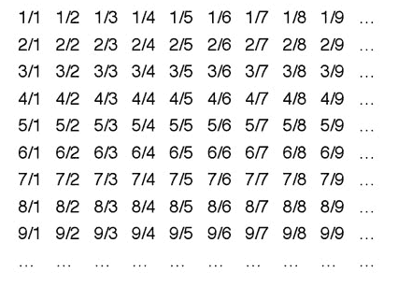
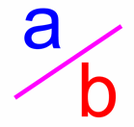
Today
Rational numbers implementation using OOP
We will write a class that represents a rational number.
Using the new type should feel like native language types
Inspired by chapter 6 from the book “Programming in Scala”

Slide 16
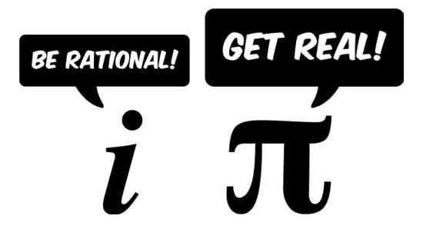
Rational Numbers
A rational number is a number that can be expressed as a ratio n/d (n, d integers, d not 0)
Examples: 1/2, 2/3, 112/239, 2/1
Not an approximation!

Slide 17
Rational Class - Specification
print should work smoothly
Support add, subtract, multiply, divide
Immutable
Should feel like native language types
>>> half = Rational(1,2) >>> two_thirds = Rational(2,3) >>> half / (2 + two_thirds) 3/16 >>> sum([1, Rational(3,2), 2]) 9/2

Slide 18
Constructing a Rational
What are the attributes?
How should a client programmer create a new Rational object?
class Rational:
""" Represents a rational number
attributes: n, d """
def __init__(self, n, d):
"""n: numerator
d: denominator"""
self.numer = n
self.denom = d

Slide 19
Additional instantiation options
Constructors other then the primary?
Example: a rational number with a denominator of 1 (e.g., 5/1 → 5)
We would like to enable: Rational(5)
>>> x = Rational(5)
Traceback (most recent call last):
File "<pyshell#8>", line 1, in <module>
x = Rational(5)
TypeError: __init__() missing 1 required positional argument: 'd'

Slide 20
Default Arguments to Constructor
def __init__(self, n, d=1):
"""n: numerator
d: denominator"""
self.numer = n
self.denom = d
>>> p = Rational(5) # == Rational(5,1)
>>> q = Rational(5,2)

Slide 21
Checking Preconditions
>>> q = Rational(5,0) >>> q 5/0
How can we make sure that the arguments are valid when the object is initialized?
print support is not implemented yet…
def __init__(self, n, d=1):
"""n: numerator
d: denominator"""
if d == 0:
print("denominator is set to 1, cannot be zero")
d = 1
self.numer = n
self.denom = d

Slide 22
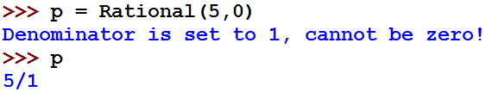
Checking Preconditions
print support is not implemented yet…
Changing the user’s data is a bad idea!
Raising an exception is a better approach !

Slide 23
Rational: Raising an exception in case of invalid input
def __init__(self, n, d=1):
"""n: numerator
d: denominator"""
if d == 0:
raise ZeroDivisionError("Denominator cannot be zero")
self.numer = n
self.denom = d
>>> a=Rational(5,0)
Traceback (most recent call last):
File "<pyshell#19>", line 1, in <module>
a=Rational(5,0)
File "C:\Users\Owner\Desktop\test_pyeng.py", line 9, in __init__
raise ZeroDivisionError("Denominator cannot be zero")
ZeroDivisionError: Denominator cannot be zero

Slide 24

Printing a Rational
>>> q = Rational(2,3) >>> q.numer 2 >>> q.denom 3 >>> q <__main__.Rational object at 0x00000272691B1BA8> >>> print(q) <__main__.Rational object at 0x00000272691B1BA8>

Slide 25
Implementing __repr__
__repr__ method:
returns the official string representation of an object
In class Rational:
In the shell:
def __repr__(self):
return str(self.numer) + '/’ + str(self.denom)
>>> q = Rational(2,3)
>>> q
2/3
>>> print(q)
2/3

Slide 26
Implementing __str__
__str__ method returns a readable string representation of an object
The default implementation of __str__ returns the return value of __repr__.
Read here about the difference between __str__ and __repr__

Slide 27
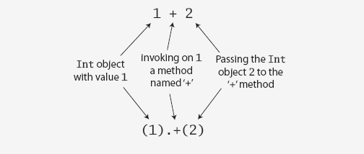
Defining Operators
Why not use natural arithmetic operators?
Operator precedence will be kept
All operations are method calls
From the book Programming in Scala
27

Slide 28
Operator Overloading
By defining some special methods, you can specify the behavior of operators on user defined types
+, -, *, /, <, >, ==, …

Slide 29
Adding Rational Numbers
>>> p = Rational(2,3)
>>> q = Rational(1,2)
>>> p+q
Traceback (most recent call last):
File "<pyshell#36>", line 1, in <module>
p+q
TypeError: unsupported operand type(s) for +: 'Rational' and 'Rational'

Slide 30
Arithmetic operators Overloading
>>> p = Rational(2,3)
>>> q = Rational(1,2)
Method | Operator
__add__(self,other) | >>> p+q
__neg__(self) | >>> -p
__sub__(self,other) | >>> p-q
__mul__(self,other) | >>> p*q
__truediv__(self,other) | >>> p/q
__floordiv__(self,other) | >>> p//q

Slide 31
Define __add__ Method
def __add__(self, other):
return Rational(self.numer * other.denom + \
other.numer * self.denom, \
self.denom * other.denom)
>>> q = Rational(1,2)
>>> r = Rational(2,3)
>>> q+r
7/6

Slide 32
Other Arithmetic Operations Implementation
def __neg__(self):
return Rational(-self.numer, self.denom)
def __sub__(self, other):
return self + (-other)
def __mul__(self, other):
return Rational(self.numer * other.numer, \
self.denom * other.denom)
def __truediv__(self, other):
return self * Rational(other.denom, other.numer)
### this implements /
### for // use __floordiv__

Slide 33
Other Arithmetic Operations
>>> q = Rational(1,2)
>>> p = Rational(2,3)
>>> -q
-1/2
>>> q-p
-1/6
>>> q*p
2/6
>>> q/p
3/4
>>> q*(q+p)
7/12
>>> q*p+q
10/12
What about p+2?

Slide 34
Mixed Arithmetics
Now we can add and multiply rational numbers!
What about mixed arithmetic: Rational+int or int+Rational?
>>> p = Rational(2,3)
>>> p + 2
Traceback (most recent call last):
File "<pyshell#71>", line 1, in <module>
p + 2
File "C:\Users\Owner\Desktop\test_pyeng.py", line 20, in __add__
return Rational(self.numer * other.denom + \
AttributeError: 'int' object has no attribute 'denom'
>>> 2 + p
Traceback (most recent call last):
File "<pyshell#72>", line 1, in <module>
2 + p
TypeError: unsupported operand type(s) for +: 'int' and 'Rational'

Slide 35
Mixed Arithmetics
Let’s try Rational + int first:
first attempt:
Rational + int => Rational + Rational(int)
>>> p = Rational(2,3)
>>> p + Rational(2)
8/3
Works, but not elegant or comfortable, so…
Add new methods for mixed addition and multiplication
Will work thanks to polymorphism

Slide 36
Mixed Arithmetics
Intuition: converting int to Rational is a good idea, we just need to figure out where to perform the conversion.
Inside the __add__ method!
def __add__(self, other):
other = Rational(other)
return Rational(self.numer * other.denom + \
other.numer * self.denom, \
self.denom * other.denom)
Will this work?

Slide 37


Mixed Arithmetics
>>> p = Rational(2,3)
>>> p + 2
8/3
>>> p + p
Traceback (most recent call last):
File "<pyshell#79>", line 1, in <module>
p + p
File "C:\Users\Owner\Desktop\test_pyeng.py", line 22, in __add__
other.numer * self.denom, \
File "C:\Users\Owner\Desktop\test_pyeng.py", line 32, in __mul__
return Rational(self.numer * other.numer, \
AttributeError: 'int' object has no attribute 'numer'
What happened?
Inside __add__ we convert other to Rational – but other is already a Rational. Invoking Rational constructor with a Rational argument generates an unexpected object:
>>> Rational(p)
2/3/1
Solution: convert only for other of type int!

Slide 38
Revised __add__
The built-in function isinstance takes a value and a class object, and returns True if the value is an instance of the class (False otherwise)
We should only convert other to Rational if it is of type int!
def __add__(self, other):
if isinstance(other, int):
other = Rational(other)
return Rational(self.numer * other.denom + \
other.numer * self.denom, \
self.denom * other.denom)
38

Slide 39
Revised __add__
>>> p = Rational(2,3)
>>> p+2
8/3
>>> p+p
12/9
What about p+2.?
If we want Rational to be used just like any other numeric data type in respect to arithmetic operations, we must implement this behavior for every operator and every data type that is supported.

Slide 40
Implicit Conversions
Now lets make int + Rational work:
When we perform 2+p, __add__ method that is called belongs to int, since and argument of type int appears on the left from the operator.
The problem: int class contains no __add__ method that takes a Rational argument ☹
Intuition: we don’t wish to change the implementation of int, the code should appear in Rational class.
Is there a method that is invoked when Rational is on the right side of the operator?

Slide 41
__radd__ - Right Side Add
__radd__ is invoked when a Rational object appears on the right side of the + operator
Rational + int: we already know how to do it!
def __radd__(self,other):
return self + other
>>> p = Rational(2,3)
>>> 2+p
8/3
Implementating __radd__ using __add__ is only possible because addition of numbers is commutative: a+b = b+a

Slide 42
Rationals addition
We now support both int + Rational and Rational + int, so we may execute complex arithmetic operations and use built-in functions:
>>> p = Rational(2,3)
>>> 1 + Rational(1,2) + Rational(3,4) + 3
42/8
>>> sum([1, Rational(1,2), Rational(3,4), 3])
42/8

Slide 43
Comparisons
>>> x = Rational(1,2)
>>> y = Rational(1,3)
>>> x > y
True
>>> x < y
False
Default implementation for these operators is based on the object addresses
What methods are responsible for comparison?
Method | Operator
__eq__(self,other) | >>> x == y
__lt__(self,other) | >>> x < y
__le__(self,other) | >>> x <= y
__gt__(self,other) | >>> x > y
__ge__(self,other) | >>> x >= y

Slide 44
Comparisons
def __eq__(self, other):
return self.numer == other.numer and self.denom == other.denom
def __lt__(self, other):
res = self.numer * other.denom < self.denom * other.numer
self_non_negative = self.numer*self.denom == abs(self.numer*self.denom)
other_non_negative = other.numer*other.denom == abs(other.numer*other.denom)
if (self_non_negative and other_non_negative) \
or (not self_non_negative and not other_non_negative):
return res
else:
return not res
def __le__(self, other):
return self == other or self <= other
def __gt__(self, other):
return not self <= other
def __ge__(self, other):
return not self < other

Slide 45
Comparisons
>>> x = Rational(1,2)
>>> y = Rational(1,3)
>>> x > y
True
>>> x < y
False
>>> x >= y
True
>>> x <= y
False
>>> max(x,y)
1/2
Why does max work?

Slide 46
Internal representation of Rationals
>>> Rational(8,6) == Rational(4,3)
False
But 8/6 is equal to 4/3!
We need to normalize the rational numbers to be able to compare them properly.
To normalize we divide the numerator and denominator by their greatest common divisor (gcd)
gcd(8,6) = 2 ➔ (8/2)/2 = 4/3
No need for Rational clients to be aware of this

Slide 47

Revised Rational
def __init__(self, n, d=1):
"""n: numerator
d: denominator"""
if d == 0:
raise ZeroDivisionError("Denominator cannot be zero")
gcd = fractions.gcd(n, d)
self.numer = n // gcd
self.denom = d // gcd
* requires importing fractions
>>> Rational(8,6) == Rational(4,3)
True
But the change in the constructor influences more than Rationals comparison:
>>> Rational(8,6)
4/3
How can we maintain both the un-normalized representation and the correct comparison?

Slide 48
Summary
We implemented a full class that naturally represents a Rational number
Attributes, methods, constructor
Method overriding
Encapsulation
Define operators as method
Method overloading
Polymorphism
Automatic type conversion

Slide 49
Rational Numbers in Python
Actually, there is a Python implementation of Rational numbers
It is called fractions http://docs.python.org/library/fractions.html
49

Slide 50
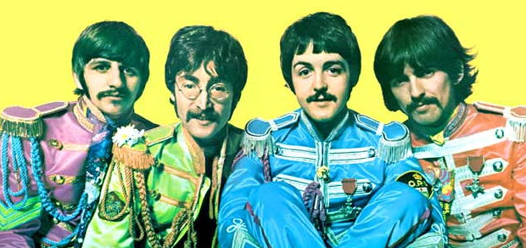
The most awesome Beatle
class Beatle:
def __init__(self, name, popularity, awesomeness):
self.name = name
self.popularity = popularity
self. awesomeness = awesomeness
def __repr__(self):
return self.name + str((self.popularity, self. awesomeness))
beatles = []
beatles.append(Beatle('John', 10, 7))
beatles.append(Beatle('Paul', 9, 8))
beatles.append(Beatle('George', 7, 10))
beatles.append(Beatle('Ringo', 5, 5))
>>> beatles
[John(10, 7), Paul(9, 8), George(7, 10), Ringo(5, 5)]
How can we find out who is the most popular Beatle and who is the most awesome one?
50

Slide 51
Finding an object with maximal attribute value
How can we find out who is the most popular Beatle and who is the most awesome one?
Easy! We can add __lt__ implementation and use max.
Is it good enough?
No, when we implement __lt__ we’ll have to choose our comparison criterion: either popularity or awesomeness

Slide 52
Using max with the key argument
max(iterable[, key])
key – an optional argument for max function. If specified, key is applied on each element of iterable.
max returns the element elem s.t. key(elem) is the maximum value among the other elements in iterable.

Slide 53
Using max with the key argument
>>> lst = ['abc', 'c', 'bb']
>>> max(lst)
'c'
>>> max(lst, key = len)
'abc'
>>> int_lst = [1,12,3]
>>> max(int_lst, key = len)
Traceback (most recent call last):
File "<pyshell#115>", line 1, in <module>
max(int_lst, key=len)
TypeError: object of type 'int' has no len()
We must be able to apply key on each element of the list

Slide 54
Who is the most awesome Beatle?
We can implement helper-functions that will help us to compare Beatles according to different criteria
def popularity_key(beatle):
return beatle.popularity
def awesomeness_key(beatle):
return beatle.awesomeness
>>> max(beatles, key = popularity_key)
John(10, 7)
>>> max(beatles, key = awesomeness_key)
George(7, 10)
The most popular Beatle
The most awesome Beatle
What about min and sort/sorted?
>>> min(beatles, key = awesomeness_key)
Ringo(5, 5)
>>> beatles.sort(key = awesomeness_key)
>>> beatles
[Ringo(5, 5), John(10, 7), Paul(9, 8), George(7, 10)]

Slide 55
Example: a Student class
class Student:
def __init__(self,name,id,grade_list):
self.name = name
self.id=id
self.grade_list=grade_list
def calc_grade_average(self):
s=0
for g in self.grade_list:
s += g
return s/len(self.grade_list)
def __repr__(self):
return self.name + ': ID=' + self.id + ' Grades: ' + str(self.grade_list)
student1 = Student('Moshe', '123456789', [90, 93, 81])
student2 = Student('David', '987654321', [78, 72, 99])
print(student1.calc_grade_average())
students = []
students.append(student1)
students.append(student2)
print(sorted(students, key = lambda x : x.calc_grade_average())) # prints the list of students sorted by student grade average
88.0
[Moshe: ID=123456789 Grades: [90, 93, 81], David: ID=987654321 Grades: [78, 72, 99]]
Lambda expression enables defining the following function on the fly:
def func(x):
return x.calc_grade_average()

