Slide 2
The new generation of Gradient Boosting

Slide 3
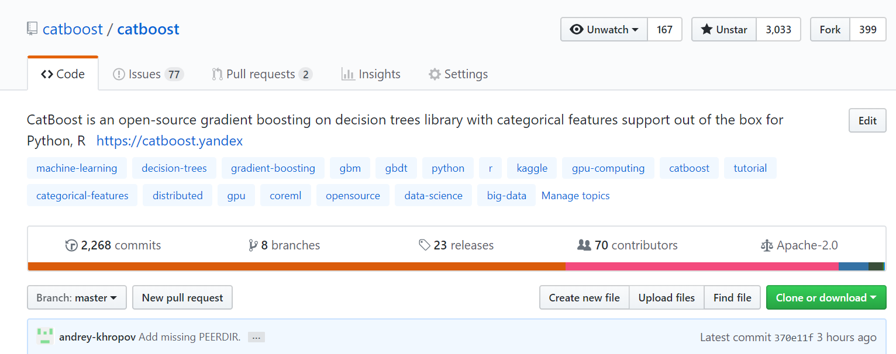
CatBoost

Slide 4
Gradient Boosting
Best solution for heterogeneous data
Easy to use
Works well for small data

Slide 5
Applications
Medicine
Industry
Finance
Music and video recommendations
Sales prediction

Slide 6
Neural networks
Images
Sound
Text

Slide 7
NN + GB
Neural networks
Gradient boosting

Slide 8
Gradient boosting
+
+
+
+
…
Loss
Loss
Loss

Slide 9
Algorithm comparison
 | CatBoost | LightGBM |  | XGBoost |  | H2O
Adult | 0.269741 | 0.276018 | + 2.33 % | 0.275423 | + 2.11% | 0.275104 | + 1.99%
Amazon | 0.137720 | 0.163600 | + 18.79 % | 0.163271 | + 18.55% | 0.162641 | + 18.09%
Appet | 0.071511 | 0.071795 | + 0.40 % | 0.071760 | + 0.35% | 0.072457 | + 1.32%
Click | 0.390902 | 0.396328 | + 1.39 % | 0.396242 | + 1.37% | 0.397595 | + 1.71%
Internet | 0.208748 | 0.223154 | + 6.90 % | 0.225323 | + 7.94% | 0.222091 | + 6.39%
Kdd98 | 0.194668 | 0.195759 | + 0.56 % | 0.195677 | + 0.52% | 0.195395 | + 0.37%
Kddchurn | 0.231289 | 0.232049 | + 0.33 % | 0.233123 | + 0.79% | 0.232752 | + 0.63%
Kick | 0.284793 | 0.295660 | + 3.82 % | 0.294647 | + 3.46% | 0.294814 | + 3.52%

Slide 10
Symmetric trees
Height > 170
Height > 170
Weight > 65
Weight > 65
Weight > 65
Age > 16

Slide 11
Numerical features
Yes
Height > 170 cm?
No

Slide 12
Categorical features
Engineer
Categorical data
Designer
Occupation
Writer
Manager
HR

Slide 13
Categorical features support
One-hot encoding
Statistics based on category and category plus label value
Usage of several permutations
Greedy constructed feature combinations
SDE
1
SDE
1
SDE
0
PR
i
SDE
1
PR
1 + 1 + 0 + a * Prior
i
3 + a

Slide 14

Classical boosting
leafValue =
$$\sum_{i=1}^{n}{\begin{aligned}\text{g}\text{(}\text{approx}\text{(}\text{i}\text{), }\text{target}\text{(}\text{i}\text{))} \\ n\end{aligned}}$$

Slide 15

Ordered boosting
leafValue(doc) =
$$\sum_{i=1}^{doc}{\begin{aligned}\text{g}\text{(}\text{approx}\text{(}\text{i}\text{), }\text{target}\text{(}\text{i}\text{))} \\ docs in the past\end{aligned}}$$

Slide 16
Modes
Classification
Regression
Ranking

Slide 17
Classification
Predict if the person will pay the credit
Which type of clouds will be present tomorrow

Slide 18
Regression
Predict the taxi drive duration
Predict dollar exchange rate

Slide 19
Ranking
What are top N hotels in Tel Aviv?
Input data: ratings
Predicting rating is not necessary!
Ranking within a group
Ranking modes:
Ranking (YetiRank, YetiRankPairwise)
Pairwise (PairLogit, PairLogitPairwise)
Ranking + Classification (QueryCrossEntropy)
Ranking + Regression (QueryRMSE)
Select top 1 candidate (QuerySoftMax)

Slide 20
Speed
CPU training
GPU training
Prediction speed

Slide 21
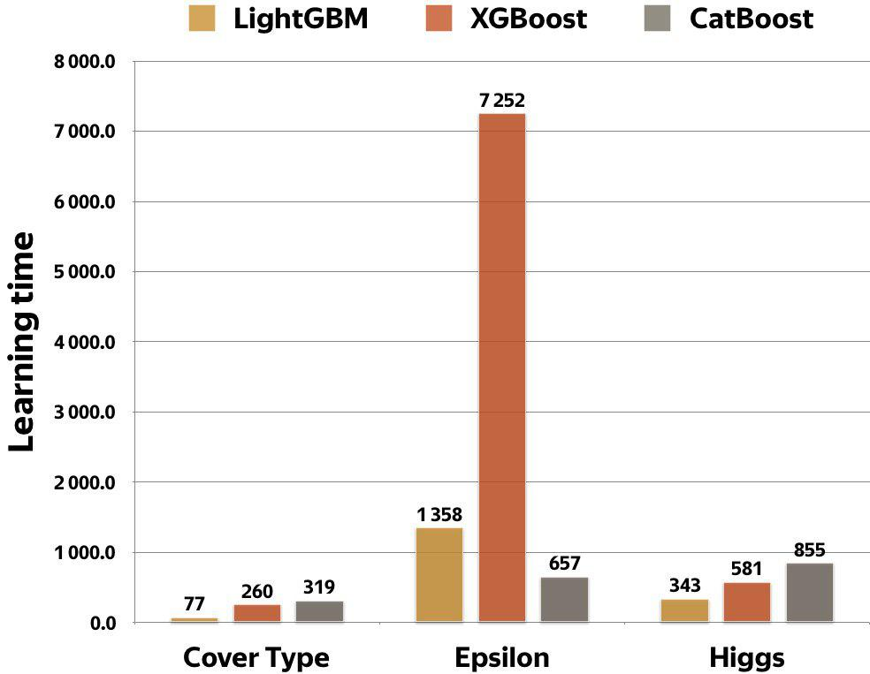
CPU: Comparison with other libraries
Parameters:
128 bins, 64 leafs, 1000 iterations
Cover type:
54 features, 522910 samples
Epsilon:
2000 features, 400k samples
Higgs:
28 features, 11M samples
Intel(R) Core(TM) i7-6800K CPU @ 3.40GHz

Slide 22
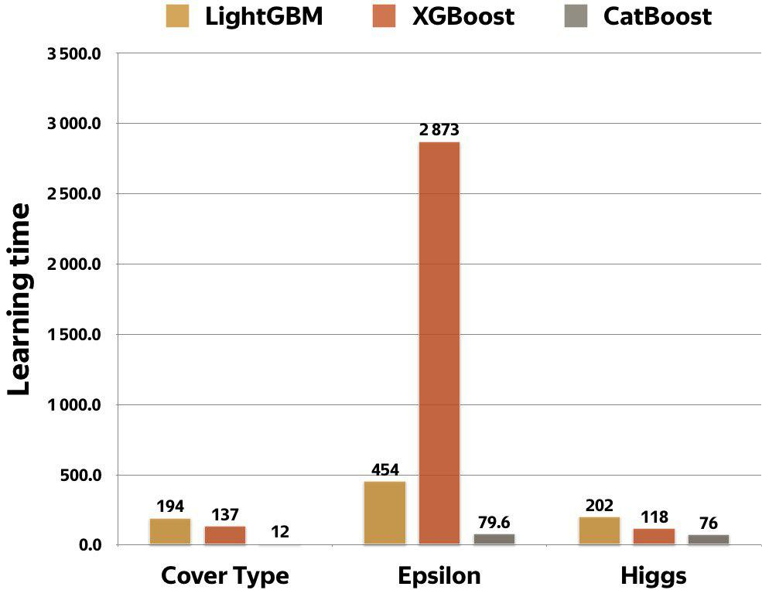
GPU: Comparison with other libraries
Parameters:
128 bins, 64 leafs, 1000 iterations
Cover type:
54 features, 522910 samples
Epsilon:
2000 features, 400k samples
Higgs:
28 features, 11M samples
GTX1080Ti

Slide 23
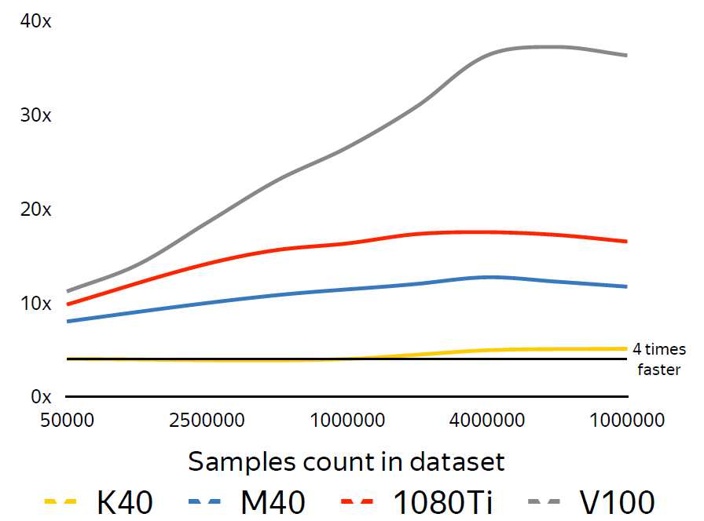
CPU vs GPU
Dual-Socket Intel Xeon E5-2660v4 as baseline
Several modern GPU as competitors
Dataset: 800 features

Slide 24
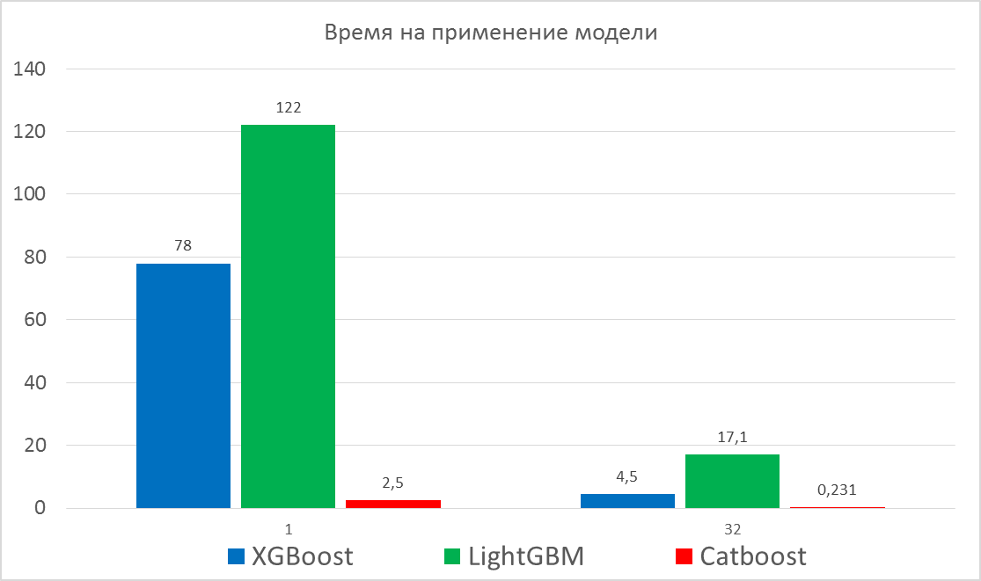
Prediction time

Slide 25
Ways to explore your data
Feature importance
Feature interaction
Per object feature importance (SHAP)

Slide 26
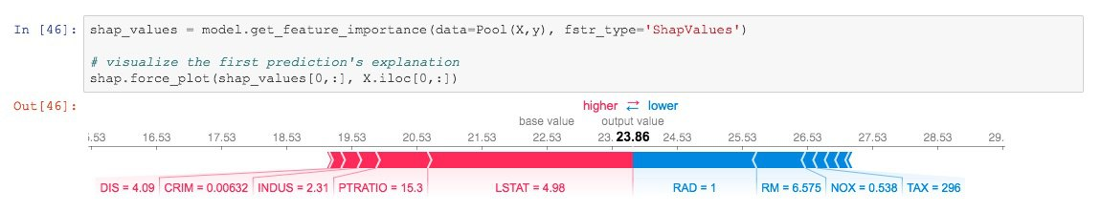
SHAP values

Slide 27
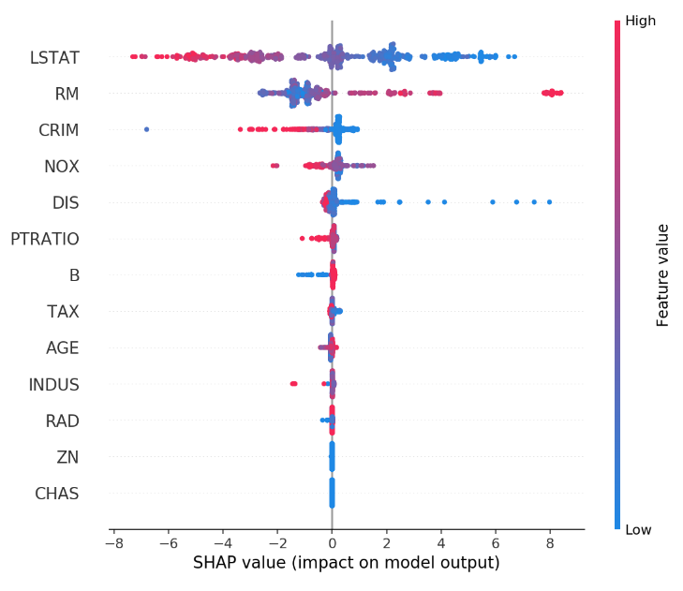
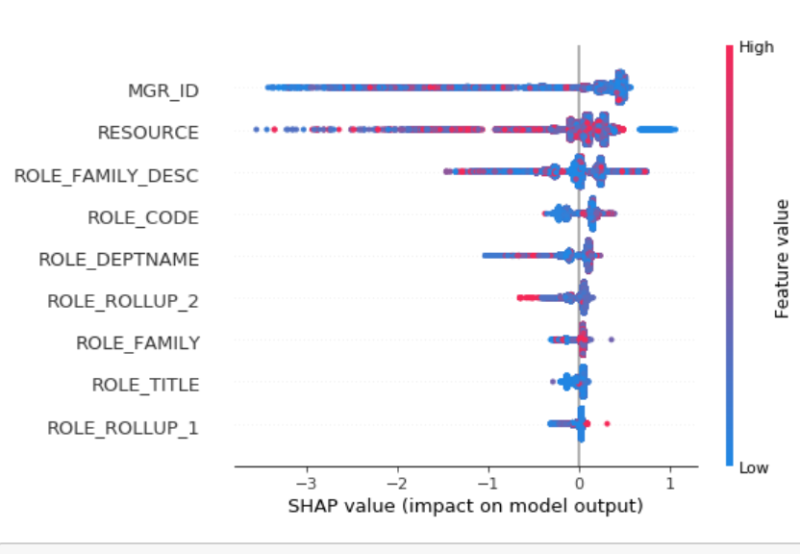
SHAP values

Slide 28
Ways to explore your data
Feature importance
Feature interaction
Per object feature importance (SHAP)
Influential documents
New features evaluation

Slide 29
Useful features
Overfitting detector
Metric evaluation during training

Slide 30
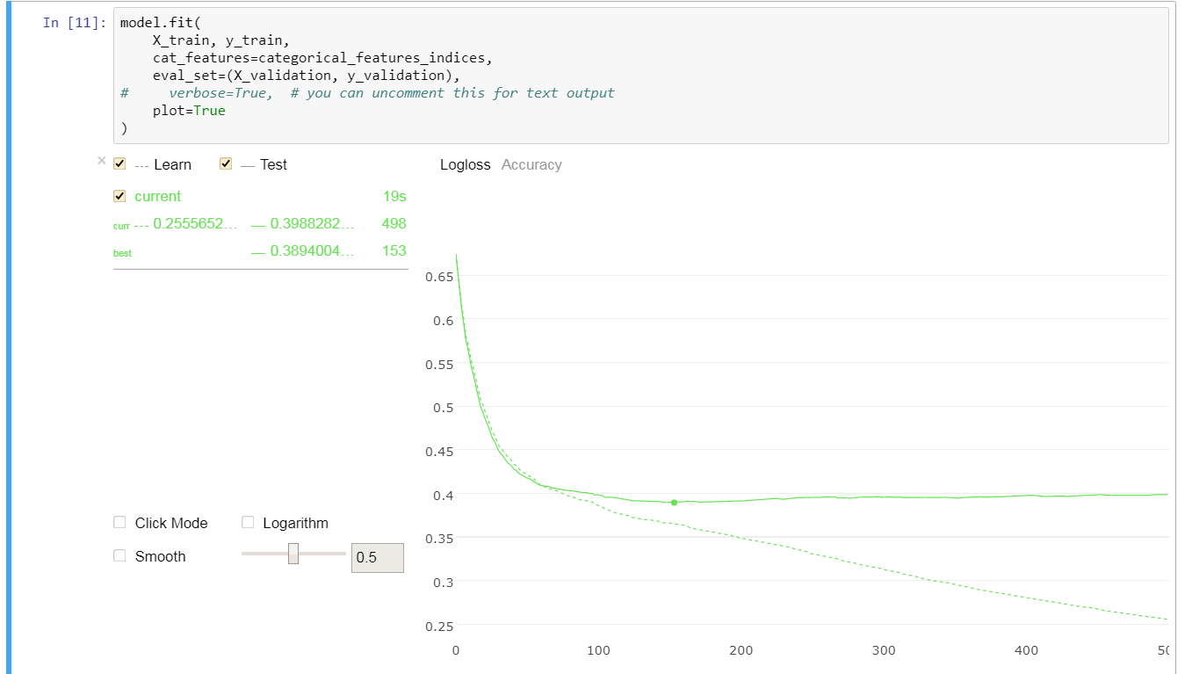
CatBoost Viewer

Slide 31
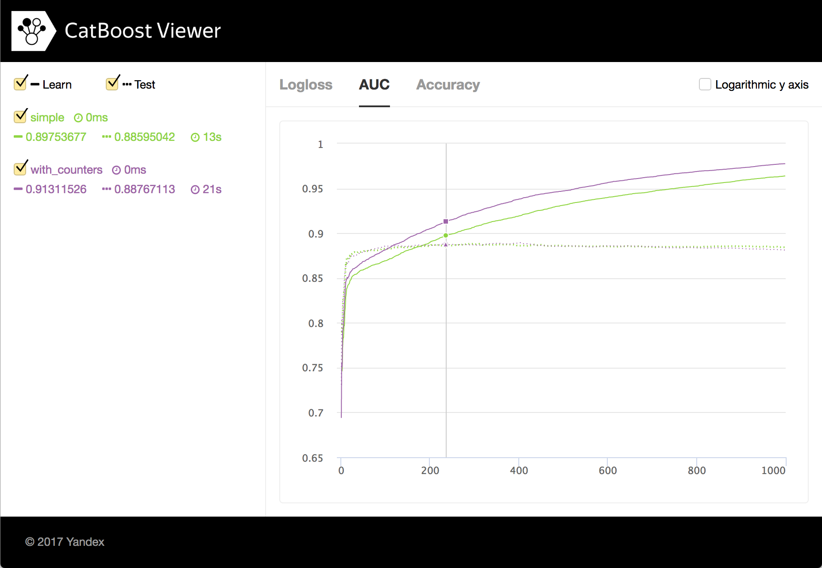
CatBoost Viewer

Slide 32
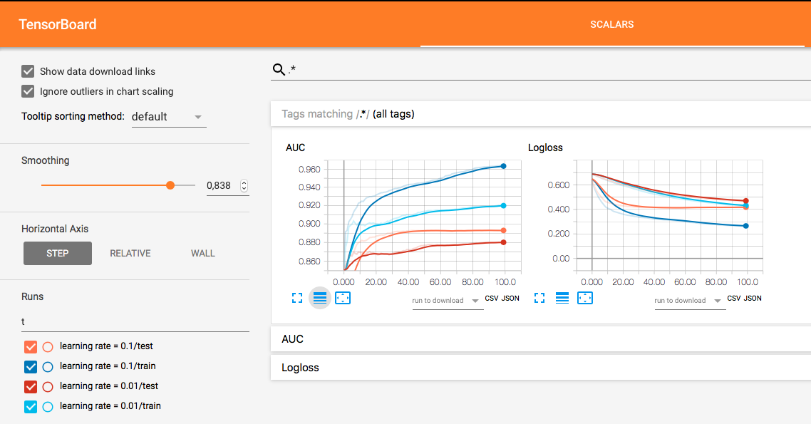
TensorBoard

Slide 33
Useful features
Overfitting detector
Metric evaluation during training
Missing values support
Cross-validation

Slide 34
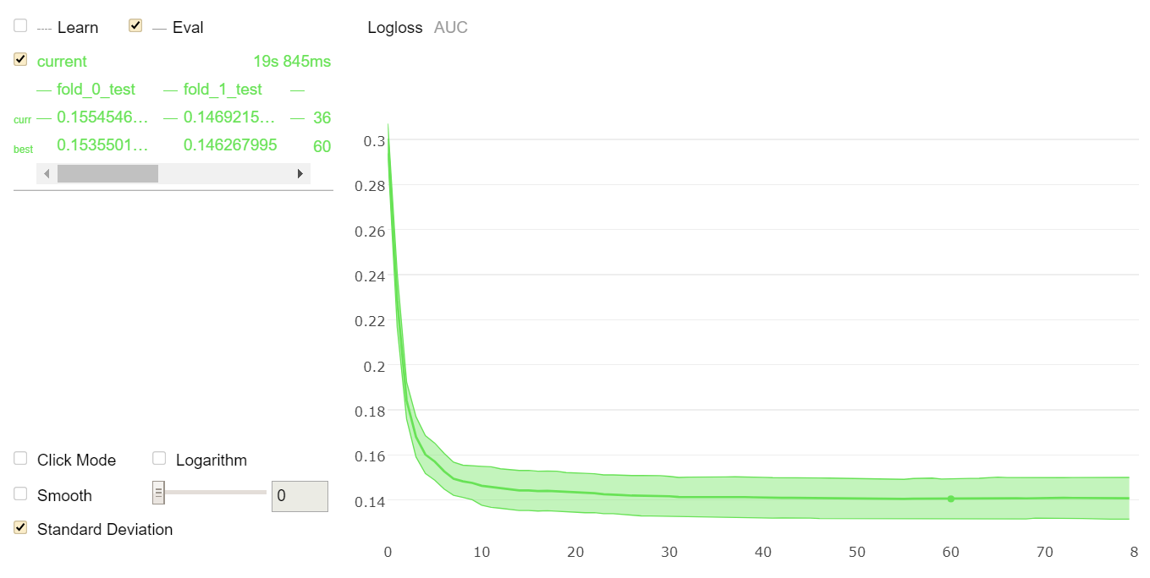
Cross-validation

Slide 35
Useful features
Overfitting detector
Metric evaluation during training
Missing values support
Cross-validation
staged_predict + metric evaluation on dataset

Slide 36
Algorithm parameters
learning_rate + iterations
depth
l2_regularization
bagging_temperature
random_strength

Slide 37
Reading
http://learningsys.org/nips17/assets/papers/paper_11.pdf
https://arxiv.org/abs/1706.09516
https://github.com/catboost/tutorials

Slide 38

Questions?
Anna Veronika Dorogush
http://catboost.yandex
Lead of CatBoost team

