Slide 1
STA 207 Project 3: Analysis on Global Covid-19 Data
Team 10: Xiaochuan Ma, Ziqin Wang, Zheyuan Yu
03/11/2021

Slide 2
Introduction and Background
Covid-19
117,573,007 confirmed cases
2,610,925 deaths
Variables of Interest
Cumulative cases
Cumulative deaths
Case-mortality rate

Slide 3
Dataset(1/3): WHO data
Cumulative cases
Cumulative deaths
Case-mortality rate
The ratio: Cumulative deaths/Cumulative cases
https://covid19.who.int/WHO-COVID-19-global-data.csv

Slide 4
Dataset(2/3): WorldBank data
Temperature
Transmission of virus can be reduced by high temperature
Hospital beds per 10000 population
Indicator of healthcare resource
Population density
Chance to get contact with virus
Age structure(0-14,15-64,65-)
The virus is more dangerous for old people
Gross domestic savings
Financial resources of people to get through the pandemic
https://data.worldbank.org

Slide 5
Dataset(3/3): Ourworldindata data
Government Stringency Index (0-100)
School closures
Workplace closures
Cancellation of public events
Restrictions on public gatherings
Closures of public transport
Stay-at-home requirements
Public information campaigns
Restrictions on internal movements
International travel controls
Contact tracing
Lockdown
https://ourworldindata.org

Slide 6
Model description
Our group uses the linear regression model to help analyze.
STEPS:
Construct full model
Subset the full model
Select the best subset model
Selection methods: Compare adjusted R square, AIC and BIC value of each model.
Also using stepwise procedure on AIC value to testify our result

Slide 7

Result
1. Model for cumulative cases:
2. Model for cumulative deaths
3. Model for Case-mortality rate:

Slide 8

Causal interpretation
Propensity score of the model for case-mortality rate is balanced.
Hypothesis:
H0:The coefficient of “tracing” is 0.
H1:The coefficient of “tracing” is not 0. Under the a=0.05
Test result:
The p value is smaller than a, thus reject the null hypothesis
Conclusion: “Tracing” variable has association with the case-mortality rate.

Slide 9
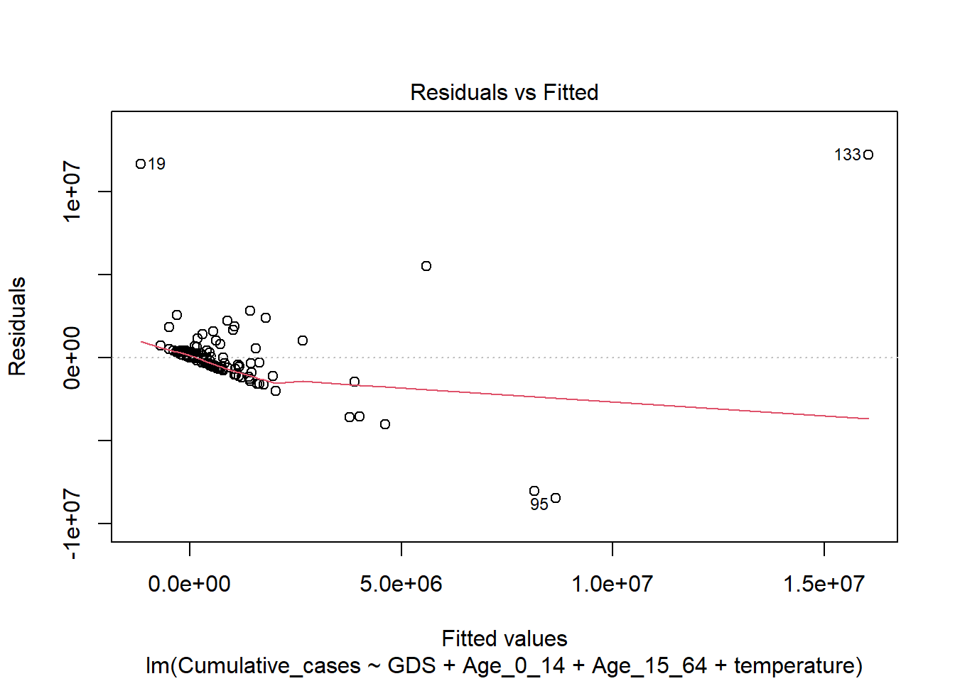
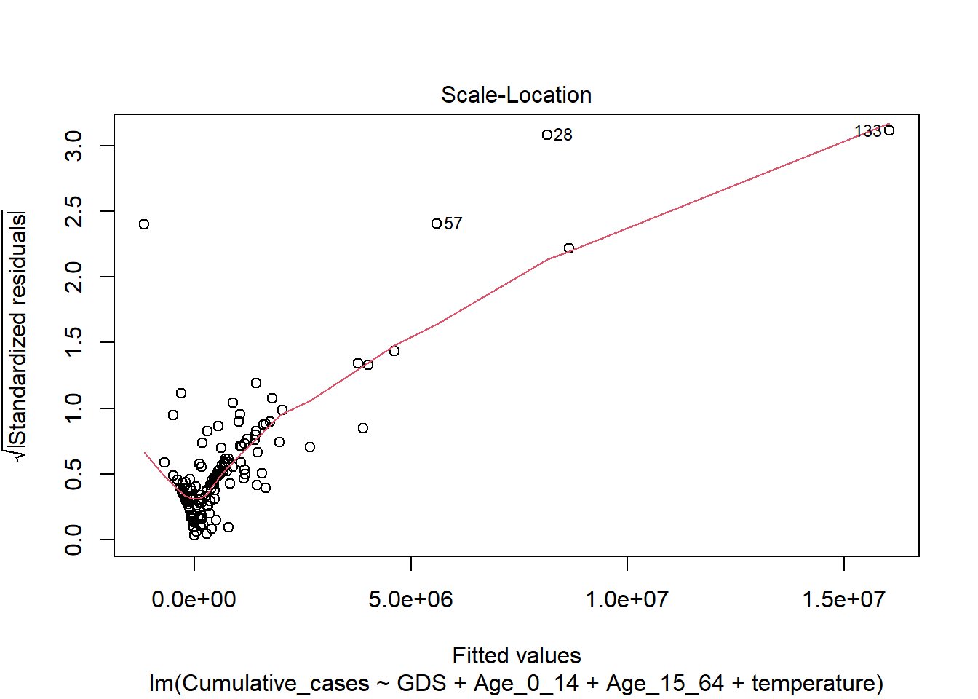
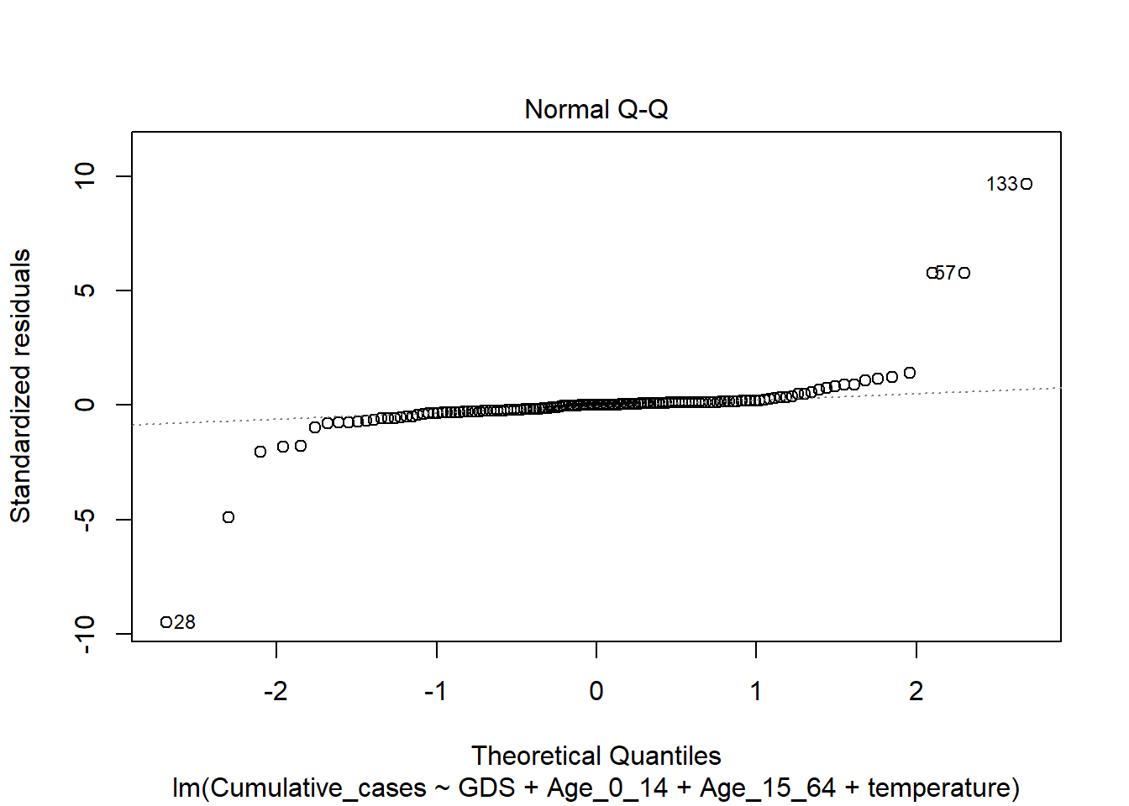
Model Diagnostic
Shapiro-Wilk Normality Test
Model | Cases | Death | Mortality Rate
Score | 2.2e-16 | 2.2e-16 | 3.9e-08

Slide 10
Countries of Interest
Countries of Interest | # Appear
United State | 6
Brazil | 4
China | 4

Slide 11
Cumulative Cases
Factors | Coefficient
Gross Domestic Saving | 5.07e-06
Age 0 – 14 | 1.83e-01
Age 15 – 64 | -7.09e-02
Average Temperature | -3.25e+04

Slide 12
Cumulative Deaths
Factors | Coefficient
Stringency Index | 5.11e+02
Age 0 – 14 | 3.16e-03
Age 15 – 64 | -1.26e-03
Average Temperature | -6.40e+02
Gross Domestic Saving | 9.36e-08

Slide 13
Case-Mortality Rate
Factors | Coefficient
Population Density | -2.95e-06
Stringency Index | 1.36e-04
Tracing Policy | -4.99e-03
Age 65+ | 1.32e-10

