Slide 1

BCHM 463 GSS – Exam III Review
David Zhao | Dr. Tseng | 11/12/2022

Slide 2

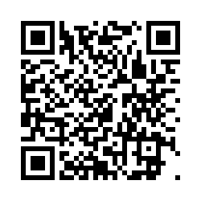
Please sign in!
https://umdsurvey.umd.edu/jfe/form/SV_8pESxFL6Ce4uYho

Slide 3

Agenda
Practice Exam Review
Metabolism and Regulation
Glycolysis
Gluconeogenesis
01
02
03
04

Slide 4

01
Practice Exam Review

Slide 5
Questions?

Slide 6
02
Metabolism and Regulation

Slide 7
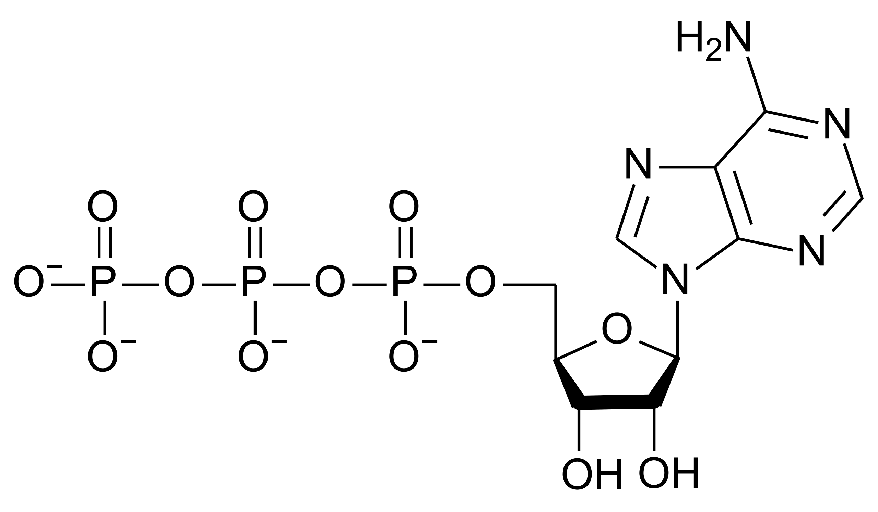
ATP – A “High Energy” Molecule
ATP is widely used in metabolism to catalyze reactions which are otherwise unfavorable under standard state conditions. Describe three reasons why ATP is considered a “high energy” molecule.

Slide 8
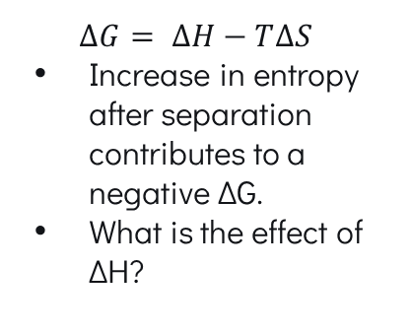

ATP – A “High Energy” Molecule
Resonance Stabilization
Entropy Increase
Charge Separation
ATP + H₂O → ADP + P_{i}
$$∆G=−30.5 kJ/mol$$
$$∆G= ∆H−T∆S$$
Increase in entropy after separation contributes to a negative ΔG.
What is the effect of ΔH?
The products of ATP hydrolysis are more resonance stabilized than the reactants.
A separation of charges in the phosphate region decreases the potential energy

Slide 9
“High Energy” Bonds
How many high energy bonds did we discuss in class? Name them and draw an example for each.

Slide 10
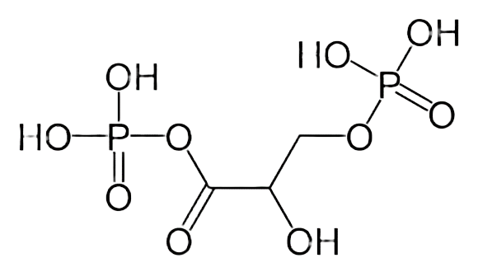
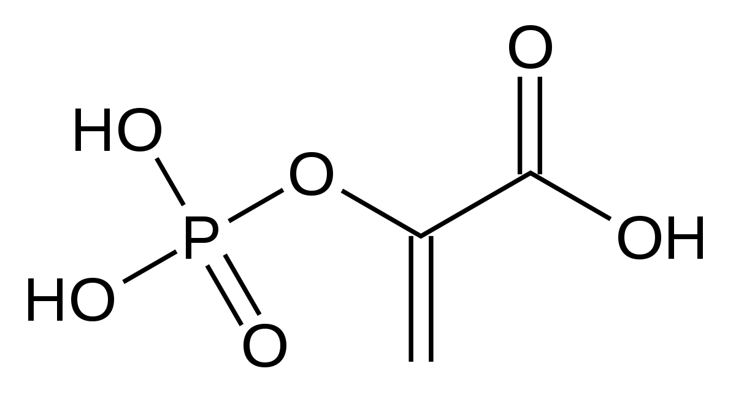
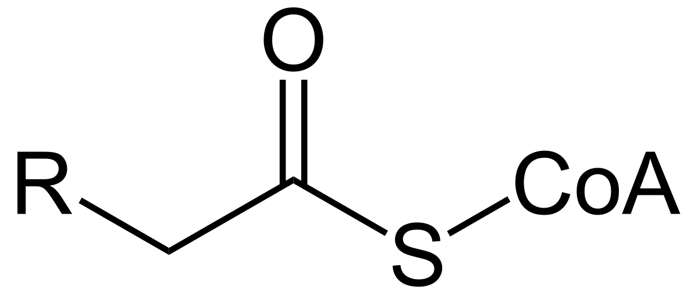
“High Energy” Bonds Covered in class
Acylphosphates
Phosphoenols
Phosphoanhydrides
Thioesters

Slide 11
Regulatory Mechanisms
We discussed two main methods by which enzymes may be regulated. Given the subclasses of those regulatory methods, what describes the methods of regulation given before?
Note: Check online session for 11/02/2022 for a more detailed diagram!
?
?
Control of Gene Expression
Control of Proteolysis
Covalent Modification
Non-covalent Modification

Slide 12
Regulatory Mechanisms
We discussed two main methods by which enzymes may be regulated. Given the subclasses of those regulatory methods, what describes the methods of regulation given before?
Enzyme Availability
Enzyme Catalytic Activity
Control of Gene Expression
Control of Proteolysis
Covalent Modification
Non-covalent Modification

Slide 13
Regulatory Mechanisms
Where does hormonal control and allosteric control come into play in this diagram?
Enzyme Availability
Enzyme Catalytic Activity
Control of Gene Expression
Control of Proteolysis
Covalent Modification
Non-covalent Modification

Slide 14
Regulatory Mechanisms
Where does hormonal control and allosteric control come into play in this diagram?
Enzyme Availability
Enzyme Catalytic Activity
Control of Gene Expression
Control of Proteolysis
Covalent Modification
Non-covalent Modification
Hormonal Control
Allosteric Control

Slide 15
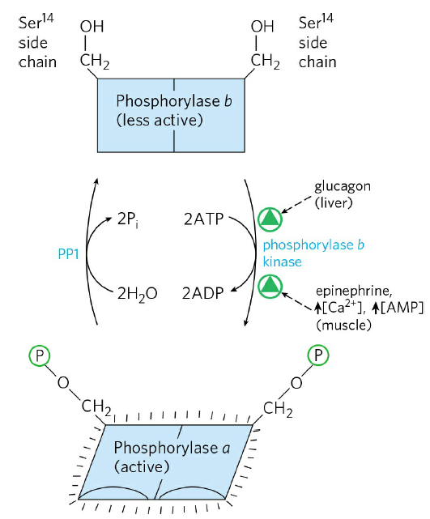
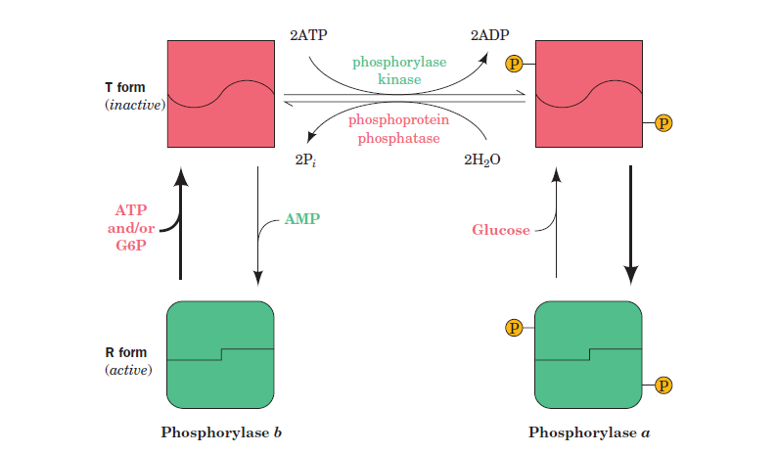
Glycogen Phosphorylase
Is glycogen phosphorylase regulated allosterically or hormonally?

Slide 16

Glycogen Phosphorylase
Trick question: It’s both!
Insulin

Slide 17
03
Glycolysis

Slide 18
Glycolysis
Four steps in glycolysis involve either the formation or use of ATP.
Name each enzyme which catalyzes these steps.
Draw the intermediates involved, making sure to specify how many of each species is reacting given one mole of glucose.

Slide 19
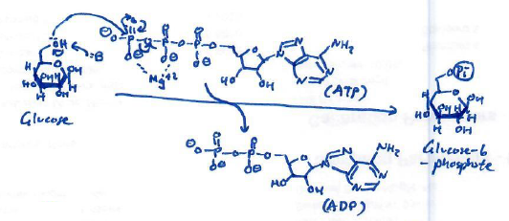
Glycolysis
Formation of G6P from Glucose via Hexokinase

Slide 20
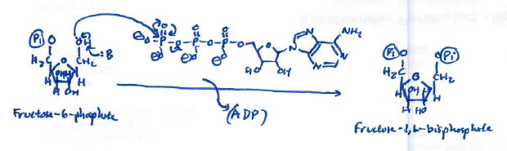
Glycolysis
Formation of F-1,6-BP from F6P via Phosphofructokinase
First committed step of glycolysis!

Slide 21
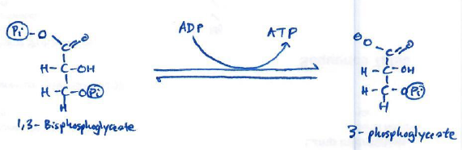
Glycolysis
Formation of 3-PG from 1,3-BPG via Phosphoglycerate Kinase
Our high energy intermediate being used.
Why is this reaction reversible?

Slide 22
Glycolysis
2x
2x
2x
2x
Formation of 3-PG from 1,3-BPG via Phosphoglycerate Kinase
Our high energy intermediate being used.
Why is this reaction reversible?

Slide 23
Glycolysis
2x
2x
2x
2x
Formation of 3-PG from 1,3-BPG via Phosphoglycerate Kinase
Our high energy intermediate being used.
Why is this reaction reversible? - The intracellular concentration of 1,3-BPG is low relative to 3-PG.

Slide 24
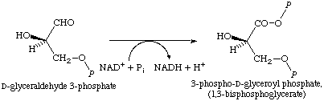
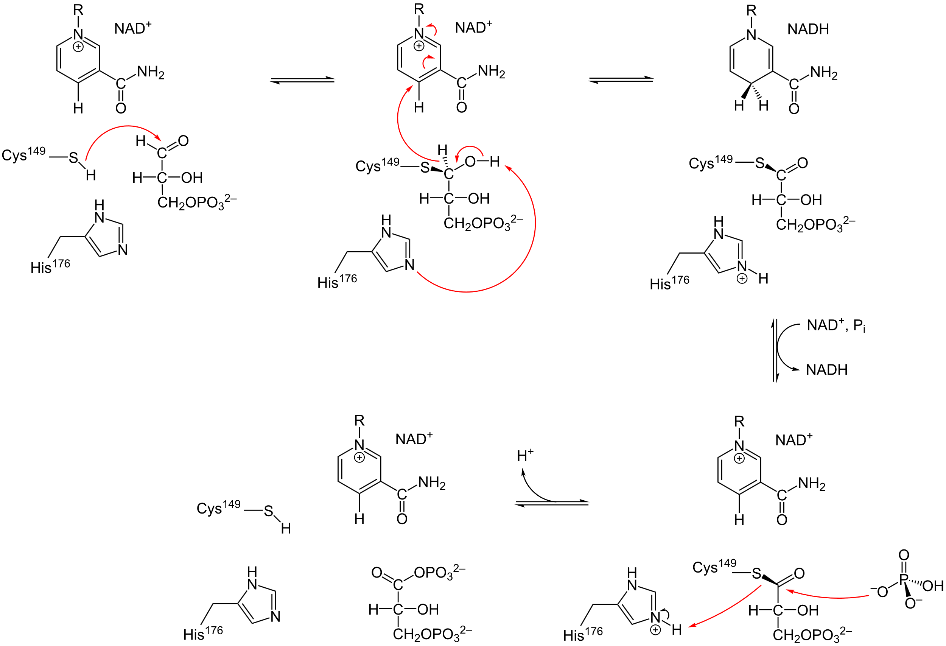
Glycolysis
Normally the addition of a phosphate to a molecule is highly thermodynamically unfavorable. So why is it that we can do it with GAPDH? The mechanism for GAPDH is given on the right for reference.

Slide 25
Glycolysis
Normally the addition of a phosphate to a molecule is highly thermodynamically unfavorable. So why is it that we can do it with GAPDH? The mechanism for GAPDH is given on the right for reference.
Do you recognize this bond?

Slide 26
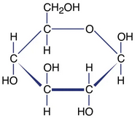

Glycolysis
Suppose carbon 1 and carbon 6 of glucose is isotopically labeled with a 13C tracer. Which carbon atom(s) of the resultant pyruvate molecule would be labeled?
*
A.) Carbon 1
B.) Carbon 2
C.) Carbon 3
*

Slide 27
Glycolysis
Suppose carbon 1 and carbon 6 of glucose is isotopically labeled with a 13C tracer. Which carbon atom(s) of the resultant pyruvate molecule would be labeled?
*
A.) Carbon 1
B.) Carbon 2
C.) Carbon 3
*
*

Slide 28
04
Gluconeogenesis

Slide 29
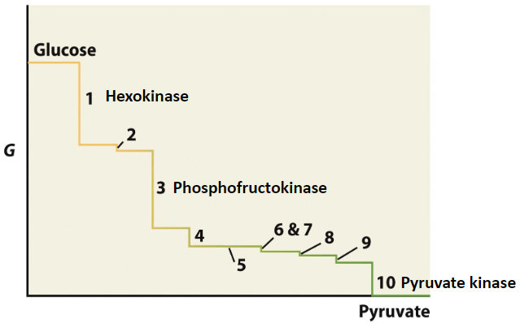
Bypass Reactions of Gluconeogenesis
There are four enzymes which help to catalyze reverse reactions of highly thermodynamically favorable steps in glycolysis. Name these four enzymes and describe some features of each.

Slide 30
Bypass Reactions of Gluconeogenesis
Glucose-6-phosphatase
Pyruvate Carboxylase / PEP Carboxykinase
FBPase
Expressed exclusively in the liver.
Allow for G6P dephosphorylation, which facilitates transport into bloodstream.
When [Glucose] is low, FBPase is highly active.
For pyruvate carboxylase:
Biotin dependent mechanism
For PEP Carboxykinase
GDP – dependent
Produces CO2

Slide 31
Bypass Reactions of Gluconeogenesis
How does exclusive G6Pase expression help with the physiological functions of the liver?

Slide 32
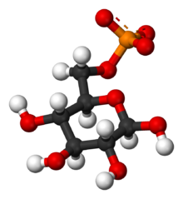
Bypass Reactions of Gluconeogenesis
How does exclusive G6Pase expression help with the physiological functions of the liver?
The liver is a “generous” organ. The phosphate group of G6P is too bulky and large for the G6P to be transported across the cell membrane.
This is also partially why glucagon acts in the liver but not in muscle cells.

Slide 33
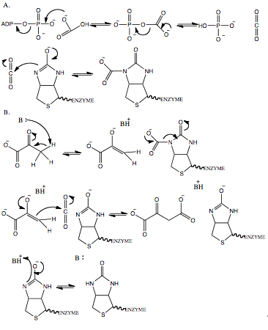
Pyruvate Carboxylase Mechanism
Converts phosphoenolpyruvate to oxaloacetate, with the help of biotin:
Do we see any high energy intermediates in this reaction mechanism?

Slide 34
Pyruvate Carboxylase Mechanism
Converts phosphoenolpyruvate to oxaloacetate, with the help of biotin:
Do we see any high energy intermediates in this reaction mechanism?

Slide 35
Sources for Pyruvate and Oxaloacetate
Name three other sources for pyruvate when there is low [Glucose]. Hint: think cycles!

Slide 36
Sources for Pyruvate and Oxaloacetate
Name three other sources for pyruvate when there is low [Glucose]. Hint: think cycles!
Cori Cycle – use of lactate to produce pyruvate.
Glucose-Alanine Cycle – Use of alanine aminotransferase to produce pyruvate
Citric acid cycle – produces OAA

Slide 37
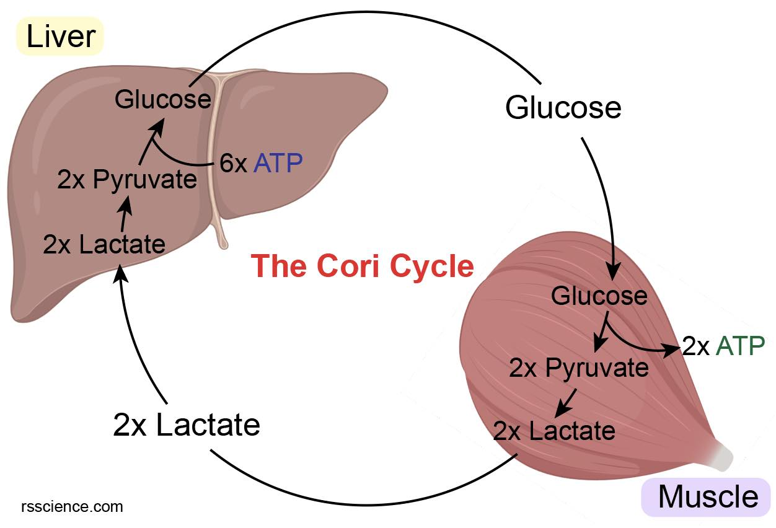
Cori Cycle

Slide 38
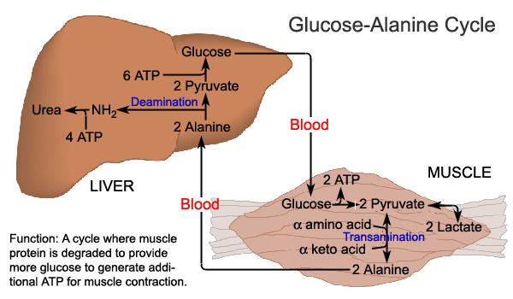
Glucose-Alanine Cycle

Slide 39
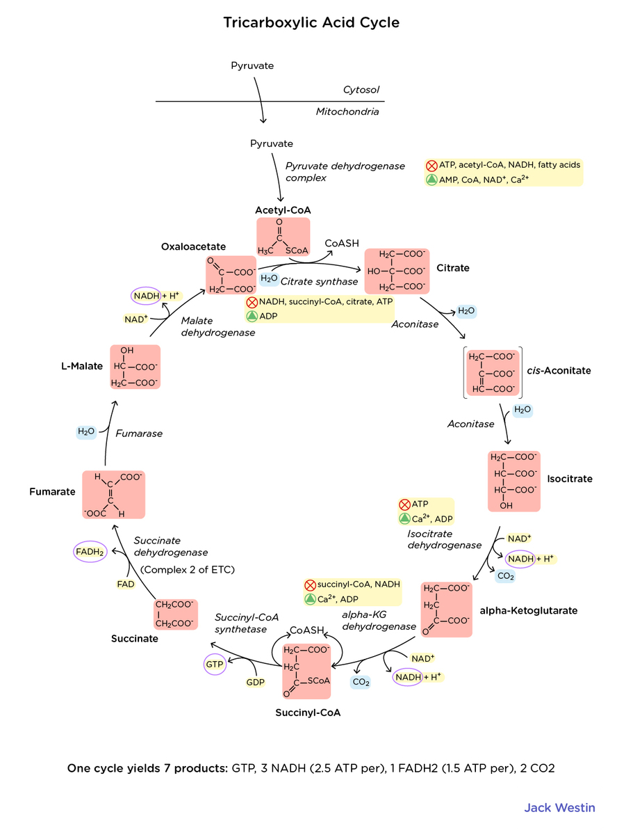
Citric Acid Cycle

Slide 40
Good luck!

