Slide 1
BCHM 463 Virtual GSS -Week 2
IMFs and Protein Structures

Slide 2

Attendance
https://umdsurvey.umd.edu/jfe/form/SV_8pESxFL6Ce4uYho

Slide 3
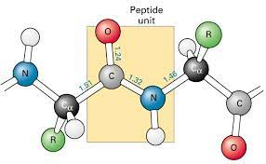
Warm-Up Question:
Why is the Peptide Bond Planar?

Slide 4

AGENDA
01
Intermolecular Forces
02
Protein Structure
Here you could describe the topic of the section
Here you could describe the topic of the section

Slide 5
01
Intermolecular Forces

Slide 6
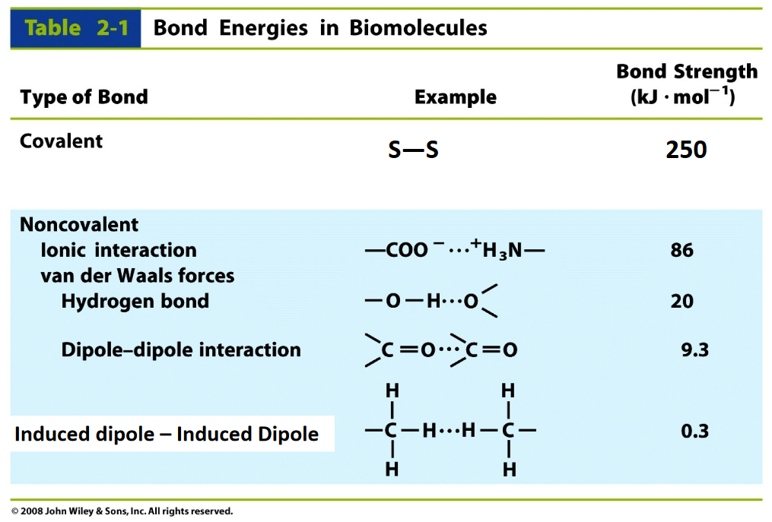
Applying our Categorization of Amino Acids to Understand IMFs

Slide 7
Applying our Categorization of Amino Acids to Understand IMFs
Covalent Linkages | Ionic Interaction | Hydrogen Bonding | Induced Dipole – Induced Dipole
Cysteine (C) | Aspartate (-) Glutamate (-) Histidine (+) Lysine (+) Arginine (+) | Serine (S) Cysteine (C) Glutamine (Q) Asparagine (N) Tyrosine (Y) Tryptophan (W) Histidine (H) Threonine (T) | Glycine (G) Alanine (A) Tryptophan (W) Valine (V) Leucine (L) Proline (P) Isoleucine (I) Methionine (M)

Slide 8

Protein Structure
02

Slide 9
Design Your Own Alpha Helix!
You are tasked with designing an alpha helix which is stabilized by at least three different types of R-group interactions. To make things simpler, let’s not worry about the propensity of different amino acids within an alpha-helix. You are limited to 9 amino acid residues.

Slide 10
Design Your Own Alpha Helix!
Results:
N' - Gly-Ala-Trp-Ile-Gln-Val-Leu-Asn-His - C'
Can you name some interactions within the helixes others made?

Slide 11
Design Your Own Beta Sheet!
You are tasked with designing an amphipathic beta sheet. To make things simpler, let’s not worry about the propensity of different amino acids within a beta sheet. You are limited to 9 amino acid residues.

Slide 12
Design Your Own Beta Sheet!
Results:

Slide 13
Exit Ticket
Are peptide bonds generally trans- isomerized or cis-isomerized? Why?
Are there any amino acids that are an exception to this rule?

