Slide 1
BCHM 463 GSS: Introduction to Metabolism
David Zhao | Dr. Tseng | 10/26/2022

Slide 2

Please sign in!
https://umdsurvey.umd.edu/jfe/form/SV_8pESxFL6Ce4uYho

Slide 3
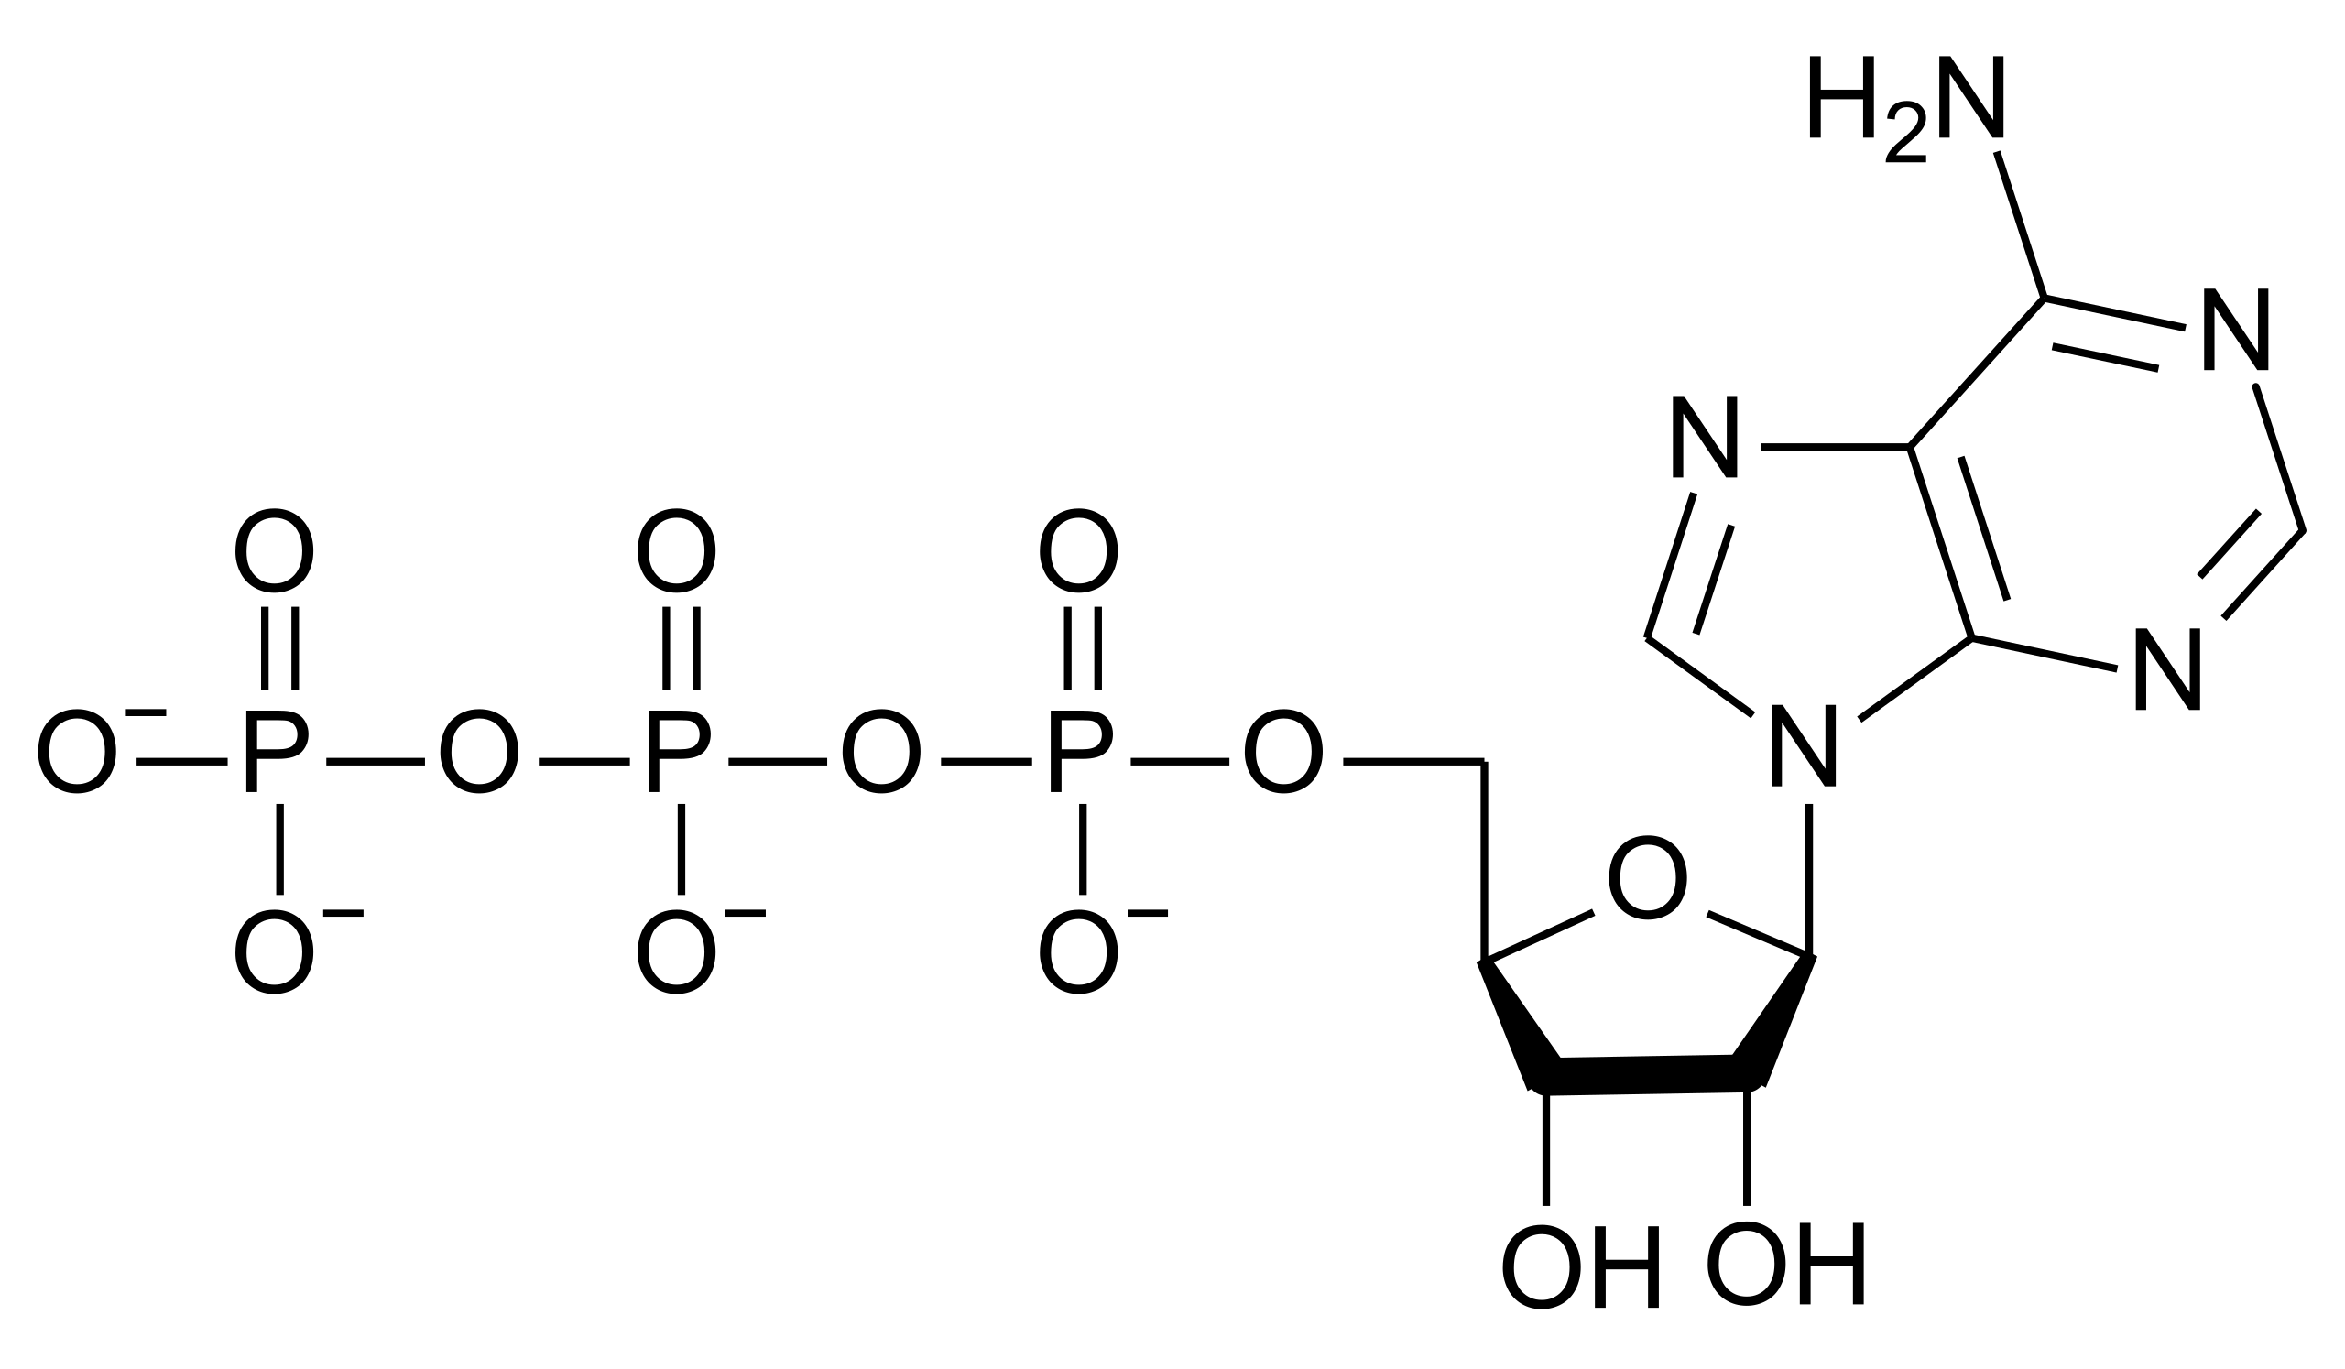
Warm-Up Question
Describe in three ways how ATP is classified as a “high energy” molecule.

Slide 4
Agenda
01
High Energy Molecules, ATP
02
Glycolysis

Slide 5
01
High Energy Molecules

Slide 6
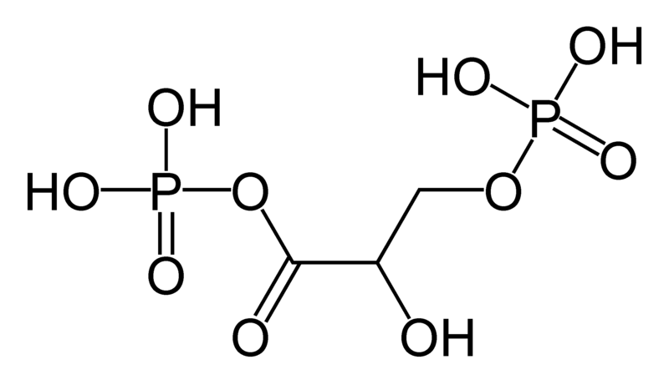
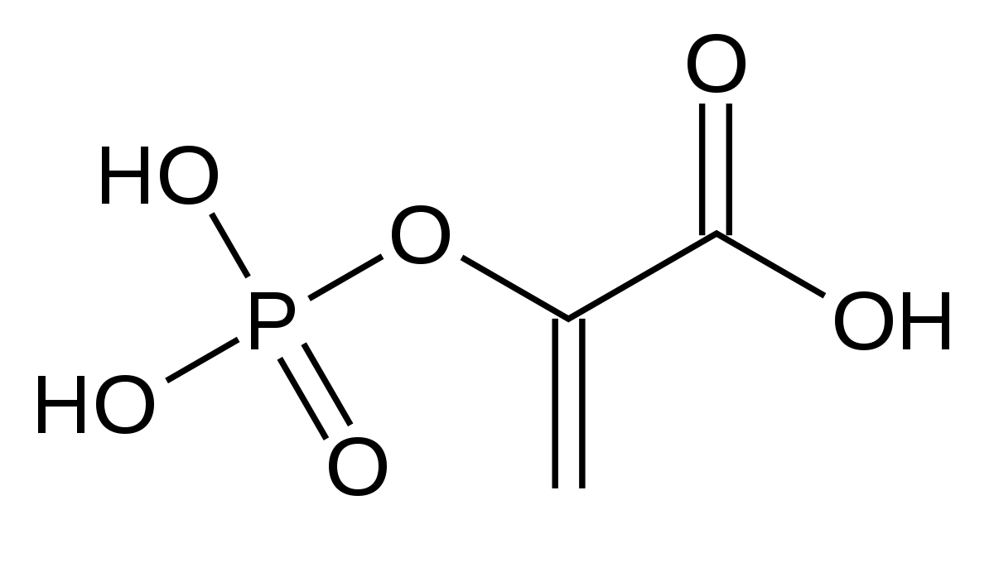
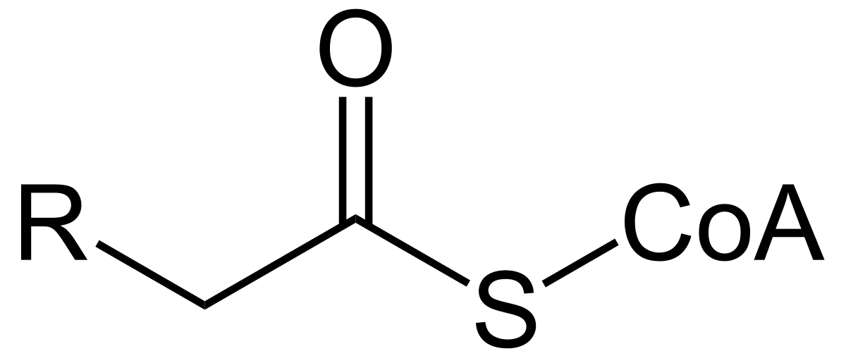
Some Types of High-Energy Covalent Bonds
Acylphosphates
Phosphoanhydrides
Phosphoenols
Thioesters

Slide 7
Some Types of High-Energy Covalent Bonds
Acylphosphates
Phosphoenols
1,3-Bisphosphoglycerate
(formed after step 6 – oxidation of glyceraldehyde-3-phosphate)
Phosphoenolpyruvate
(formed after step 9 – removal of water from 2-phosphoglycerate)
Intermediates of Glycolysis!

Slide 8
Some Types of High-Energy Covalent Bonds
Acylphosphates
Phosphoenols
1,3-Bisphosphoglycerate
(formed after step 6 – oxidation of glyceraldehyde-3-phosphate)
Phosphoenolpyruvate
(formed after step 9 – removal of water from 2-phosphoglycerate)
Intermediates of Glycolysis!
Review the steps of glycolysis. What other reaction is shared after both intermediate compounds are formed? Would the other reaction normally occur under standard state conditions?

Slide 9
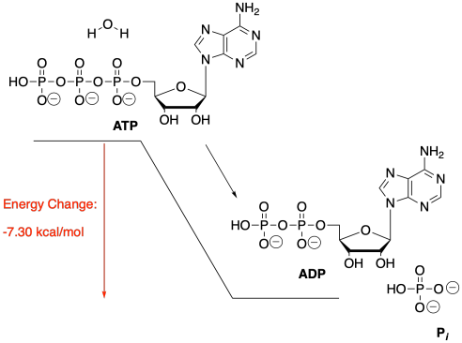
ATP Hydrolysis - Does this Provide Energy for the Metabolic Pathway?

Slide 10
ATP Hydrolysis - Does this Provide Energy for the Metabolic Pathway?
Where is this energy going?

Slide 11
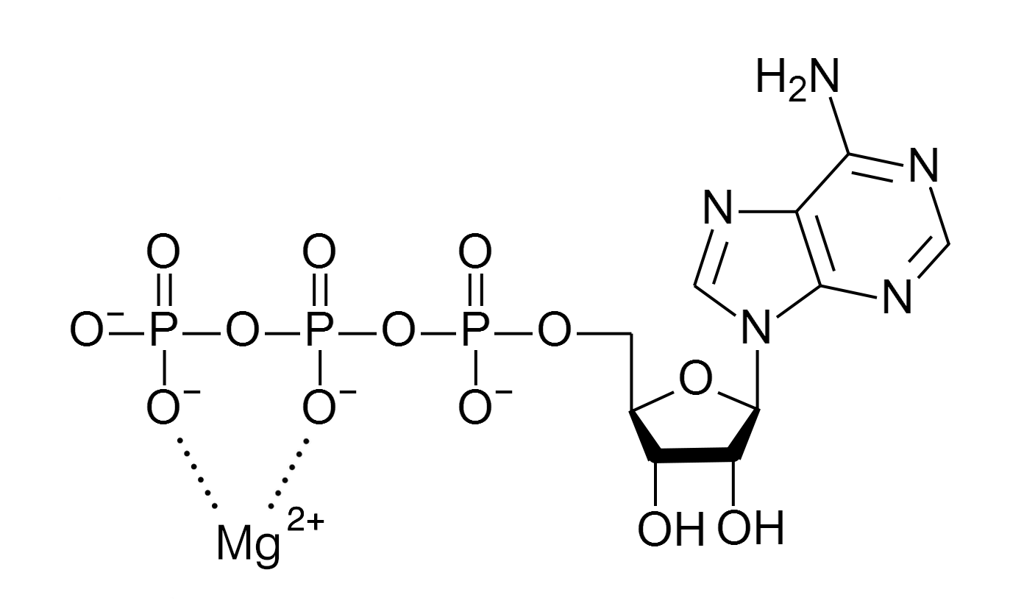
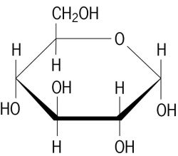
What really happens?
(Catalyzed by Hexokinase)

Slide 12
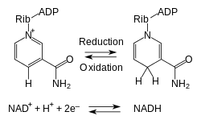
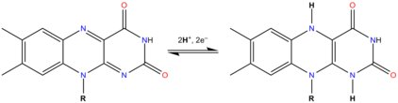
Electron Carrying Species
FAD
FADH₂
Lower energy, more stable state
Higher energy, more unstable state, carrying electrons for energy transfer in oxidative phosphorylation

Slide 13
02
Glycolysis

Slide 14
For each irreversible step in glycolysis, name the enzyme which catalyzes the reaction. What do all these steps have in common?

Slide 15
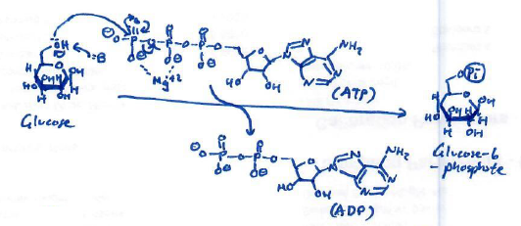
Types of Enzymes in Glycolysis
What class of enzyme would catalyze this reaction? Name the enzyme which catalyzes this step.

Slide 16
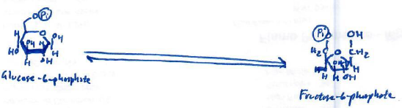
Types of Enzymes in Glycolysis
What class of enzyme would catalyze this reaction? Name the enzyme which catalyzes this step.

Slide 17
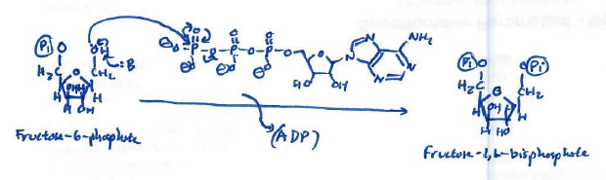
Types of Enzymes in Glycolysis
What class of enzyme would catalyze this reaction? Name the enzyme which catalyzes this step.

Slide 18
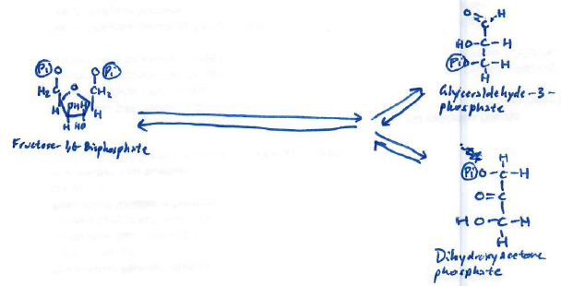
Types of Enzymes in Glycolysis
What class of enzyme would catalyze this reaction? Name the enzyme which catalyzes this step.

Slide 19
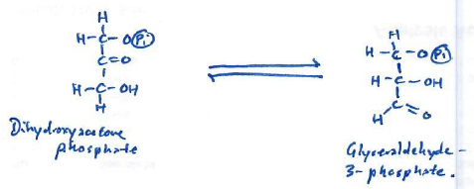
Types of Enzymes in Glycolysis
What class of enzyme would catalyze this reaction? Name the enzyme which catalyzes this step.

Slide 20
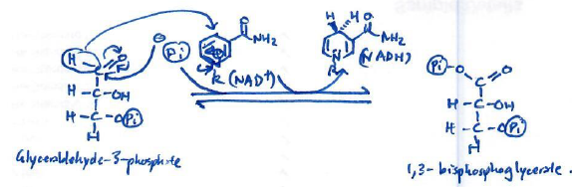
Types of Enzymes in Glycolysis
What class of enzyme would catalyze this reaction? Name the enzyme which catalyzes this step.

Slide 21
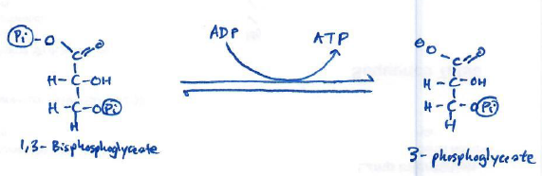
Types of Enzymes in Glycolysis
What class of enzyme would catalyze this reaction? Name the enzyme which catalyzes this step.

Slide 22
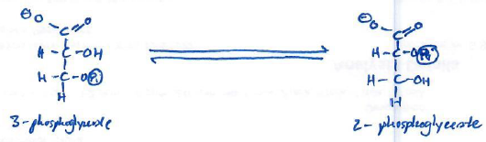
Types of Enzymes in Glycolysis
What class of enzyme would catalyze this reaction? Name the enzyme which catalyzes this step.

Slide 23
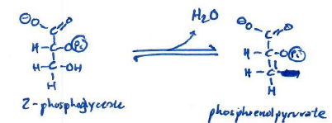
Types of Enzymes in Glycolysis
What class of enzyme would catalyze this reaction? Name the enzyme which catalyzes this step.

Slide 24
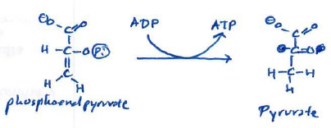
Types of Enzymes in Glycolysis
What class of enzyme would catalyze this reaction? Name the enzyme which catalyzes this step.

Slide 25
Types of Enzymes in Glycolysis
Hexokinase – Transferase
Phosphoglucose isomerase – Isomerase
Phosphofructokinase – Transferase
Aldolase – Lyase
Triose-phosphate isomerase – Isomerase
Glyceraldehyde-3-phosphate dehydrogenase – Oxidoreductase (Maybe Transferase)
Phosphoglycerate Kinase – Transferase
Phosphoglycerate Mutase – Isomerase
Enolase – Lyase
Pyruvate Kinase - Transferase

Slide 26
Types of Enzymes in Glycolysis
Hexokinase – Transferase
Phosphoglucose isomerase – Isomerase
Phosphofructokinase – Transferase
Aldolase – Lyase
Triose-phosphate isomerase – Isomerase
Glyceraldehyde-3-phosphate dehydrogenase – Oxidoreductase (Maybe Transferase)
Phosphoglycerate Kinase – Transferase
Phosphoglycerate Mutase – Isomerase
Enolase – Lyase
Pyruvate Kinase - Transferase
“Helen Paints Pictures Along Training Grounds Praying People Enjoy Paintings”

Slide 27
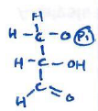
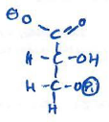
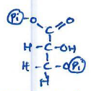

What is the Correct Order?
A
B
C
D
Mars
Saturn
Venus
For four of the intermediates of glycolysis shown above, determine the correct order each appear in the pathway.
A.) D, A, C, B
B.) C, B, A, D
C.) A, C, D, B
D.) A, B, C, D

Slide 28
What is the Correct Order?
A
B
C
D
Mars
Saturn
Venus
Glyceraldehyde-3-phosphate
3-phosphoglycerate
1,3-bisphosphoglycerate
Dihydroxyacetone phosphate
For four of the intermediates of glycolysis shown above, determine the correct order each appear in the pathway.
A.) D, A, C, B
B.) C, B, A, D
C.) D, A, B, D
D.) D, B, C, D
Note: Technically DHAP and GAP “appear” at the same time in glycolysis with the cleavage of fructose-1,6-bisphosphate by aldolase. However, since DHAP is metabolized to GAP in glycolysis, I am considering GAP to be after DHAP.

Slide 29
Exit Ticket
Which steps in glycolysis use ATP? Which steps in glycolysis consume ATP? How many net ATPs are produced through glycolysis?

